Slide 1
Adolescence II:
Moonlight, dir. Barry Jenkins
Week 6

Slide 2
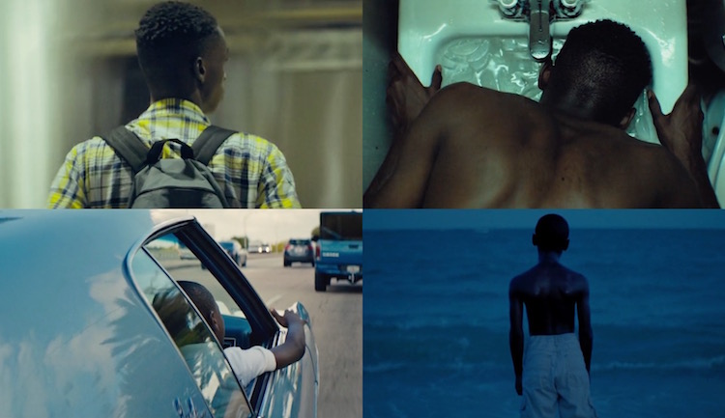

Slide 3


Slide 4
Anupa Mistry, ‘Tarell Alvin McCraney’s Play Got Shelved. Then It Inspired The Year’s Best Film, Moonlight’. Fader magazine, October 26, 2016
Tarell Alvin McCraney originally wrote the source material for Moonlight over a decade ago, after he graduated from DePaul University. It was a play script based on his own life called In Moonlight, Black Boys Look Blue. It wasn’t quite working as a play, though, so it sat on his desk until a mutual friend from the Miami drama scene emailed the script to Barry Jenkins.
McCraney and Jenkins grew up just blocks from each other in Miami’s Liberty City. They didn’t know each other as kids both navigating a tough neighborhood, with home lives afflicted by drug addiction, and instead met as adult artists when Jenkins received the play and began to adapt it as a film.
McCraney says of the adaptation: “Barry has a very intimate voice with Miami. I'm from a more poetic dialogue and background and Barry has an incredible eye for visual storytelling; his ability to marry sound and visuals is extraordinary.” (Fader magazine)

Slide 5
McCraney on the setting
Liberty City is the inner city; it's one of the few neighborhoods that's actually within the city limits of Miami.
Whereas what most people think of as Miami is South Beach, which is actually on Miami Beach and a different city altogether. There's a kind of blinding, distracting light that keeps you focused on the popular beaches and not the abject poverty. […] So what happens in Liberty City when you're not adjacent to the ocean? […] [Liberty City] is a unique place in that the same things that exist in other urban general populations exist for us, and yet there are palm trees and beautiful sunsets and you can smell the ocean five miles away.
You know that you live in a place with incredible natural beauty and, at the same time, you recognize that it can be equally dangerous. There’s a silence that permeates that. It's almost like, Be quiet, you're beautiful.

Slide 6
When did you realize you didn’t have to be quiet?
It wasn’t necessarily that I didn’t; after a while, I couldn’t. One of the eloquent things that Barry put into the film is that you see these young men, and they’re all really quiet. They don’t say more than five words, and yet they say so much. Once I did get an avenue where I could speak for myself or for that person that I love; in that circumstance it’s necessary to come to the table with full and unadulterated access.
When did you discover that theater could be a powerful or effective way to tell these stories?
  I was exposed to these incredible art programs. A lot of them don’t exist anymore, but I was lucky enough to be introduced to these programs that were free and wanted kids involved. I didn’t know right away that I could tell stories through them; I was just telling the stories I knew, and then I found that a lot of people kept saying things like, ‘We’ve never heard this before’ or ‘A drug dealer teaching a kid how to ride a bike? That’s a crazy idea.’ And I’m thinking, This is my everyday life.

Slide 7
One time we were doing a show at a halfway house — it was one of the ones my mom had been in — about kids and their parents and drugs. It sounds kind of hokey but I remember one of the women in the program asked us to stop because she was very emotional; she was crying and upset. We’re like 14, 15, thinking we're doing incredible protest art, and she said, ‘I now know what my children were like when I was on drugs. I couldn’t remember those times but you guys are making me remember what my kids were going through.’ And that was when I was like, Ahh, I have to keep doing this. Maybe if I had done this while my mom was here she would have a better understanding, maybe it would have helped her.

Slide 8
Personal observations form much of your work […]
I was trying to piece out my life and experiences through art and in Liberty City. I was a grown man when I was writing this piece and I was looking at what my decisions were and if I’d made a turn at some point could I have been a totally different person? That’s the script I created and I shelved it because I was like, ‘This won't work as a play, it’s way too visual and too intimate in the characters and I didn’t have time to invent the world for the form. [Eventually] the Borscht Film Festival gave it to Barry, who I had not met but we grew up four blocks away from each other.
Everything is personal but I wasn't literally writing down moments from my life. Moonlight is one of the few pieces based on actual events; there are scenes in the movie that happened — the words and the scenario and the person, those things happened. And then there are parts that never happened to me and some of it happened to Barry.

Slide 9
Mr. Jenkins, after making his first film six years earlier, had been trying to figure out his next project and felt that it should be something personal. He’d written a film treatment that would tell the story of his growing up in Miami.
“It was about my mom, and then I was like: ‘Ugh, nah, it’s too personal. I don’t want to make that,’” Mr. Jenkins said. What attracted him to Mr. McCraney’s screenplay was that the story was so close to his own, yet not his own.
A few years passed, and finally, Mr. Jenkins decided to try to adapt the screenplay on his own. James Baldwin once wrote: “All art is a kind of confession, more or less oblique. All artists, if they are to survive, are forced, at last, to tell the whole story, to vomit the anguish up.” And, it was through the rewriting that Mr. Jenkins realized he had been fooling himself.
“I thought I could hide behind Tarell in this piece, thinking, ‘This is personal for this cat; it’s not personal for me,’” Mr. Jenkins said. “I was wrong.”

Slide 10
New York Times (cont.)
It had just finished raining, in that swift and furious Miami way, and the director Barry Jenkins and the playwright Tarell Alvin McCraney were heading through the Liberty Square housing projects.
The two men strolled past crumpled snack wrappers and empty Olde English beer cans, broken toys and charcoal-colored rat traps. […] He stopped, raised his arms and spread them wide.
This is the world of ‘Moonlight,’” he said, smiling, […]. “It’s beautiful, right? When the sun comes out, it just pops.”
Mr. McCraney nodded. “It is the confluence of madness and urban blight,” he said. “Yet, it is incredibly beautiful. It is still a neighborhood.”
Liberty City, one of the poorest sections of Miami and almost entirely black, is geographically tiny, little more than the housing projects and the blocks surrounding them. But it is also tiny in that particular way that poverty and extreme racial isolation build formidable, and virtually unscalable, walls. Liberty City was not just their neighborhood. It was their universe.

Slide 11
Both men were born to mothers who had their first children when they were teenagers. Both saw their mothers become H.I.V. positive after falling victim to the crack epidemic that overtook their community. Both were taken away from their mothers and bounced around; caregivers, related and not, took them in. They both knew what it was like to have the water turned off for lack of payment […]
Yet their family members, including their mothers, pushed school and a love of reading; their neighbors and educators fought for them and encouraged their talents.
When Mr. McCraney wrote the screenplay, it was 2003. He had just graduated from DePaul University in Chicago and was headed to the Yale University School of Drama […]
Then his mother died of AIDS. She had gotten clean by then, but there was no reconciliation like the one that plays out in the movie between Chiron, the main character, and his mother.
“Since 13, I’ve kind of been wading through that water and finally, to get to the arrival of her death, was sort of surprisingly calm,” he said. “But then, I started to continuously have these memories, thoughts of growing up in Miami and my mother in that time. I had bad guilt for not being at her bedside when she died, terrible guilt about not asking her the questions you always regret not asking your parents when they pass away.”
“I just started writing those thoughts down,” he said. “I was a 22-year-old mourner. I was crying my way through it.”
Juan: “I hated my mother too. / But I sure do miss her now. / That’s all I’m going to say on that.”

Slide 12
Their memories unknowingly reflect Liberty Square’s original idealism when it opened in 1937. One of the first federal public housing projects for black people, Liberty Square had indoor plumbing and electricity — a rarity — and attracted middle-class strivers who had been hemmed into substandard segregated neighborhoods. The community was proud and close-knit, though it was literally walled off from a white neighborhood by a concrete border.
And then, as is the history of this country, Liberty City was sabotaged by racist urban renewal policy and official neglect. The city rammed an Interstate through a nearby low-income black neighborhood, displacing those residents and flooding Liberty City with poverty and few resources to deal with it. […] Businesses fled, as did much of the black middle class, leaving behind those with no resources to go.
“Very, very slowly certain areas of the neighborhood began to be off limits,” Mr. Jenkins said. “I just remember this moment where it went from being this thing where you could wander anywhere, almost like Huck Finn, to places you had to avoid.”
“My mom went through so many things,” Mr. Jenkins said. Like Mr. McCraney’s mother, she had been sexually abused, and she had gotten pregnant as a teenager, but she still went on to find work as a nurse’s aide and raise her older children before succumbing to addiction. “She beat all these things, and she couldn’t beat this. And I think she had held on for so long and eventually you break, and I think crack cocaine filled that break.
“I don’t judge her. And the beauty in that is that when I create these characters when I’m on set, I’m not judging them either.”

Slide 13
Juan is modeled after Blue, the father of Mr. McCraney’s younger brother. As a child, Mr. McCraney looked up to him. Blue was Mr. McCraney’s defender, the person who made sure he had nice clothes, kept the boy’s mother from spanking him and taught him to make salmon croquettes. But when Mr. McCraney was about 6, Blue was shot and killed, and shortly after, the devastated child witnessed his grieving mother overdose on drugs.
“I do know the dope boy on the corner sometimes goes out and gets bread for the family that doesn’t have it, and equally there are boys on the corner who aren’t selling dope who do terrible things to the community, too,” Mr. McCraney said. “Those stories are all true, and we have to embrace them. If we don’t tell those stories, we lose who we are.”

Slide 14
Mr. McCraney recalls an assignment in college where students were asked to write a monologue about their happiest childhood experience. / “I was like: ‘O.K., great. Everybody is going to come in with the time Dad took them pony riding,’” he said, mock rolling his eyes.
Still some of his happiest moments were with Blue. “So, I wrote about the time a drug dealer got off his crate and taught me how to ride a bike.”
“And I just remember the kind of shock and awe on people’s faces,” he said. “It hurt me. It embarrassed me, and I wasn’t embarrassed because of him or the situation. I was embarrassed because it felt like again me putting on exhibition for mostly white privileged people a world they had never seen.”
But Blue, his mother’s boyfriend, was shot and killed. Tarell came back from a weekend away from the project, aged about 6 or 7 to the news.
He was thinking: “This is something you have to remember. This is a very strong lesson for you. The good things in your life are not always. If you go away for the weekend, if you don’t pay proper attention, you will come back and they won’t be here.”

Slide 15
McCraney interviewd in the The Observer, 5 February 2017
He wrote the script not in anger, he says, or only in grief or guilt, though he felt both of those emotions. He wrote it in panic. “The panic came from there being a whole other part of me that wasn’t being accessed in the work I was doing,” he says. “At Yale I was around white people most of the time, people who came mostly from supportive families, people who didn’t grow up with drug addicts. All of the things that were still keeping me awake every night, these feelings that I was still this kid back in eighth grade, were in that other place, a big part of which had just died.”
He was thinking, too, about role models. People told him he had been lucky to have been taken up by August Wilson, to be cast by Peter Brook, and he knew that was true, but he knew also that his role models weren’t only in theatre. One of them, Blue, was a drug dealer, but a good man. “The question kept coming to me: ‘Why didn’t I become a drug dealer?’ It was in many ways the obvious choice, growing up here.”
The script he wrote mapped out some of that territory. He wrote it fast, 60-odd typed pages that confronted his mother’s decline, the brutality of the childhood bullying he experienced – he was hit with bricks, lost several teeth – as well as the moments of grace he achieved with Blue, and the transcendence of a solitary sexual encounter with his only true childhood friend.

Slide 16
Black queer adolescence
Franklin-Phipps and Smithers (2020) have argued that “Black queer adolescents have limited opportunities to imagine themselves in affirming ways [due to the domninant images of popular media (Shotwell, 2011)].” (1)
Robert Randolph, writing in Queer Studies in Media & Pop Culture as a Black queer man, seems to concur:
  “It is always a strange sensation seeing oneself on the screen. If you are a straight white man, then this sensation is probably common and pedestrian. If you are a queer black man, then the sensation is arresting and reflective, and no film in recent memory has captured the black queer imagination the way that Moonlight has.”
Instead, they argue, “dominant structures and cultures encourage [Black queer adolescents] to imagine themselves in ways that cohere to oppressive systems that deny their subjectivity.”
Kara Keeling (2007) writes, ‘as living images, our senses are conditioned to accommodate oppression and exploitation, even our own’ (p. 15).
Franklin-Phipps and Smithers: educational institutions are complicit in the production of minoritized subjects as lacking, problems to be fixed, and/or nothing at all (Anyon, 1981; Dumas, 2014; la paperson, 2017; Ringrose, 2011)

Slide 17
Franklin-Phipps and Smithers, 2
In presenting “single mothers, drug dealers, and queer boys”, Moonlight presents bodies and social locations largely absented from the archives (Campt, 2017) and rarely represented beyond uncritical examples of social pathology, a contrast to the category of the human (Wynter, 2003).
They compare Moonlight to Dee Rees’s 2011 Film Pariah, about queer Black teen girls
Jenkins and Rees, they argue, present “complex lives and fluid subjectivities” that challenge the ‘abject’ representation of queer Black individuals.
They suggest that the film does not just represent queer Black experience but “interrogate the very constitution of that image as representative”(Kara Keeling, p. 18)

Slide 18
Tarell Alvin McCraney on the character of Chiron:
The community knows things about him before he knows them about himself. People want to place him in a category before he even understands what that means. This happens to all of us, whether we’re male, female, black, white, straight or gay. There are moments when our community decides to tell us what they see us as. How we respond to that makes our struggle very real, and deeply influences how our lives unfold.

Slide 19
Franklin-Phipps and Smithers, 3
the broken promise of the heteronormative nuclear family
Keeling (2019) names this broken and continually breaking promise quotidian violence, or the violence of being locked in an overdetermined spacetime
For Berlant (2011), this broken and breaking promise produces crisis ordinariness, wherein ‘if you’re lucky you get to be exploited, and if you’re lucky you can avoid one more day being the focus of a scene that hails and ejects you when it is your time to again become worthless’ (Berlant, 2011, p. 171, emphasis in original).
Quotidian violence and crisis ordinariness condition each other; violence maintains a rigid, permanent present, and a rigid, permanent present is all for which most citizens of late racialized capitalism can hope.

Slide 20
Roderick Ferguson (2004):
Liberal ideology has typically understood the family as the institution that provides stability and civility against the instability and ruthlessness of civil society. That ideology has historically constructed the African American family as an insufficient tether against the chaos of civil society. (p. 20)
Family a mechanism of gender and sexuality regulation that coheres with American state investment in the production of surplus labor
Ferguson (2004): diverse sexual expression was common among enslaved Black people. It was not until post-slavery in the United States that the state saw use in regulating gender and sexuality through policies with a particular attention to Black populations
the economic oppression faced by many African-American families across generations has been theorized by American sociologists as a product of insufficient adherence to the heterosexual norms of the family

Slide 21
Sara Ahmed’s “queer phenomenology”
Robert Randolph (2017) suggests that because the film focuses on the interior life of Chiron, Sara Ahmed's (2006) notion of queer phenomenology might be a useful theoretical construct
Ahmed attends to the directional aspect of queerness, noting that it is 'what is "oblique" or "off line", [...] odd, bent, [and] twisted' (2006:161). This definition emphasizes counter-hegemonic and anti-normative logics and highlights queerness's tendency towards 'social disorientation' (Ahmed 2006: 162).
Queerness therefore brings to light “theoretical and material territories that often conceal intersectional realities of class, race, gender and sexuality” (Randolph).

Slide 22
citizens of late racialized capitalism […] precarious subjects too consumed by the project of everyday living to take to the streets and demand a new world. (Franklin-Phipps and Smithers, 4)
Berlant discusses “the ordinary as an impasse shaped by crises in which people find themselves developing skills for adjusting to newly proliferating pressures [in order] to scramble for modes of living on” (2011, 8)
While there are no white people in the film, the material and social conditions of the Black community in this segregated and depressed area of Florida is the outcome of racism and the afterlife of slavery (Hartman, 1997; Sharpe, 2016)
Three factors that make Chiron vulnerable to bullying: poverty, Blackness and what Franklin-Phipps and Smithers call “insufficiently normative gender performance” (9)

Slide 23
The encounter with Kevin on the beach is followed swiftly (the next day?) by Kevin being coerced into beating Chiron up at school.
F&S, 9: Chiron exits his impasse only for others to attempt to beat him back into it.
[but] Chiron refuses to be disciplined back into the world as he knows it by this moment of violence. With each blow, Kevin pleads with Chiron to stay on the ground so that he can then stop hitting him, but Chiron will not remain on the ground.
Chiron looks into Kevin’s eyes as he continues to pummel him refusing his destruction, preserving the possibility of something else (Esberg & Jenkins, 2016, 1:00:57).
He will not follow the regulations and tell on Kevin or the boys who conspired to beat him. But the next day he breaks a chair over the back of the gang leader and orchestrator of the violence against him.
For Keeling (2019), Black futures are ‘animated in queer times and inseparable from queer relations … here in every now. The ungovernable, anarchic here and now harbors Black futures’ (p. 32). […] In this space of extreme, layered, and unrelenting violence—violence meant to discipline and regulate Chiron’s existence and position him as nothing—Chiron carves a virtual escape route. […] an escape route through violence (F&S 11)

Slide 24
Works Cited
Berlant, L. (2011). Cruel optimism. Duke University Press.
Franklin-Phipps, Asilia & Laura Smithers (2020): ’Queer Black adolescence, the impasse, and the pedagogy of cinema’, Educational Philosophy and Theory. URL: Queer Black adolescence, the impasse, and the pedagogy of cinema: Educational Philosophy and Theory: Vol 0, No 0 (tandfonline.com)
Keeling, K. (2019). Queer times, Black futures. New York University Press.
Randolph, Robert (2017), ‘Moonlight, Barry Jenkins (2016): USA [review]’, Queer Studies in Media & Pop Culture, vol. 2, issue 3.

Slide 25
Consider one or more of these themes/ ideas in relation to the film (and/or your own idea). Where does it find relevance/ articulation?
Silence
“Social disorientation” (Ahmed)
Time (the ‘rigid, permanent present’)
The sea
“Quotidian violence” (Keeling)
The “broken promise” of the family (and queer
[Your ideas!]

Slide 26
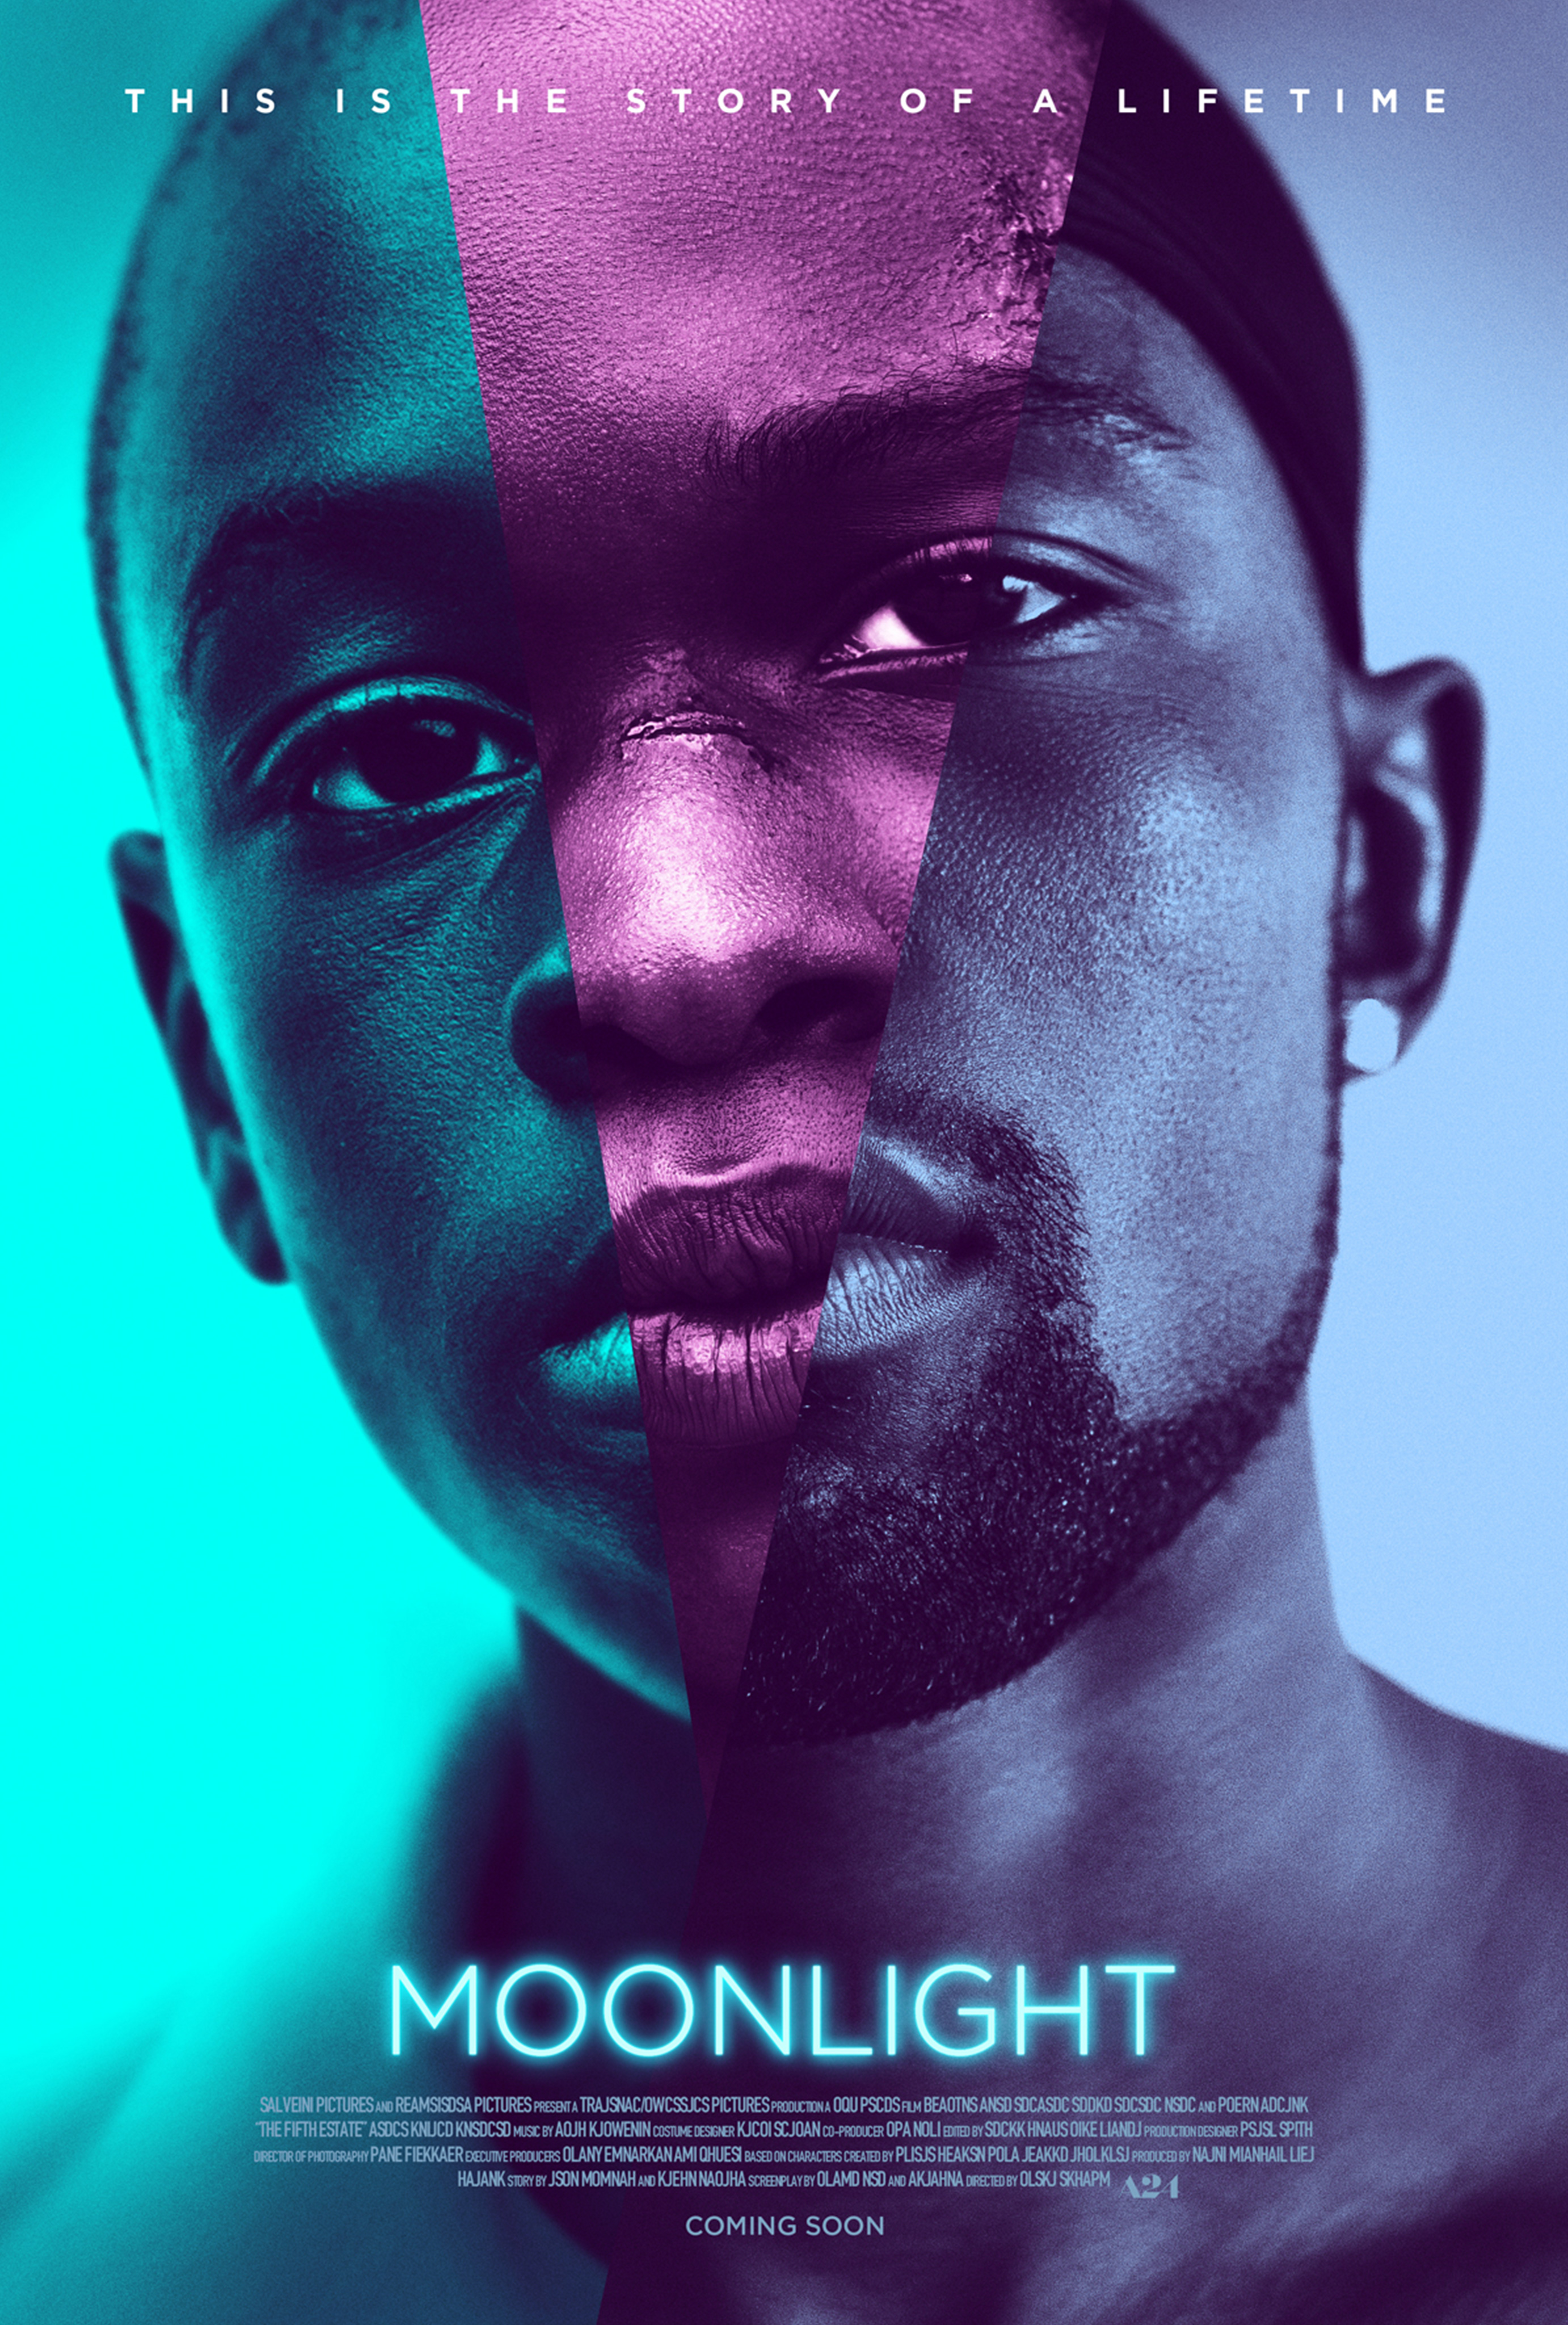
Tarell Alvin McCraney, In Moonlight, Black Boys Look Blue (unpublished) becomes Moonlight (2016), dir. Barry Jenkins
Original play: “the circular structure of the play, with the three different versions of the character playing out their lives at the same time.”
Film makes this circular structure linear, but film progresses by a series of disconnected ‘moments’. Features Chiron, the central character, at 11, 16 and 25.
The film doesn’t proceed according to the “normal” rules of narrative development: cause–effect logic, clear linear development, steady pacing.

Slide 27
Pamela Demory on ‘queer time’ in Moonlight (2016)
Judith Halberstam writes in In a Queer Time and Place that the threat of having “no future” produced an “urgency of being [that] also expands the potential of the moment and … squeezes new possibilities out of the time at hand” (2). Halberstam argues that this queer temporality—the intense focus on “the now”—applies also to “women, transgenders, and queers,” particularly “queer people of color” (3). It would also apply to the characters in Moonlight, who are living under a similar threat of “no future”—in this case due to pervasive poverty, violence, and drugs.
Tarell Alvin McCraney (who wrote the original play the film is based on] says he often tells people his plays take place in “the distant present,” a phrasing that suggests a time that is “just out of reach, yet not quite fully in the time of the now. But it is close enough to register as familiar” (Roman 188). The concept is similar to what Valerie Rohy calls an “expanded present tense” (253) or what Carolyn Dinshaw calls “the multitemporality of the now” (qtd. in Rohy 253)

