Slide 1
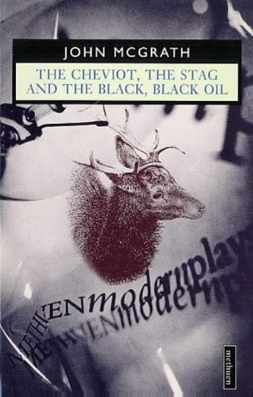
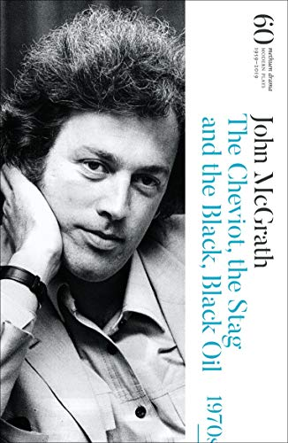
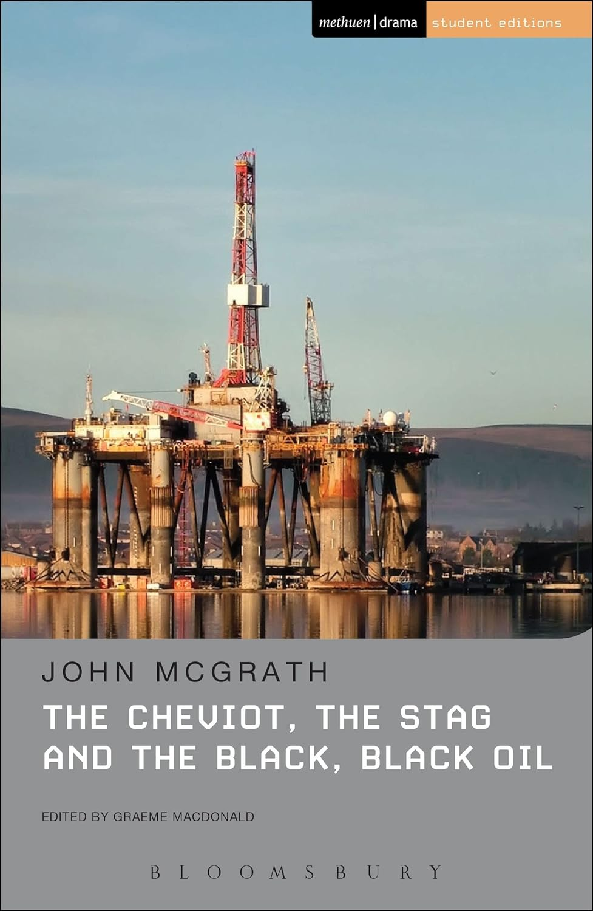
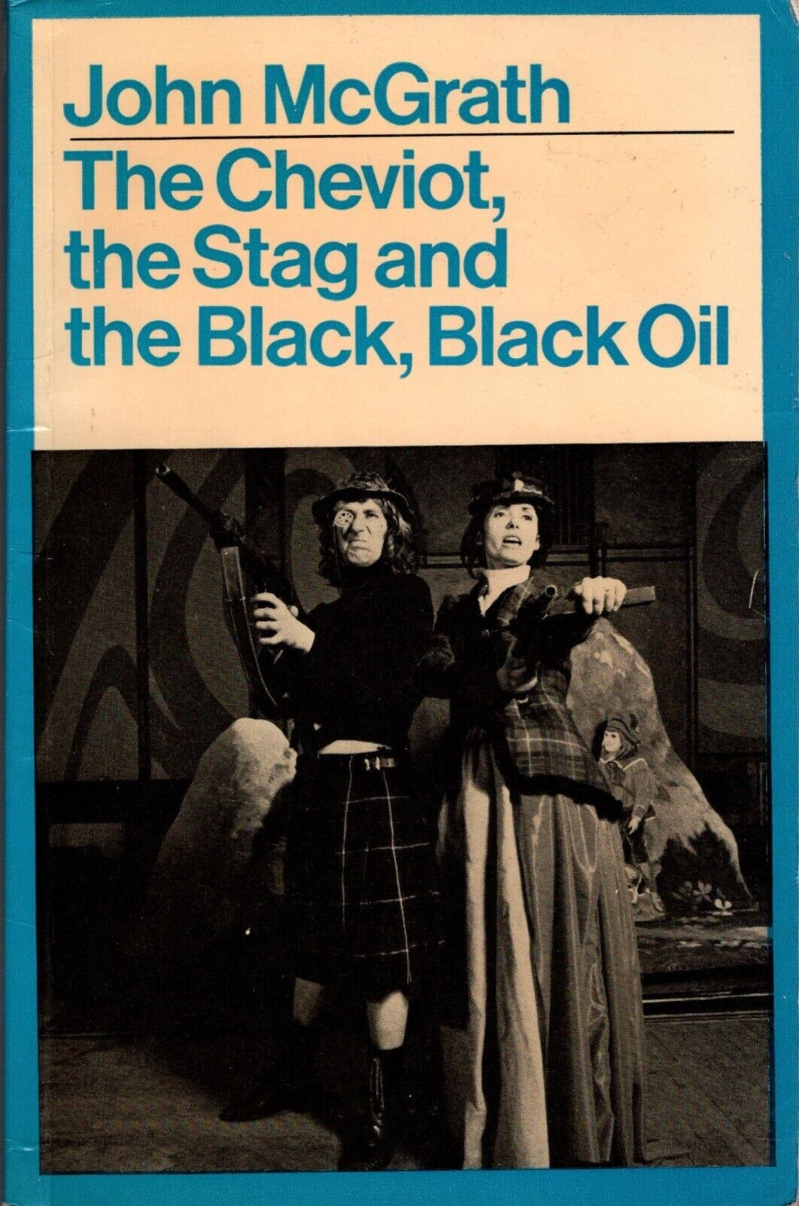
1973

Slide 2



Slide 3



Slide 4
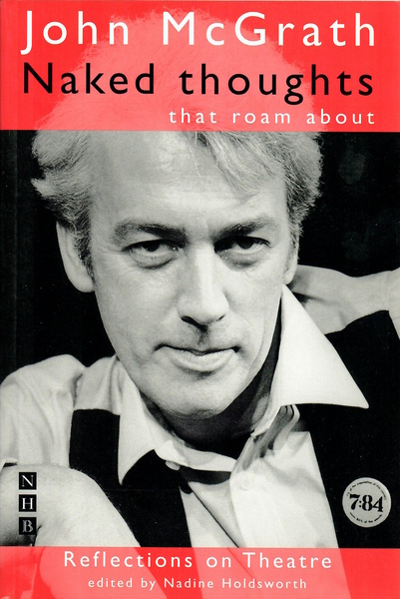
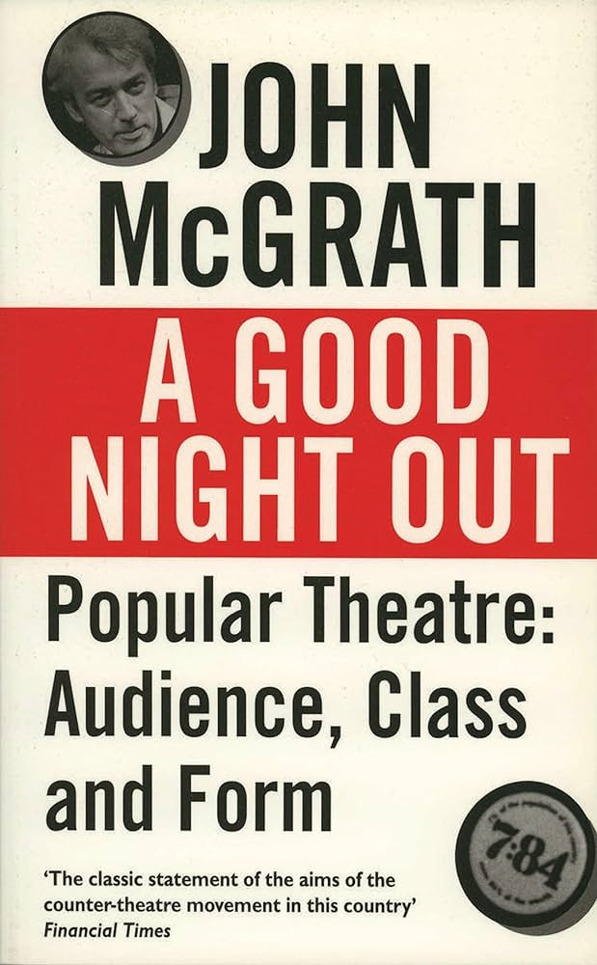

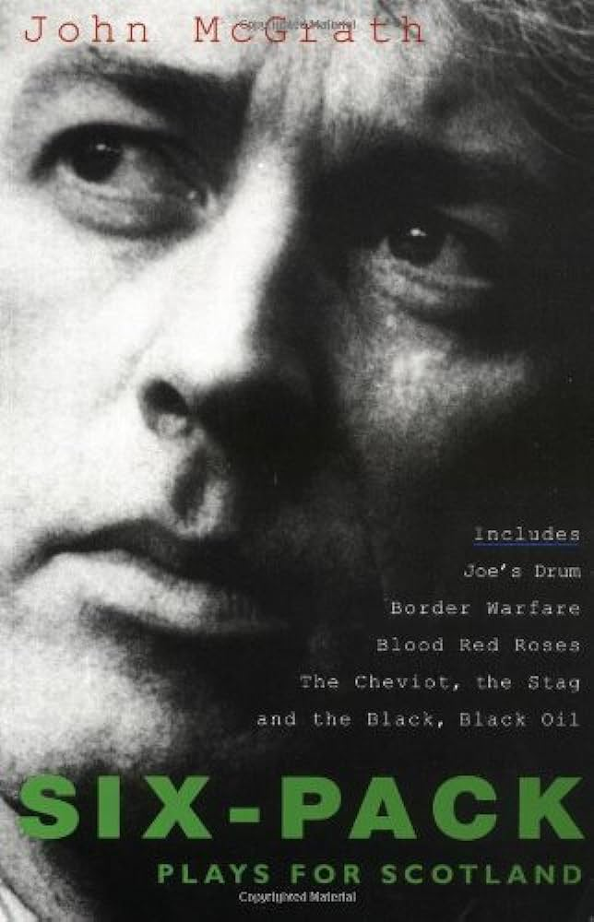
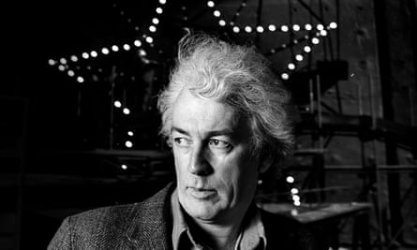

Slide 5
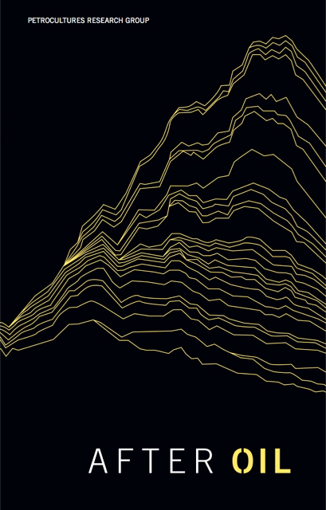
“We will not make an adequate or democratic transition to a world after oil without first changing how we think, imagine, see, and hear [transition] is an “imaginative” exercise, with distinct roles played by words, images, and performances.”
Petrocultures Research Group: After Oil (2016)

Slide 6
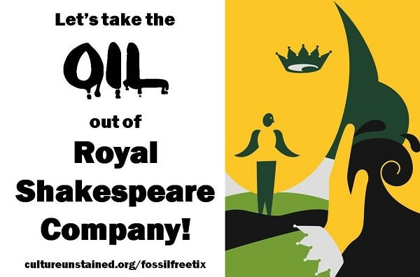
“Petro-Theatre” – Some examples
Leo Lania, Konjunktur (Germany, 1928)
Lion Feuchtwanger, Die Petroleuminseln (1928)
Georg Kaiser, The Coral, Gas I, Gas II (1917-20)
John McGrath, The Cheviot, The Stag and the Black, Black Oil (1973)
- Boom (1975)
Ken Saro-Wiwa, Four Farcical Plays (1989)
Ahmed Yerima, Hard Ground (2005)
Akpos Adesi, Agadagba Warriors and Other Plays (2008)
Sam Ukala, Harvest of Ghosts (1999)
JP Clark, All For Oil (2000)
- The Wives Revolt (1991)
Duncan McLean, Julie Allardyce (1999)
Lucy Prebble, Enron (2009)
Donal O’Kelly, Little Thing, Big Thing (2014)
Ella Hickson, Oil (2016)
Clare Duffy, Arctic Oil (2018)
“Petroleum resists the five-act form” Bertolt Brecht

Slide 7

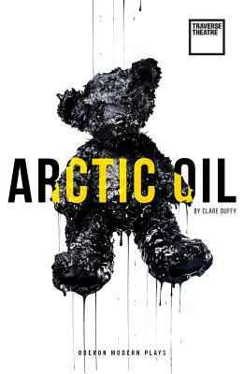

391 × 600

Slide 8
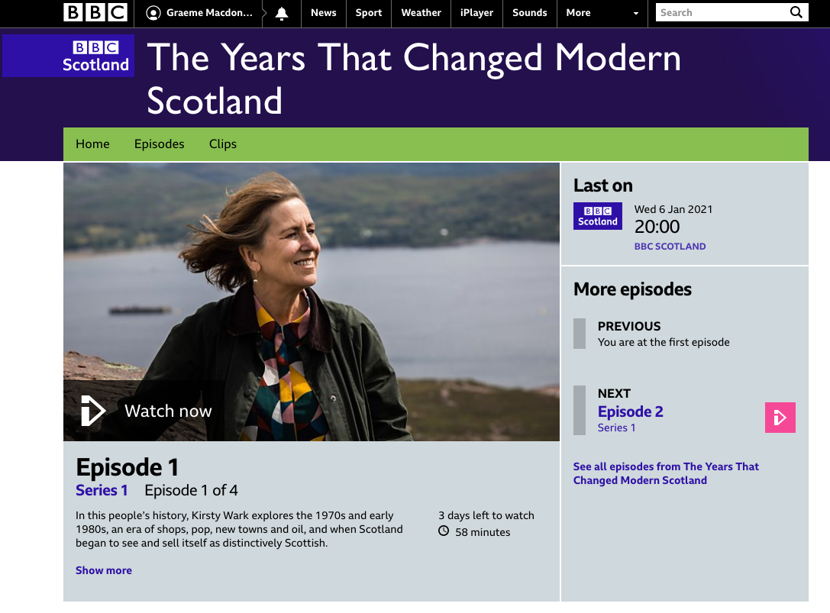

Slide 9
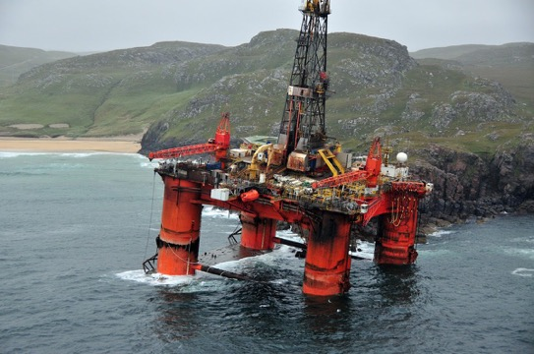
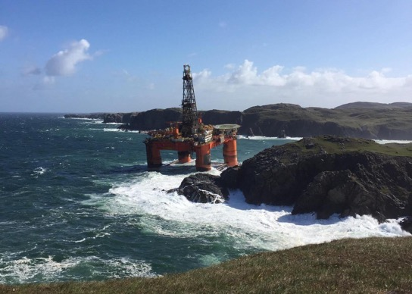
“These oil rigs are quite spectacular. I hear they actually attract the tourists –” John McGrath, The Cheviot, the Stag and the Black, Black Oil (1973)

Slide 10
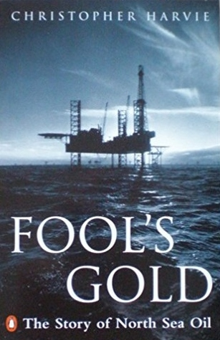
Offshore oil was discreet, geographically withdrawn from the main population centres…there was a non-critique of oil culture.
Oil failed almost totally to surface in the imaginative literature of Anglo-Britain. Where was the novel or the poem of North sea oil? Or the play?
Some authors were vividly conscious of the implications of the oil, particularly for politics, and nearly all of them were Scots…they realized that the oil had triggered a very complex transformation, at once local and international. It was worth treating experimentally, using it as a means of focusing Scottish history. Thus while the thing itself was local, occurring in specific basins of activity, it was incorporated into the national repertoire of metaphors.
Christopher Harvie, Fool’s Gold: A History of North Sea Oil (1994)

Slide 11
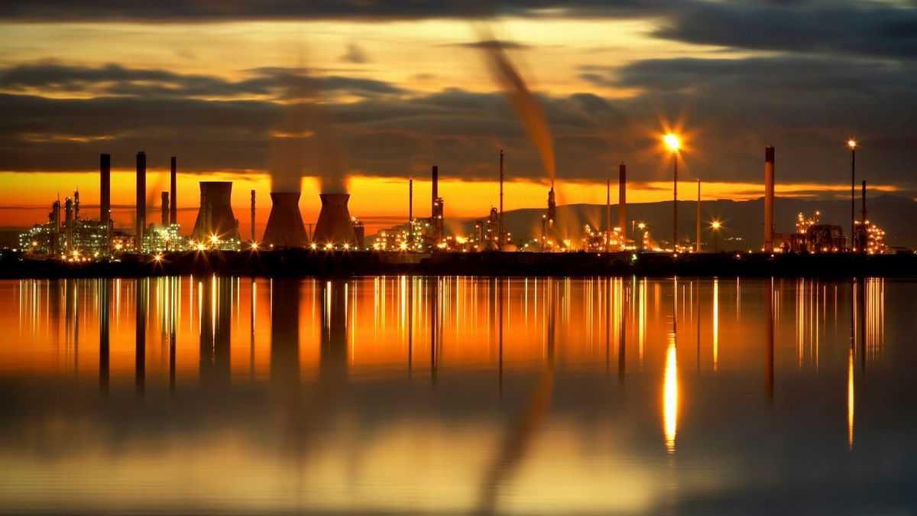
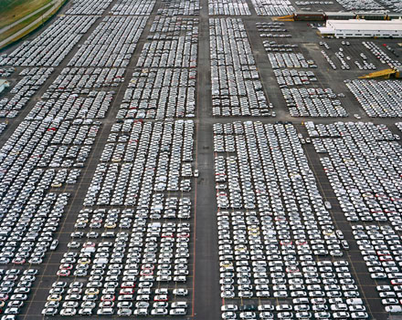

Slide 12


Slide 13


Slide 16
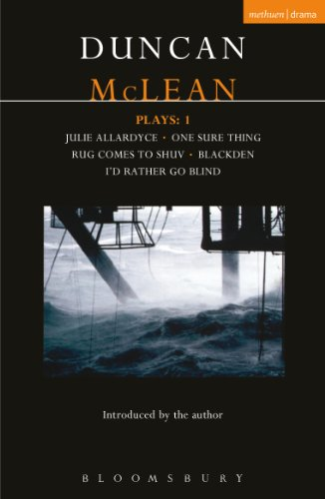
Finn Here’s what I think: I think there’s a lot of people on the beach that don’t give a toss about us working out there. They drive about in their cars, they switch on their central heating, they fry up their bacon and beans – and the thought of folk in the middle of the North Sea drilling up the oil and gas they’re using, it never enters their head. And then one day, a chopper ditches, or there’s a gas leak, or a platform comes adrift in a gale, and oh dear me, suddenly they’re up in arms, getting themselves in a state, shooting their mouths off! And why? Cause they feel guilty! Cause ninety-nine per cent of the time they don’t even think of us. Cause a hundred per cent of the time they’re gobbling up the stuff we produce – they’re keeping us out here!
Duncan MacLean, Julie Allardyce (1999)

Slide 17
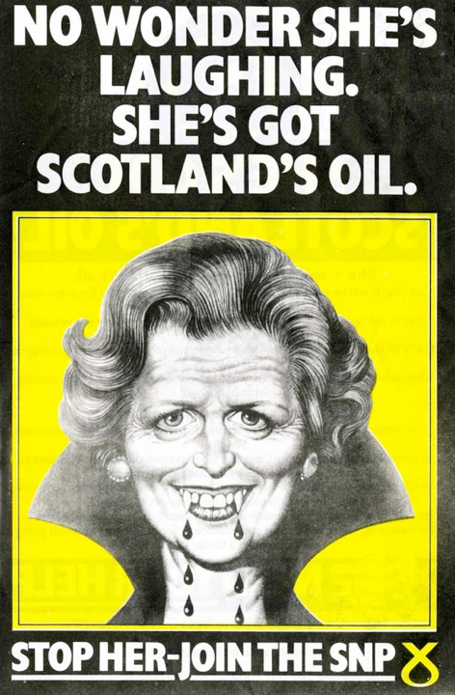

Slide 18
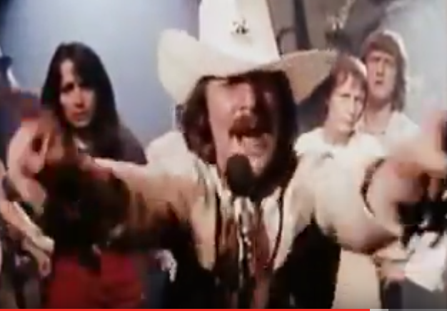
“All your government needs is fixin’”
Take your oil rigs by the score
Drill a little well just a little off-shore,
Pipe that Oil in from the sea,
Pipe those profits - home to me
[…]
I’ll go home when I see fit
And all I’ll leave is a heap of shit.
The Cheviot, the Stag and the Black, Black Oil

Slide 19
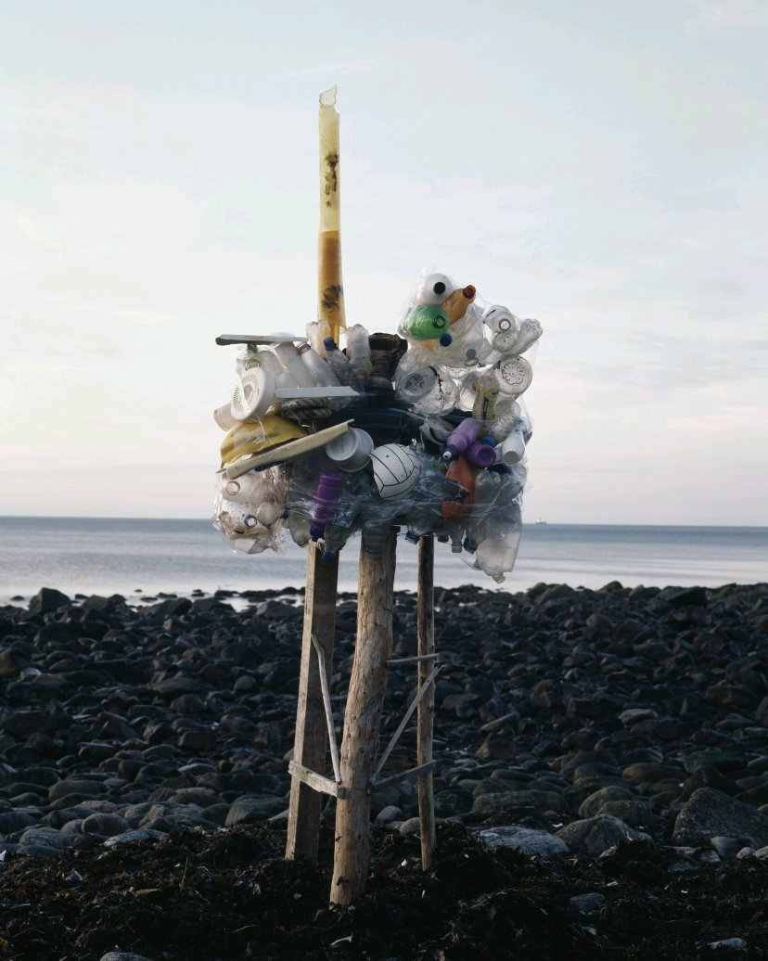
Ernst Logar
“Tillydrone”
From Invisible Oil

Slide 20
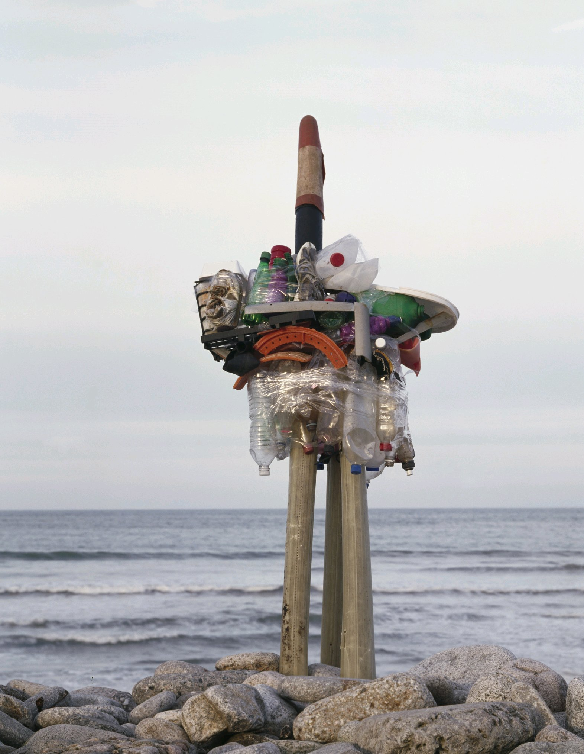
Ernst Logar
“Torrie”
From Invisible Oil

Slide 21
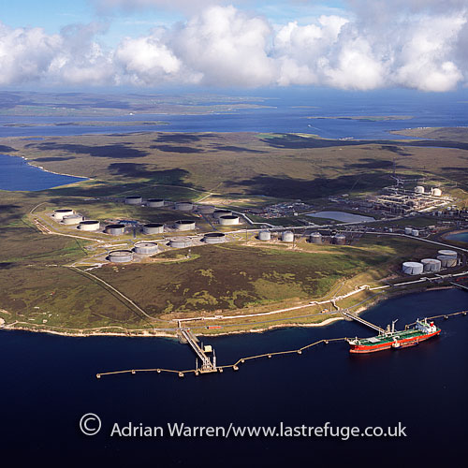
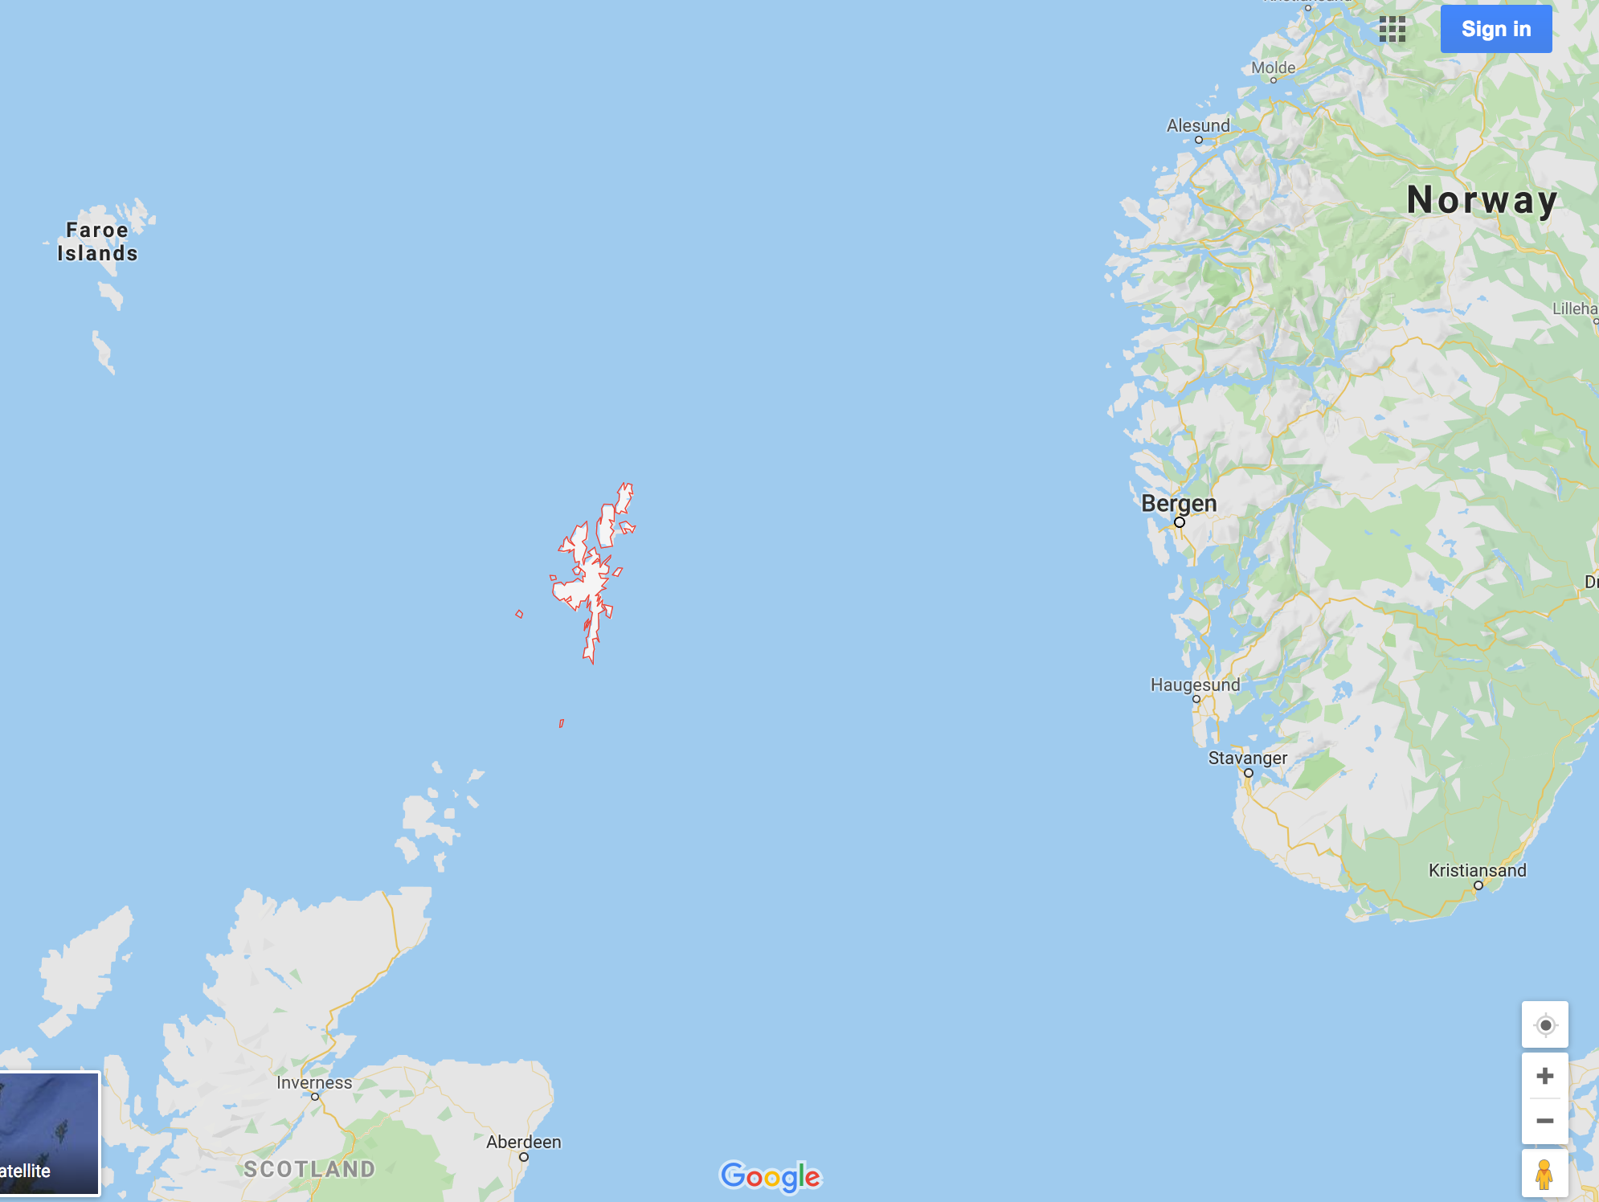
Lowrie a’Wurlie waits for the bus home. He buys a poke of chips from the Viking Café and reads the month-old news on the scrap of newspaper, the Aberdeen Press and Journal. He spots a report on lamb sales at the city marts, but the prices fetched are wrapping someone else’s chips.
At half-past three the bus departs for the north, pulling slowly up the hill away from the town. Lowrie looks northwards, and through the mirk he sees the distinctive glow of the main gas flare at Sullom Voe Oil Terminal. The bus radio plays away the long miles through the Lang Kames, where a deserted moorland valley skirts the new oil age highway north. Then to the west, the sea glints blue and the village of Voe is reached. Lowrie winces as he looks on the estates of new houses which have been built there. To his mind they are depressing in their uniformity, all lit up with lights in identical windows. The bus continues on along the side of a sea loch till it reaches Brae, another village afflicted by this oily sprawl. When Lowrie was a young man, courting, he went many a night to dances in the hall there. Now the Brae that Lowrie knew is lost, swallowed up and gone.
The two-lane highway ends a few miles further north and transforms into the old single-track road, winding its way along the shores of a series of small, peaty hill-lochs. Then it climbs to the top of a brae and there, to the east, between the hills, lies Sullom Voe, the huge urban outpost, the oil terminal. It makes a striking spectacle, vivid and alive in the mirk of the night like a downtown area of some lost city – a myriad lights shine out of the gloom, surrounded on all sides by blankness and above all shines its beacon, the gas flare.
To Lowrie a’Wurlie it is a gigantic alien, constructed out of nothing natural by hands which never belonged to faces.
Robert Alan Jamieson, Thin Wealth (1986)

Slide 22
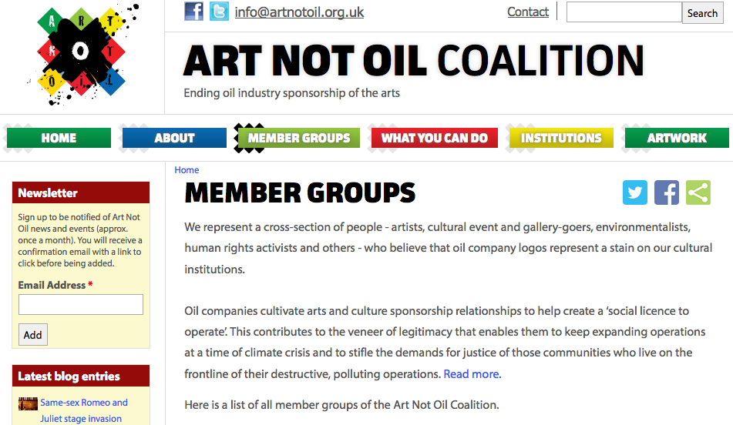

Slide 23
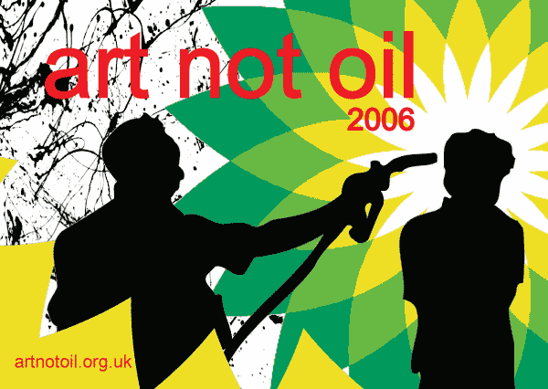

Slide 24
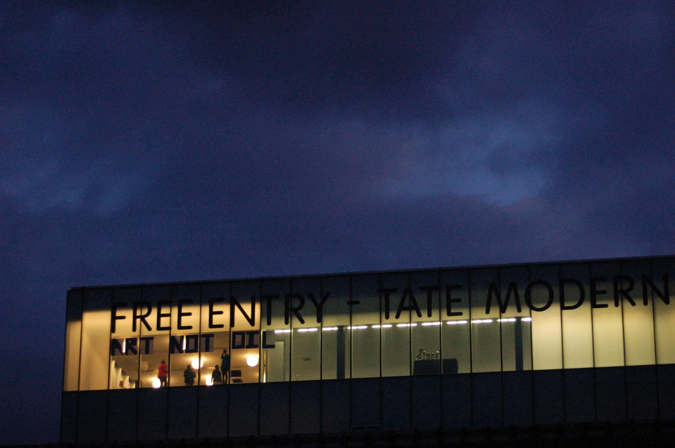
Liberate Tate

Slide 25
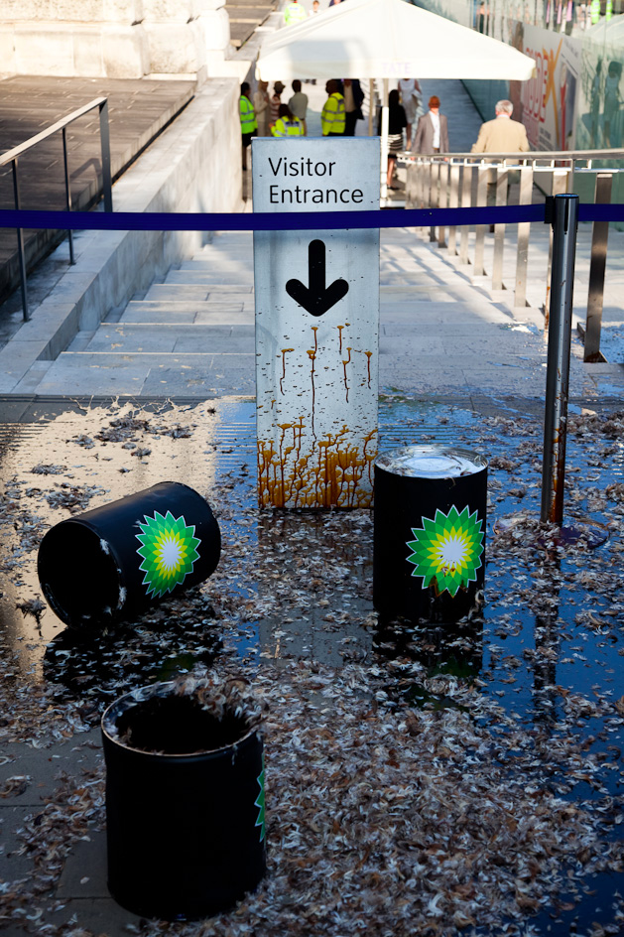
Licence to Spill
(2010)
“Next time A Caribbean island is battered beyond Recognition, burst in upon banquet of luxury emissions or a Shell board meeting.”
Andreas Malm, How to Blow Up a Pipeline

Slide 26
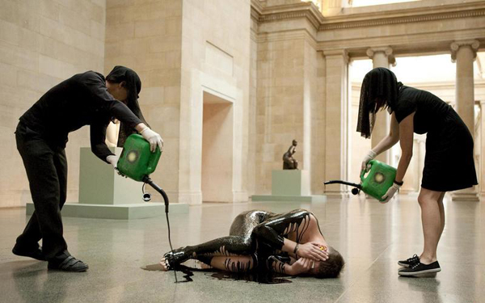
Human Cost (2011)

Slide 27
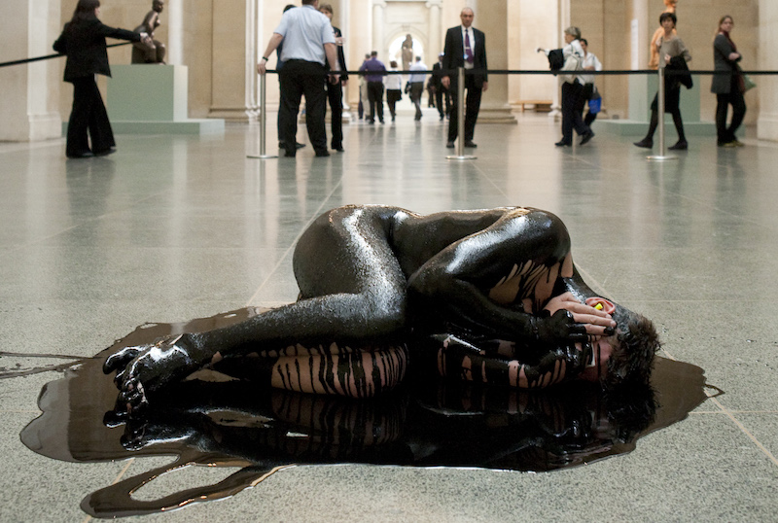

Slide 28
“How could a militant climate struggle avoid veering down into such deep ditches? The set-up would, for a start, inverse deep ecology: whereas the latter wants to wage war against civilisation and indeed humanity as such, the former would fight for the possibility of civilisation, in the sense of organised social life for Homo sapiens. Unlike the deep variety, it would target a particular deformed kind of civilisation – namely, that erected on the plinth of fossil capital – and tear it down so that another form of civilisation can endure (or none will). This implies that climate militancy would have to be articulated to a wider anti-capitalist groundswell, much as in earlier shifts of modes of production, when physical attacks on ruling classes formed only minor parts of societywide reorganisation. How could that happen? This cannot be known beforehand. It can be found out only through immersion in practice.” 157-8
How to Blow Up a Pipeline: Learning to Fight in a World on Fire
Andreas Malm
To make an effective challenge to the ethics of the art museum, a
confrontation needs to be made from within the gallery. This might
mean from within a community of artists who hold a stake in the
formation of the institutional politic, from within the public realm that
can claim the museum as a public space, or to be sufficiently confrontational
to pose opposition, from physically within the galleries. This
sheds light on the space to be opened out by artists wishing to create
institutional critique in their work: not too close yet not too far, seeking
to open up an ‘interstice’, or crack, of dissent within the institution.
This opening is forged at an ‘interstitial distance’ between the inside
and the outside of the institution.
Sometimes art as intervention might not have the proximity to the
subject to give sufficient leverage to create a space within it, at other
moments too great an intimacy and acceptance by the gallery might
limit efficacy. A tightrope must be walked, or a route in especially
carved. In this understanding, artists are critical friends of the larger
institution: part of Cutler’s Guattarian ecosophic whole, but acting at
enough critical distance to make an effective challenge. In this way
artworks can open up an interstice of opposition to the status quo of
the gallery. Artwash 161

Slide 29
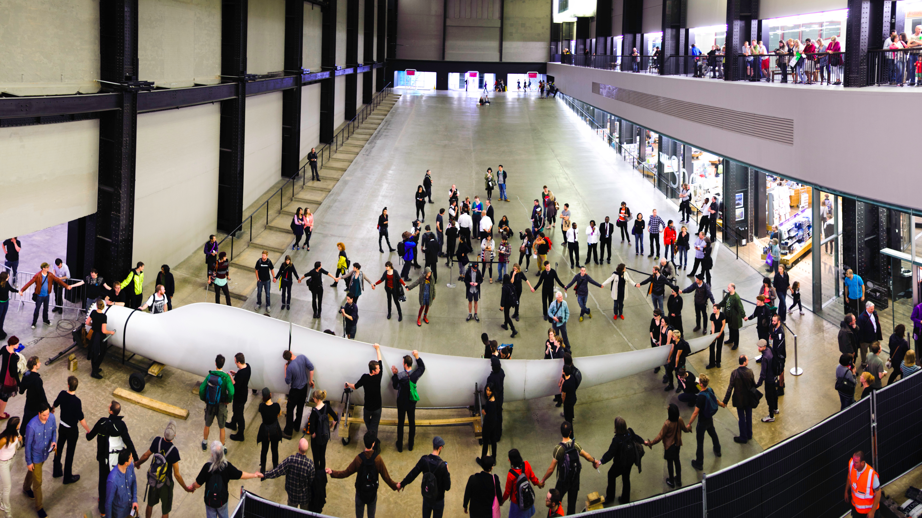
The Gift (2012)

Slide 30
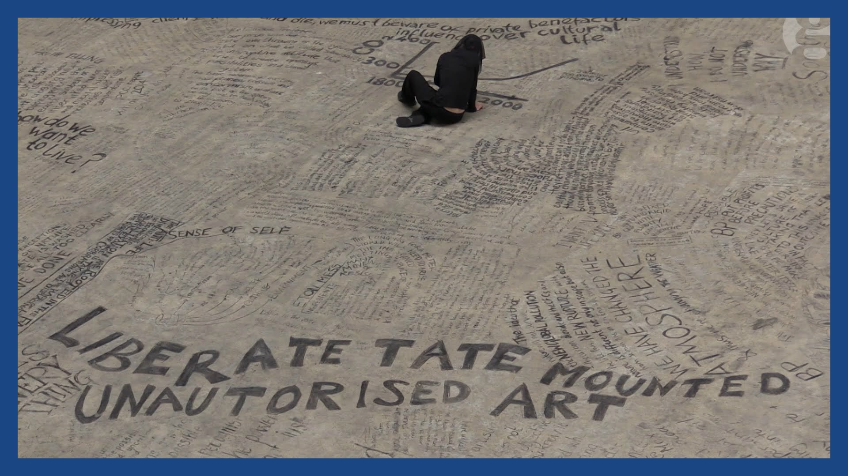

Slide 31
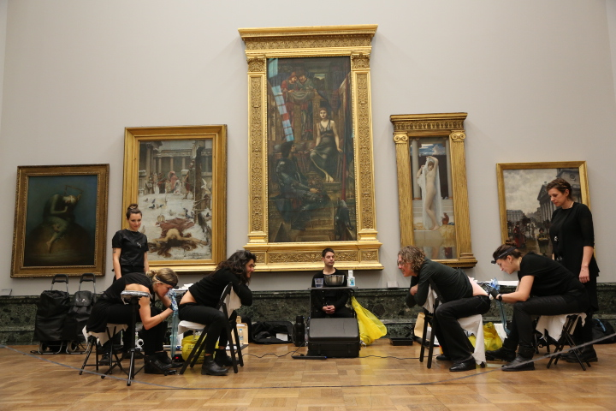
Birthmark (2015)

Slide 32
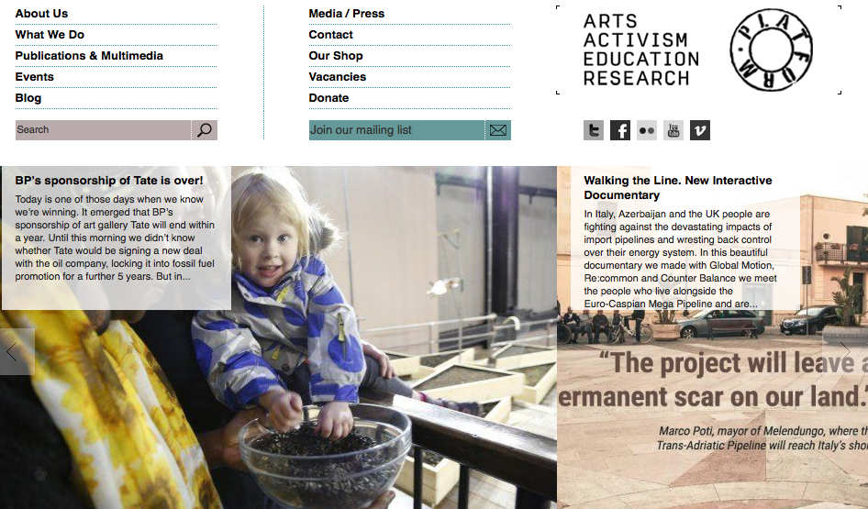

Slide 33

There is a cynical PR strategy to every oil sponsorship deal, and the companies themselves do not deny this….Oil companies’ desire to associate themselves with prestigious arts institutions is a survival strategy of an industry that itself feels increasingly precarious, both upstream and downstream. In the theatre of the global public relations and brand management industry, arts sponsorship becomes a way for the global, transnational corporation to present and benefit from a nationally specific brand identity: it offers a pretence of corporate responsibility for the callous profiteer; and becomes an illusionary act of cultural relevance for outmoded industries.
Mel Evans, Artwash

Slide 34
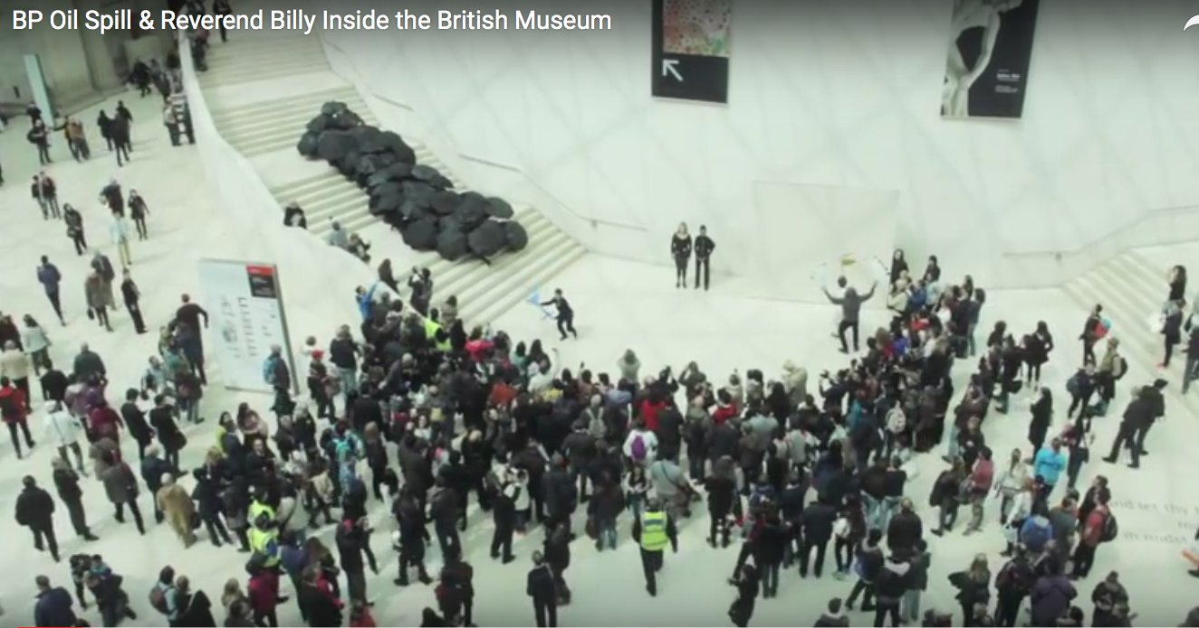
“It started with a crude spill/on the Gulf Coast/from a rig of BP…”

Slide 35
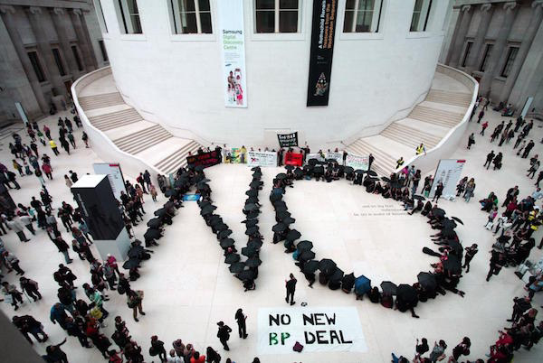

Slide 36
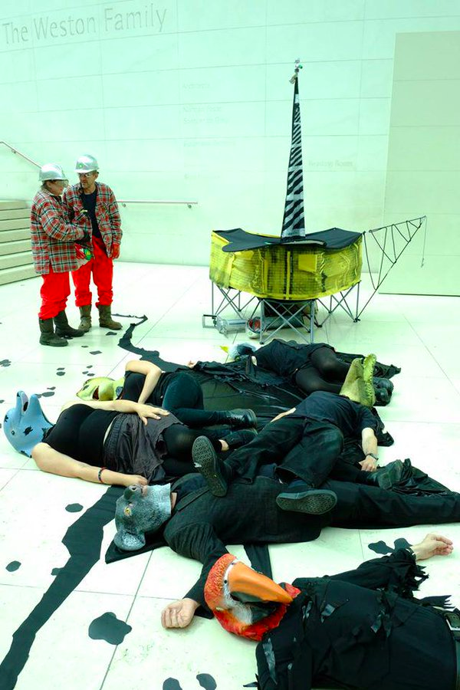
Performance is a core part of communications.
This rule applies from public relations to protest.
To artwash is therefore part public relations and
part theatre. Mel Evans, Artwash

Slide 37
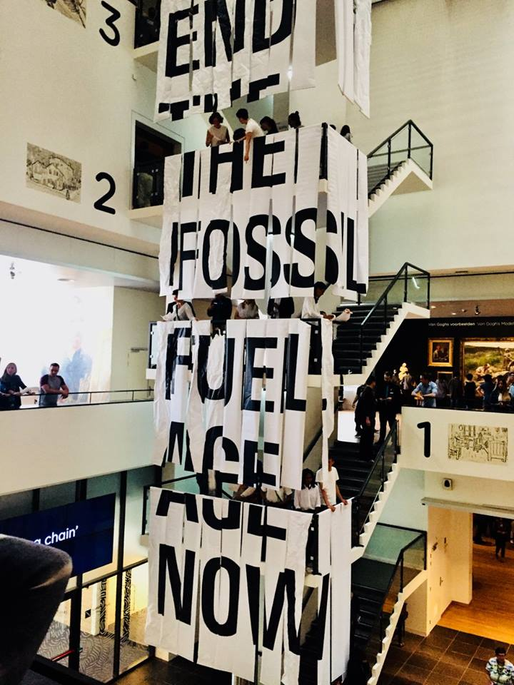


Slide 38
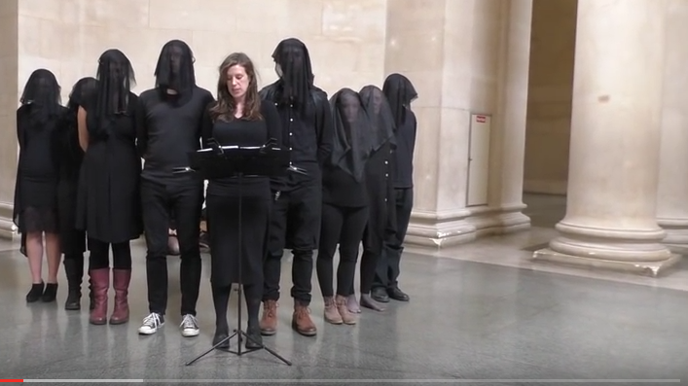
Our words spill into this space like oil. We utter a stain; a slick black trail traced through spheres of art and history. It’s a gestural embodiment of the BP oil money invested in the cultural estate. Sponsorship money that artwashes the oil giant’s image and grants its social license to operate. This oil trail leads our performance intervention from Tate, through the National Portrait Gallery. Liberate Tate – 5th Assessment 2015 http://www.liberatetate.org.uk/5th-assessment/

Slide 39
