Slide 1


Slide 2


Slide 3
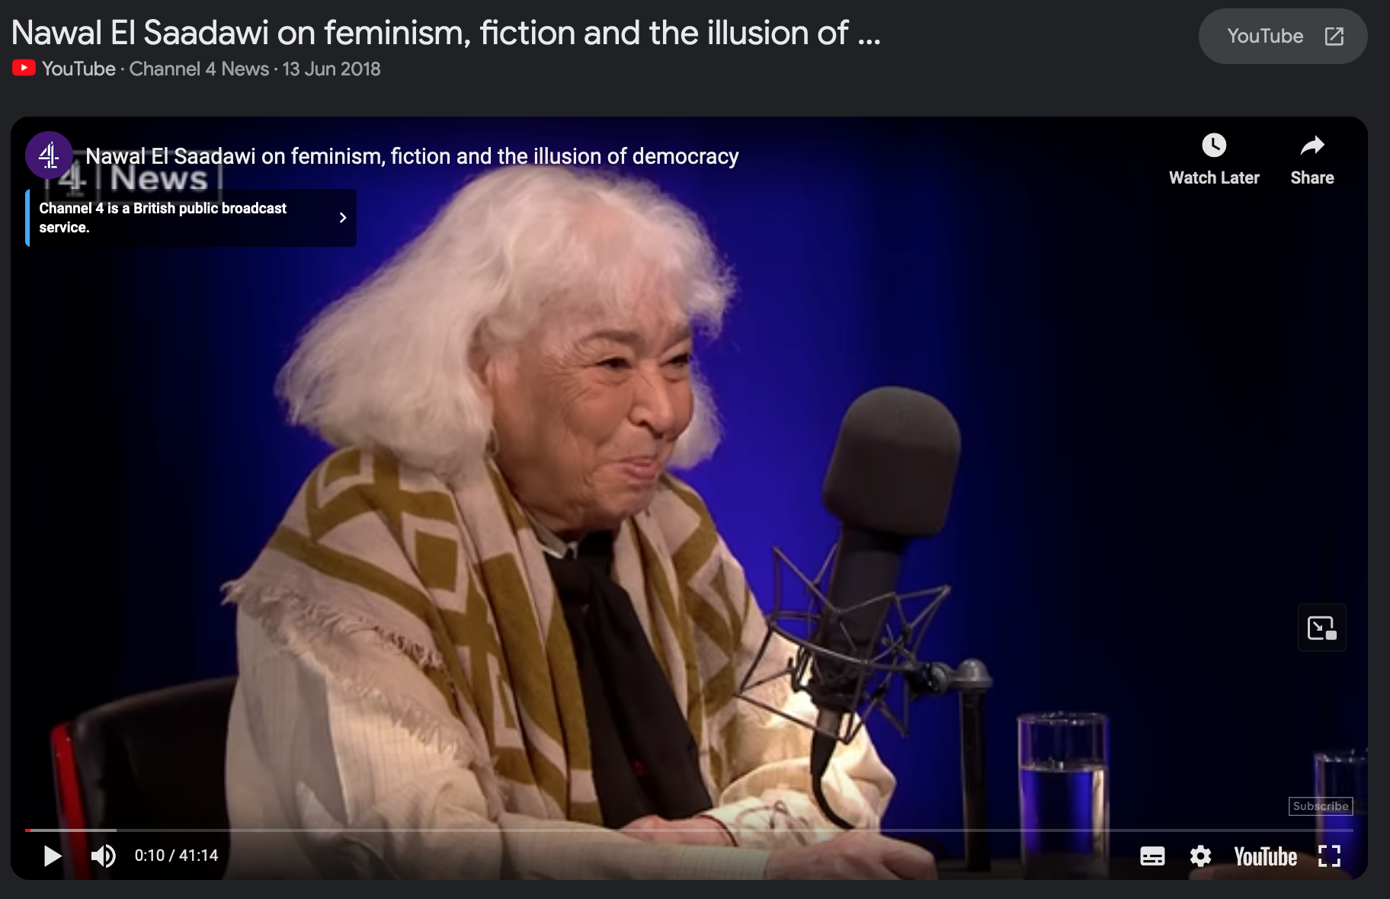

Slide 4
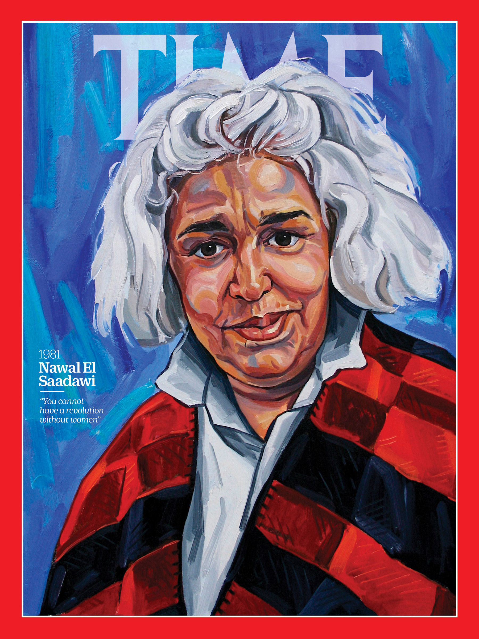


Slide 5
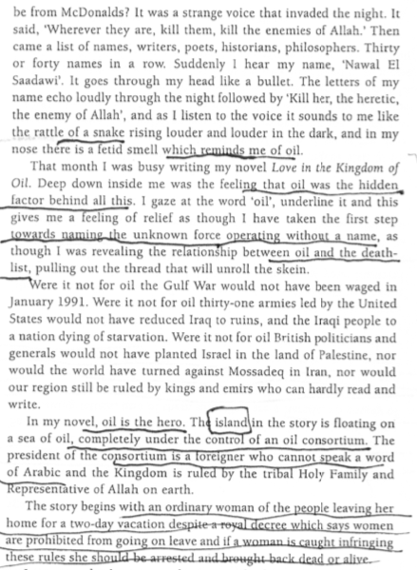


Slide 6
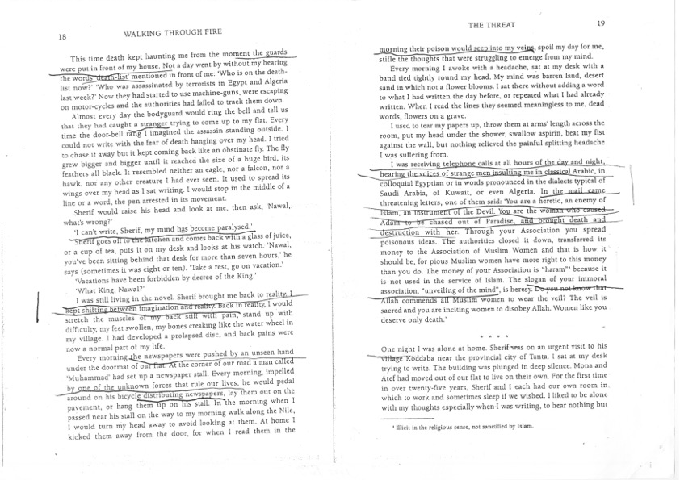

Slide 7


Slide 8

2008

Slide 9

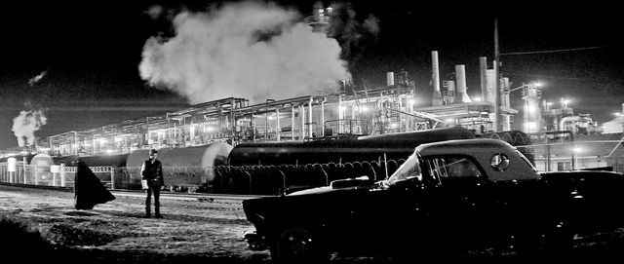

Slide 10



Slide 11



Dir. Jonathan Glazer, 2013

Slide 12








Slide 13


(dir. Ridley Scott, 1991)

Slide 14


Slide 15



Slide 16
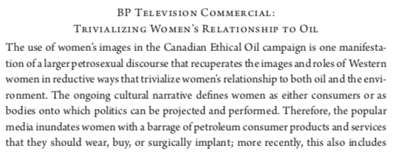
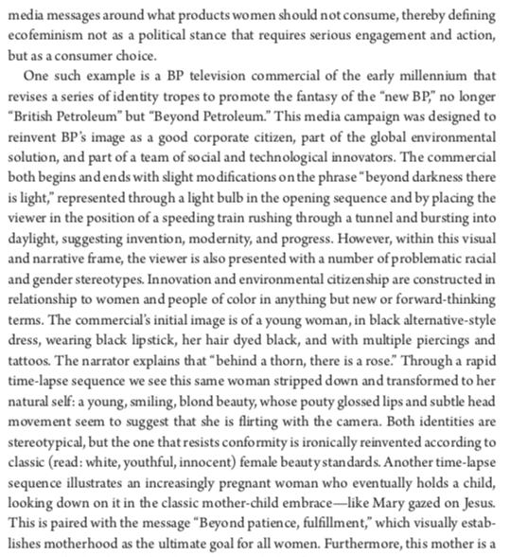
Sheena Wilson, Gendering Oil
Chevron
Beyond Petroleum (2005)

Slide 17


