Slide 1
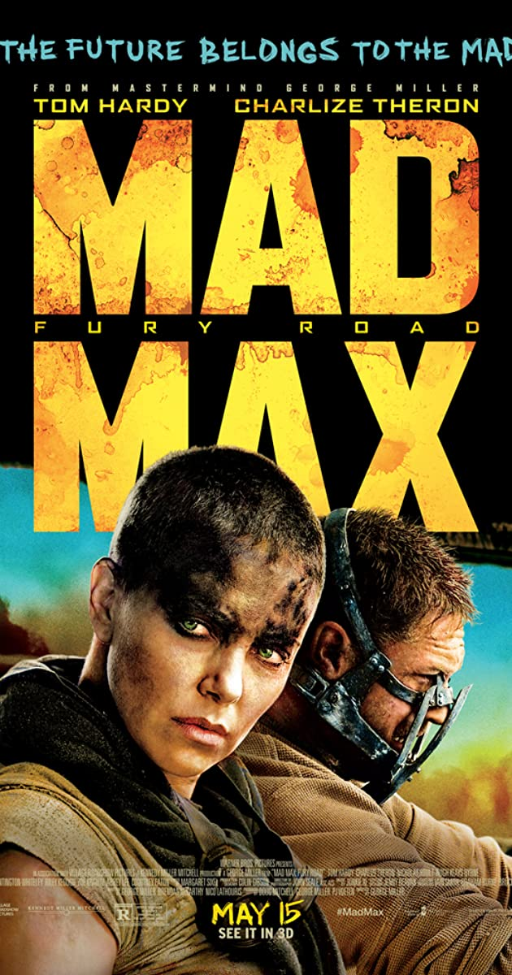

Slide 2
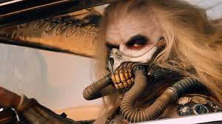
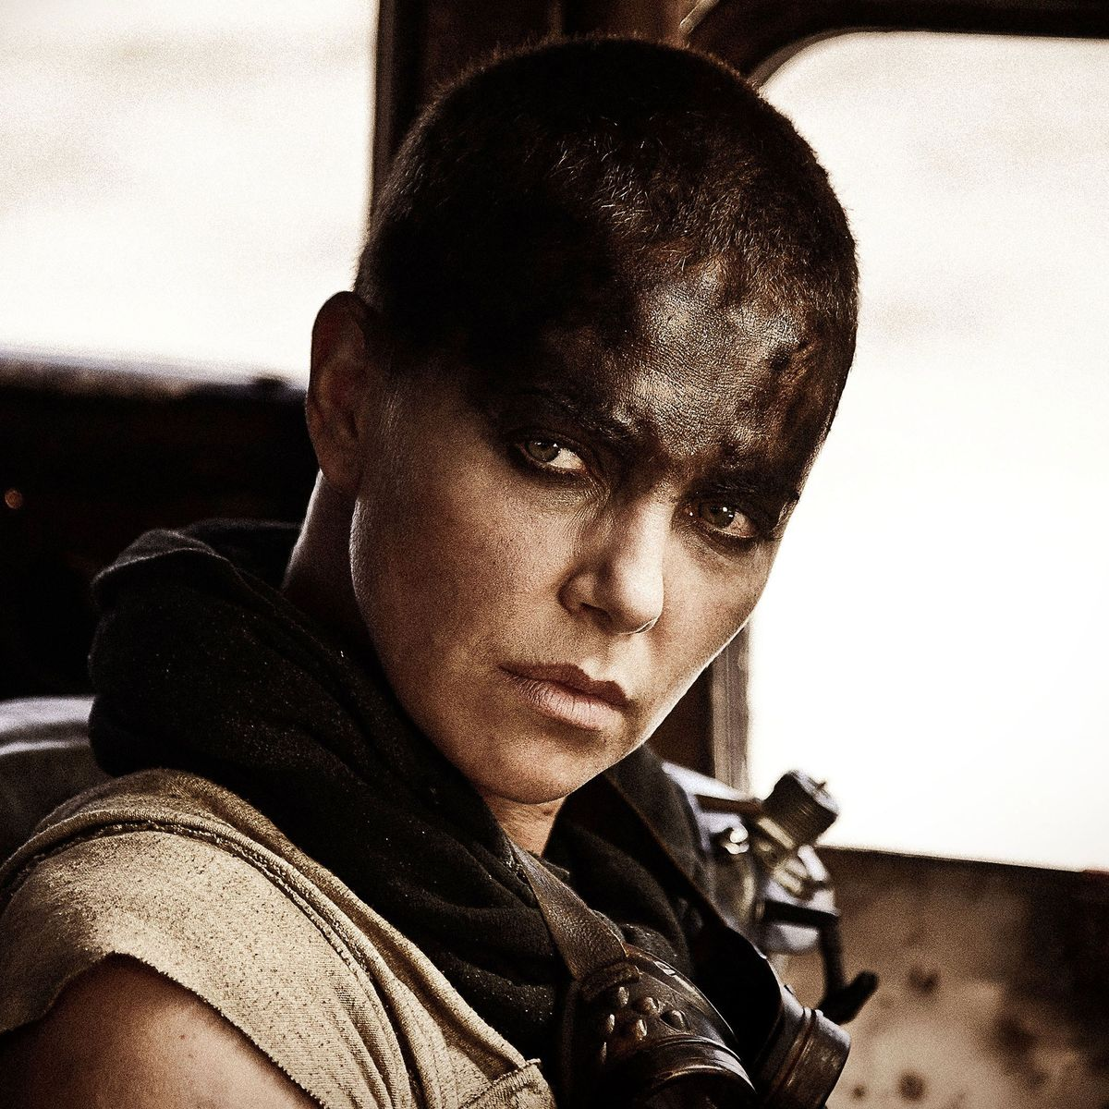
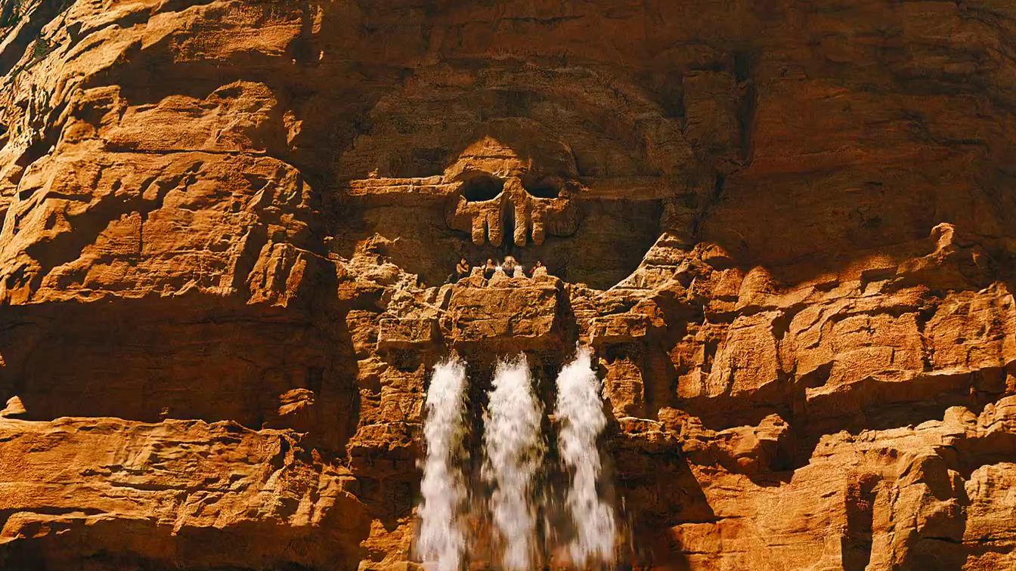
The ruler is the one who controls all this vast apparatus, this infrastructure of four flows. He controls the raiding parties that steal the fuel. He controls the water that secures the obedience of the excluded class without. He controls reproduction, and we see women strapped to apparatus that extracts breast milk. He also controls the flow of blood. Max, as a ‘universal donor,’ has to provide blood for the anemic warriors who go out to steal the fuel.
Fuel – called guzzoline – is about power, violence and death. It is what the city’s war parties fight and die for. It is also the only object that features in a (failed) exchange. It is the fuel of acceleration, of a world that can only keep going as it goes, as machine of violence and exchange value.
Blood is the liquid that embodies one of the things that might halt that acceleration. Max tries to oppose and negate the guzzoline-fueled world. But it can’t be done, and another strategy is called for. Blood is also the remnant sign of a kind of masculine science of life. In a scene worthy of Bogdanov, Max keeps another hero alive with his own blood, this time voluntarily.
Water has feminine associations. We see the harem hose each other down in a sort of post-apocalyptic wet t-shirt moment. It is a slow scene, as Furiosa cannot yet mediate between madman Max and the female harem. Later water will bog the whole party down. The green world will turn out to be swamped by an excess, by poisonous water. Water is the liquid of inertia and slowness but not quite of death. It is the liquid perhaps of a nonhuman life, but also of culture, of the myth of the green world.
Milk is also coded feminine, of course. But it is the liquid of a more human life. It is the promise of the new, of fresh starts, even of the aesthetic. Its control back in the city is the mark of that city’s sinister character. That Furiosa and the harem actually have some with them on their escape truck is troubling to Max, however. Of all the fluids, it’s the most difficult. That the lactating women turn on the water for the excluded class when Furiosa and Max retake the city is the sign more of the problem it poses than a solution.
McKenzie Wark, Fury Road, Public Seminar

Slide 3
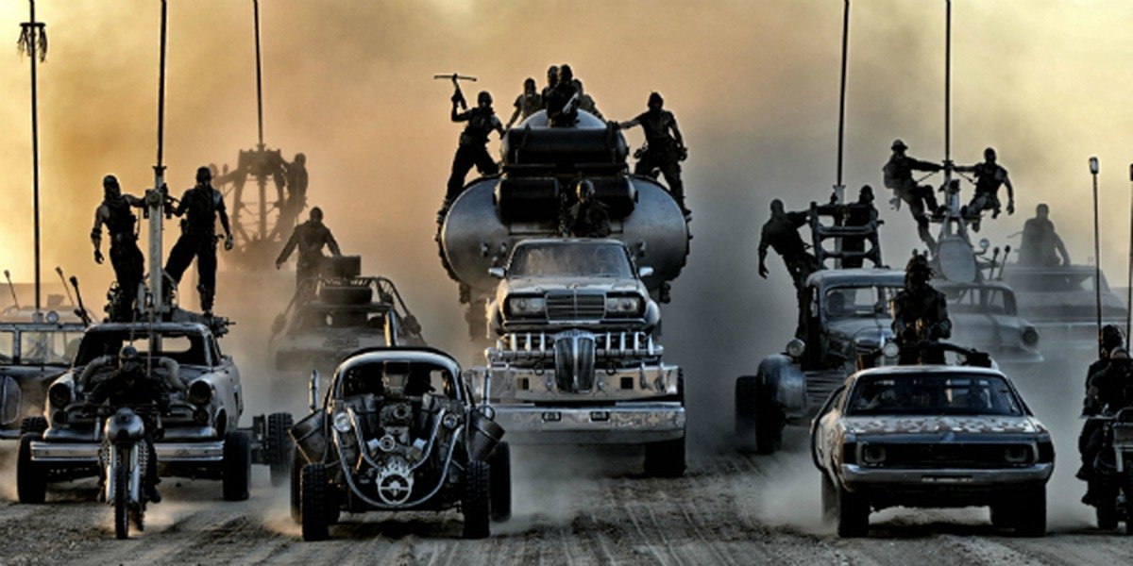

Slide 4
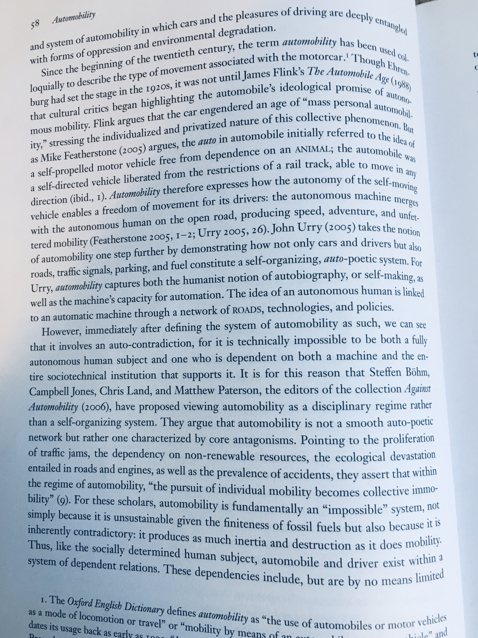
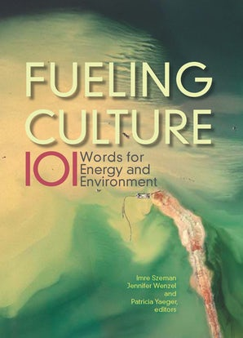

Slide 5
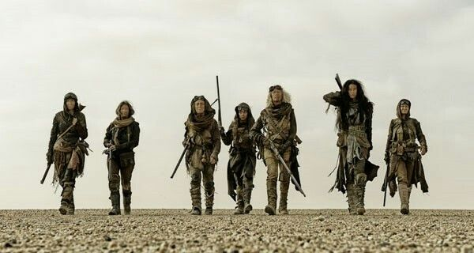
In this article, I shall demonstrate how Fury Road, though written and directed by men, transforms nature into a space of feminist possibility. I enter the discourse around Fury Road’s feminism through the perspective of environmentalism, showing how the film’s gender politics are intimately linked to the film’s environmental politics. I argue that the film draws from, but crucially disrupts, a dominant Western environmental narrative – what Carolyn Merchant calls the Edenic recovery narrative. According to Merchant, Edenic recovery narratives traditionally (re)produce a binary dichotomy of passive, female nature and active, male culture. In disrupting the traditional Edenic recovery narrative, Fury Road divorces female nature from its assumed passive status. Female nature gains agency. In this way, the film serves to ‘re-cast nature as feminist space’ (Alaimo 13). The film’s feminism along these lines is significant, especially considering it is a mainstream film in a popular franchise series.
Nature as a space of feminist possibility: Fury Road’s Edenic recovery narrative
Like Mad Max 2, Fury Road is an after-Eden narrative that represents the human Fall from the Garden due to capitalist accumulation gone wild. Ostensibly depicting a post-nuclear-holocaust world, Fury Road could equally represent a future marked by climate change and the environmental issues associated with the Anthropocene – drought, pollution and severe weather patterns. We learn from the opening voiceover that there have been oil wars and then later water wars, battles fought over these increasingly scarce natural resources. The film’s plot follows Furiosa (Charlize Theron) and the Five Wives as they seek the Green Place, Furiosa’s former homeland that supposedly lies to the east of the Citadel. In seeking the Green Place, these women hope to not only recover the Garden of Eden, but also to escape patriarchal oppression and enslavement by Immortan Joe (Hugh Keays-Byrne), the lord of the Citadel, and his army of ‘War Boys’. Furiosa says that in seeking the Green Place, she hopes to find redemption, a term that refers both to being saved from evil and to reclaiming one’s freedom. Thus, as in the traditional recovery narrative, the film initially sets up the Garden of Eden as a beautiful, good place in need of rediscovery. Unlike the traditional recovery narrative, however, the film also marks the Garden of Eden as a place of freedom from patriarchy, particularly for women like Furiosa and the Five Wives. In this way, Fury Road disrupts the traditional Edenic recovery narrative by representing nature as a space of feminist possibility rather than a safe haven for masculine agency.
….. the film’s protagonists and audience learn that the Garden of Eden no longer exists in the material reality of the film’s world. Rather, the Garden of Eden only exists in the memories and imaginations of the film’s characters.
Michelle Yates, “Re-casting nature as feminist space in Mad Max : Fury Road”
Science Fiction Film and Television, Volume 10, Issue 3, Autumn 2017, pp. 353-370

Slide 6
