Slide 1
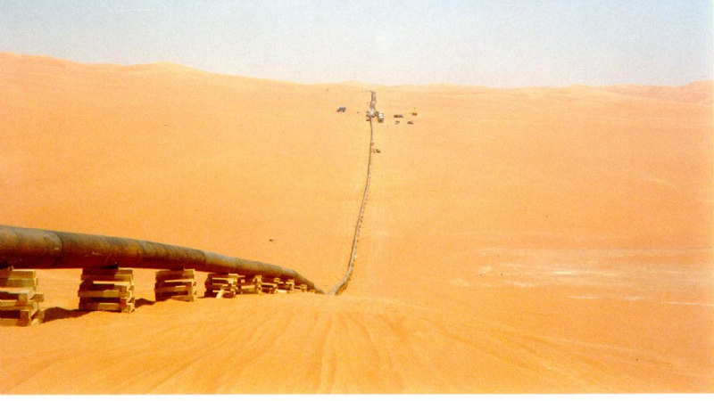
Petrofiction

Slide 2

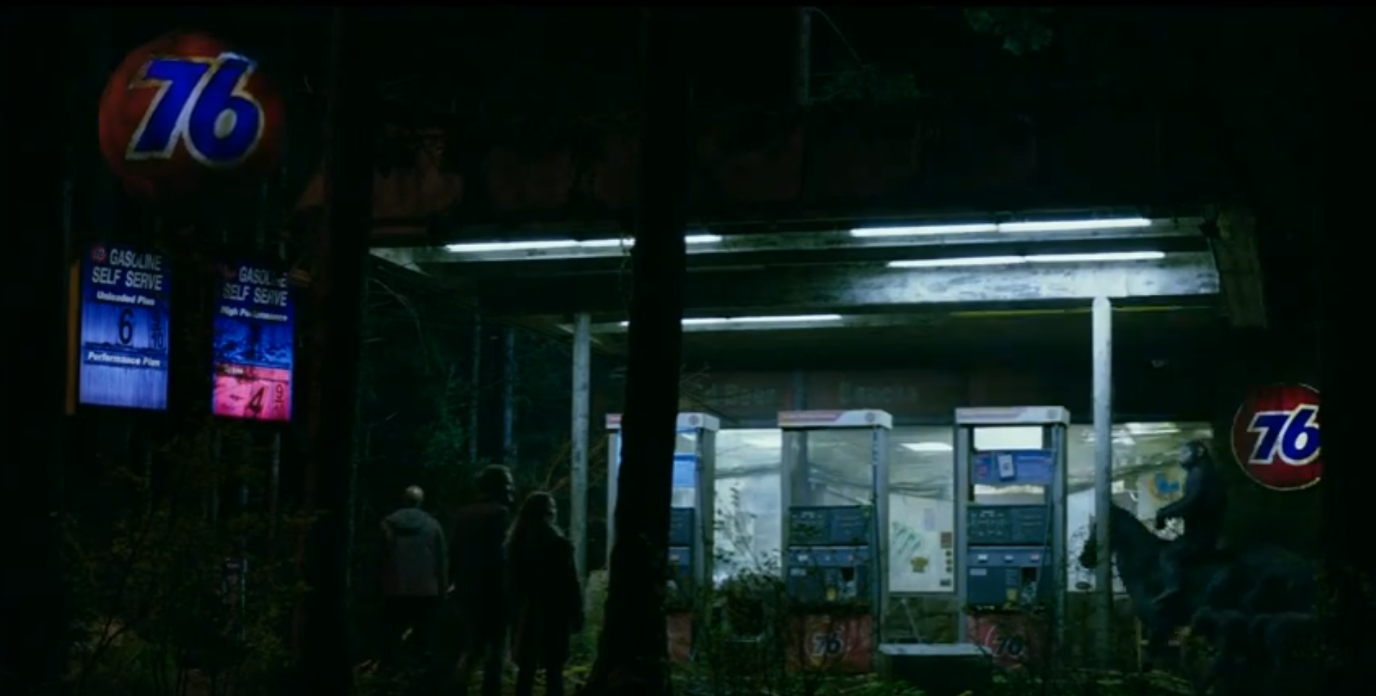

Slide 4
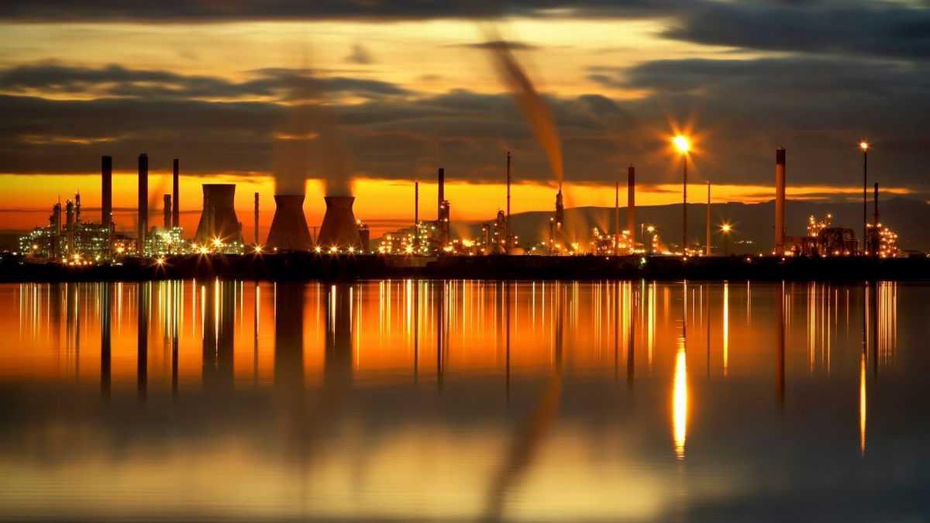
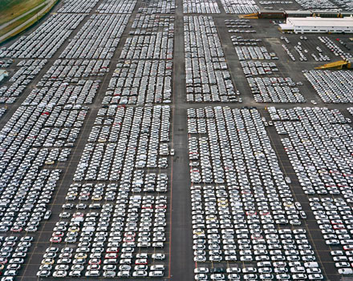

Slide 5
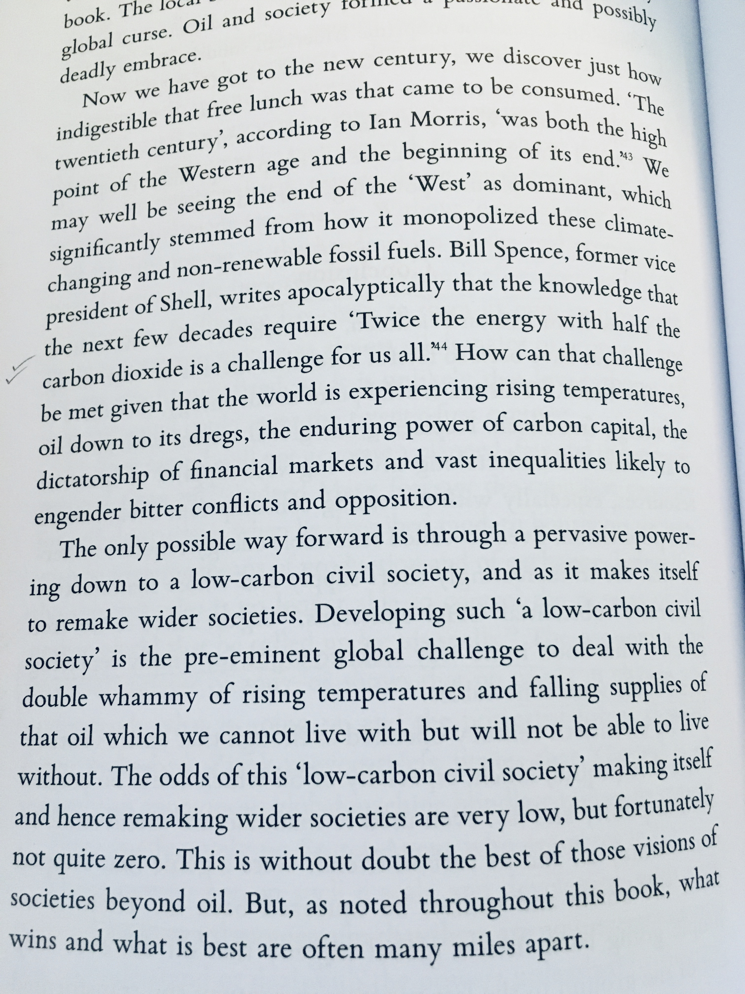


Slide 6
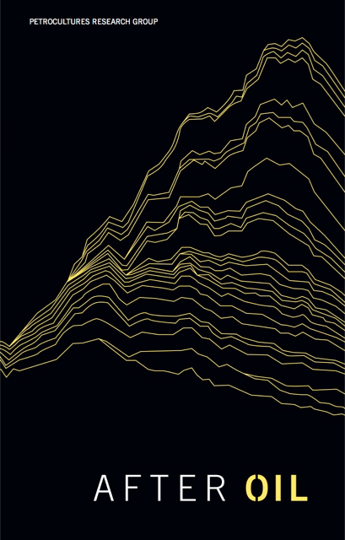

Slide 7
What makes speculating about energy futures productive is that it highlights all the more powerfully the political fantasies in which literature currently indulges.
What if after energy surplus comes deficit? How might literature respond to a future of less rather than more?
We can only speculate, for even in the genre that deals with the future – science fiction – there are strikingly few examples of cultures of less…lack of energy is found only in postapocalyptic scenarios – cautionary tales about where our fiction of surplus might lead.
Imre Szeman, “Literature and Energy Futures”, PMLA

Slide 8
Notes:
Here – four flows are all in short supply – oil//milk/water, leading to a large flow of blood – a world of scarcity and neo-primitivism, violence and ritualized gatherings around gangsterish cults, driven by brutal climates and agricualtraul collapse – but eco-apocalyptic registers are complemented by others, such as techno-utopian genres – such as….next slide

Slide 9
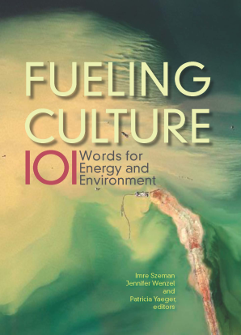
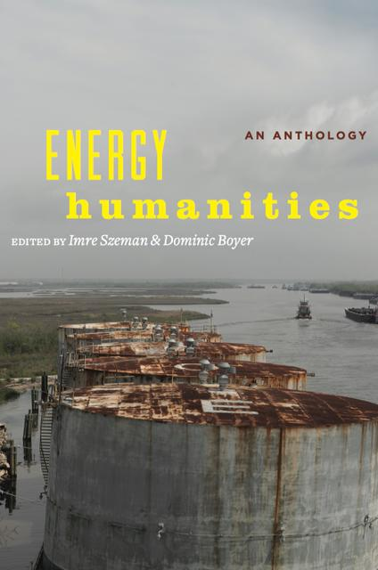
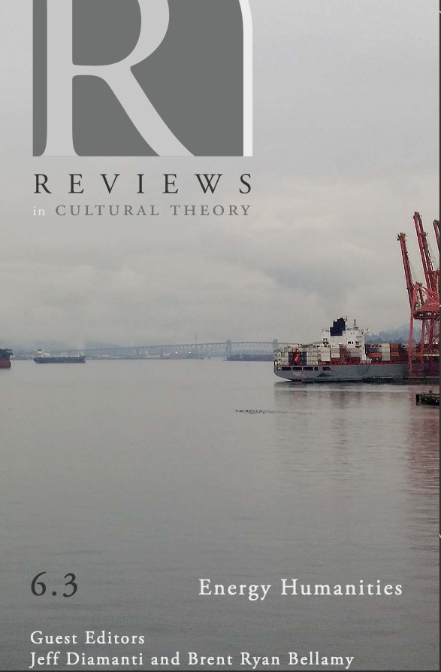
Energy Humanities scholars wish to shed light on the fuel apparatus of modernity,
which is all too often invisible or subterranean, but which pumps and seeps into the groundwaters of politics, cultures, institutions, and knowledge in unexpected ways. Moreover energy humanities aspires to provide a speculative
impulse as well as a critical diagnostics. Boyer & Szeman, 2017.
…to gain critical purchase not only on the pressure that energy exerts on culture but also the pressure that culture exerts on energy regimes. Jennifer Wenzel,
‘Introduction’ to Fueling Culture, 2017.

Slide 10
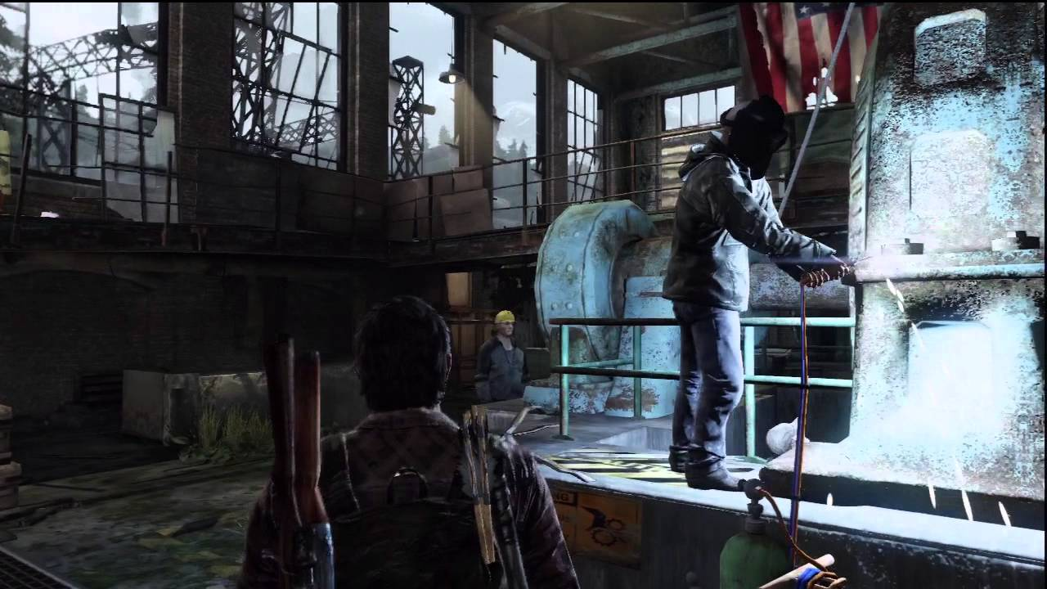

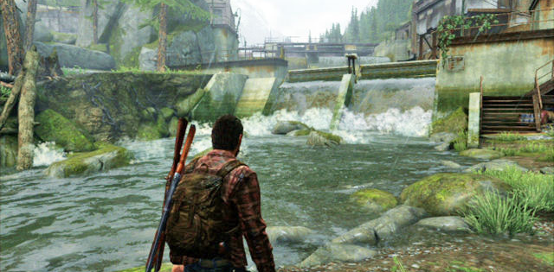

Slide 11


Slide 12


Slide 13
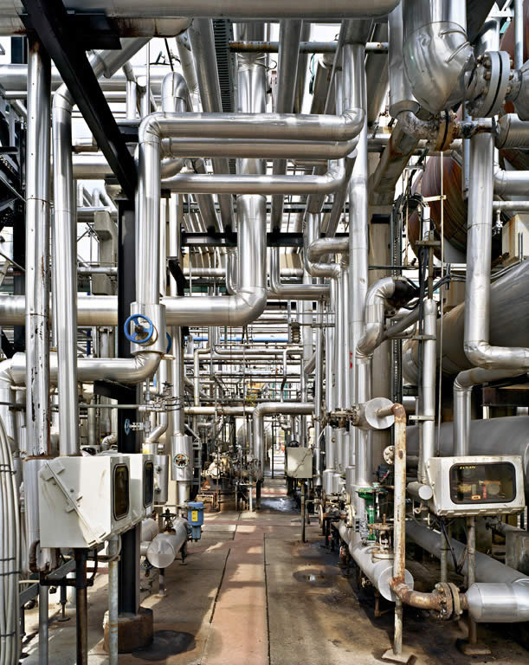
Ed Burtynsky, “Oakville”, from Oil (2010)

Slide 14
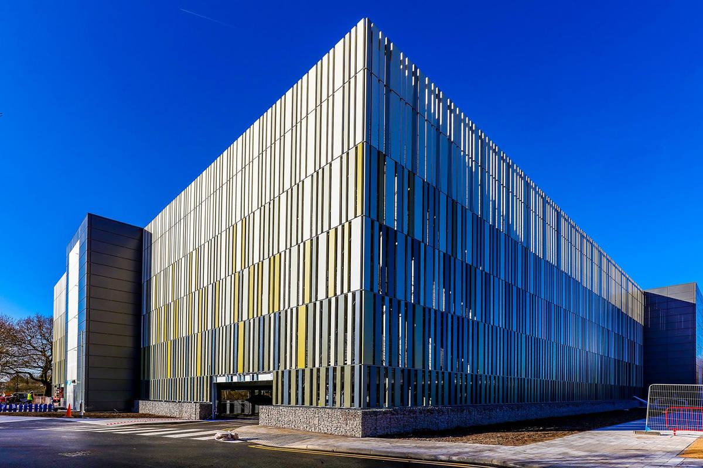

Slide 15
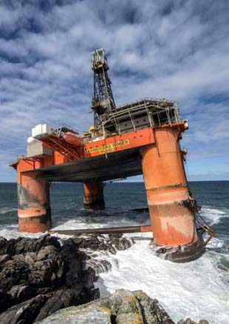
“These were clumsy steps with which it came […] a few waves-width from the beach it hesitated, [with a] strange ungainliness, it moved like a quadruped skiing”.
“Covehithe”

Slide 16
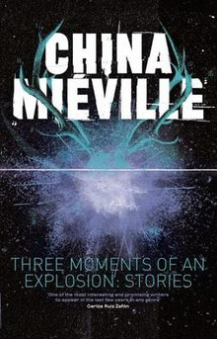
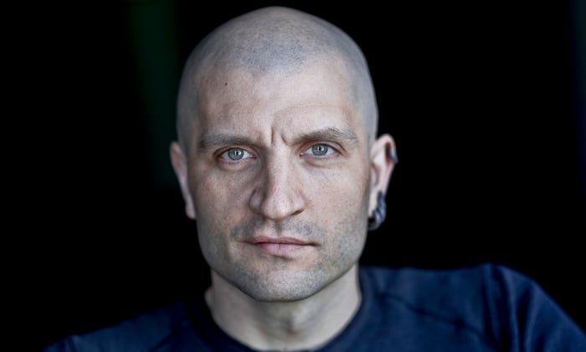
It was she who pointed, who first saw something in the sea […] A tower. A steeple of girders. Streaming and rising.
The girl stood. The metal was twisted. Off-true and angular like a skew-whiff crane, resisting collapse. It did not come steadily but lurched, hauling up and landward in huge jerks. After each swaying hesitation; then another move higher and closer.
The lights on the beach went out. Flame ignited at the tower’s tip. Sooty sepia guttering lifted the shaft. The sea at its base spread flat and fell away from suddenly rising intricate blackness, black angled and extrusioned. As if a quarried wedge of the seabed itself had come up to look.
The towerwork was on a platform. In the glow of the thing’s own flame they saw edificial flanks, the concrete and rust of them, the iron of the pylon barnacled, shaggy with benthic growth now lank gelatinous bunting.
It was coming at the Covehithe cliff. Under its strains and excrescences were more regular markings, stencilled warnings. Paint remnants: an encircled H.
China Miéville, “Covehithe” (2011)

Slide 17
We continue to indulge in the fiction that energy surplus, an unrepeatable historical event, will define daily life on into the future, without major change or crisis. The fiction of surplus in which we subsist shapes not only the belief that there will always be plenty of energy to go around but also the complementary idea that easy access to energy plays (at best) a secondary role in history by comparison with human intellect and the adventure of progress; it is not just energy that constitutes a limit but also our present understanding of its social role and significance.
Imre Szeman, “Literature and Energy Futures”, PMLA 126.2 (2011): 323–5.

Slide 18
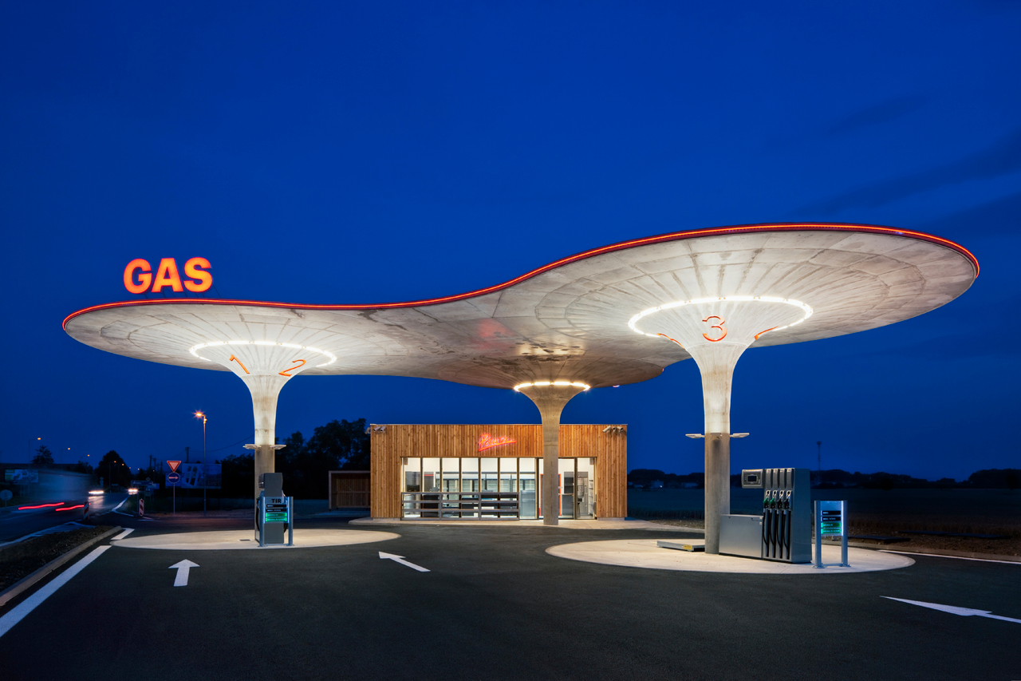

Slide 19
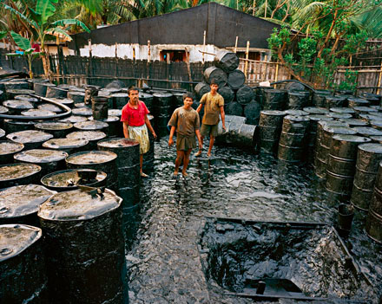

Slide 20
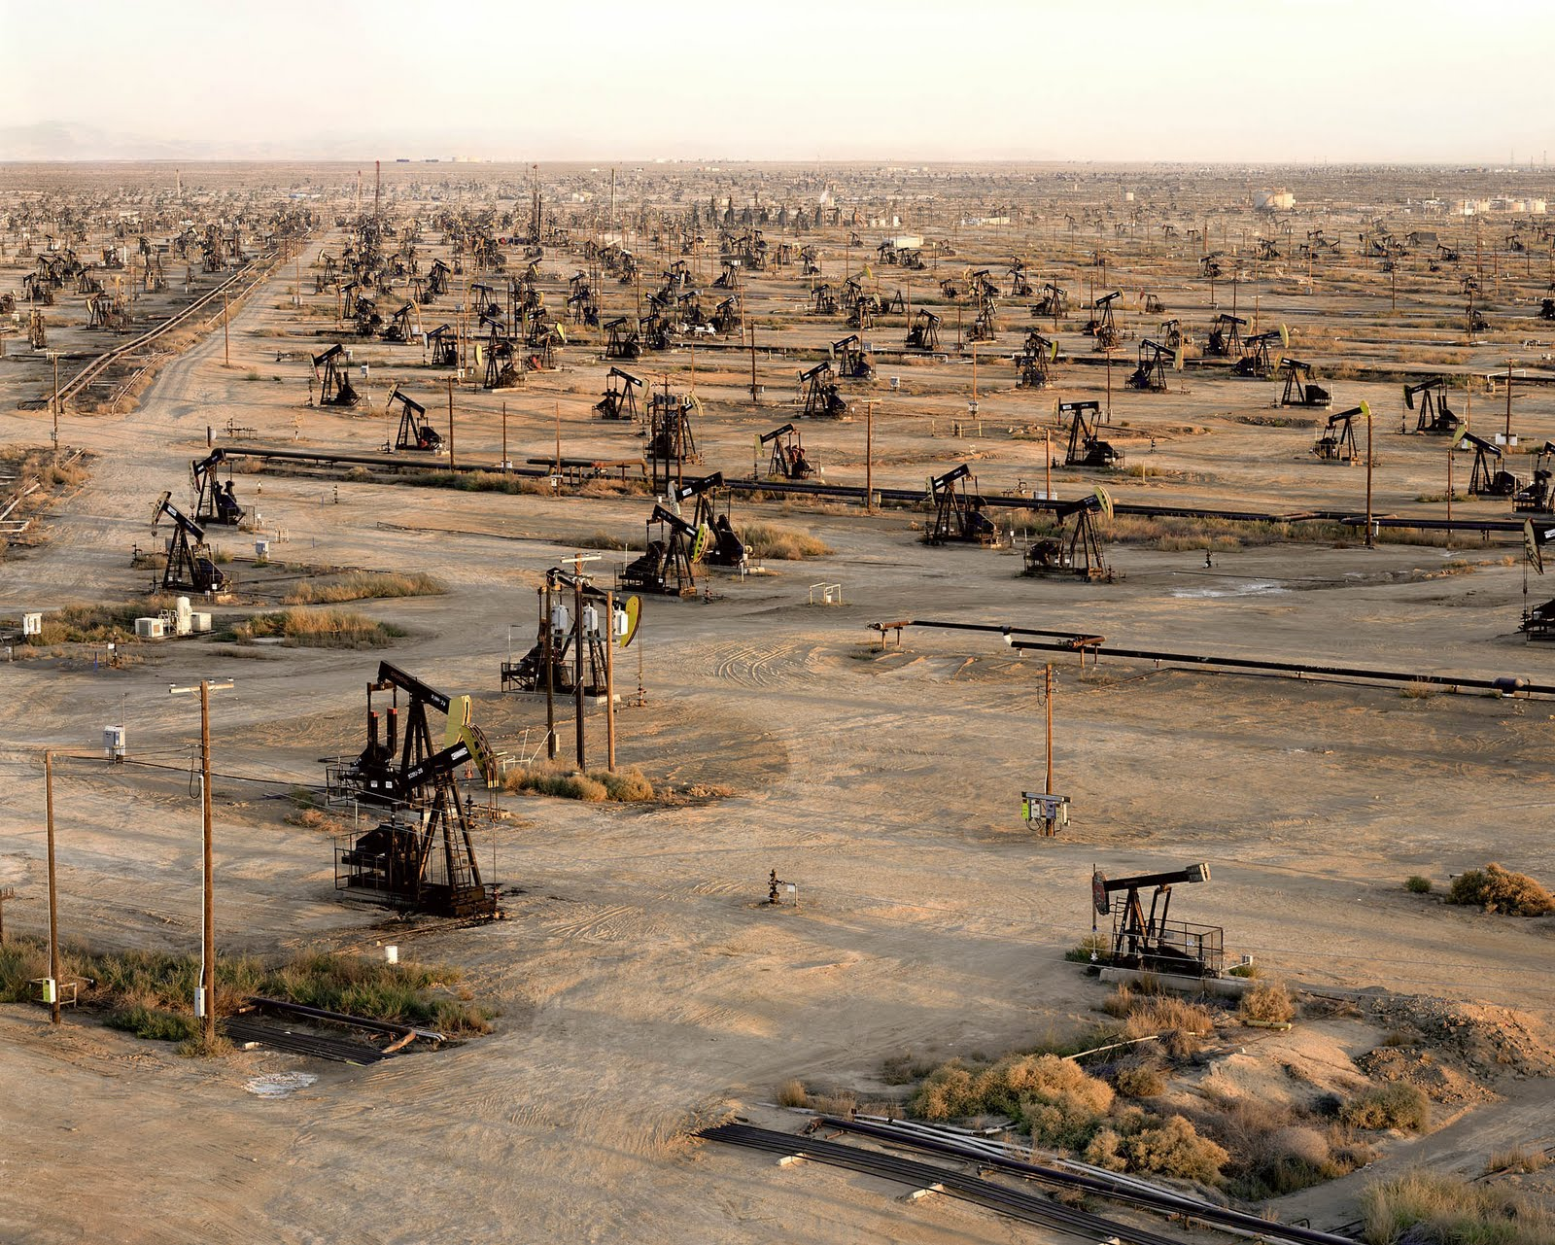

Slide 21
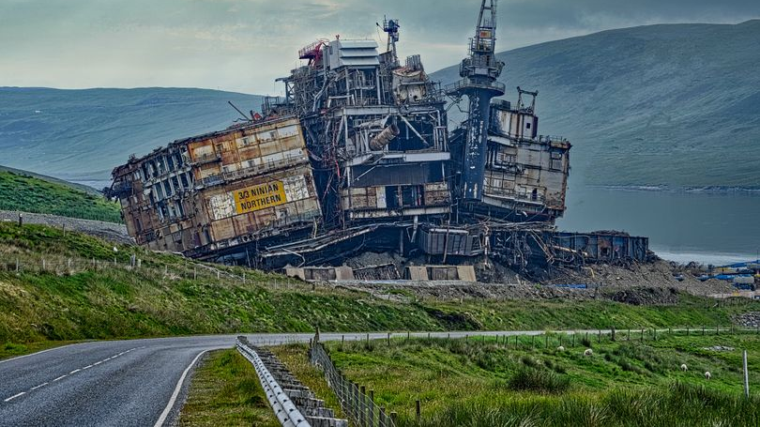

Slide 22

Hayao Miyazaki
Howl’s Moving Castle
(2003)

Slide 23
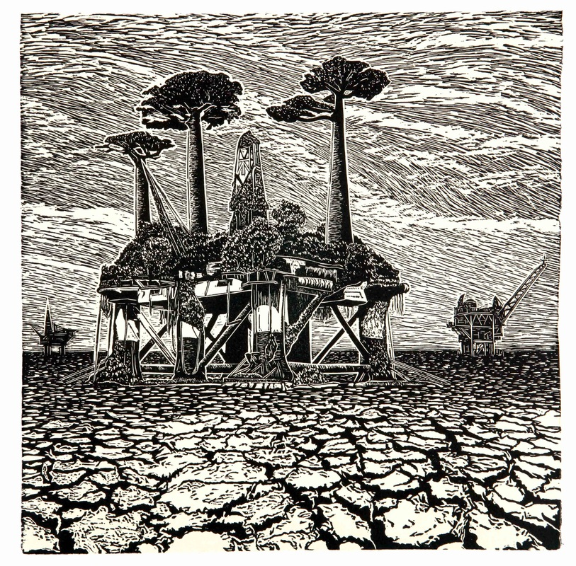
Ade Adesina,
“Hope” (Linocut)

