Slide 1
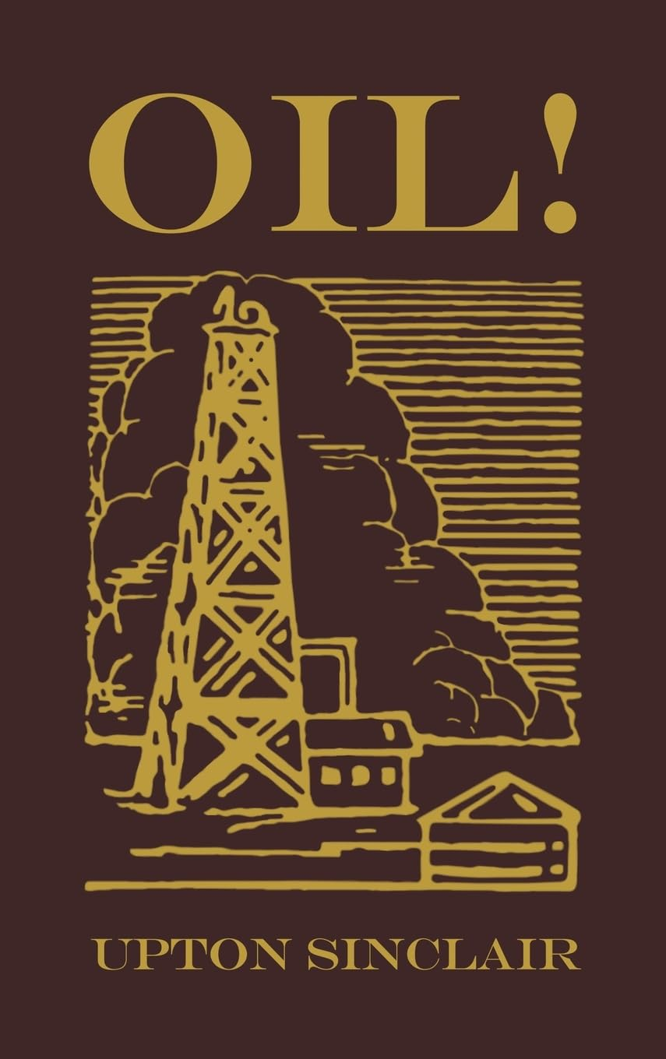

1926/7

Slide 2
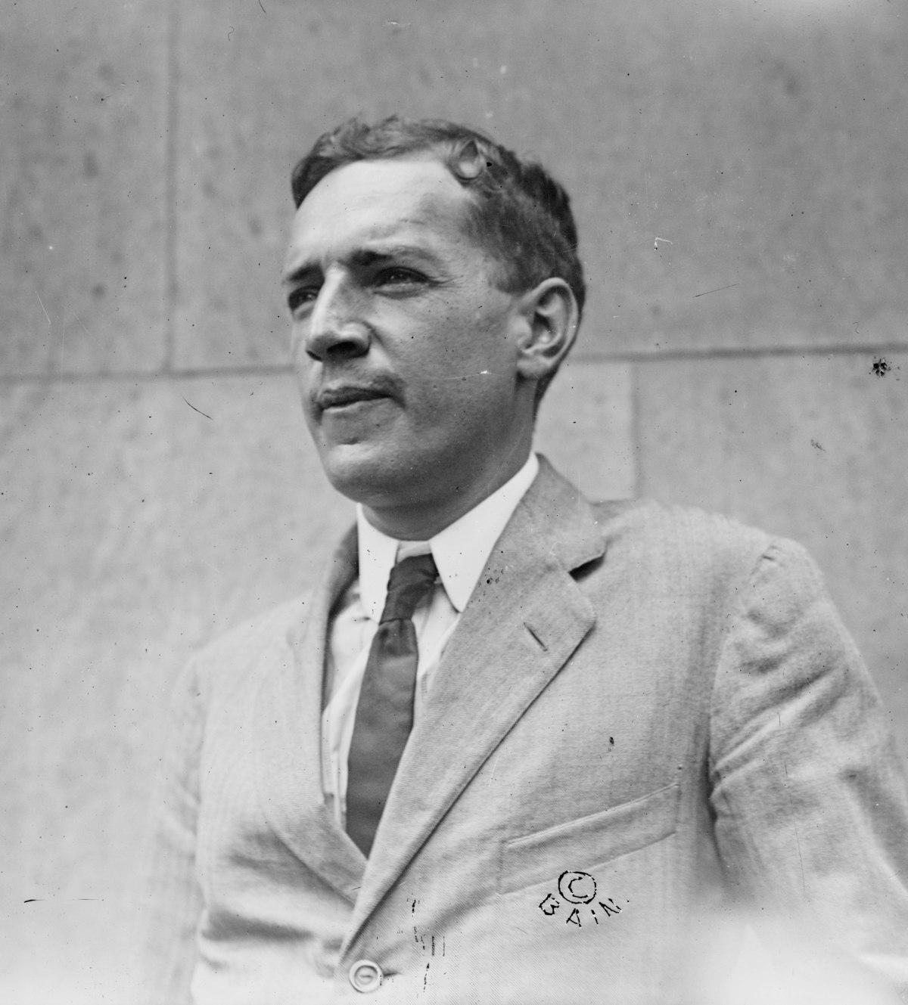

Slide 3
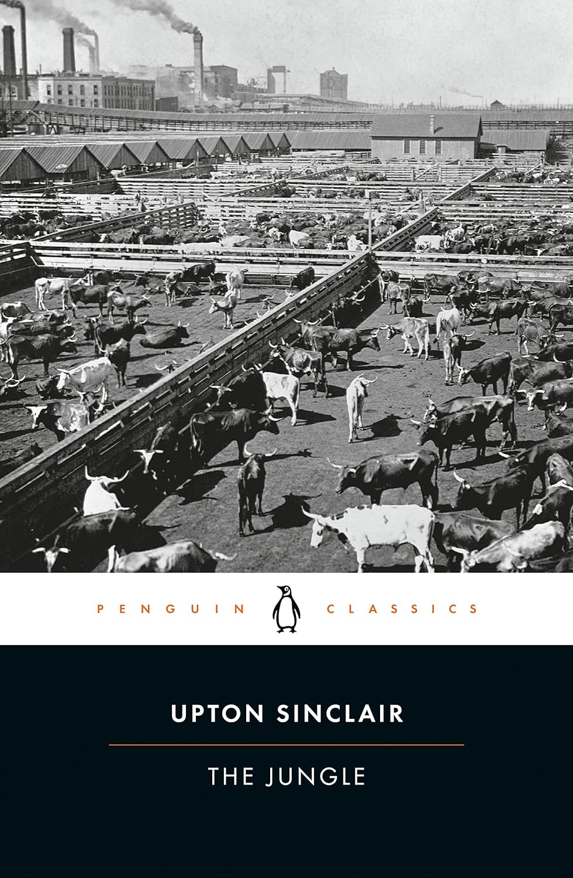


1906

Slide 4
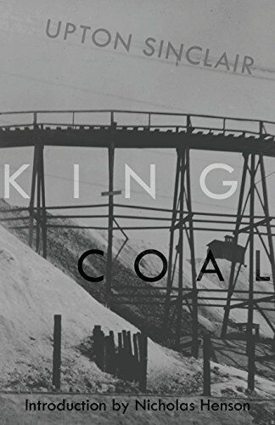
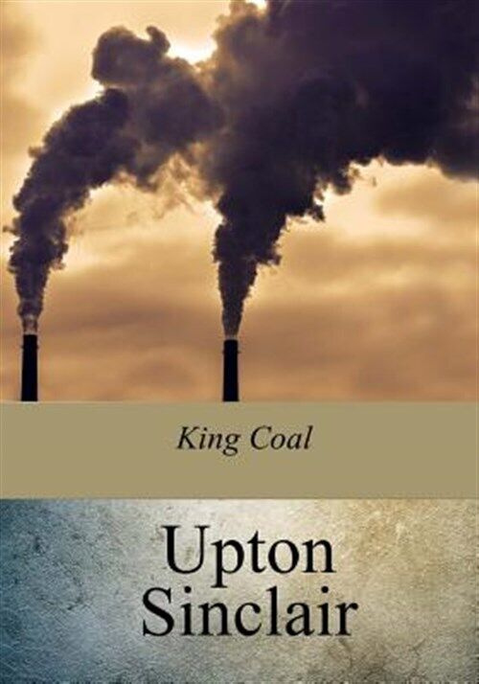
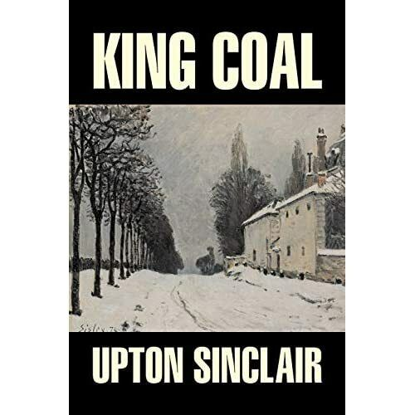
1917

Slide 5
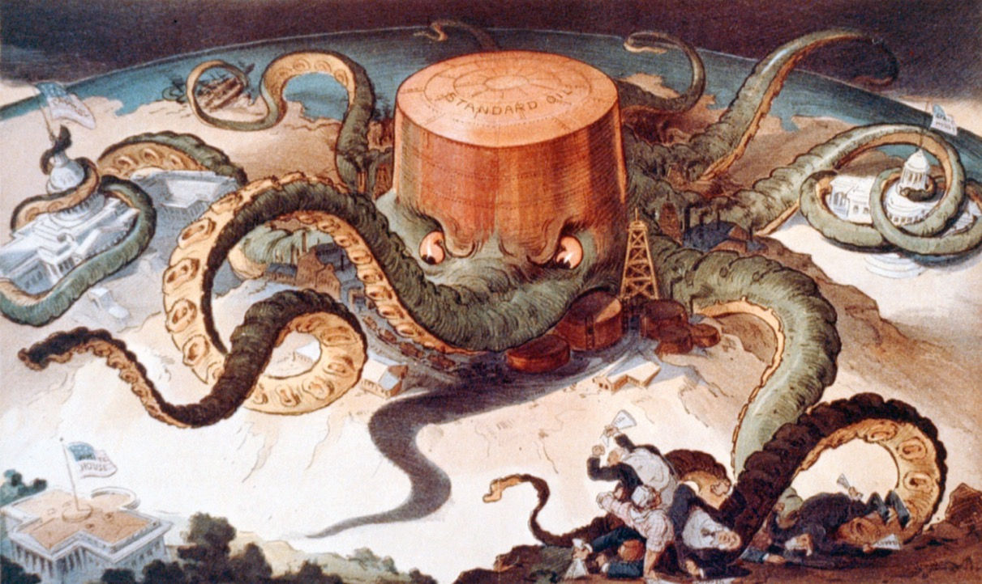

Slide 6
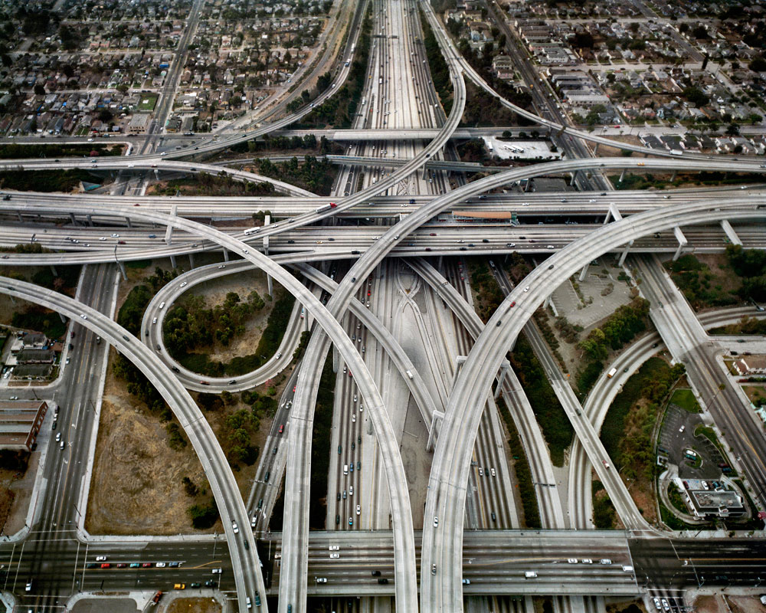

Slide 7
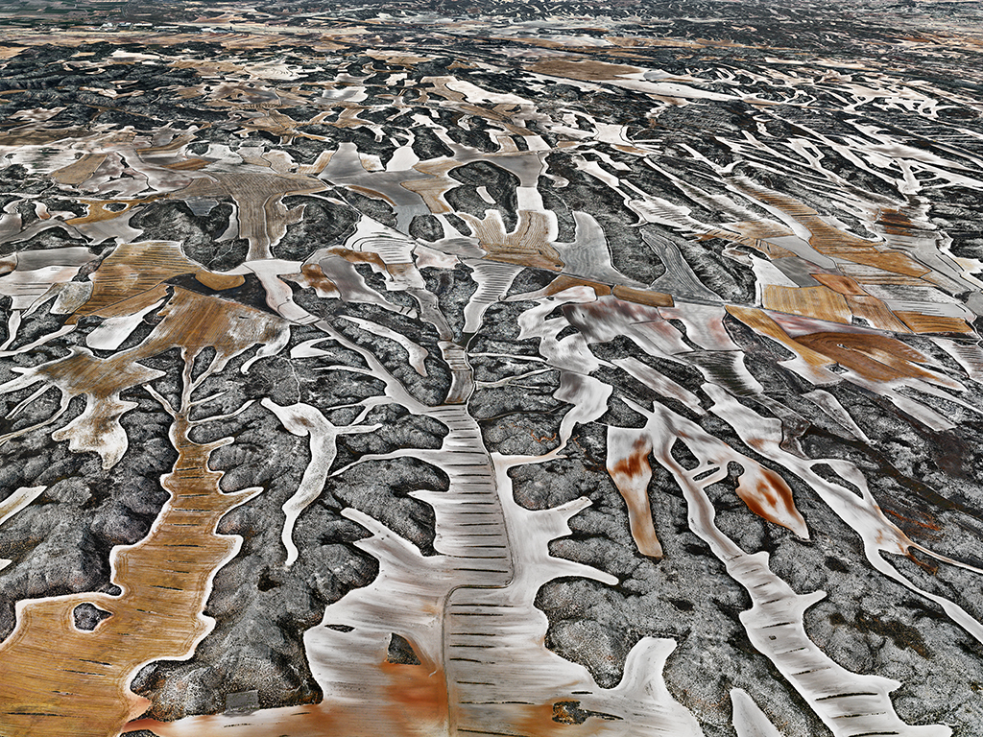

Slide 8
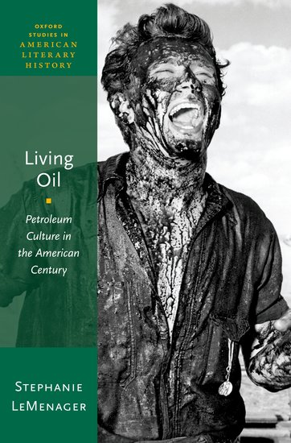
the petroleum infrastructure has become embodied memory and habitus for modern humans, insofar as everyday events such as driving or feeling the summer heat or asphalt on the soles of one’s feet are incorporating practices…de-coupling human corporeal memory from the infrastructures that have sustained it may be the primary challenge for ecological narrative in the service of human species survival beyond the twenty-ﬁrst century. (26)

Slide 9


Slide 10
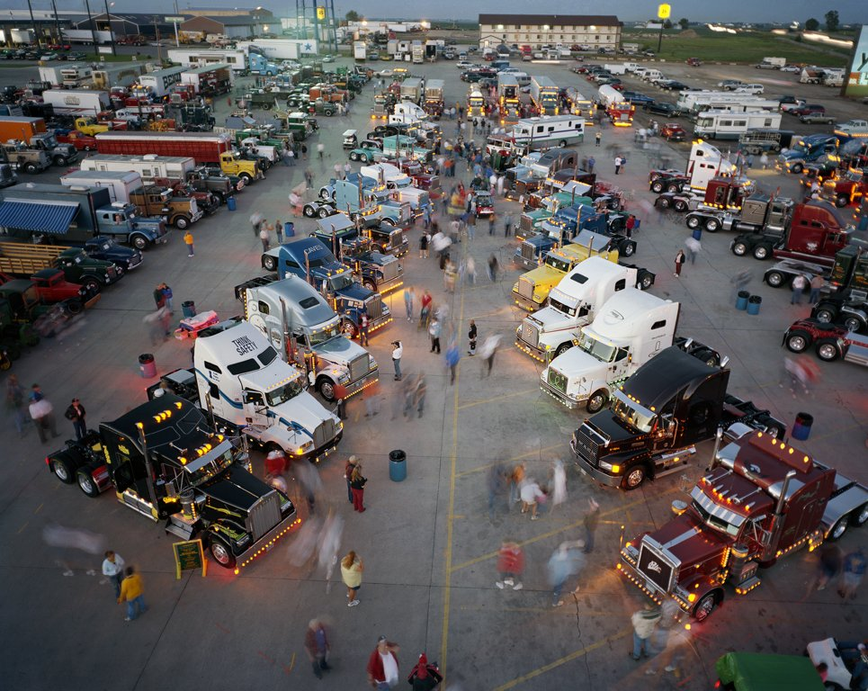

Slide 11
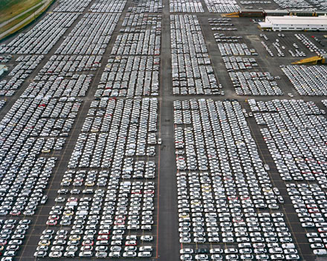

Slide 12

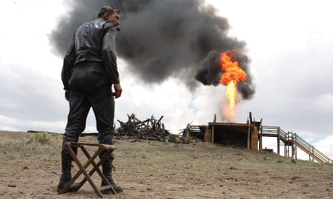
(2007)

Slide 13
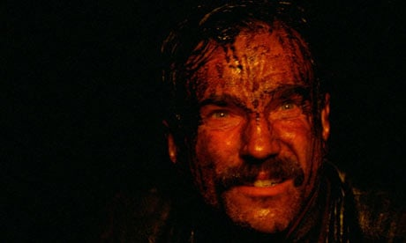

Slide 14
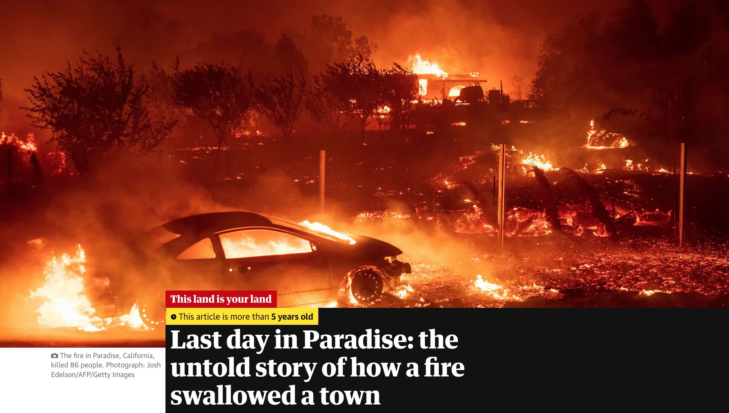

Slide 15
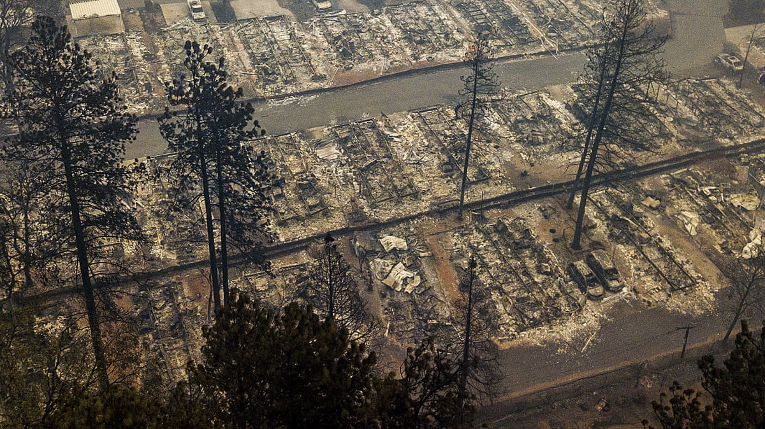

Slide 16


Slide 17
