Slide 1
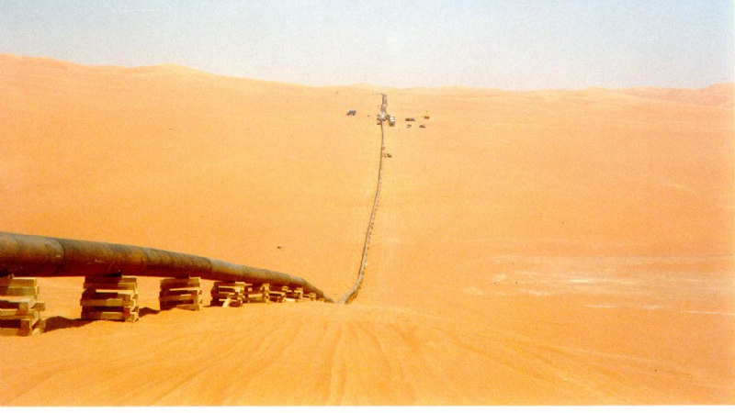
EN963 Petrofiction
Graeme Macdonald
Dept of English and Comparative Literary Studies
University of Warwick

Slide 2
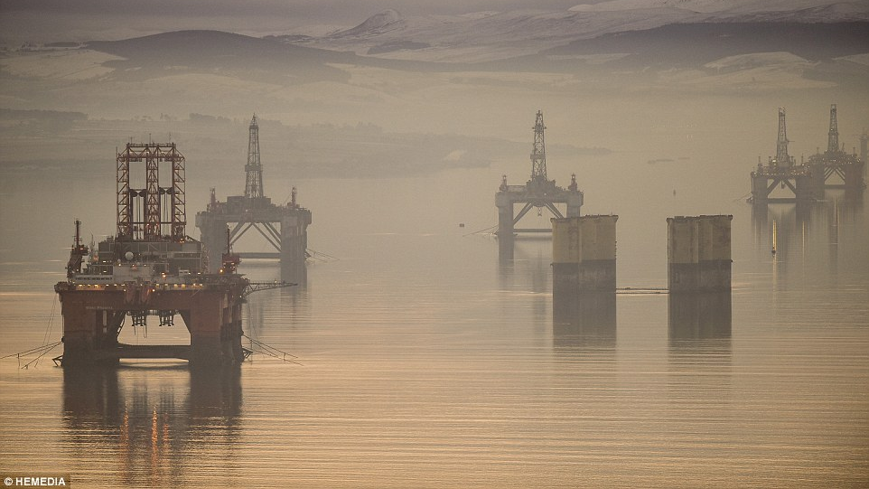
EN 963 Petrofiction
Graeme Macdonald
Dept of English and Comparative Literary Studies
University of Warwick

Slide 3
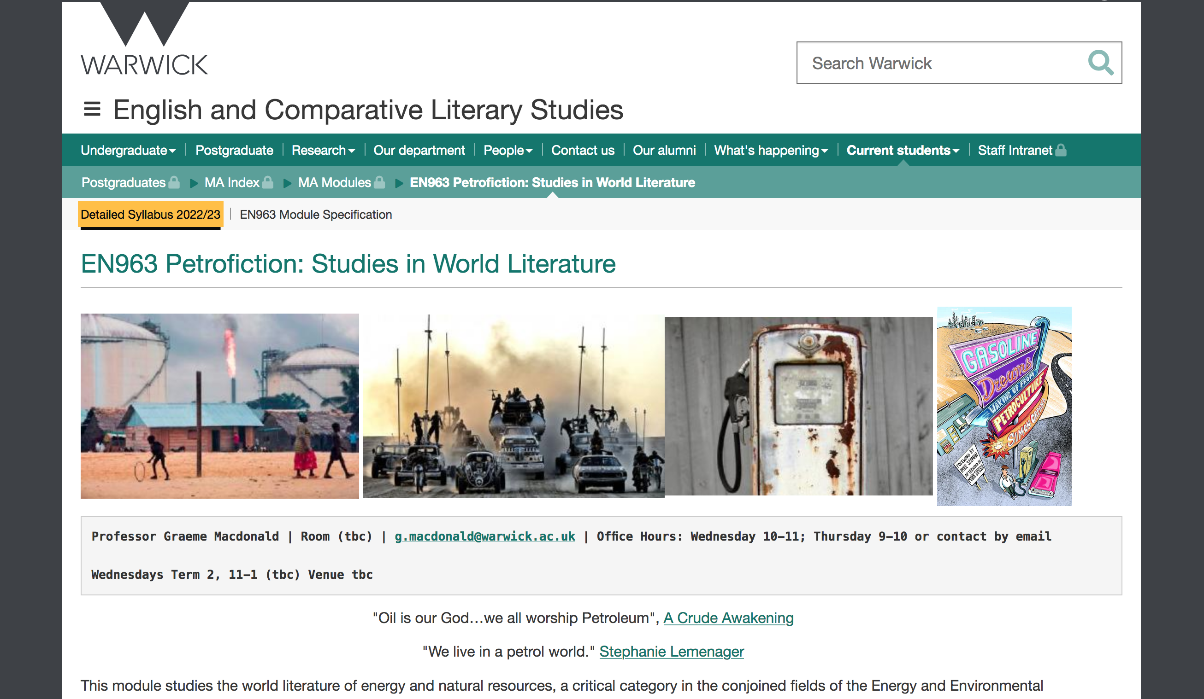

Slide 4


Slide 5


Slide 6
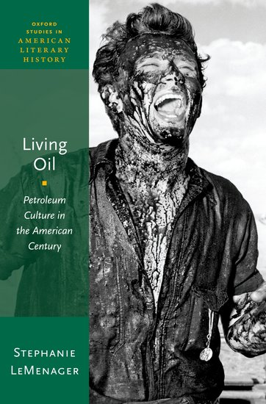
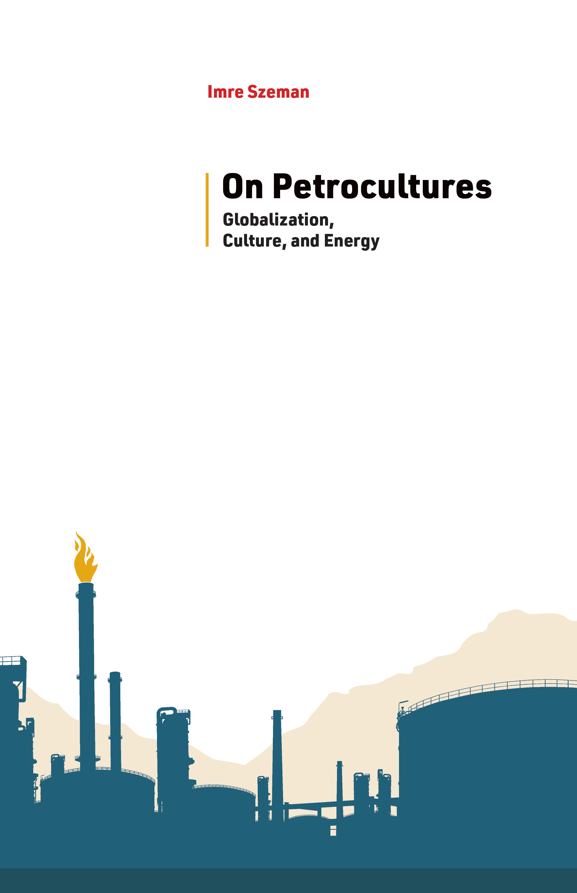
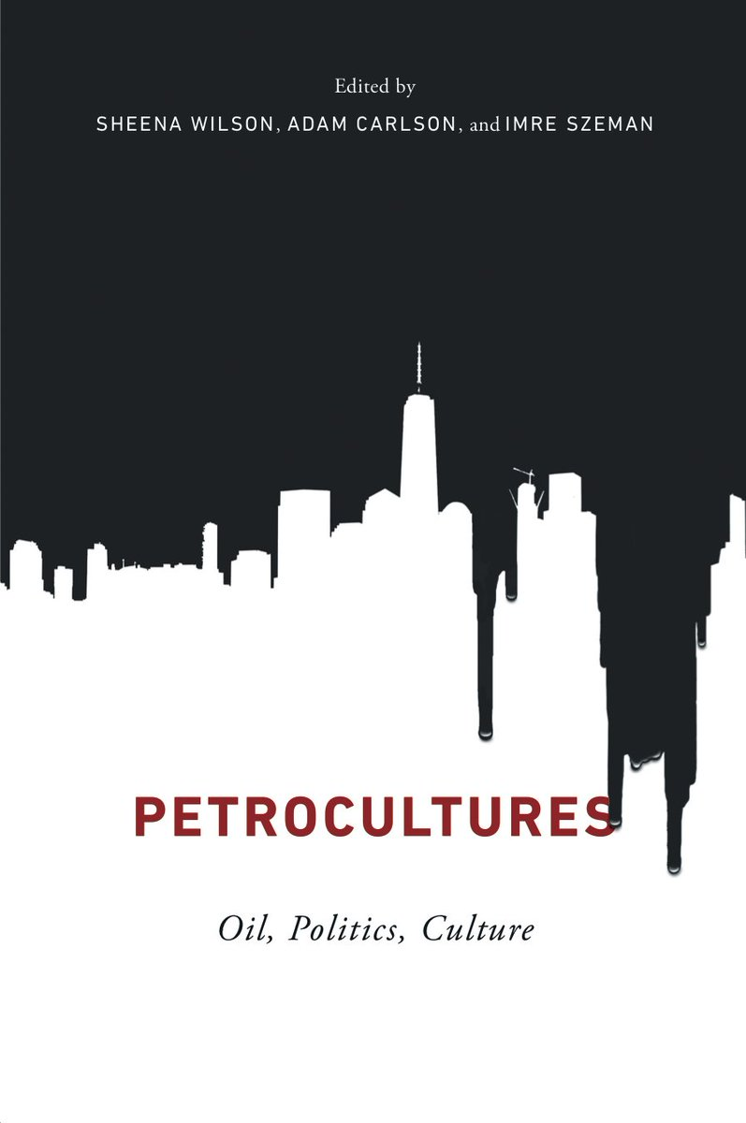
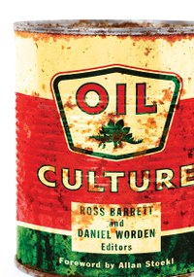
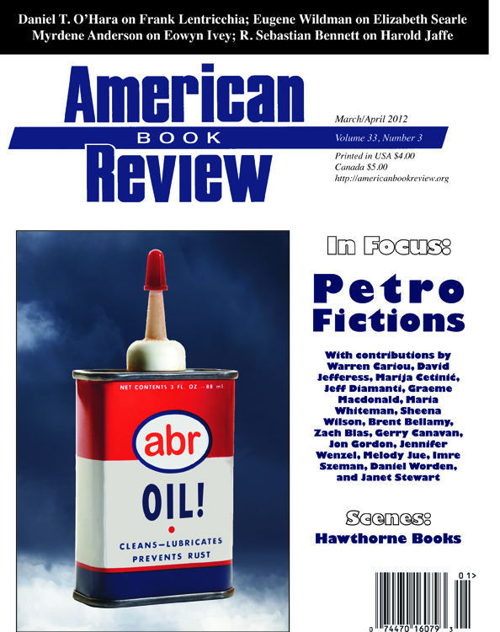

Slide 7
What is oil culture? (And are there cultures, more than one?) Along with that, and perhaps conditioning it: How are oil and culture conjoined? What is it for oil to be cultural? And culture to be oily? Why is oil culture and its fragmentation in cultures so fundamentally important?
Allan Stoekl, “Foreword” to Oil Culture, eds. Ross Barrett and Daniel Worden (Minneapolis: University of Minnesota Press, 2014), p. xi.

Slide 8
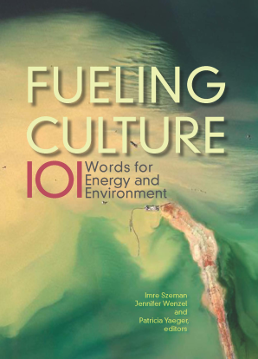
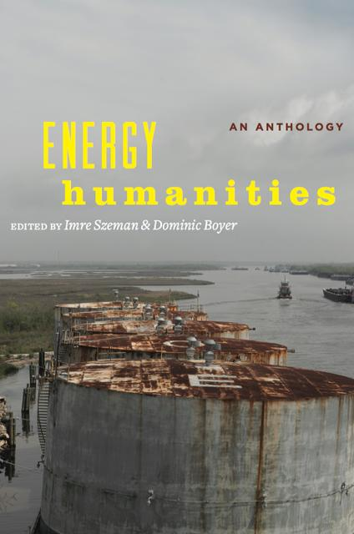
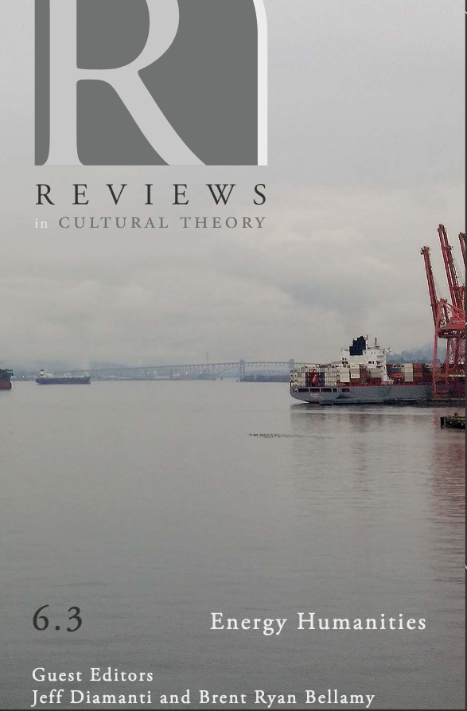
Energy Humanities scholars wish to shed light on the fuel apparatus of modernity,
which is all too often invisible or subterranean, but which pumps and seeps into the groundwaters of politics, cultures, institutions, and knowledge in unexpected ways. Moreover energy humanities aspires to provide a speculative
impulse as well as a critical diagnostics. Boyer & Szeman, 2017.
…to gain critical purchase not only on the pressure that energy exerts on culture but also the pressure that culture exerts on energy regimes. Jennifer Wenzel,
‘Introduction’ to Fueling Culture, 2017.

Slide 9
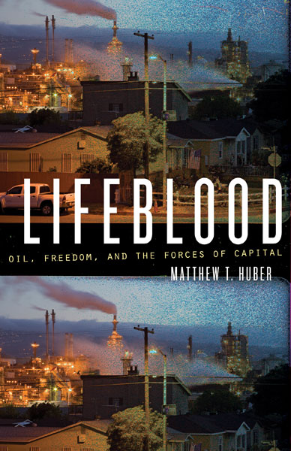
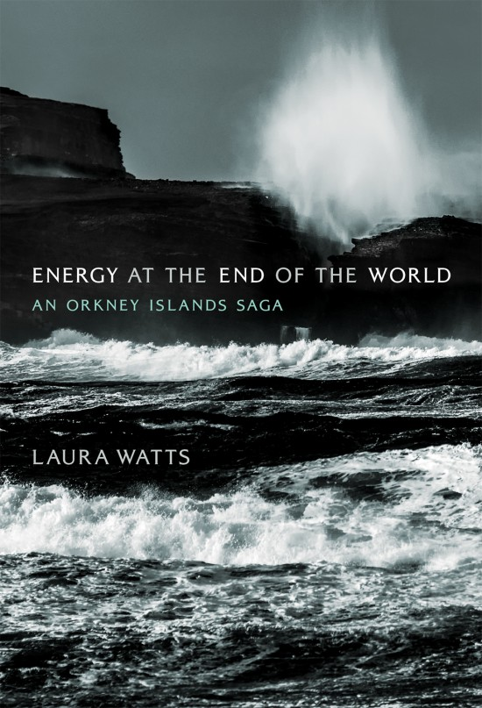
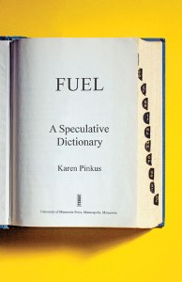
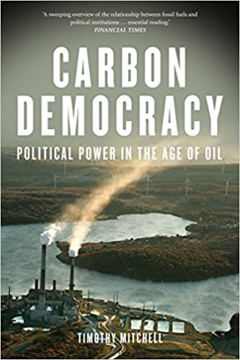
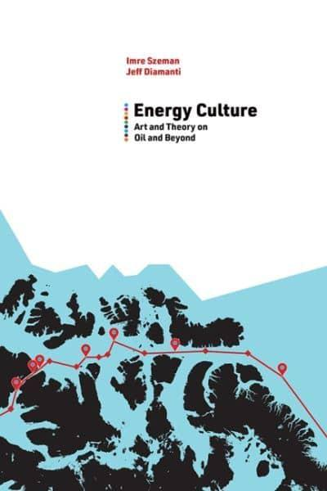
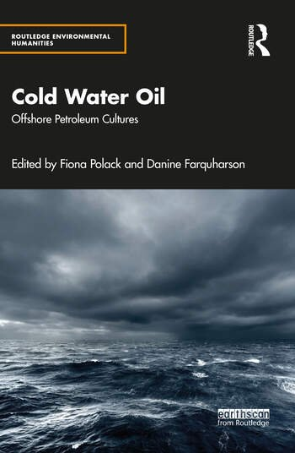
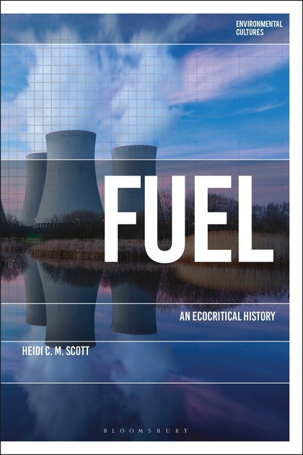
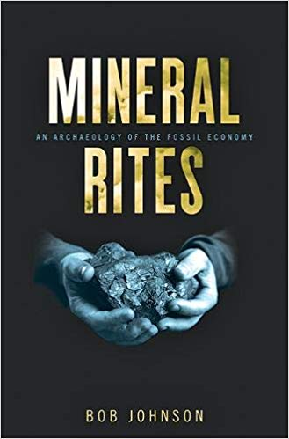
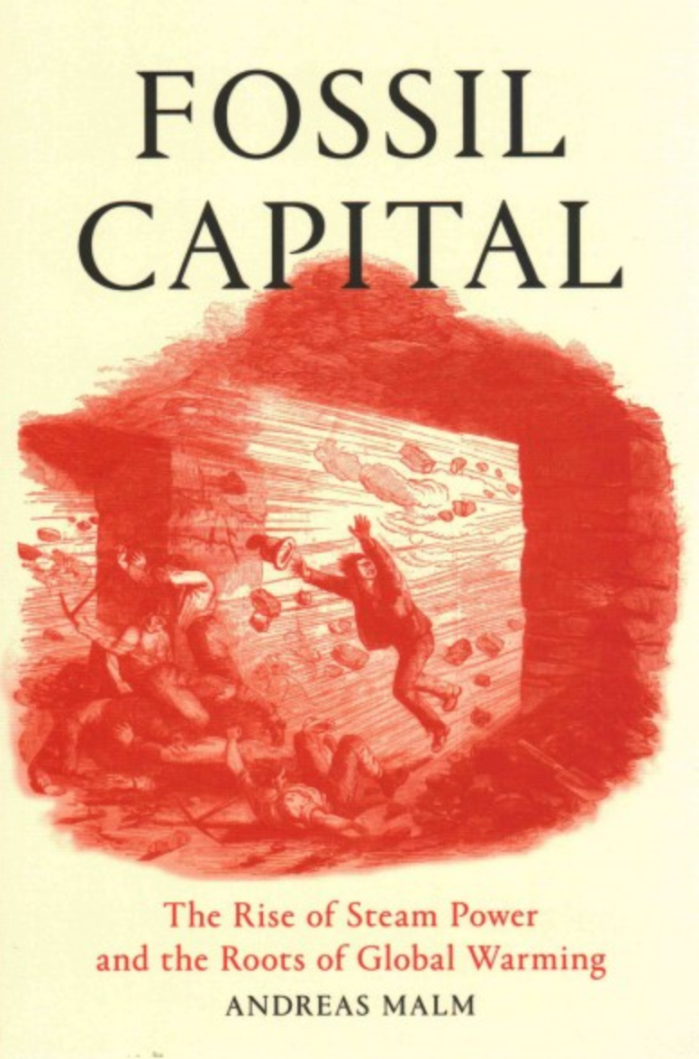

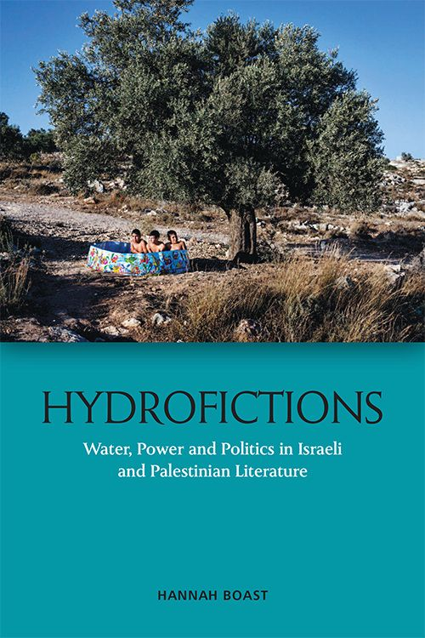
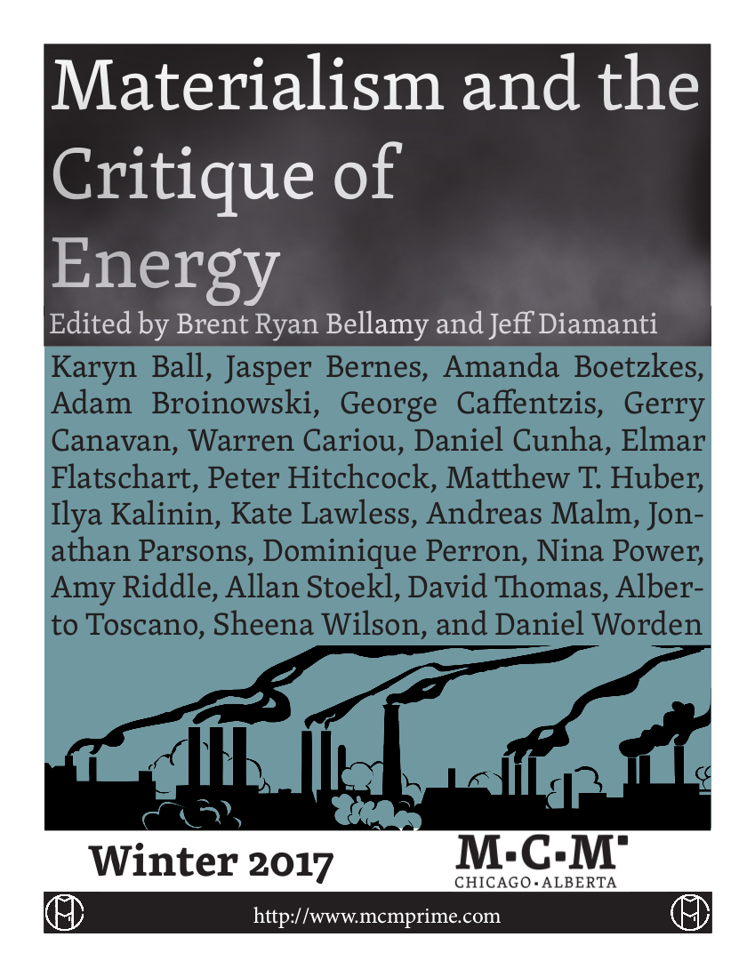

Slide 10

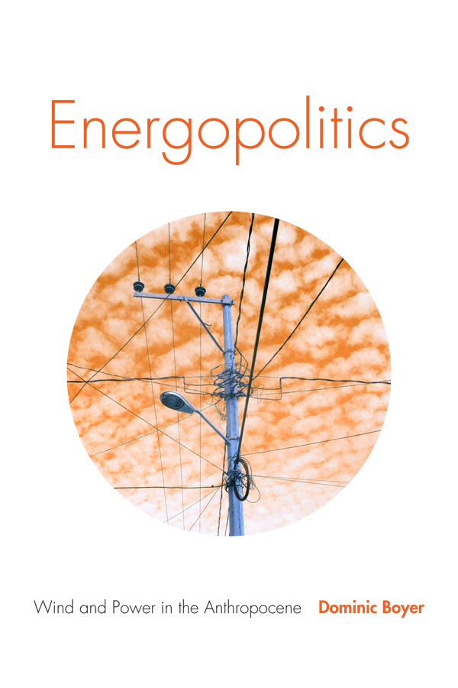
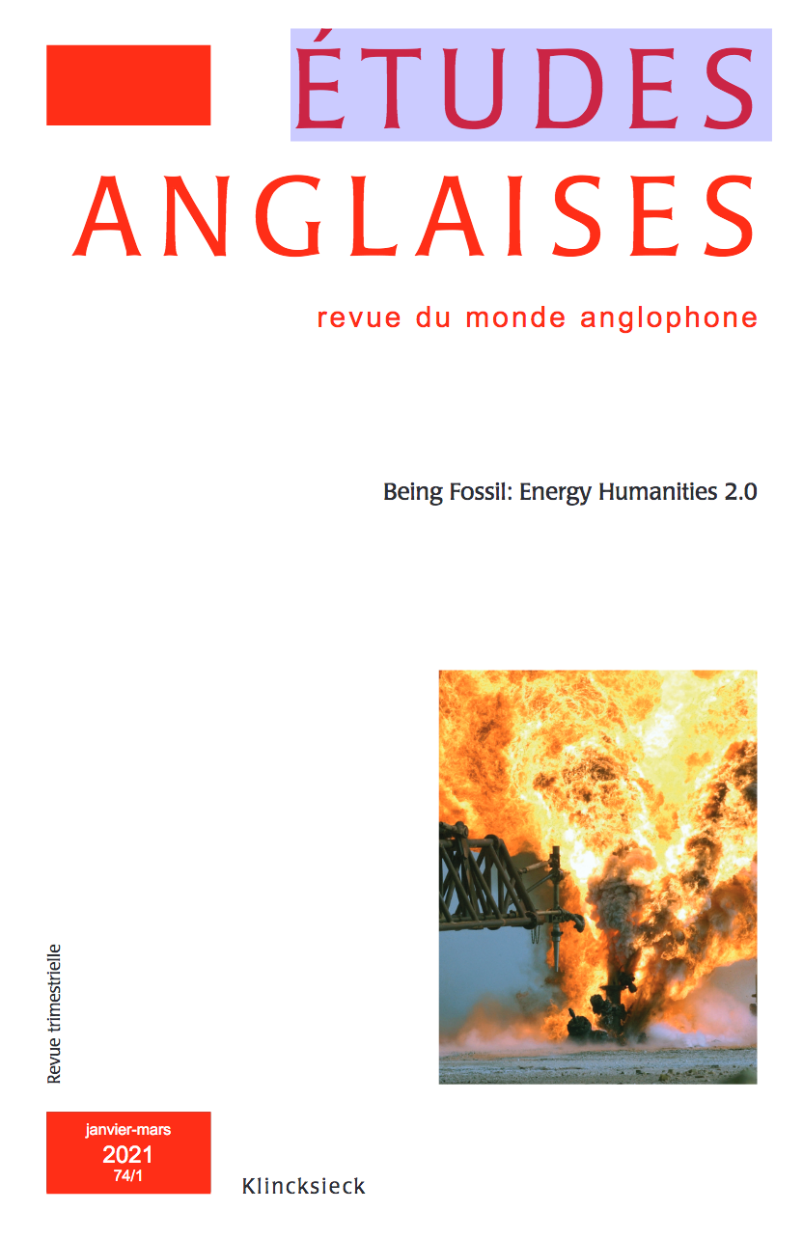
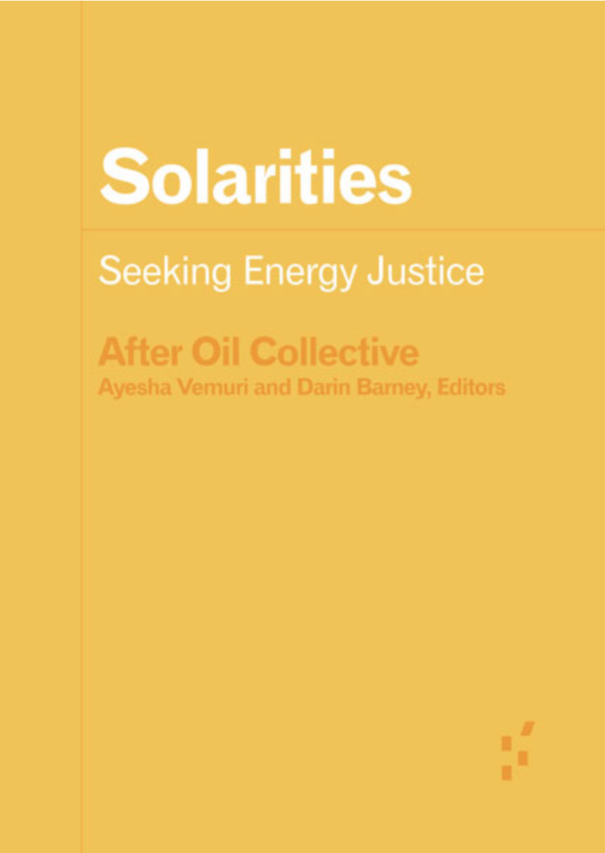
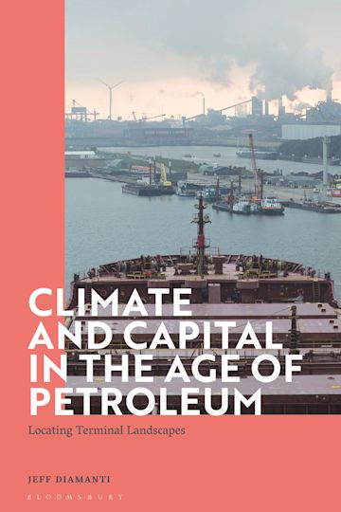
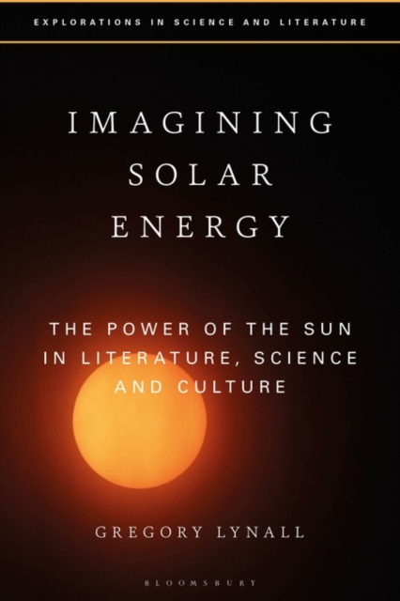
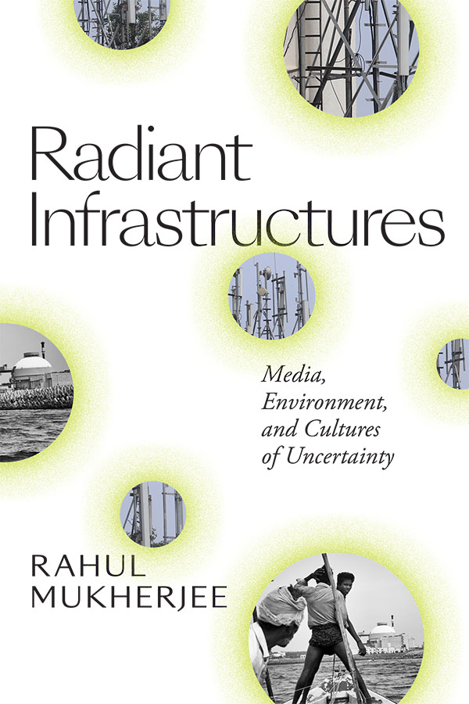

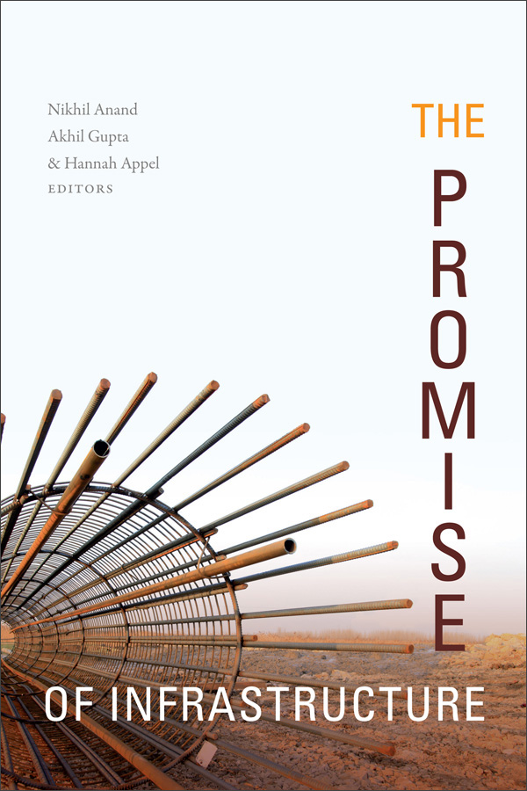

Slide 11
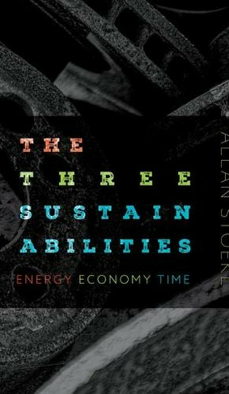
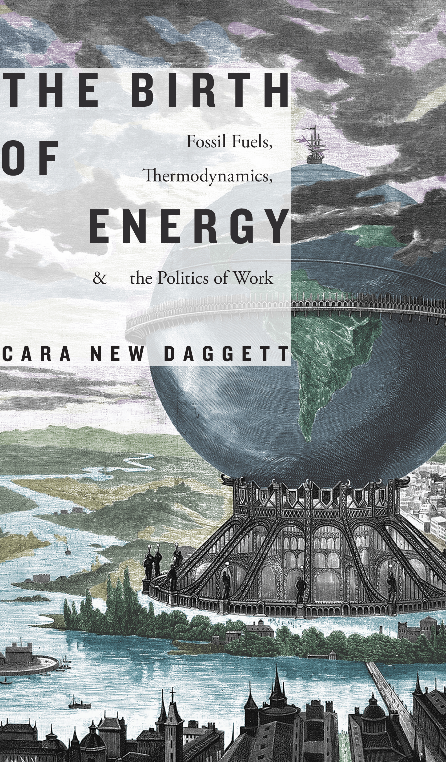


Slide 12
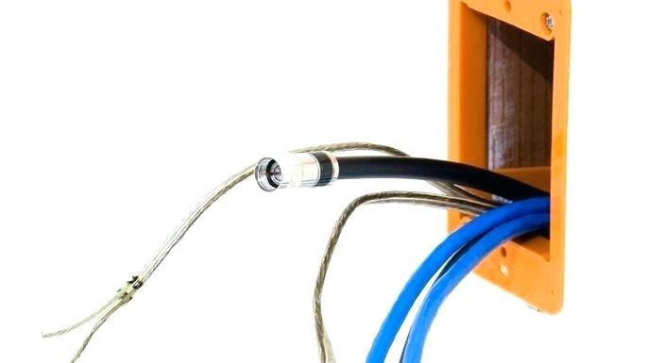
“The Energy Unconscious…..”
This Editor’s Column peruses the relation between energy resources and literature. Instead of divvying up literary works into hundred-year intervals (or elastic variants like the long eighteenth or twentieth century) or categories harnessing the history of ideas (Romanticism, Enlightenment), what happens if we sort texts according to the energy sources that made them possible?
What happens if we rechart literary periods and make energy sources a matter of urgency to literary criticism? What happens if we think systematically about how… texts relate to energy sources across time and space?
Patricia Yaeger, “Editor’s Column: Literature in the Ages of Wood, Tallow, Coal, Whale-Oil, Gasoline, Atomic Power and Other Energy Sources.” PMLA 126.2 (2011): 305–10.

Slide 13
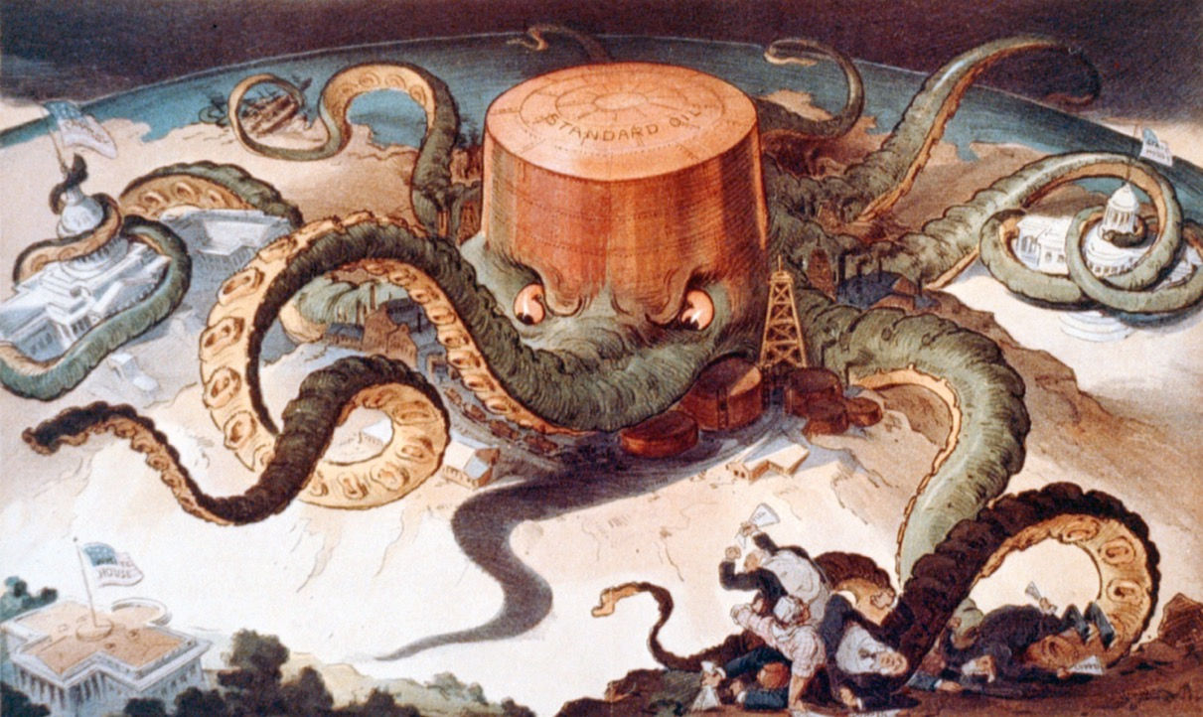

Slide 14
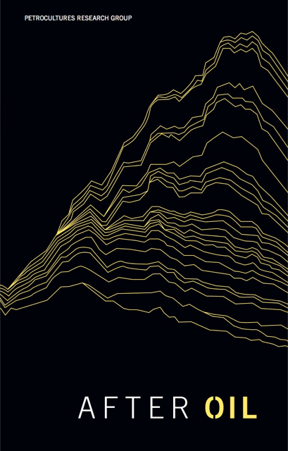
“We will not make an adequate or democratic transition to a world after oil without first changing how we think, imagine, see, and hear [transition] is an “imaginative” exercise, with distinct roles played by words, images, and performances.”
Petrocultures Research Group: After Oil (2016)

Slide 15
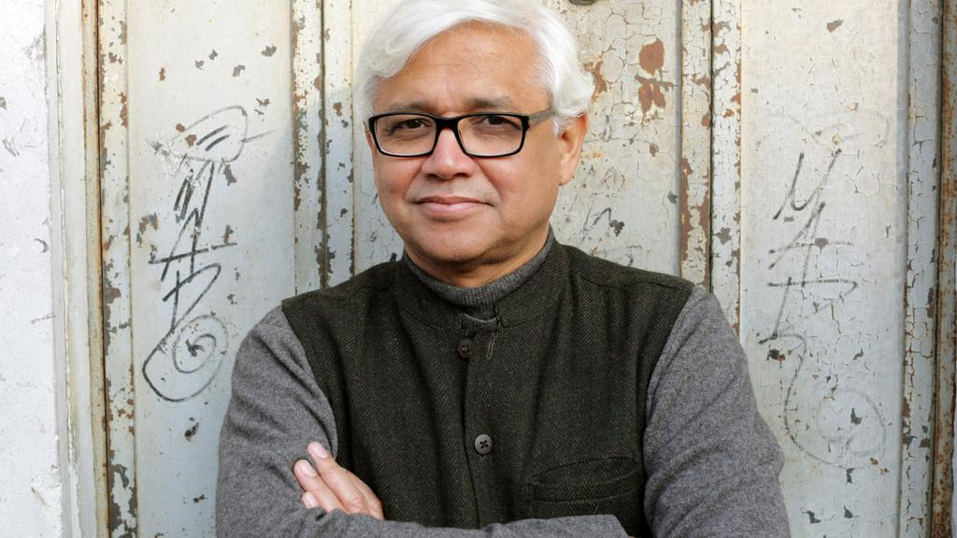

The experiences associated with oil are lived out within a space that is no place at all, a world that is intrinsically displaced, heterogeneous, and international. It is a world that poses a radical challenge not merely to the practice of writing as know it, but to much of modern culture … the truth is that we do not yet possess the form that can give the Oil encounter a literary expression.
Amitav Ghosh, “Petrofiction”, The New Republic (1992), pp. 30-31.

Slide 16
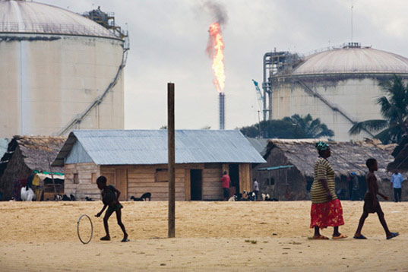
“Once in a while, a building of modern construction, properly painted and maintained, would peep out of the bush, a reminder of other possibilities. Now and again we would drive past a gas flare reminding us that this was oil-bearing country….”
Ken Saro-Wiwa, ‘Progres’, from Forest of Flowers

Slide 17
the petroleum infrastructure has become embodied memory and habitus for modern humans, insofar as everyday events such as driving or feeling the summer heat or asphalt on the soles of one’s feet are incorporating practices…de-coupling human corporeal memory from the infrastructures that have sustained it may be the primary challenge for ecological narrative in the service of human species survival beyond the twenty-ﬁrst century. (26)

Slide 18
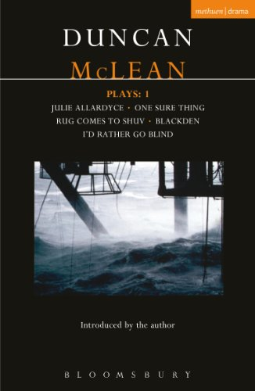
Finn Here’s what I think: I think there’s a lot of people on the beach that don’t give a toss about us working out there. They drive about in their cars, they switch on their central heating, they fry up their bacon and beans – and the thought of folk in the middle of the North Sea drilling up the oil and gas they’re using, it never enters their head. And then one day, a chopper ditches, or there’s a gas leak, or a platform comes adrift in a gale, and oh dear me, suddenly they’re up in arms, getting themselves in a state, shooting their mouths off! And why? Cause they feel guilty! Cause ninety-nine per cent of the time they don’t even think of us. Cause a hundred per cent of the time they’re gobbling up the stuff we produce – they’re keeping us out here!
Duncan MacLean, Julie Allardyce (1999)

Slide 19
The question of how to write about the oil encounter has plagued novelists and critics, particularly those frustrated by what Szeman describes as the Left’s failure to generate alternatives to oil capital at a moment when the dwindling of conventional oil reserves might tip us toward Tough Oil or toward a more sustainable future… I’m not seeking a literary ace in the hole or novel that writes oil as it is, “intrinsically displaced, heterogeneous, and international.” Szeman and a dynamic group of self-named “petrocritics” have begun to archive potential candidates for this best, most representationally astute oil novel. But compelling oil media are everywhere. Films, books, cars, foods, museums, even towns are oil media. The world itself writes oil, you and I write it. Petrofiction provides one route to understanding our entanglement. So does everything else. As a critical essayist, my challenge has been to find a point of view from which to frame the everything of oil.
The regional frame assists, too, in the pursuit of the psychologically ultradeep, the affects and emotions lodged in gasoline fuel, cars, and in the thousands of everyday items made from petroleum feedstock, from lip balms to tampon applicators, dental polymers, and aspirin tablets… we must hold ourselves accountable to a materiality that is never merely an external, blank, or inert space but an active, emergent substance of ourselves and others.” What [Stacey] Alaimo calls “an ethics of mattering” becomes particularly complex, sticky, when it comes to petroleum. We wear and eat it. Our bodies write it.

Slide 20
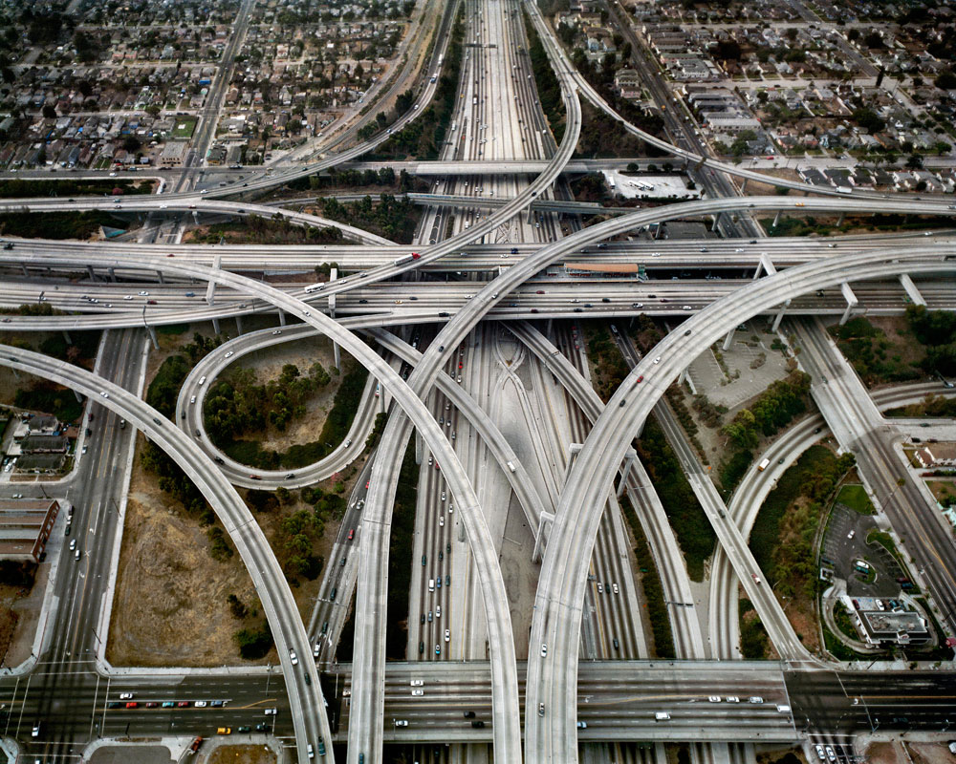

Slide 21


Slide 22
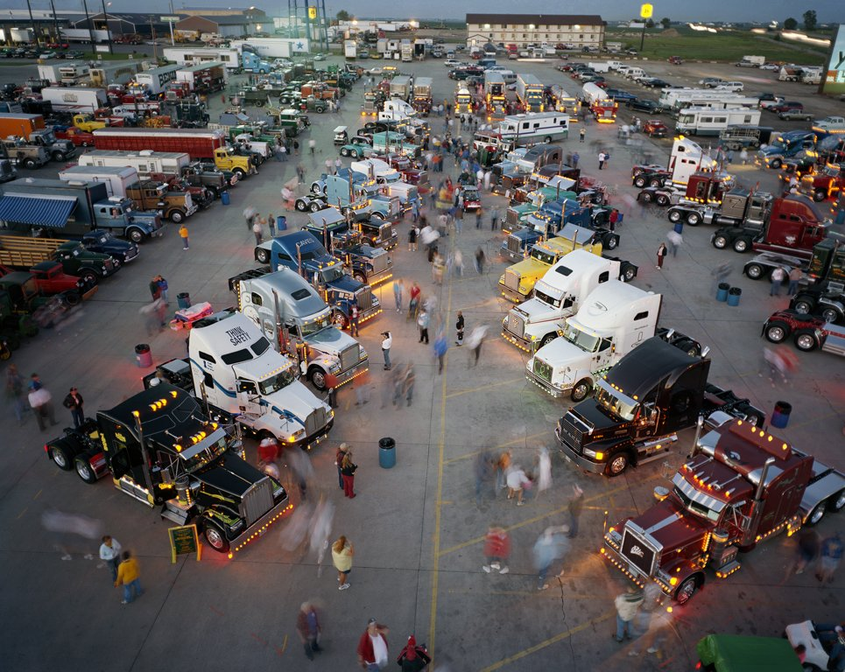

Slide 23
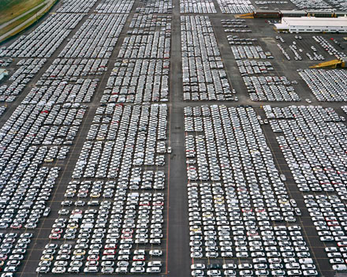

Slide 24
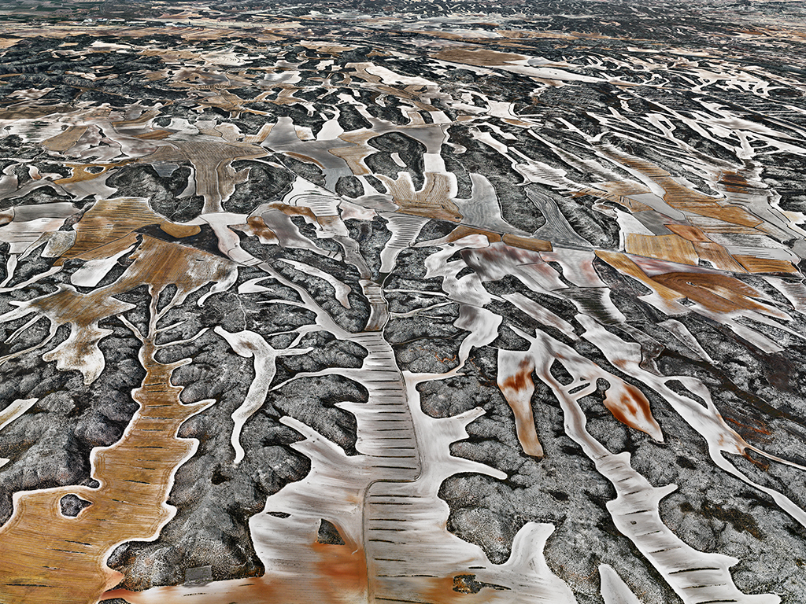

Slide 25
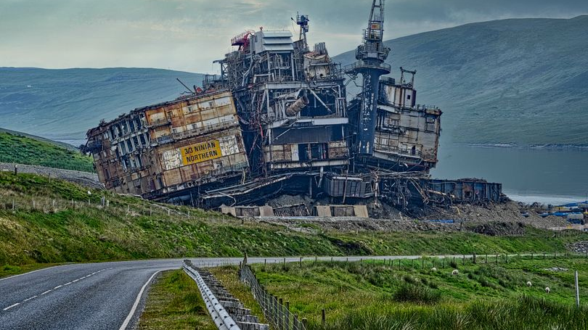

Slide 26
Notes:
Here – four flows are all in short supply – oil//milk/water, leading to a large flow of blood – a world of scarcity and neo-primitivism, violence and ritualized gatherings around gangsterish cults, driven by brutal climates and agricualtraul collapse – but eco-apocalyptic registers are complemented by others, such as techno-utopian genres – such as….next slide

Slide 27
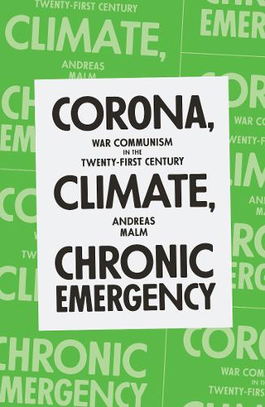
There is a related belief that Covid-19 represented
a more serious danger to humanity in some absolute,
Objective, clinical sense. This is not tenable. Unabated
global heating will burn through the foundations of human
Live (not to mention that of other species without number).
Covid-19 could do no such thing….Climate breakdown…is not
Something from which a majority can recover.
Andreas Malm, Corona, Climate, Chronic Emergency (Verso, 2020)

Slide 28
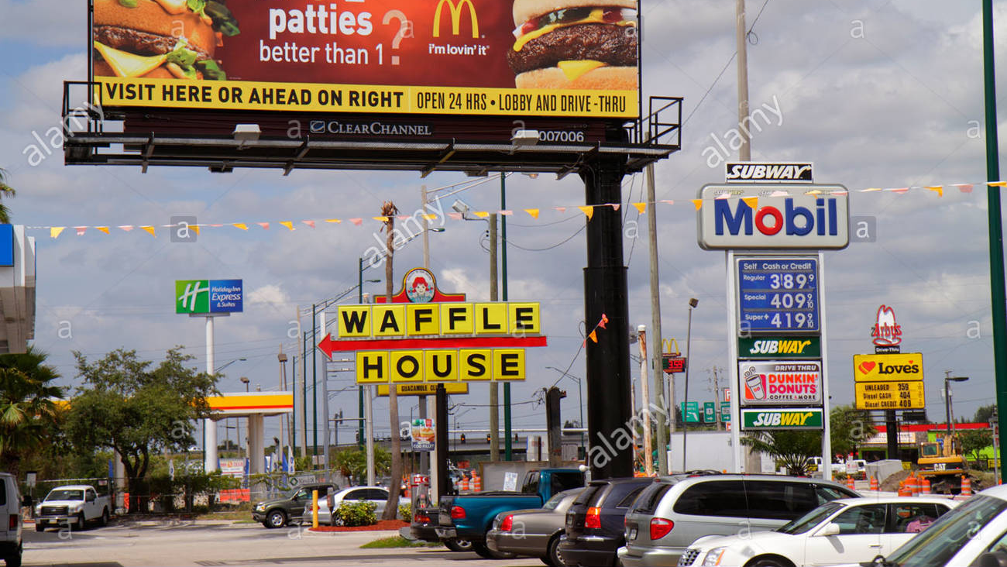
Notes:
maybe the dystopia is with us now, we are living it - and have been for some time - since when? Its easier to drmatise disaster than resilience, repair, the changed world – maybe the first steo is actually turning the generic tables and recognizing the dystopian in the every day – in what you will do now as you leave the building and drive home, have a beer, eat a burger, buy a book, have a bath – maybe the dystopias are the police dramas, the soaps that show business as usual….maybe its hard to imagine ourselves in a totally retoriftted utopan world of regulated climate and natural restoration, a clean transition

Slide 29


Slide 30
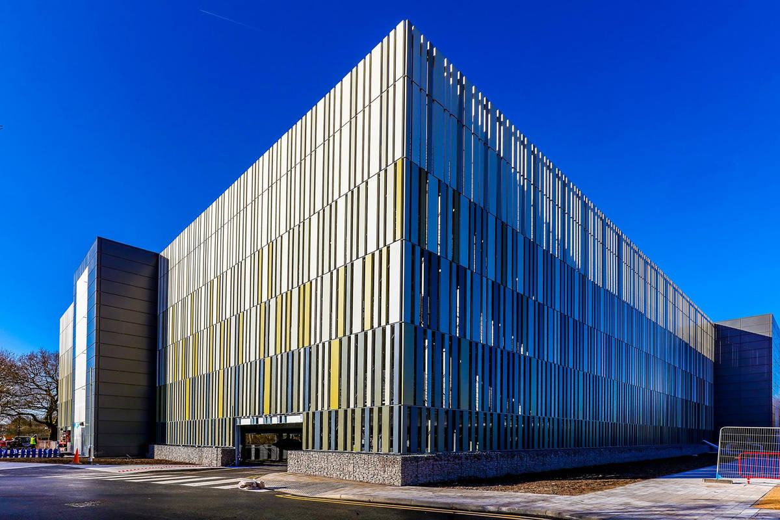

Slide 31
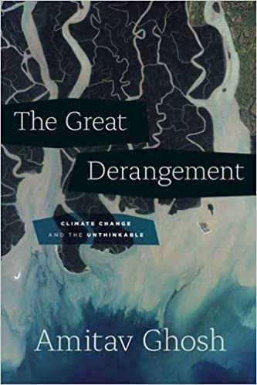
The history of oil is a matter of embarrassment verging on the unspeakable, the pornographic…To a great many Americans oil smells bad. It reeks of unavoidable overseas entanglements, a worrisome foreign dependency, economic uncertainty, risky and expensive military enterprises; of thousands of dead civilians and children….and to make things still worse, it begins to smell of pollution and environmental hazards. It reeks, it stinks, it becomes a Problem that can only be written about in the language of Solutions. […]
The territory of oil is bafflingly multilingual, for example, while the novel with its conventions of naturalistic dialogue, is most at home within monolingual speech communities (within nation-states in other words). Equally the novel is never more comfortable than when it is luxuriating in a “sense of place”, revelling in its unique power to evoke mood and atmosphere. But the experiences associated with oil are lived out within a space that is no place at all, a world that is intrinsically displaced, heterogeneous, and international. It is a world that poses a radical challenge not merely to the practice of writing as know it, but to much of modern culture … the truth is that we do not yet possess the form that can give the Oil encounter a literary expression.
Amitav Ghosh, “Petrofiction”, The New Republic (1992), pp. 30-31.

Slide 32
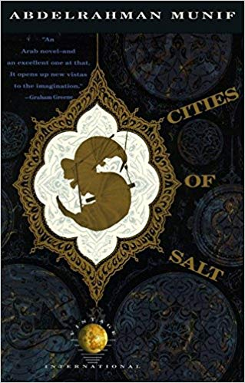
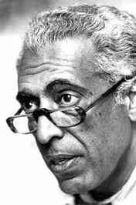

Slide 33
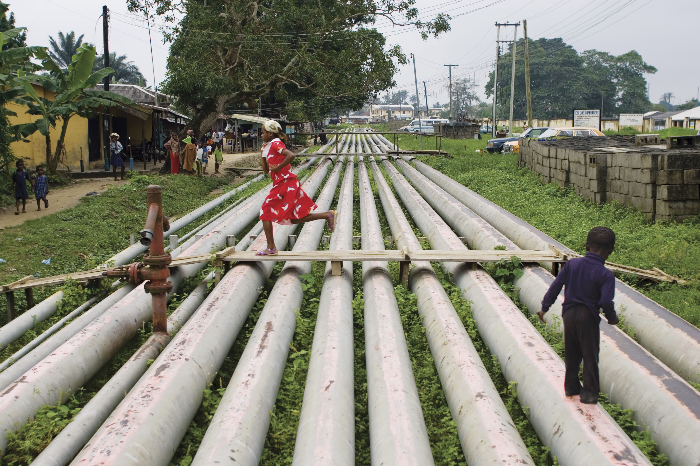
Ed Kashi, from Curse of the Black Gold:
50 Years of Oil in the Niger Delta (2008)
On the horizon was the top of a hill. The village stretched out
below it. Massive pipes tore through it, gushing with what
looked like black water. There were also wide mouthed wells
from which flowed a liquid resembling mercury; there was
a smell of gas mixed with that of human beings, and
something like salted sardines or kippers, and dead dogs
on the dirt road that had been knocked down by vehicles
speeding through the night….she gazed around her.
What village was this?
A long string of women hidden under black abayas walked
along slowly with jars on their heads.
From Nawal el-Sadaawi, Love in the Kingdom of Oil
(Egypt, 1992)

Slide 34
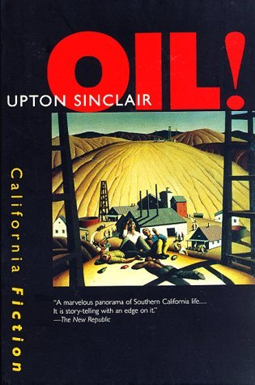











Slide 35











Slide 36




Slide 37



Slide 38








Slide 39







313 × 475

Slide 41

In what sense can we speak about an aesthetics of oil cultures, a set of recurring spatial, infrastructural, or architectural motifs, for example, or even a dominant structure of feeling or experience which seems to pass through the very molecules of a whole historical reality? Is there an aesthetics of oil or are its cultural manifestations too diverse and localized to be usefully generalized?
Andrew Pendakis and Ursula Biemann, “This Is Not A Pipeline: Thoughts on the Politico-Aesthetics of Oil,” Imaginations 3-2 (2012), 6-15, 8.

Slide 42

“Petro-Theatre” – Some examples
Leo Lania, Konjunktur (Germany, 1928)
Lion Feuchtwanger, Die Petroleuminseln (1928)
Georg Kaiser, The Coral, Gas I, Gas II (1917-20)
John McGrath, The Cheviot, The Stag and the Black, Black Oil (1973)
- Boom (1975)
Ken Saro-Wiwa, Four Farcical Plays (1989)
Ahmed Yerima, Hard Ground (2005)
Akpos Adesi, Agadagba Warriors and Other Plays (2008)
Sam Ukala, Harvest of Ghosts (1999)
JP Clark, All For Oil (2000)
- The Wives Revolt (1991)
Duncan McLean, Julie Allardyce (1999)
Lucy Prebble, Enron (2009)
Donal O’Kelly, Little Thing, Big Thing (2014)
Ella Hickson, Oil (2016)
Clare Duffy, Arctic Oil (2018)
“Petroleum resists the five-act form” Bertolt Brecht

Slide 43








Slide 44


Slide 45


Notes:
collapse, entropy, painful pedestrianism, without maps, following the cracked highway - the bunker episode - Predilection for dystopia and apocalypse (end times threats; cautionary tales; extrapolations of the present; also small morality tales within of how to deal wth it and how to be better and perhaps prevent it)
One vein of thinking is that this seems to be not real at all, difficult to grasp – so maybe bunker thinking is both a natural response and also a fearful/problematic one. other forms of escape and shelter are seen in fagan -

Slide 46




Slide 47





Slide 48
“I should have thought about it before, it’s too late now. It’s after twelve thirty and I didn’t remember to fill up; the service stations will be closed until three. Every year two million tons of crude are brought up from the earth’s crust where they have been stored for millions of centuries in the folds of rocks buried between layers of sand and clay. If I set off now there’s a danger I’ll run out on the way; the gauge has been warning us for quite a while that the tank is in reserve. They have been warning us for quite a while that underground global reserves can’t last more than twenty years or so. I had plenty of time to think about it, as usual I’ve been irresponsible; when the red light begins to wink on the dashboard I don’t pay attention, or I put things off, I tell myself there’s still the whole reserve to use up, and then I forget about it. No, maybe that’s what happened in the past, being careless like that and forgetting about it: in the days when petrol still seemed as plentiful as the air itself. Now when the light come on it transmits a sense of alarm, of menace at once vague and impending; that is the message I pick up and record along with the many angst-ridden signs sedimenting down among the folds of my consciousness, dissolving in a state of mind that I can’t shake off, but that doesn’t prompt me to any precise practical action as a consequence, such as, for example, stopping at the first pump I find and filling up.
Italo Calvino (“The Petrol Pump”, 1974)
Notes:
But beyond this, how is any text an oil text? Read for energy

Slide 49
“…sailing up there close to the clouds, with an engine full of power, magically harnessed, subject to the faintest pressure from the ball of your foot….this magic ribbon of concrete laid out for you.”(5)
“They came to a little house by the road side, with a shed that you drove under, and a round-bellied object, half glass and half red paint that meant gasoline for sale.”(11)

Slide 50


Slide 51


Slide 52


Edward Hopper
Portrait of Orleans (1950)
Gas (1940)

Slide 53


Ed Ruscha, Standard Station, Amarillo Texas (1963-)

Slide 54



Slide 55




The Birds (1963)

Slide 56



Christine 1983
The original self-driving car….?

Slide 57



Robocop (1987)

Slide 58


Slide 59


They came upon a roadside gas station. They stood in the road and studied it….the weeds they forded fell to dust about them. They crossed the broken asphalt apron and found the tank for the pumps. The cap was gone and the man dropped to his elbows to smell the pipe but the odor of gas was only a rumor, faint and stale. He stood and looked over the building. The pumps standing with their hoses oddly still in place. The windows intact. The door to the service bay was open and he went in. A standing metal toolbox against one wall. He went through the drawers but there was nothing there that he could use….He stood looking around the garage. A metal barrel full of trash…dust and ash everywhere….Some old automotive manuals, swollen and sodden.
The Road 4-5

Slide 60

Offshore oil was discreet, geographically withdrawn from the main population centres…there was a non-critique of oil culture.
Oil failed almost totally to surface in the imaginative literature of Anglo-Britain. Where was the novel or the poem of North sea oil? Or the play?
Some authors were vividly conscious of the implications of the oil, particularly for politics, and nearly all of them were Scots…they realized that the oil had triggered a very complex transformation, at once local and international. It was worth treating experimentally, using it as a means of focusing Scottish history. Thus while the thing itself was local, occurring in specific basins of activity, it was incorporated into the national repertoire of metaphors.
Christopher Harvie, Fool’s Gold: A History of North Sea Oil (1994)

Slide 61


Slide 62


Slide 63


Slide 66
“Petro-Theatre” – Some examples
Leo Lania, Konjunktur (Germany, 1928)
Lion Feuchtwanger, Die Petroleuminseln (1928)
Georg Kaiser, The Coral, Gas I, Gas II (1917-20)
John McGrath, The Cheviot, The Stag and the Black, Black Oil (1973)
- Boom (1975)
Ken Saro-Wiwa, Four Farcical Plays (1989)
Ahmed Yerima, Hard Ground (2005)
Akpos Adesi, Agadagba Warriors and Other Plays (2008)
Sam Ukala, Harvest of Ghosts (1999)
JP Clark, All For Oil (2000)
- The Wives Revolt (1991)
Duncan McLean, Julie Allardyce (1999)
Lucy Prebble, Enron (2009)
Donal O’Kelly, Little Thing, Big Thing (2014)
Ella Hickson, Oil (2016)
Clare Duffy, Arctic Oil (2018)
“Petroleum resists the five-act form” Bertolt Brecht

Slide 67

Ernst Logar
“Tillydrone”
From Invisible Oil

Slide 68

Ernst Logar
“Torrie”
From Invisible Oil

Slide 69

We drove past sleepy little villages hacked out of the forest, fondly embracing the earth and the foliage. We drove past farms planted with mixtures of yams, cassava, maize, pepper and melon, mostly stunted and crying for fertilizers. We went swiftly past men riding rickety bicycles and women with large bundles of firewood or huge white basins on their heads and babies tied to their backs with dirty rags. Once in a while, a building of modern construction, properly painted and maintained, would peep out of the bush, a reminder of other possibilities. Now and again we would drive past a gas flare reminding us that this was oil-bearing country and that from the bowels of this land came the much-sought-after liquid that fuelled the wheels of modern civilisation.
Ken Saro-Wiwa, ‘Progres’, from A Forest of Flowers (1996)
George Osodi, “Ebocha Gas Flare”

Slide 70


Lowrie a’Wurlie waits for the bus home. He buys a poke of chips from the Viking Café and reads the month-old news on the scrap of newspaper, the Aberdeen Press and Journal. He spots a report on lamb sales at the city marts, but the prices fetched are wrapping someone else’s chips.
At half-past three the bus departs for the north, pulling slowly up the hill away from the town. Lowrie looks northwards, and through the mirk he sees the distinctive glow of the main gas flare at Sullom Voe Oil Terminal. The bus radio plays away the long miles through the Lang Kames, where a deserted moorland valley skirts the new oil age highway north. Then to the west, the sea glints blue and the village of Voe is reached. Lowrie winces as he looks on the estates of new houses which have been built there. To his mind they are depressing in their uniformity, all lit up with lights in identical windows. The bus continues on along the side of a sea loch till it reaches Brae, another village afflicted by this oily sprawl. When Lowrie was a young man, courting, he went many a night to dances in the hall there. Now the Brae that Lowrie knew is lost, swallowed up and gone.
The two-lane highway ends a few miles further north and transforms into the old single-track road, winding its way along the shores of a series of small, peaty hill-lochs. Then it climbs to the top of a brae and there, to the east, between the hills, lies Sullom Voe, the huge urban outpost, the oil terminal. It makes a striking spectacle, vivid and alive in the mirk of the night like a downtown area of some lost city – a myriad lights shine out of the gloom, surrounded on all sides by blankness and above all shines its beacon, the gas flare.
To Lowrie a’Wurlie it is a gigantic alien, constructed out of nothing natural by hands which never belonged to faces.
Robert Alan Jamieson, Thin Wealth (1986)

Slide 71


Slide 72

Ade Adesina,
“Hope” (Linocut)

Slide 73

That night I dreamed about oil wells. I was up on the roof of our house
Singing the praises of the flares to a group of people down below but
I didn’t recognize them. The flares came closer and closer and I carried
on praising them … They flickered even brighter and came right up to me
in a circular wave of stars and fire…I dreamed of oil wells many times after
that night, and it seemed as if my dreams were coming true…the wells
sprung up nearer and nearer to my village.

