Slide 1
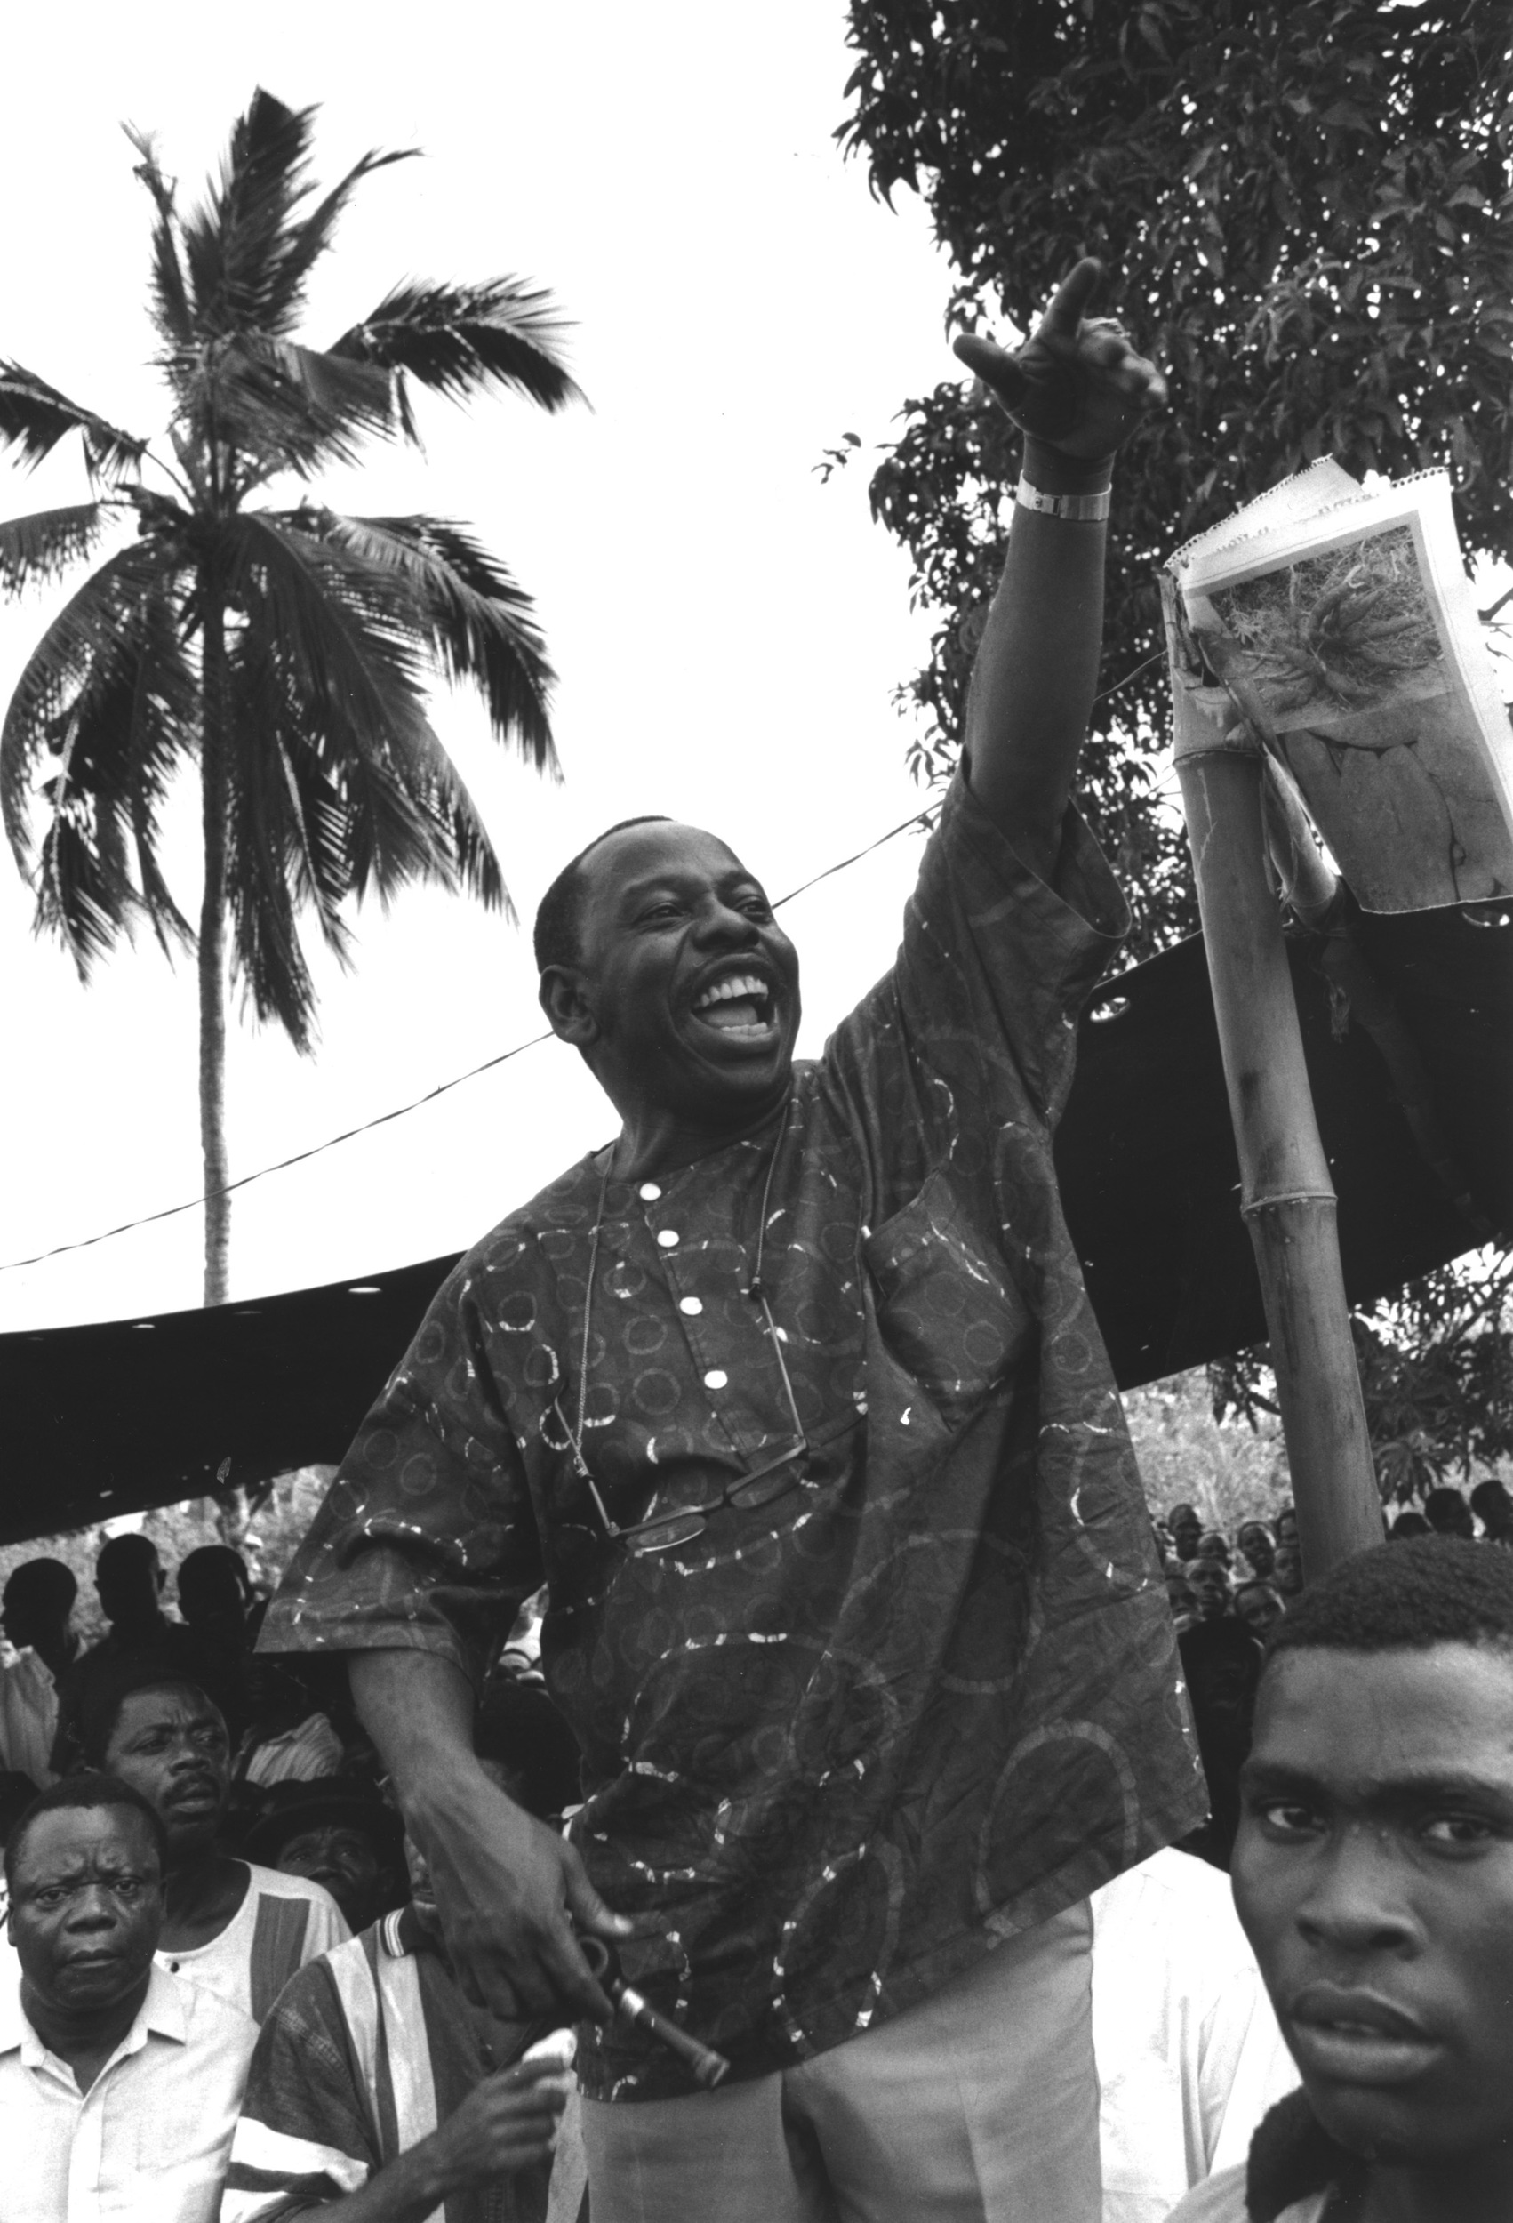


Slide 2

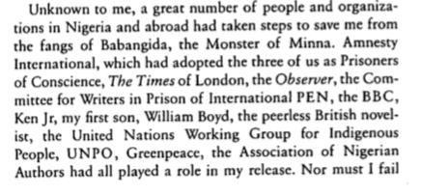
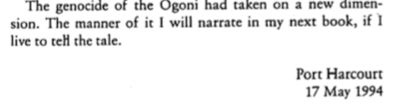
“Why are you people doing this to me? What sort of a nation is this?”
K S-W’s final words, 10th November 1995

Slide 3




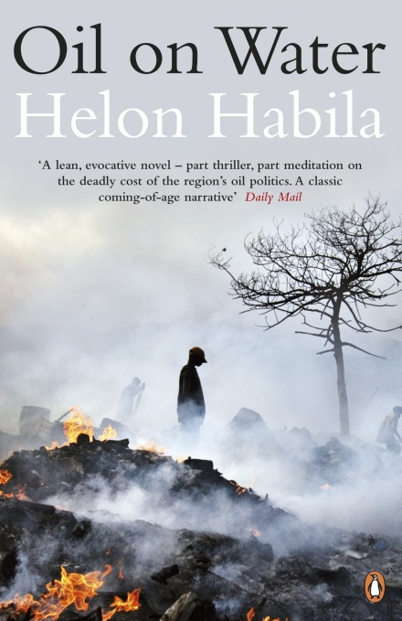


Slide 4
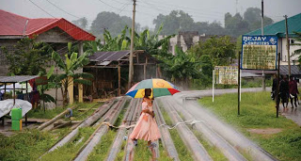
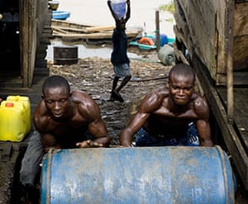
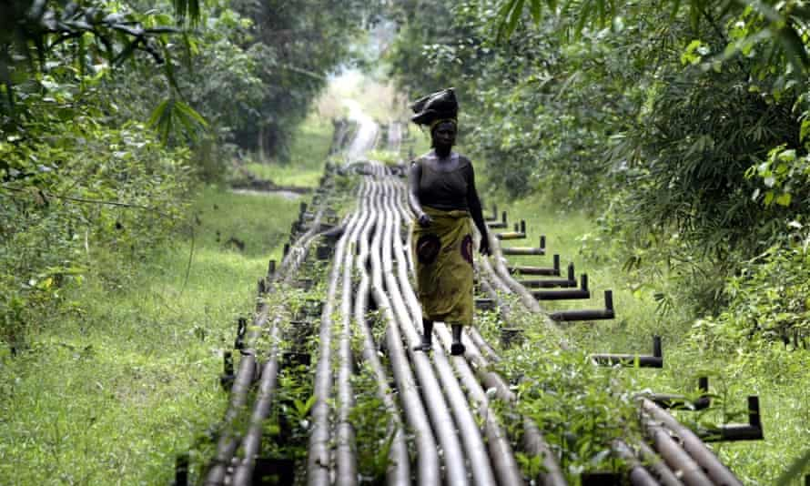
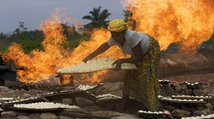

Slide 5
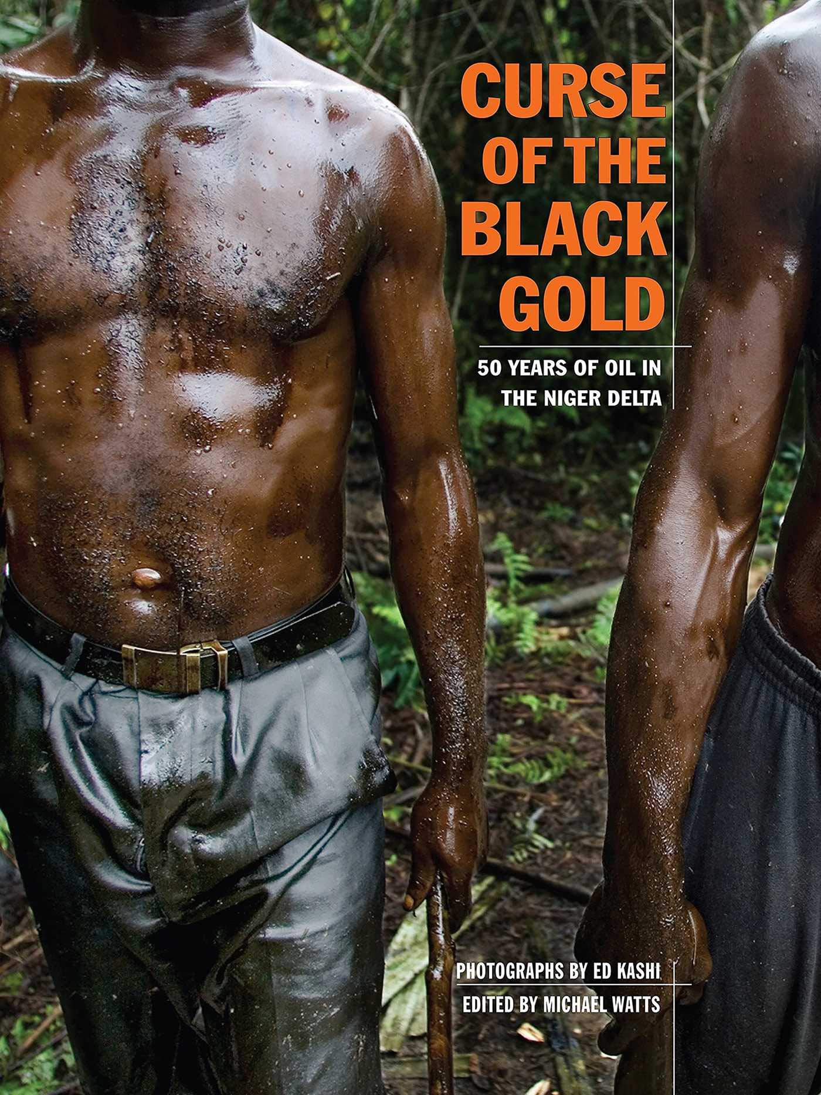
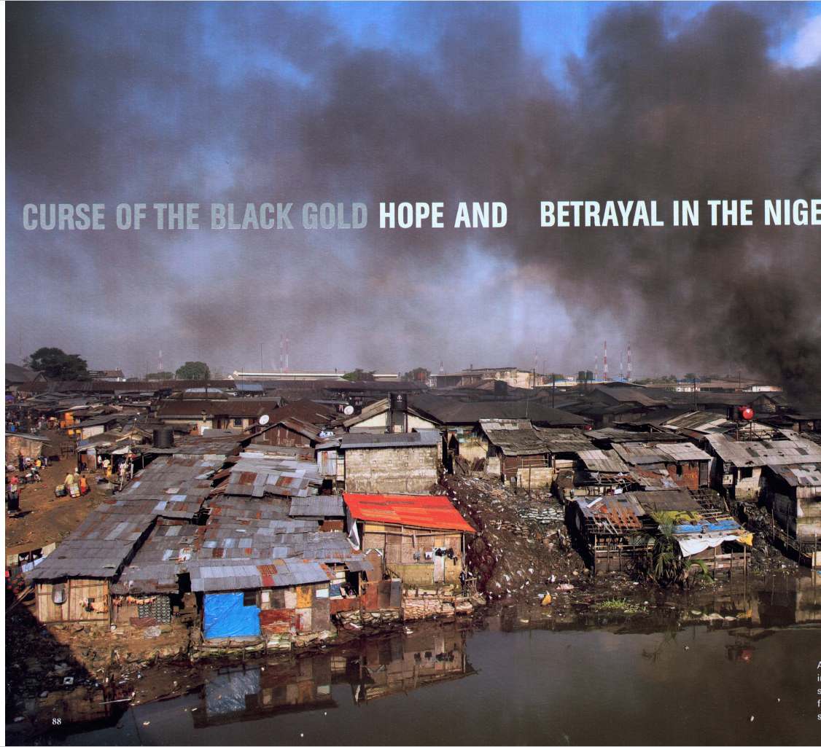
2008

Slide 6
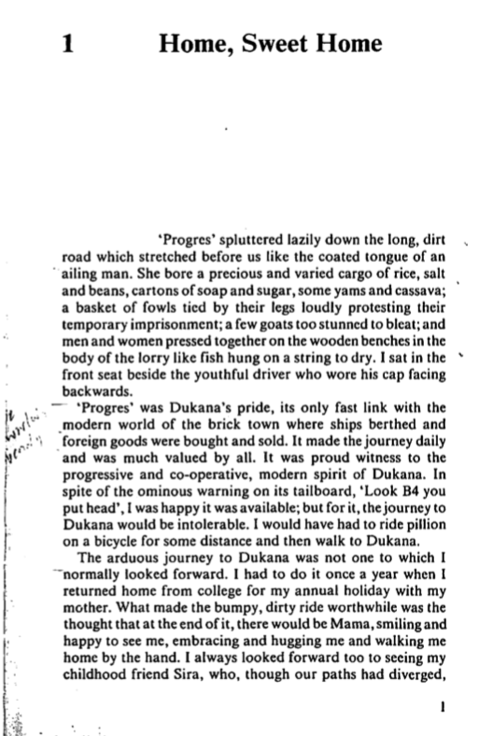

Slide 7
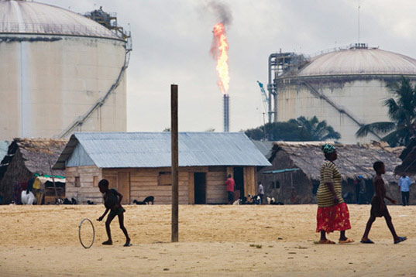
“Once in a while, a building of modern construction, properly painted and maintained, would peep out of the bush, a reminder of other possibilities. Now and again we would drive past a gas flare reminding us that this was oil-bearing country….”
Ken Saro-Wiwa, ‘Progres’, from Forest of Flowers

Slide 8
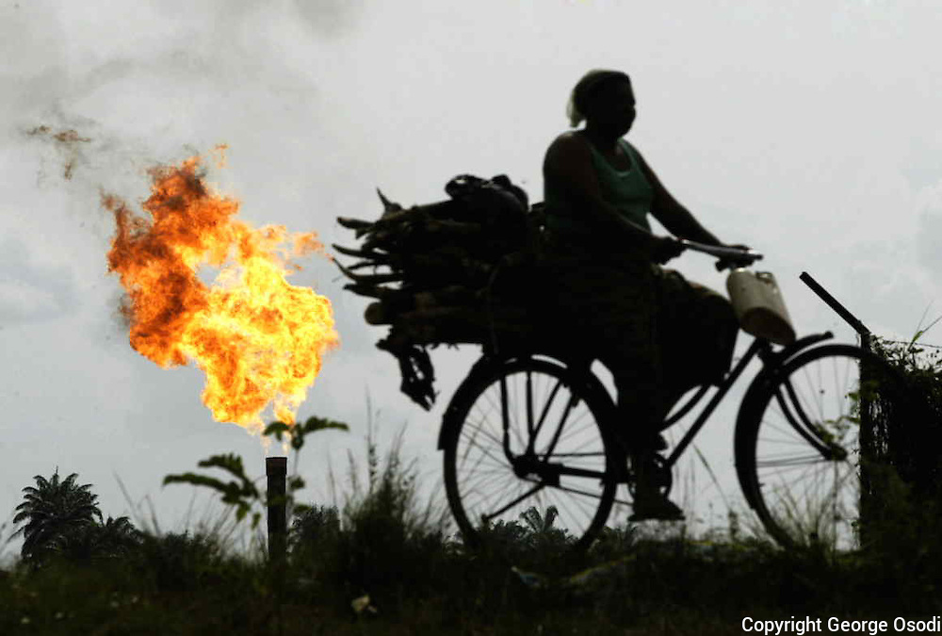
We drove past sleepy little villages hacked out of the forest, fondly embracing the earth and the foliage. We drove past farms planted with mixtures of yams, cassava, maize, pepper and melon, mostly stunted and crying for fertilizers. We went swiftly past men riding rickety bicycles and women with large bundles of firewood or huge white basins on their heads and babies tied to their backs with dirty rags. Once in a while, a building of modern construction, properly painted and maintained, would peep out of the bush, a reminder of other possibilities. Now and again we would drive past a gas flare reminding us that this was oil-bearing country and that from the bowels of this land came the much-sought-after liquid that fuelled the wheels of modern civilisation.
Ken Saro-Wiwa, ‘Progres’, from A Forest of Flowers (1996)
George Osodi, “Ebocha Gas Flare”

Slide 9
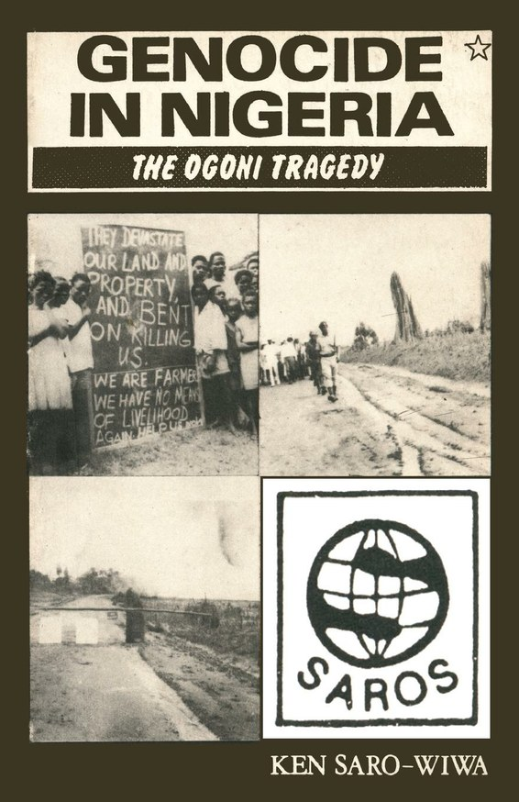
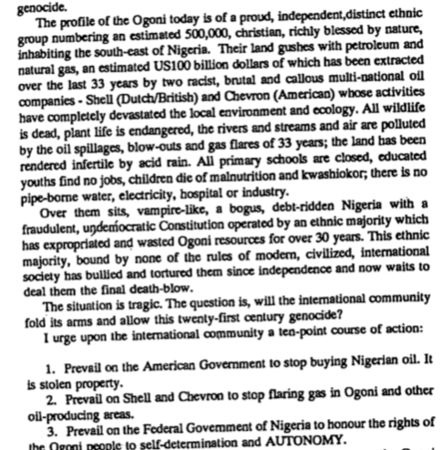

Slide 10
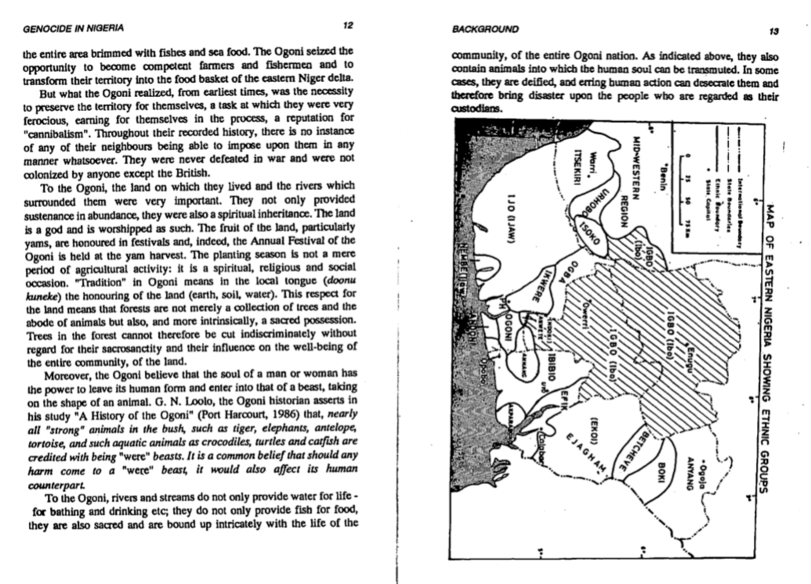

Slide 11
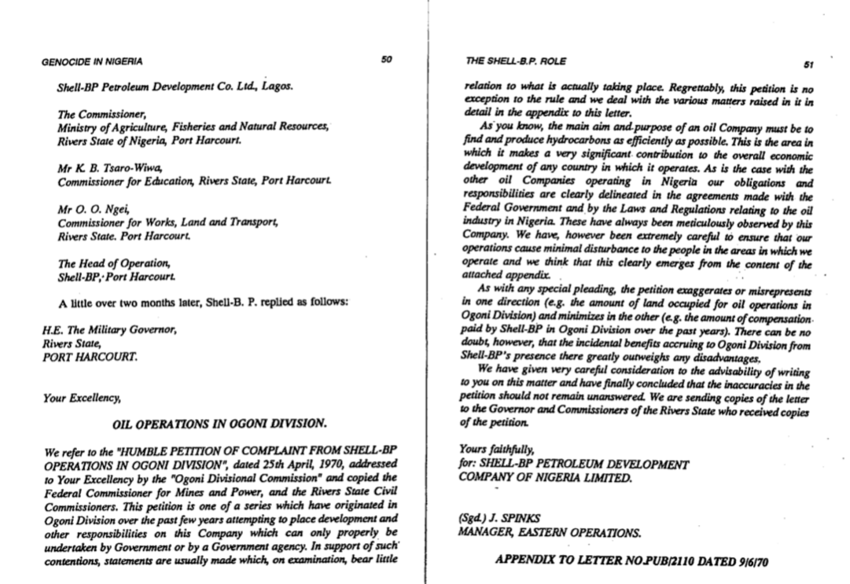

Slide 12
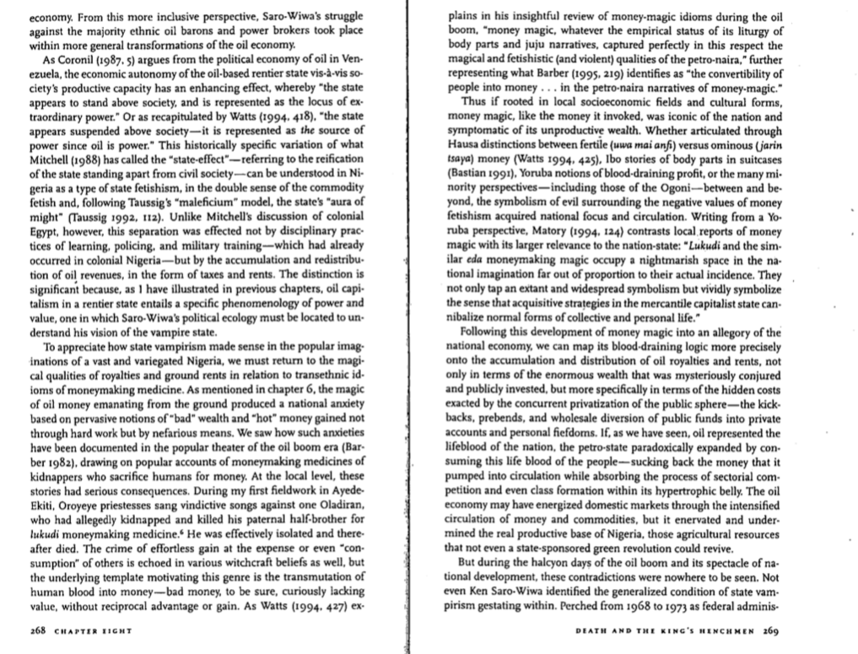
Andrew Apter

Slide 13
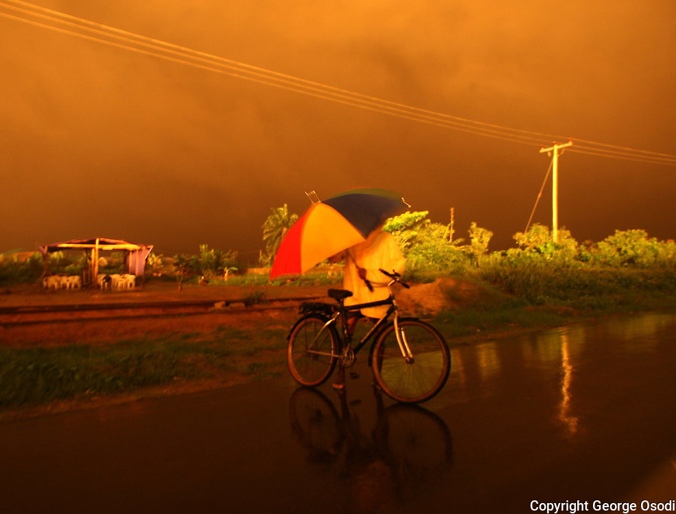

Slide 14
