Slide 1


Notes:
collapse, entropy, painful pedestrianism, without maps, following the cracked highway - the bunker episode - Predilection for dystopia and apocalypse (end times threats; cautionary tales; extrapolations of the present; also small morality tales within of how to deal wth it and how to be better and perhaps prevent it)
One vein of thinking is that this seems to be not real at all, difficult to grasp – so maybe bunker thinking is both a natural response and also a fearful/problematic one. other forms of escape and shelter are seen in fagan -

Slide 2








Slide 3




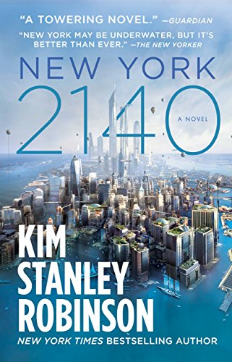



Slide 4
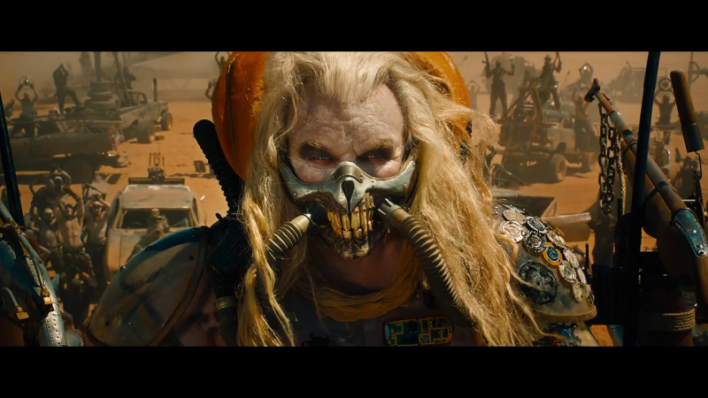

Slide 5

the petroleum infrastructure has become embodied memory and habitus for modern humans, insofar as everyday events such as driving or feeling the summer heat or asphalt on the soles of one’s feet are incorporating practices…de-coupling human corporeal memory from the infrastructures that have sustained it may be the primary challenge for ecological narrative in the service of human species survival beyond the twenty-ﬁrst century. (26)

Slide 6
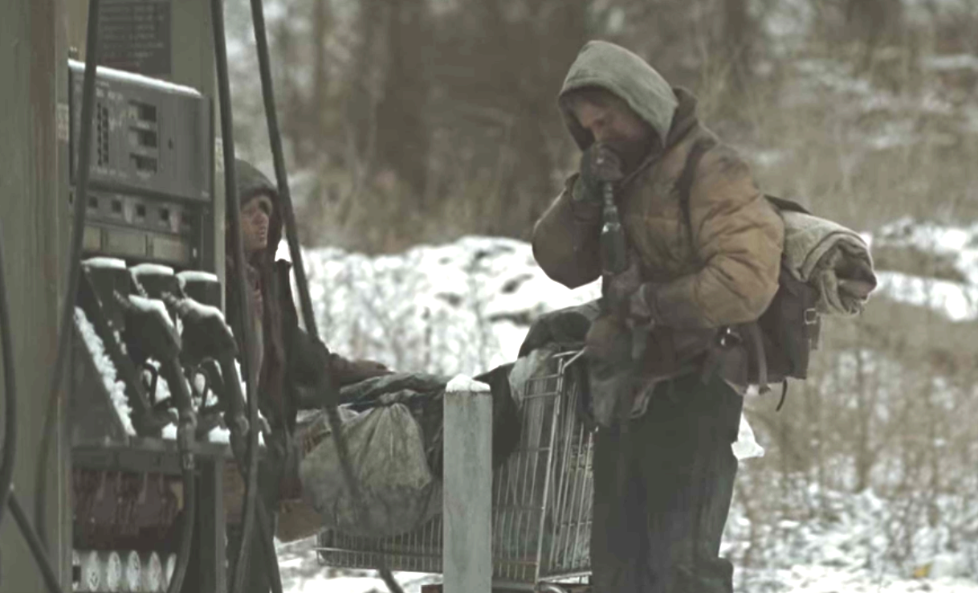
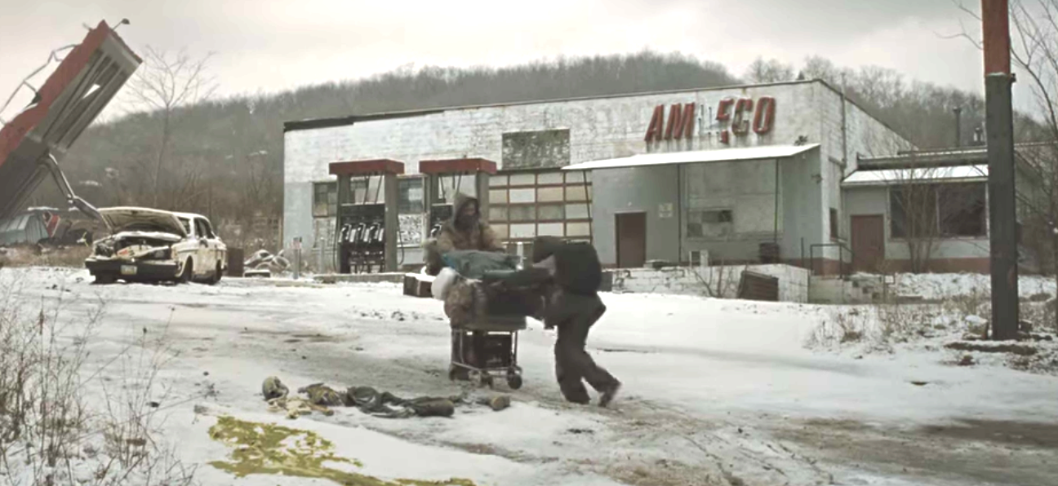
They came upon a roadside gas station. They stood in the road and studied it….the weeds they forded fell to dust about them. They crossed the broken asphalt apron and found the tank for the pumps. The cap was gone and the man dropped to his elbows to smell the pipe but the odor of gas was only a rumor, faint and stale. He stood and looked over the building. The pumps standing with their hoses oddly still in place. The windows intact. The door to the service bay was open and he went in. A standing metal toolbox against one wall. He went through the drawers but there was nothing there that he could use….He stood looking around the garage. A metal barrel full of trash…dust and ash everywhere….Some old automotive manuals, swollen and sodden.
The Road 4-5

Slide 7
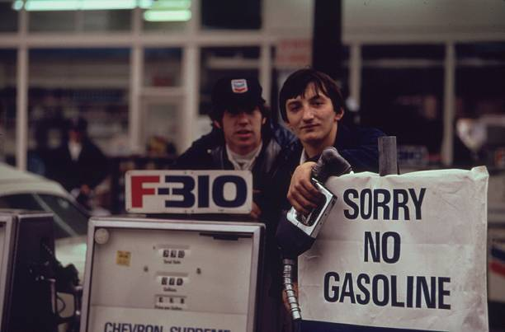
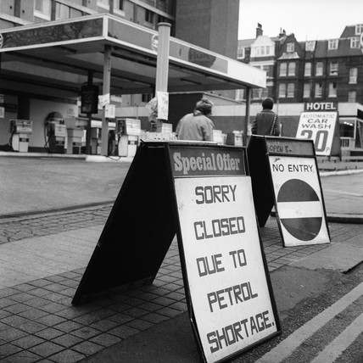
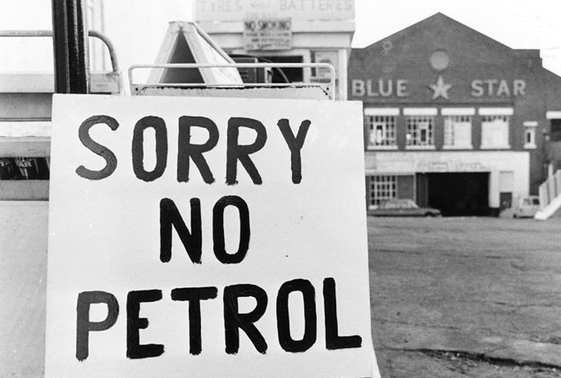
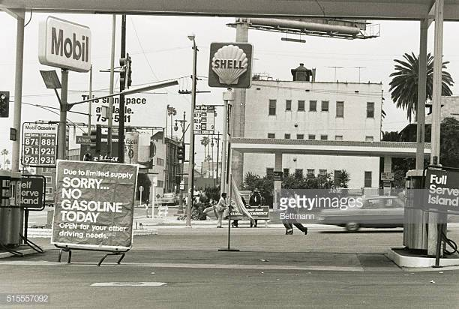

Slide 8
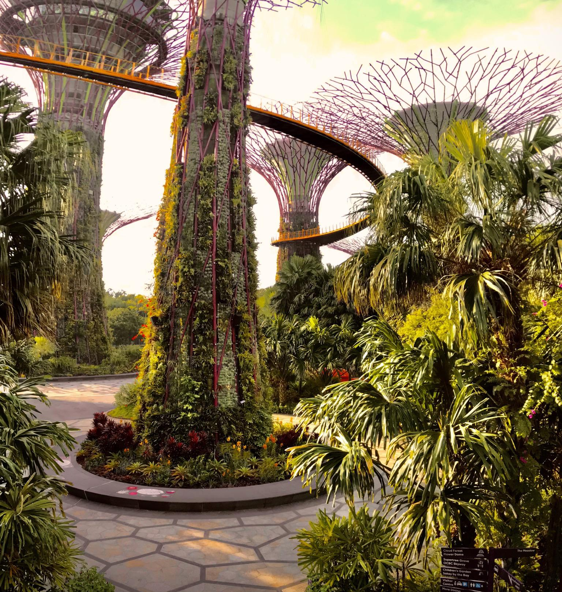
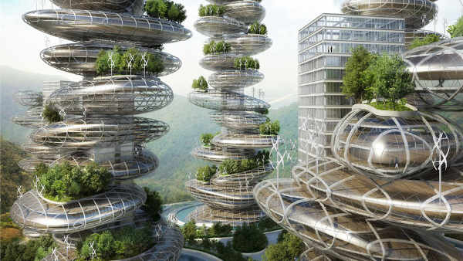


Slide 9
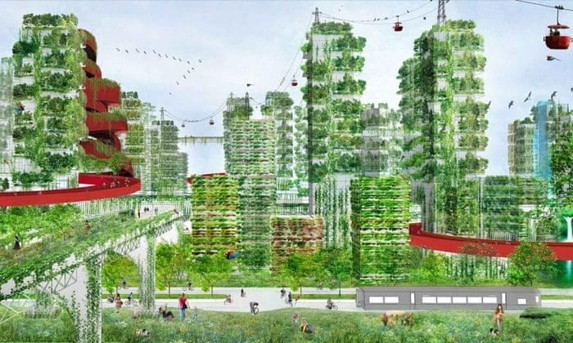

Slide 10
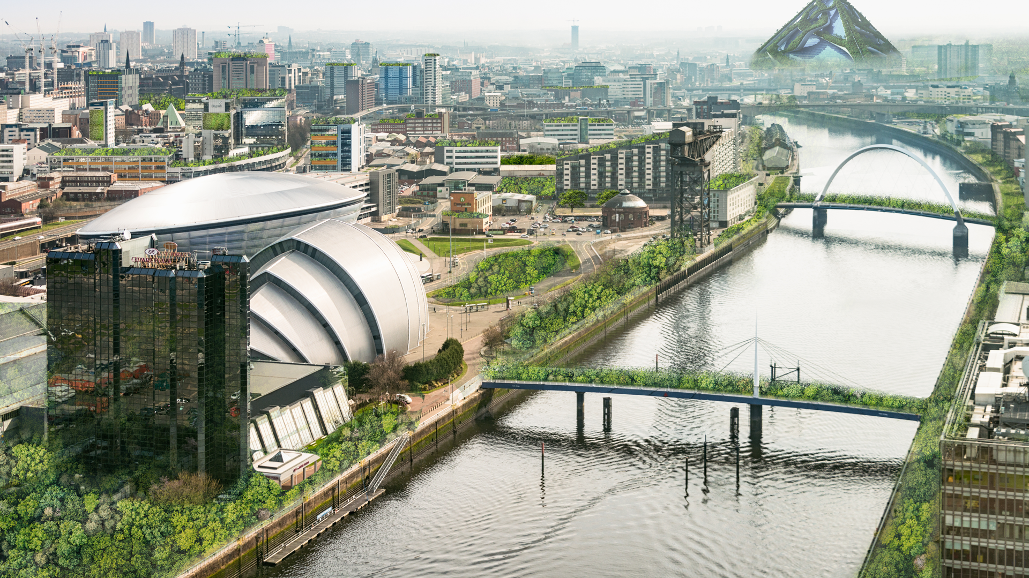
Notes:
What do you want? This? Or……FINAL SLIDE MAD MAX (AND GO BACK AND FORTH)

Slide 11
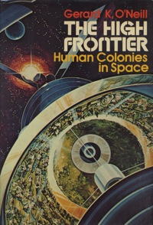
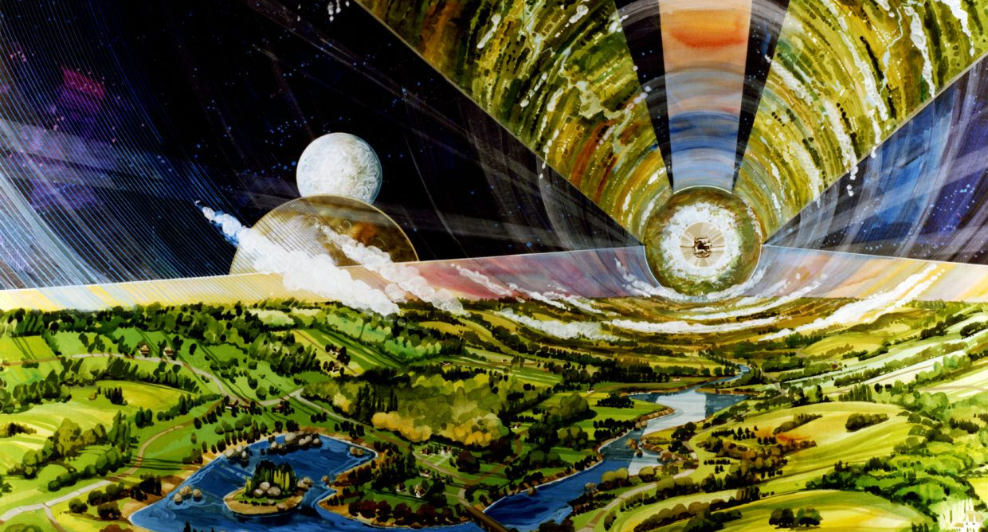

Slide 12
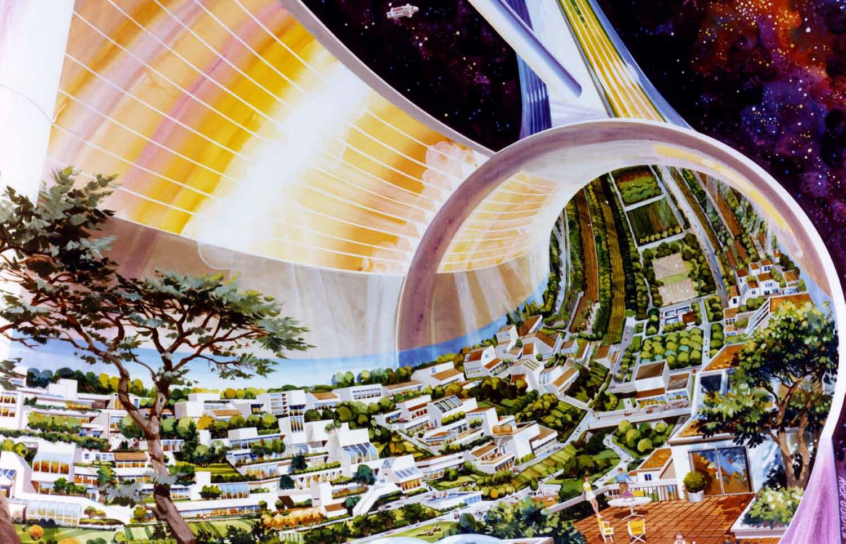

Slide 13
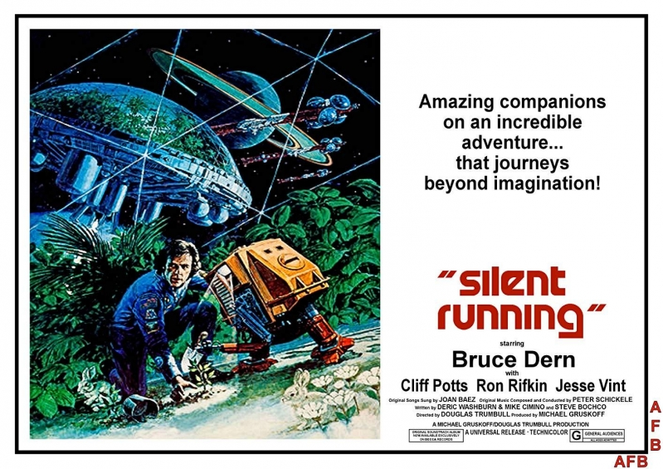

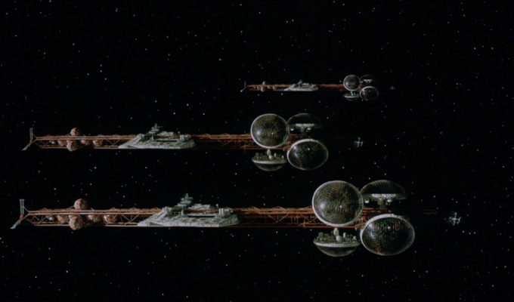

Slide 14

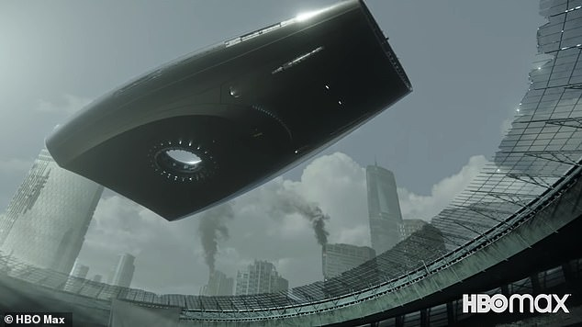
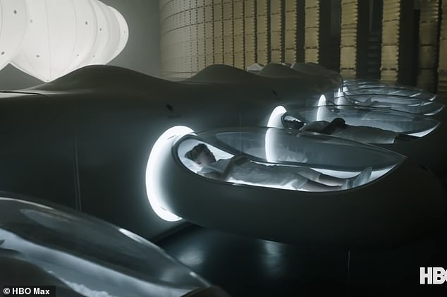


Slide 15
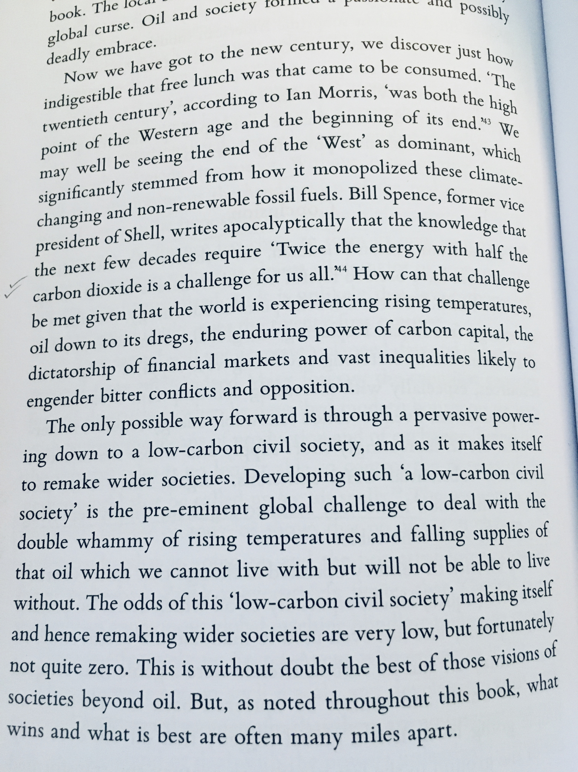


Slide 16
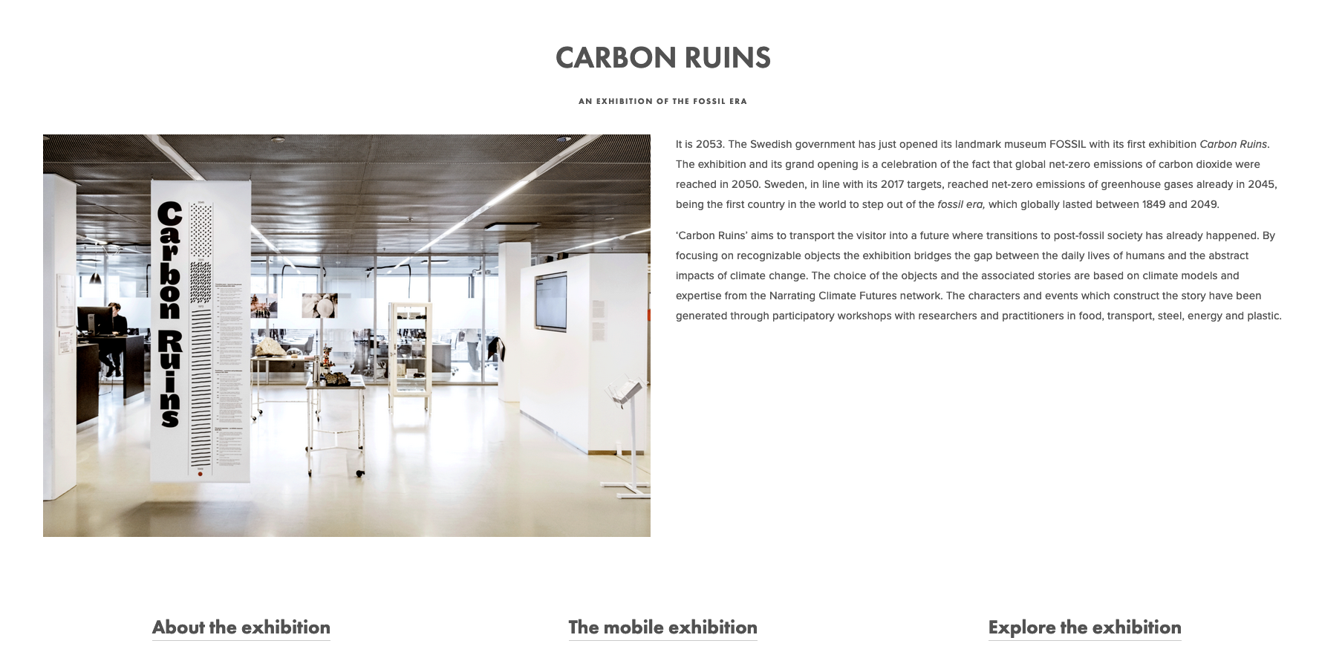
https://www.climaginaries.org/carbon-ruins

Slide 17


