Slide 1
Options meeting
English and comparative Literary Studies

Slide 2
CHOOSING YOUR OPTIONS
Deadline for online applications: 11 March 2020
Please give yourself enough time to ask convenors questions; staff will respond as soon as they can.

Slide 3
PROCESS APPLIES TO:
ENGLISH LITERATURE
ENGLISH AND THEATRE
ENGLISH AND HISTORY

Slide 4
ENGLISH LITERATURE AND CREATIVE WRITING STUDENTS
WARWICK WRITING PROGRAMME
OPTIONS MARKET:
Wednesday 4 March, 14.00-15.00, F204 Millburn House

Slide 5
WHAT’S ON OFFER
Collect a handbook from H545 after this session
Lists all modules on offer
Some modules are only available to specific degree courses
Nearly all are available to both second and final year students

Slide 6
CHOOSE YOUR MODULES BASED ON:
What you enjoy studying
Assessment methods (see module websites)

Slide 7
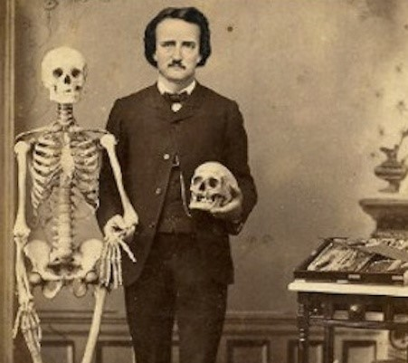
AMERICAN STUDIES
Twentieth-Century US Literature
US Writing and Culture 1780–1920
States of Damage: Twenty-First Century US Writing and Culture
American Horror Story: U.S. Gothic Cultures, 1790-Present
American Poetry: Modernity, Rupture, Violence

Slide 8
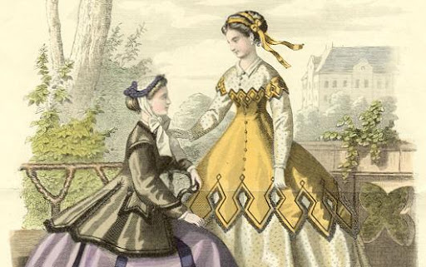
EIGHTEENTH AND NINETEENTH CENTURY LITERATURE
Romantic and Victorian Poetry
The English Nineteenth-Century Novel
Asia and the Victorians
English Literature and Feminisms, 1790-1899
Eighteenth-Century Literature
Crime Fiction, Nation and Empire: Britain 1850-1947

Slide 9

EARLY LITERATURE (pre-1800)
Seventeenth Century: The First Modern Age of English Literature
Arthurian Literature and its Legacy
Early Modern Drama
The Classical Tradition in English Translation: The Renaissance
Restoration Drama
Literature and Revolution 1640-1660: Turning the World Upside Down

Slide 10
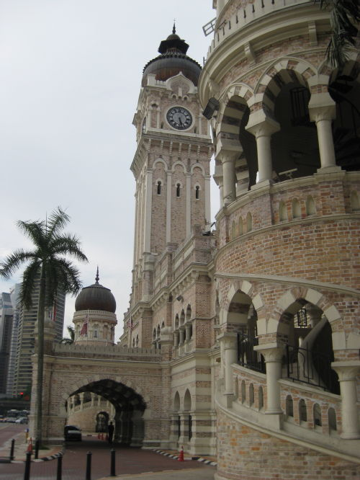
POSTCOLONIAL / WORLD LITERATURES
New Literatures in English
Asia and the Victorians
Crime Fiction, Nation and Empire: Britain 1850-1947
Literature and Empire: Britain and the Caribbean to c. 1900
Yiddish Literature in Translation: A World Beyond Borders

Slide 11
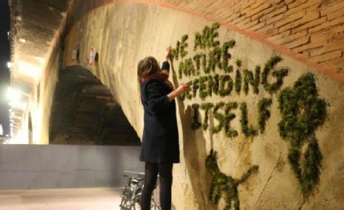
ENVIRONMENTALISM
Literature, Environment, Ecology
Ecopoetics
Commodity Fictions: World Literature and World-Ecology
The Question of the Animal

Slide 12

POETRY
American Poetry: Modernity, Rupture, Violence
Romantic and Victorian Poetry
Transatlantic Modernist Poetry
Ecopoetics
The Question of the Animal
Seventeenth Century: The First Modern Age of English Literature
The Classical Tradition in English Translation: The Renaissance

Slide 13
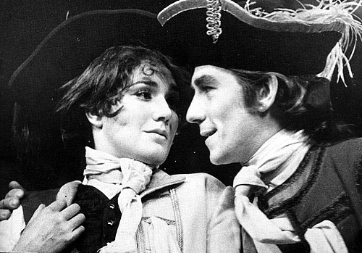
THEATRE
Seventeenth Century: The First Modern Age of English Literature
Early Modern Drama
Restoration Drama
The Classical Tradition in English Translation: The Renaissance
European Theatre
Remaking Shakespeare
Shakespeare and Selected Dramatists of His Time (finalists only)

Slide 14
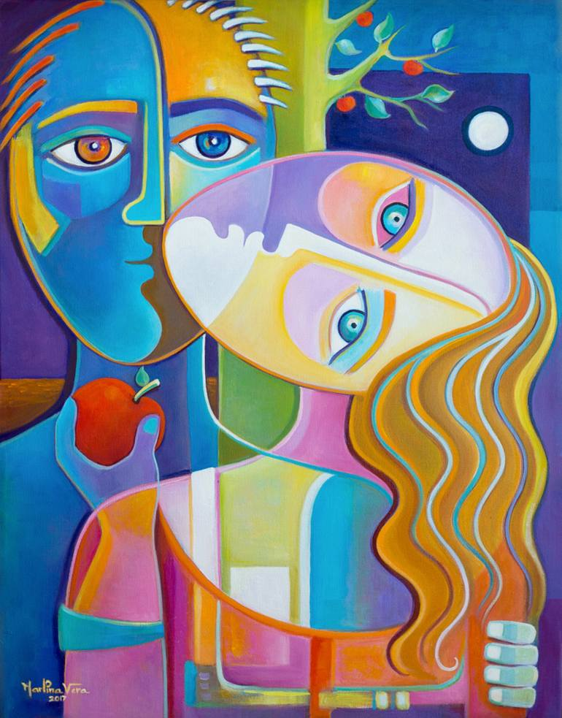
CONTEMPORARY
Literature, Theory and Time
Yiddish Literature in Translation: A World Beyond Borders
New Literatures in English
Twentieth-Century Avant-Gardes
Modernist Cultures
Small Press Publishing: History, Theory, Practice
Queering the Literary Landscape
Queer and There: Queer Theory and the History of Sexuality in the Global Context
The Novel Now

Slide 15
Dissertation module
Finalists only
Details on process in the handbook
Talk to your personal tutor and/or discuss your topic with members of staff you’d like to work with
Go to the EN320 Dissertation website for more details
Next information session: Friday 28th February 2020 at 10:00-11:30 in the Library Training Room

Slide 16
MODULES FROM OTHER DEPARTMENTS
Film and Television Studies
Philosophy
History
Sociology
Liberal Arts
School of Law
School of Modern Languages and Cultures
Warwick Business School
School of Creative Arts, Performance, and Visual Cultures
Centre for Education Studies

