Slide 1
Get Started with the Library
For English
Sarah Akhtaruzzaman – Academic Support Librarian

Slide 2
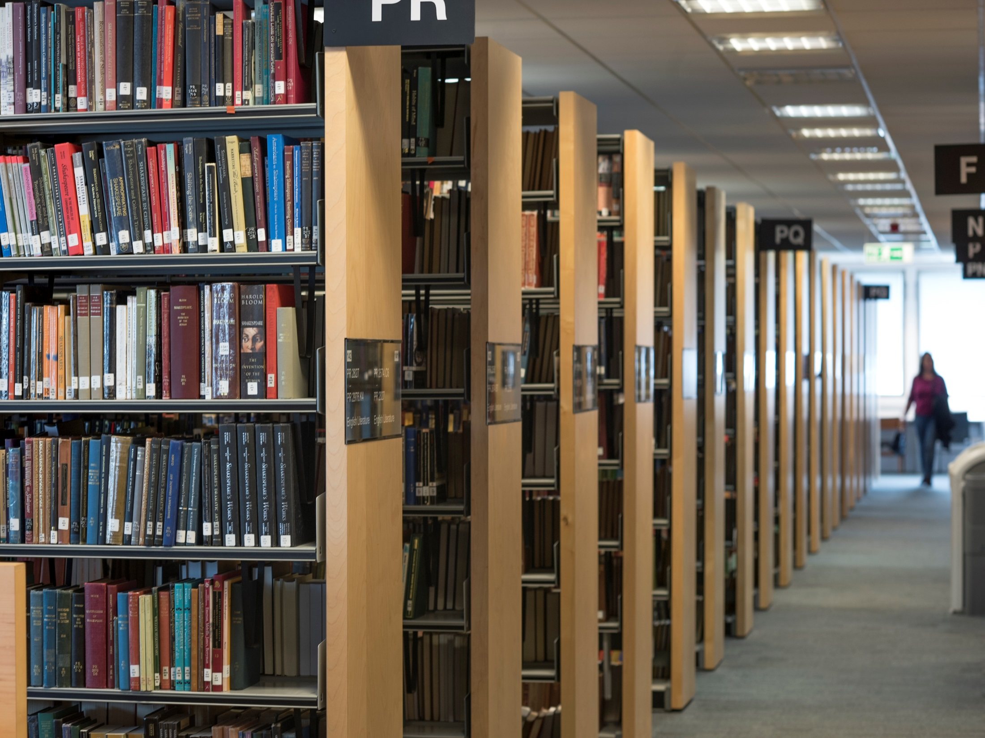
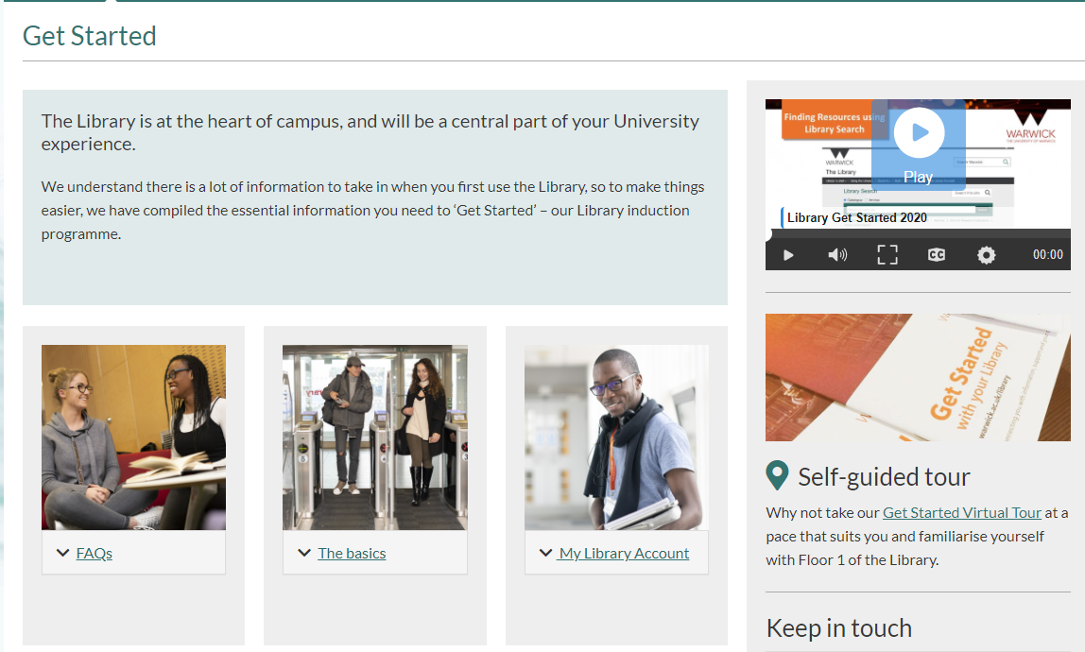
Get Started

Slide 3
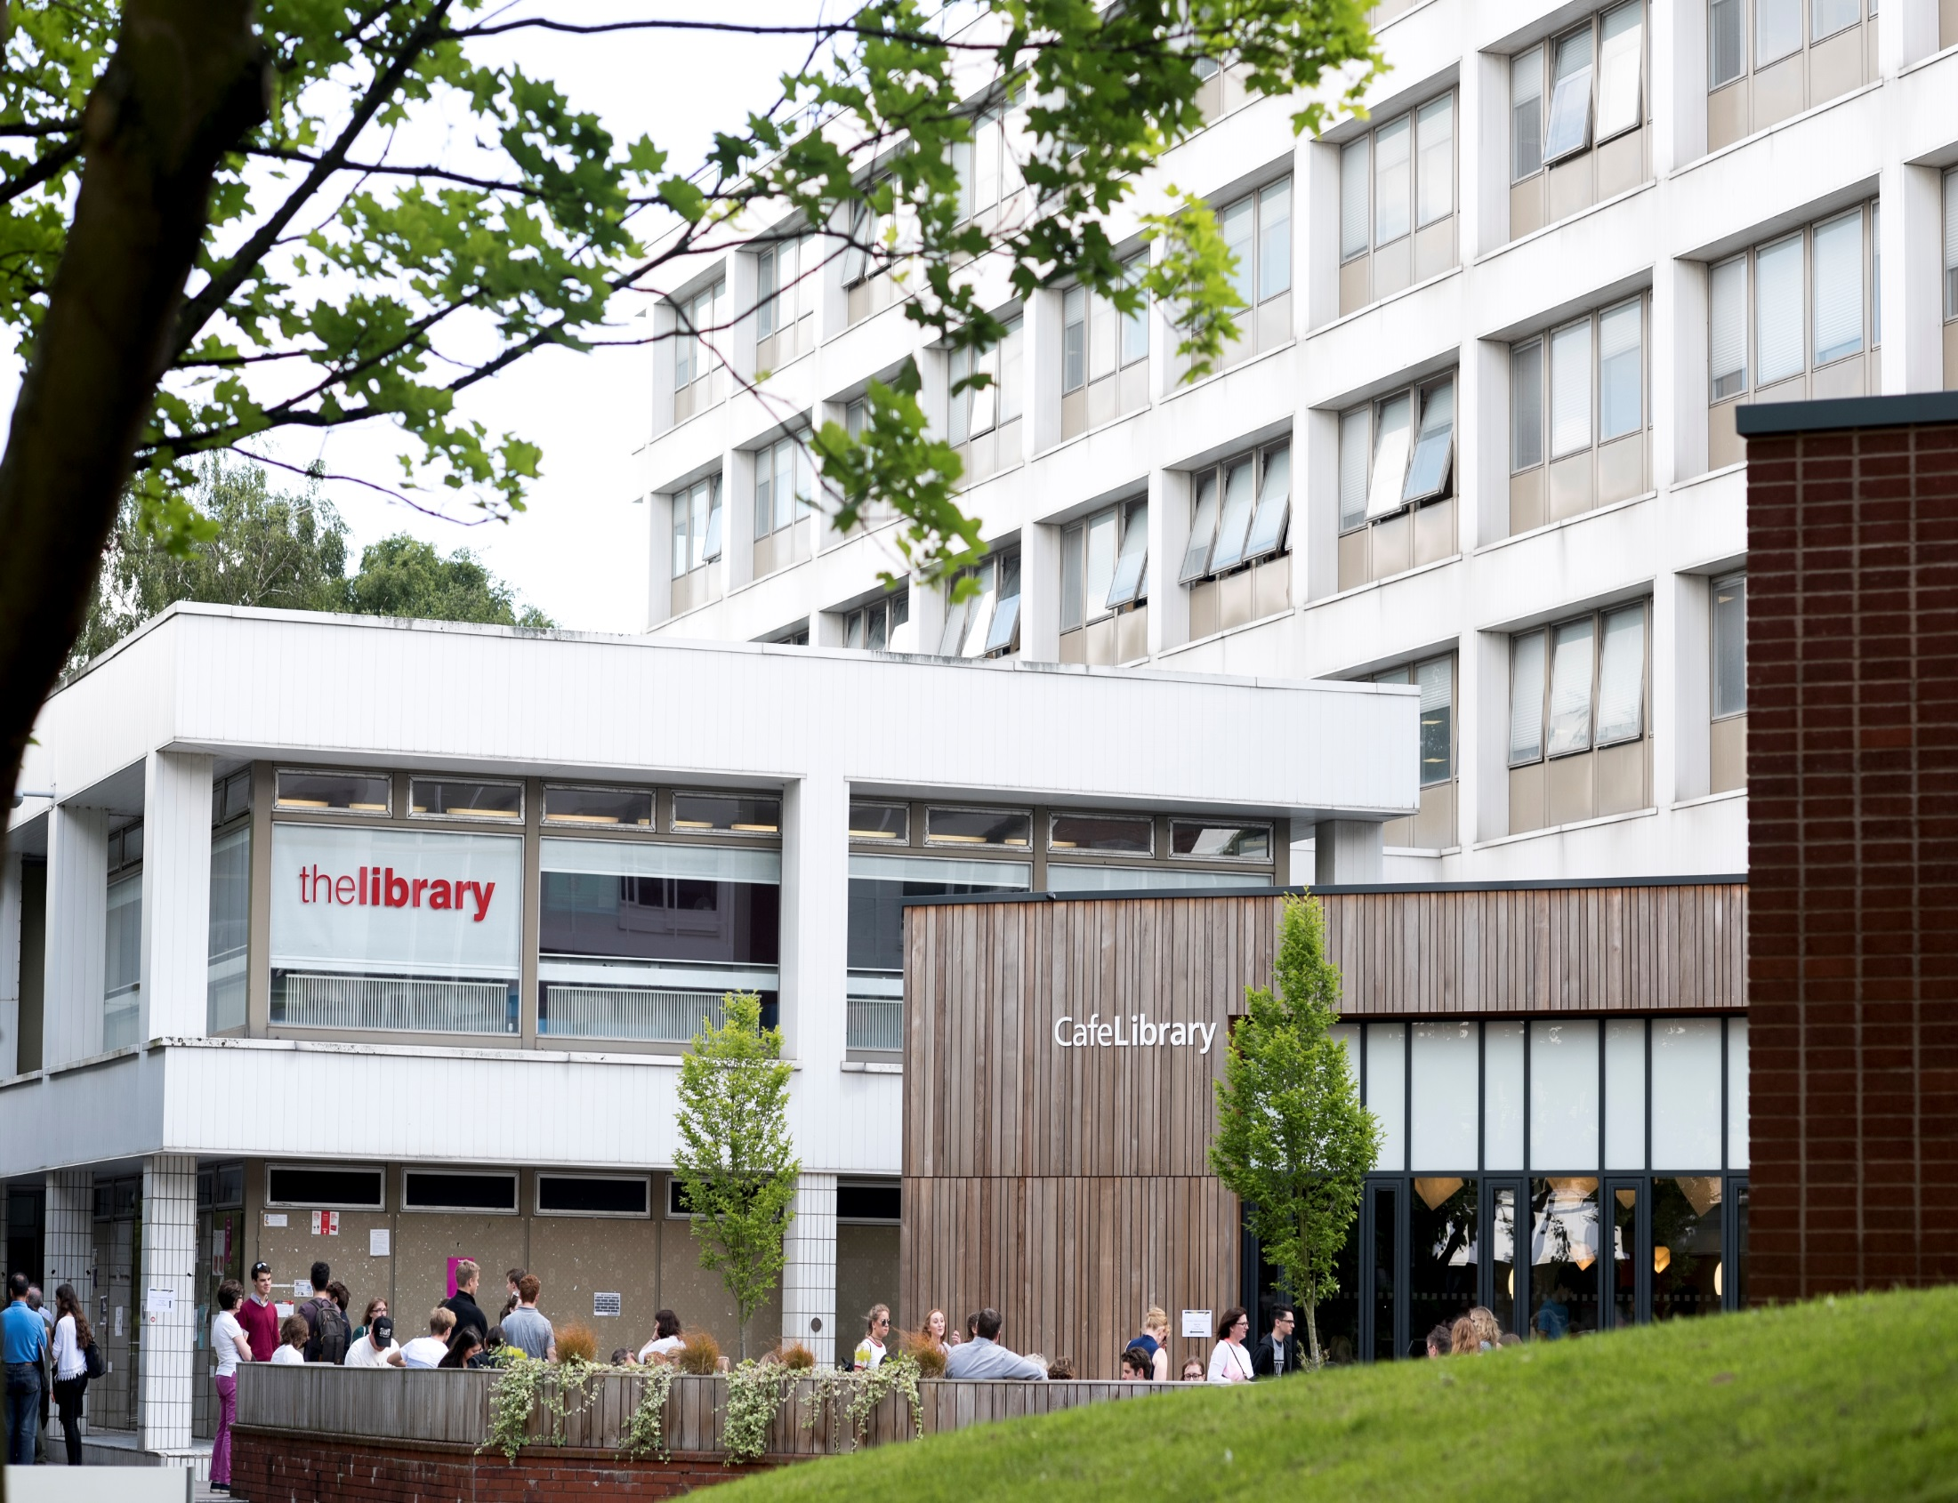
Find us! …
Open 24/7

Slide 4
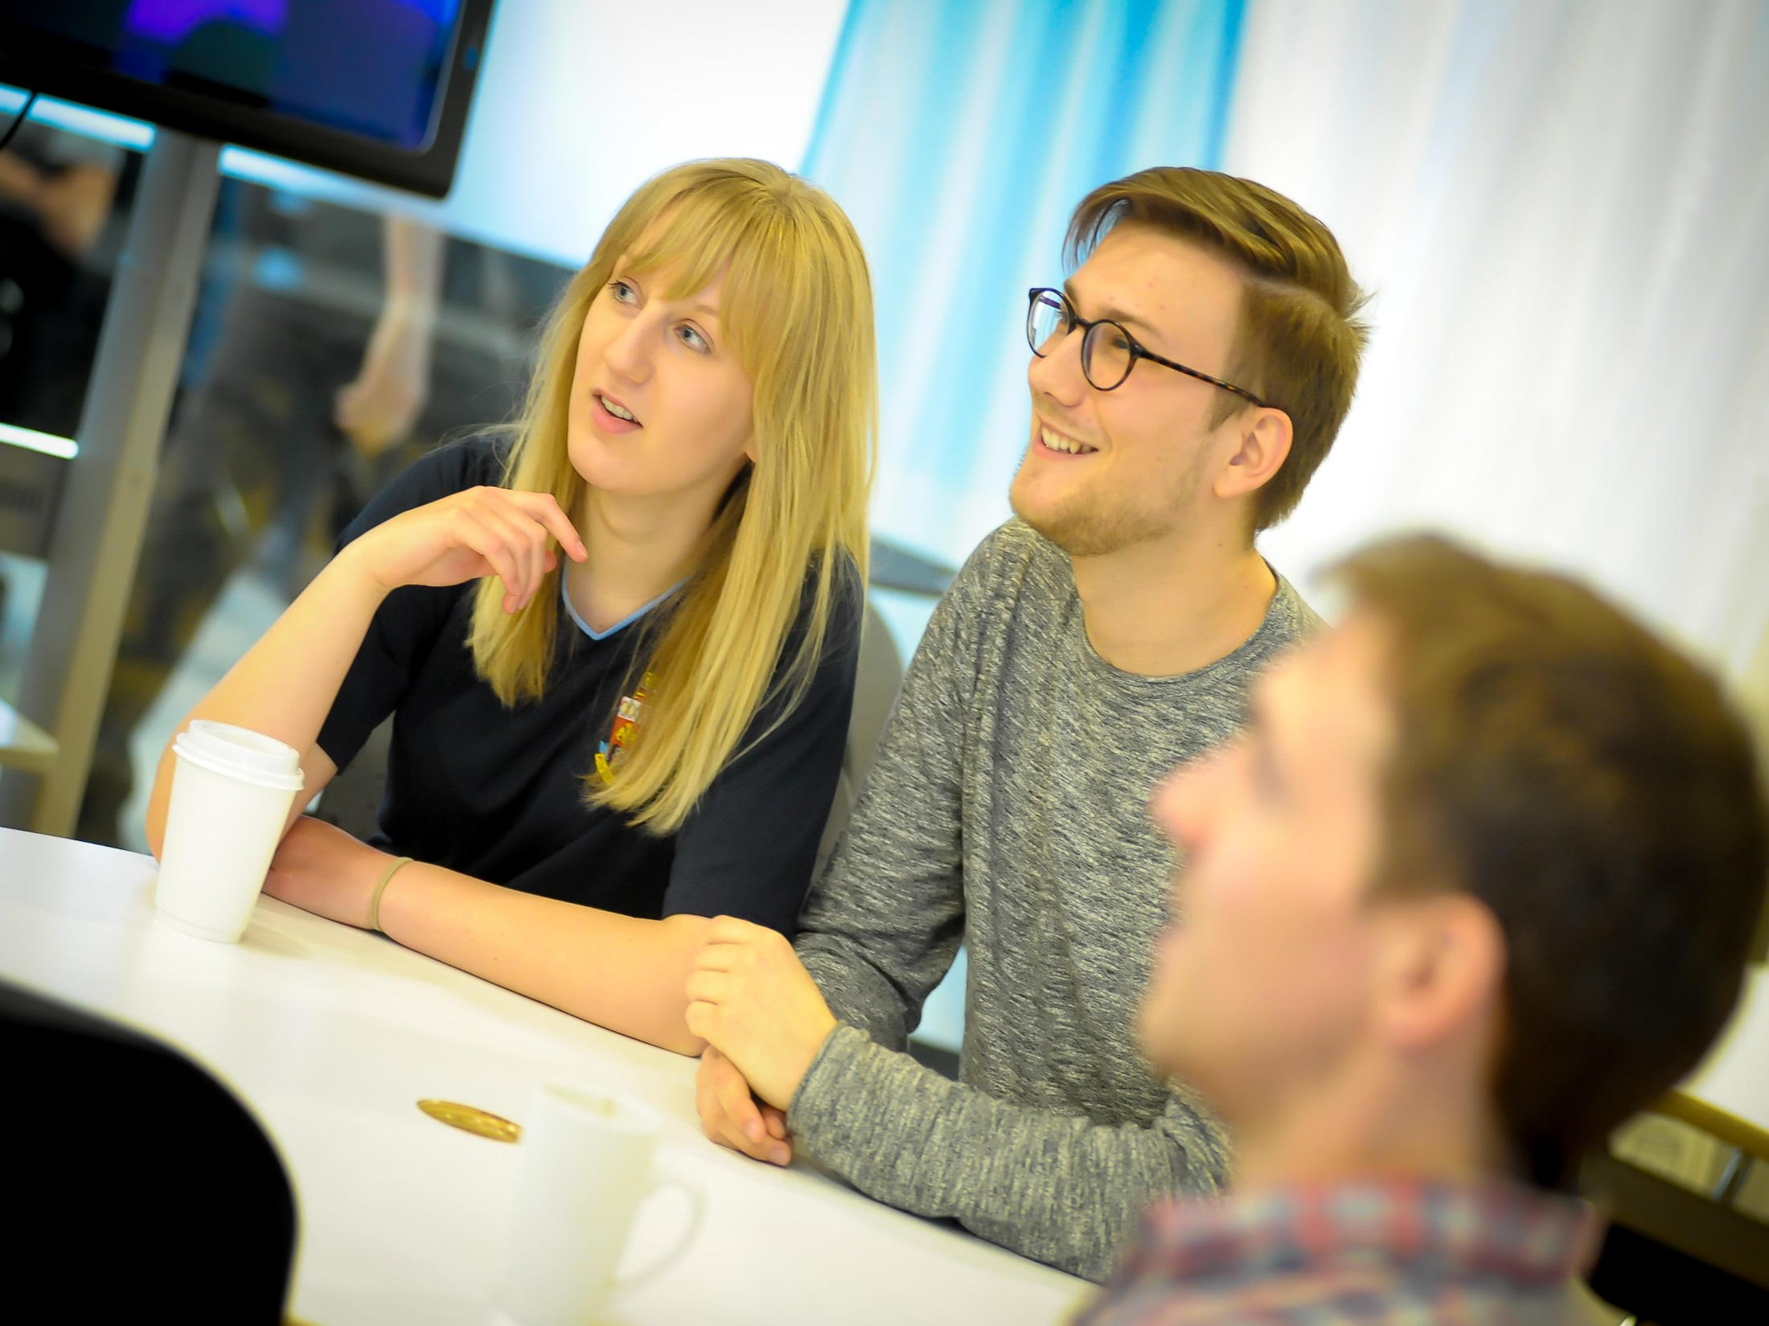
Group study

Slide 5
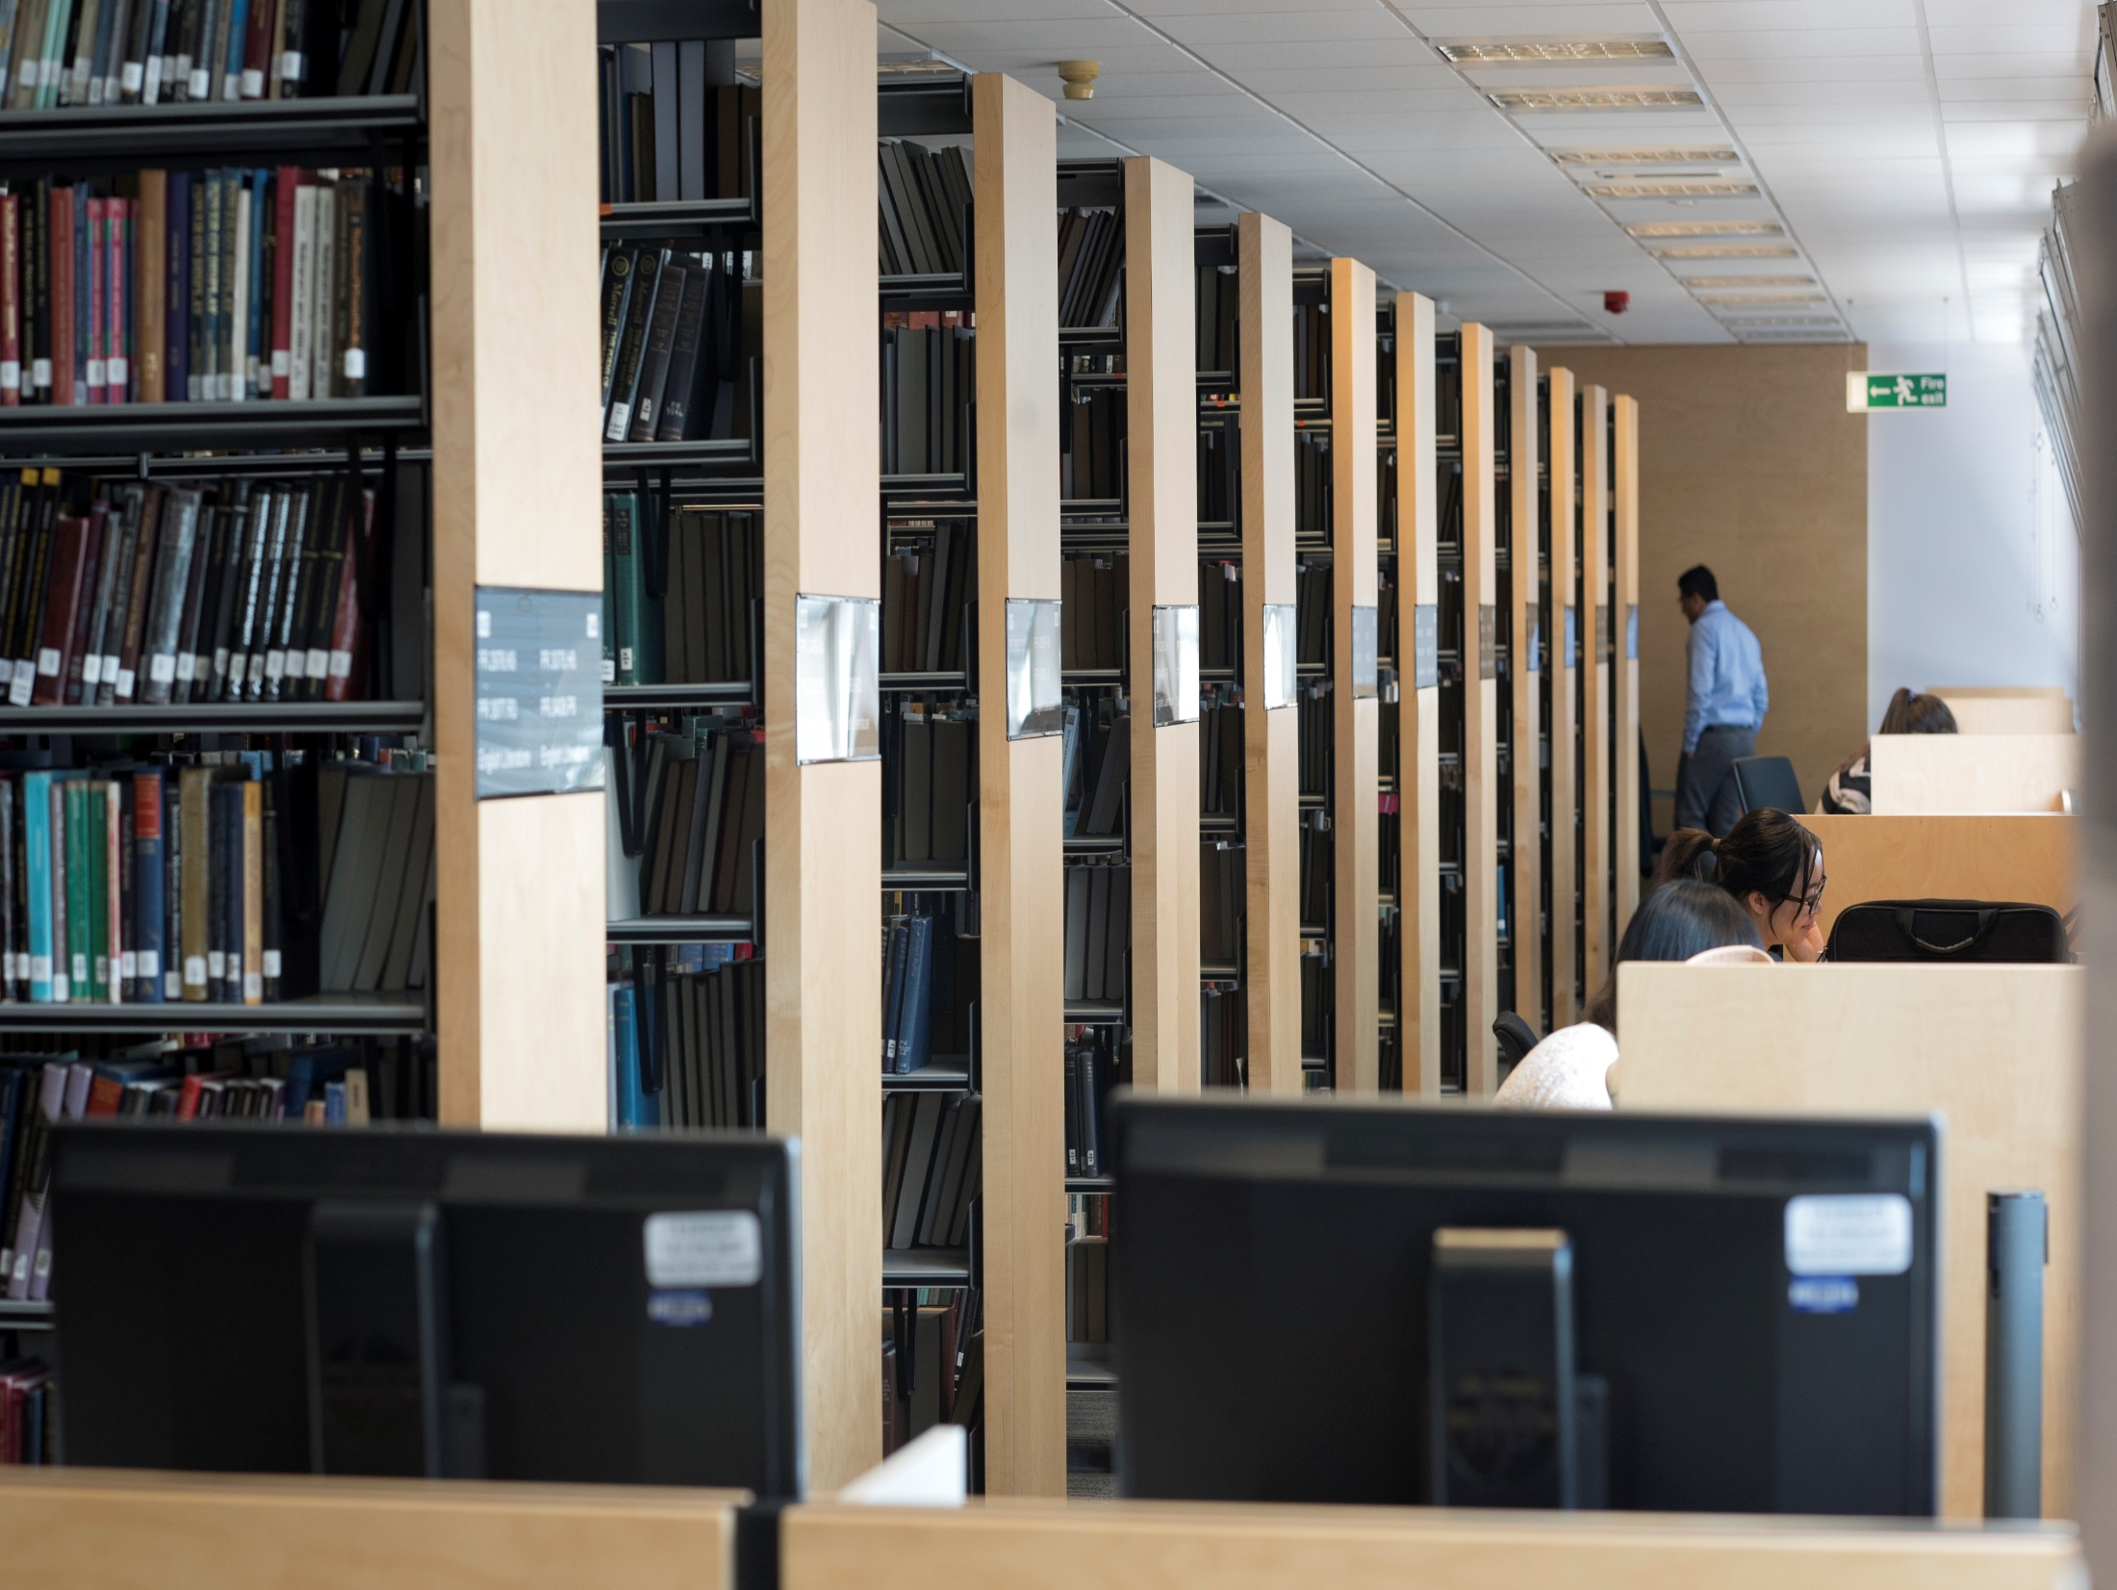
Quiet study

Slide 6
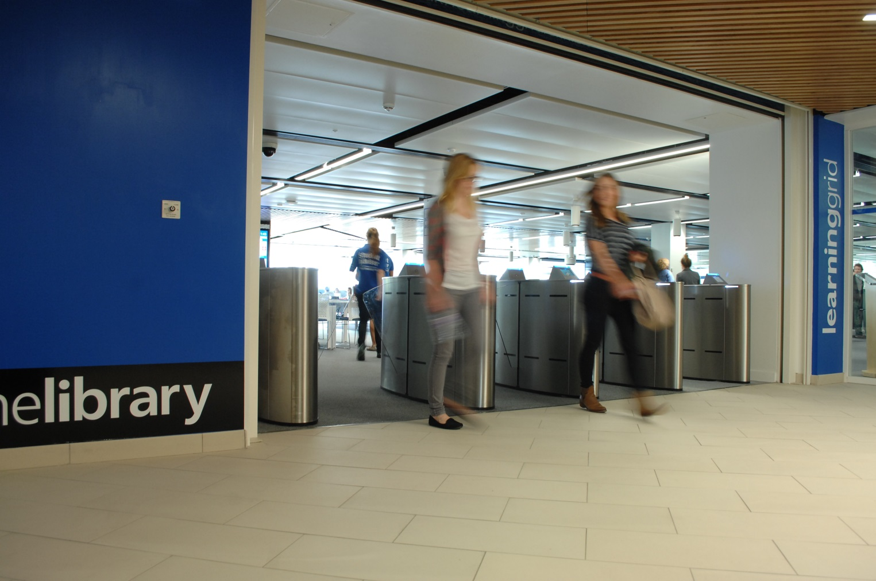
Learning Grids - Rootes and
University House

Slide 7
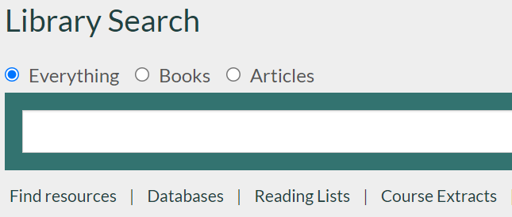
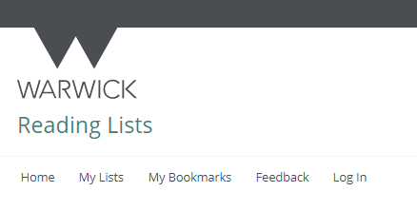
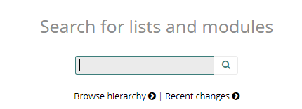

Find material from your reading lists
Find the reading list for your module in Moodle
Or follow the reading list link under Library Search

Slide 8
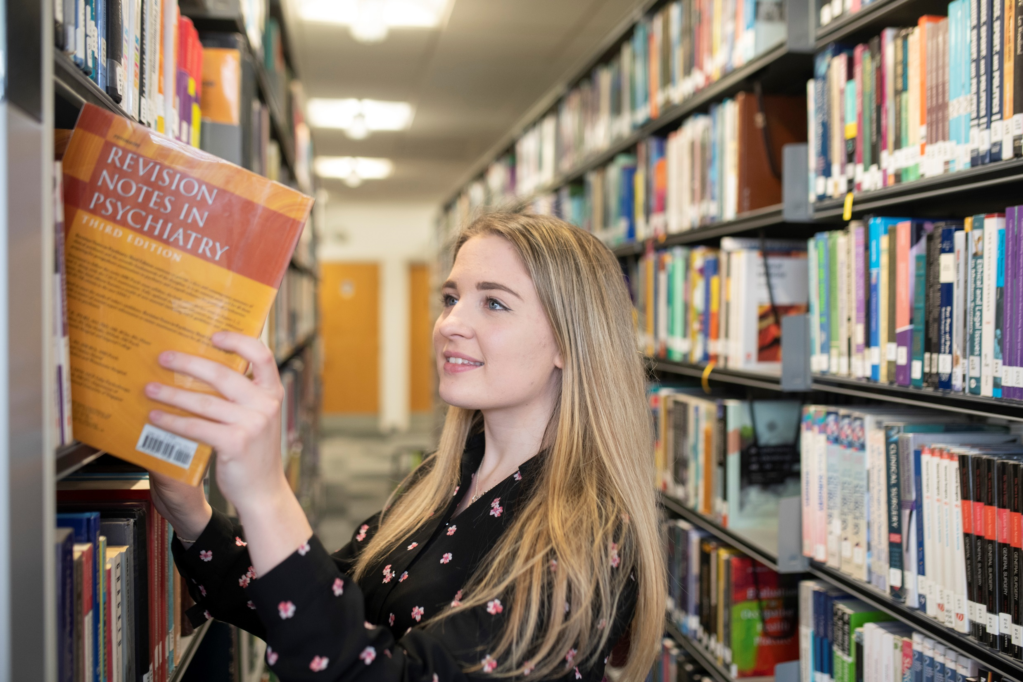
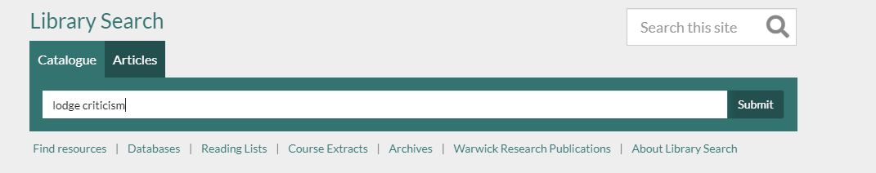
Find books

Slide 9

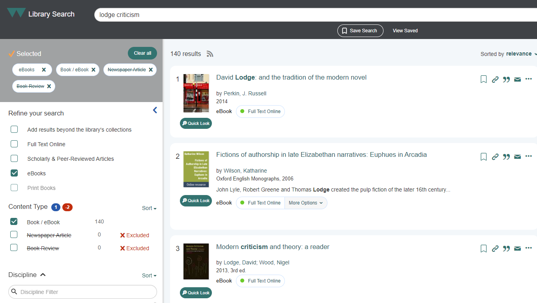

Slide 10
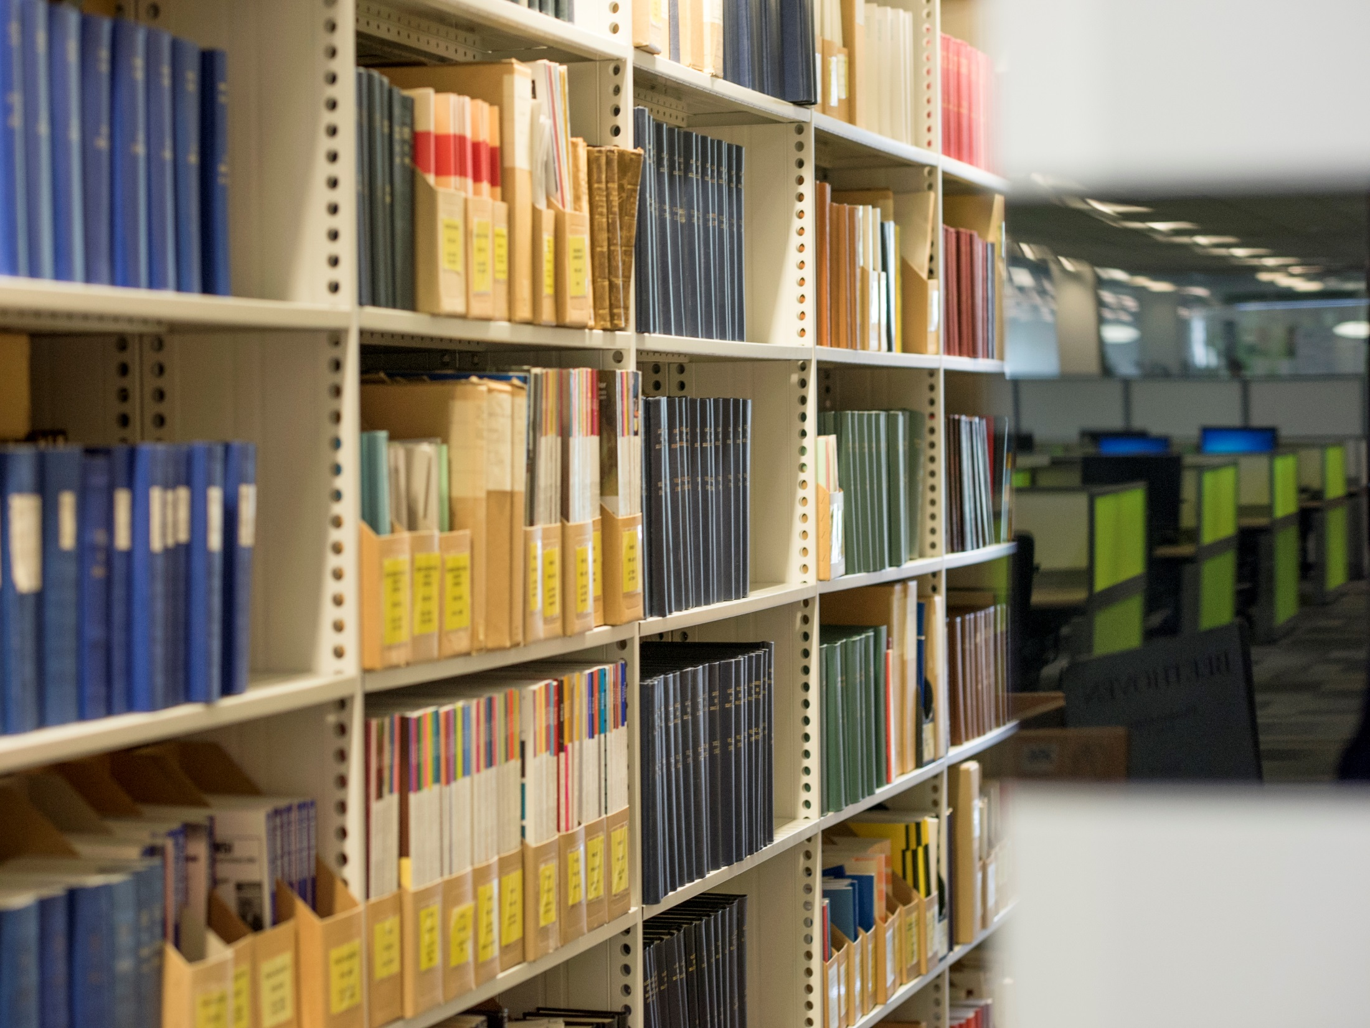
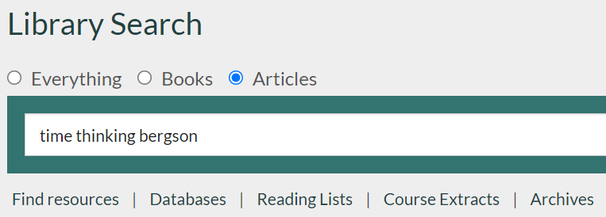

Find articles

Slide 11
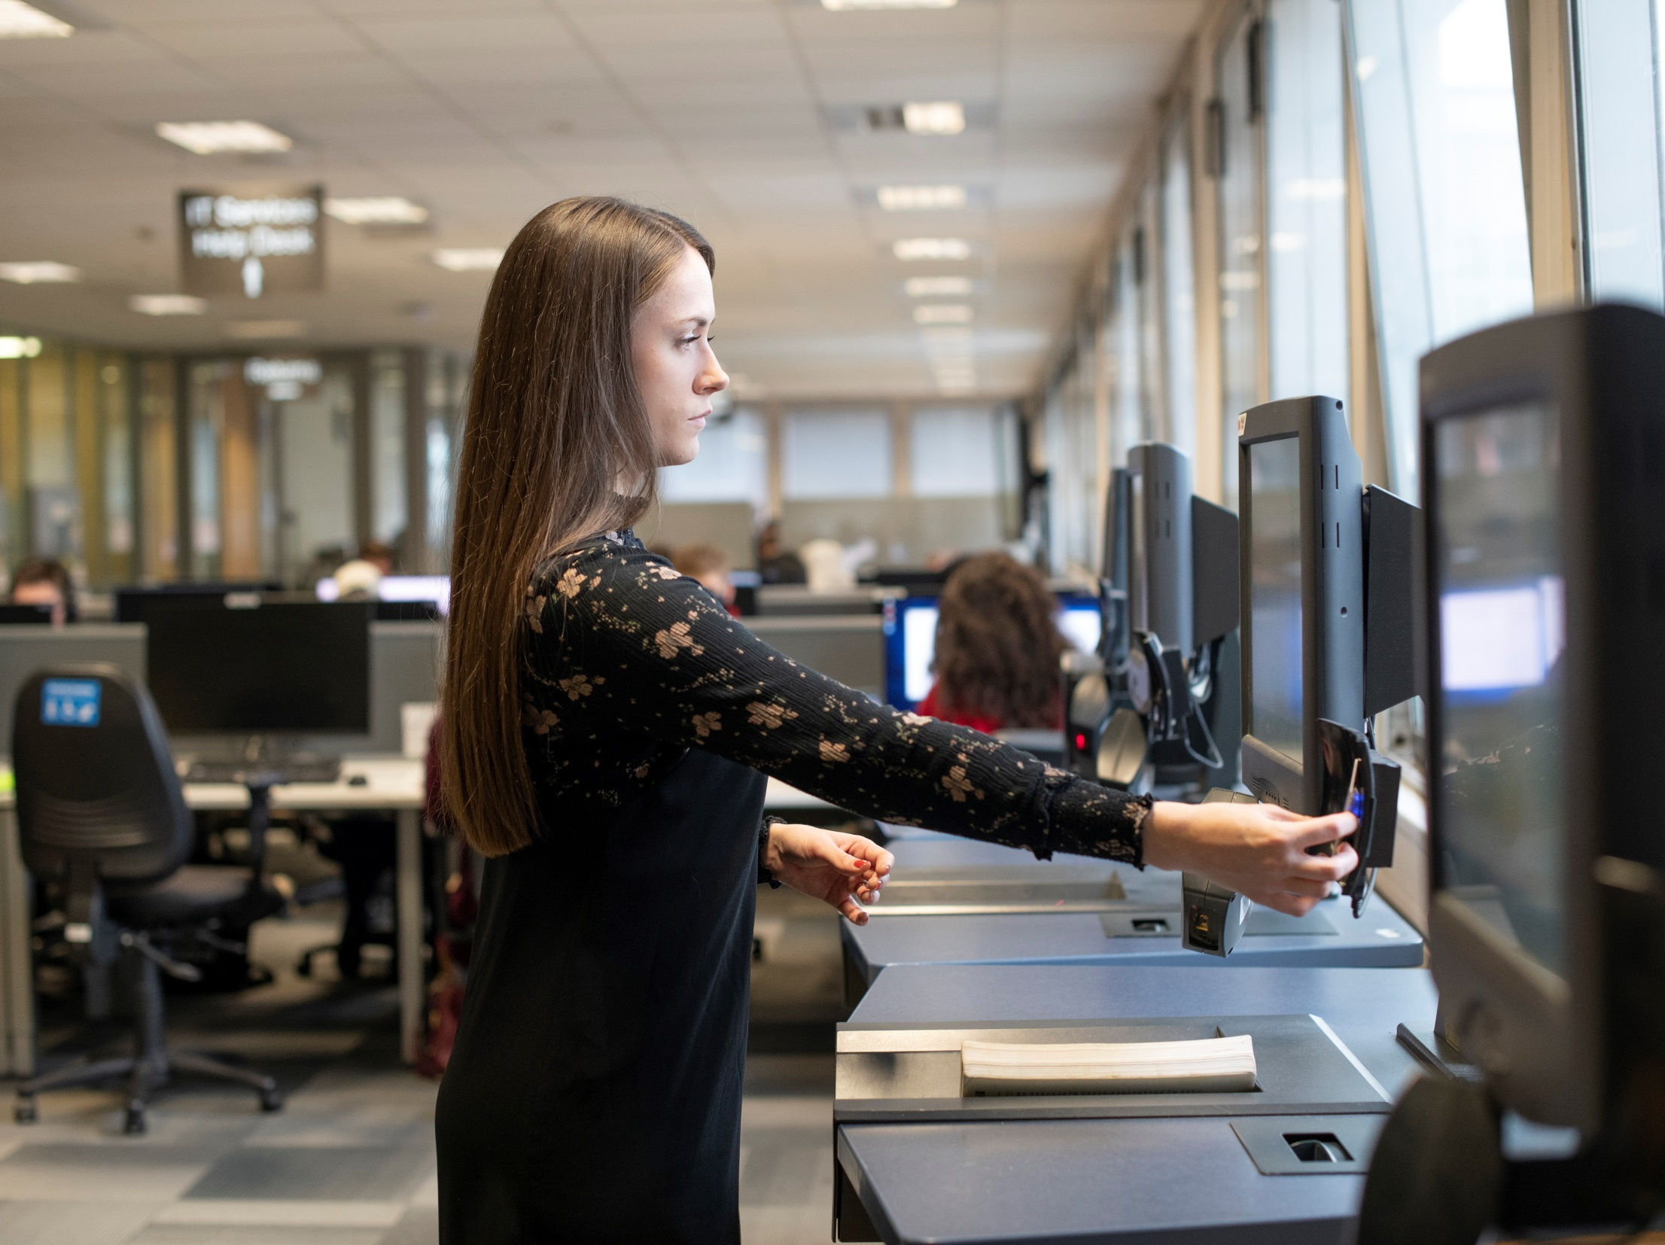
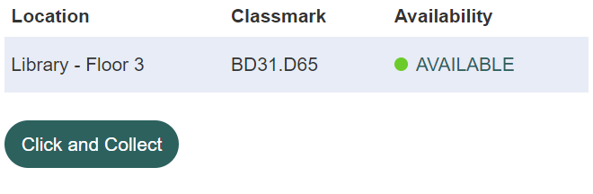

Borrowing from the Library
Up to 999 items
+ 3 Day Loans

Slide 12
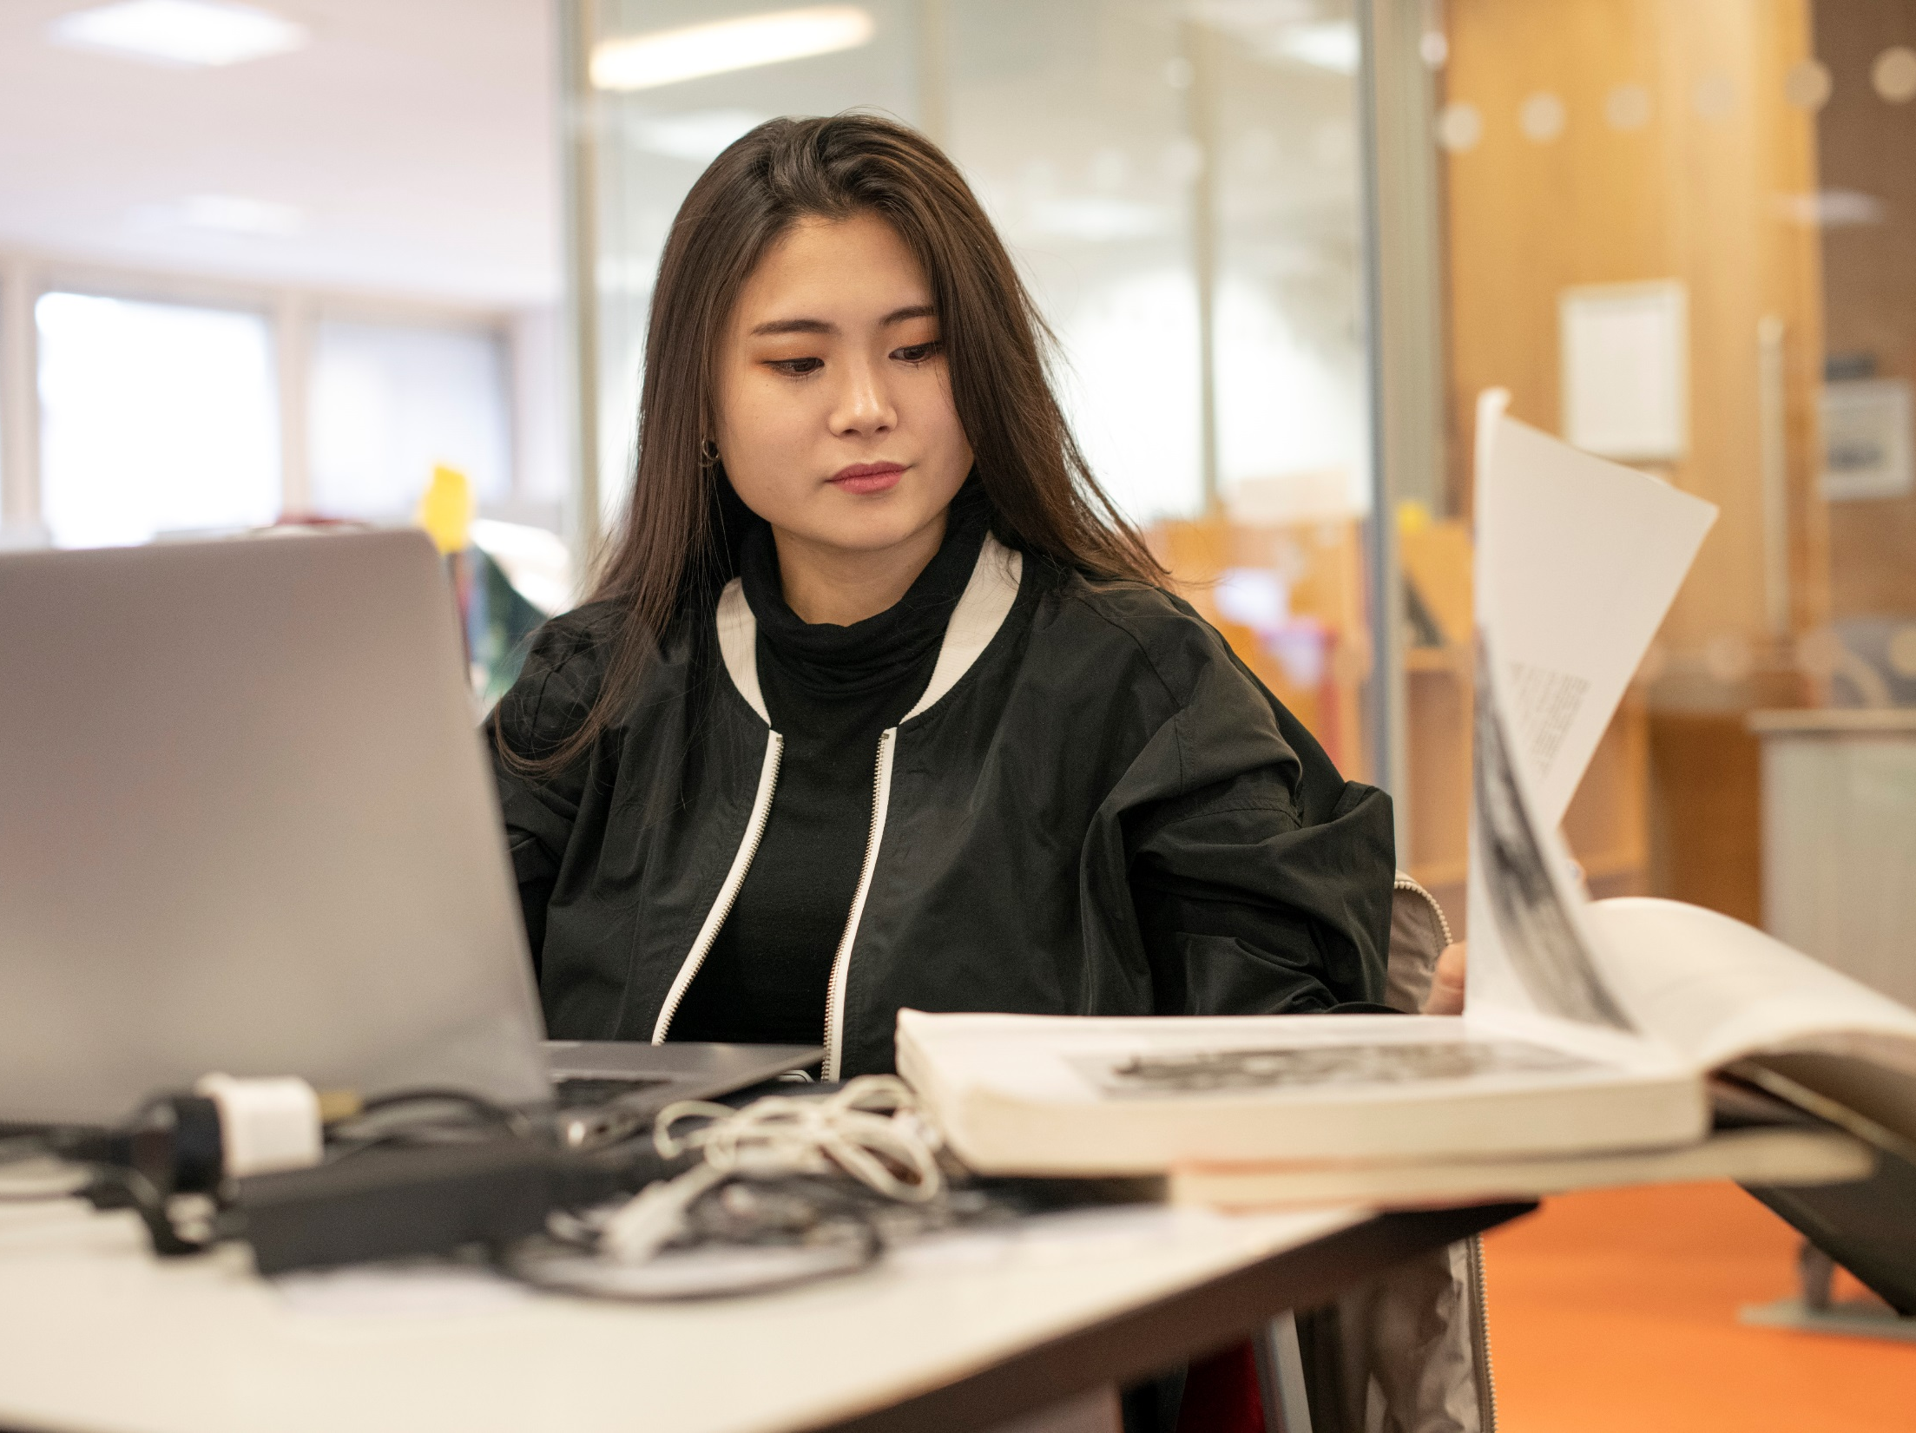
Manage your Library account
My Library Account
manage your loans
keep up to date with your account

Slide 13

Remote services
Click and collect
Scan and deliver
Postal loan – and free returns

Slide 14
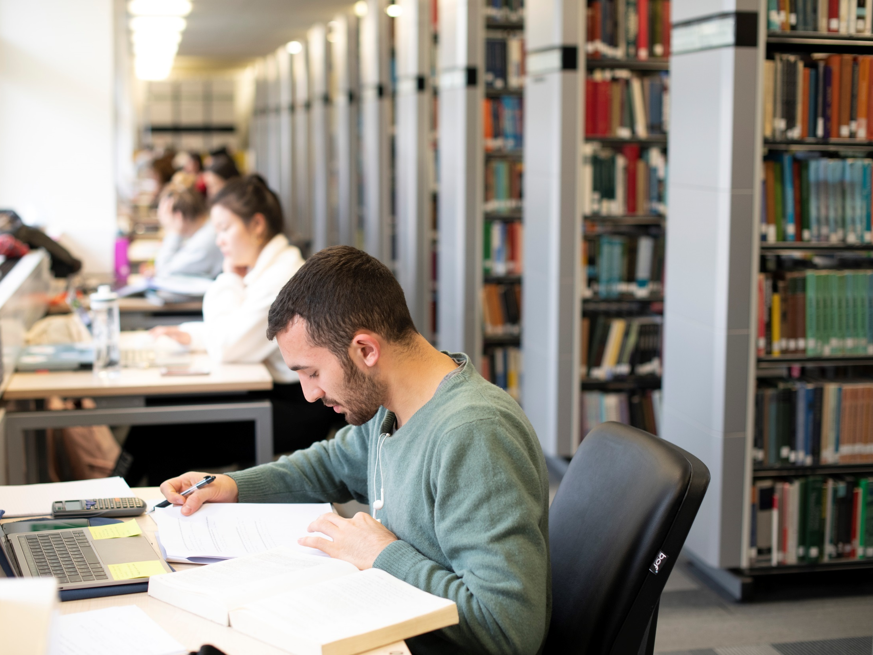
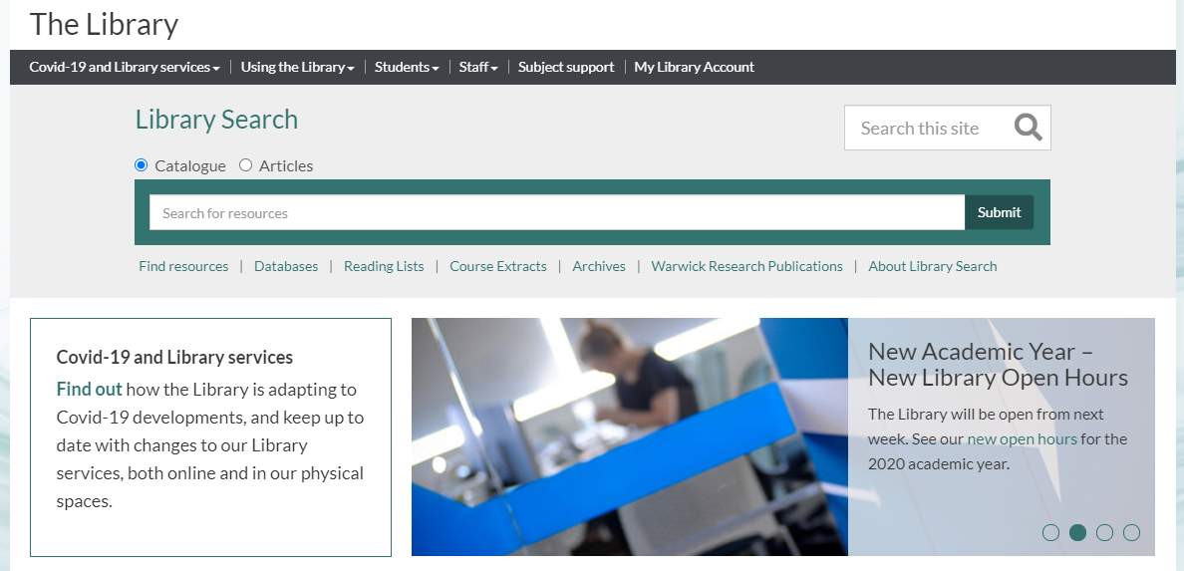
Updates: visit Library webpages

Slide 15
The Library has…
1.6 million volumes
Over 1.1 million e-books
900 print journals
Over 100,000 e-journals
14,900 m archives & manuscripts in the MRC
…spent over £6,000,000 Library resources last year

Slide 16
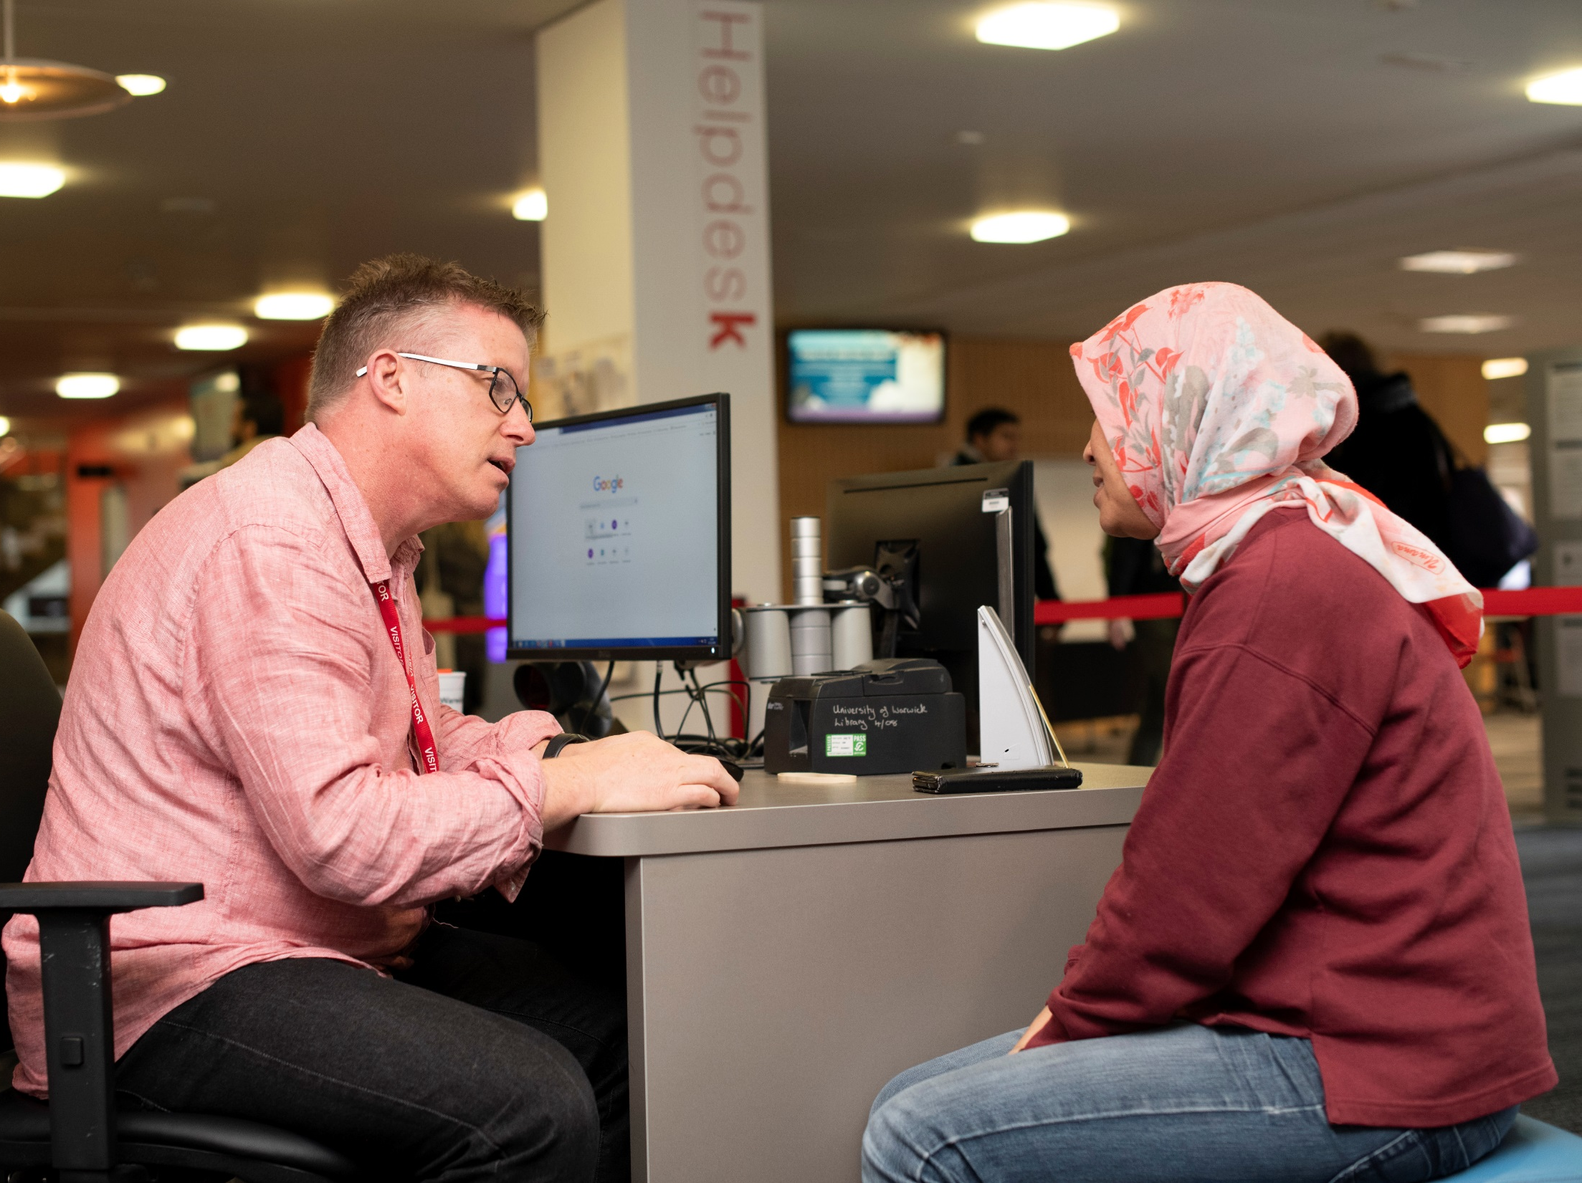
Ask for help

Slide 17
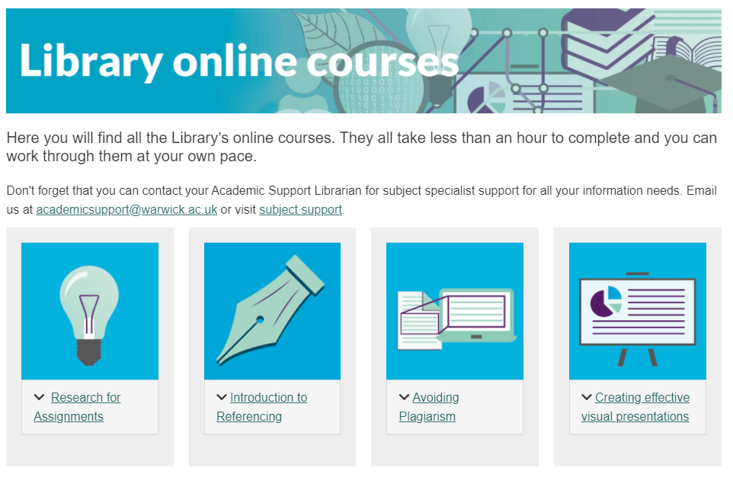
Get support for your studies

Slide 18
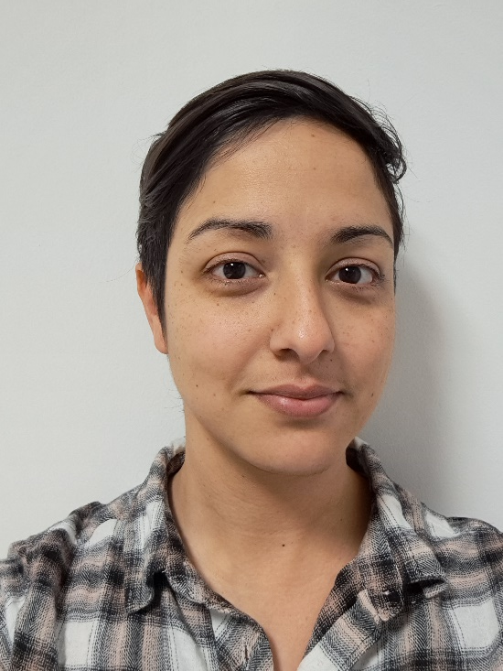
Academic Support Librarian
Sarah Akhtaruzzaman
Help with course-related enquiries, finding literature, referencing and resources for your subject.
s.e.akhtaruzzaman@warwick.ac.uk

Slide 19
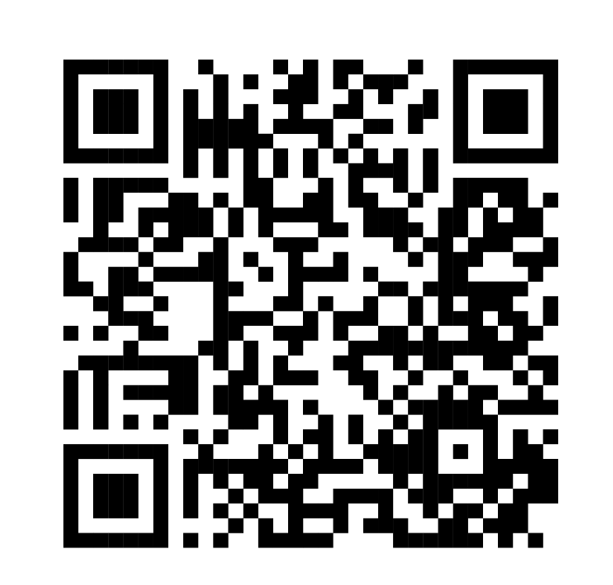




Library Student Partners
Helping us with our events and to help us improve the Library, are our Library Student Partners.
These peers are also here to help connect with you and support you during your time at the University, so if you need help or have any suggestions for making the library a better place, talk to them.
You can also connect with us on Social Media or by emailing us.
@WarwickUniLibrary
lib-community@warwick.ac.uk
@WarwickLibrary
@WarwickLibrary
Notes:
We’re also quite active on social media and we love to connect with our students! You can find us on Facebook, Instagram and Twitter. If you follow us on there, you’ll find up to date information about our offers, initiatives and events and you can also ask us questions too. If you do need to get in touch with us for any other reason, please do feel free to reach out to us at lib-community@warwick.ac.uk.

Slide 20
Get in touch
www.warwick.ac.uk/library
library@warwick.ac.uk
s.e.akhtaruzzaman@warwick.ac.uk

