Slide 1

ECLS Induction 3
Opportunities
and the ECLS community
Thursday 26th September 2024

Slide 2
Outline
Introduction: Dr Sarah Wood
Students’ Union
Student-Staff Liaison Committee: Dr Sarah Wood and Harriet Paget
Lit Soc: Amelia Thomas/ Lizzie Shooter
Widening Participation and Transformations: Alex Breeze
Equality, Diversity, Inclusion: Dr Emma Francis
Q&A

Slide 3

Warwick Students’ Union
Always Something For You

Slide 4

Your Democratic Representation

Slide 5
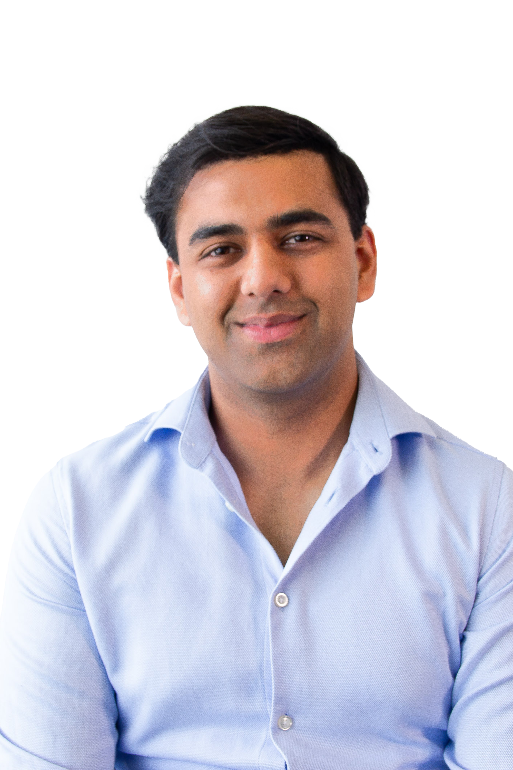
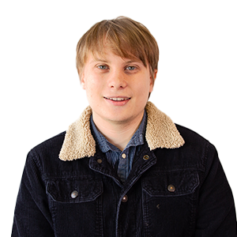
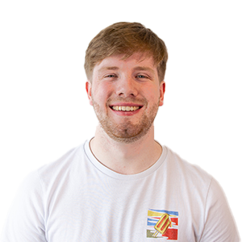
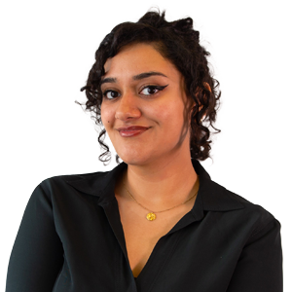
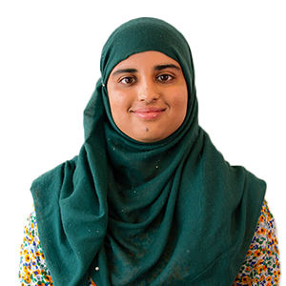
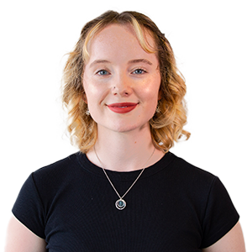
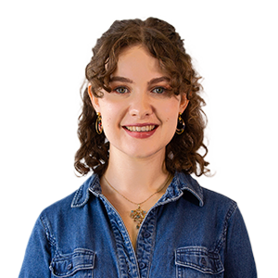
Your Democratic Representation
Officer Team
Enaya Nihal
President
She/Her
Muneeba Amjad
VP Education
She/They
Sasha King- Smith
VP Democracy & Development
Alijah Taha
VP Postgraduates
He/Him
Naomi Carter
VP Welfare & Campaigns
She/Her
Joe Stanley
VP Societies
He/Him
Louis Gosling
VP Sports
He/Him
Mature Students Officer
Ethnic Minorities Students Officer
Songjia Cao
Mads Wainman and Nye Steele
Disabled Students' Officer
Raj Hacker
Environment and Ethics Officer
Summer Jones and Ariane Dayes
LGBTQUA+ Officers
Dorian Valentine and Isra Rai
Trans Students' Officer
Mathew Stephenson and Aden Wood
Widening Participation Officers
Gurismar Kaur
Women's Officer
International
Officer (non-EU
International Officer (EU)

Slide 6
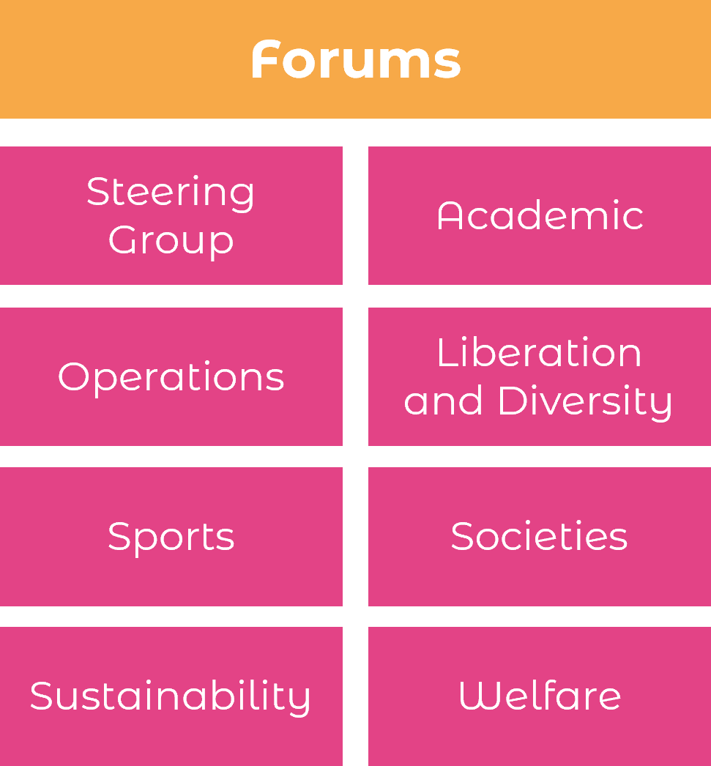
Your Democratic Representation
Forums, Student Council and ASV
Student Council
SU Policy
Students Submit Motions
All Student Vote
(ASV)
Postgraduate Forum

Slide 7
Your Democratic Representation
Termly Elections
Officers
Forum Reps
Academic Reps
Society and Club Leadership
Nominations close 4th October and voting opens 7-11th October!

Slide 8
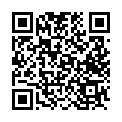
Your Democratic Representation
VOTE HERE

Slide 9
Your Academics

Slide 10
Your Academics
Course Reps
Faculty Reps
SSLC Chairs
Course Reps
Muneeba Amjad
VP Education
Student Staff Liaison Committees (SSLCs)
Exam Pressure
Self-Certs
Study Space
Lecture Capture
Access to Learning
Alijah Taha
VP Postgraduates

Slide 11
Your Support and Advice

Slide 12

Your Support and Advice
Free, confidential, impartial and non-judgemental advice, independent from the University.
Personal Issues
Housing Advice
Course-related problems
Immigra-tion issues
Finance and Funding
Support Sign-posting
University Complaints/ Disciplinary Proceedings
The service is easy to access, just fill out an enquiry form at warwicksu.com/help-support/ and one of our expert advisors will reach out within 2 working days.

Slide 13





Your Campaigns
Course Reps

Slide 14
Your Socialising

Slide 15
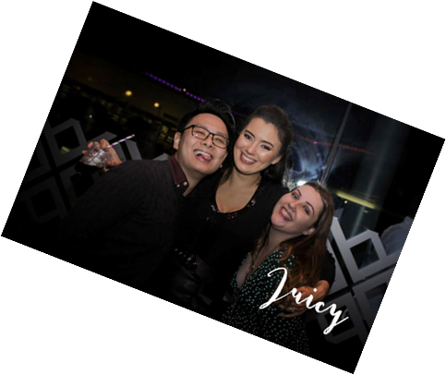







Your Socialising
Course Reps
Our Food and Drink Outlets
We run a packed programme of events throughout the year, from club nights in the Copper Rooms to our Pub Quiz in the Dirty Duck, to dog-petting sessions in exam season, as well as supporting hundreds of student groups in running their own events.
Over 60 Sports Clubs!
Over 250 Societies!
All revenue from our outlets goes straight back into delivering services for Warwick students!

Slide 16
Job Opportunities

Slide 17
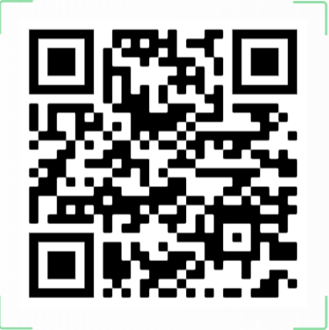
Job and Volunteering Opportunities
Course Reps

Slide 18

Any questions?
Please do drop in and say hello!

Slide 19
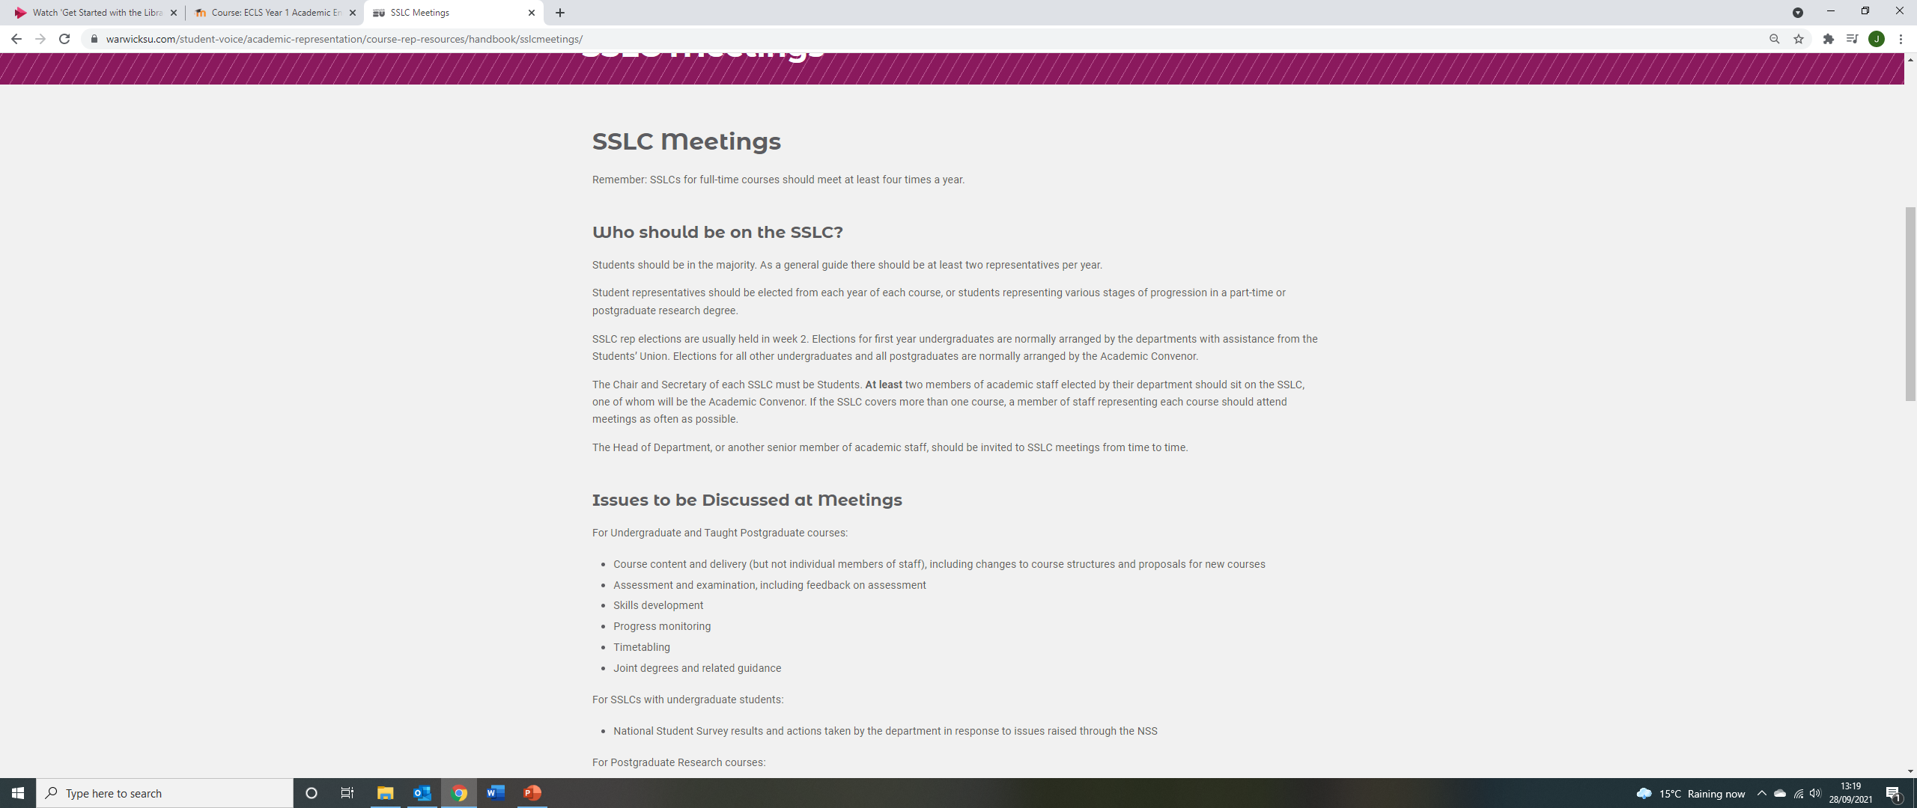
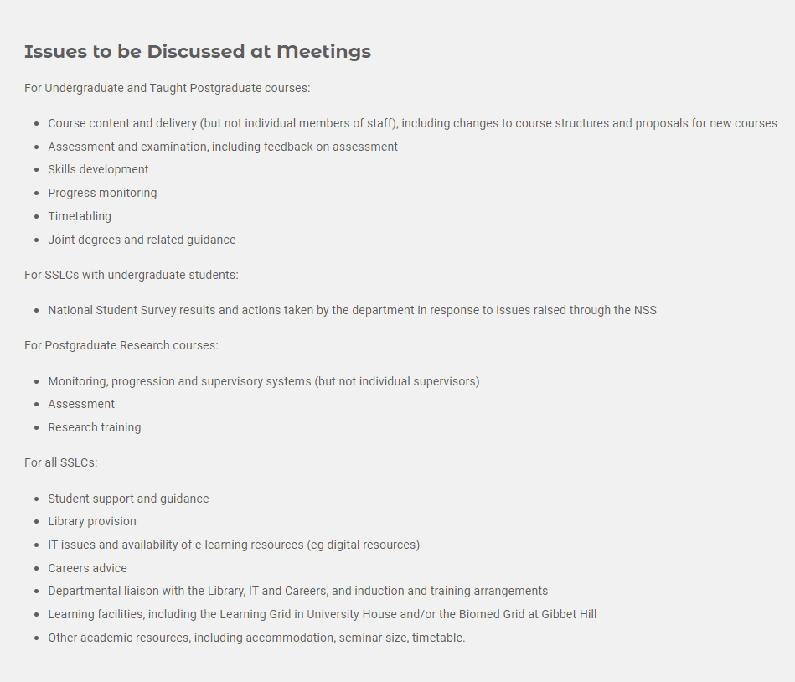
JOIN THE Staff-Student Liaison Committee
You will receive emails from the SU and Director of Student Experience next week.

Slide 20

Warwick Literature Society
2024/5
Co presidents: Amelia thomas and lizzie shooter

Slide 21

What We Do
We are the home for all Literature enthusiasts here at Warwick
We are not just for people studying English so please feel free to bring any friends along!
Our exec is always available for any questions you might have during your time at Warwick
We are a safe space for all students for any queries/concerns you may have starting at university
The society has three strands: academic, social, and creative, all of which have a multitude of events over the year

Slide 22

Academic Side
As an academic society we do a wide variety of different academic socials to help support you when starting academic work at university
We also have a Facebook group called, ‘Pass the Book’ which allows students to sell any old module texts they may have and do not want anymore for a much cheaper price!
We hold study sessions both on campus and in Leamington as well as holding essay Q&A’s where you can ask our exec, primarily the academic aid, any questions you may have surrounding writing university assignments
We have also put together a fresher starter pack surrounding academics which can be found by following the link in our Instagram bio.

Slide 23
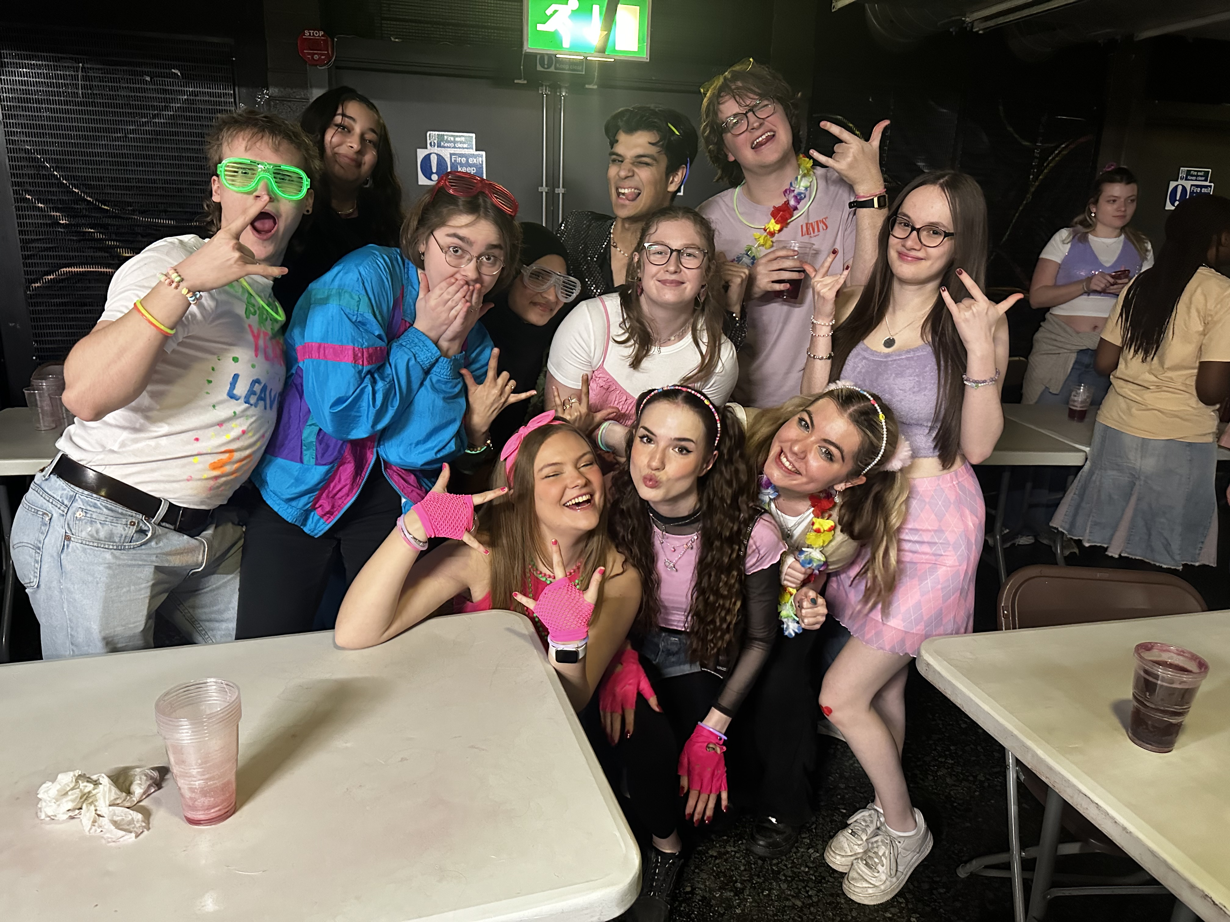
Social
Another major part of the society is the social side where every week we hold a variety of sober and non-sober socials but there is never any pressure to drink at any event
We always have at least one member of our exec who remain completely sober who can look after and help with any issues during the event
We also do charity events which are a great opportunity to raise money for amazing causes in fun ways
Every term we have welfare events which provide a safe space to come and destress or talk about how you’re feeling in a safe and supportive environment
Here are some examples of socials we do throughout the year:
Circles
Bar crawls
Scavenger hunts
Day trips
Bowling
Movie nights
Charity sports day
Welfare walks and meditation sessions

Slide 24
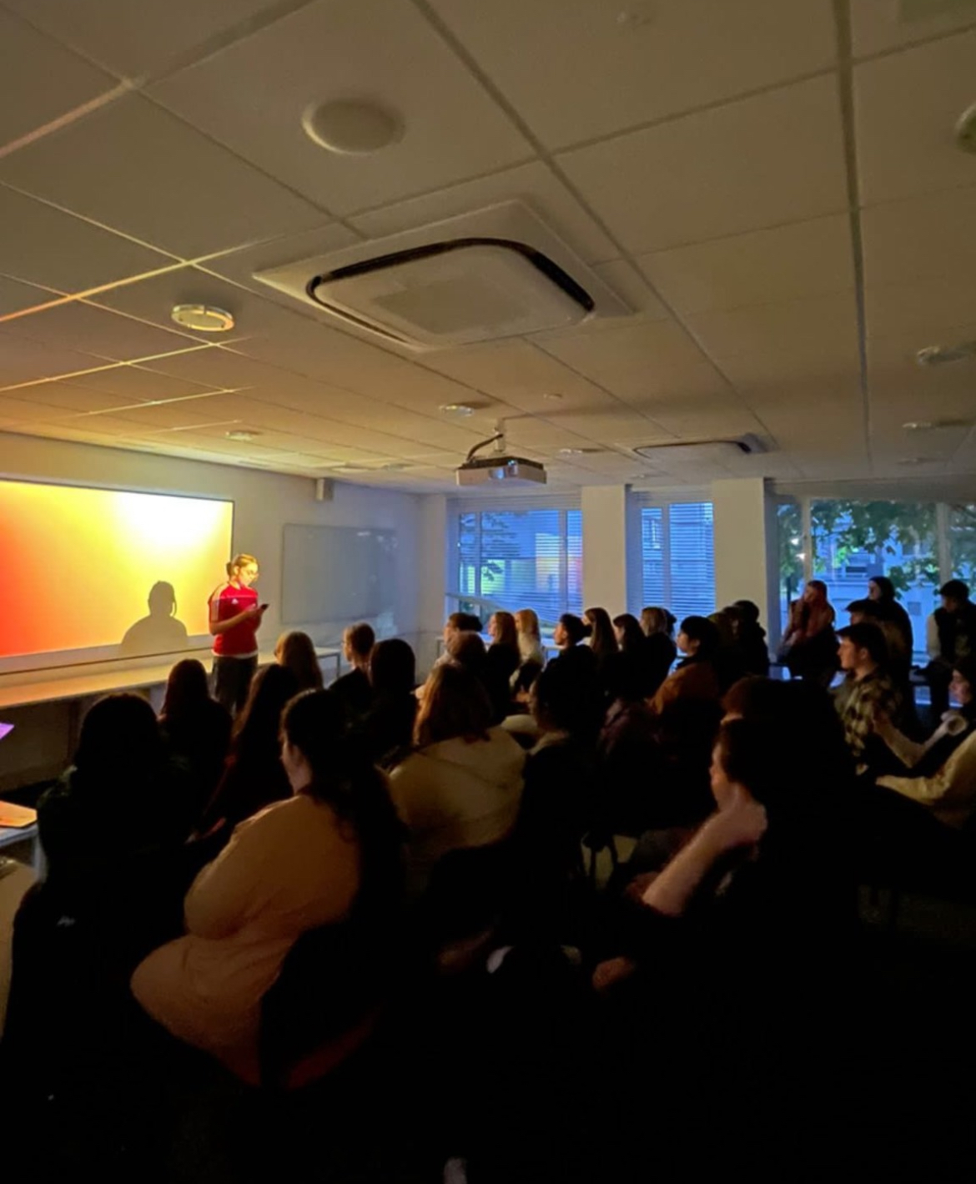
Creative
The third aspect of our society is the creative side
We create an open and welcoming environment for anyone who wants to express their creativity regardless of degree subject or experience
There is no pressure to perform, you can always just come and watch
Here are some examples of creative events we do:
  Open mic nights
  Creative collabs with other societies
  Slam poetry evenings
  Creative collage sessions

Slide 25
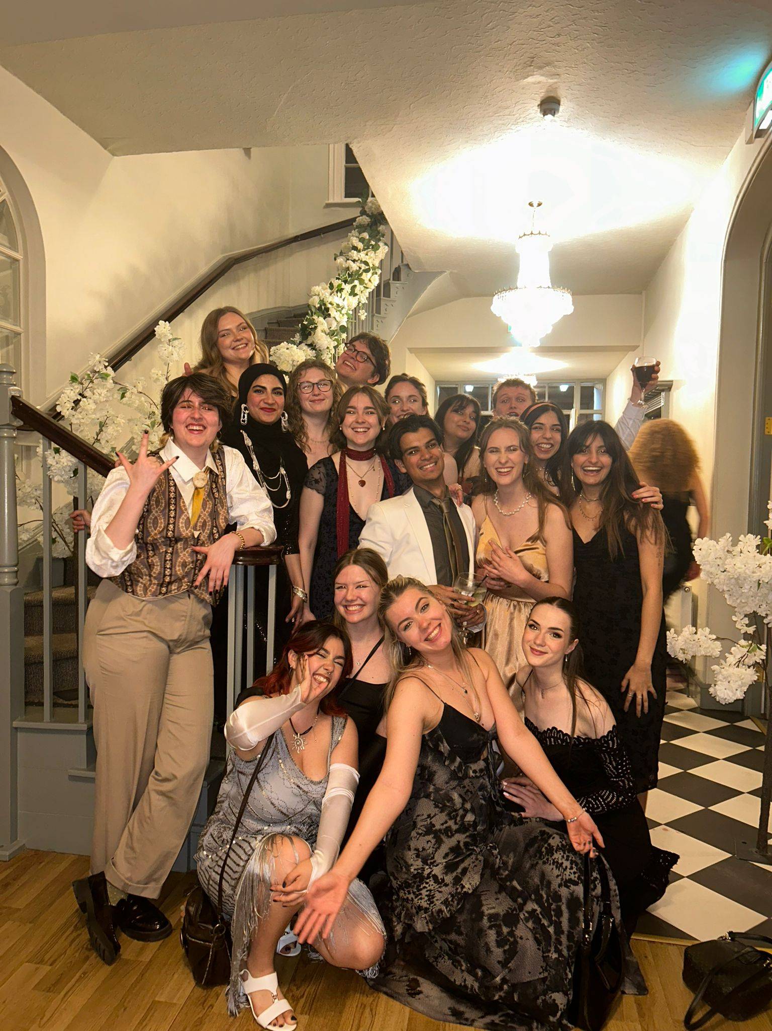
Bigger things we are doing this year
Family scheme – a small group of first years are placed with two older students so they can ask any questions and have an immediate point of contact for any concerns surrounding university work
The annual Litsoc ball – a great opportunity to come and celebrate the end of the year with all your friends
Recruiting Fresher Reps – this is a great opportunity to become a part of the exec and act as a spokesperson for your year and to express any ideas you may have surrounding Litsoc

Slide 26

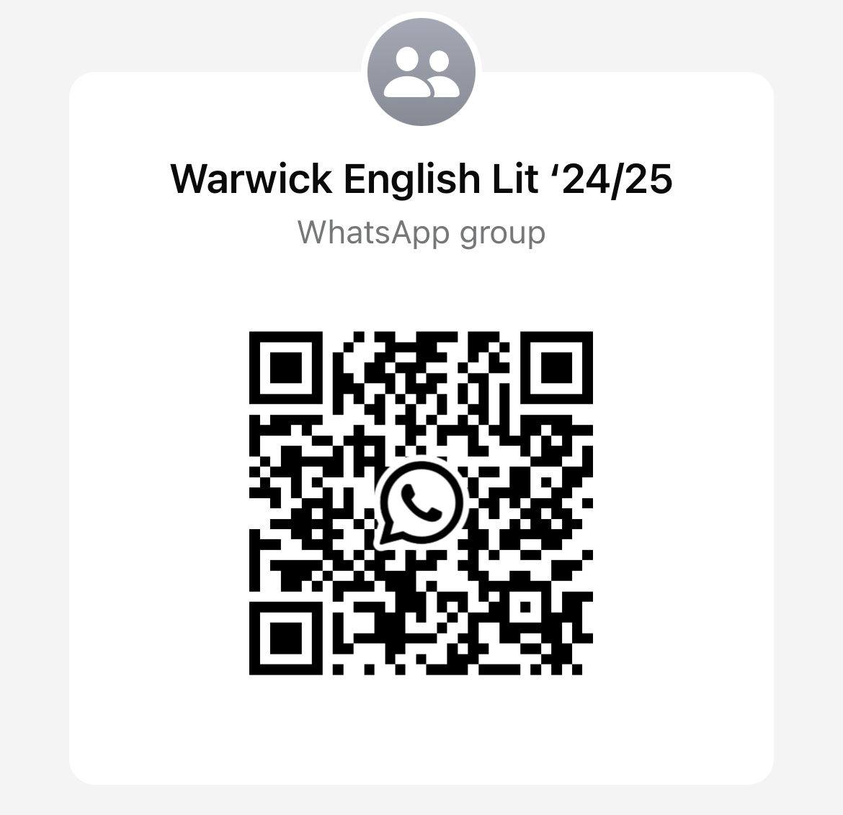
How to keep up to date!
Follow and look at our Instagram for a detailed look at all our upcoming events - @warwicklitsoc
Join our WhatsApp group using this QR code, if you haven’t already, to hear about all upcoming events as well as having a direct contact with all the exec for any questions you may have. Or dm our Instagram and we can add you!

Slide 27
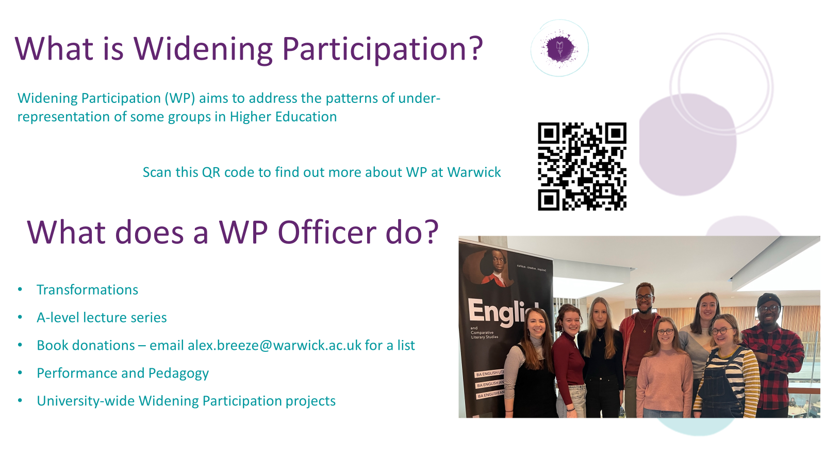

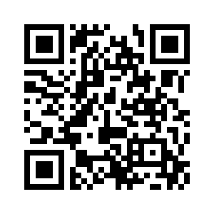
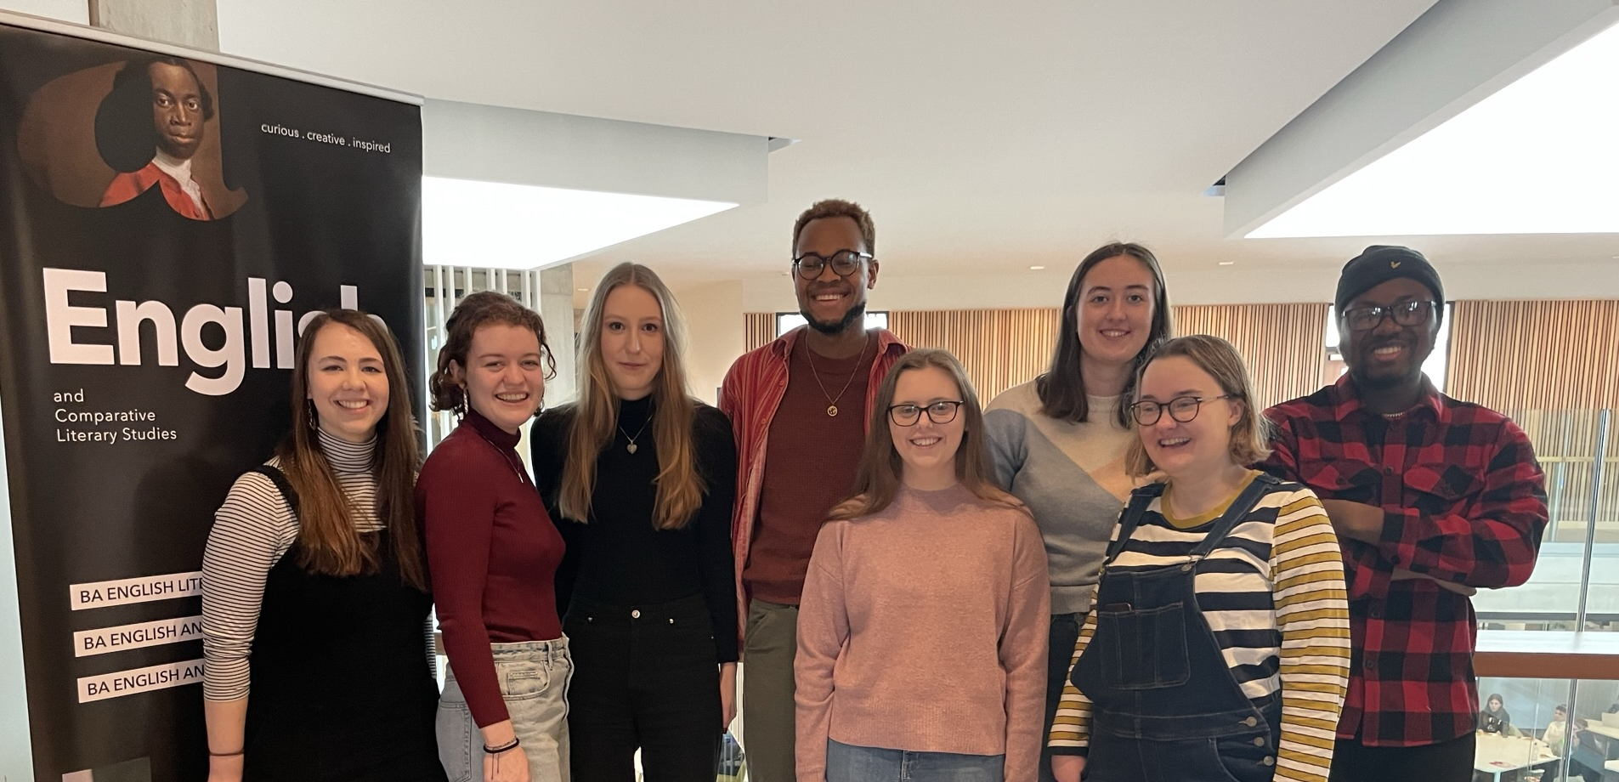

What is Widening Participation?
Widening Participation (WP) aims to address the patterns of under-representation of some groups in Higher Education
Transformations
A-level lecture series
Book donations – email alex.breeze@warwick.ac.uk for a list
Performance and Pedagogy
University-wide Widening Participation projects
Scan here to find out more about WP at Warwick
What does a WP Officer do?

Slide 28
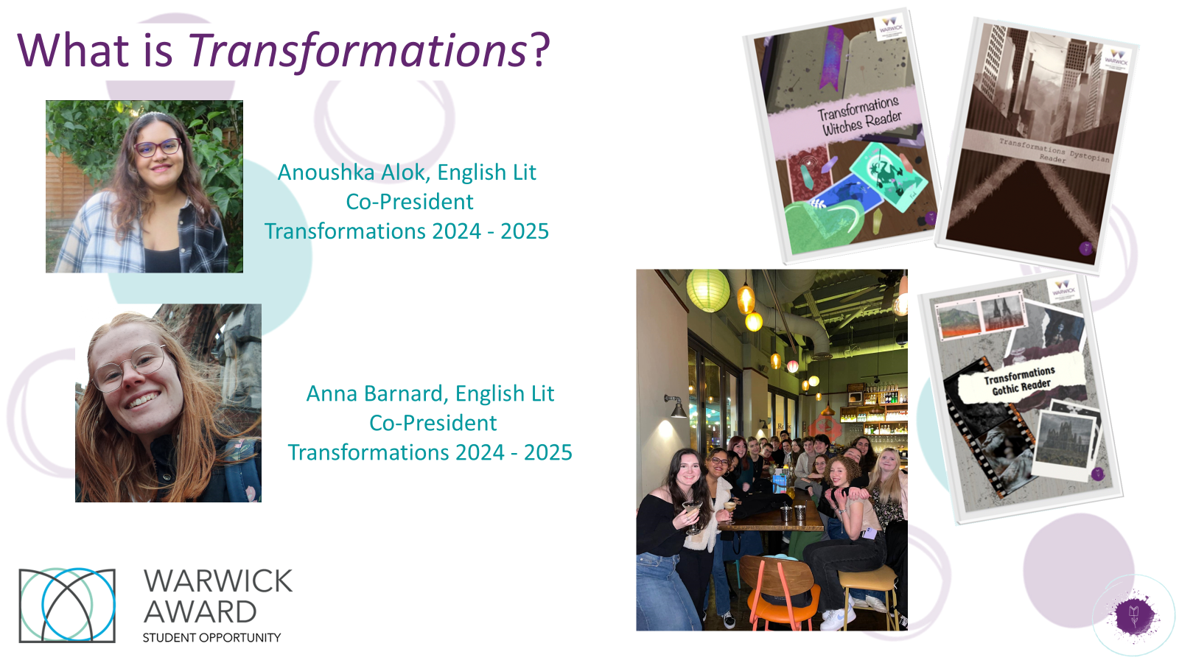

Slide 29
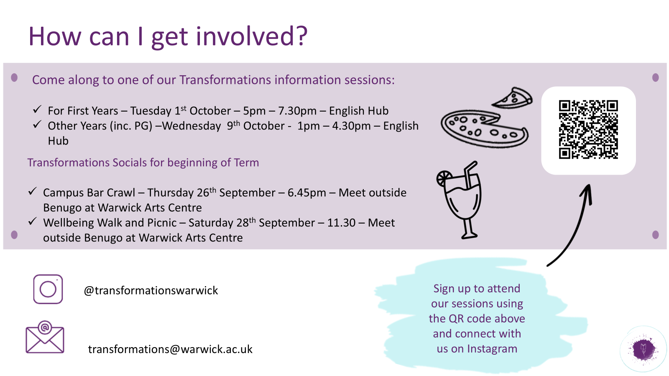

Slide 30





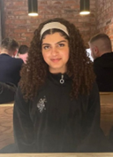

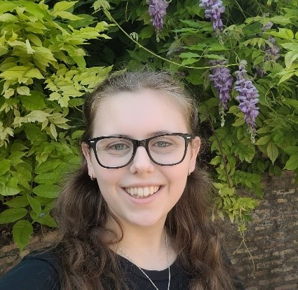
What is Transformations?
Maryam Khonat
Co-President
English Literature & History Finalist
Bethan Davies
Co-President
English Literature & History Finalist

Slide 31

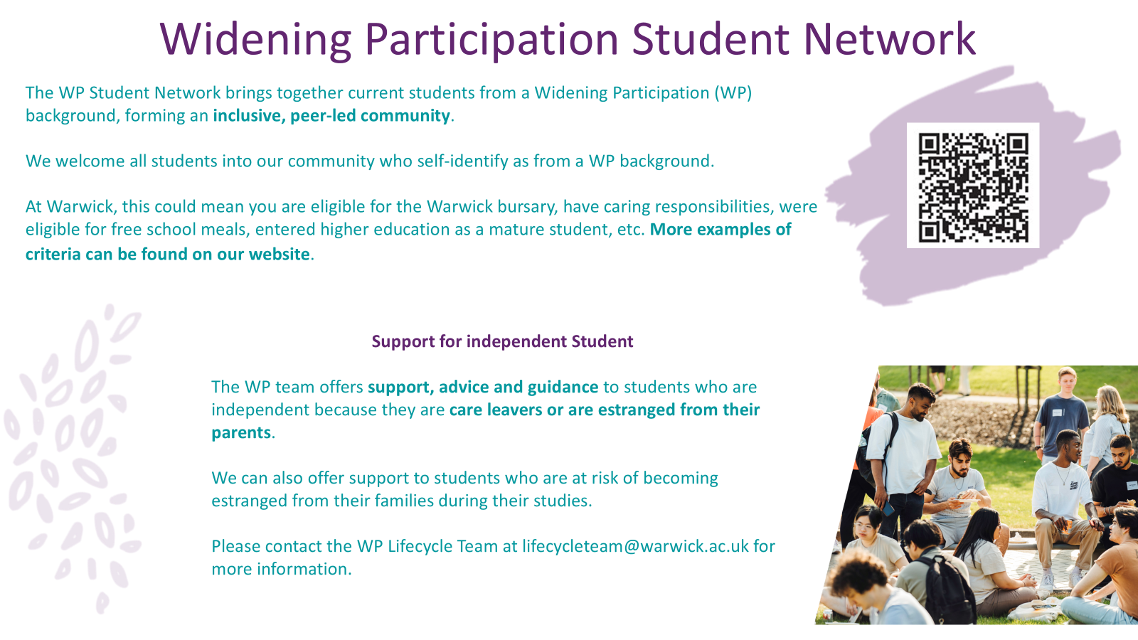

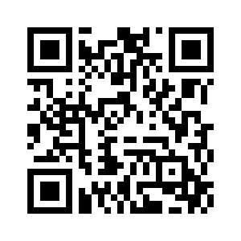

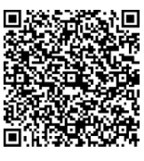
How can I get involved?
Come along to one of our Transformations information sessions:
Tuesday 3rd Oct (week 1) 5-7pm, Student Hub (FAB5.49) - Info session, pizza and chat to Transformations member
Wednesday 11th Oct (week 2) 1.45-3pm, Student Hub (FAB5.49)
transformationswarwick
For more info, including videos, take a look at the Transformations page within the ‘Your Department’ section of the ECLS website
transformations@warwick.ac.uk

Slide 32
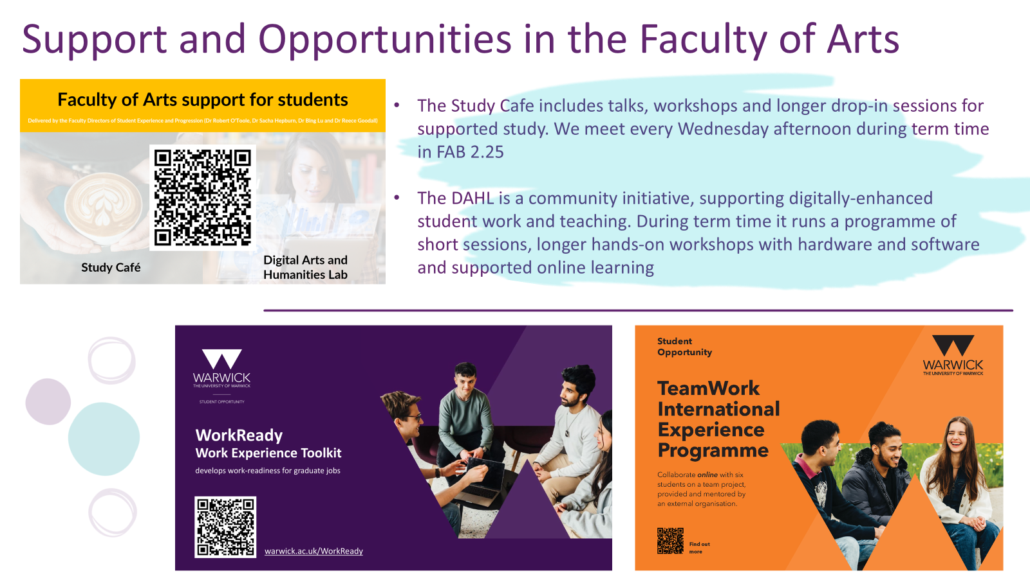

Slide 33
Equality, Diversity, Inclusion in ECLS
Department EDI Officer:
Dr Emma Francis
e.j.francis@warwick.ac.uk
https://warwick.ac.uk/fac/arts/english/people/francisdremma/

Slide 34
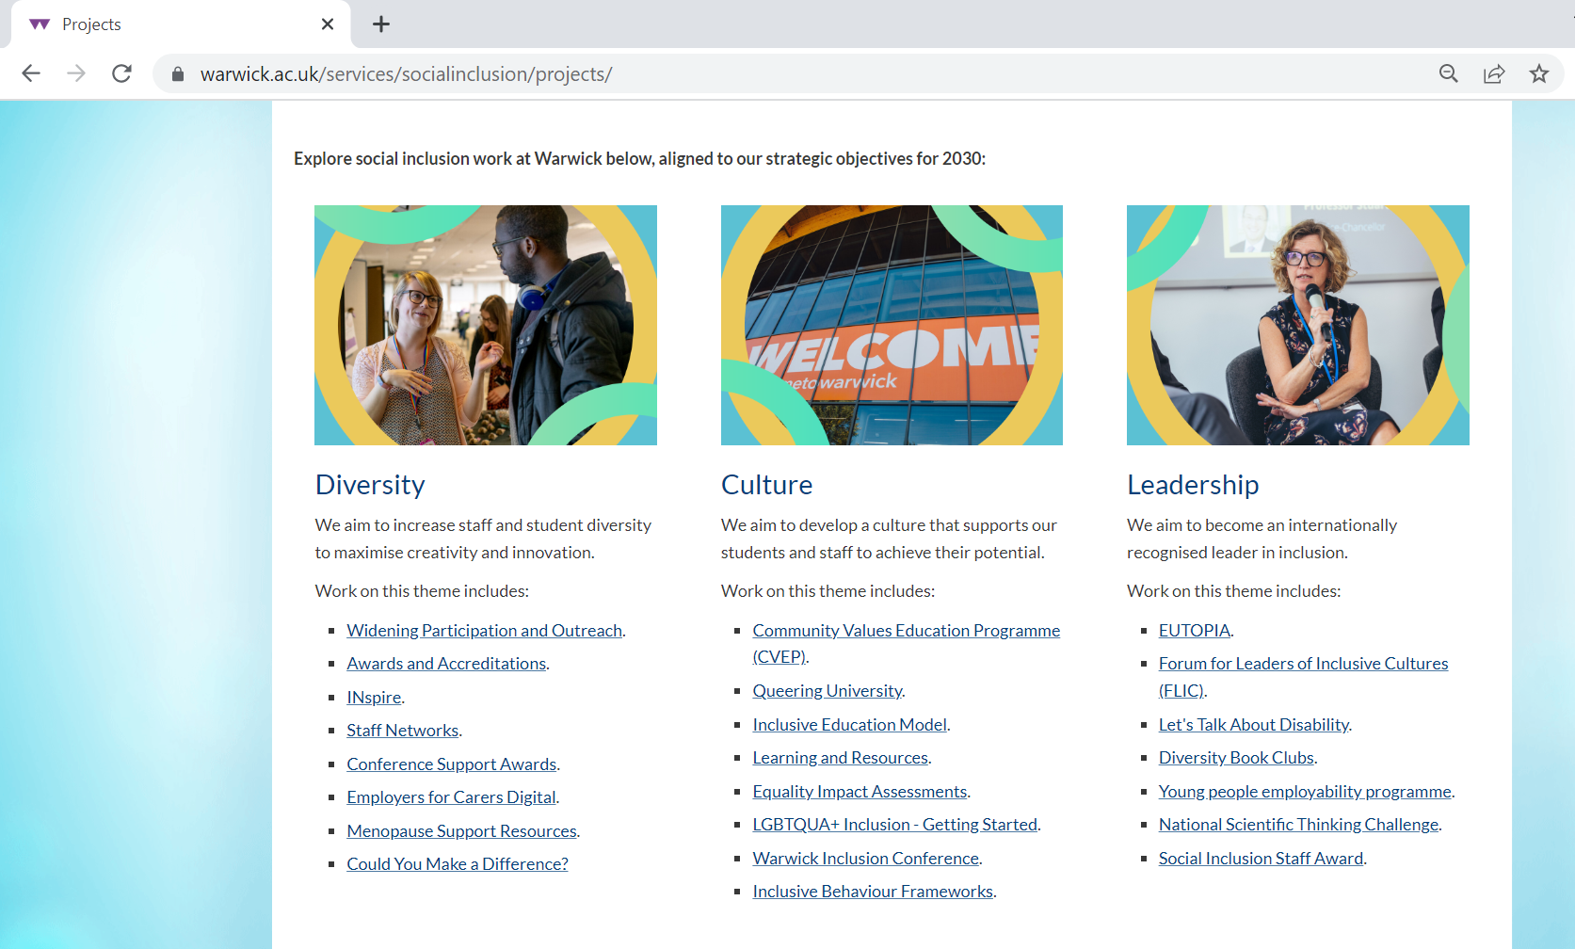

Slide 35
If the induction slides or induction handout don’t answer your question about Tabula/seminar sign-up, or other administrative issues then get in touch with the UG office:
FAB 5.42
Monday-Thursday 10am - 12pm & 2pm – 4pm
Friday 10am - 12pm & 2pm - 3pm
Or email ugenglish@warwick.ac.uk

Slide 36
Dr Sarah Wood
sarah.wood@warwick.ac.uk
I mostly oversee communications about academic work, support your academic first year, and help with:
Course transfers (in first 3 weeks) and restarts
Temporary withdrawal from study

Slide 37
What’s next today?
2pm Workshop: Looking out for yourself and your friends (Woods-Scawen Room, Arts Centre)
VQ32 English and History students have a degree specific meeting with Dr Alice Kelly in FAB 5.03 at 3pm, plus meeting with History dept 12-1pm FAB2.43.
Visiting Students have an induction with Dr Natalya Din-Kariuki 1-2pm in FAB2.43.
And next Monday (week 1) – Hidden Curriculum talk 9am. Room TBC on Tabula.

