Slide 1

ECLS Induction 3
Opportunities
and the ECLS community
Thursday 28th September

Slide 2
Outline
Introduction: Dr Sarah Wood
Students’ Union
Student-Staff Liaison Committee: Dr Sarah Wood and Emma Baker
Lit Soc: Benjamin Gavelle
Widening Participation and Transformations: Charlotte Pearce, Bethan Davies, Maryam Khonat
Equality, Diversity, Inclusion: Dr Emma Francis
Subject-related initiatives: Decolonising the Curriculum (Dr Emma Francis)
Q&A

Slide 3
Warwick Students’ Union
Always Something For You
Welcome Week 2023
www.warwicksu.com
Notes:
Presenter(s) to introduce themselves, and give a brief overview of what they are going to be talking about.

Slide 4
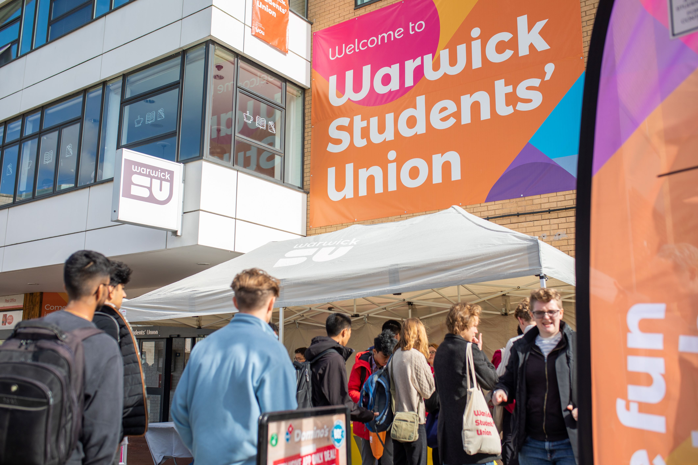
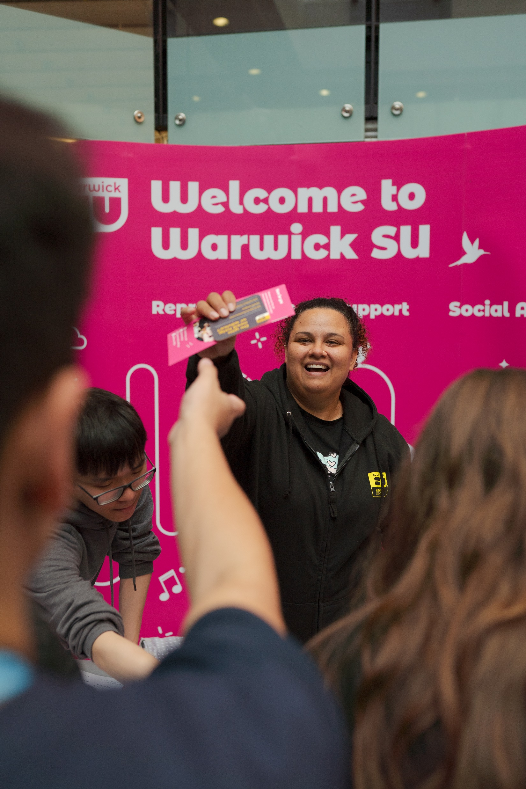
Our values
Welcoming
  Here for all Warwick students, providing something for everyone
Democratic
  Officer and other roles, elected by students to represent their needs
Independent
  Separate from the University, providing an independent voice for
  Warwick students
Enriching
  Enhancing the University experience by helping students
  achieve their aspirations
Student-focused
  Students at the heart of everything we do
Notes:
• Welcoming. We are here for all Warwick students, to provide representation, social activities and support.
• Democratic. What’s on the slide plus forums like student council to hold students in those roles to account.
• Independent. Although we receive funding from the University, we are a completely separate organisation, providing an independent voice for Warwick students.
• Enriching. We strive to enhance the University experience for Warwick students by supporting them to achieve their aspirations and develop new skills.
• Student-focused . Put simply, students are at the heart of everything we do.

Slide 5
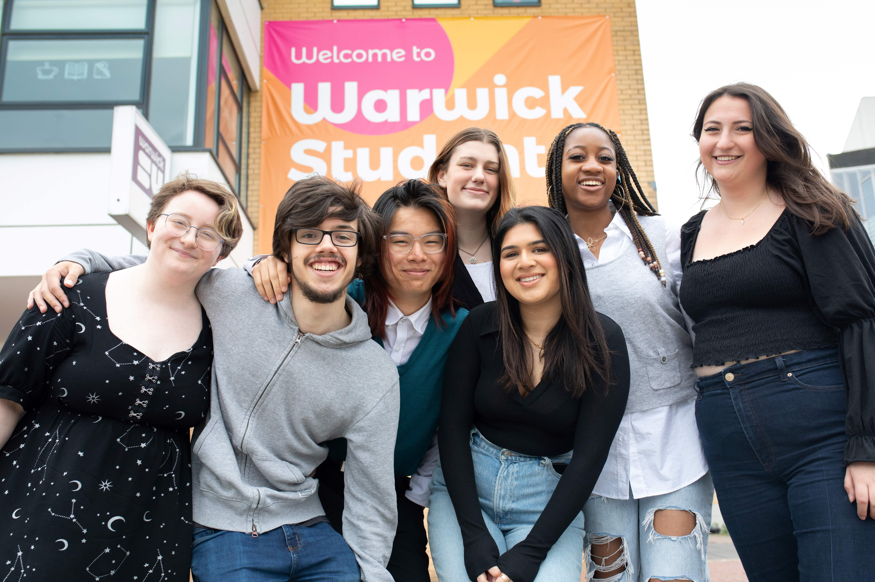
Student Voice
7 x paid Full-Time Officers
10 x voluntary Part-Time Officers
  Representing specific groups of students,
  running campaigns and raising awareness
Officers ensure the interests of Warwick
students are at the heart of any
decision-making the SU/Uni make.
Notes:
Most Officers are elected in spring. They work alongside the SU staff team for a year on students’ behalf to enact change and advocate for student rights.
Whether they are campaigning, speaking at University meetings, or lobbying local council, all the SU Officers are there to keep the interests of Warwick students at the heart of any decision-making process.

Slide 6

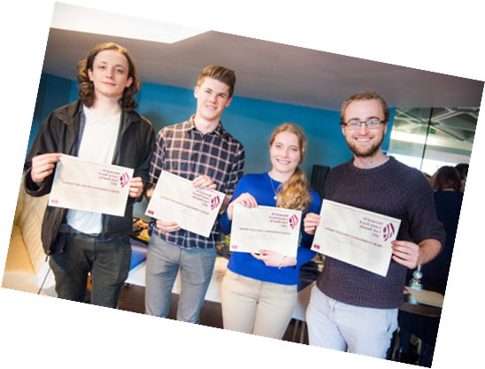
Student Voice
Make Your Mark
  Students can propose motions or petitions which may
  become SU Policy
Academic Representation
  Over 300 Course Reps elected by students
  Giving students a say on their educational experience
  Reps take student feedback to Student Staff Liaison
  Committee (SSLC)
  Can deliver constructive changes and improvements to
  courses
Notes:
There are other ways students can make a change at Warwick without nominating themselves to stand in elections.
Motions, etc. get reviewed by our Democracy Executive, and can then potentially get approved by Student Council or an All Student Vote to become SU Policy.
The SU's Academic Representation system ensures that students have a say on their educational experience here at Warwick. We currently have 300+ course reps who have been elected by students to represent the interests of those on their course. Students can provide feedback to their Course Rep, which they then discuss with the University at a Student Staff Liaison Committee. This can lead to constructive changes to the course, such as receiving specific learning resources, improvements to timetabling, or continuing aspects of a course that students have enjoyed.

Slide 7

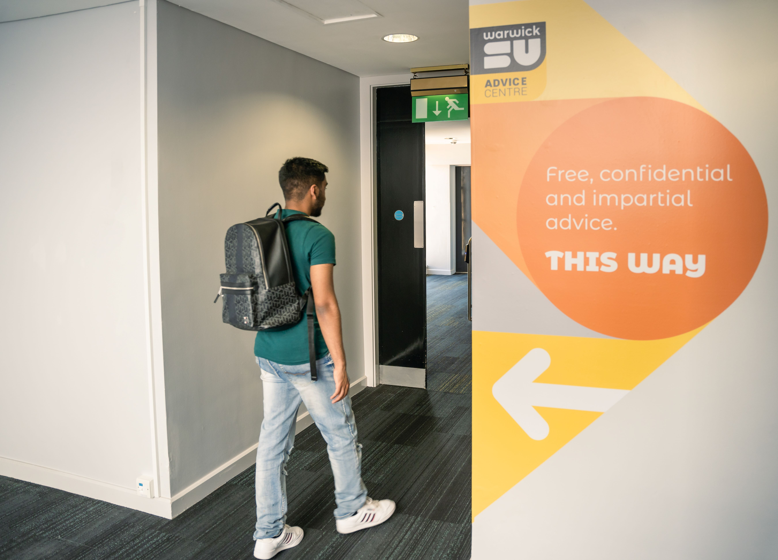
SU Advice Centre
Free, independent advice
Support on a range of issues:
  Money
  Housing
  Academic
  Health and Wellbeing
Experienced, friendly advisors
www.warwicksu.com/advice
Notes:
The Advice Centre, is a free, professional, confidential, non-judgmental service, independent from the University.
If you are experiencing a problem in relation to your studies, accommodation, money or personal problems and need help, you can complete their online enquiry form to get in touch.
Their team of expert advisors will then get back to you within 48 hours during weekdays.
You will be assigned an advisor who will offer you advice, guidance, information and options to help you resolve your problem or signpost you to the right service who can help you.

Slide 8
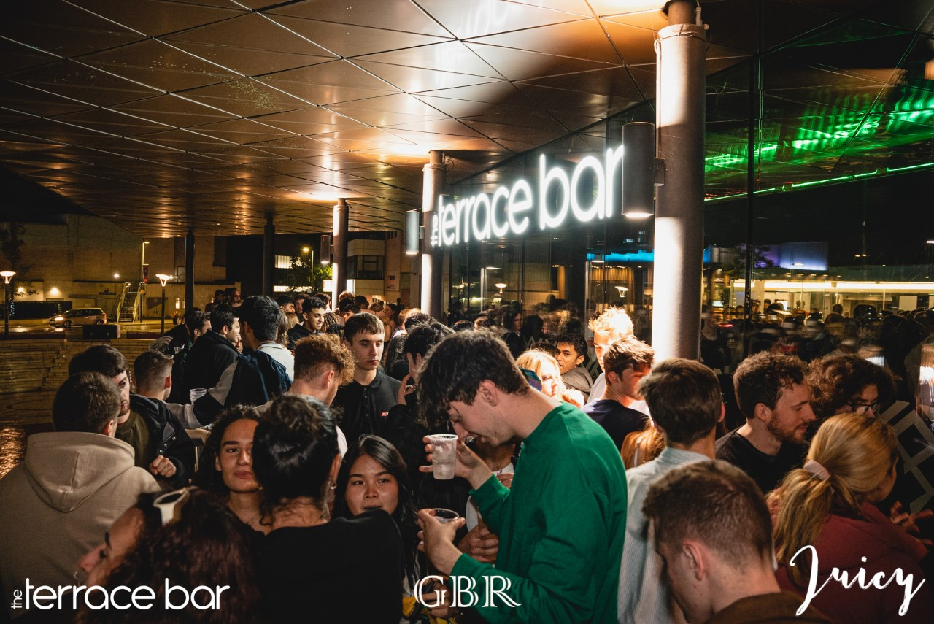
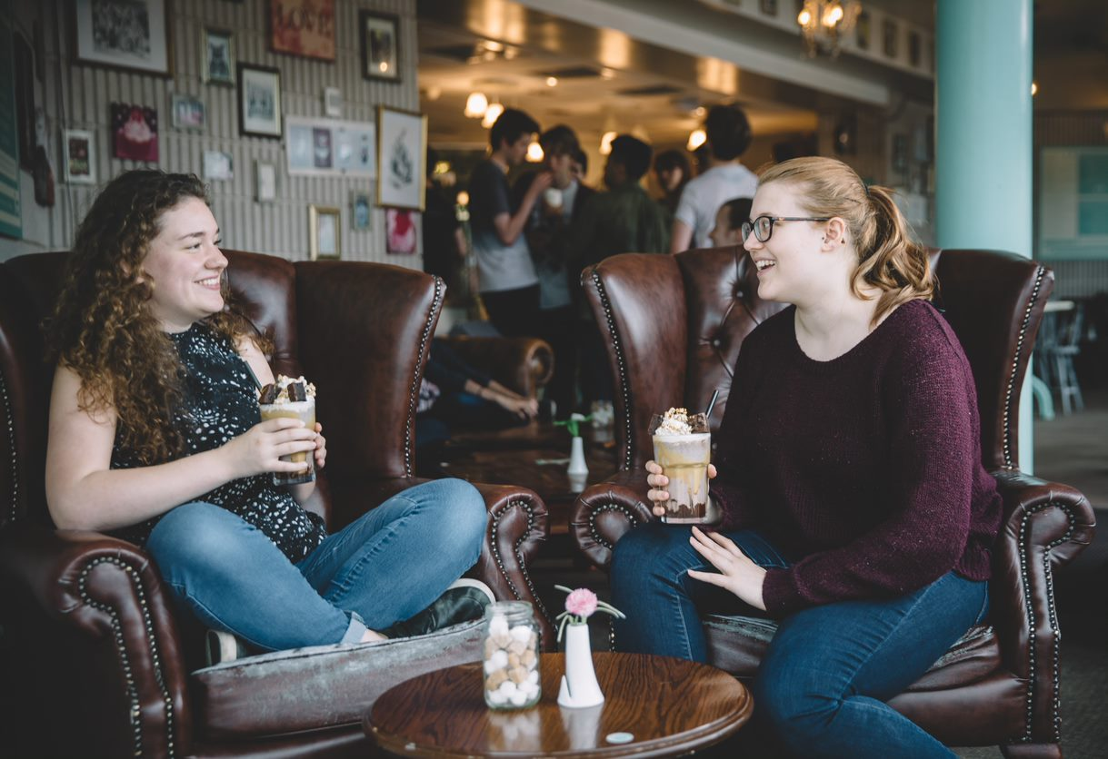
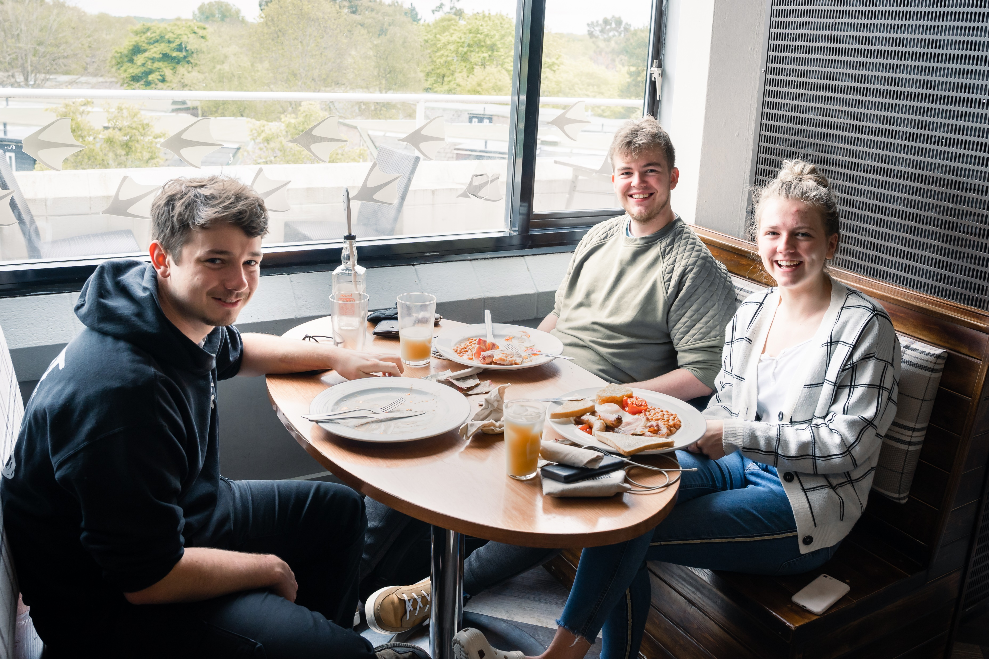
Food and Drink
SU runs 4 x food and drink outlets:
  Curiositea
  The Bread Oven
  The Dirty Duck
  Terrace Bar
All money generated goes toward the
running costs of your SU services
Notes:
The SU caters for a wide range of tastes.
Curiositea. Tea, coffee, hot chocolate, cakes. Specials every week. Always very popular.
Bread Oven. Baguettes, snacks and drinks. Great value for money with meal deal from £4.25
Dirty Duck. Classic pub food and drinks plus events like karaoke, bingo, quiz.
Terrace Bar. Relax on the balcony overlooking the Piazza. Well stocked bar plus cocktail menu.

Slide 9
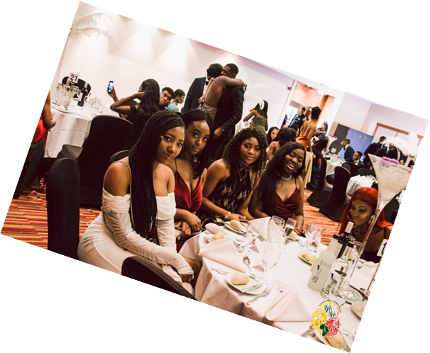
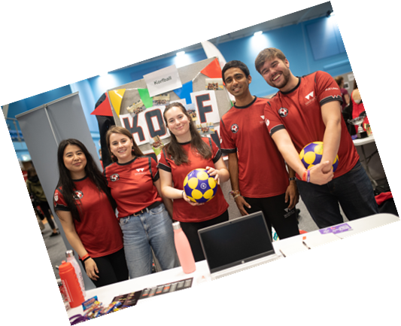
Societies and Sports Clubs
Over 250 student societies
  Something for everyone
  Make friends and feel part of a community
65 sports clubs
  Stay active and meet new people
  Support from Warwick Sport
  Fundraising, volunteering and campaigns
  Varsity
Notes:
250 societies covering a wide range of student interests, so there really should be something for everyone. from Music and Performance to cultural and religious plus food, academic, campaigning and a whole host of other areas. Plus take part in competitions and fundraise for charity.
Similar story with our 65 sports clubs. Stay active, be part of a team, meet new people - gives you access to all the social events they organise too.
Although they are student-run, SU clubs benefit from support from Warwick Sport; who provide them with state-of-the-art sport and fitness facilities, at the new Sport & Wellness Hub. Sports clubs are not just about sporting success; they also raise money for charities, volunteer in the community and support campaigns during Trans-awareness Week, Pride Week, as well as This Girl Can and Show Racism the Red Card.
Varsity tournament every Spring. Different sporting fixtures against Coventry University. Warwick won previous 30 tournaments!

Slide 10
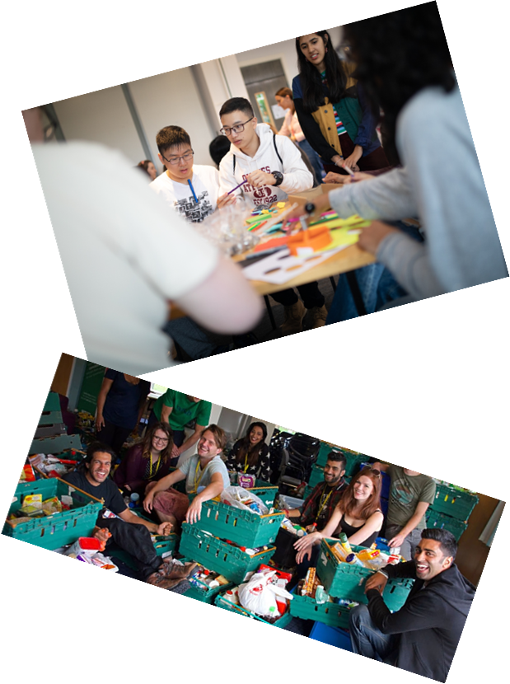
Projects and Campaigns
Support student campaigns
  The Environment
  Cost of living
  Liberation and Diversity
  Welfare and more
Contact SU Officers to discuss campaigns
Support for marginalised communities
  Online community hubs
www.warwicksu.com/campaigns-communities
Notes:
WSU active in supporting student campaigns to improve life on campus, the local community or national issues.
Help students campaign on a range of issues which are important to them, including The Environment, Education, Liberation and Diversity, Welfare and more.
Active campaigns include End Period Poverty, We Get Consent, Party Smart, re-shaping sport, Liberate Teaching and Learning, and many more. Students can contact the SU Officers if there a campaign they would like to start working on or get involved with.
The SU also supports minority groups on campus by organising events and activities specifically for them - you can find out about all these and more on the Campaigns and Community pages of the SU website.

Slide 11
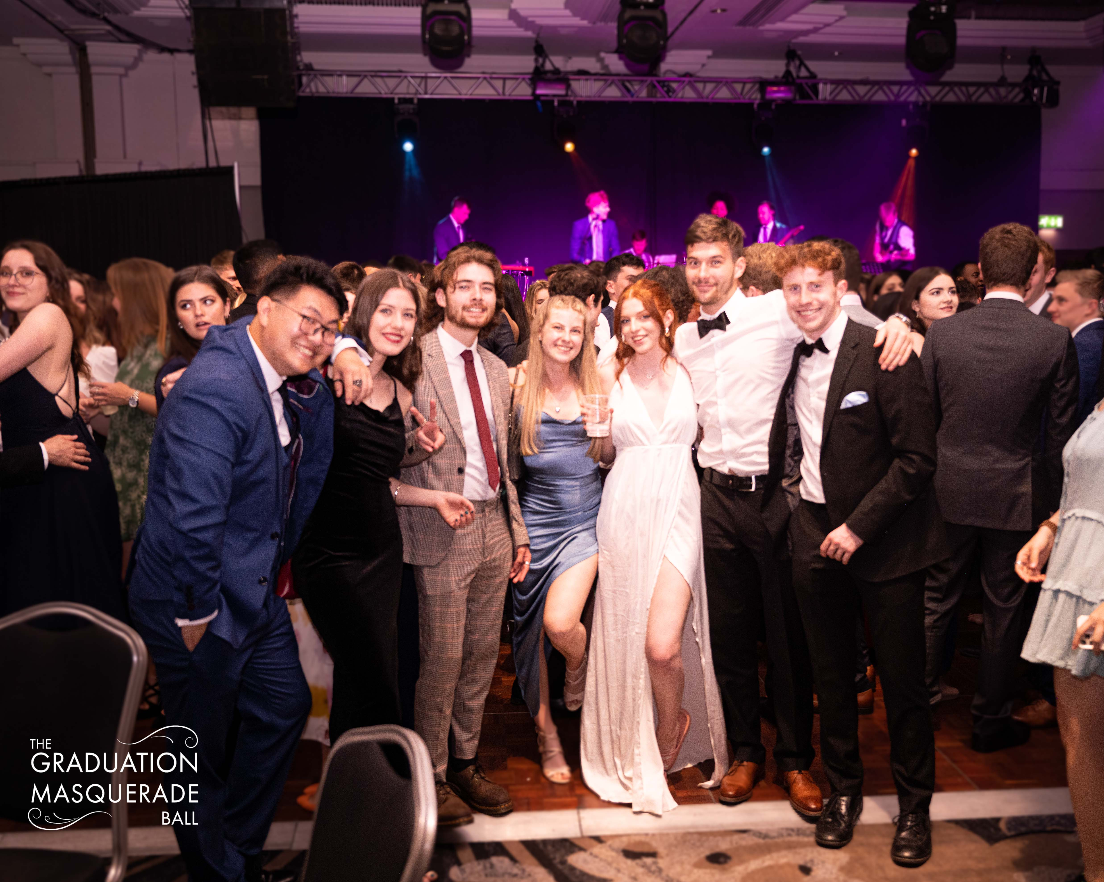
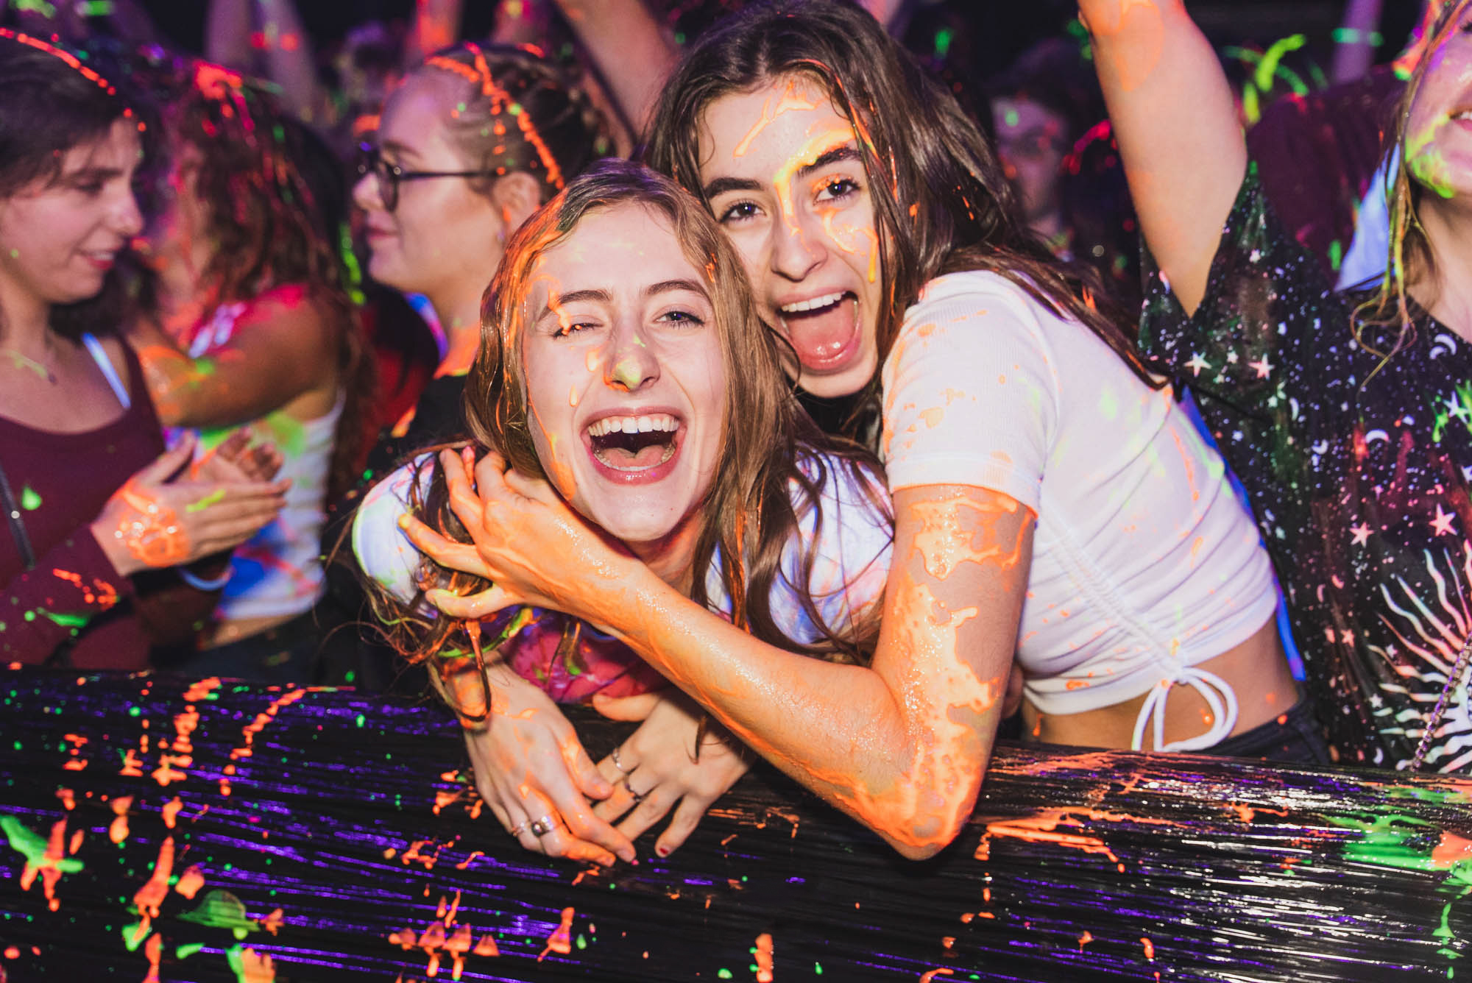
Events
Club nights for a range of tastes:
  Pop!
  Reflektor
  Loud & Proud
Main events in Copper Rooms
Daytime and non-drinking socials
End of year balls and awards ceremonies
www.warwicksu.com/venues-events
Notes:
The SU puts on club nights to cater for a range of tastes, with cheesy classics at Pop!, Indie tunes at Reflektor and Loud & Proud for LGBTQUIA+ students and their allies.
All the biggest night-time events take place in our 1200 capacity club venue the Copper Rooms, which is located in the main SU building and split over 2 floors.
The SU also organises daytime and non-drinking social get togethers throughout the year, plus we organise end of year balls and awards ceremonies.
There is always something different going on that students can get involved with, and it’s worth taking a look in the Events section of the SU website to get a sense of how much is happening.

Slide 12
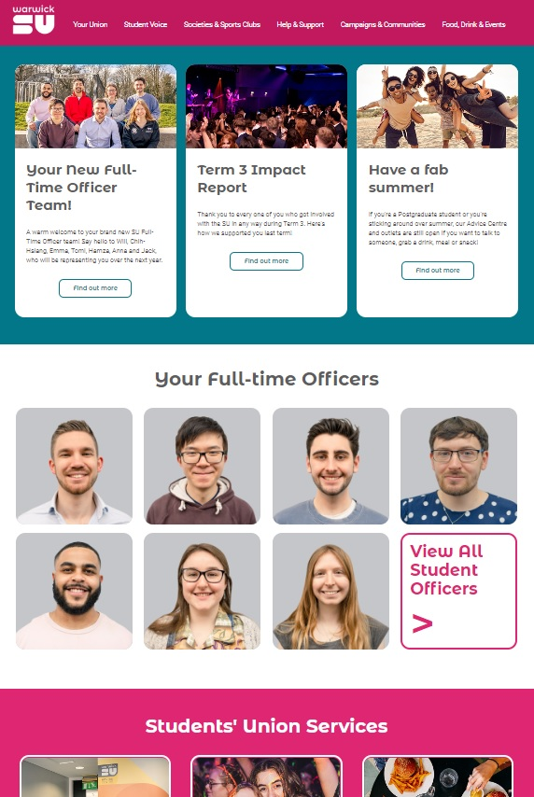
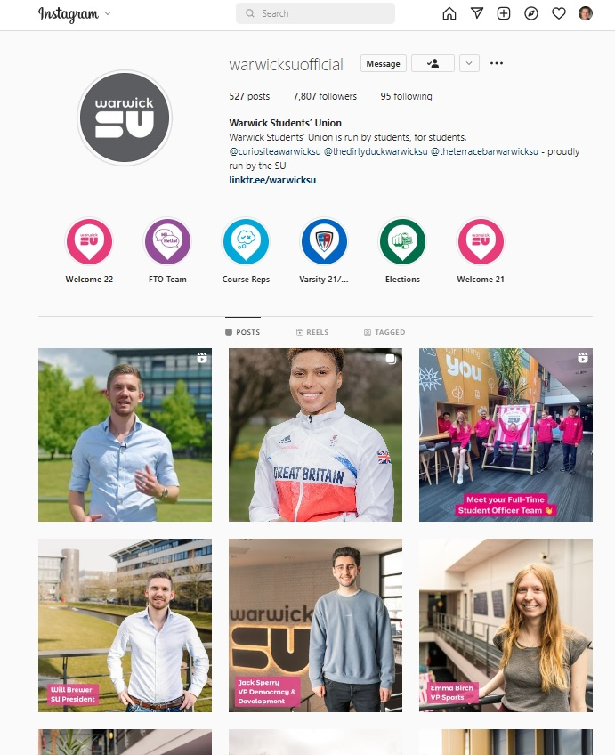
Stay up-to-date
Website: warwicksu.com
Weekly email newsletter
Instagram: @warwicksuofficial
TikTok: @warwicksuofficial
LinkedIn.com/company/warwicksu
Facebook: @warwicksu
Twitter: @Warwick SU
Notes:
Mentioned throughout that more info is available on website. Please take a look.
The best way to keep up to date with everything we have going on is to follow us on social media.
And also keep an eye out for our weekly email newsletter.

Slide 13
Any questions?
www.warwicksu.com

Slide 14
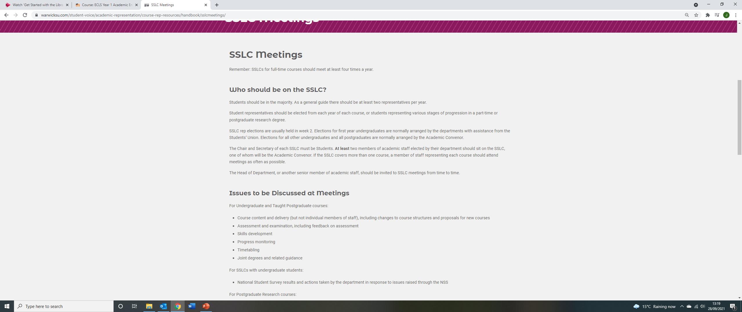
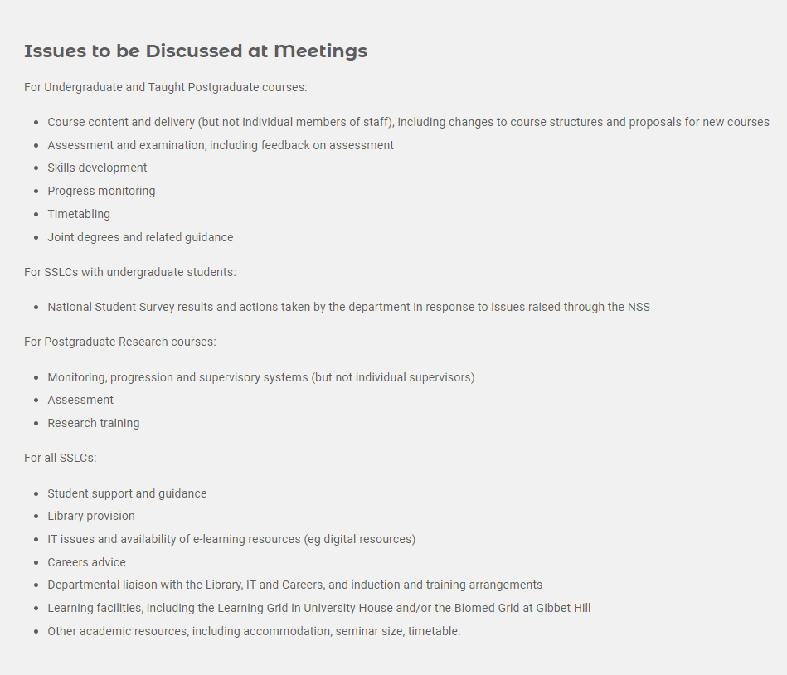
JOIN THE Staff-Student Liaison Committee
You will receive emails from the SU and from the Academic convenor of the SSLC (Dr Sarah Wood) next week.

Slide 15

Warwick Literature Society
2023/4

Slide 16

What We Do
We are the home for all Literature enthusiasts here at Warwick
We are not just for people studying English so please feel free to bring any friends along!
Our exec is always available for any initial questions you might have during your time at Warwick
We are a safe space for all students for any queries you may have starting at university
We have three distinct areas that we do a variety of events for: academic, social and creative

Slide 17

Academic Side
As an academic society we do a wide variety of different academic socials to help support you when starting academic work at university
We also have a Facebook group called, ‘Pass the Book’ which allows students to sell any old module texts they may have and do not want anymore for a much cheaper price!
We hold study sessions both on campus and in Leamington as well as holding essay QnA’s where you can ask our exec, primarily the academic aid, any questions you may have surrounding writing university assignments
We have also put together a fresher starter pack surrounding academics which can be found by following the link in our Instagram bio.

Slide 18
Social
Another major part of the society is the social side where every week we hold a variety of sober and non-sober socials but there is never any pressure to drink at any event
We always have at least one member of our exec who remain completely sober who can look after and help with any issues during the event
We also do charity events which are a great opportunity to raise money for amazing causes in fun ways
Every term we have welfare events which provide a safe space to come and destress or talk about how you’re feeling in a safe and supportive environment
Here are some examples of socials we do throughout the year:
Circles
Bar crawls
Scavenger hunts
Day trips
Bowling
Movie nights
Charity sports day
Welfare walks and meditation sessions

Slide 19
Creative
The third aspect of our society is the creative side
We create an open and welcoming environment for anyone who wants to express their creativity regardless of degree subject or experience
There is no pressure to perform, you can always just come and watch
Here are some examples of creative events we do:
Open mic nights
Creative collabs with other societies
Slam poetry evenings
Creative collage sessions

Slide 20
Bigger things we are doing this year
Family scheme – a small group of first years are placed with two older students so they can ask any questions and have an immediate point of contact for any concerns surrounding university work
We are looking in to putting together a LitSoc anthology of different creative pieces to highlight the immense creativity we have as a society
Tour – for the first time since the pandemic we are going on tour!
The annual ball – a great opportunity to come and celebrate the end of the year with all your friends
We are putting together a termly/monthly book club and the books we decide to talk about will be voted for via polls on our story
Recruiting Fresher Reps – this is a great opportunity to become a part of the exec and act as a spokesperson for your year and to express any ideas you may have surrounding Litsoc.

Slide 21

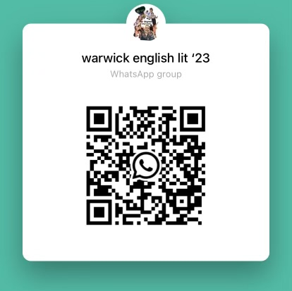
How to keep up to date!
Follow and look at our Instagram for a detailed look at all our upcoming events - @warwicklitsoc
Join our WhatsApp group using this QR code, if you haven’t already, to hear about all upcoming events as well as having a direct contact with all the exec for any questions you may have. Or dm our Instagram and we can add you!

Slide 22

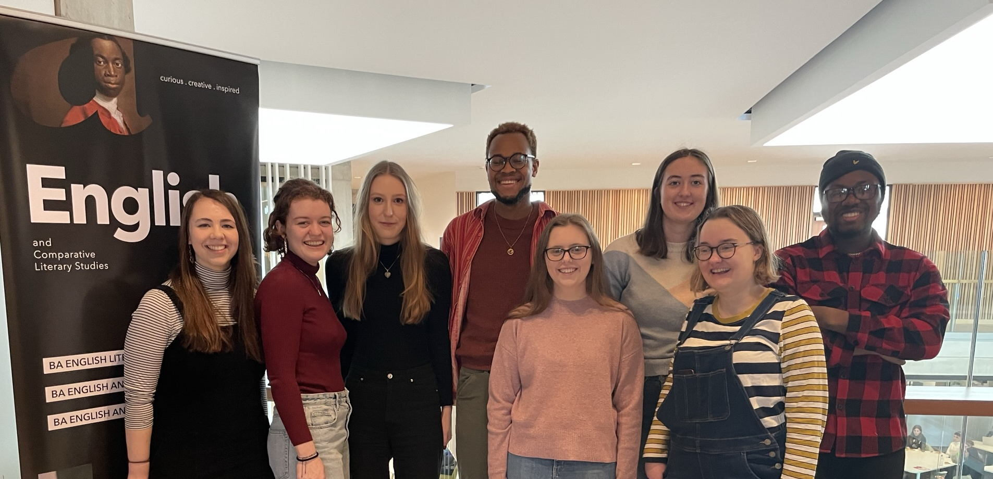

What is Widening Participation?
Widening Participation (WP) aims to address the patterns of under-representation of some groups in Higher Education
Transformations
A-level lecture series
Book donations – email charlotte.pearce@warwick.ac.uk for a list
Performance and Pedagogy
University-wide Widening Participation projects
What does a WP Officer do?

Slide 23
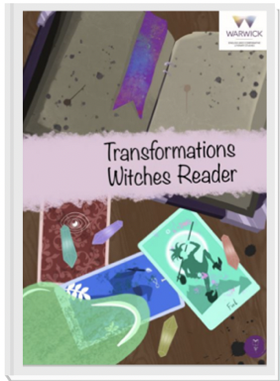


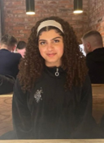

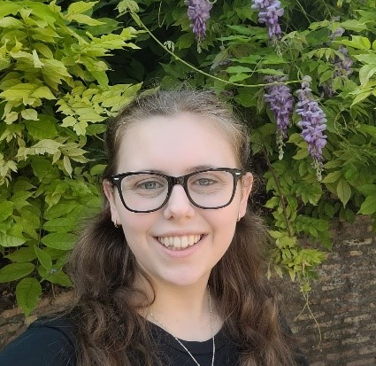
What is Transformations?
Maryam Khonat
Co-President
English Literature & History Finalist
Bethan Davies
Co-President
English Literature & History Finalist

Slide 24

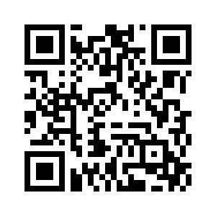

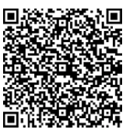
How can I get involved?
Come along to one of our Transformations information sessions:
Tuesday 3rd Oct (week 1) 5-7pm, Student Hub (FAB5.49) - Info session, pizza and chat to Transformations member
Wednesday 11th Oct (week 2) 1.45-3pm, Student Hub (FAB5.49)
transformationswarwick
For more info, including videos, take a look at the Transformations page within the ‘Your Department’ section of the ECLS website
transformations@warwick.ac.uk

Slide 25
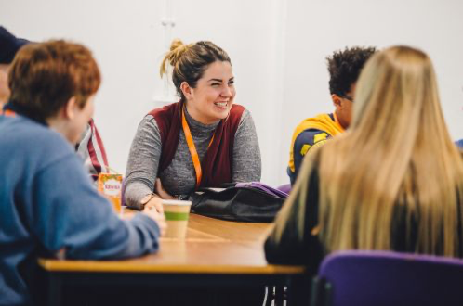
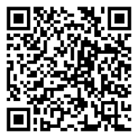
Widening Participation Student Network
A university-wide network. This is a chance to share experiences, find out about opportunities and gain insight into a wide variety of topics
For students who:
Are first generation in their family to attend university
Received a contextual offer
Come from an area with low progression rate to university
Receive a Warwick Bursary or other means tested financial support
Have a disability
Are over 21 when starting university
Have caring responsibilities
Have spent time in local authority care
Received free school meals

Slide 26
Equality, Diversity, Inclusion in ECLS
Department EDI Officer:
Dr Emma Francis
e.j.francis@warwick.ac.uk
https://warwick.ac.uk/fac/arts/english/people/francisdremma/

Slide 27
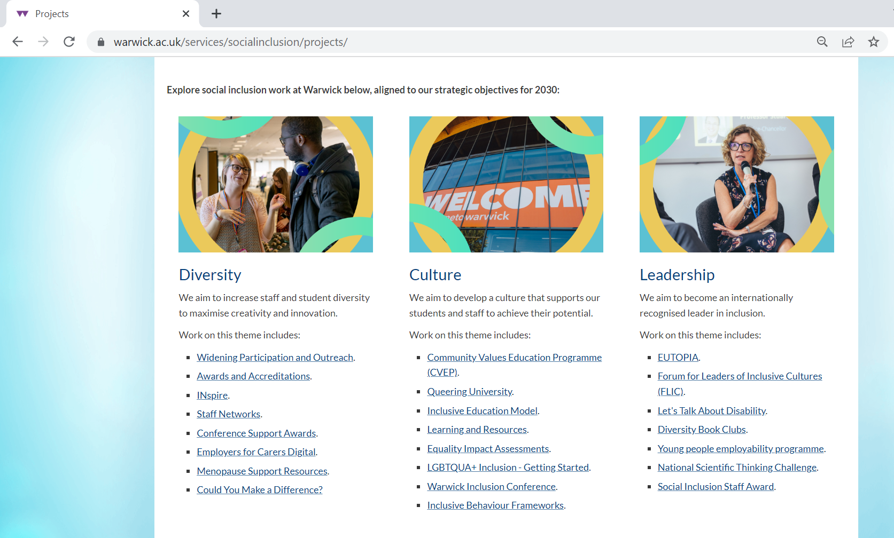

Slide 28
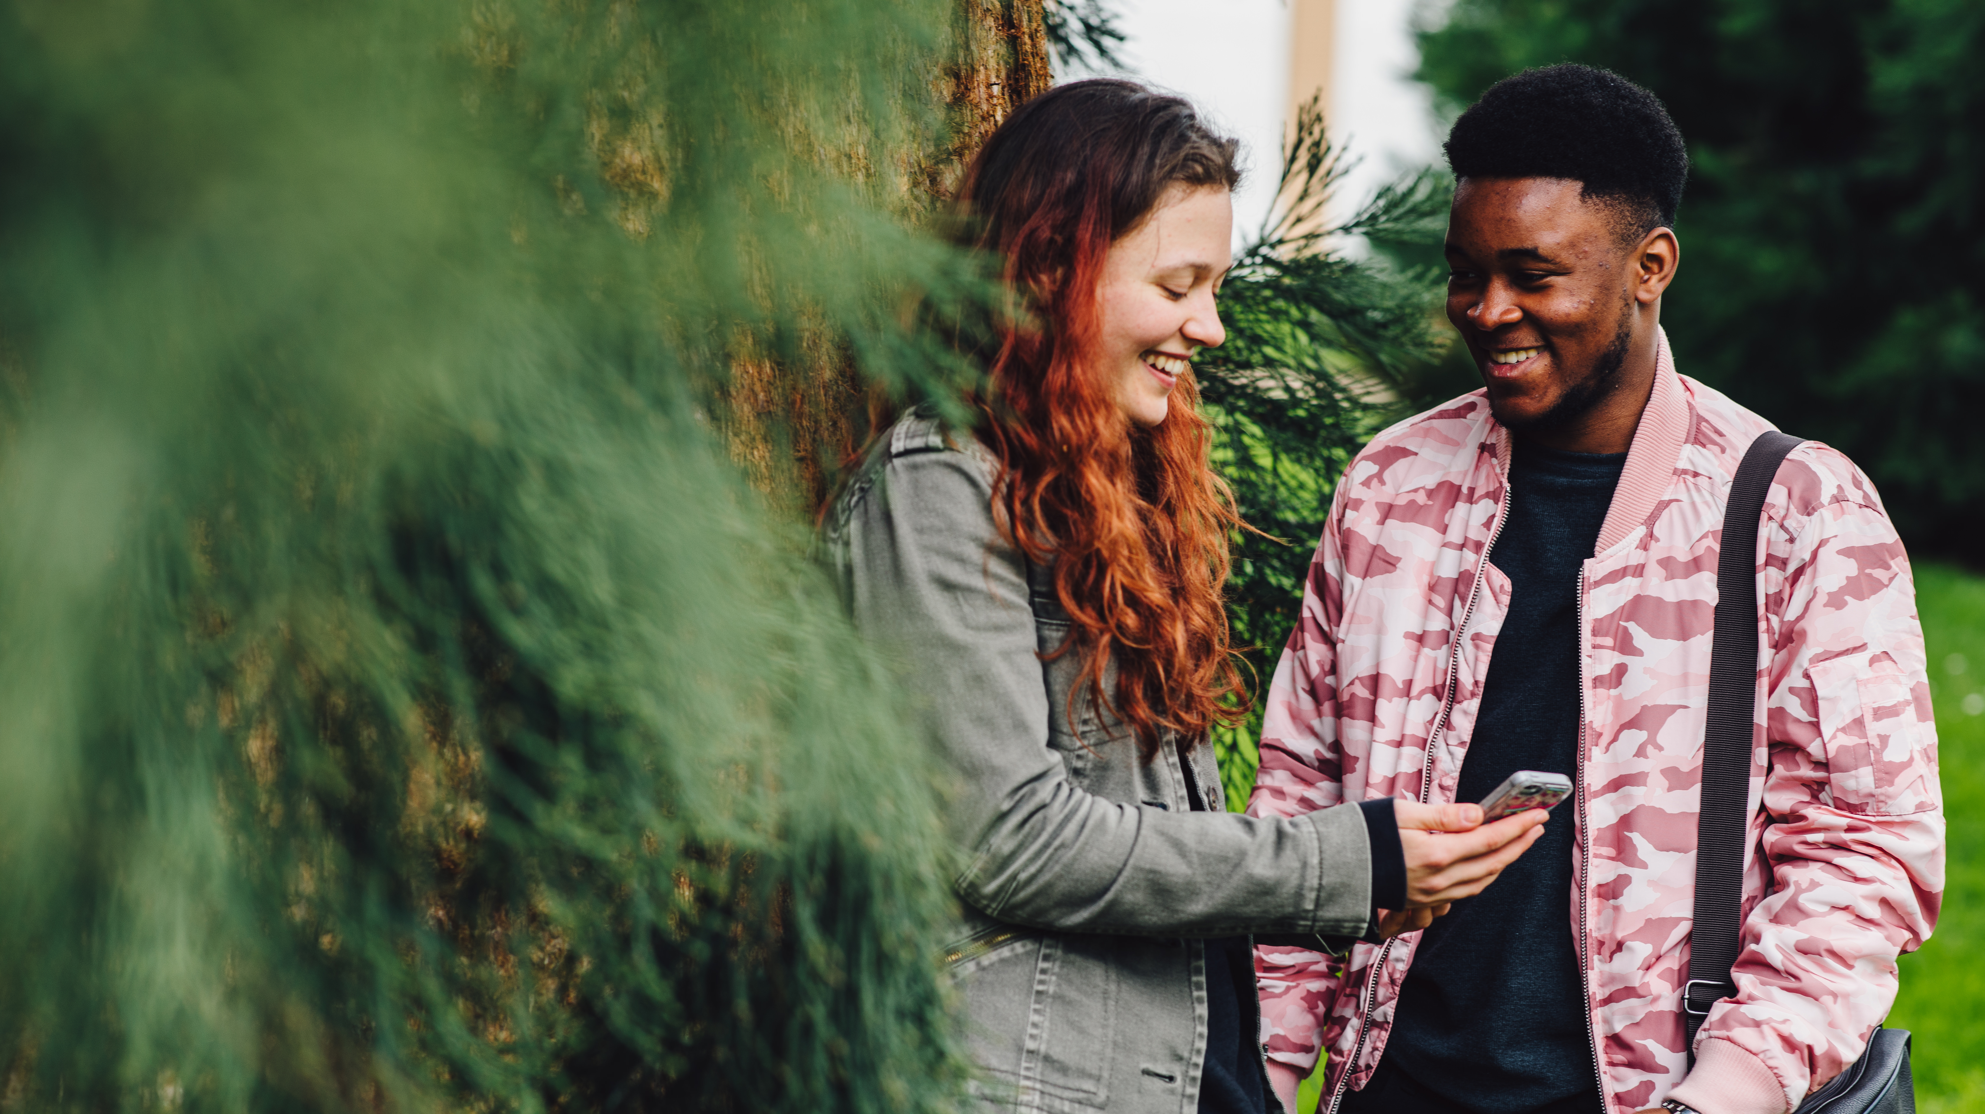

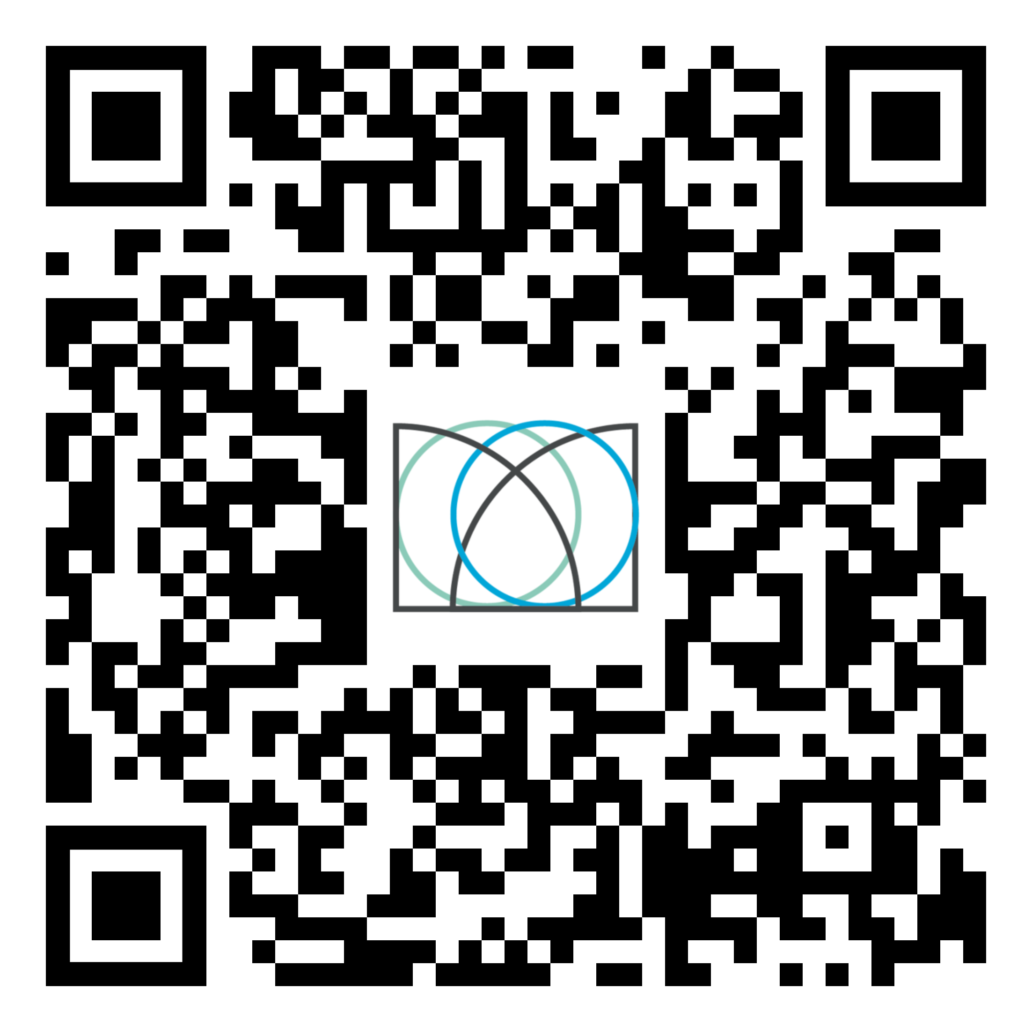
Shape your future with the Warwick Award
Develop & showcase your employability skills
Free to join & recognised by the University
Personalise it to fit your needs & complete it at a time that suits you
Find out more: warwick.ac.uk/warwickaward
or scan the QR code

Slide 29
If the induction slides or induction handout don’t answer your question about Tabula/seminar sign-up, or other administrative issues then get in touch with the UG office:
UG office is generally open.
Mon to Friday: 10am-12pm and 2-4pm
FAB 5.42 Or email ugenglish@warwick.ac.uk

Slide 30
Dr Sarah Wood
sarah.wood@warwick.ac.uk
I mostly oversee communications about academic work, support your academic first year, and help with:
Course transfers (in first 4-5 weeks)
Specific Extensions for Assessment
You can drop in to see me TODAY 12-1pm in FAB 5.57 about any of the above or if you haven’t yet been assigned/met your Personal Tutor and need help.

Slide 31
What’s next today?
VQ32 English and History students have a degree specific meeting with Dr Alice Kelly in FAB 5.01 at 3pm, plus meeting with History dept 12-1pm FAB2.43.
Visiting Students have an induction with Dr Liz Barry 1-2pm in FAB5.03.
And next Monday (week 1) – Hidden Curriculum talk 9-11am. Room TBC on Tabula.

