Slide 1


English and Creative Writing, English and French; English and Hispanic Studies; English and German; English and Italian; Film and Literature; Philosophy and Literature; Philosophy, Literature and Classics; English and Classics; and modules as part of the Liberal Arts English Pathway, or Centre for Lifelong Learning.
Welcome to ECLS!
Joint Honours Induction
Wednesday 28th September 2022

Slide 2
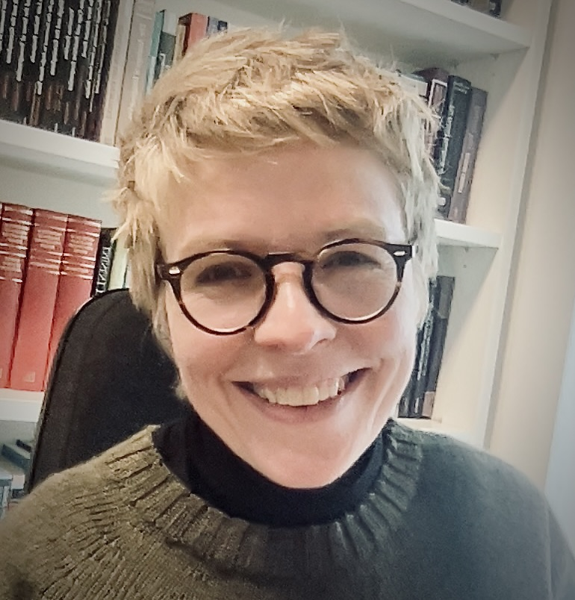
Professor Emma Mason
Head of the Department of English and Comparative Literary Studies (also Lecturer/Tutor in Romanticism)
My office is FAB 5.44
My email address is: emma.mason@warwick.ac.uk

Slide 3
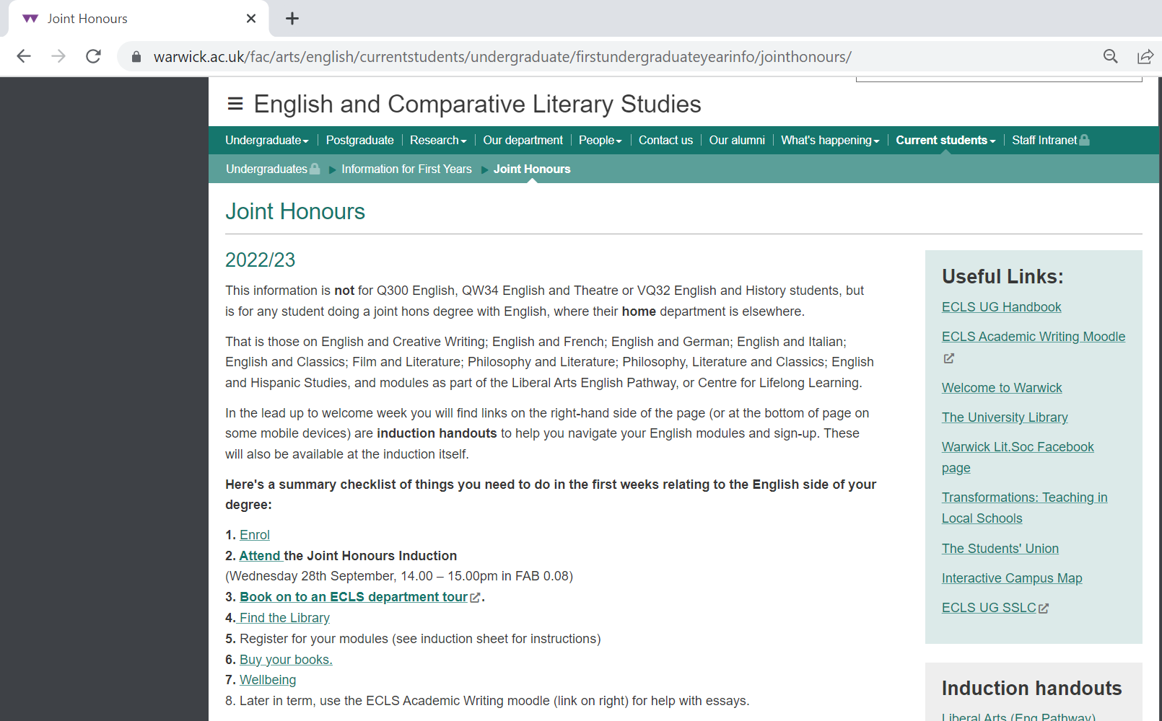
Joint Honours (warwick.ac.uk)
Tabula (warwick.ac.uk)
Handbook (warwick.ac.uk)

Slide 4
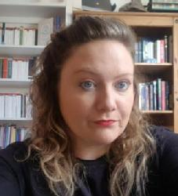
Dr Jen Baker
First Year Director of Undergraduate Studies (DUGS) (also Lecturer/Tutor C19th and C20th Literature)
My office is FAB 5.26
My email address is: J.Baker.5@warwick.ac.uk
https://warwick.ac.uk/fac/arts/english/people/drjenbaker/

Slide 5
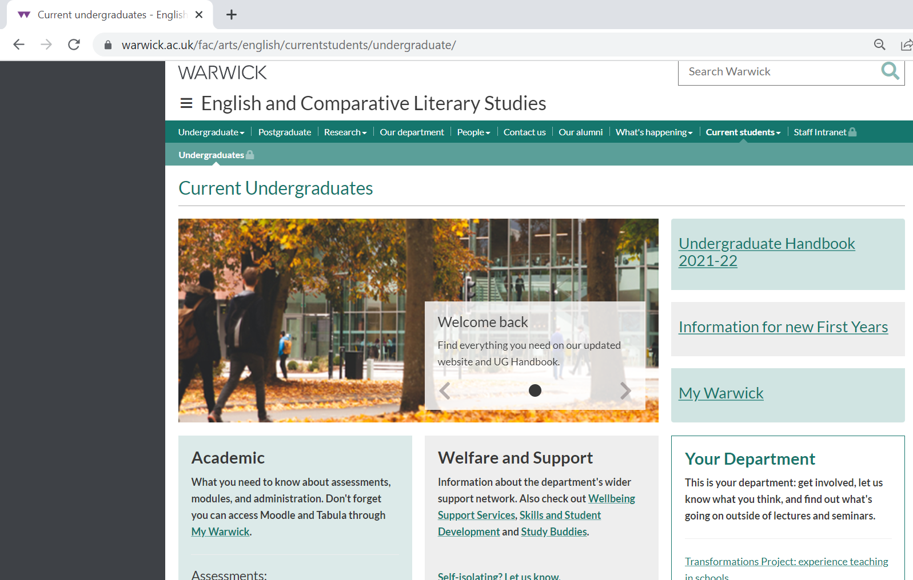
MAIN DEPARTMENT WEBPAGES
https://warwick.ac.uk/fac/arts/english/currentstudents/undergraduate/

Slide 6
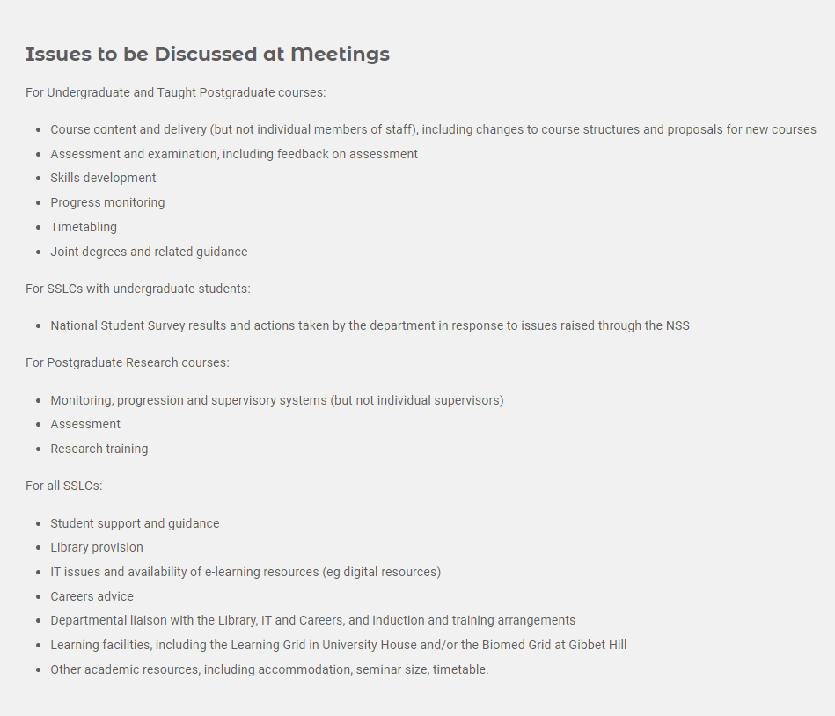
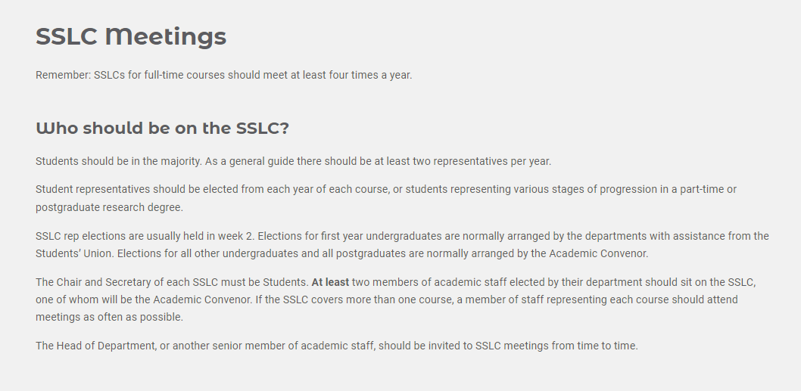
JOIN THE SSLC!

Slide 7

First Year English 30 CAT Modules: An Overview
 | Modes of Reading | Medieval to Renaissance | Epic into the Novel | Modern World Lit
Film and Literature
English &Creative Writing
Classics and English |  | Option 1 or | Option 2
Philosophy, Literature and Classics | Option 1 or |  | Option 2
Philosophy and Literature |  | Option 1 or | Option 2 or | Option 3 or
English and French |  | Option 1 or | Option 2 or | Option 3
English and German |  | Option 1 or | Option 2 or | Option 3
English and Italian |  | Option 1 or | Option 2 or | Option 3
English and Hispanic Studies |  | Option 1 or | Option 2 or | Option 3
Centre for Lifelong Learning |  | Option 1 or | Option 2 or | Option 3
Option 4 30 CATS Philos modules instead

Slide 8
ALL ECLS modules have an Introductory meet and greet with registered seminar groups in week 1, but don’t worry if you miss these because of choosing between options.
Each ECLS module has an Introductory lecture in week 1. These will be particularly useful if you need help choosing between modules. See your induction handout for times.
Official ECLS seminars, for which you need to have done some preparatory reading begin in week 2.

Slide 9
EN101: Epic into Novel
Convenor: Dr John Gilmore
J.T.Gilmore@warwick.ac.uk
EN101 Epic into Novel - Honours Variants – EN2J4/EN3J4 (warwick.ac.uk)

Slide 10

Epic into Novel: What to do in Week 1
Acquire a copy of Andrew George’s Penguin Classics translation of The Epic of Gilgamesh. Make sure you get the most recent (2020) edition – this is available in paperback and Kindle. Read the “Standard Version”, which is Chapter 1 – it is quite short!
Acquire a copy of Caroline Alexander’s translation of Homer’s Iliad. This is also available as an e-book in the library catalogue.
Start to read the set extracts from this translation in preparation for your seminars in week 2. These extracts are listed on front page of module website.
Attend the first lecture in week 1 as detailed on Tabula.
Attend your meet and greet seminar in week 1.

Slide 11
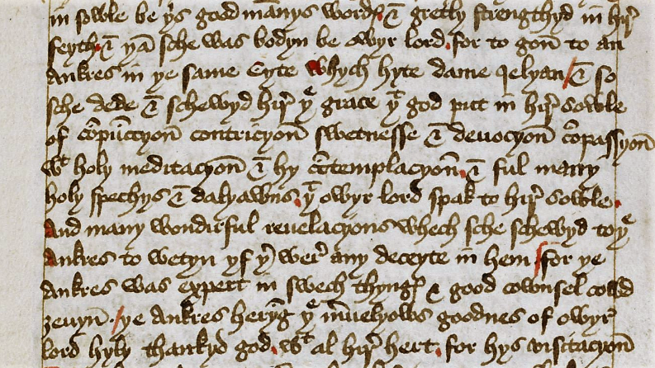
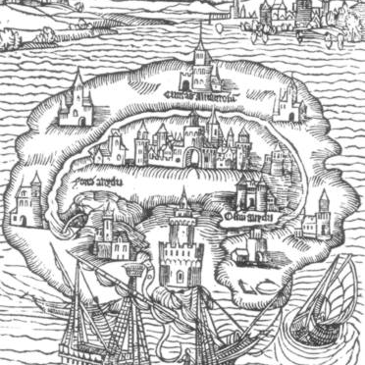
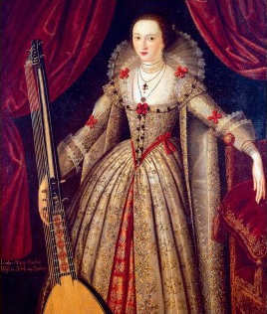
EN121 Medieval and Early Modern Literature Dr Sarah Wood sarah.wood@warwick.ac.uk https://warwick.ac.uk/fac/arts/english/currentstudents/undergraduate/modules/fulllist/first/en121/

Slide 12

What to do next:
Acquire a copy of The Norton Chaucer: The Canterbury Tales, ed. by David Lawton (2019)
OR The Canterbury Tales: Seventeen Tales and The General Prologue, ed. V. A. Kolve and Glending Olson, 3rd edition (Norton, 2018) OR The Riverside Chaucer, ed. L. D. Benson, 3rd edition (OUP, 2008)
Attend the first lecture in week 1, Tues 4th 12-1pm.
Attend your meet and greet seminar.
Read The General Prologue, The Miller’s Prologue and Tale, and The Reeve’s Prologue and Tale for your seminar in week 2.
Visit the Reading Middle English page for information about the reading classes in weeks 2-5.

Slide 13





EN122: Modes of Reading
Course convenors: Dr Myka Tucker-Abramson
M.Abramson@warwick.ac.uk

Slide 14
Term 1
Week 1: Introduction to the course (Dr. Myka Tucker-Abramson) [you also have meet and greet seminars]
Unit I: Narrative
*** Text to read over the summer for this unit, Chris Kraus I Love Dick ***
Week 2: Structuralism and Structural Linguistics (Prof. Daniel Katz)
Ferdinand de Saussure, 'The Object of Linguistics'Link opens in a new window and 'Nature of the Linguistic Sign'Link opens in a new window and 'Linguistic Value'Link opens in a new window Course in General Linguistics. Translated by Wade Baskin, Columbia University Press, 2011 [1916], pp. 7-17; pp 65-70; pp 111-122. Roman Jakobson 'Two Aspects of Language and Two Types of Aphasic DisturbancesLink opens in a new window.' Language in Literature, Edited by Krystyna Pomorska and Stephen Rudy, Harvard University Press, 1987 [1941], pp 96-114.
Week 3: Historical Materialism (Dr. Nick Lawrence)
Karl Marx. excerpt from 'The German IdeologyLink opens in a new window.' Modern Criticism and Theory, Edited by David Lodge and Nigel Wood, Routledge 2014 [1845], pp. 31-41. Raymond Williams. 'LiteratureLink opens in a new window.' Marxism and Literature, Oxford University Press, 1978.
Week 4: Psychoanalysis (and Structuralism redux) (Dr. Myka Tucker-Abramson)
Sigmund Freud 'The Method of Interpreting Dreams: An Analysis of a Specimen DreamLink opens in a new window' The Interpretation of Dreams. Translated from the German and edited by James Strachey, Basic Books, 2010 [1899], pp. 121-145. Louis Althusser 'Ideology and Ideological State ApparatusesLink opens in a new window' (excerpted) Lenin and Philosophy and Other Essays. Translated from the French by Ben Brewster, Monthly Review Books, 2001 [1970], pp. 159-186.

Slide 15
What to do in week 1.
Attend the meet and greet seminars with your seminar group in week 1.
Attend the Lecture in week 1, Thursday 10-11am (See tabula)
Please make sure that you have read I Love Dick by Chris Kraus for week 2.
Look through the Modes of Reading webpage (you will be added to the moodle if you sign up for the module)

Slide 16
EN123: MODERN WORLD LITERATURES
Convenor: Dr. Mike Niblett
m.niblett@warwick.ac.uk
https://warwick.ac.uk/fac/arts/english/currentstudents/undergraduate/modules/fulllist/first/en123/

Slide 17

Modern World Literatures

Slide 18
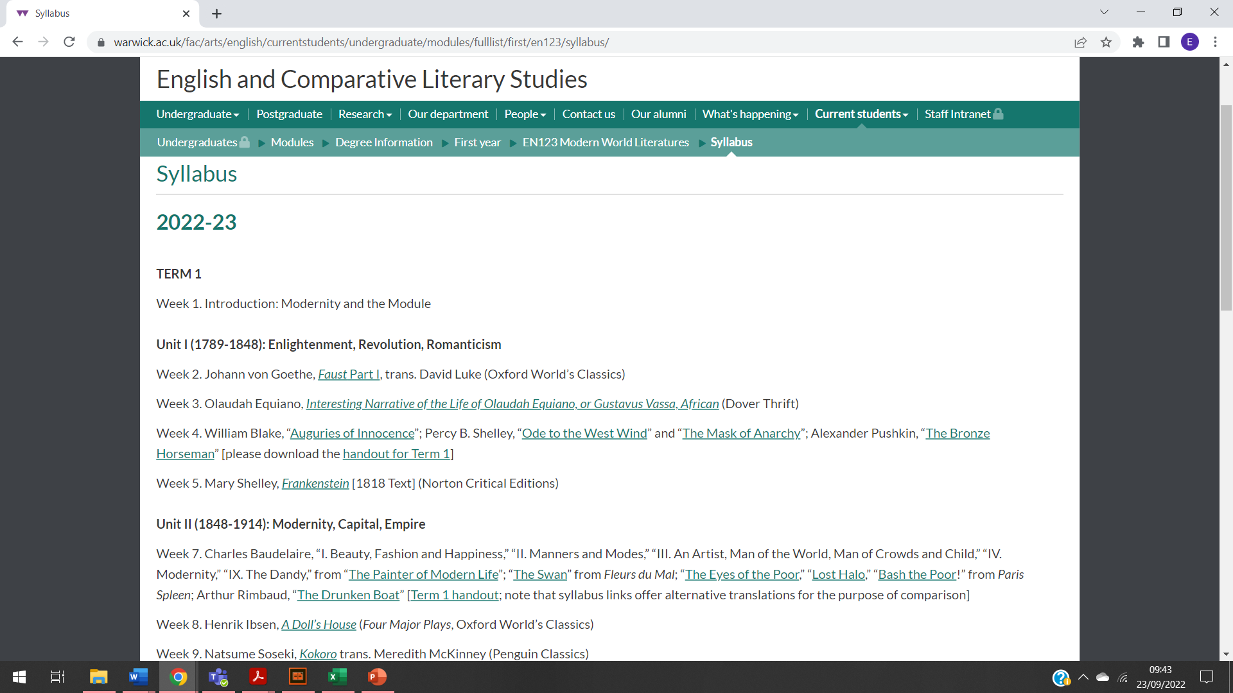
MIKE to CHECK/ UPDATE

Slide 19
What to do in week 1 for MWL.
Familiarize yourself with the website
Go through the syllabus reading list
Attend the lecture in week 1, Tuesday (4th), 2pm, as well as the week 1 meet and greet seminars
Make a start on reading Faust Part 1 for the lecture and seminars in week 2.

Slide 20
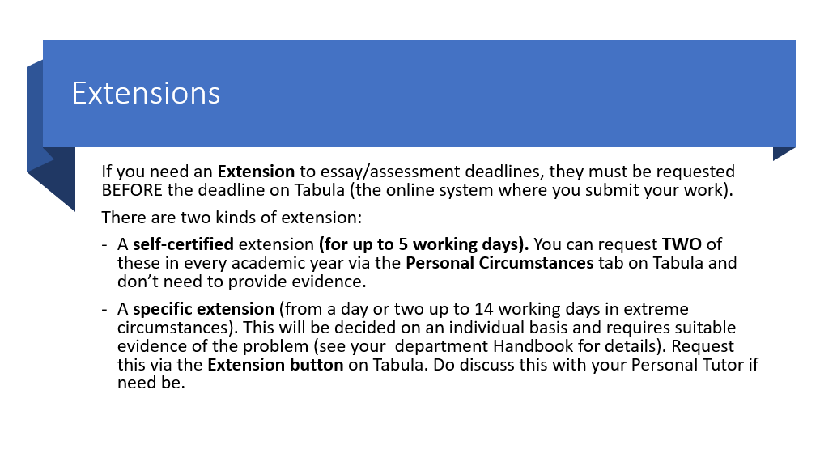

Slide 21
REASONABLE ADJUSTMENTS
If you have spoken to Disability and wellbeing services and your home department about Reasonable Adjustments for any physical or mental health condition that impacts your studies, once a report is created it will be shared with us.
If you want to use your flexible deadlines, you may then use the Specific Extension route, but simply write in the comments box that you have RAs and attach the report or add notes to make us aware of any situation.

Slide 22
Academic Writing Moodle
This is a new resource which contains over 40 screencasts on all topics associated with researching, planning and writing your assignments for ECLS.
It will also be updated during the coming academic year with further worked example resources on a variety of writing and research skills.
You will be added to this Moodle in the first couple of weeks of Term 1, so you don’t need to take any action now.

Slide 23
Academic Writing 1-2-1s
ECLS also hosts academic writing one-to-one support to help you address specific issues with your assignment-writing.
These one-to-ones are delivered by Dr Rochelle Sibley, either in-person or online.
The full details on what these one-to-ones cover and how you can book them are here.
If you have any questions about academic writing resources, please contact Dr Rochelle Sibley at Rochelle.Sibley@warwick.ac.uk

Slide 24
Academic Writing Support moodle/tutors in ECLS
Wider Issues with researching and writing English Lit assignments
Issue with ECLS module (e.g.):
Accessing lectures Assessment ideas Resource recommendations
Seminar absence Issues with the seminar Reading content
ECLS Module Tutor
Administration issues for ECLS modules (e.g.) Tabula/timetabling issues/clashes module registration issues ugenglish@warwick.ac.uk https://warwick.ac.uk/fac/arts/english/about/
English UG office
Issue with your academic work more widely (e.g.):
Personal issues impacting your wellbeing Advice about choosing module
Mitigating Circumstances When you aren't sure where to get help Course Transfer
Your Personal Tutor in your home department

Slide 25
English UG office is open:
Mon to Friday: 10am-12pm and 2-4pm
FAB, 5th Floor, room 5.33 (you need card access)
Or email ugenglish@warwick.ac.uk
If the induction slides or induction handout doesn’t answer your question about Tabula/seminar sign-up, then get in touch with the UG office

Slide 26
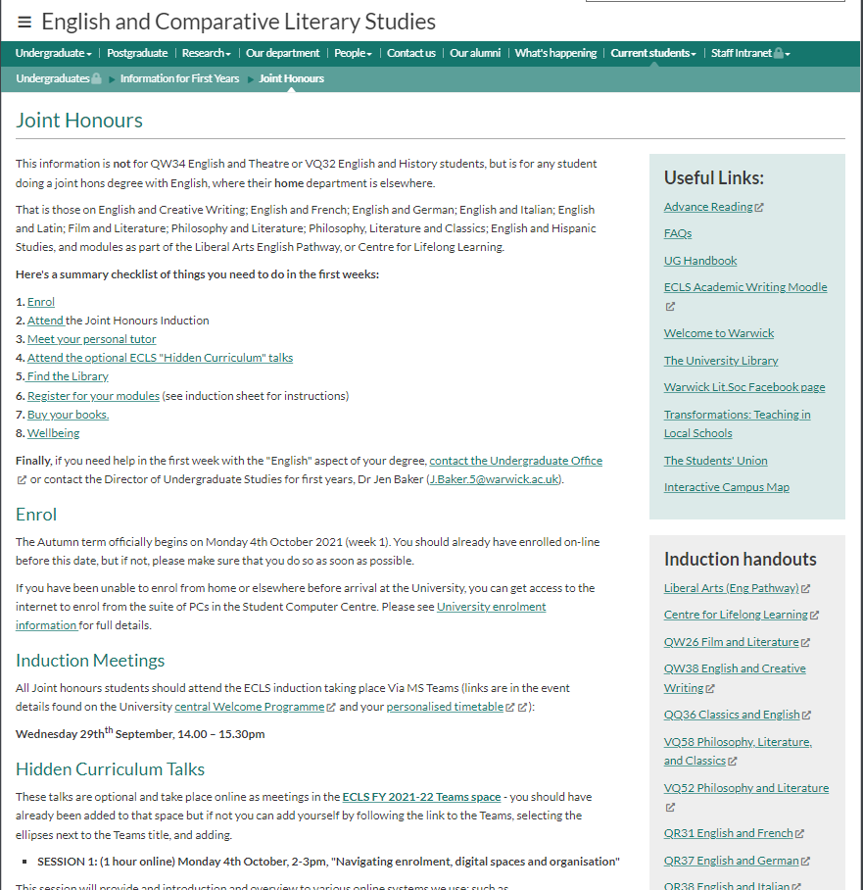
Joint Honours (warwick.ac.uk)
Tabula (warwick.ac.uk)
Handbook (warwick.ac.uk)

Slide 27
