Slide 1


School of Modern Languages and Cultures
The Language Centre

Slide 2
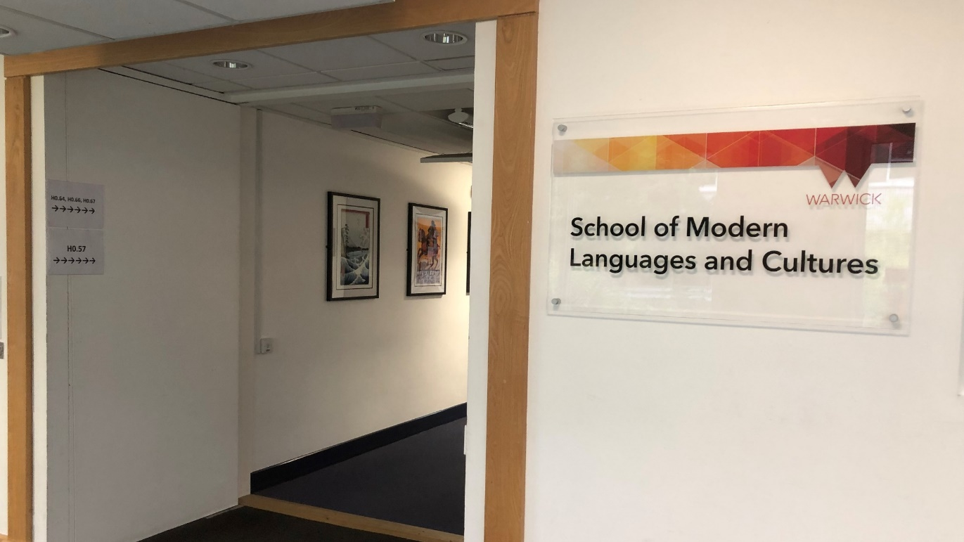

The Language Centre
Located on the central campus, on the ground floor of the Humanities Building
Transnational Resource Centre
Notes:
*Students can use the TRC to study and they can also find a collection of films in multiple languages.

Slide 3
Academic Programme – Modules for credits
normally taken as part of an undergraduate degree course
but also open to others (not for credit - for a £500 fee)
Lifelong Language Learning (LLL) Programme – (not for credit)
language courses for students and staff

Slide 4
LANGUAGES
Arabic
Chinese (Mandarin)
French
German
Italian
Japanese
Korean (LLL only)
Russian (academic only)
Spanish

Slide 5

Accelerated Modules for able linguists
In one year,
Beginners – Covers levels 1 and 2
Intermediate – Covers levels 3 and 4
Notes:
*if you really need to reach a high level quickly, we have the accelerated modules.
*if you want to study abroad and you have never studied that Language, it is still possible.

Slide 6
What to expect from an Academic Module
Class contact
2-4 hours per week depending on language and level
+ independent study and online language learning
Skills
listening, speaking, reading, writing, intercultural awareness
lexis and grammar
preparation for taking an active part in academic or social life in country of language studied
Notes:
2 hours per week for European languages
3 hours per week for Arabic, Chinese, Japanese and accelerated modules

Slide 7
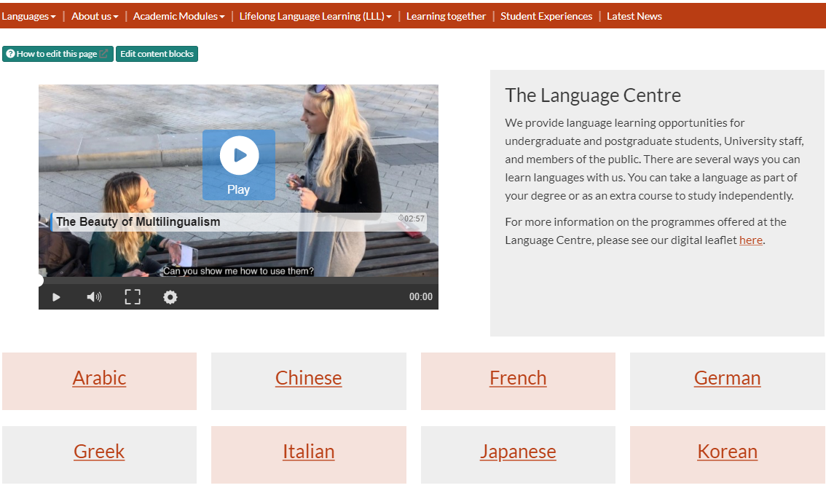
ENROLMENT
Details of enrolment for both programmes:
Language Centre website.

Slide 8
Enrolment – Academic Programme
Please follow the steps below to enrol with us:
1. Decide which language you would like to learn.
Are you taking the course as part of your degree (for credit) or separately from your degree study (not for credit)?
2. Select and complete pre-enrolment form.
Fill in the correct pre-enrolment form for you. If you are taking a module not for credit payment must be made at this time.
You will also be asked to complete an online diagnostic test in your chosen language
3. A tutor from your chosen language will contact you:
Enrolment for 2020/21 will take place remotely
Once your completed form has been received, a tutor will be in touch to discuss your options – this may include a call via MS Teams.
4. If you are taking the module for credit.
Ensure your module registration is updated accordingly with your home department.

Slide 9
Placement and Diagnostic Testing
It is important that we help you to find the
right level for your chosen language
Look at previous qualifications
Brief online test /conversation with tutor
Possibility of change in first three weeks
GCSE → level 2
Int bac standard grade 4 → level 3
Int bac higher grade 4/5 → level 4
AS level grade A/B → level 4
A level grade A/B → level 5
Int bac higher grade 6/7 → level 5

Slide 10
Enrolment – Lifelong Language Learning Programme
Choose your language and level from our website.
Contact tutor only if you need to discuss which level (level can be changed in the first few weeks)
Register and pay online.

Slide 11

Think now about your future!
Year abroad
- Universities usually require a minimum level of Language proficiency to offer you a place.
- For a work placement how confident are you with your language skills?
Employability
Employers value people with a knowledge of languages and intercultural awareness.

Slide 12

Certification
Language learning appears on HEAR (Higher Education Achievement Record)
Expressed in terms of CEFR (Common European Framework of Reference)
e.g. A2, B1, B2, C1

Slide 13
We look forward to meeting you!
Thank you
شكرا 谢谢您 Merci
Danke σας ευχαριστώ
Grazie ありがとう
Obrigada Спасибо Gracias

