Slide 1

Page title (more bullet points)
Important parts of the text can be highlighted in demi bold weight for added impact.
Nunc a nisl vitae massa volutpat volutpat. Sed bibendum mauris id rutrum feugiat.
Or every bullet point can be in demi bold.
Nunc a nisl vitae massa volutpat volutpat. Sed bibendum mauris id rutrum feugiat.

Slide 2
Our Programmes
Academic
= Modules for credits
normally taken as part of an undergraduate degree course
but also open not for credit - for a £500 fee
Lifelong Language Learning (LLL)
= Courses not for credit
language courses for students, staff, members of the public
More leisurely pace
£250 fee
Two terms - online

Slide 3

Languages
Arabic
Chinese (Mandarin)
French
German
Italian
Japanese (academic only)
Korean
Portuguese (academic only)
Russian (academic only)
Spanish

Slide 4

Accelerated Academic Modules
for Able Linguists
In one year:
Beginners Accelerated – Covers levels 1 and 2
Intermediate Accelerated – Covers levels 3 and 4

Slide 5
What to expect from an Academic Module
Class Contact
2-4 hours per week depending on language and level
+ independent study and online language learning
Skills
Listening, speaking, reading, writing, intercultural awareness
Lexis and grammar
Preparation for taking an active part in academic, professional and/or social life in country of language studied

Slide 6


Details of Enrolment

Slide 7
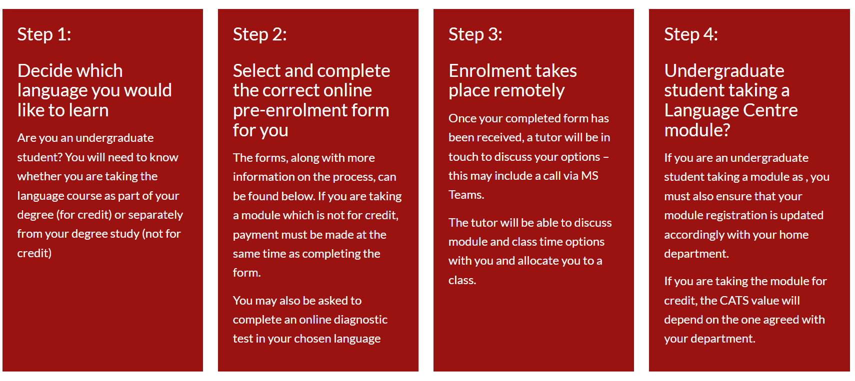
Enrolment – Academic Module

Slide 8
Placement and Diagnostic Testing
It is important that we help you to find the right level for your chosen language
Look at previous qualifications
Brief online test/conversation with tutor
Possibility of transfer in first three weeks of term
GCSE → level 2
Int bac standard grade 4 → level 3
Int bac higher grade 4/5 → level 4
AS level grade A/B → level 4
A level grade A/B → level 5
Int bac higher grade 6/7 → level 5

Slide 9

Think now about your future!
Study Abroad
Universities usually require a minimum level of Language Proficiency to offer you a place.
For a work placement how confident are you with your language skills?
Employability Employers value people with a knowledge of languages and intercultural awareness.

Slide 10


Can count towards the Warwick Award:
Certification
Language learning appears on HEAR (Higher Education Achievement Record)
Expressed in terms of CEFR (Common European Framework of Reference)
e.g. A2, B1, B2, C1
+ Can count towards the

Slide 11
Can count towards the Warwick Award:
We look forward to meeting You!
Thank you
شكرا 谢谢您 Merci
Danke σας ευχαριστώ
Grazie ありがとう
Obrigada Спасибо Gracias

Slide 12
Page title (more bullet points)
Important parts of the text can be highlighted in demi bold weight for added impact.
Nunc a nisl vitae massa volutpat volutpat. Sed bibendum mauris id rutrum feugiat.
Or every bullet point can be in demi bold.
Nunc a nisl vitae massa volutpat volutpat. Sed bibendum mauris id rutrum feugiat.

