Slide 1


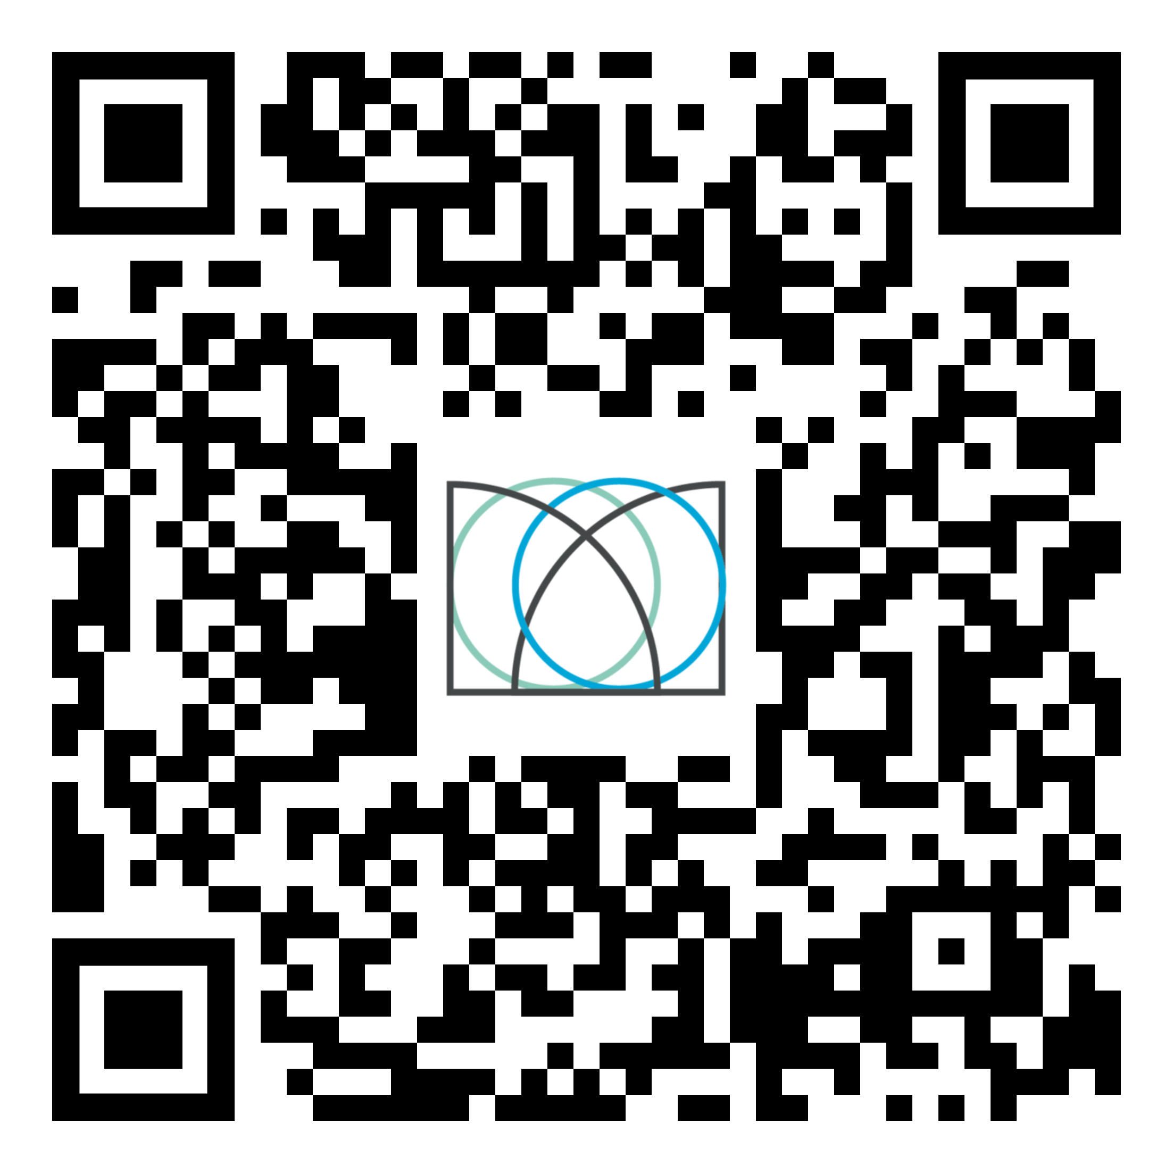
Shape your future with the Warwick Award
Develop & showcase your employability skills
Free to join & recognised by the University
Personalise it to fit your needs & complete it at a time that suits you
Find out more: warwick.ac.uk/warwickaward
or scan the QR code

