Slide 1


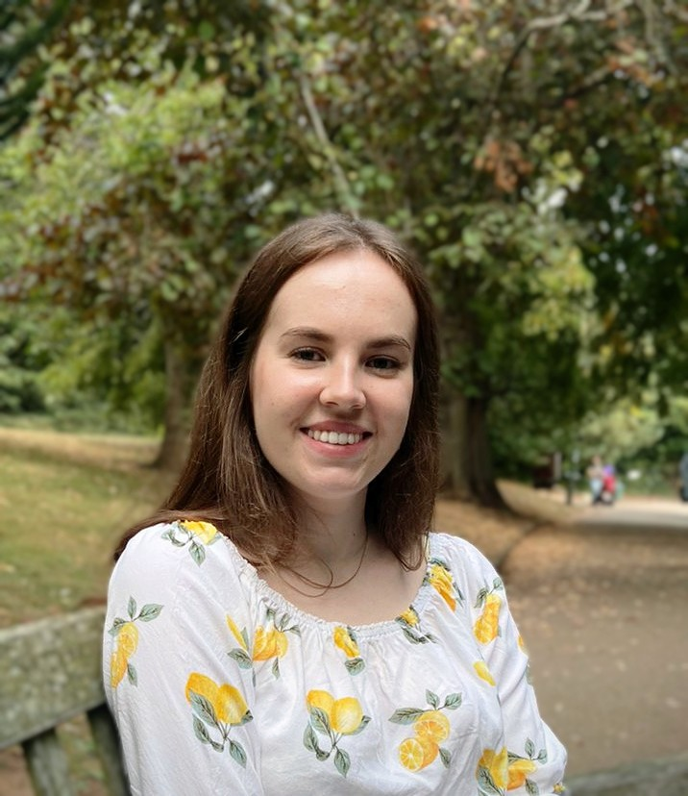
Careers support for English & CLS students at the University of Warwick
Ellie Wetherhill
Careers Consultant
careers@warwick.ac.uk

Slide 2
Career Planning
Self-Awareness | Exploration | Decision-making | Action - Apply
Knowing yourself Your interests, values, skills, strengths, weaknesses and motivations | Research your ideas and options Trying out through gaining experience Talking to people in the role/sector | Make choices : Work experience & other opportunities Roles/sectors Next steps | Put together a CV and get feedback Know how to write cover letters Practice and prepare for interviews

Slide 3
1:1 careers support
Careers guidance
Face to face or via MS Teams
With a Careers Consultant
In-depth conversation about career planning and choices
Mock interviews
Application feedback & opportunity advice
Face to face, via MS Teams or written feedback
With a member of the Job Search team
Feedback on CVs, cover letters, personal statements and application forms
Advice on interviews, assessment centres, searching for work and networking
Ellie Wetherhill is the Careers Consultant linked to English & CLS: book an appointment by visiting MyAdvantage or get in touch via email Ellie.Wetherhill@warwick.ac.uk

Slide 4
Events
Careers Fairs
Autumn Fair- Thur 12th Oct (Week 2)
Law Fair- Tue 24th Oct (Week 4)
Creative Careers Fair- Tue 6th Feb
Employer Talks
Careers Workshops
CVs and Applications
Interviews
Assessment Centres
LinkedIn
Career Planning & Neurodivergence
Survive Job Rejection
Meet the Professionals
Events focused on marketing, tech and data, government and public sector, investment banking and more
Notes:
Careers workshops mentioned are all scheduled to run during autumn term
Further details of careers fairs will be circulated closer to time (locations etc)
All events bookable via MyAdvantage

Slide 5
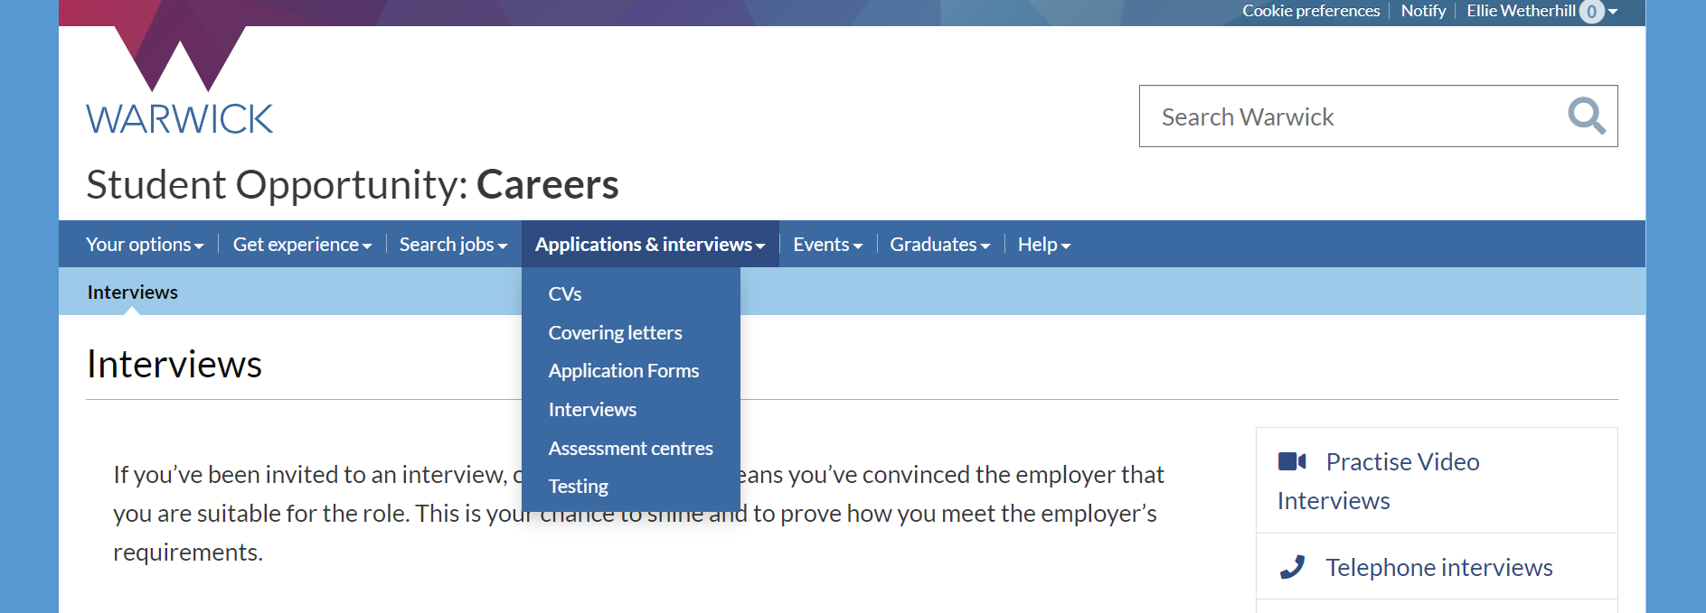
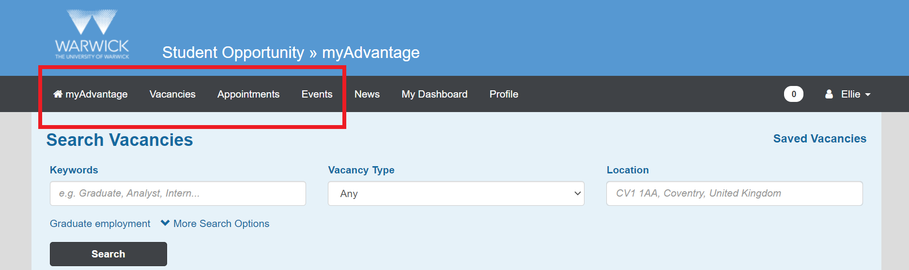
Online resources

Slide 6
Find us – contact us
Student Opportunity Hub: Ground floor, Senate House
Find out more via the Warwick Careers website
Or email us careers@warwick.ac.uk
You can also find us on the following channels:
  Twitter: @so_warwick
  YouTube: Careers and Skills
  Facebook: WarwickStudentOpportunity
  Warwick Careers Blog

Slide 7


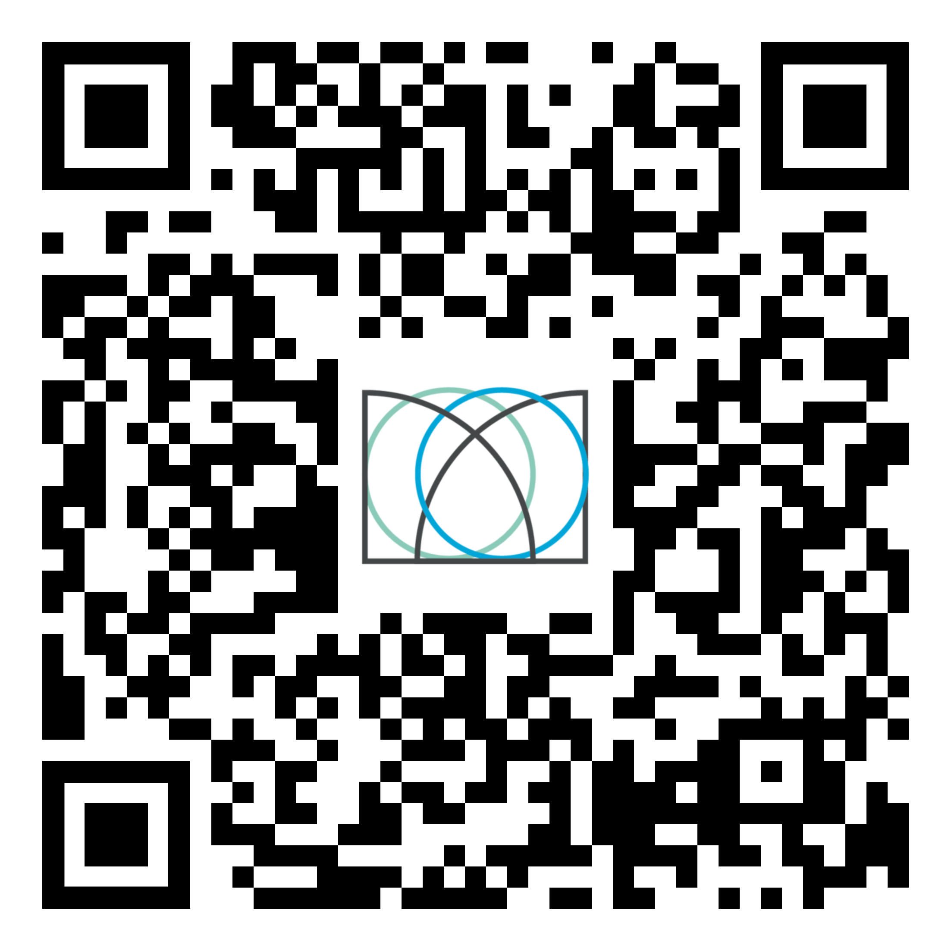
Shape your future with the Warwick Award
Develop & showcase your employability skills
Free to join & recognised by the University
Personalise it to fit your needs & complete it at a time that suits you
Find out more: warwick.ac.uk/warwickaward
or scan the QR code

