Slide 1

Welcome
to ECLS!
Induction 1 for Q300, QW34, VQ32
& Visiting Students
Monday 23rd September 2024

Slide 2
Outline
Welcome from the Head of Department (Prof. Paulo de Medeiros)
Welcome from the First Year DUGS (Dr Sarah Wood)
Introduction to the English Department Office and practical information
Introduction to First Year Modules:
Epic into Novel (Dr John West)
Medieval and Early Modern Literature (Dr Sarah Wood)
Modes of Reading (Dr Myka Tucker-Abramson)
Modern World Literatures (Dr Mike Niblett)
Optional modules from School of Modern Languages and Culture and from The Language Centre
Q&A

Slide 3
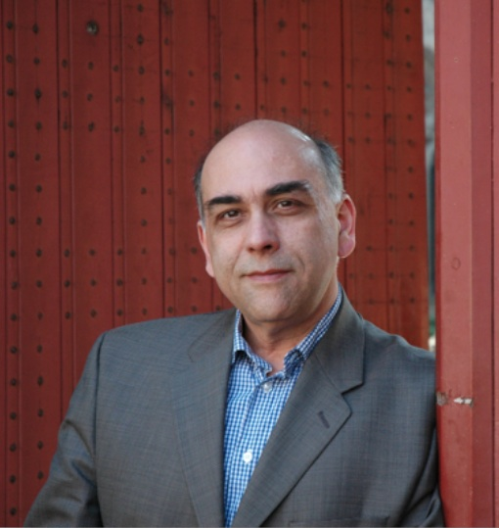
Professor Paulo de Medeiros
Head of the Department
of English and Comparative Literary Studies
(also teaches and researches Critical Theory/World Literature/Lusophone Literature/Modernism/Postcolonial Studies)
My office is FAB 5.08
My email address is: P.De-Medeiros@warwick.ac.uk

Slide 4
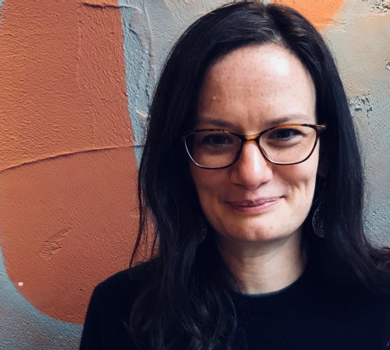
Dr Sarah Wood
Director of Undergraduate Studies (DUGS) for First-Years
(also Reader in Middle English Literature)
My office is FAB 5.57
My email address is: sarah.wood@warwick.ac.uk
https://warwick.ac.uk/fac/arts/english/people/drsarahwood/

Slide 5
Director of Undergraduate Studies (DUGS)
ECLS has one DUGS for first years and one for Honours level (intermediate years and finalists), and they mostly oversee communications about academic work and help with:
Course transfers (in first 3 weeks) and restarts
Temporary withdrawal from study

Slide 6
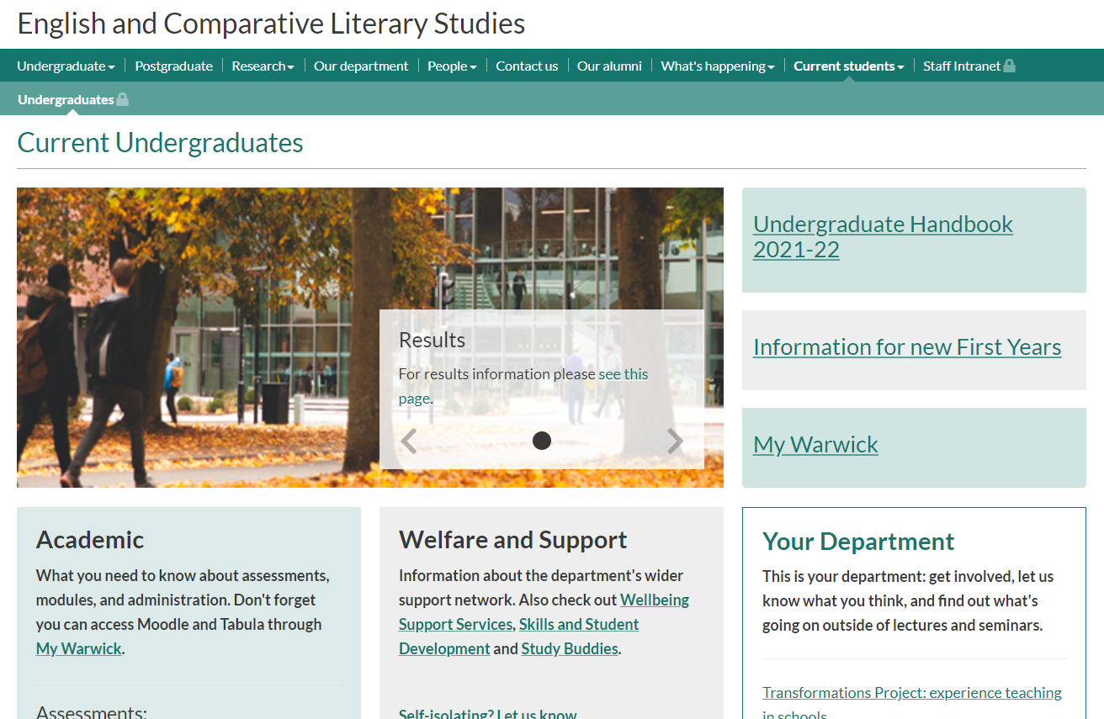
MAIN DEPARTMENT WEBPAGES
https://warwick.ac.uk/fac/arts/english/currentstudents/undergraduate/
First Year UG Info for your first week or so:
https://warwick.ac.uk/fac/arts/english/currentstudents/undergraduate/firstundergraduateyearinfo/

Slide 7
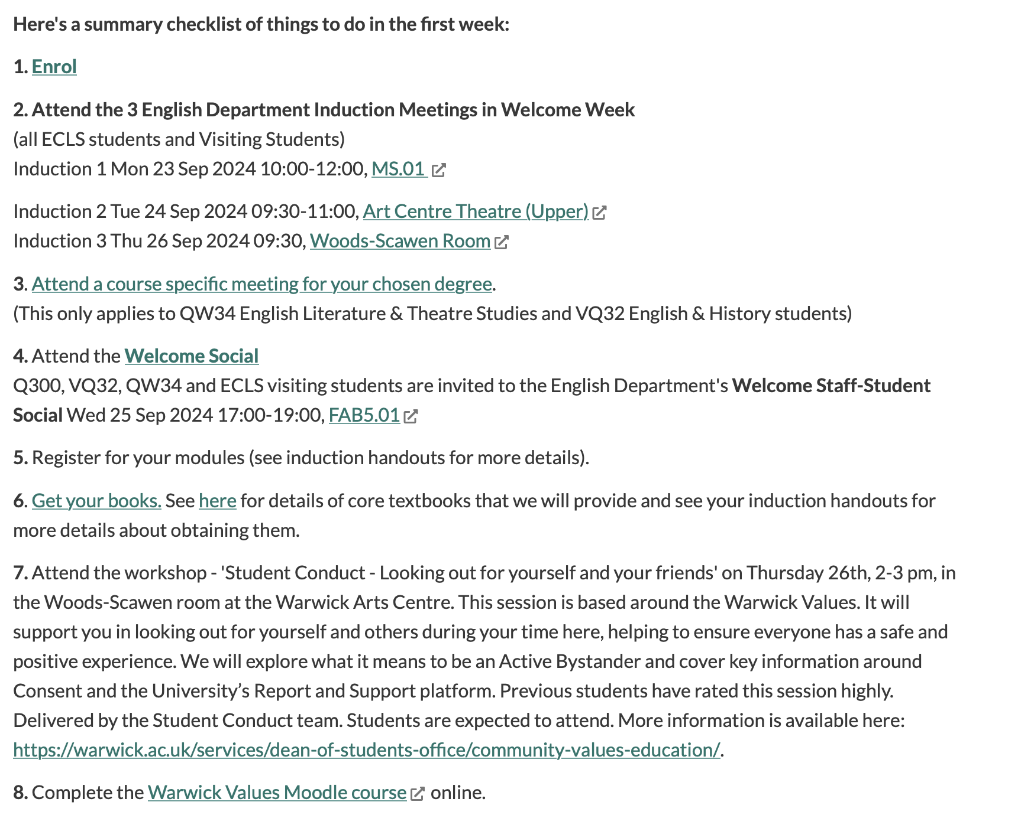

Slide 8
English Department Office
FAB 5.42
Monday-Thursday 10am - 12pm & 2pm – 4pm
Friday 10am - 12pm & 2pm - 3pm
Or email ugenglish@warwick.ac.uk
https://warwick.ac.uk/fac/arts/english/about/

Slide 9
Personal Tutor
Issue with your academic/personal life
Constant low marks; Issues with writing; Advice about choosing modules
Mitigating Circumstances; When you aren't sure where to get help
Course Transfer; Personal issues impacting your wellbeing
Academic Enrichment Tutor
Issue with your academic work more widely (e.g.):
Constant low marks; Issues with writing
Module Tutor and/or Convenor
Issue with module (e.g.):
Accessing lectures; Assessment ideas; Seminar absence; Issues with the seminar; Reading content
English UG office
Administration issues (e.g.)
Tabula/timetabling issues
module registration
enrolment

Slide 10
DUGS
Generally you will be referred to DUGs by your Personal Tutor for course transfers, wider academic issues.
Senior Tutor
Unless the ST contacts you directly, generally you will be referred to the ST by your Personal Tutor for help with managing how health and wellbeing issues impact your studies.
HoD
If you have been to all other sources of help and there is an extremely serious issue you need assistance with, you will be referred to the Head of Department.

Slide 11
YOUR MODULES WITH ECLS
ALL THE FOLLOWING ECLS modules have an informal meet and greet with seminar groups in week 1 (i.e. next week).
There will be lectures to attend in week 1.

Slide 12
EN101: Epic into Novel
Convenor: Dr John West
j.west.1@warwick.ac.uk
EN101 Epic into Novel
Epic is Compulsory for Q300
Optional for QW34 and VQ32

Slide 13

Epic into Novel:
What to do in Week 1
Acquire a copy of Andrew George’s Penguin Classics translation of The Epic of Gilgamesh. Make sure you get the most recent (2020) edition – this is available in paperback and Kindle. Read the “Standard Version”, which is Chapter 1 – it is quite short!
Acquire a copy of Caroline Alexander’s translation of Homer’s Iliad. This is also available as an e-book in the library catalogue.
Start to read the set extracts from this translation in preparation for your seminars in week 2. These extracts are listed on front page of module website.
Note: you will get a free copy of both of these from the Department!
Attend the first lecture in week 1 as detailed on Tabula.
Attend your meet and greet seminar in week 1.

Slide 14
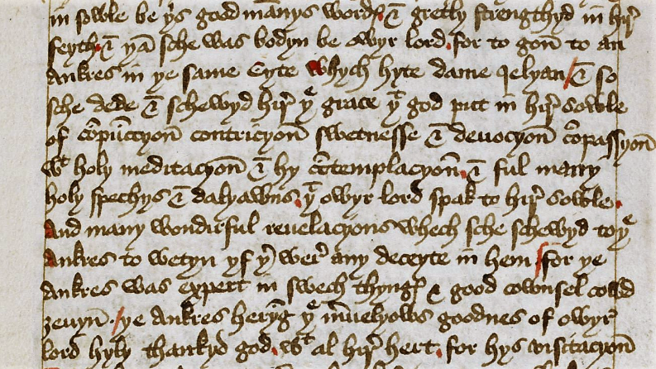
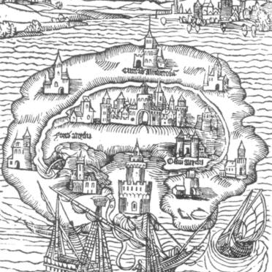
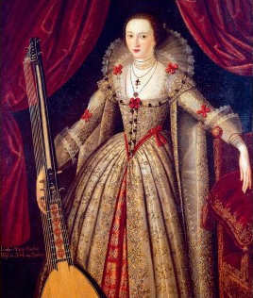
EN121 Medieval and Early Modern Literature
Dr Sarah Wood sarah.wood@warwick.ac.uk https://warwick.ac.uk/fac/arts/english/currentstudents/undergraduate/modules/fulllist/first/en121/
This is Compulsory for Q300 and QW34.
Optional for VQ32 .

Slide 15

What to do next:
Acquire a copy of The Norton Chaucer: The Canterbury Tales, ed. by David Lawton (2019)
Attend the first lecture and welcome seminar in week 1. Lecture: Tues 12, MS0.01
Read The General Prologue, The Miller’s Prologue and Tale, and The Reeve’s Prologue and Tale for your seminar in week 2.
Visit the Reading Middle English page for information about the reading classes in weeks 2-5.

Slide 16






EN122: Modes of Reading
Course convenor: Dr Myka Tucker-Abramson
M.Abramson@warwick.ac.uk
This is Compulsory for Q300
Optional for VQ32 and QW34

Slide 17
What to do in week 1.
Attend the meet and greet seminars with your seminar group in week 1.
Attend the Lecture in week 1, Thursday 10-11am
Please make sure that you have read I Love Dick by Chris Kraus for week 2.

Slide 18
EN123: MODERN WORLD LITERATURES
Convenor: Dr. Mike Niblett
m.niblett@warwick.ac.uk
https://warwick.ac.uk/fac/arts/english/currentstudents/undergraduate/modules/fulllist/first/en123/
Q300’s choose between this and a language module.
Optional for VQ32.
Not available for QW34 this year but can take at hons level.

Slide 19

Modern World Literatures

Slide 20
What to do in week 1 for MWL.
Familiarize yourself with the website
Go through the syllabus reading list
Attend the lecture in week 1, Tuesday, 2pm, as well as the week 1 meet and greet seminars
Make a start on reading Faust Part 1 for the lecture and seminars in week 2.

Slide 21


First Year Core Text Scheme
We will be handing out free copies of selected core texts for modules at the following times in the Student Hub (5th floor of the FAB, by the English Student Support Office) to all home students
Please make a note of the time and date for your specified programme of study
  Monday 23rd September – 12.30pm to 1.30pm – English Literature Students (Surnames A to L)
  Monday 23rd September – 2pm to 3pm – English Literature Students (Surnames M to Z)
  Wednesday 25th September – 11am to 12pm – English and History Students
  Thursday 26th September – 11.30am to 12.30pm – English and Theatre Studies
Please note, some module texts are considered ‘Optional Core’ so will not be available to students on some modes of study

Slide 22
Language Options
Claude Trégoat (The Language Centre/School of Modern Languages and Cultures)

Slide 23

Page title (more bullet points)
Important parts of the text can be highlighted in demi bold weight for added impact.
Nunc a nisl vitae massa volutpat volutpat. Sed bibendum mauris id rutrum feugiat.
Or every bullet point can be in demi bold.
Nunc a nisl vitae massa volutpat volutpat. Sed bibendum mauris id rutrum feugiat.

Slide 24
Our Programmes
Academic
= Modules for credits
normally taken as part of an undergraduate degree course
but also open not for credit - for a £500 fee
Lifelong Language Learning (LLL)
= Courses not for credit
language courses for students, staff, members of the public
More leisurely pace
£250 fee
Two terms - online

Slide 25

Languages
Italian
Japanese (academic only)
Korean
Portuguese (academic only)
Russian (academic only)
Spanish
Arabic
Chinese (Mandarin)
French
German
Hindi (LLL only)

Slide 26

Accelerated Academic Modules
for Able Linguists
In one year:
Beginners Accelerated – Covers levels 1 and 2
Intermediate Accelerated – Covers levels 3 and 4

Slide 27
What to expect from an Academic Module
Class Contact
2-4 hours per week depending on language and level
+ independent study and online language learning
Skills
Listening, speaking, reading, writing, intercultural awareness
Lexis and grammar
Preparation for taking an active part in academic, professional and/or social life in country of language studied
Assessment
Interim test OR Portfolio
+ R/W test
+ Oral test
(+ Listening test for Chinese)

Slide 28
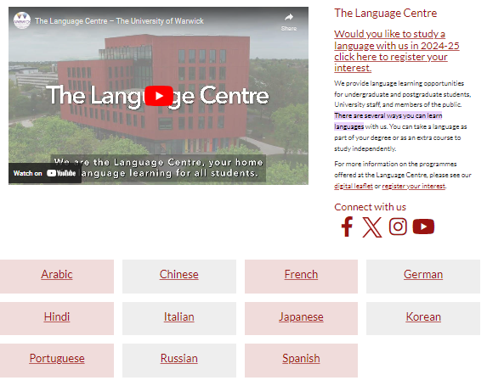

Details of Enrolment

Slide 29
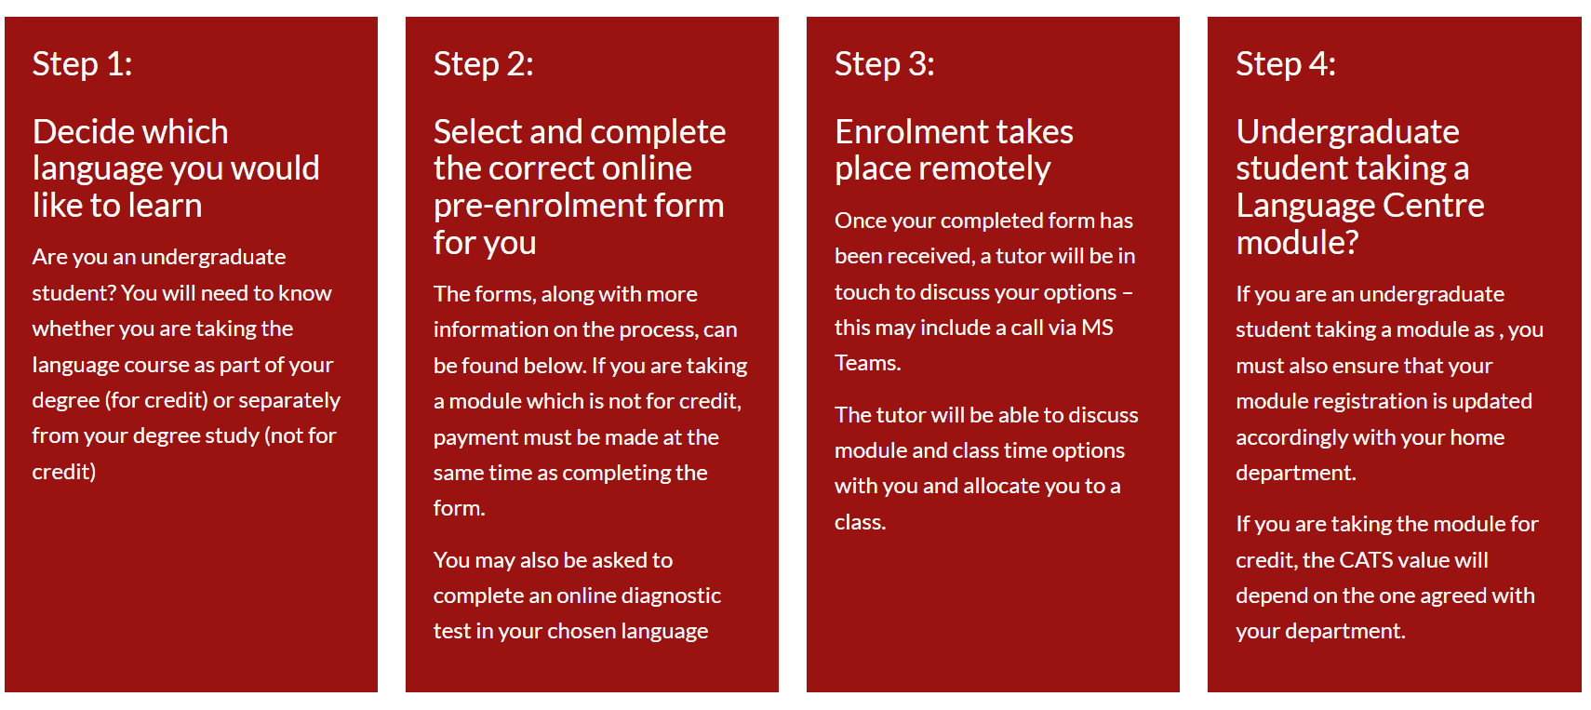
Enrolment – Academic Module

Slide 30
Placement and Diagnostic Testing
It is important that we help you to find the right level for your chosen language
Look at previous qualifications
Brief online test/conversation with tutor
Possibility of transfer in first three weeks of term
GCSE → level 2
Int bac standard grade 4 → level 3
Int bac higher grade 4/5 → level 4
A level grade A/B → level 5
Int bac higher grade 6/7 → level 5

Slide 31

Think now about your future!
Study Abroad
Universities usually require a minimum level of Language Proficiency to offer you a place.
For a work placement, how confident are you with your language skills?
Employability
Employers value people with a knowledge of languages and intercultural awareness.

Slide 32


Can count towards the Warwick Award:
Certification
Language learning appears on HEAR (Higher Education Achievement Record)
Expressed in terms of CEFR (Common European Framework of Reference)
e.g. A2, B1, B2, C1
+ Can count towards the

Slide 33
Can count towards the Warwick Award:
We look forward to meeting You!
Thank you
شكرا 谢谢您 Merci
Danke σας ευχαριστώ
धन्यवाद Grazie ありがとう
Obrigada Спасибо Gracias

Slide 34
Page title (more bullet points)
Important parts of the text can be highlighted in demi bold weight for added impact.
Nunc a nisl vitae massa volutpat volutpat. Sed bibendum mauris id rutrum feugiat.
Or every bullet point can be in demi bold.
Nunc a nisl vitae massa volutpat volutpat. Sed bibendum mauris id rutrum feugiat.

Slide 35
Outside ‘Culture’ modules in SMLC (School of Modern Languages and Cultures)
2024-25

Slide 36
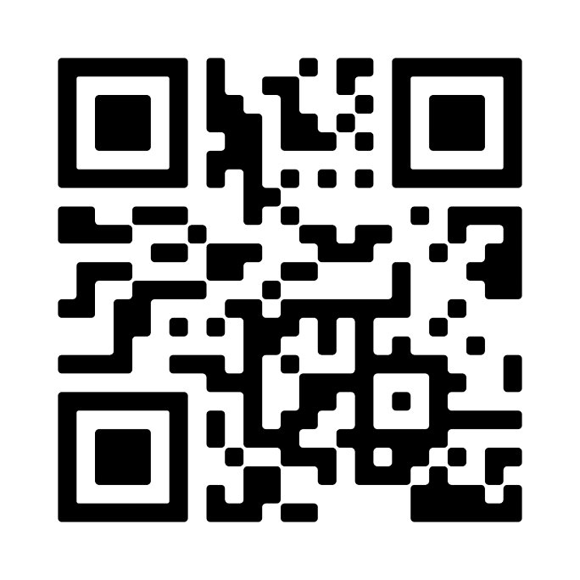
HP103
Language Text and Identity in the Hispanic World
(no pre-requisite)
How does the variety of Spanish spoken across different regions reflect and shape cultural and linguistic identities within Hispanic communities, especially in relation to other languages?
In what ways do writers working between languages, such as Latinx authors, navigate and express their identity through literature?
How do language, literature, and cultural practices (such as football and tango) in Hispanic societies reflect and shape collective and individual identities?

Slide 37
HP 104
Icons and Representations of the Hispanic World
(no pre-requisite)
Where did the familiar stereotypes of Spain and Latin America come from?
How have they circulated and been received at different times and in different places?
And how have cultural representations played out in the entangled histories of Spain and Latin America?

Slide 38
GE 112
Provincial—Pariah—Powerhouse: Reading German-language Culture in a Global Perspective
(No pre-requisite)
How did Germany develop from provinces to a cultural, political and economic powerhouse? How does what Germany was influence what Germany is?
The module focuses in four blocks on the media and representations through which many of us first encounter German-language culture: fairy-tales and their afterlives; performance; screen culture; music, art and museums.
Sample the works and ideas that have put Germany and the German language on the world map.

Slide 39
FR121
The Story of Modern France
(some prior knowledge or GCSE required)
Through a mixture of genres spanning the 12th to 21st centuries (political prints and posters, short fiction, film, epic and essay), we’ll consider the following:
How should we understand modern French identity, and where do ideas about French and francophone identities come from?
How are national narratives created? Why are storytelling and mythmaking such powerful tools?
How has France's relationship with the francophone world developed and changed over time?

Slide 40
IT116
Introducing Italy: Local and Global Perspectives
(some prior knowledge or GCSE required)
What do we mean by Italian culture and Italian identity?
How has interaction with other cultures shaped Italian identities?
How has Italian thought and culture shaped the world around us?
What impact has mobility and migration had on Italy?

Slide 41
Assessment patterns
Teaching arrangements
Weekly lectures and seminars
Regular contribution to online discussion areas
Working in partnership with other members of group outside the class
Teaching on cultural modules starts in week 1
Formative task during term 1
Summative written tasks
Presentations OR creative assignments
Summer exam paper

Slide 42
To sum up
HP103 Language Text and Identity in the Hispanic World
HP103 Language, text and identity-20230911_200135-Meeting Recording.mp4 (sharepoint.com)
Module Convenor: Raquel Navas r.navas@warwick.ac.uk
HP104 Icons and Representations of the Hispanic World
HP104 Introduction to the module 2024-25
Module Convenor: Michela Coletta m.coletta@warwick.ac.uk
GE112 Provincial—Pariah—Powerhouse: Reading German-language Culture in a Global Perspective
Introduction to GE112.mp4 (sharepoint.com)
Module Convenor: Dan Hall. D.Hall.3@warwick.ac.uk
FR121 The Story of Modern France (some prior knowledge of French or GCSE level)
Watch 'French Welcome intro video Story of Modern France' | Microsoft Stream (Classic)
Module Convenor: Cathy Hampton C.M.Hampton@warwick.ac.uk and Philippe Le Goff P.Le-Goff@warwick.ac.uk
IT116 Introducing Italy: Local and Global Perspectives (some prior knowledge of Italian or GCSE level)
Introductory video to IT116 Introducing Italy: Local and Global Perspectives
Module Convenor: Cecilia Piantanida cecilia.piantanida@warwick.ac.uk
IF YOU ARE NOT SURE ABOUT MODULE CHOICES, PLEASE CONTACT THE MODULE CONVENOR CONCERNED.

Slide 43
WHAT’S NEXT?
TOMORROW: Tues 24th Sept
9.30am Induction 2 for Q300, VQ32, QW34 and ECLS Visiting Students. Arts Centre Theatre
Events with Theatre department for students on QW34

