Slide 1

ECLS Induction 2
Further Academic Support and Welfare
Tuesday 24th September, 9.30-11am

Slide 2
Outline
Overview of Session:
Introduction to the Academic Enrichment Programme (Dr Jen Baker)
ECLS and Employability (Ellie Wetherhill, Careers Consultant)
The Library with Sarah Akhtaruzzaman from the Library
Introduction to the UG Handbook
Senior Tutor and welfare (Dr Teresa Grant, Senior Tutor)

Slide 3
The Academic Enrichment Programme (FYAE)
Convenor: Dr Jen Baker - J.Baker.5@warwick.ac.uk (also Director of Student Experience and lecturer on c19th and Gothic modules at hons level)
Support with:
academic writing and research skills for Q300, VQ32, and QW34 students.
Personal and Professional development (e.g. employability skills)
Being a scholar and part of a new community

Slide 4
The Academic Enrichment Programme (FYAE)
Is compulsory course across year 1 and year 2, with a mixture of lectures, tutor sessions, workshops, and online materials.
You have been allocated a seminar time and tutor on Tabula, these alternate with all-year group lectures – see Tabula timetable.
FIRST SESSION "Hidden Curriculum" is next Monday 30th September at 9am (location in tabula)
Week 2 is a lecture.

Slide 5
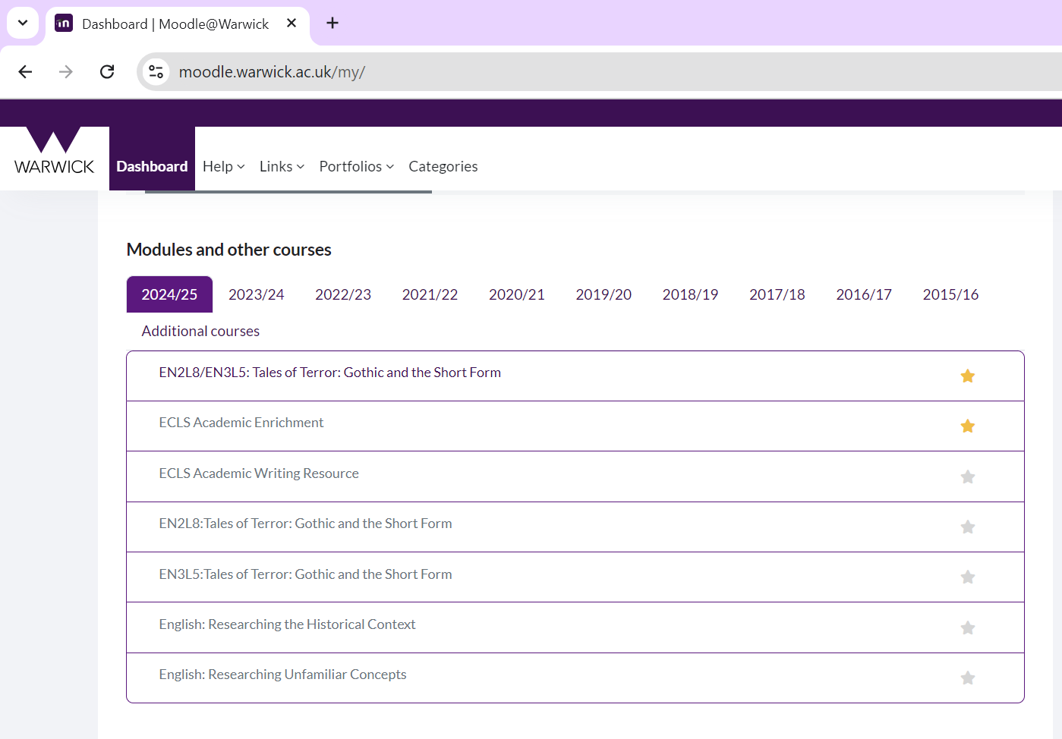
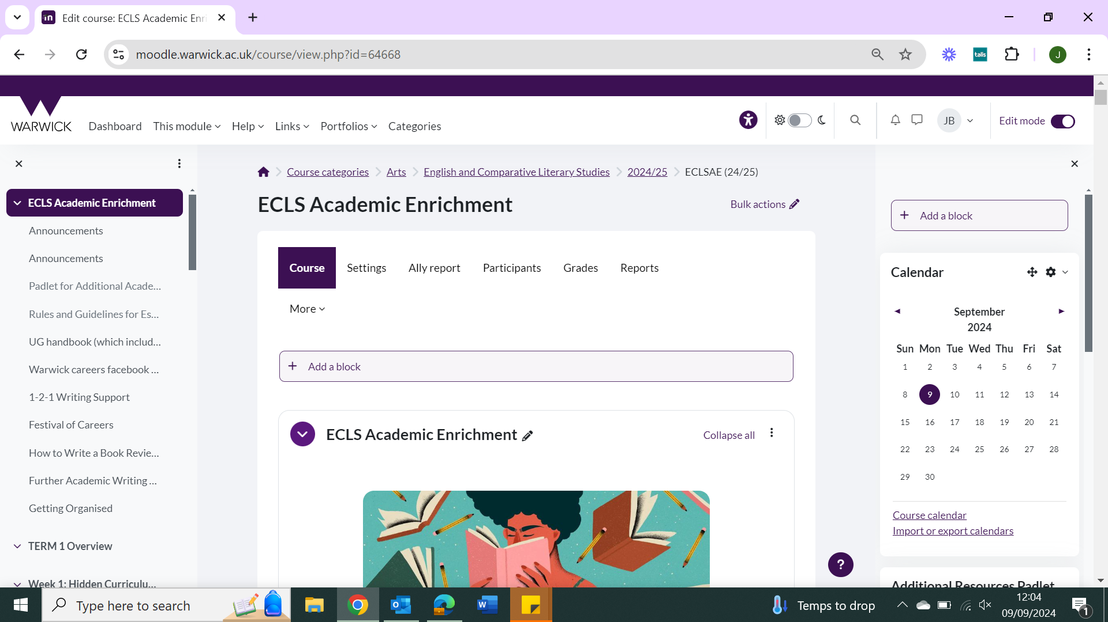



Slide 6
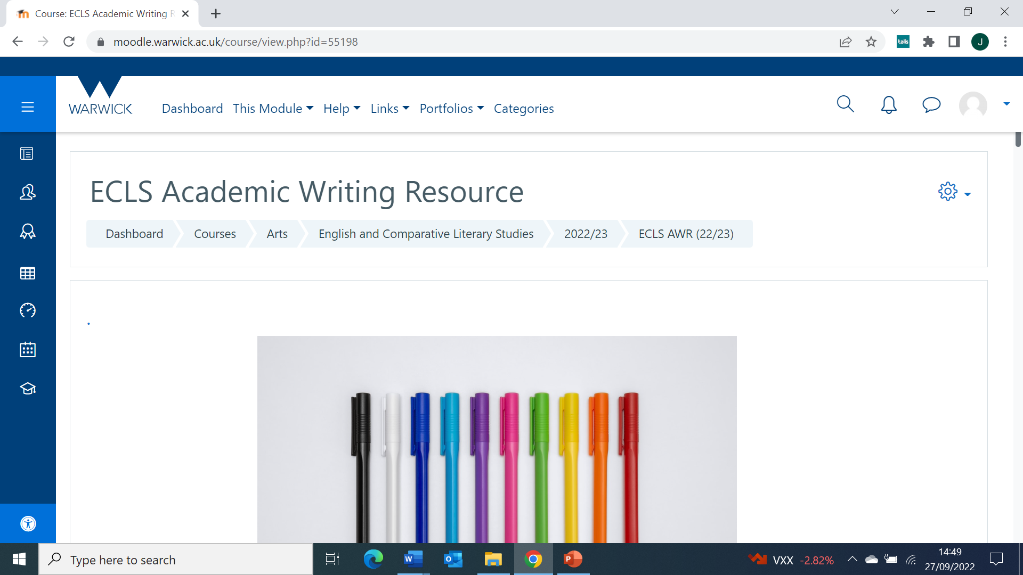
Academic Writing Resource
All students, including joint hons and Visiting Students have access to our Academic Writing Moodle
You can also use our 1-2-1 writing service

Slide 7
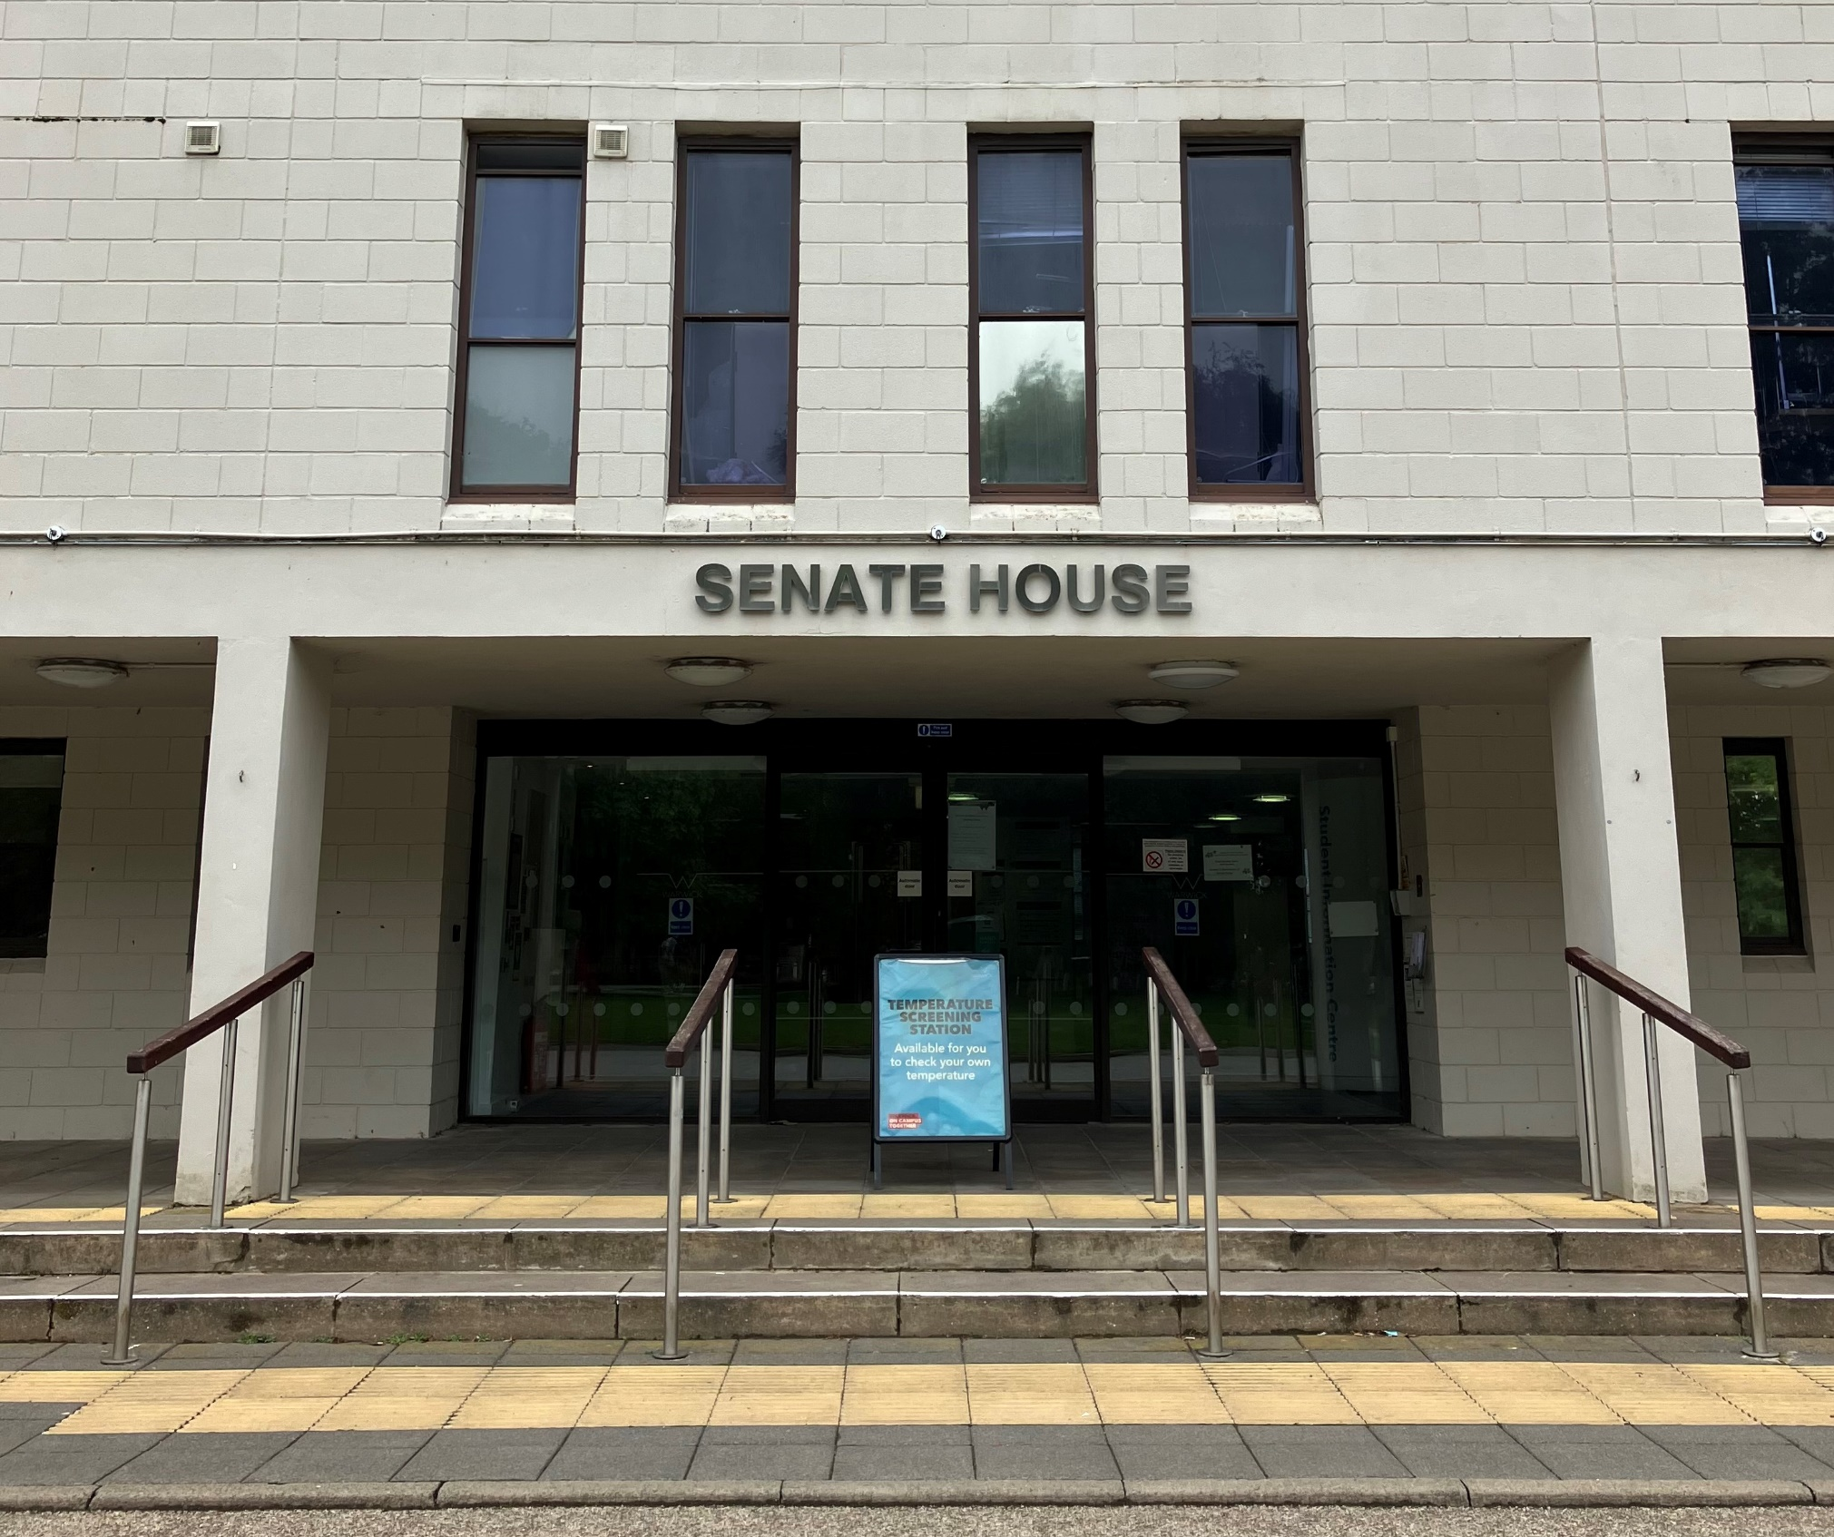
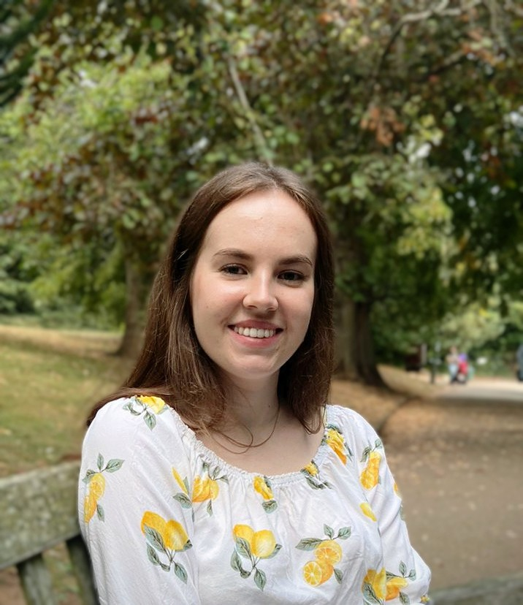
Careers support for English & CLS students
Ellie Wetherhill
Careers Consultant
careers@warwick.ac.uk

Slide 8
When should I contact careers?
Whenever!
Know what you want to do and need more information to make it happen
Have no idea what you want to do
About to finish degree and not found a job yet
Feeling a bit lost and needing to re-plan
In your first year and planning ahead
Applying to roles and hearing a lot of ‘no’s

Slide 9

1:1 careers support
Careers guidance
Face to face or via MS Teams
With a Careers Consultant
In-depth conversation about career planning and choices
Application feedback & opportunity advice
Face to face, via MS Teams or written feedback
With a member of the Job Search team
Feedback on CVs, cover letters, personal statements and application forms
Advice on interviews, assessment centres, searching for work and networking
Ellie Wetherhill is the Careers Consultant linked to English & CLS: book an appointment by visiting MyAdvantage or get in touch via email Ellie.Wetherhill@warwick.ac.uk

Slide 10
Events
Careers Fairs
Autumn Fair- Thur 10th Oct (Week 2)
Law Fair- Tue 22nd Oct (Week 4)
Creative Careers Fair- Spring Term
Employer Talks
Hear from employers what they’re looking for in applicants
Careers Workshops
CVs and Applications
Interviews
Assessment Centres
LinkedIn
Career Planning & Neurodivergence
Staying motivated with applications
Using AI in your career planning
Meet the Professionals
Meet Warwick grads working in a range of sectors
Notes:
Careers workshops mentioned are all scheduled to run during autumn term
Further details of careers fairs will be circulated closer to time (locations etc)
All events bookable via MyAdvantage

Slide 11
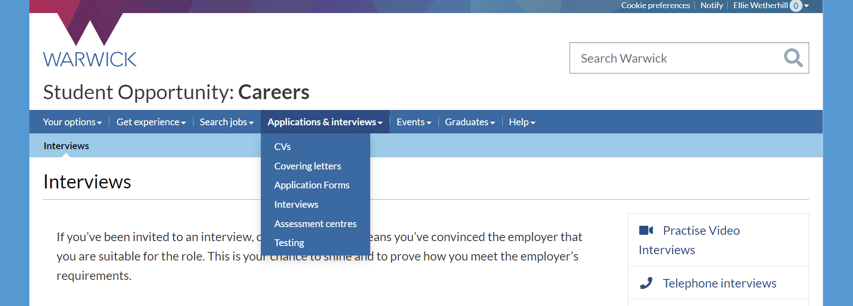
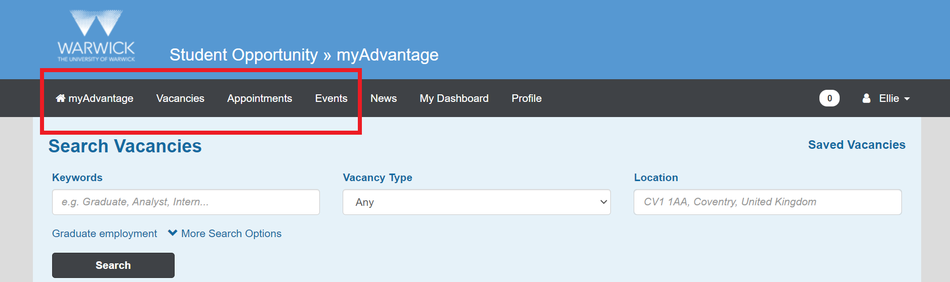
Online resources
Warwick Careers website

Slide 12

Find us – contact us
Student Opportunity Hub: Ground floor, Senate House
Find out more via the Warwick Careers website
Or email us careers@warwick.ac.uk
You can also find articles on specific topics on the Warwick Careers Blog

Slide 13


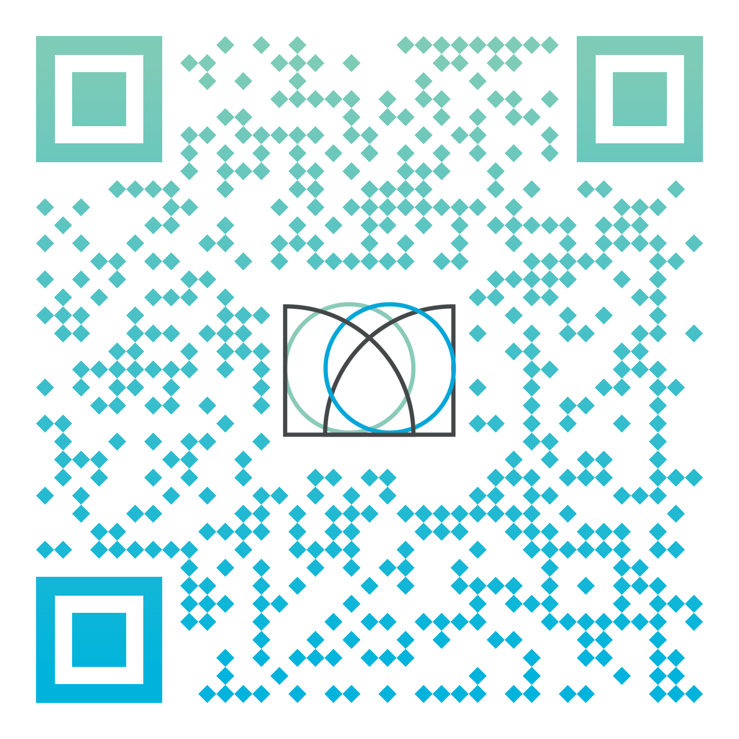
Shape your future with the Warwick Award
A free University Award programme to help you develop core skills during your time at Warwick.
Officially recognised by the University, appearing on your Higher Education Achievement Record
Can be personalised to suit your training and development needs, and completed at any time during your studies
Find out more at warwick.ac.uk/warwickaward or scan the QR code to sign up/sign in

Slide 14

Why join?
The chance to recognise, reflect on and articulate skills
Identify areas for development
Navigate opportunities from across campus
Try new activities and experiences
Have fun, make friends, belong to the Warwick community

Slide 15
Getting started
Make sure you Gradintelligence account is activated
Register for the Warwick Award
Complete the skills profiler
Browse or search for activities – register and claim the points by submitting your reflection
If you have any questions or need any help you can:
Contact the skills team on skills@warwick.ac.uk
Contact me directly on zoe.young@warwick.ac.uk
Go to the Warwick Award website for further information and FAQs

Slide 16
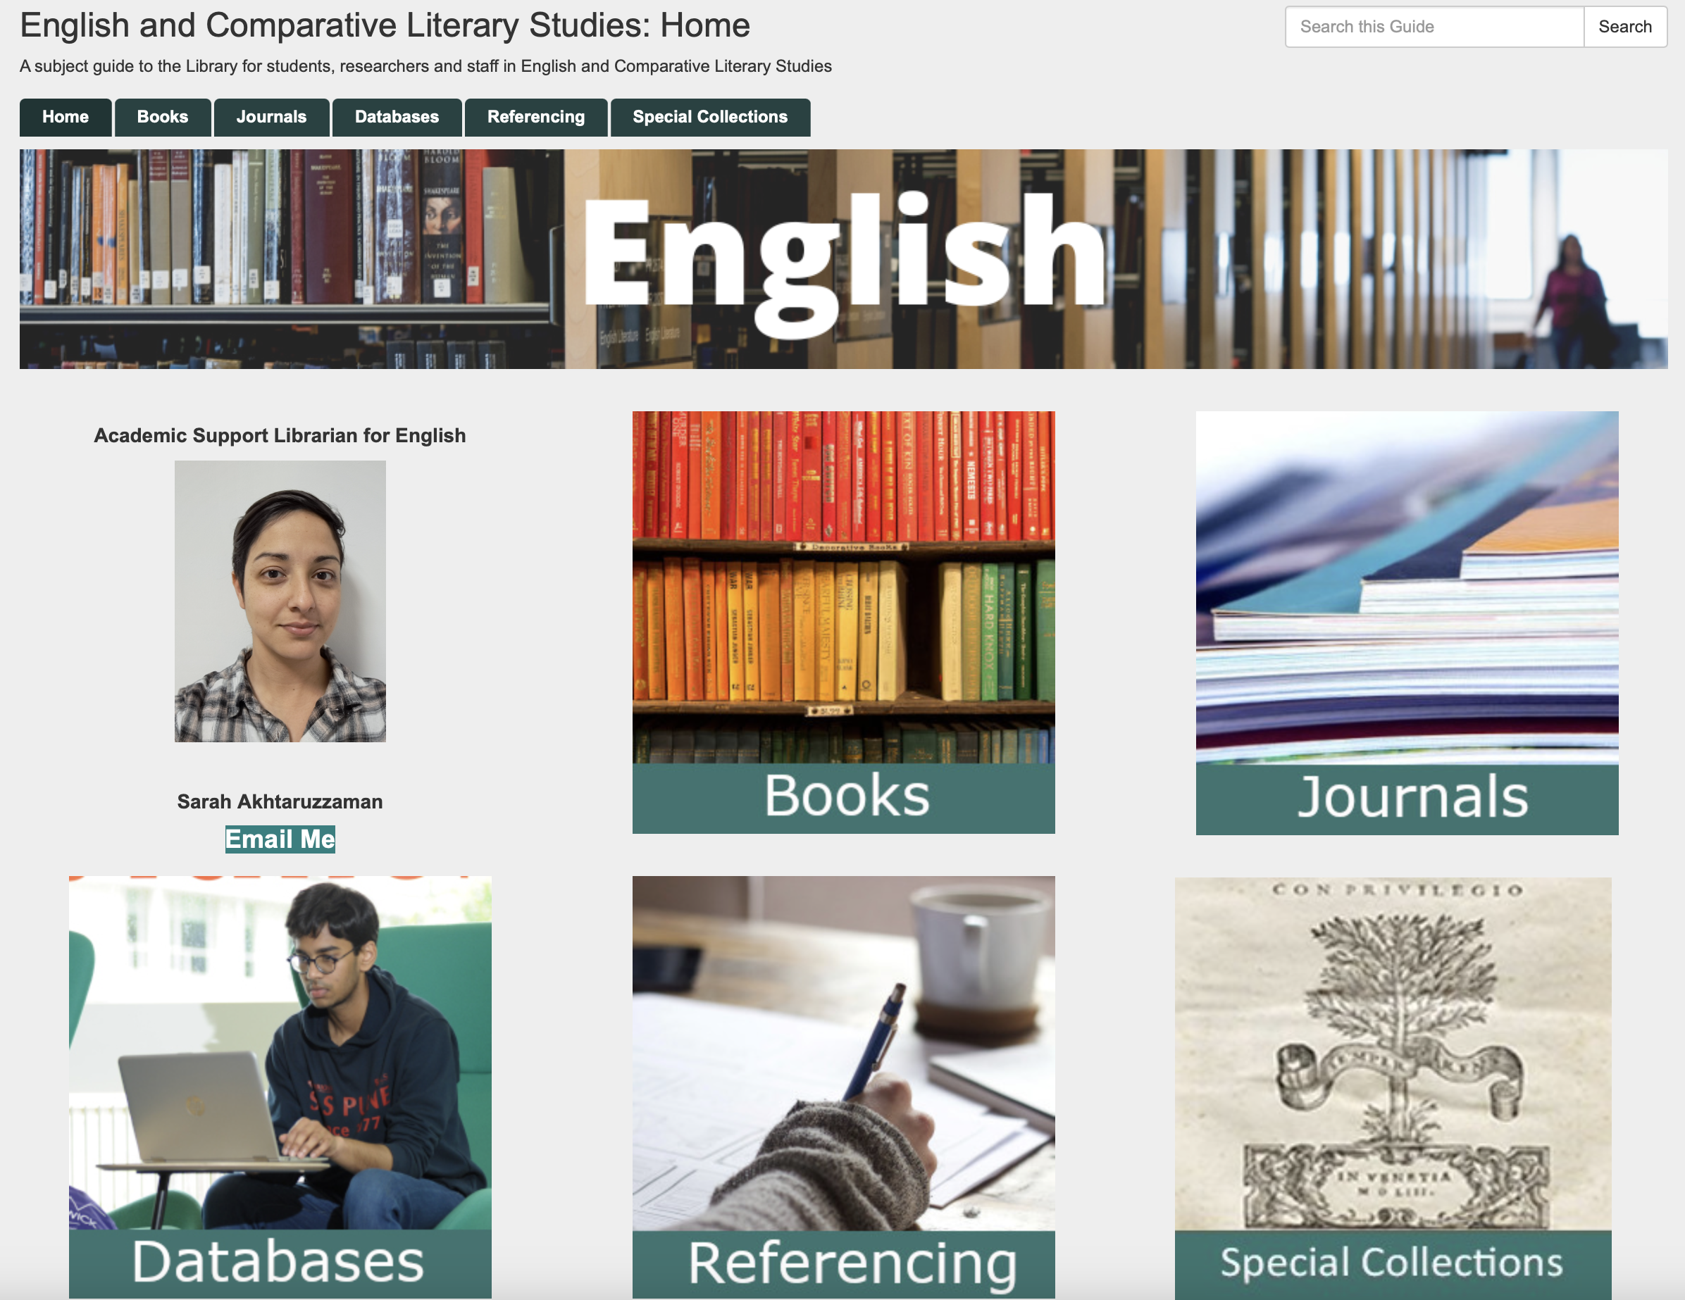
The Library: support for English https://warwick.libguides.com/english

Slide 17
Dr Sarah Wood
Director of UG Studies for first year students & Reader in Middle English Literature sarah.wood@warwick.ac.uk
I mostly oversee communications about academic work and help with:
Course transfers (by end of week 3 term 1) and restarts
Temporary withdrawal from study
This week you can drop in to see me on Weds 12-1pm in FAB 5.57 about any of the above or if you need help with anything.

Slide 18


English classes for international students
https://livewarwickac.sharepoint.com/sites/EnglishforAcademicPurposes

Slide 19
The Handbook
https://warwick.ac.uk/fac/arts/english/currentstudents/undergraduate/

Slide 20
If the induction slides or induction handout don’t answer your question about Tabula/seminar sign-up, or other administrative issues then get in touch with the UG office:
FAB 5.42
Monday-Thursday 10am - 12pm & 2pm – 4pm
Friday 10am - 12pm & 2pm - 3pm
Or email ugenglish@warwick.ac.uk

Slide 21
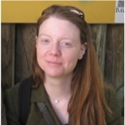
Dr Teresa Grant
Senior Tutor (also Professor in Renaissance Theatre)
My office is FAB 5.25
My email address for ST business is: englishseniortutor@warwick.ac.uk

Slide 22
SENIOR TUTOR
The Senior Tutor is responsible for overseeing student support and welfare, including:
The Personal Tutor System
Liaison with Wellbeing and Disability Services
Advice about Mitigating Circumstances and Reasonable Adjustments (if your personal tutor can’t help)

Slide 23
PERSONAL TUTOR SYSTEM
You will be allocated a Personal Tutor who is also an academic in the department and offers personal support and guidance during your degree. Their information will be on your Tabula profile.
You will meet them individually at least once a term. This is one of your monitoring points.
They can help with aspects such as general advice about studying and learning; module selection; signpost to other areas of support; provide references; communicate with other tutors if you encounter major issues.

Slide 24
University Support Services
Outside of the department there are various services that can help if you are in difficulty during your degree.
You can access them directly without speaking to the department first, but can also ask your personal tutor to help sign-post, if you are unsure what help you need or want to alert them to issues you are facing.

Slide 25
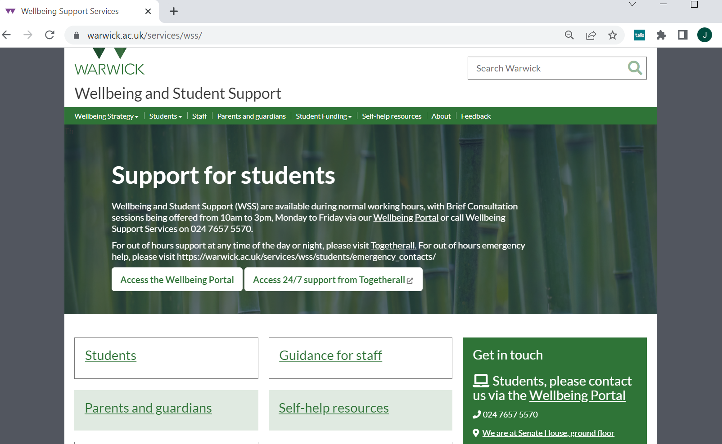
This is the place to go to get help with emotional/psychological, work/stress, study strategies, and is also the portal for Disability Support

Slide 26
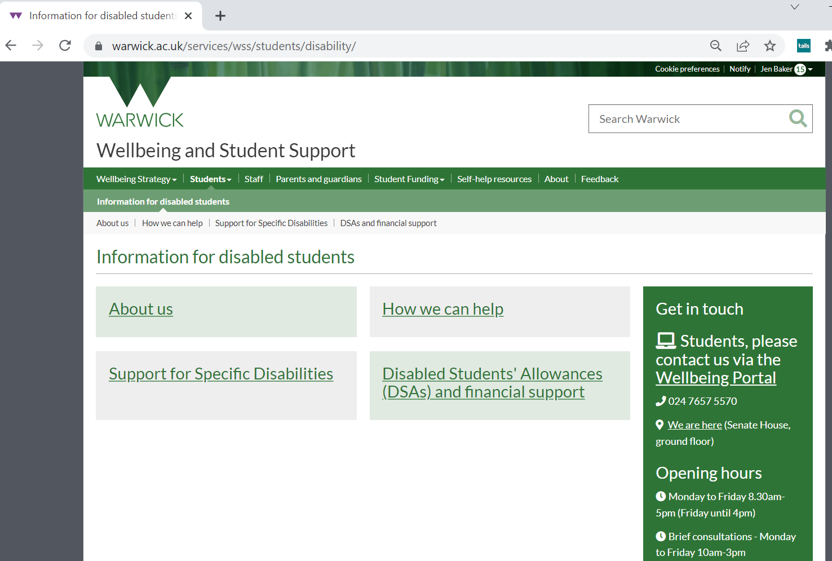
The University Disability Support team helps in various ways including mediating financial and academic support (called Reasonable Adjustments) for students with physical disabilities as well as mental health conditions and neurodiversity such as (ADHD, ASC, dyslexia).
This is the case whether you already had support pre-University or think you need to be screened for an undiagnosed condition during the degree.
The sooner these RAs are made the better!
IMPORTANT Even if you declared a condition when you applied you should still contact Disability services for a 1-2-1 so that they can discuss the right support for you.

Slide 27
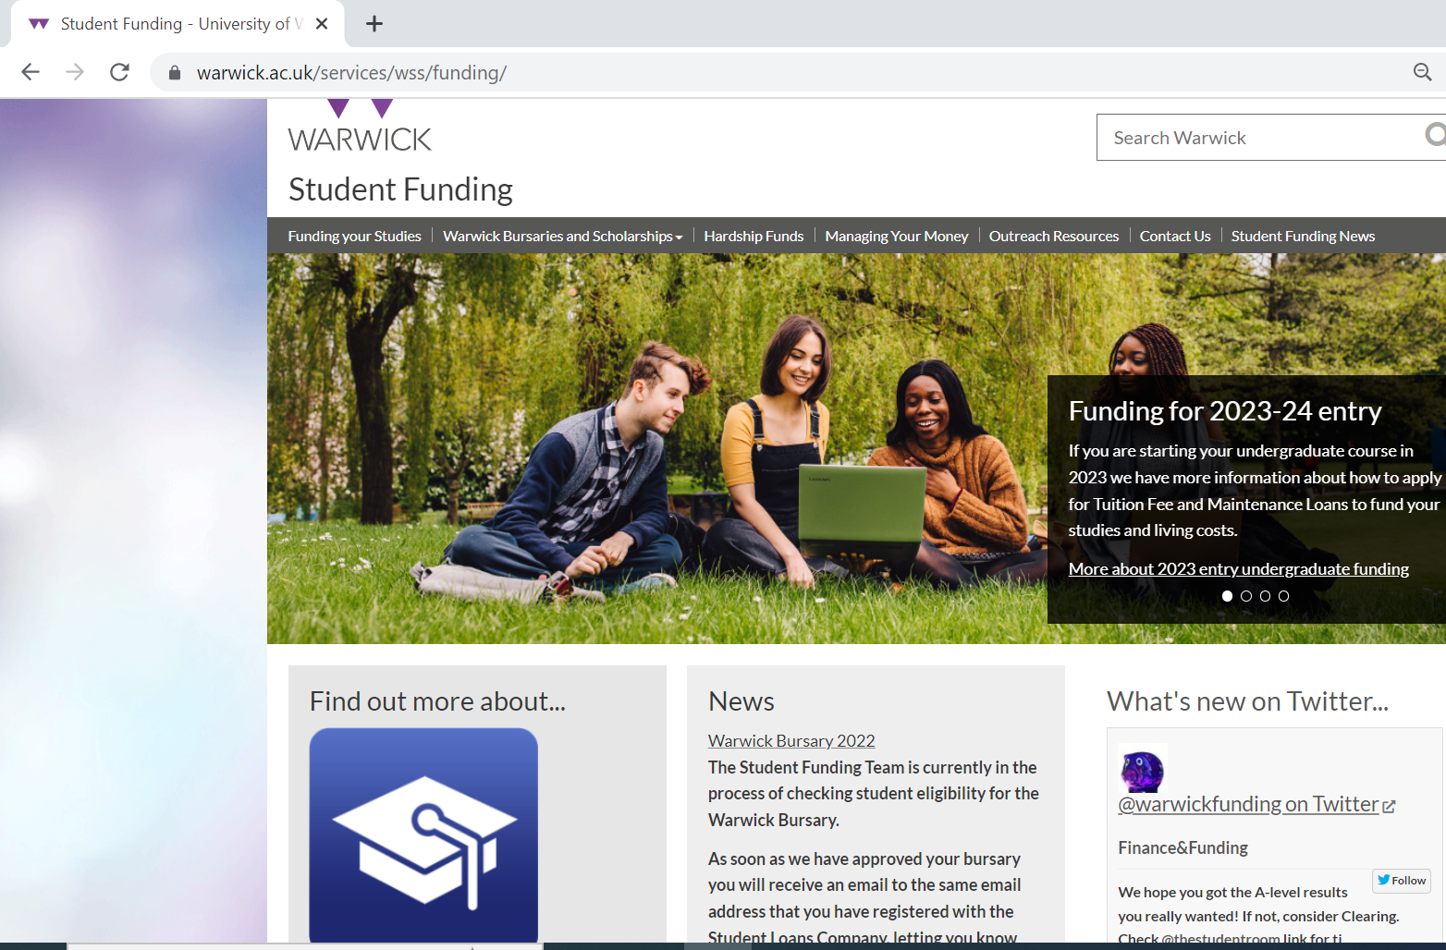
The University Student Funding pages can help with bursary applications, advice on budgeting and advice on Hardship Funds.
If you are a Widening Participation Student you can also speak to Alex Breeze who works in the English department.

Slide 28
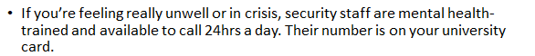
Other Support Services
Student’s Union Advice Centre (you will meet them at Induction 3)
Library Study-Happy Team
The Health Centre
Residential Life Team if you live on campus
Report and Support

Slide 29
Mitigating Circumstances
are acute, severe, exceptional circumstances outside the student’s control which affect their ability to complete work. Circumstances eligible for mitigating circumstances will usually be unforeseen and not normally of a duration greater than a term
Contact your Personal Tutor if there is some unexpected problem, illness or situation affecting your work that we should know about.
Keep dates/details as things go along, and save any external evidence (such as GP letters, hospital admissions, legal documents, supporting statements).
If you think this has affected your work significantly, you can make a claim at the end of the year for these circumstances to be taken into account by the exam board in relation to your assessment, and/or degree classification. This can lead to greater options if you have work missing or with considerable late penalties, for instance. Your Personal Tutor can help with this process.
The request is made is via the Personal Circumstances button on Tabula
There are details in the online department Handbook as to what constitutes appropriate evidence, and how sensitive information is handled in such matters.

Slide 30
What’s next?
Tomorrow - QW34 English and Theatre specific degree meeting at 12pm with Dr Jo Hofer-Robinson (FAB 5.03)
Tomorrow - Staff-Student Social at 5-7pm in FAB5.01
Thursday - final induction for ECLS at 9.30am in Woods Scawen room (Arts Centre). Plus workshop 'Looking out for yourself and your friends'
Thursday – VQ32 English and History specific degree meeting with Dr Alice Kelly at 3pm (FAB 5.03)

