Slide 1


English and Creative Writing,
English and French;
English and Hispanic Studies;
English and German;
English and Italian;
Film and Literature;
Philosophy and Literature;
Philosophy, Literature and Classics;
English and Classics;
and modules as part of the Liberal Arts English Pathway
Welcome
to ECLS!
Joint Honours Induction
Wednesday 25th September 2024

Slide 2
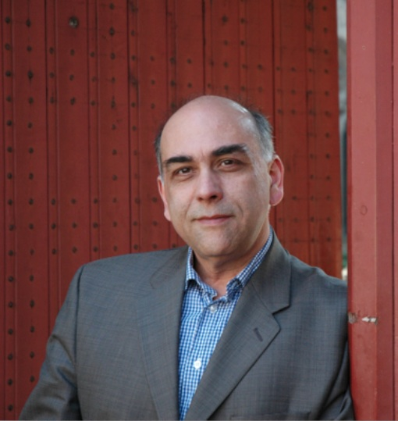
Professor Paulo de Medeiros
Head of the Department
of English and Comparative Literary Studies
(also teaches and researches Critical Theory/World Literature/Lusophone Literature/Modernism/Postcolonial Studies)
My office is FAB 5.08
My email address is: P.De-Medeiros@warwick.ac.uk

Slide 3
Dr Sarah Wood
First Year Director of Undergraduate Studies (DUGS)
(also Convenor of EN121 Medieval and Early Modern Literature)
My office is FAB 5.57
My email address is: sarah.wood@warwick.ac.uk
https://warwick.ac.uk/fac/arts/english/people/drsarahwood/

Slide 4
Joint Honours (warwick.ac.uk)
Tabula (warwick.ac.uk)
Handbook (warwick.ac.uk)

Slide 5
English UG office:
FAB, 5th Floor, room 5.42 (you need card access)
Or email ugenglish@warwick.ac.uk
If the induction slides or induction handout doesn’t answer your question about Tabula/seminar sign-up, then get in touch with the UG office

Slide 6
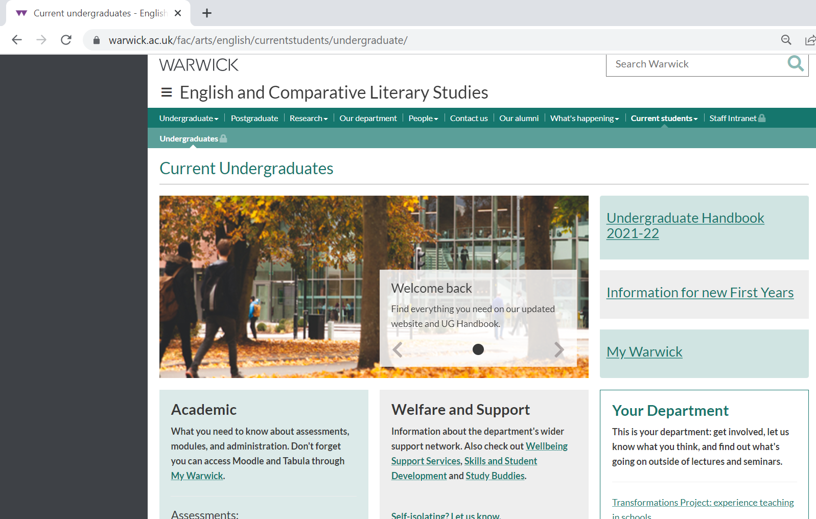
MAIN DEPARTMENT WEBPAGES
https://warwick.ac.uk/fac/arts/english/currentstudents/undergraduate/

Slide 7
ALL ECLS modules have an Introductory meet and greet with registered seminar groups in week 1, but don’t worry if you miss these because of choosing between options.
Each ECLS module has an Introductory lecture in week 1. These will be particularly useful if you need help choosing between modules. See your induction handout for times.
Official ECLS seminars, for which you need to have done some preparatory reading, begin in week 2.

Slide 8

First Year English 30 CAT Modules: An Overview
 | Modes of Reading | Medieval to Renaissance | Epic into the Novel | Modern World Lit
Film and Literature
English &Creative Writing
Classics and English |  | Option 1 or | Option 2
Philosophy, Literature and Classics | Option 1 or |  | Option 2
Philosophy and Literature |  | Option 1 or | Option 2 or | Option 3 or
English and French |  | Option 1 or | Option 2 or | Option 3
English and German |  | Option 1 or | Option 2 or | Option 3
English and Italian |  | Option 1 or | Option 2 or | Option 3
English and Hispanic Studies |  | Option 1 or | Option 2 or | Option 3
Centre for Lifelong Learning |  | Option 1 or | Option 2 or | Option 3
Option 4 30 CATS Philos modules instead

Slide 9
EN101: Epic into Novel
Convenor: Dr John West
Email address: j.west.1@warwick.ac.uk
EN101 Epic into Novel - Honours Variants – EN2J4/EN3J4 (warwick.ac.uk)

Slide 10

Epic into Novel:
What to do in Week 1
Acquire a copy of Andrew George’s Penguin Classics translation of The Epic of Gilgamesh. Make sure you get the most recent (2020) edition – this is available in paperback and Kindle. Read the “Standard Version”, which is Chapter 1 – it is quite short!
Acquire a copy of Caroline Alexander’s translation of Homer’s Iliad. This is also available as an e-book in the library catalogue.
Start to read the set extracts from this translation in preparation for your seminars in week 2. These extracts are listed on front page of module website.
Attend the first lecture in week 1 as detailed on Tabula.
Attend your meet and greet seminar in week 1.

Slide 11
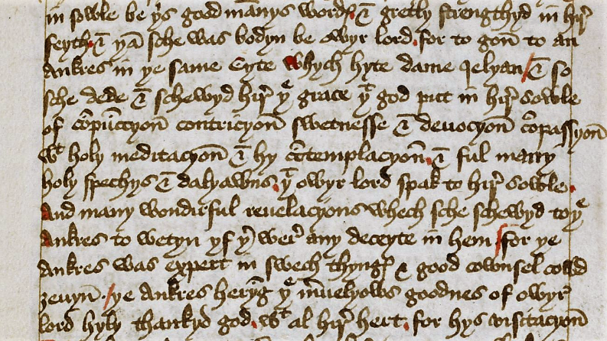
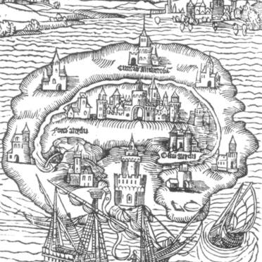
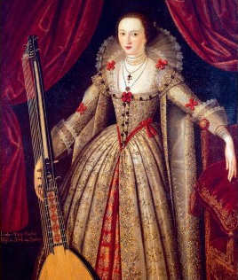
EN121 Medieval and Early Modern Literature
Dr Sarah Wood sarah.wood@warwick.ac.uk https://warwick.ac.uk/fac/arts/english/currentstudents/undergraduate/modules/fulllist/first/en121/

Slide 12

What to do next:
Acquire a copy of The Norton Chaucer: The Canterbury Tales, ed. by David Lawton (2019)
Attend the first lecture in week 1
Attend your meet and greet seminar
Read The General Prologue, The Miller’s Prologue and Tale, and The Reeve’s Prologue and Tale for your seminar in week 2.
Visit the Reading Middle English page for information about the reading classes in weeks 2-5.

Slide 13






EN122: Modes of Reading
Course convenor: Dr Myka Tucker-Abramson
M.Abramson@warwick.ac.uk

Slide 14
What to do in week 1.
Attend the meet and greet seminars with your seminar group in week 1.
Attend the Lecture in week 1, Thursday 10-11am
Please make sure that you have read I Love Dick by Chris Kraus for week 2.

Slide 15
EN123: MODERN WORLD LITERATURES
Convenor: Dr. Mike Niblett
m.niblett@warwick.ac.uk
https://warwick.ac.uk/fac/arts/english/currentstudents/undergraduate/modules/fulllist/first/en123/

Slide 16

Modern World Literatures

Slide 17
What to do in week 1 for MWL.
Familiarize yourself with the website
Go through the syllabus reading list
Attend the lecture in week 1, Tuesday (4th), 2pm, as well as the week 1 meet and greet seminars
Make a start on reading Faust Part 1 for the lecture and seminars in week 2.

Slide 18
Academic Writing Moodle
This is resource contains over 40 screencasts on all topics associated with researching, planning and writing your assignments for ECLS.
It will also be updated during the coming academic year with further worked example resources on a variety of writing and research skills.
You will be added to this Moodle in the first couple of weeks of Term 1, so you don’t need to take any action now.

Slide 19
REASONABLE ADJUSTMENTS
If you have spoken to Wellbeing Services and your home department about Reasonable Adjustments for any physical or mental health condition that impacts your studies, once a report is created it will be shared with us.
If you want to use your flexible deadlines, you may then apply for an extension of up to 7 days using the 'Extension' button in Tabula. You can simply write in the comments box that you have RAs and attach the report or add notes to make us aware of any situation.

Slide 20
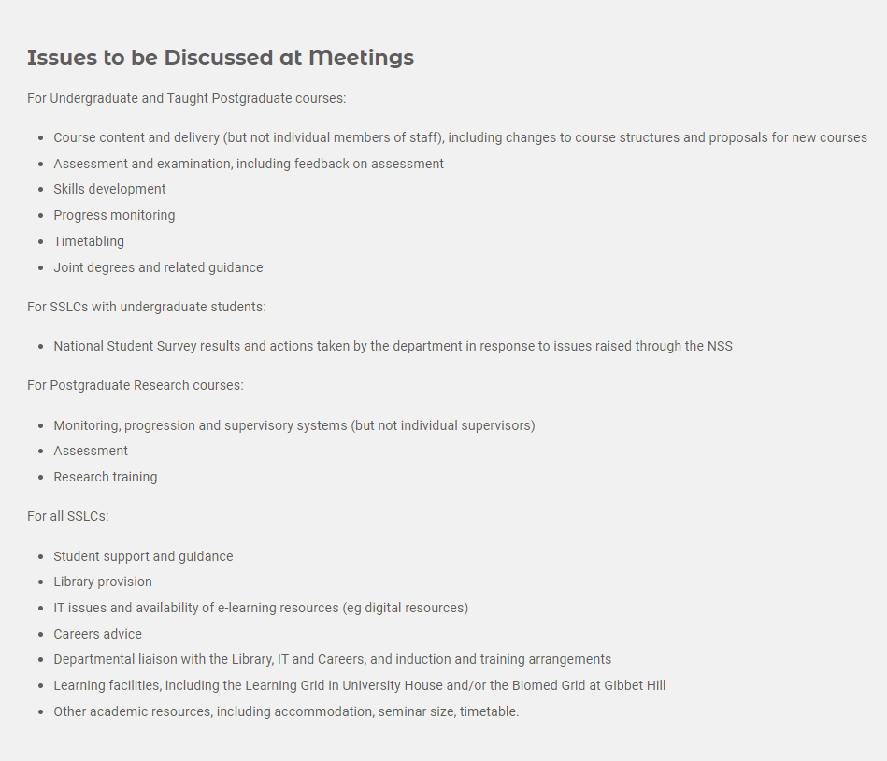
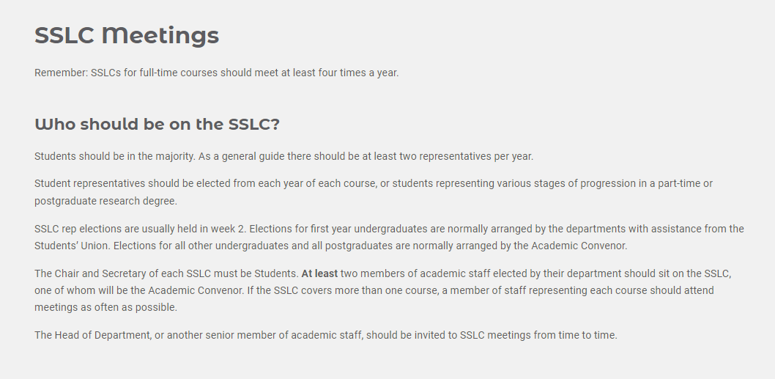
JOIN THE SSLC!

Slide 21
Academic Writing Support Moodle/tutors in ECLS
Wider issues with researching and
writing English Lit assignments
Issue with ECLS module (e.g.):
Accessing lectures
Assessment ideas
Resource recommendations
Seminar absence
Issues with the seminar
Reading content
ECLS
Module Tutor
Administration issues for ECLS modules (e.g.)
Tabula/timetabling issues/clashes
module registration issues
ugenglish@warwick.ac.uk
https://warwick.ac.uk/fac/arts/english/about/
English UG office
Issue with your academic work more widely (e.g.):
Personal issues impacting your wellbeing
Advice about choosing module
Mitigating Circumstances
When you aren't sure where to get help
Course Transfer
Your Personal Tutor in your home department

