Slide 1
Emma and the Enlightenment
Dr. Michael Meeuwis
English and Comparative Literary Studies
University of Warwick

Slide 2
Some big questions:
How do you we know what we know?
Do we think on our own, or along with others?

Slide 3
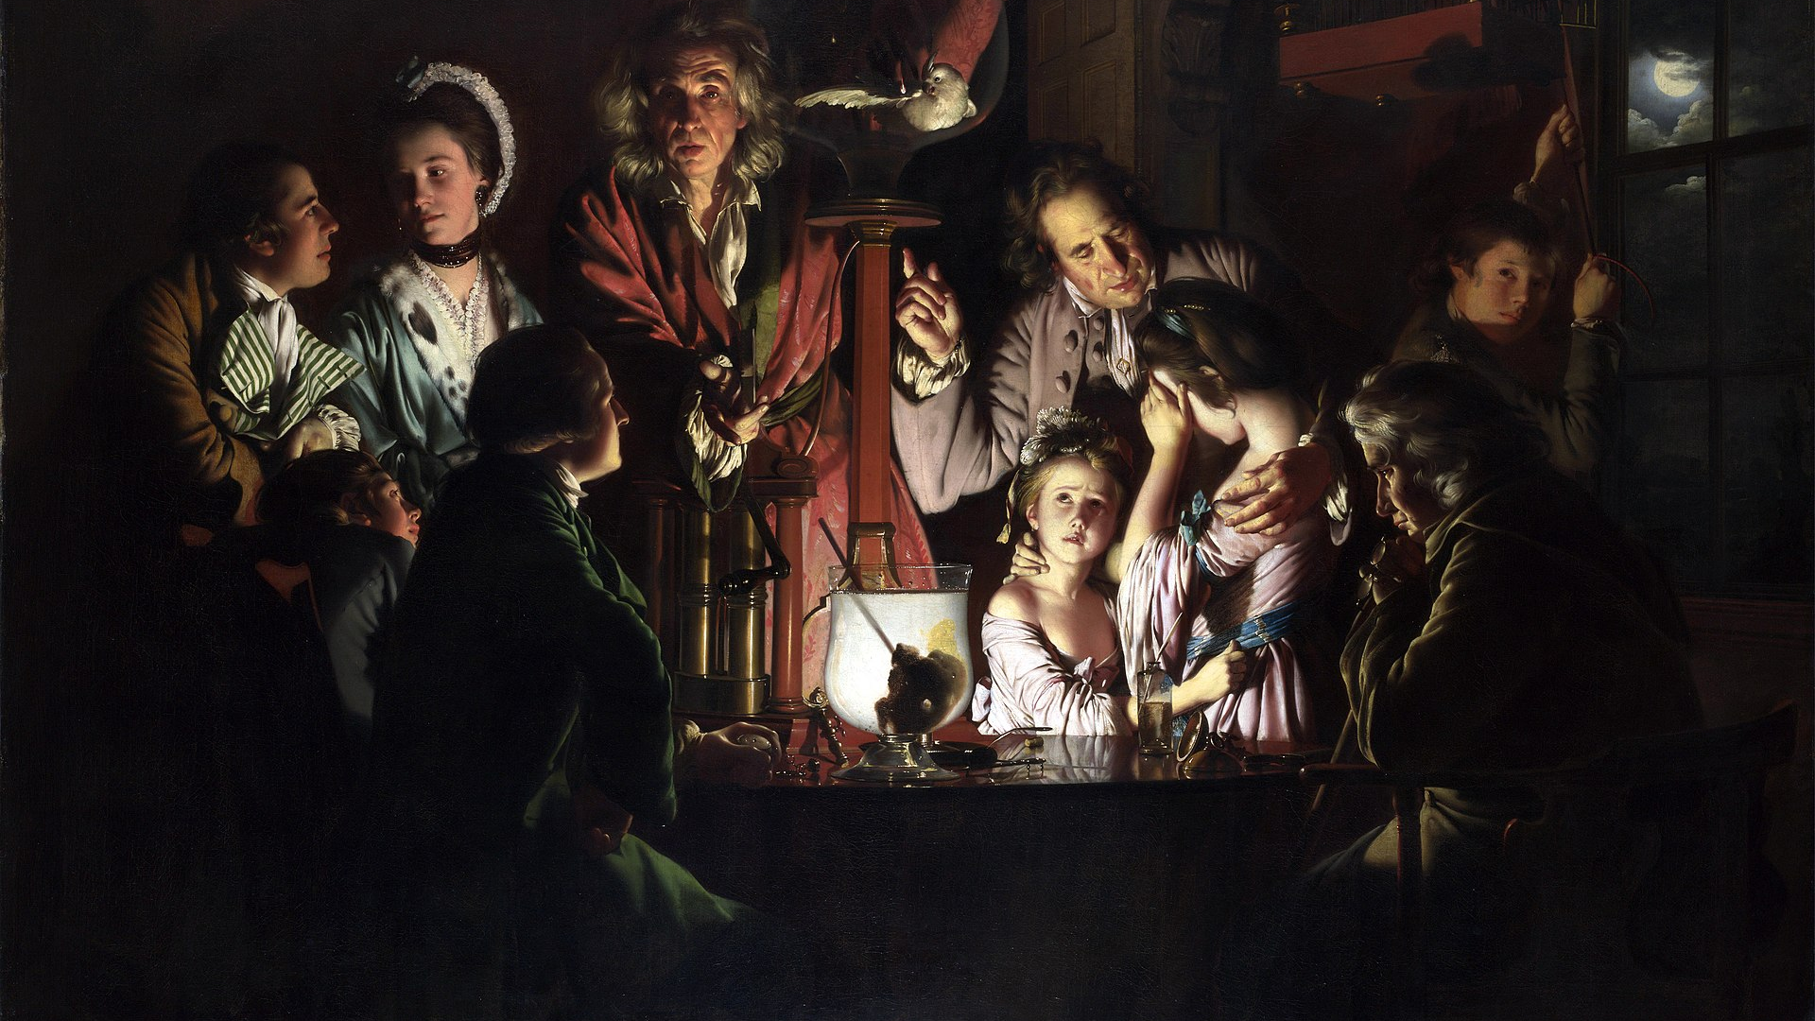
The Enlightenment

Slide 4
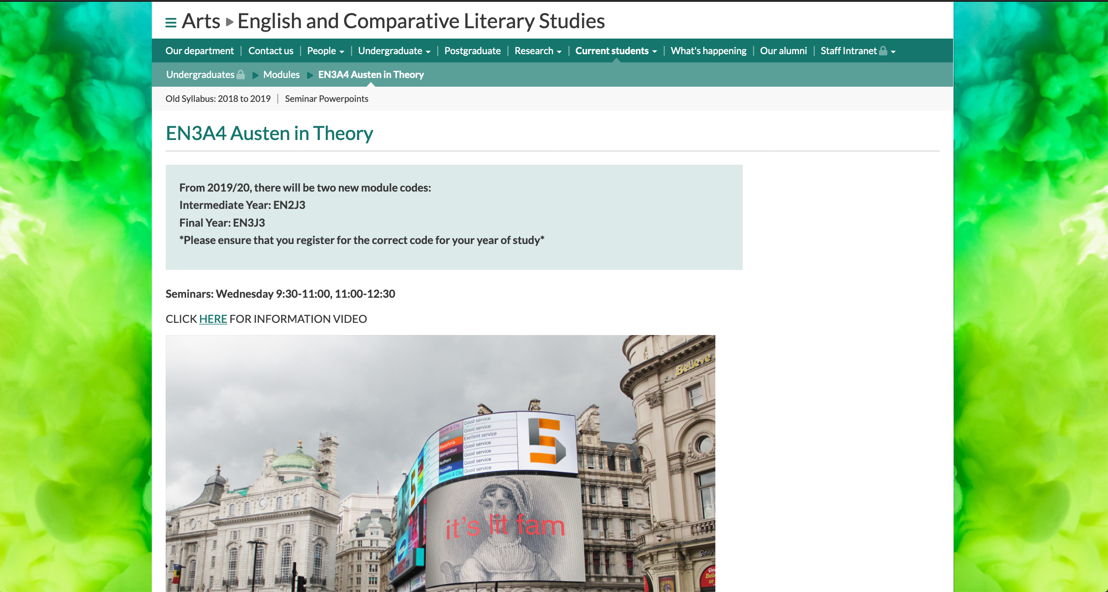

Slide 5
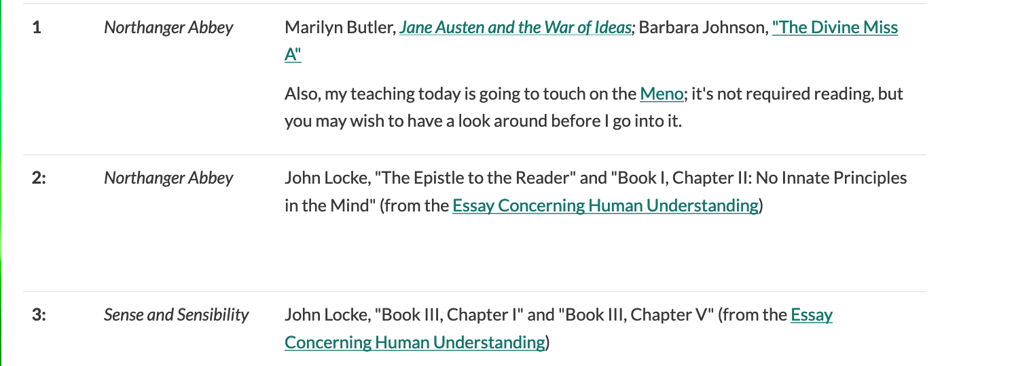

Slide 6

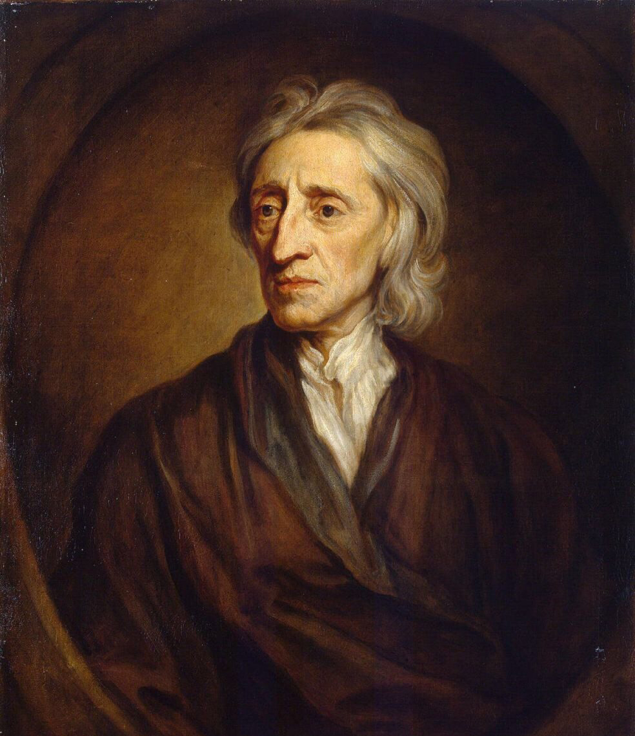
John Locke (1632-1704)
Philosopher, physician
School of thought called empiricism: belief that we should believe in what we come to know through our senses
But also: we think along with our communities—through conversation with other minds

Slide 7

The Blank Slate
The Senses at first let in particular Ideas, and furnish the yet empty Cabinet: And the Mind by degrees growing familiar with some of them, they are lodged in the Memory, and Names got to them…
(An Essay Concerning Human Understanding, [1689], I.iii)

Slide 8
Learning from our community
But alas, amongst Children… Their Notions are few and narrow, borrowed only from those Objects, they have had most to do with, and which have made upon their Senses the frequentest and strongest Impressions. A Child knows his Nurse, and his Cradle, and by degrees the Play-things of a little more advanced Age … he that from a Child untaught, or a wild Inhabitant of the Woods, will expect these abstract Maxims, and reputed Principles of Sciences, will I fear, find himself mistaken.
(An Essay Concerning Human Understanding, [1689], I.iii)

Slide 9
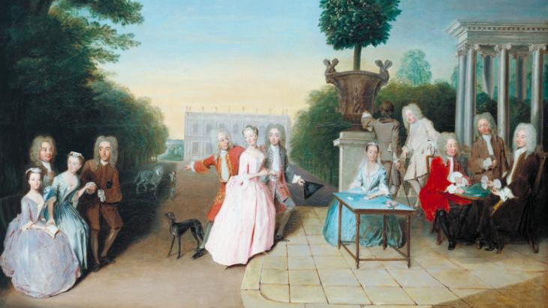
Man is “a sociable Creature, made … not only with an inclination, and under a necessity to have fellow-ship with those of his own kind; but furnished … also with Language, which was to be the great Instrument, and common Tye of Society.” (Locke, III.1)

Slide 10
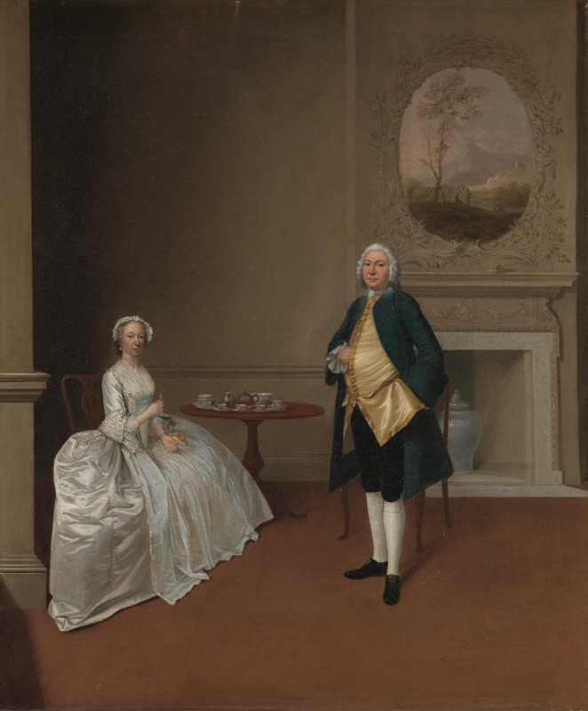
How do we learn?
One way: “the pleasure of rational conversation with a friend, or of well-directed study in the search and discovery of truth.”

Slide 11
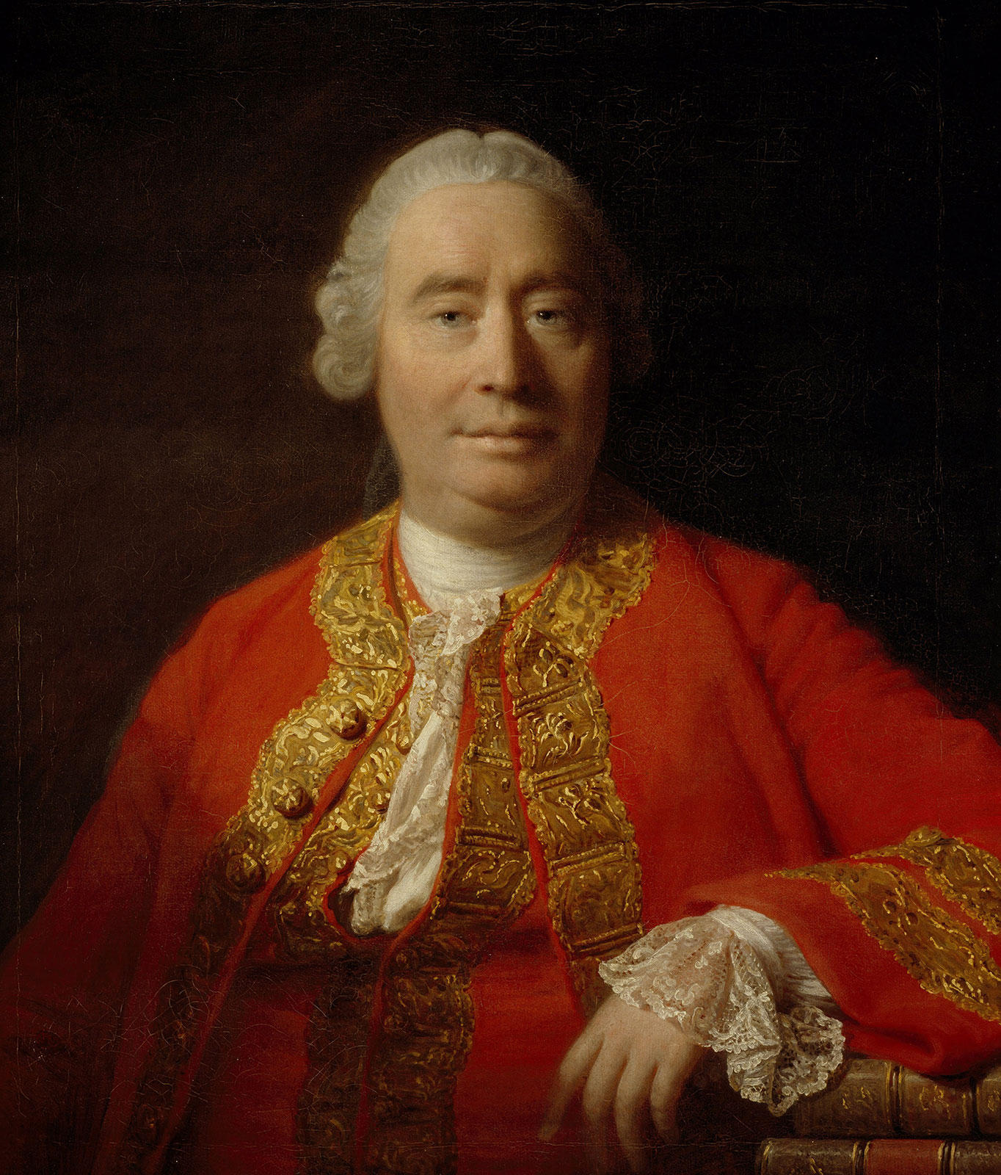
David Hume (1711-1776)
Scottish Enlightenment philosopher, fellow empiricist to Locke, famed essayist
Attempt to create a science-like account of human nature
Human knowledge grounded in experience

Slide 12
Tis with great Pleasure I observe, That Men of Letters, in this Age, have lost, in a great Measure, that Shyness and Bashfulness of Temper, which kept them at a Distance from Mankind; and, at the same Time, That Men of the World are proud of borrowing from Books their most agreeable Topics of Conversation. ’Tis to be hop’d, that this League betwixt the learned and conversible Worlds, which is so happily begun, will be still farther improv’d to their mutual Advantage; and to that End, I know nothing more advantageous than such Essays as these with which I endeavour to entertain the Public. In this View, I cannot but consider myself as a Kind of Resident or Ambassador from the Dominions of Learning to those of Conversation; and shall think it my constant Duty to promote a good Correspondence betwixt these two States, which have so great a Dependence on each other. I shall give Intelligence to the Learned of whatever passes in Company, and shall endeavour to import into Company whatever Commodities I find in my native Country proper for their Use and Entertainment. The Balance of Trade we need not be jealous of, nor will there be any Difficulty to preserve it on both Sides. The Materials of this Commerce must chiefly be furnish’d by Conversation and common Life: The manufacturing of them alone belongs to Learning.
As ’twou’d be an unpardonable Negligence in an Ambassador not to pay his Respects to the Sovereign of the State where he is commission’d to reside; so it wou’d be altogether inexcusable in me not to address myself, with a particular Respect, to the Fair Sex, who are the Sovereigns of the Empire of Conversation. I approach them with Reverence; and were not my Countrymen, the Learned, a stubborn independent Race of Mortals, extremely jealous of their Liberty, and unaccustom’d to Subjection, I shou’d resign into their fair Hands the sovereign Authority over the Republic of Letters. As the Case stands, my Commission extends no farther, than to desire a League, offensive and defensive, against our common Enemies, against the Enemies of Reason and Beauty, People of dull Heads and cold Hearts. From this Moment let us pursue them with the severest Vengeance: Let no Quarter be given, but to those of sound Understandings and delicate Affections; and these Characters, ’tis to be presum’d, we shall always find inseparable.
Hume, “Of Essay-Writing,” https://oll.libertyfund.org/titles/hume-essays-moral-political-literary-lf-ed

Slide 13
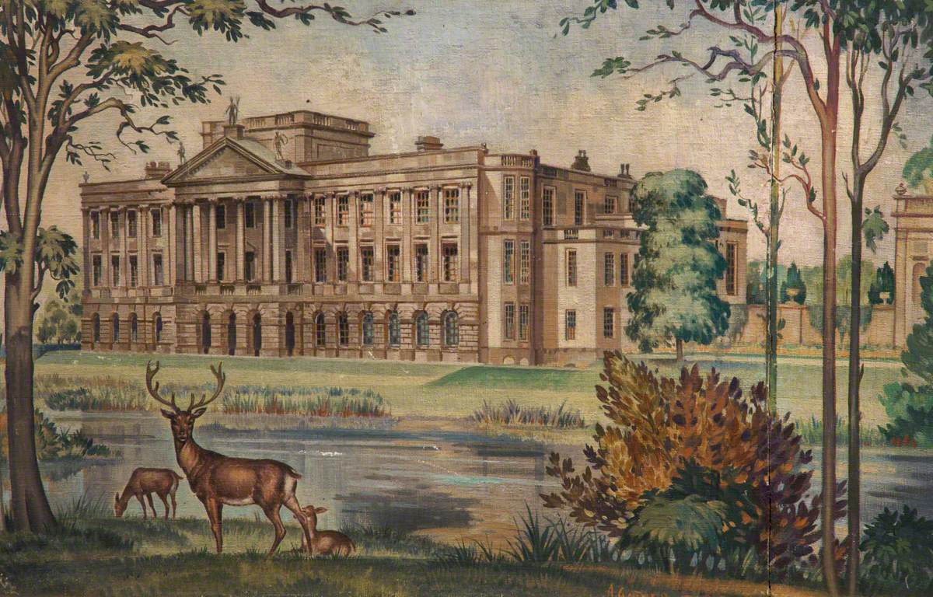
Jane Austen, Emma (1815)

Slide 14
Austen’s novels: the importance of female impressions
How Austen Works, an upcoming project:
  Jane Austen’s novels anticipate a feminist consciousness in the way that they focus closely on the experiences of women, which frame these women as meaningful contributions to the intellectual lives of their society. In particular they show female characters who are resilient in the face of the difficulties faced by a class of women who understood—and indeed could reasonably expect—that finding a suitable marriage match was the most significant event in their lives. These women all navigate a suitable resolution to this dilemma by learning to play the rules of this very starkly-defined social system to their advantage.

Slide 15
Austen’s novels: thinking in a community
How Austen Works, an upcoming project:
  while Austen’s narrator stays close to the minds of its female characters, it also reflects the extent to which these minds are influenced, and even compromised, by the opinions and beliefs of their communities—down even, we might say, to the epistemological level, the most basic level of understanding their place in the world. Austen’s patriarchs, older female gossips, and other established characters hold considerable influence over how characters under their sway perceive the world—particularly for less assertive heroines like Fanny Price and Anne Elliot. Something happens that is analogous to gravity: even when dominant characters are not visible, they exert influence at a distance, in effect dictating what other, less dominant characters notice.

Slide 16
“Free indirect style”
Austen’s novels take us inside and outside of the brains of her characters
Sometimes third-person narration: outside of scenes, characters
Sometimes, we go inside of characters’ brains:
“[Harriet] was a very pretty girl, and her beauty happened to be of a sort which Emma particularly admired…Emma was as much pleased with her manners as her person, and quite determined to continue the acquaintance.”
In Emma, we watch the main character move from relying to much on her own impressions to conversation with others

Slide 17
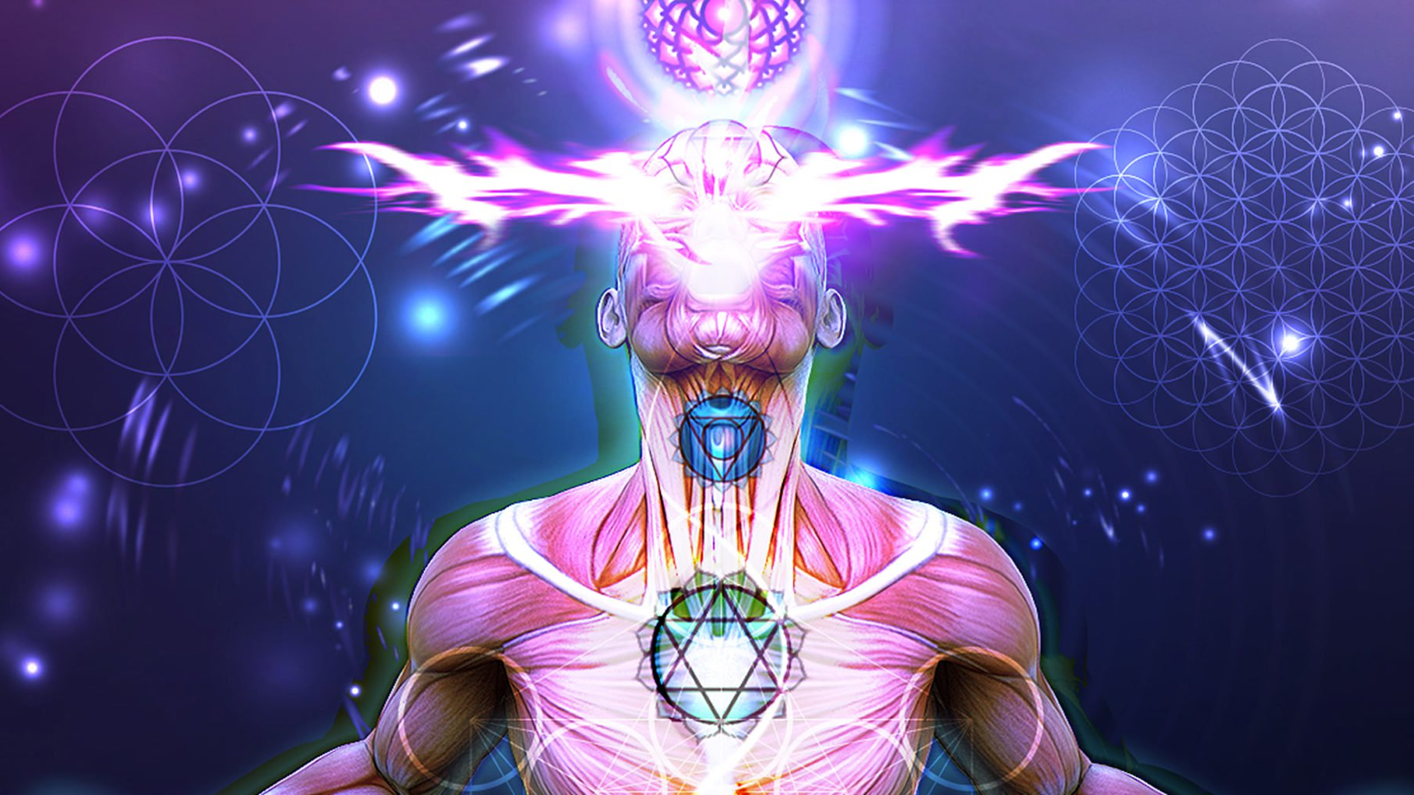
Free indirect style: Emma’s impressions, no conversation
Emma's colour was heightened by this unjust praise; and with a smile, and shake of the head, which spoke much, she looked at Mr. Knightley.—It seemed as if there were an instantaneous impression in her favour, as if his eyes received the truth from hers, and all that had passed of good in her feelings were at once caught and honoured.— He looked at her with a glow of regard. She was warmly gratified—and in another moment still more so, by a little movement of more than common friendliness on his part.—He took her hand;—whether she had not herself made the first motion, she could not say—she might, perhaps, have rather offered it—but he took her hand, pressed it, and certainly was on the point of carrying it to his lips—when, from some fancy or other, he suddenly let it go.—Why he should feel such a scruple, why he should change his mind when it was all but done, she could not perceive.—He would have judged better, she thought, if he had not stopped.—The intention, however, was indubitable; and whether it was that his manners had in general so little gallantry, or however else it happened, but she thought nothing became him more.—It was with him, of so simple, yet so dignified a nature.—She could not but recall the attempt with great satisfaction. It spoke such perfect amity.—He left them immediately afterwards—gone in a moment. He always moved with the alertness of a mind which could neither be undecided nor dilatory, but now he seemed more sudden than usual in his disappearance.

Slide 18
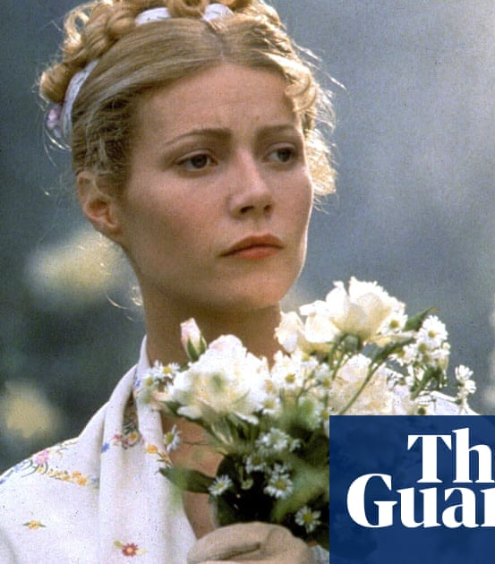
“Emma Woodhouse, handsome, clever, and rich, with a comfortable home and happy disposition, seemed to unite some of the best blessings of existence; and had lived nearly twenty-one years in the world with very little to distress or vex her.”

Slide 19
"The real evils indeed of Emma's situation were the power of having rather too much her own way, and a disposition to think a little too well of herself; these were the disadvantages which threatened alloy to her many enjoyments. The danger, however, was at present so unperceived, that they did not by any means rank as misfortunes with her."

Slide 20
“Quick and decided in her ways…”
“Emma could not feel a doubt of having given Harriet's fancy a proper direction and raised the gratitude of her young vanity to a very good purpose …”

Slide 21
Emma's eyes were instantly withdrawn; and she sat silently meditating, in a fixed attitude, for a few minutes. A few minutes were sufficient for making her acquainted with her own heart. A mind like hers, once opening to suspicion, made rapid progress. She touched—she admitted—she acknowledged the whole truth. Why was it so much worse that Harriet should be in love with Mr. Knightley, than with Frank Churchill? Why was the evil so dreadfully increased by Harriet's having some hope of a return? It darted through her, with the speed of an arrow, that Mr. Knightley must marry no one but herself!

Slide 22
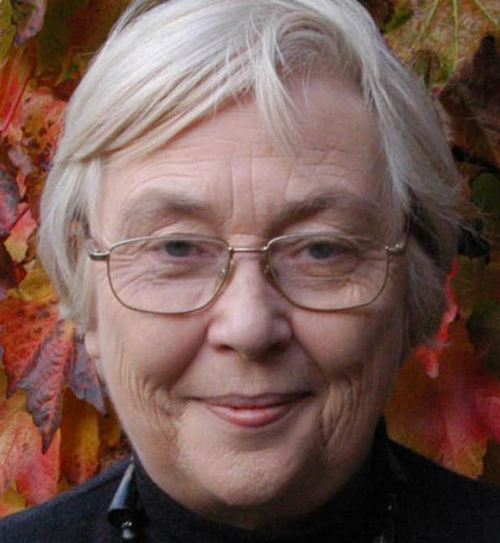
Marilyn Butler: In Emma, “none of the comic characters communicate. They surround themselves with a web of words but with words that convey their own selfhood, their individuality and make little or no impact on the consciousness of others” (Jane Austen and the War of Ideas, 271).

Slide 23
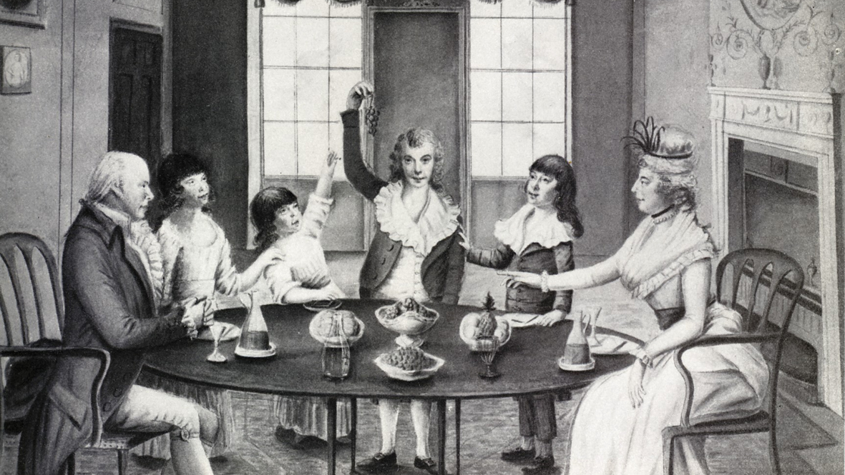
The solution is conversation

Slide 24
Emma continued to entertain no doubt of her being in love. Her ideas only varied as to the how much. At first, she thought it was a good deal; and afterwards, but little. She had great pleasure in hearing Frank Churchill talked of…

Slide 25
Emma's pensive meditations, as she walked home, were not interrupted; but on entering the parlour, she found those who must rouse her. Mr. Knightley and Harriet had arrived during her absence, and were sitting with her father.

Slide 26

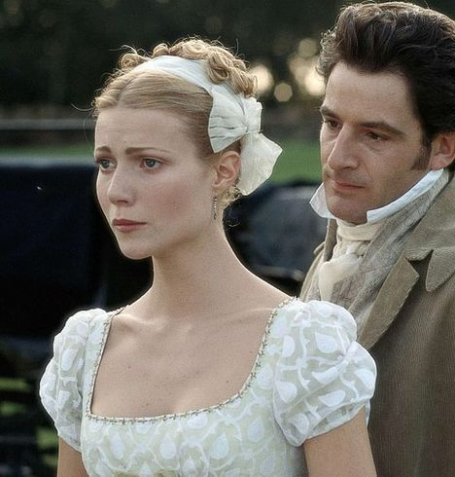
Mr. Knightley was thoughtful again. The result of his reverie was, “No, Emma, I do not think the extent of my admiration for her will ever take me by surprize.—I never had a thought of her in that way, I assure you.” And soon afterwards, “Jane Fairfax is a very charming young woman—but not even Jane Fairfax is perfect. She has a fault. She has not the open temper which a man would wish for in a wife.”

Slide 27
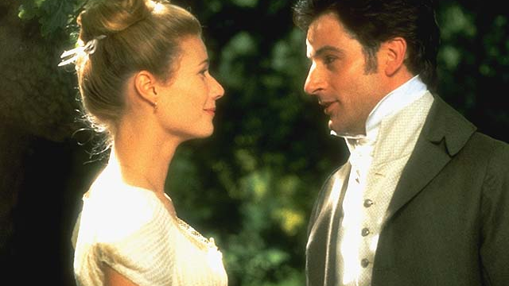
“I cannot make speeches, Emma:” he soon resumed; and in a tone of such sincere, decided, intelligible tenderness as was tolerably convincing.—“If I loved you less, I might be able to talk about it more. But you know what I am.—You hear nothing but truth from me.—I have blamed you, and lectured you, and you have borne it as no other woman in England would have borne it.—Bear with the truths I would tell you now, dearest Emma, as well as you have borne with them. The manner, perhaps, may have as little to recommend them. God knows, I have been a very indifferent lover.—But you understand me.—Yes, you see, you understand my feelings—and will return them if you can. At present, I ask only to hear, once to hear your voice.”

Slide 28
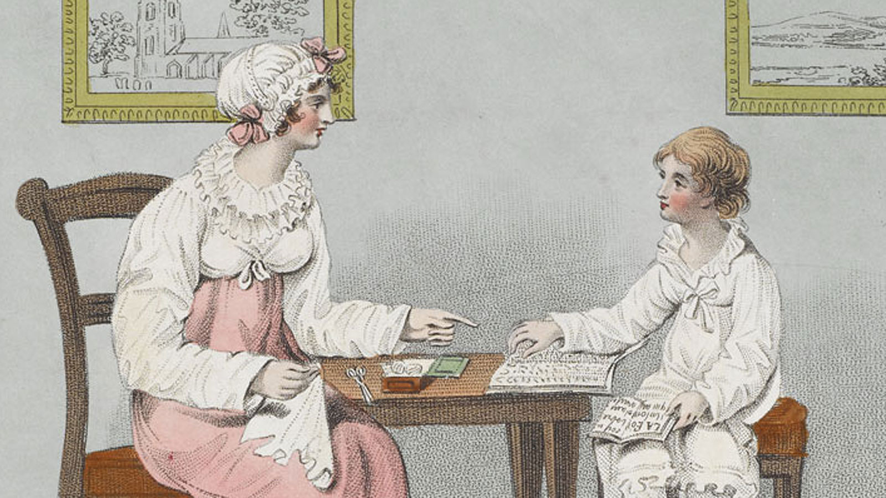
Some conclusions:
The Enlightenment: an interplay between our impressions and our communities
Locke: the bridge is conversation
Austen: philosophical novels about how female impressions enter community thinking
Emma: a romance novel about love as a conversation

