Slide 1
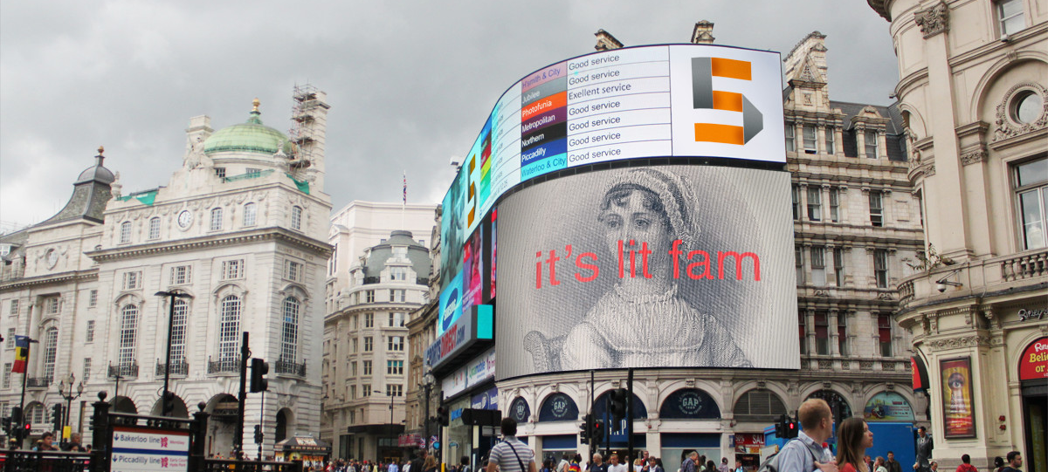
AUSTEN IN THEORY
Term One, Week One: Housekeeping, Marilyn Butler, Lady Susan

Slide 2
Housekeeping
Papers are due Friday, T1W11 and T2W11 (14 December 2024 and 21 March 2025; please check your TABULA for final confirmation)
Intermediate papers 3,500 words, final year 4,000 words
Any Austen edition is fine, I recommend World’s Classics

Slide 3
Preamble and Major Course Theme
I.e. “the style is part of the point”

Slide 4
The Windhover
To Christ Our Lord
I caught this morning morning's minion, king-
dom of daylight's dauphin, dapple-dawn-drawn Falcon, in his riding
Of the rolling level underneath him steady air, and striding
High there, how he rung upon the rein of a wimpling wing
In his ecstasy! then off, off forth on swing,
As a skate's heel sweeps smooth on a bow-bend: the hurl and gliding
Rebuffed the big wind. My heart in hiding
Stirred for a bird, – the achieve of, the mastery of the thing.
Brute beauty and valour and act, oh, air, pride, plume, here
Buckle! AND the fire that breaks from thee then, a billion
Times told lovelier, more dangerous, O my chevalier!
No wonder of it: shéer plód makes plough down sillion
Shine, and blue-bleak embers, ah my dear,
Fall, gall themselves, and gash gold-vermilion.

Slide 5
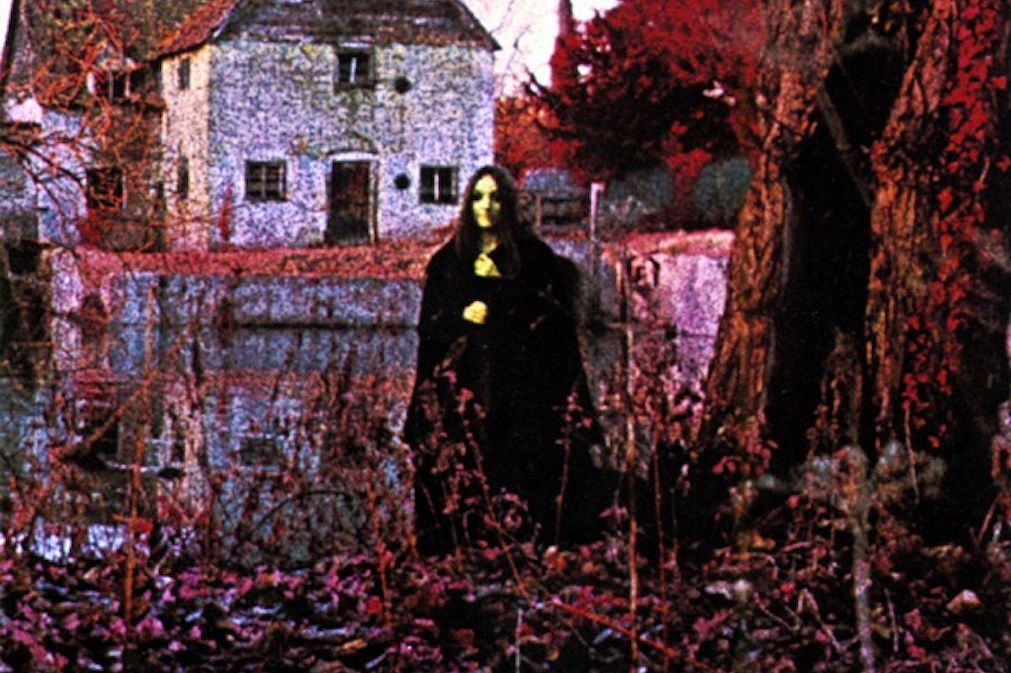
Notes:
https://www.youtube.com/watch?v=YztzNyDGcpc

Slide 6
“It is a truth universally acknowledged, that a single man in possession of a good fortune, must be in want of a wife.”

Slide 7
Free indirect style/discourse
Tags indicating “she thought/he said” disappear
To use term from linguistics, centre of evaluation is uncertain (Morini, 2009)
It gets pretty profound (and potentially, trippy)

Slide 8
Other features
Long stretches of dialogue where narrator withdraws (again, no evaluation within text)
Letters between characters, presented as socially thick objects—writing bearing traces of the society that produced (and continues to produce) it

Slide 9
Reading Austen now
Emma chapter XVII, Jane Fairfax to Mrs. Elton:
“But, my dear child, the time is drawing near; here is April, and June, or say even July, is very near, with such business to accomplish before us. Your inexperience really amuses me! A situation such as you deserve, and your friends would require for you, is no everyday occurrence, is not obtained at a moment’s notice; indeed, indeed, we must begin inquiring directly.”
“Excuse me, ma’am, but this is by no means my intention; I make no inquiry myself, and should be sorry to have any made by my friends. When I am quite determined as to the time, I am not at all afraid of being long unemployed. There are places in town, offices, where inquiry would soon produce something—Offices for the sale—not quite of human flesh—but of human intellect.”
“Oh! my dear, human flesh! You quite shock me; if you mean a fling at the slave-trade, I assure you Mr. Suckling was always rather a friend to the abolition.”
“I did not mean, I was not thinking of the slave-trade,” replied Jane; “governess-trade, I assure you, was all that I had in view; widely different certainly as to the guilt of those who carry it on; but as to the greater misery of the victims, I do not know where it lies. But I only mean to say that there are advertising offices, and that by applying to them I should have no doubt of very soon meeting with something that would do.”
“Something that would do!” repeated Mrs. Elton. “Aye, that may suit your humble ideas of yourself;—I know what a modest creature you are; but it will not satisfy your friends to have you taking up with any thing that may offer, any inferior, commonplace situation, in a family not moving in a certain circle, or able to command the elegancies of life.”

Slide 10
Lady Susan (1794, pub. 1871)

Slide 11
Questions (take 5 mins, work in threes)
I know, right?
How is this unlike Austen’s other texts? (and, how like?)
  Style
  Plot
  Outcome

