Slide 1
Week 7, Day 1
John Locke and Northanger Abbey

Slide 2
Part one
Locke I

Slide 3
The Enlightenment Two-step
Writers of the European Enlightenment will propose radically freeing and progressive notions of the human in one paragraph, and then in the next deny the full humanity of much of the human population
C.f. David Hume, “I am apt to suspect the Negroes [sic] to be naturally inferior to the whites. There scarcely ever was a civilized nation of that complexion, nor even individual eminent in action or speculation…” (“Of National Characters,” 1777)
I still teach these writers because
  These ideas remain part of the basic operating assumptions of what constitutes humanity, particularly as Western notions of property rights have become widely used or imposed
  They were progress from the absolutism that preceded them
  They can be adapted for our time—progressive readings of the Enlightenment are possible, indeed foundational to our time

Slide 4
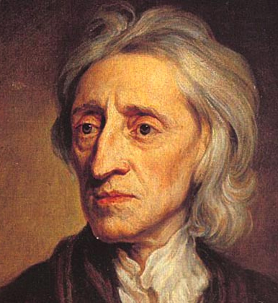
John Locke

Slide 5
Significant Works
1689/90. Two Treatises of Government
1689/90. An Essay Concerning Human Understanding

Slide 6
But first: Thomas Hobbes
In [the state of nature], there is no place for industry; because the fruit thereof is uncertain: and consequently no culture of the earth; no navigation, nor use of the commodities that may be imported by sea; no commodious building; no instruments of moving, and removing, such things as require much force; no knowledge of the face of the earth; no account of time; no arts; no letters; no society; and which is worst of all, continual fear, and danger of violent death; and the life of man, solitary, poor, nasty, brutish, and short.

Slide 7
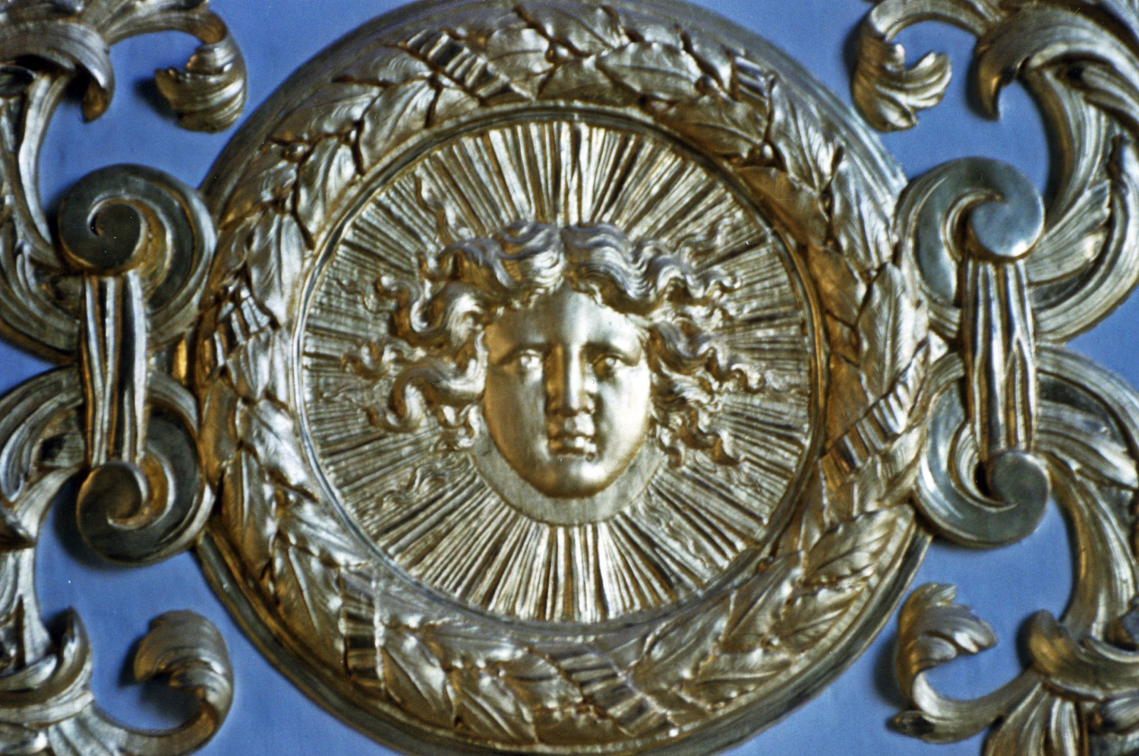

Slide 8
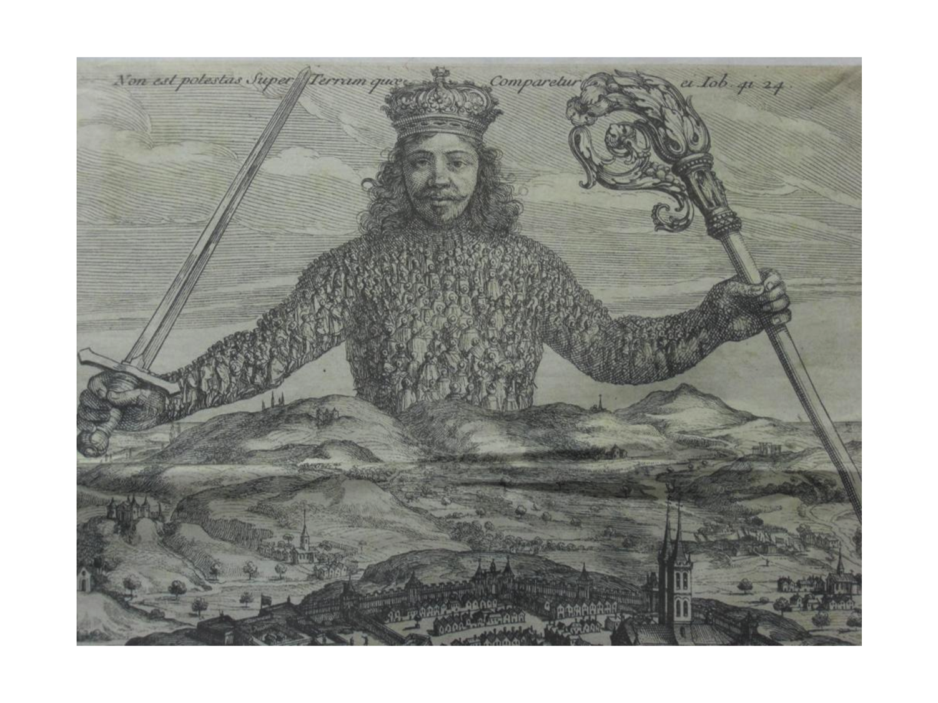
Thomas Hobbes, Leviathan (frontispiece), 1651

Slide 9
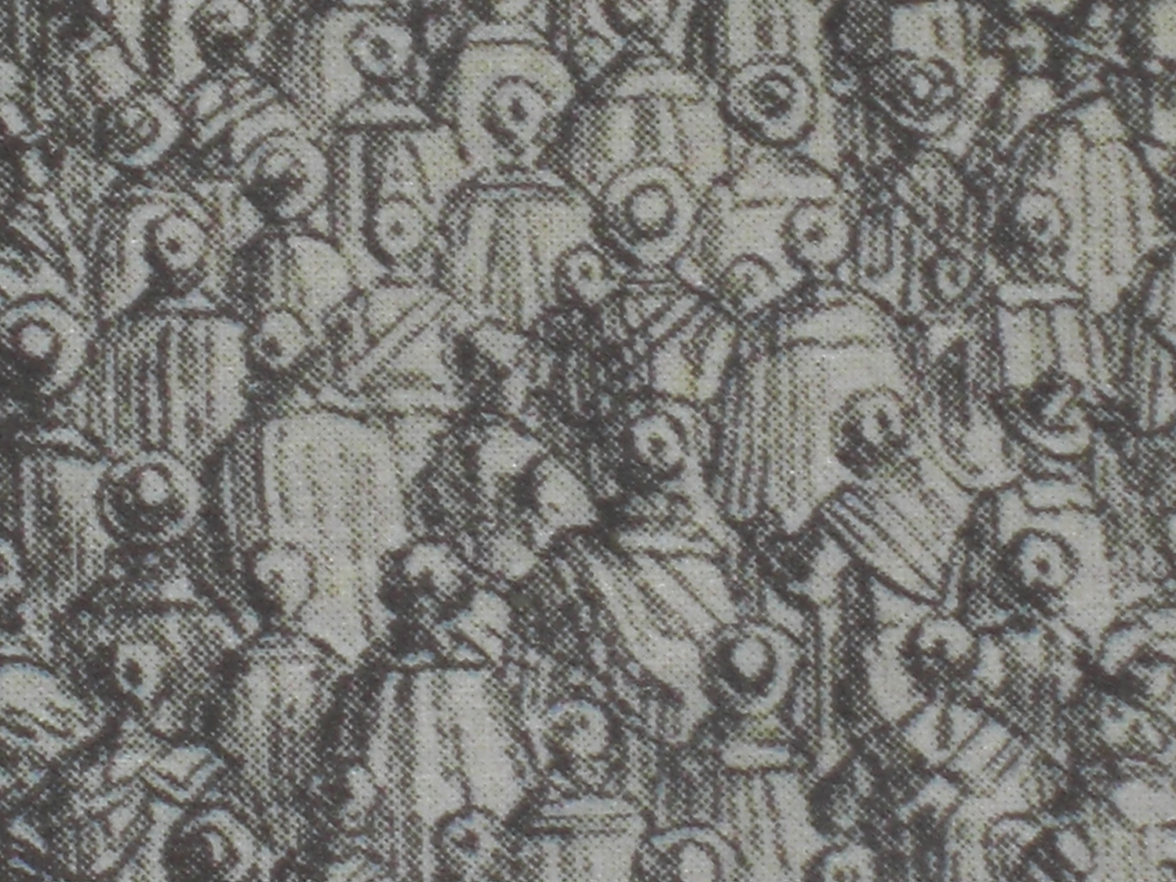

Slide 10
Quick idea: innate concept
Debate: is how we think innate in us from birth, or learned through experience?
The empiricist view held that our ideas come from our experience
This was contrary to certain interpretations of Christianity, which held to certain conditions being as it were pre-existing (Original Sin, for example)
More interesting (and challenging) as a democratizing principle: everyone’s experience matters
Worth noting that “Christianity” can’t be meaningfully opposed to “empiricism,” except in the vaguest terms

Slide 11
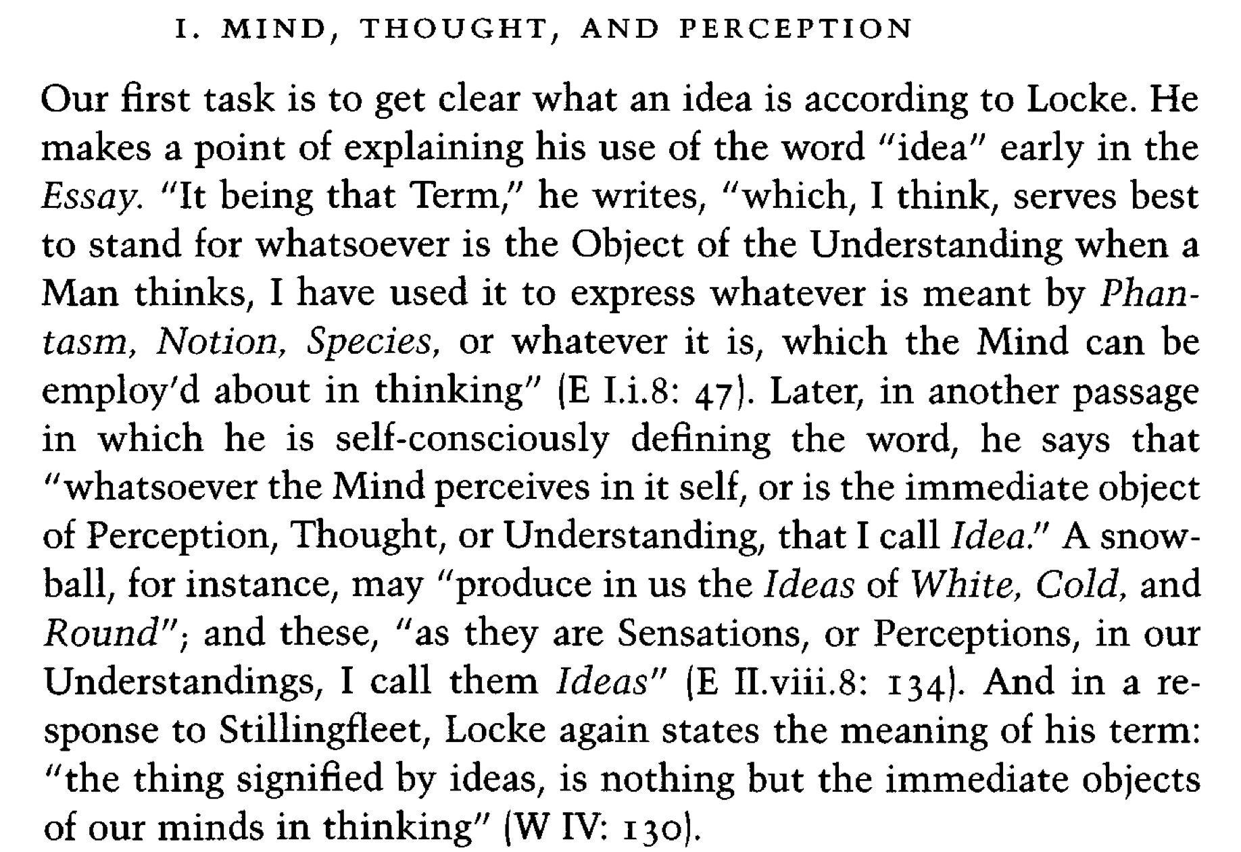
Quick idea concept: ideas I
1. Chappell V. Locke’s theory of ideas. In: Chappell V, ed. The Cambridge Companion to Locke. Cambridge Companions to Philosophy. Cambridge University Press; 1994:26-55.

Slide 12
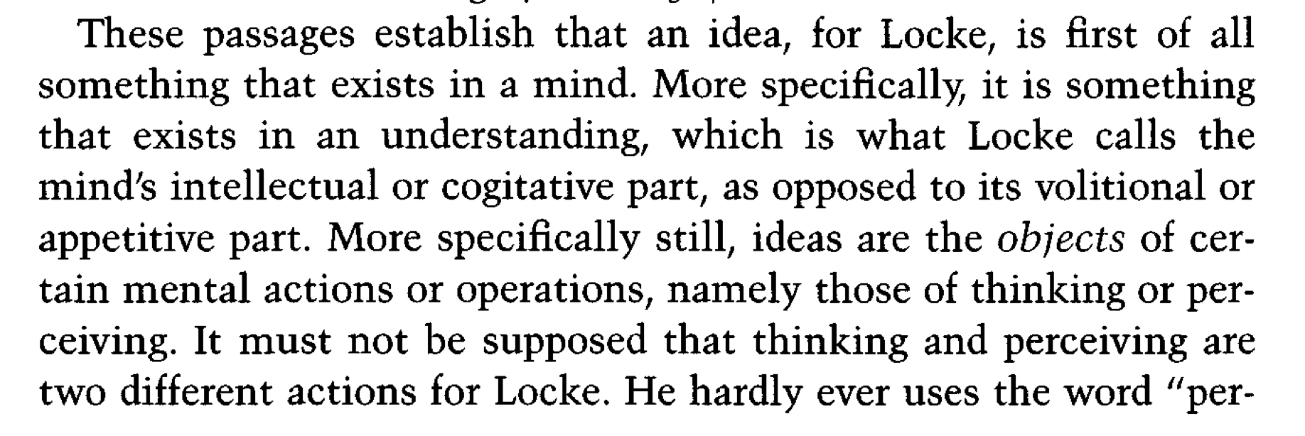
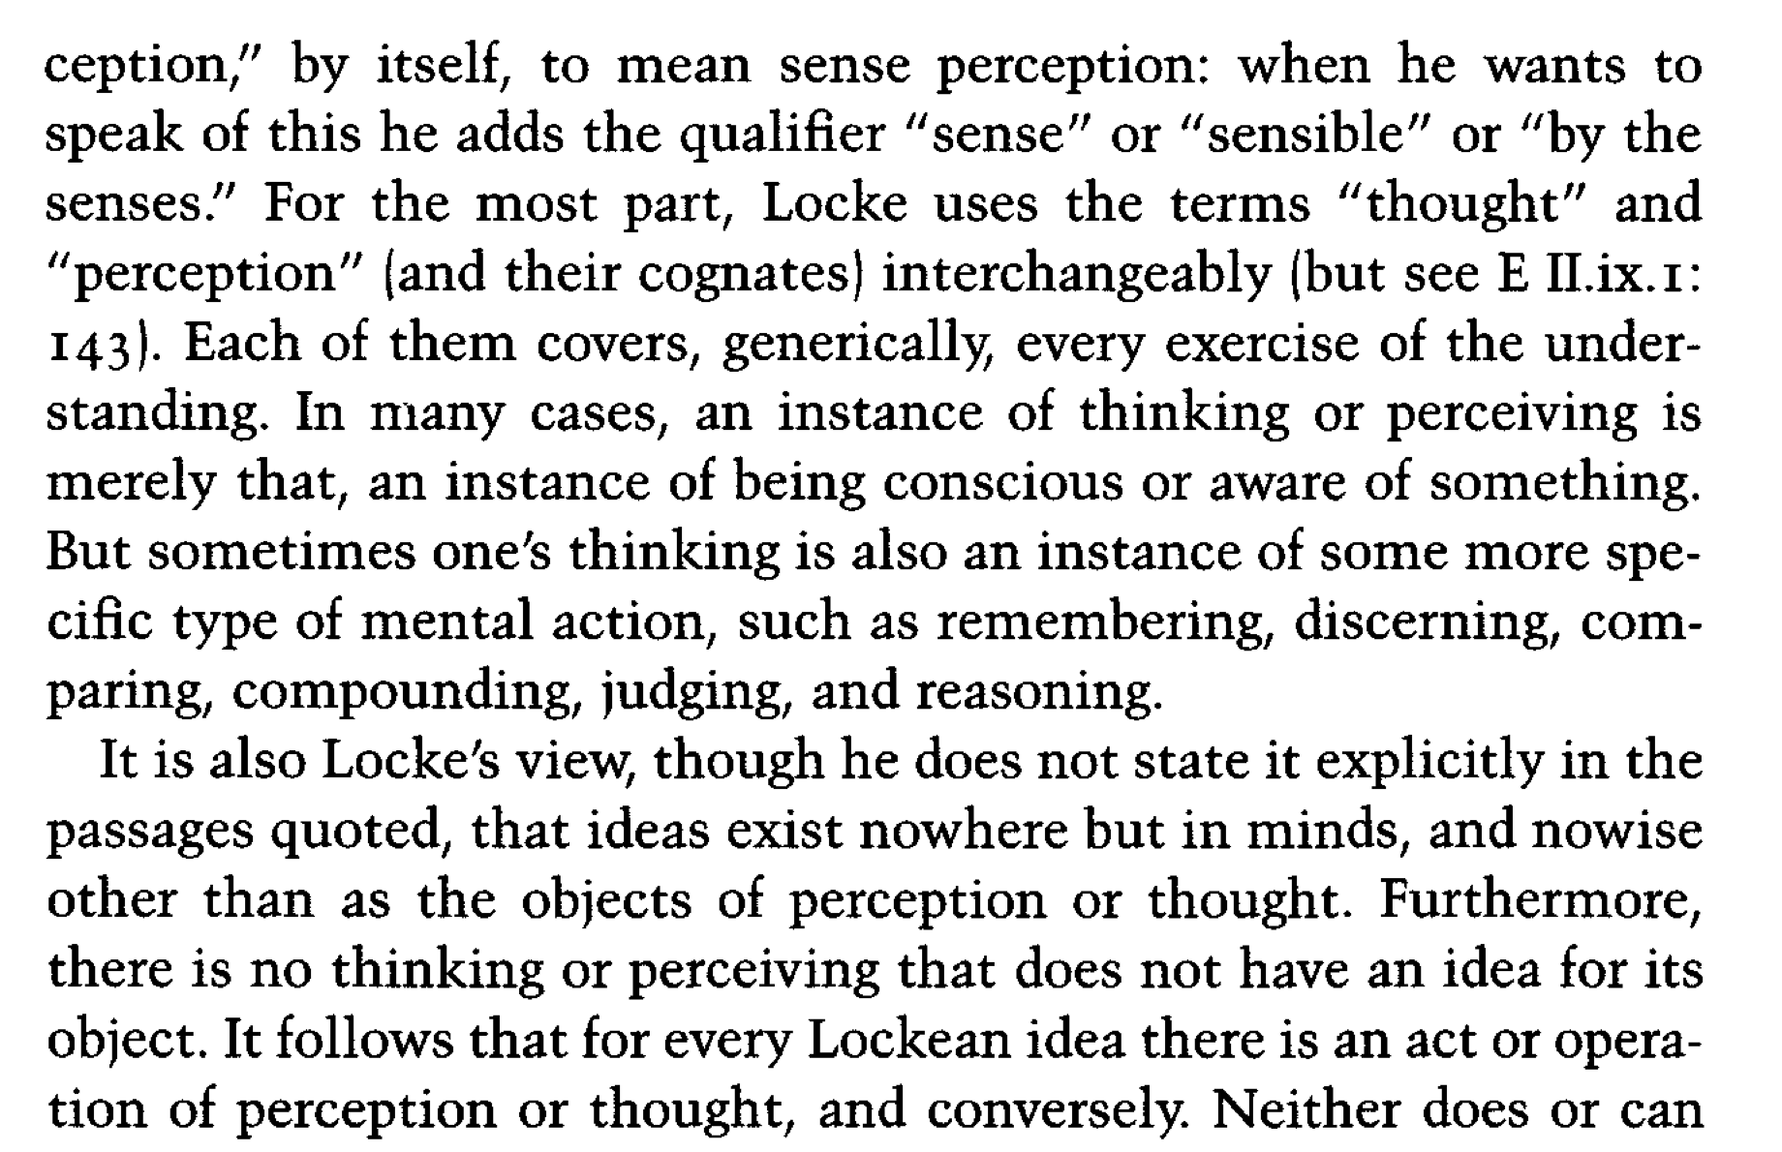

Slide 13
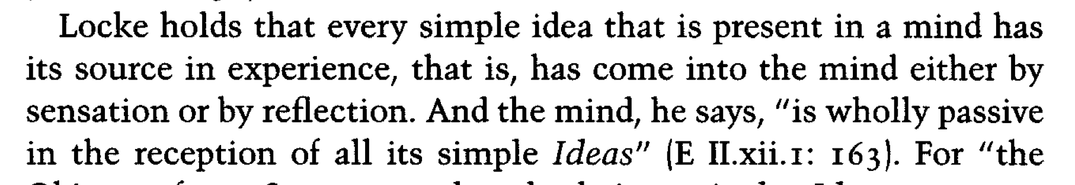
Let me try to summarise
Our sense perceptions-–touch, sight—produce in the mind ideas
These ideas combine, forming more complex ideas—snowball out of white and cold and round
Language-–as we’ll eventually see—becomes the way we can know things beyond our immediate experience; but, ultimately, what we assent to is grounded in our own sense perceptions

Slide 14


Slide 15
“Epistle to the Reader”
It will possibly be censured as a great piece of vanity or insolence in me, to pretend to instruct this our knowing age; it amounting to little less, when I own, that I publish this Essay with hopes it may be useful to others. But, if it may be permitted to speak freely of those who with a feigned modesty condemn as useless what they themselves write, methinks it savours much more of vanity or insolence to publish a book for any other end; and he fails very much of that respect he owes the public, who prints, and consequently expects men should read, that wherein he intends not they should meet with anything of use to themselves or others: and should nothing else be found allowable in this Treatise, yet my design will not cease to be so; and the goodness of my intention ought to be some excuse for the worthlessness of my present. It is that chiefly which secures me from the fear of censure, which I expect not to escape more than better writers. Men’s principles, notions, and relishes are so different, that it is hard to find a book which pleases or displeases all men. I acknowledge the age we live in is not the least knowing, and therefore not the most easy to be satisfied. If I have not the good luck to please, yet nobody ought to be offended with me. I plainly tell all my readers, except half a dozen, this Treatise was not at first intended for them; and therefore they need not be at the trouble to be of that number. But yet if any one thinks fit to be angry and rail at it, he may do it securely, for I shall find some better way of spending my time than in such kind of conversation. I shall always have the satisfaction to have aimed sincerely at truth and usefulness, though in one of the meanest ways. The commonwealth of learning is not at this time without master-builders, whose mighty designs, in advancing the sciences, will leave lasting monuments to the admiration of posterity: but every one must not hope to be a Boyle or a Sydenham; and in an age that produces such masters as the great Huygenius and the incomparable Mr. Newton, with some others of that strain, it is ambition enough to be employed as an under-labourer in clearing the ground a little, and removing some of the rubbish that lies in the way to knowledge;—which certainly had been very much more advanced in the world, if the endeavours of ingenious and industrious men had not been much cumbered with the learned but frivolous use of uncouth, affected, or unintelligible terms, introduced into the sciences, and there made an art of, to that degree that Philosophy, which is nothing but the true knowledge of things, was thought unfit or incapable to be brought into well-bred company and polite conversation. Vague and insignificant forms of speech, and abuse of language, have so long passed for mysteries of science; and hard and misapplied words, with little or no meaning, have, by prescription, such a right to be mistaken for deep learning and height of speculation, that it will not be easy to persuade either those who speak or those who hear them, that they are but the covers of ignorance, and hindrance of true knowledge. To break in upon the sanctuary of vanity and ignorance will be, I suppose, some service to human understanding; though so few are apt to think they deceive or are deceived in the use of words; or that the language of the sect they are of has any faults in it which ought to be examined or corrected, that I hope I shall be pardoned if I have in the Third Book dwelt long on this subject, and endeavoured to make it so plain, that neither the inveterateness of the mischief, nor the prevalency of the fashion, shall be any excuse for those who will not take care about the meaning of their own words, and will not suffer the significancy of their expressions to be inquired into.

Slide 16
I.2 , “No innate…”
For, first, it is evident, that all children and idiots have not the least apprehension or thought of them. And the want of that is enough to destroy that universal assent which must needs be the necessary concomitant of all innate truths: it seeming to me near a contradiction to say, that there are truths imprinted on the soul, which it perceives or understands not: imprinting, if it signify anything, being nothing else but the making certain truths to be perceived. For to imprint anything on the mind without the mind’s perceiving it, seems to me hardly intelligible. If therefore children and idiots have souls, have minds, with those impressions upon them, THEY must unavoidably perceive them, and necessarily know and assent to these truths; which since they do not, it is evident that there are no such impressions. For if they are not notions naturally imprinted, how can they be innate? and if they are notions imprinted, how can they be unknown? To say a notion is imprinted on the mind, and yet at the same time to say, that the mind is ignorant of it, and never yet took notice of it, is to make this impression nothing. No proposition can be said to be in the mind which it never yet knew, which it was never yet conscious of. For if any one may, then, by the same reason, all propositions that are true, and the mind is capable ever of assenting to, may be said to be in the mind, and to be imprinted: since, if any one can be said to be in the mind, which it never yet knew, it must be only because it is capable of knowing it; and so the mind is of all truths it ever shall know. Nay, thus truths may be imprinted on the mind which it never did, nor ever shall know; for a man may live long, and die at last in ignorance of many truths which his mind was capable of knowing, and that with certainty. So that if the capacity of knowing be the natural impression contended for, all the truths a man ever comes to know will, by this account, be every one of them innate; and this great point will amount to no more, but only to a very improper way of speaking; which, whilst it pretends to assert the contrary, says nothing different from those who deny innate principles. For nobody, I think, ever denied that the mind was capable of knowing several truths. The capacity, they say, is innate; the knowledge acquired. But then to what end such contest for certain innate maxims? If truths can be imprinted on the understanding without being perceived, I can see no difference there can be between any truths the mind is CAPABLE of knowing in respect of their original: they must all be innate or all adventitious: in vain shall a man go about to distinguish them. He therefore that talks of innate notions in the understanding, cannot (if he intend thereby any distinct sort of truths) mean such truths to be in the understanding as it never perceived, and is yet wholly ignorant of. For if these words “to be in the understanding” have any propriety, they signify to be understood. So that to be in the understanding, and not to be understood; to be in the mind and never to be perceived, is all one as to say anything is and is not in the mind or understanding. If therefore these two propositions, “Whatsoever is, is,” and “It is impossible for the same thing to be and not to be,” are by nature imprinted, children cannot be ignorant of them: infants, and all that have souls, must necessarily have them in their understandings, know the truth of them, and assent to it.

Slide 17
I.2 , “No innate…”
The senses at first let in PARTICULAR ideas, and furnish the yet empty cabinet, and the mind by degrees growing familiar with some of them, they are lodged in the memory, and names got to them. Afterwards, the mind proceeding further, abstracts them, and by degrees learns the use of general names. In this manner the mind comes to be furnished with ideas and language, the MATERIALS about which to exercise its discursive faculty. And the use of reason becomes daily more visible, as these materials that give it employment increase. But though the having of general ideas and the use of general words and reason usually grow together, yet I see not how this any way proves them innate. The knowledge of some truths, I confess, is very early in the mind; but in a way that shows them not to be innate. For, if we will observe, we shall find it still to be about ideas, not innate, but acquired; it being about those first which are imprinted by external things, with which infants have earliest to do, which make the most frequent impressions on their senses. In ideas thus got, the mind discovers that some agree and others differ, probably as soon as it has any use of memory; as soon as it is able to retain and perceive distinct ideas. But whether it be then or no, this is certain, it does so long before it has the use of words; or comes to that which we commonly call “the use of reason.” For a child knows as certainly before it can speak the difference between the ideas of sweet and bitter (i.e. that sweet is not bitter), as it knows afterwards (when it comes to speak) that wormwood and sugarplums are not the same thing.

Slide 18
I.2 , “No innate…”
A child knows not that three and four are equal to seven, till he comes to be able to count seven, and has got the name and idea of equality; and then, upon explaining those words, he presently assents to, or rather perceives the truth of that proposition. But neither does he then readily assent because it is an innate truth, nor was his assent wanting till then because he wanted the use of reason; but the truth of it appears to him as soon as he has settled in his mind the clear and distinct ideas that these names stand for. And then he knows the truth of that proposition upon the same ground and by the same means, that he knew before that a rod and a cherry are not the same thing; and upon the same ground also that he may come to know afterwards “That it is impossible for the same thing to be and not to be,” as shall be more fully shown hereafter. So that the later it is before any one comes to have those general ideas about which those maxims are; or to know the signification of those generic terms that stand for them; or to put together in his mind the ideas they stand for; the later also will it be before he comes to assent to those maxims;—whose terms, with the ideas they stand for, being no more innate than those of a cat or a weasel he must stay till time and observation have acquainted him with them; and then he will be in a capacity to know the truth of these maxims, upon the first occasion that shall make him put together those ideas in his mind, and observe whether they agree or disagree, according as is expressed in those propositions. And therefore it is that a man knows that eighteen and nineteen are equal to thirty-seven, by the same self-evidence that he knows one and two to be equal to three: yet a child knows this not so soon as the other; not for want of the use of reason, but because the ideas the words eighteen nineteen, and thirty-seven stand for, are not so soon got, as those which are signified by one, two, and three.

Slide 19
I.2 , “No innate…”
But we have not yet done with “assenting to propositions at first hearing and understanding their terms.” It is fit we first take notice that this, instead of being a mark that they are innate, is a proof of the contrary; since it supposes that several, who understand and know other things, are ignorant of these principles till they are proposed to them; and that one may be unacquainted with these truths till he hears them from others. For, if they were innate, what need they be proposed in order to gaining assent, when, by being in the understanding, by a natural and original impression, (if there were any such,) they could not but be known before? Or doth the proposing them print them clearer in the mind than nature did? If so, then the consequence will be, that a man knows them better after he has been thus taught them than he did before. Whence it will follow that these principles may be made more evident to us by others’ teaching than nature has made them by impression: which will ill agree with the opinion of innate principles, and give but little authority to them; but, on the contrary, makes them unfit to be the foundations of all our other knowledge; as they are pretended to be. This cannot be denied, that men grow first acquainted with many of these self-evident truths upon their being proposed: but it is clear that whosoever does so, finds in himself that he then begins to know a proposition, which he knew not before, and which from thenceforth he never questions; not because it was innate, but because the consideration of the nature of the things contained in those words would not suffer him to think otherwise, how, or whensoever he is brought to reflect on them. And if whatever is assented to at first hearing and understanding the terms must pass for an innate principle, every well-grounded observation, drawn from particulars into a general rule, must be innate. When yet it is certain that not all, but only sagacious heads, light at first on these observations, and reduce them into general propositions: not innate but collected from a preceding acquaintance and reflection on particular instances. These, when observing men have made them, unobserving men, when they are proposed to them cannot refuse their assent to.

Slide 20
We BY DEGREES get ideas and names, and LEARN their appropriated connexion one with another; and then to propositions made in such, terms, whose signification we have learnt, and wherein the agreement or disagreement we can perceive in our ideas when put together is expressed, we at first hearing assent; though to other propositions, in themselves as certain and evident, but which are concerning ideas not so soon or so easily got, we are at the same time no way capable of assenting. For, though a child quickly assents to this proposition, “That an apple is not fire,” when by familiar acquaintance he has got the ideas of those two different things distinctly imprinted on his mind, and has learnt that the names apple and fire stand for them; yet it will be some years after, perhaps, before the same child will assent to this proposition, “That it is impossible for the same thing to be and not to be”; because that, though perhaps the words are as easy to be learnt, yet the signification of them being more large, comprehensive, and abstract than of the names annexed to those sensible things the child hath to do with, it is longer before he learns their precise meaning, and it requires more time plainly to form in his mind those general ideas they stand for. Till that be done, you will in vain endeavour to make any child assent to a proposition made up of such general terms; but as soon as ever he has got those ideas, and learned their names, he forwardly closes with the one as well as the other of the forementioned propositions: and with both for the same reason; viz. because he finds the ideas he has in his mind to agree or disagree, according as the words standing for them are affirmed or denied one of another in the proposition. But if propositions be brought to him in words which stand for ideas he has not yet in his mind, to such propositions, however evidently true or false in themselves, he affords neither assent nor dissent, but is ignorant. For words being but empty sounds, any further than they are signs of our ideas, we cannot but assent to them as they correspond to those ideas we have, but no further than that. But the showing by what steps and ways knowledge comes into our minds; and the grounds of several degrees of assent, being; the business of the following Discourse, it may suffice to have only touched on it here, as one reason that made me doubt of those innate principles.

Slide 21
For children, idiots, savages, and illiterate people, being of all others the least corrupted by custom, or borrowed opinions; learning and education having not cast their native thoughts into new moulds; nor by superinducing foreign and studied doctrines, confounded those fair characters nature had written there; one might reasonably imagine that in THEIR minds these innate notions should lie open fairly to every one’s view, as it is certain the thoughts of children do. It might very well be expected that these principles should be perfectly known to naturals; which being stamped immediately on the soul, (as these men suppose,) can have no dependence on the constitution or organs of the body, the only confessed difference between them and others. One would think, according to these men’s principles, that all these native beams of light (were there any such) should, in those who have no reserves, no arts of concealment, shine out in their full lustre, and leave us in no more doubt of their being there, than we are of their love of pleasure and abhorrence of pain. But alas, amongst children, idiots, savages, and the grossly illiterate, what general maxims are to be found? what universal principles of knowledge? Their notions are few and narrow, borrowed only from those objects they have had most to do with, and which have made upon their senses the frequentest and strongest impressions. A child knows his nurse and his cradle, and by degrees the playthings of a little more advanced age; and a young savage has, perhaps, his head filled with love and hunting, according to the fashion of his tribe. But he that from a child untaught, or a wild inhabitant of the woods, will expect these abstract maxims and reputed principles of science, will, I fear find himself mistaken. Such kind of general propositions are seldom mentioned in the huts of Indians: much less are they to be found in the thoughts of children, or any impressions of them on the minds of naturals. They are the language and business of the schools and academies of learned nations accustomed to that sort of conversation or learning, where disputes are frequent; these maxims being suited to artificial argumentation and useful for conviction, but not much conducing to the discovery of truth or advancement of knowledge. But of their small use for the improvement of knowledge I shall have occasion to speak more at large, l.4, c. 7.

Slide 22
Part two
Northanger Abbey

Slide 23
No one who had ever seen Catherine Morland in her infancy would have supposed her born to be an heroine. Her situation in life, the character of her father and mother, her own person and disposition, were all equally against her. Her father was a clergyman, without being neglected, or poor, and a very respectable man, though his name was Richard—and he had never been handsome. He had a considerable independence besides two good livings—and he was not in the least addicted to locking up his daughters. Her mother was a woman of useful plain sense, with a good temper, and, what is more remarkable, with a good constitution. She had three sons before Catherine was born; and instead of dying in bringing the latter into the world, as anybody might expect, she still lived on—lived to have six children more—to see them growing up around her, and to enjoy excellent health herself. A family of ten children will be always called a fine family, where there are heads and arms and legs enough for the number; but the Morlands had little other right to the word, for they were in general very plain, and Catherine, for many years of her life, as plain as any. She had a thin awkward figure, a sallow skin without colour, dark lank hair, and strong features—so much for her person; and not less unpropitious for heroism seemed her mind. She was fond of all boy’s plays, and greatly preferred cricket not merely to dolls, but to the more heroic enjoyments of infancy, nursing a dormouse, feeding a canary-bird, or watering a rose-bush. Indeed she had no taste for a garden; and if she gathered flowers at all, it was chiefly for the pleasure of mischief—at least so it was conjectured from her always preferring those which she was forbidden to take. Such were her propensities—her abilities were quite as extraordinary. She never could learn or understand anything before she was taught; and sometimes not even then, for she was often inattentive, and occasionally stupid. Her mother was three months in teaching her only to repeat the “Beggar’s Petition”; and after all, her next sister, Sally, could say it better than she did. Not that Catherine was always stupid—by no means; she learnt the fable of “The Hare and Many Friends” as quickly as any girl in England. Her mother wished her to learn music; and Catherine was sure she should like it, for she was very fond of tinkling the keys of the old forlorn spinnet; so, at eight years old she began. She learnt a year, and could not bear it; and Mrs. Morland, who did not insist on her daughters being accomplished in spite of incapacity or distaste, allowed her to leave off. The day which dismissed the music-master was one of the happiest of Catherine’s life. Her taste for drawing was not superior; though whenever she could obtain the outside of a letter from her mother or seize upon any other odd piece of paper, she did what she could in that way, by drawing houses and trees, hens and chickens, all very much like one another. Writing and accounts she was taught by her father; French by her mother: her proficiency in either was not remarkable, and she shirked her lessons in both whenever she could. What a strange, unaccountable character!—for with all these symptoms of profligacy at ten years old, she had neither a bad heart nor a bad temper, was seldom stubborn, scarcely ever quarrelsome, and very kind to the little ones, with few interruptions of tyranny; she was moreover noisy and wild, hated confinement and cleanliness, and loved nothing so well in the world as rolling down the green slope at the back of the house. (Ch. 1)

Slide 24
Mrs. Allen was one of that numerous class of females, whose society can raise no other emotion than surprise at there being any men in the world who could like them well enough to marry them. She had neither beauty, genius, accomplishment, nor manner. The air of a gentlewoman, a great deal of quiet, inactive good temper, and a trifling turn of mind were all that could account for her being the choice of a sensible, intelligent man like Mr. Allen. In one respect she was admirably fitted to introduce a young lady into public, being as fond of going everywhere and seeing everything herself as any young lady could be. Dress was her passion. She had a most harmless delight in being fine; and our heroine’s entree into life could not take place till after three or four days had been spent in learning what was mostly worn, and her chaperone was provided with a dress of the newest fashion. Catherine too made some purchases herself, and when all these matters were arranged, the important evening came which was to usher her into the Upper Rooms. Her hair was cut and dressed by the best hand, her clothes put on with care, and both Mrs. Allen and her maid declared she looked quite as she should do. With such encouragement, Catherine hoped at least to pass uncensured through the crowd. As for admiration, it was always very welcome when it came, but she did not depend on it. (Ch. 2)

Slide 25
The progress of Catherine’s unhappiness from the events of the evening was as follows. It appeared first in a general dissatisfaction with everybody about her, while she remained in the rooms, which speedily brought on considerable weariness and a violent desire to go home. This, on arriving in Pulteney Street, took the direction of extraordinary hunger, and when that was appeased, changed into an earnest longing to be in bed; such was the extreme point of her distress; for when there she immediately fell into a sound sleep which lasted nine hours, and from which she awoke perfectly revived, in excellent spirits, with fresh hopes and fresh schemes. The first wish of her heart was to improve her acquaintance with Miss Tilney, and almost her first resolution, to seek her for that purpose, in the pump-room at noon. In the pump-room, one so newly arrived in Bath must be met with, and that building she had already found so favourable for the discovery of female excellence, and the completion of female intimacy, so admirably adapted for secret discourses and unlimited confidence, that she was most reasonably encouraged to expect another friend from within its walls. Her plan for the morning thus settled, she sat quietly down to her book after breakfast, resolving to remain in the same place and the same employment till the clock struck one; and from habitude very little incommoded by the remarks and ejaculations of Mrs. Allen, whose vacancy of mind and incapacity for thinking were such, that as she never talked a great deal, so she could never be entirely silent; and, therefore, while she sat at her work, if she lost her needle or broke her thread, if she heard a carriage in the street, or saw a speck upon her gown, she must observe it aloud, whether there were anyone at leisure to answer her or not. At about half past twelve, a remarkably loud rap drew her in haste to the window, and scarcely had she time to inform Catherine of there being two open carriages at the door, in the first only a servant, her brother driving Miss Thorpe in the second, before John Thorpe came running upstairs, calling out, “Well, Miss Morland, here I am. Have you been waiting long? We could not come before; the old devil of a coachmaker was such an eternity finding out a thing fit to be got into, and now it is ten thousand to one but they break down before we are out of the street. How do you do, Mrs. Allen? A famous ball last night, was not it? Come, Miss Morland, be quick, for the others are in a confounded hurry to be off. They want to get their tumble over.” (Ch. 9)

Slide 26
Monday, Tuesday, Wednesday, Thursday, Friday, and Saturday have now passed in review before the reader; the events of each day, its hopes and fears, mortifications and pleasures, have been separately stated, and the pangs of Sunday only now remain to be described, and close the week. The Clifton scheme had been deferred, not relinquished, and on the afternoon’s Crescent of this day, it was brought forward again. In a private consultation between Isabella and James, the former of whom had particularly set her heart upon going, and the latter no less anxiously placed his upon pleasing her, it was agreed that, provided the weather were fair, the party should take place on the following morning; and they were to set off very early, in order to be at home in good time. The affair thus determined, and Thorpe’s approbation secured, Catherine only remained to be apprised of it. She had left them for a few minutes to speak to Miss Tilney. In that interval the plan was completed, and as soon as she came again, her agreement was demanded; but instead of the gay acquiescence expected by Isabella, Catherine looked grave, was very sorry, but could not go. The engagement which ought to have kept her from joining in the former attempt would make it impossible for her to accompany them now. She had that moment settled with Miss Tilney to take their proposed walk tomorrow; it was quite determined, and she would not, upon any account, retract. But that she must and should retract, was instantly the eager cry of both the Thorpes; they must go to Clifton tomorrow, they would not go without her, it would be nothing to put off a mere walk for one day longer, and they would not hear of a refusal. Catherine was distressed, but not subdued. “Do not urge me, Isabella. I am engaged to Miss Tilney. I cannot go.” This availed nothing. The same arguments assailed her again; she must go, she should go, and they would not hear of a refusal. “It would be so easy to tell Miss Tilney that you had just been reminded of a prior engagement, and must only beg to put off the walk till Tuesday.” (Ch. 13)

Slide 27
The advantages of natural folly in a beautiful girl have been already set forth by the capital pen of a sister author; and to her treatment of the subject I will only add, in justice to men, that though to the larger and more trifling part of the sex, imbecility in females is a great enhancement of their personal charms, there is a portion of them too reasonable and too well informed themselves to desire anything more in woman than ignorance. But Catherine did not know her own advantages—did not know that a good-looking girl, with an affectionate heart and a very ignorant mind, cannot fail of attracting a clever young man, unless circumstances are particularly untoward. In the present instance, she confessed and lamented her want of knowledge, declared that she would give anything in the world to be able to draw; and a lecture on the picturesque immediately followed, in which his instructions were so clear that she soon began to see beauty in everything admired by him, and her attention was so earnest that he became perfectly satisfied of her having a great deal of natural taste. He talked of foregrounds, distances, and second distances—side-screens and perspectives—lights and shades; and Catherine was so hopeful a scholar that when they gained the top of Beechen Cliff, she voluntarily rejected the whole city of Bath as unworthy to make part of a landscape. Delighted with her progress, and fearful of wearying her with too much wisdom at once, Henry suffered the subject to decline, and by an easy transition from a piece of rocky fragment and the withered oak which he had placed near its summit, to oaks in general, to forests, the enclosure of them, waste lands, crown lands and government, he shortly found himself arrived at politics; and from politics, it was an easy step to silence. The general pause which succeeded his short disquisition on the state of the nation was put an end to by Catherine, who, in rather a solemn tone of voice, uttered these words, “I have heard that something very shocking indeed will soon come out in London.” (Ch. 14)

