Slide 1
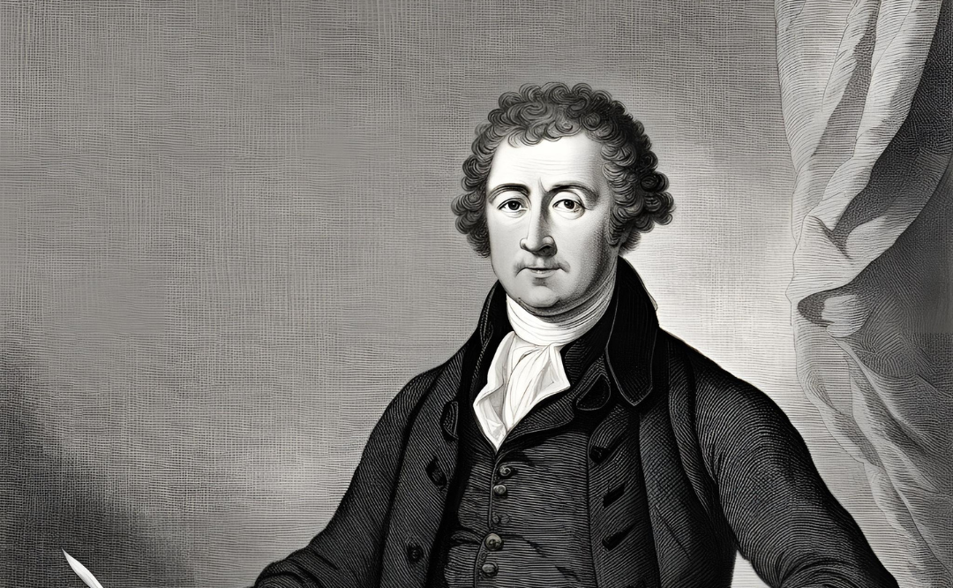
Edmund Burke and Pride and Prejudice
Austen in Theory
Term 1 Week 7

Slide 2
Edmund Burke
Part One

Slide 3
Edmund Burke (1729-1797)
Anglo-Irish politician and political philosopher, served in the Whig (later Liberal) Party—this party would become divided over the question of the French Revolution
Famous speeches in favour of the American colonists (but not American independence), and attacking Warren Hastings for the excesses of the East India Company
Most famous now for his attack on the French Revolution—in the 1790s (before England at war with France), a divisive issue in England

Slide 4
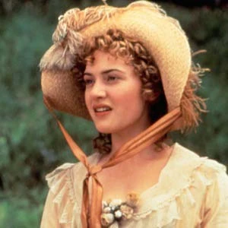
Atheists are not our preachers; madmen are not our lawgivers. We know that we have made no discoveries, and we think that no discoveries are to be made, in morality,—nor many in the great principles of government, nor in the ideas of liberty, which were understood long before we were born altogether as well as they will be after the grave has heaped its mould upon our presumption, and the silent tomb shall have imposed its law on our pert loquacity. In England we have not yet been completely embowelled of our natural entrails: we still feel within us, and we cherish and cultivate, those inbred sentiments which are the faithful guardians, the active monitors of our duty, the true supporters of all liberal and manly morals. We have not been drawn and trussed, in order that we may be filled, like stuffed birds in a museum, with chaff and rags, and paltry, blurred shreds of paper about the rights of man. We preserve the whole of our feelings still native and entire, unsophisticated by pedantry and infidelity. We have real hearts of flesh and blood beating in our bosoms. We fear God; we look up with awe to kings, with affection to Parliaments, with duty to magistrates, with reverence to priests, and with respect to nobility. Why? Because, when such ideas are brought before our minds, it is natural to be so affected; because all other feelings are false and spurious, and tend to corrupt our minds, to vitiate our primary morals, to render us unfit for rational liberty, and, by teaching us a servile, licentious, and abandoned insolence, to be our low sport for a few holidays, to make us perfectly fit for and justly deserving of slavery through the whole course of our lives.

Slide 5
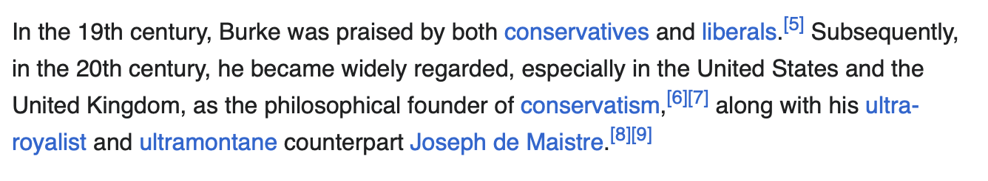

Slide 6
Key term: SENTIMENTALISM
Argument as factual claim: “The anti-sentimental writing of Jane Austen has been taken as primarily burlesque of a style…” (8)
“Among the most controversial positions of the sentimentalism…in the eyes of the next [i.e. Austen’s] generation—was his proposition that man’s instincts were good.” (8) Why controversial?

Slide 7
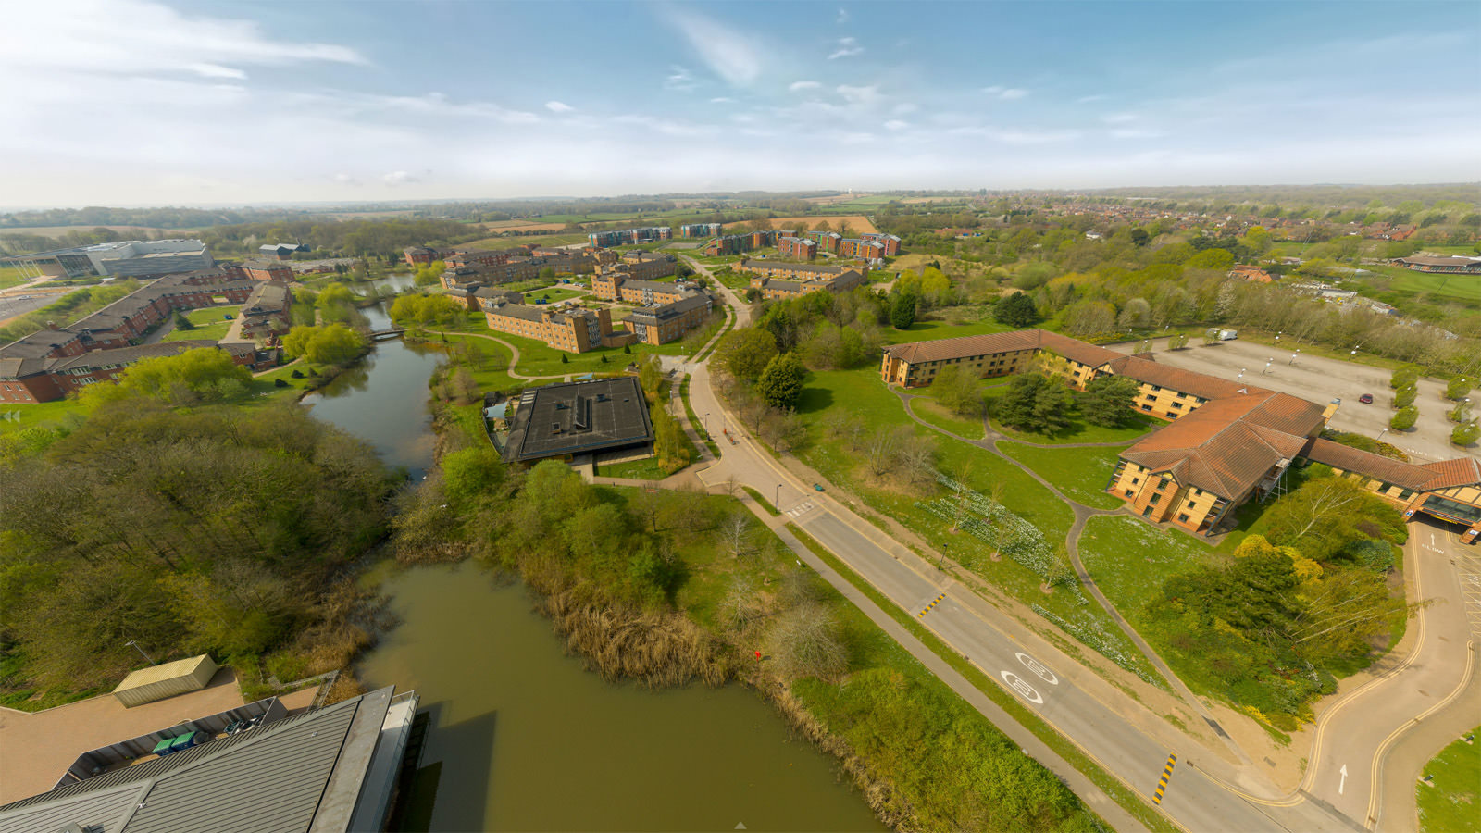

Slide 8
Burke: Key Ideas
An organic tradition: slow change across time (diachronic, we would say) superior to sudden change at a particular moment (synchronic)
A belief in the irrational: humans are swayed by passion and rhetoric, according to our nature
  Burke splits the difference with some of the Enlightenment writers we’ve considered: he seems to believe there are innate principles, but also that we are swayed by our sense-impressions according to this nature (as in the awe of kings and parliaments in the previous quotation)

Slide 9
Marily Butler, “Jane Austen…”, 1.2
In the Reflexions on the Revolution in France (1790), Edmund Burke advances two main propositions, both of them adapted from familiar positions of the Anglo-Scottish science of man. First he proposes that an advanced (‘civil’) society, such as contemporary France or England, is an organic whole, the equivalent in political life of inter-related systems of plant-life (since Linnaeus a fashionable study), or of the cosmos, which Newton had shown as answerable to its own law. Second, Burke implies a view of the nature of man which is in line with the psychology of the irrational. His human beings intuitively feel love or sympathy for family, for neighbours, and, by a natural associative process, for the head of the wider family, in the person of the head of state. Only the perverted think in terms of their selfish individual ‘rights’ or advantages. It is only by obeying his deepest instincts, which are social, and by mistrusting his reason, which may delude him with false notions of where his advantage lies as an individual, that man can achieve happiness and fulfil his nature. Burke has in fact seen the political logic of Hume's more pessimistic side, his picture of man as the involuntary servant of his affective experiences and instincts. That inclination in Hume's History towards political quietism becomes the major theme of the Reflexions, and it is cunningly worked out with the full range of sentimental effects.

Slide 10
It is far from impossible to reconcile, if we do not suffer ourselves to be entangled in the mazes of metaphysic sophistry, the use both of a fixed rule and an occasional deviation,—the sacredness of an hereditary principle of succession in our government with a power of change in its application in cases of extreme emergency. Even in that extremity, (if we take the measure of our rights by our exercise of them at the Revolution,) the change is to be confined to the peccant part only,—to the part which produced the necessary deviation; and even then it is to be effected without a decomposition of the whole civil and political mass, for the purpose of originating a new civil order out of the first elements of society.

Slide 11
A state without the means of some change is without the means of its conservation. Without such means it might even risk the loss of that part of the Constitution which it wished the most religiously to preserve. The two principles of conservation and correction operated strongly at the two critical periods of the Restoration and Revolution, when England found itself without a king. At both those periods the nation had lost the bond of union in their ancient edifice: they did not, however, dissolve the whole fabric. On the contrary, in both cases they regenerated the deficient part of the old Constitution through the parts which were not impaired. They kept these old parts exactly as they were, that the part recovered might be suited to them. They acted by the ancient organized states in the shape of their old organization, and not by the organic moleculæ of a disbanded people. At no time, perhaps, did the sovereign legislature manifest a more tender regard to that fundamental principle of British constitutional policy than at the time of the Revolution, when it deviated from the direct line of hereditary succession. The crown was carried somewhat out of the line in which it had before moved; but the new line was derived from the same stock. It was still a line of hereditary descent; still an hereditary descent in the same blood, though an hereditary descent qualified with Protestantism. When the legislature altered the direction, but kept the principle, they showed that they held it inviolable.

Slide 12
Marily Butler, “Jane Austen…”, 1.2
Like all sentimental writers, Burke is aware above all of the reader. He knows how to enlist his active participation by evoking a series of rapidly changing reactions. The Reflexions is a typical sentimental performance because it goes far beyond either rational political discussion or even detached treatment of matter seen as irrational: it tries to evoke the living experience—alternately of belonging to the community and of threatened alienation from it—in the half-consciousness of the reader. Through a subtle web of association Burke evokes the living organism of English society as it has existed in its continuity over centuries; and he shows how inseparable the life of the community is from the life of the individual. Exploiting the mind's natural process of building up impressions by association, rather than proceeding by logic, he moves apparently at random from the English Revolution Society and Dr. Richard Price to a legalistic discussion of the seventeenth century, to events in France, and back again to the Revolution's English supporters. It is only gradually that the desired effect builds up: the clustering on one side, that of the existing English constitution, of a vast range of images, from the homely and endearing, to the venerable, and even, by virtue of Miltonic associations, to the cosmic.

Slide 13
Pride and Prejudice
Part Two

