Slide 1

Galperin and Emma
Austen in Theory, Term 2 Week 2

Slide 2
Galperin in summary
Reading is generally the act of believing the text, of naturalizing the world it proposes—in Galperin’s reading, Emma plays with this
Ultimately many of the sources of knowledge in the book are wrong or have only partial information—and this includes the narrator, who seems unaware of the Frank/Jane Fairfax plot

Slide 3
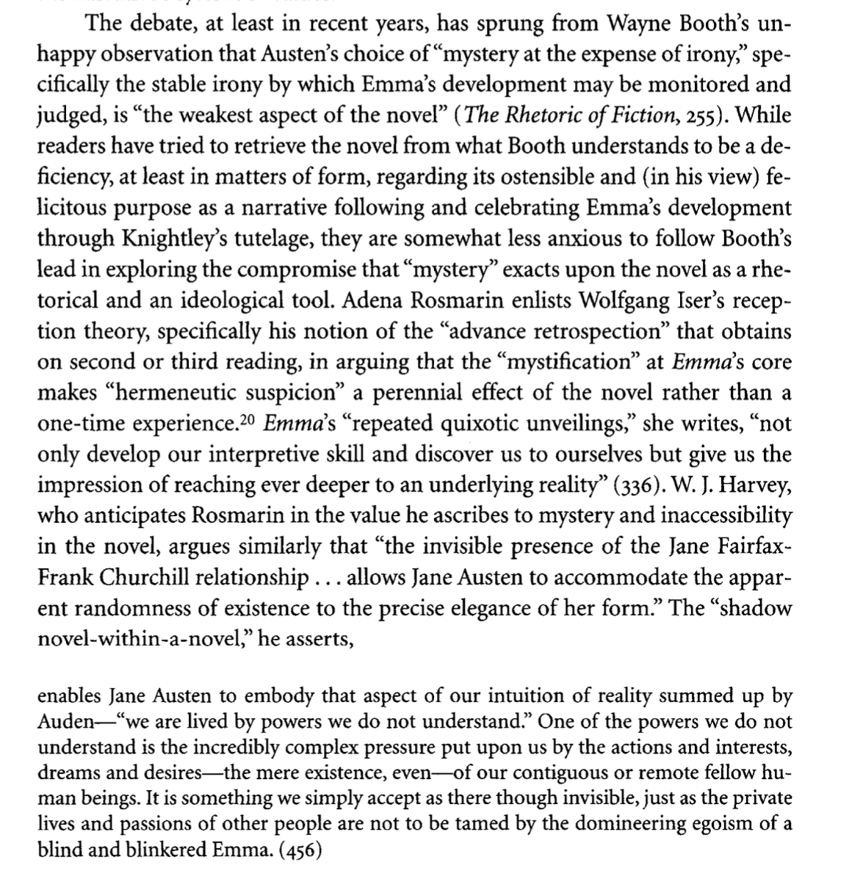

Slide 4
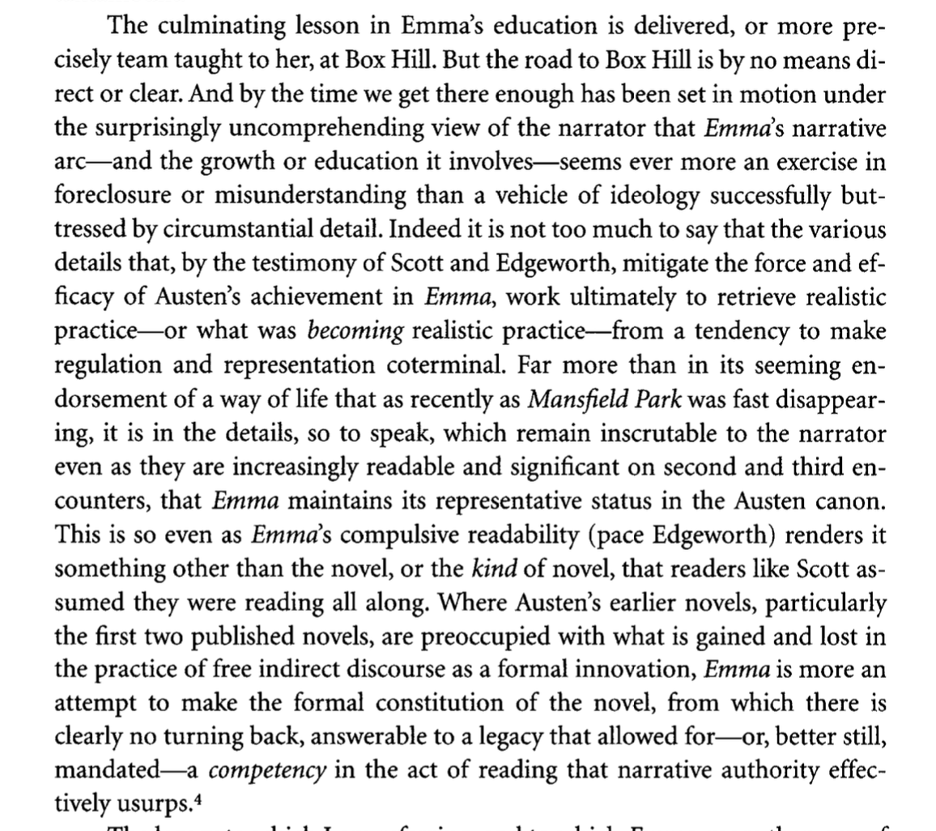

Slide 5
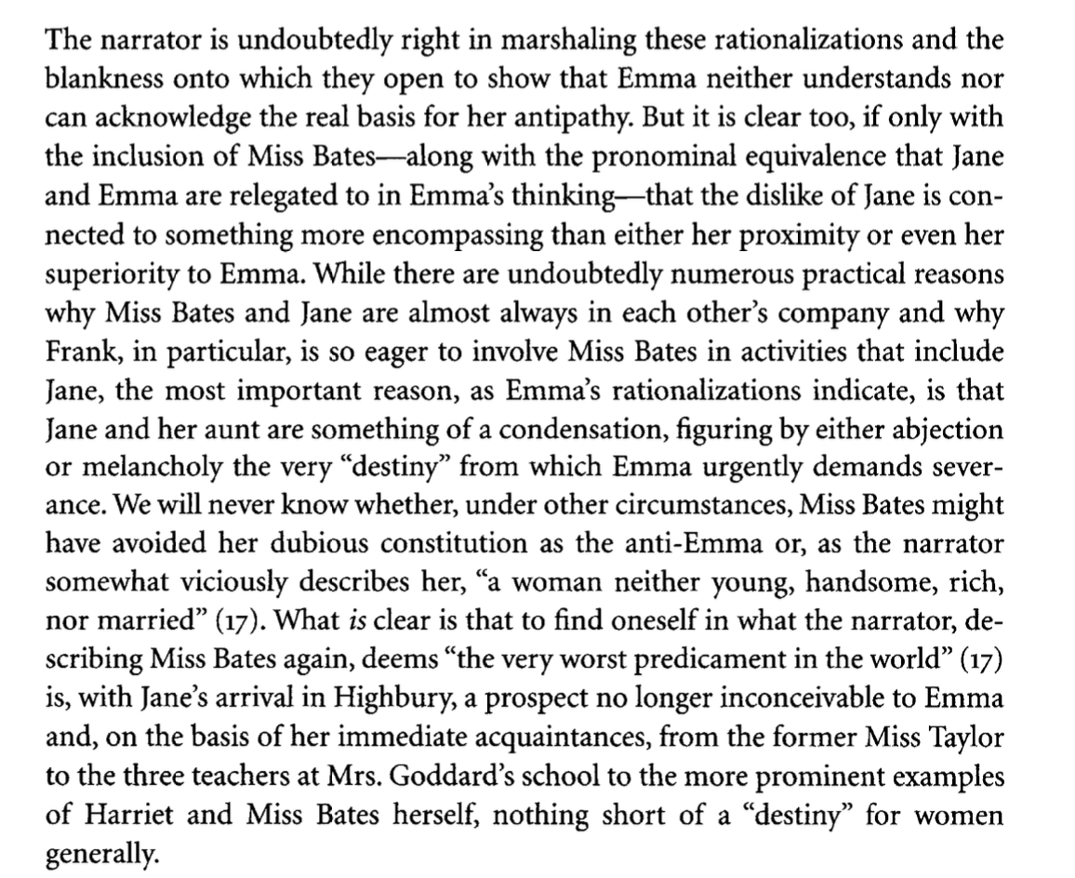

Slide 6
Resistable Vraisemblance
Austen's historicizable achieve- ment can be reckoned, following Scott, as an amalgam of the naturalizing and regulatory function that Roland Barthes describes as a reality effect (l'effet de reel)6 and a more oppositional marshaling of the everyday in what one early commentator described as an "irresistible vraisemblance" (Atlas, 30 Jan. 1833, 40). The notion of a representation capable of overcoming artificiality or con- trivance would seem to accord with Williams's sense of the managed and ma- nipulative nature of Austen's world. But what the notion points to, particularly in this formulation, is a circuit of response that has at some point measured Austen's achievement with a "vraisemblance" that is resistible. (4)--he picks up on the sickening nature of the term realism in Barthes
“the resistant or uncanny character of a reality whose proclivity [b to 5] to difference and to otherness is no less a response to something close at hand and altogether familiar” (4-5)
“There are many reasons that Austen would be available to such a reading, ranging from the unsettled nature of realistic practice at the time that she was allegedly bringing the novel to some kind of stability, to the humorless tracts and directives that envisioned such stability as essential to the disciplining of Austen's readership.? Another, and quite fundamental, explanation involves the temporal gap, or duree, between the first three novels' conception and their moment of publication. In this interval of approximately fifteen years, during which Sense and Sensibility, Pride and Prejudice, and Northanger Abbey were all revisited and substantially revised, Austen achieved a perspective on her milieu, and on the way she had represented it, that was also indissoluble from the tran- sience of certain initiatives and prospects, whose prestige would be linked in- creasingly to their anteriority.” (5)

Slide 7
“While plainly mindful of the significance and importance of free indirect discourse in the developing genre of the novel, Austen recognized by the time of her first novels' publication that this mode was also an especially sinister instrument of coercion” (10)
I begin with Austen's first two published novels, Sense and Sensibility and Pride and Prejudice, which were heavily revised for over a decade and, in the case of at least one (and perhaps both), underwent a transformation analogous to the genre of the novel itself in their respective metamorphoses from episto- lary form. Without disputing the formal and stylistic advance that the move- ment to free indirect discourse constituted in this instance, I show-with an assist from Lady Susan, the only mature epistolary narrative of Austen's cur- rently extant-that for Austen, unlike Scott, the rise of the novel was not with- out its costs. Most important among these was the "new" novel's complicity with certain social formations to which the actions of more marginal charac- ters, for example, Jane Bennet, are opposed. While Austen may have succeeded in becoming for a time the subtly coercive writer that literary historians and critics regularly construe, the epistolary legacy suggests that this was not always the case. Beginning with the earliest published novels, the achievement of au- thority we associate with Austen's realism was an ongoing problem that her continued, and continually vexed, practice of free indirect discourse has also obscured.

Slide 8
