Slide 1
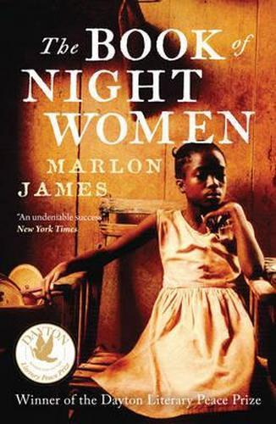

Marlon James, The Book of Night Women (2009)

Slide 2
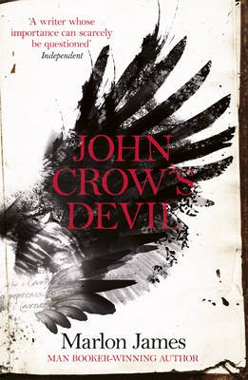
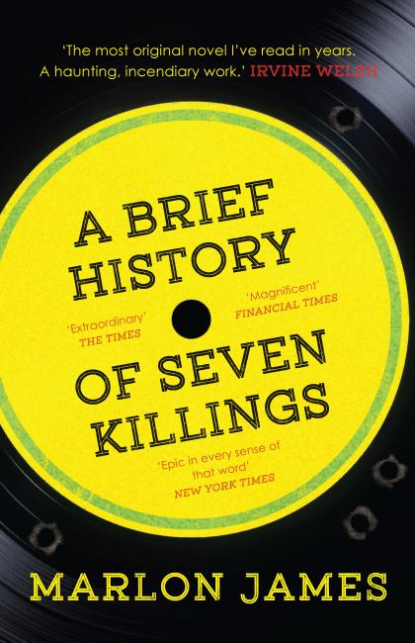
James’ novels:
John Crow’s Devil (2005)
The Book of Night Women (2009)
A Brief History of Seven Killings (2015)
Kei Miller, review of Brief History in The Guardian:
“Easily one of the best Jamaican novels ever written, The Book of Night Women, a slave narrative, is an incredible feat of plotting, pace and language. While it embraces a Jamaican dialect, it also established James as an international star. In every way, it is a bigger novel than John Crow’s Devil; epic in scale, and written with far more narrative power and lyricism.”

Slide 3
Slave narratives
Narrative of the Uncommon Sufferings and Surprising Deliverance of Briton Hammon (1760)
Ukawsaw Gronniosaw, A Narrative of the Most Remarkable Particulars (1770)
Quobna Cugoano, Thoughts and Sentiments (1787)
Olaudah Equiano, The Interesting Narrative of the Life of Olaudah Equiano (1789)
Mary Prince, The History of Mary Prince: A West Indian Slave (1831)
Frederick Douglass, Narrative of the Life of Frederick Douglass (1845)
Harriet A. Jacobs, Incidents in the Life of a Slave Girl (1861)
…and neo-slave narratives
Ishmael Reed, Flight to Canada (1976)
Toni Morrison, Beloved (1987)
Charles Johnson, Middle Passage (1990)
David Dabydeen, A Harlot’s Progress (1999).

Slide 4
The slave narrative form:
Narratives of individual development and redemption
Typically employ a double register of young, naïve writer who develops into a mature subject
Often borrowed the form of the spiritual autobiography
Spiritual autobiography typically deployed a three-part structure depicting a person’s enslavement to sin, harrowing conversion experience, and subsequent state of spiritual rebirth
this re-written in terms of the slave’s passage from physical enslavement, to harrowing escape experience, to ultimate freedom

Slide 5
The power of the ‘word’
Writing construed as a sign of ‘civility’ in colonial ideology
For the slave to write was therefore to claim civility, humanity
Slave narratives not only a record of experience, but an effort by the enslaved to write themselves into history as subjects, to claim personhood
Literacy and freedom: The Autobiography of Frederick Douglass: “I now understood what had been to me a most perplexing difficulty—to wit, the white man’s power to enslave the black man. It was a grand achievement, and I prized it highly. From that moment, I understood the pathway from slavery to freedom...I set out with high hope, and a fixed purpose, at whatever cost of trouble, to learn how to read.”

Slide 6
Night Women and the slave narrative
James’ novel “not a redemption narrative”
“Every negro walk in a circle. Take that and make of it what you will”
Lilith’s reading of Henry Fielding's Joseph Andrews: “Joseph want her to be a woman of the sort she don’t want to be” (218).
“But Joseph Andrews lying to her, making her wish for a place and a time that never goin’ come. No Mr. Adams waiting for a nigger. Nothing in this book a nigger can use.” (220)

Slide 7
“the way in which slaves were, like books, read and consumed by an audience. Slave narratives were instrumental in the abolitionist cause, but they were part of a process of representing black people which was not devoid of exploitation.”
(Abigail Ward, “David Dabydeen’s A Harlot’s Progress, Journal of Postcolonial Writing, 43:1 (2007): 32-44)

Slide 8
‘In the past, James has discussed the theory of how white depictions of black experience are often presented so that even the worst horrors visited upon black people are viewed as learning experiences for white characters. I ask him how he saw 12 Years a Slave – whether it felt to him like a film directed by a black director (Steve McQueen) or the product of a white film industry. “It did feel like the film of a black director,” he says, pointing to its depiction of “casual cruelty – when somebody breaks a glass in someone’s face just because they can. Even liberal artists draw the line at casual cruelty… institutionalised brutality, yes; sadism, not so much. It means you have to accept a level of cruelty that your ancestors were capable of that you may not want to.”’
Interview in The Telegraph, October 2015.

Slide 9
“The second event that spurred me to write of Bigger was more personal and subtle. I had written a book of short stories which was published under the title of Uncle Tom's Children. When the reviews of that book began to appear, I realized that I had made an awfully naive mistake. I found that I had written a book which even bankers' daughters could read and weep over and feel good about. I swore to myself that if I ever wrote another book, no one would weep over it; that it would be so hard and deep that they would have to face it without the consolation of tears. It was this that made me get to work in dead earnest.” (Richard Wright, “How Bigger was Born”)

Slide 10
“Every negro walk in a circle. Take that and make of it what you will. A circle like the sun, a circle like the moon, a circle like bad tidings that seem gone but always, always comes back. Woman work round the sun and sleep round the moon and sometimes work round both, especially if it be crop time. Other times woman wait on the moon, especially if it be fat with blood and rise low over the Blue Mountain.” (22)
“blood spurt from the skin, on spring from the axe, the cat-o'-nine, the whip, the cane and the blackjack and every day in slave life is a day that colour red” (3)

Slide 11
Allewaert: “Plantation spaces possessed those who traversed them. The heat that changed the orientation and movements of bodies and the diseases that the climate was thought to carry, as well as the bites of the region's insects and venomous snakes, all compromised bodily and metaphysical integrity. Bodies so penetrated could not be diffused into singular yet abstract corpuses like that of a republic sustained by print culture; they were pulled instead into the sprawling (and overlapping) biological, economic, and social systems of the plantation zone.”
Monique Allewaert, “Swamp Sublime: Ecologies of Resistance in the American Plantation Zone” PMLA, 123.2 (2008): 342-43

Slide 12
“Early colonial Jamaica was much more than a failed settler society; it was an abundant garden of power and terror. Demographic turmoil, rather than terminating social development and stifling cultural practice, was a seedbed for particular forms of being, belonging, and striving appropriate to this world of relentless exploitation. It is thus less revealing to see the extravagant death rate in Jamaican society as an impediment to the formation of culture than it is to view it as the landscape of culture itself, the ground that produced Atlantic slavery's most meaningful idioms. Death served as the principal arena of social life and gave rise to its customs.”
Vincent Brown, The Reaper’s Garden (Harvard UP, 2008), p. 59.

Slide 13
“the high price for sugar on the international commodity market occasioned by the hostilities on the French island of Saint Domingue (Haiti) attracted speculators to the sugar industry. Therefore, the 1790s witnessed never-before-seen increases in sugar prices and a subsequent expansion in the number of sugar estates throughout the British Caribbean as speculators flocked to take advantage of the high prices offered on the international market. This speculative bubble led to a phenomenal increase in sugar production during this period. This exuberance – or the period of ‘good times’ – proved short-lived, however, as the price of sugar decreased from 1799 onwards. Planter innovation and productivity during the 1790s laid the foundations, therefore, for, in Ryden’s view, a growing overproduction crisis from 1799 to 1807.”
Ahmed Reid, “Sugar, Slavery and Productivity in Jamaica, 1750–1807”, Slavery & Abolition, 37:1 (2016): 159-182, summarizing the arguments of David Ryden in West Indian Slavery and British Abolition, 1783-1807.

Slide 14
Names of 19th century Cuban sugar estates
“Good Results”,
“Gamble” “Wits’ End”
“Audacious” “Woe”
“New Hope” “Disenchantment”
“Hope”

Slide 15
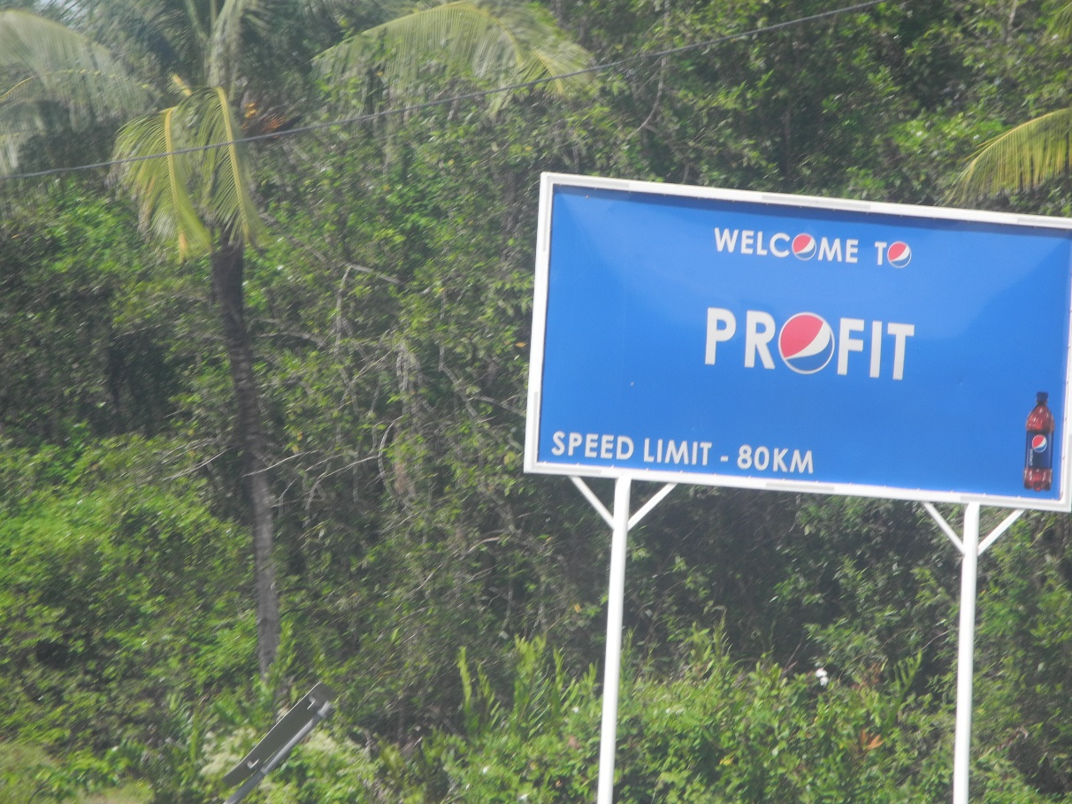
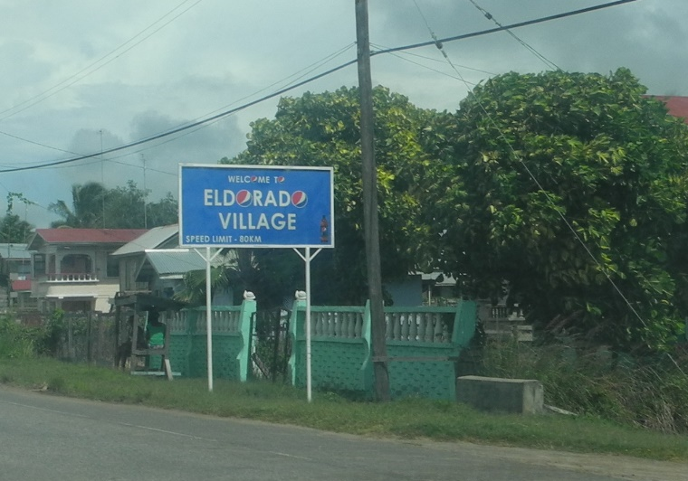
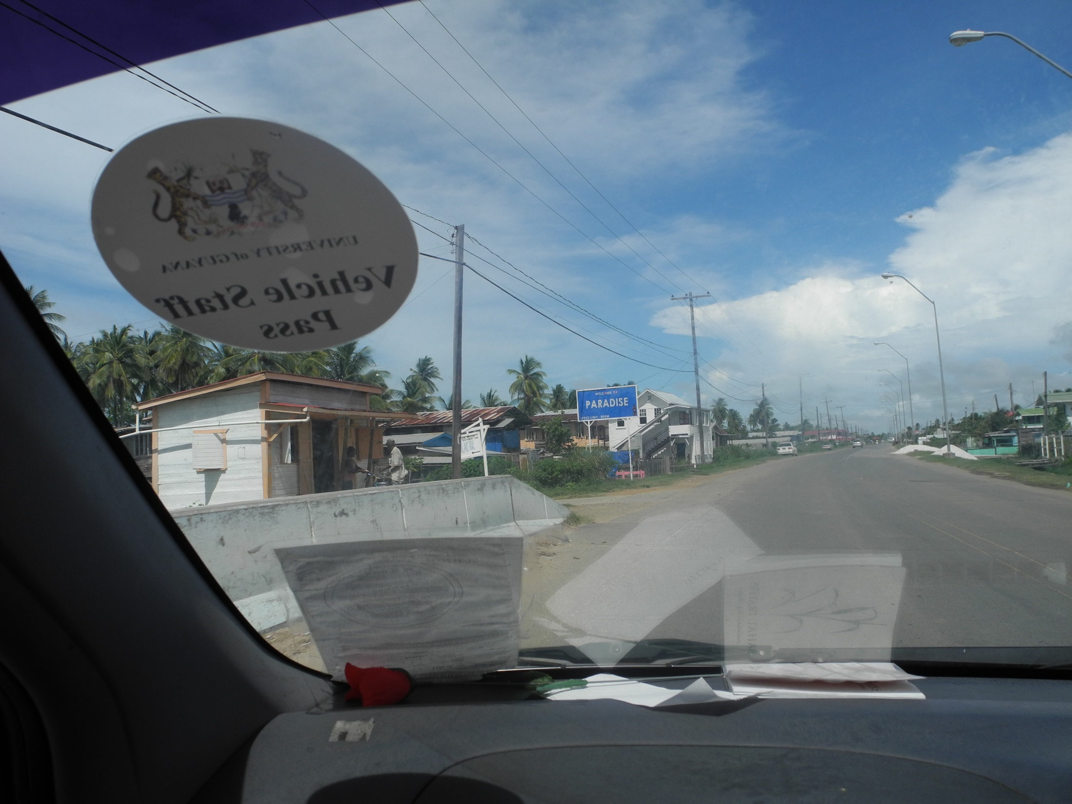

Slide 16
“When slaveholders were asked to describe the way their slaves looked, they often began with the hands, noting missing or mutilated fingers, “small hands,” or “short fingers.” There was, that is to say, a two-sided character to the way slaveholders viewed the relationship of ecology and labor in the Mississippi Valley. Plant was to be shaped to hand, and hand to plant; natural complexity was simplified into a single strain; human capacity was rendered increasingly productive, even as it was reduced to the capillary repetition of a single motion.” (Walter Johnson, River of Dark Dreams, 153)
“In effect, their senses, their muscles, and their minds were reeducated to suit their work. Measuring crops and slaves “to the hand” was an ecological as well as an economic measure—an attempt to regulate the exchange between slaves and soil by prescribing benchmark measures for the process by which human capacity and earthly fertility were metabolized into capital.” (Ibid., 154)

Slide 17
Maria Mies, Patriarchy and Accumulation on a World Scale (1986)
“women, nature, and colonies”
the “underground of capitalist patriarchy or civilized society” (77)
an “underground” trinity, one that over “the last four or five centuries” has been “declared to be outside civilized society, pushed down, and thus made invisible”, even as it constitutes “the base of the whole” (77)
Capitalism works through the racialization and gendering of work, designating some work as less valuable or as having no value as compared to other types of work
The same applies to that work performed by extra-human nature, which is typically treated as a ‘free gift’

