Slide 1
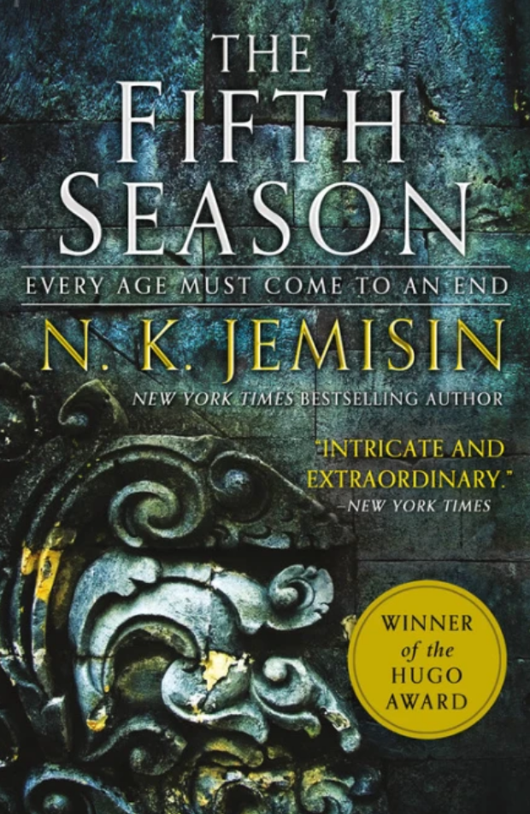


Slide 2


Slide 3


Slide 4
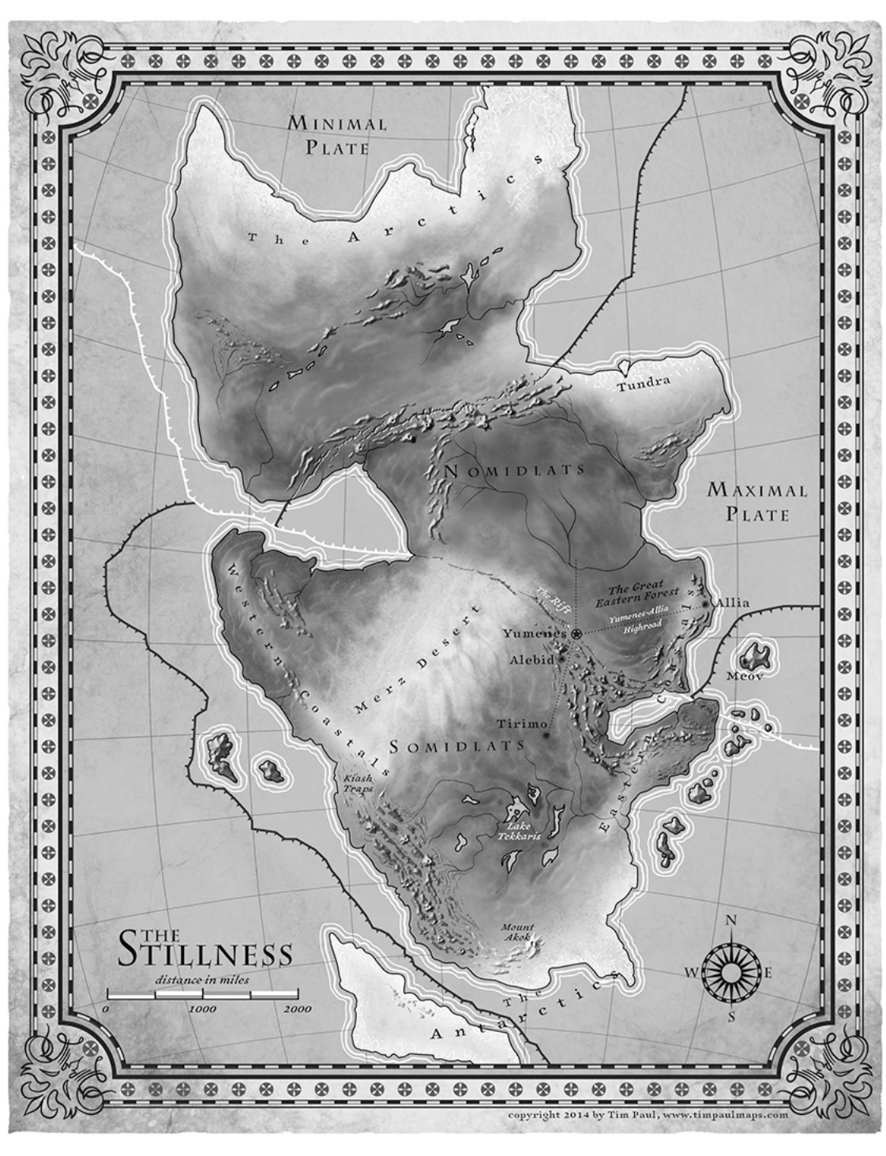

Slide 5

PBS Interview

Slide 6


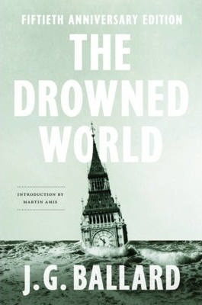

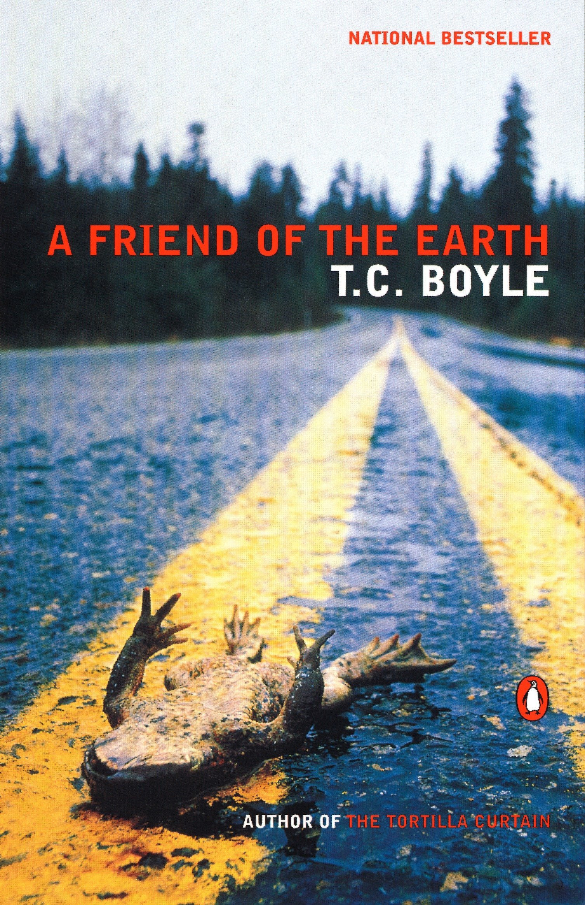
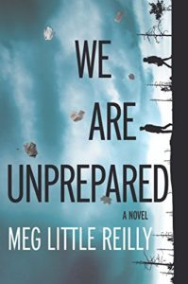

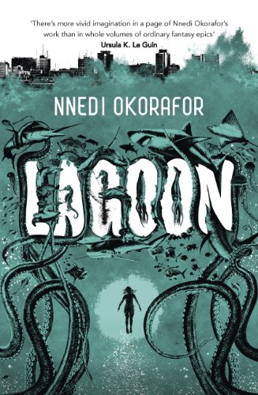
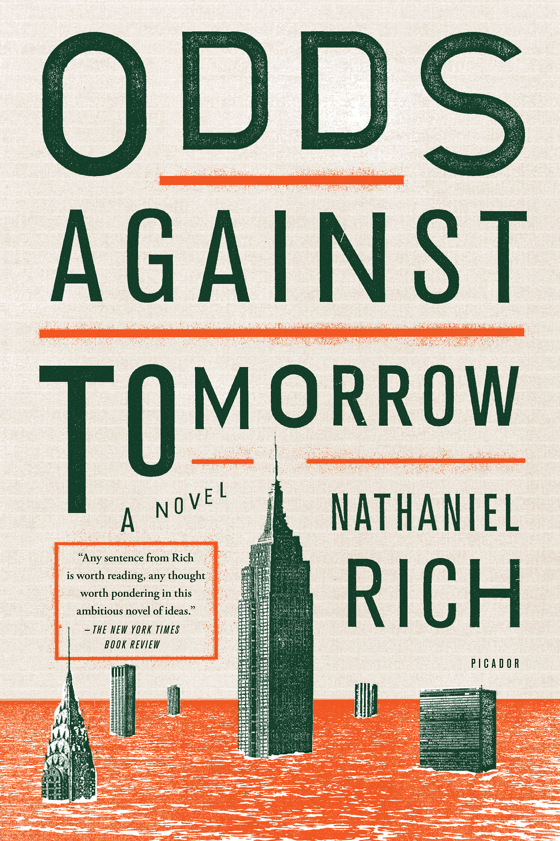

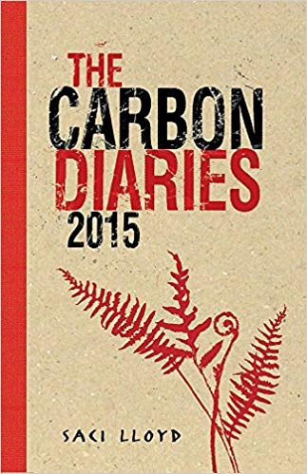


Notes:
YET – there IS A strong idenfiiable strand of climate fiction - ‘clifi’ – what Ghosh resigned to the ‘outhouses’ of culture – there are indeed so many examples of societal meltdown and earth system collapse on our screens that it’s harder to choose one. Predilection for dystopia and apocalypse (end times threats; cautionary tales; extrapolations of the present; also small morality tales within of how to deal wth it and how to be better and perhaps prevent it)
Examples of clifi from all over and through various genres and audicnes, YA fiction to sf to fantasy and the orthodox novel – this fiction is almost always trying to register a massive change and usually involves dystopian worlds, either of adapation to a new and radically transformed climate or a word where an apocalypse is creating dystopian forms of reaction and governance – next slide is benumbing reality in this work….

Slide 7
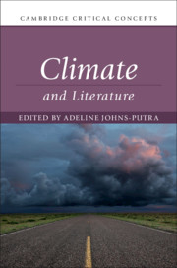
The formal study of climate science introduces the global to individual and local scales of experience, which literature – most obviously, the novel – accommodates. But literary convention is rather more stretched by climatic conceptions of time. Alongside individual and local timescales (that is, human lifetimes and historical epochs), climate science and, particularly, this century’s concerns about climate change bring into purview not just individual and local but geological durations of time. It is, then, not the climatological expansion of the concept of time as universal time that is at stake here – universal time is a function of a global sensibility and thus a matter of rendering time as spatially simultaneous. What matters as climate science turns its gaze to climate systems and climate change is not the apprehension of time as universal, as a function of the apprehension of space as global, but the ability to expand time frames and durations.
Adeline Johns-Putra, ‘Introduction’ to Climate and Literature, CUP, 2019

Slide 8
The Anthropocene blurs and even scrambles some crucial categories by which people have made sense of the world and their lives. It puts in crisis the lines between culture and nature, fact and value, and between the human and the geological or meteorological. As a bewildering and often destructive contamination of human aims and natural causality, the Anthropocene manifests itself in innumerable possible hairline cracks in the familiar life-world, at the local and personal scale of each individual life. Something planetary is breaking through, entailing a politicization of what may once have seemed insignificant, as familiar day-to-day practices incite an engaged ‘green’ political awareness. For example, someone’s routinely driving a car may be condemned as an act of more significance, on the planetary scale, than their voting habits. Clark, p.9

Slide 9
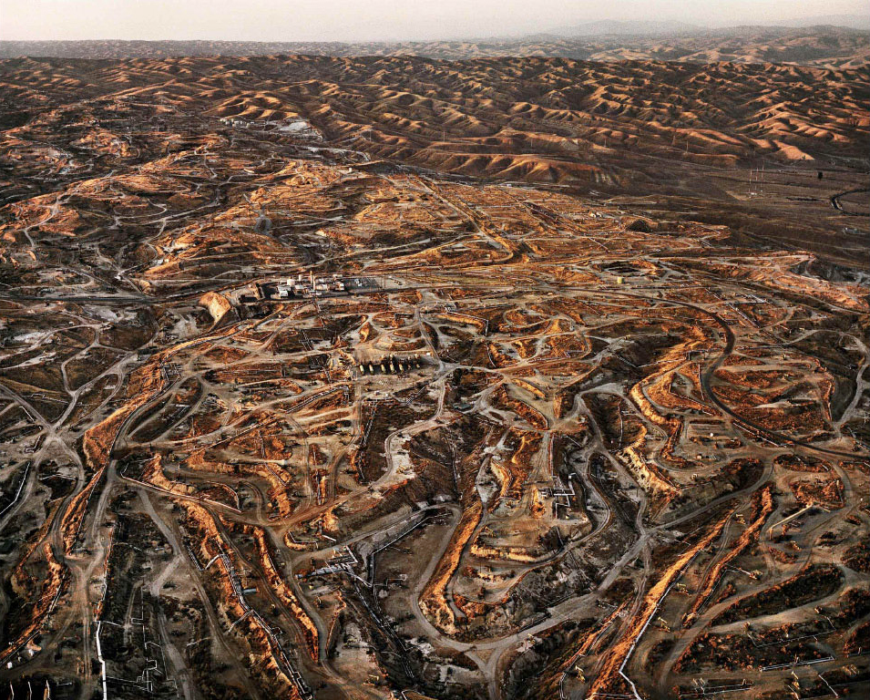

Slide 10
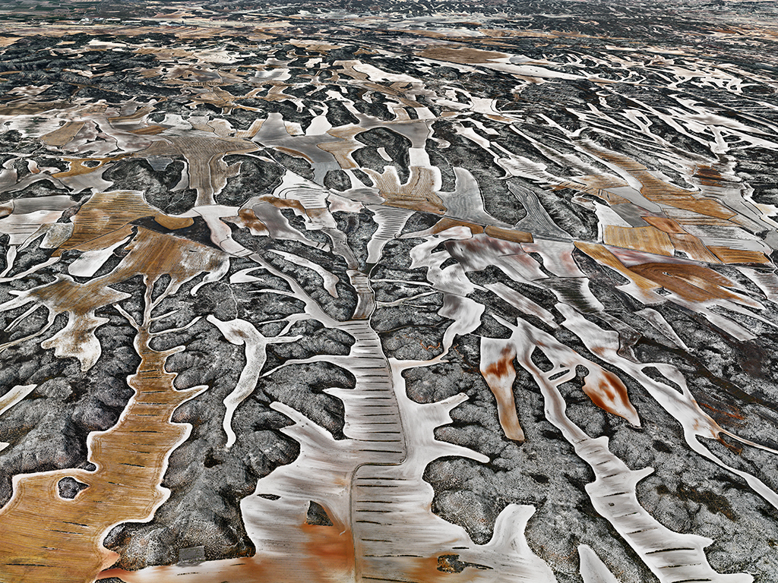

Slide 11
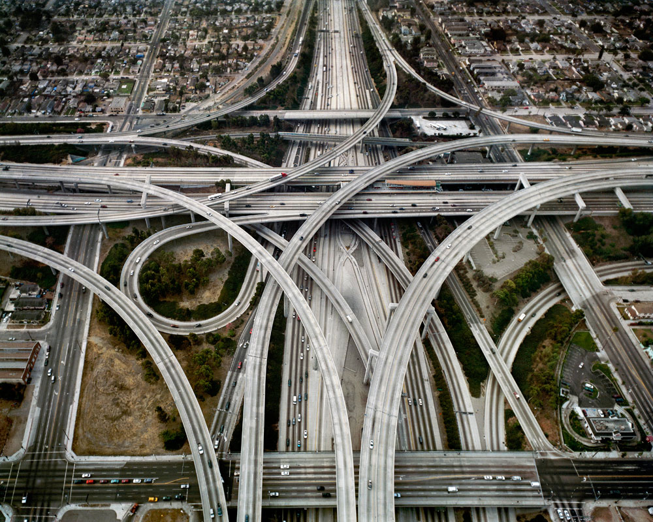

Slide 12
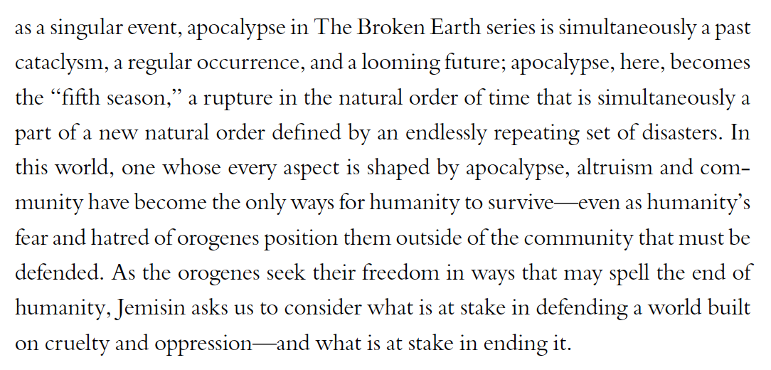
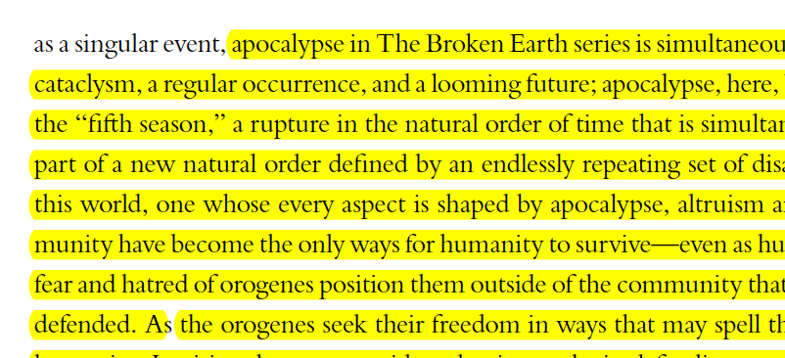
An Apocalypse is a Relative Thing: An Interview with N. K. Jemisin
Jessica Hurley, N. K. Jemisin
ASAP/Journal, Volume 3, Number 3, September 2018, pp. 467-477

Slide 13
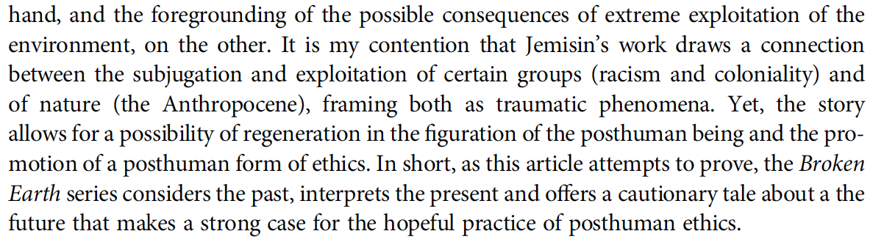
María Ferrández San Miguel (2020) “Ethics in the Anthropocene: Traumatic
Exhaustion and Posthuman Regeneration in N. K. Jemisin’s Broken.Earth Trilogy, English Studies,
101:4, 471-486, DOI: 10.1080/0013838X.2020.1798138
This renders the nature/culture divide that has
long supported Western philosophy unsustainable in the trilogy. In Jemisin’s post-
Anthropocene Earth, characterised as it is by the vengeful retaliation of a wilful Father
Earth as a result of previous boundless exploitation of natural resources on the part of
humans, by orogenes’ genetically engineered ability to control seismic activity, by Guardians’
prosthetically enhanced capacity to use the force of the environment and by
stone eaters’ power to merge with and move through the substance of the Earth, nature
is shown to be no longer separable from culture.
……More importantly, the series draws a connection between coloniality and the Anthopocene—between the enslavement
of a group of beings and the exploitation of natural resources: just as the ethos of
coloniality is based on denying a collective, in this case orogenes, the status of humans

Slide 14
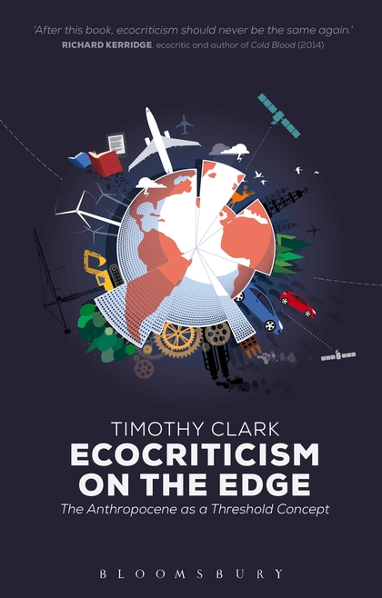
The twenty-first century has seen an increased awareness of forms of environmental destruction that cannot immediately be seen, localized or, by some, even acknowledged. Phenomena such as ocean acidification, climate change, the general effects of incremental forms of ecological degradation across the planet, global overpopulation and resource depletion do not present any obvious or perceptible target for concern or protest at any one place, or often any immediate antagonist perceptible at the normal human scale. The largely benumbed recognition of this reality has become one feature of life in the so-called Anthropocene, to use the currently still informal term for the epoch at which largely unplanned human impacts on the planet’s basic ecological systems have passed a dangerous, if imponderable, threshold. One major new effort at work in contemporary literary and artistic practice and criticism is to find some way of usefully or authentically engaging such crucial but elusive concerns, precisely when it is acknowledged that they resist representation at the kinds of scale on which most thinking, culture, art and politics operate. Timothy Clark, from ‘Preface’ to Ecocriticism on the Edge

Slide 15
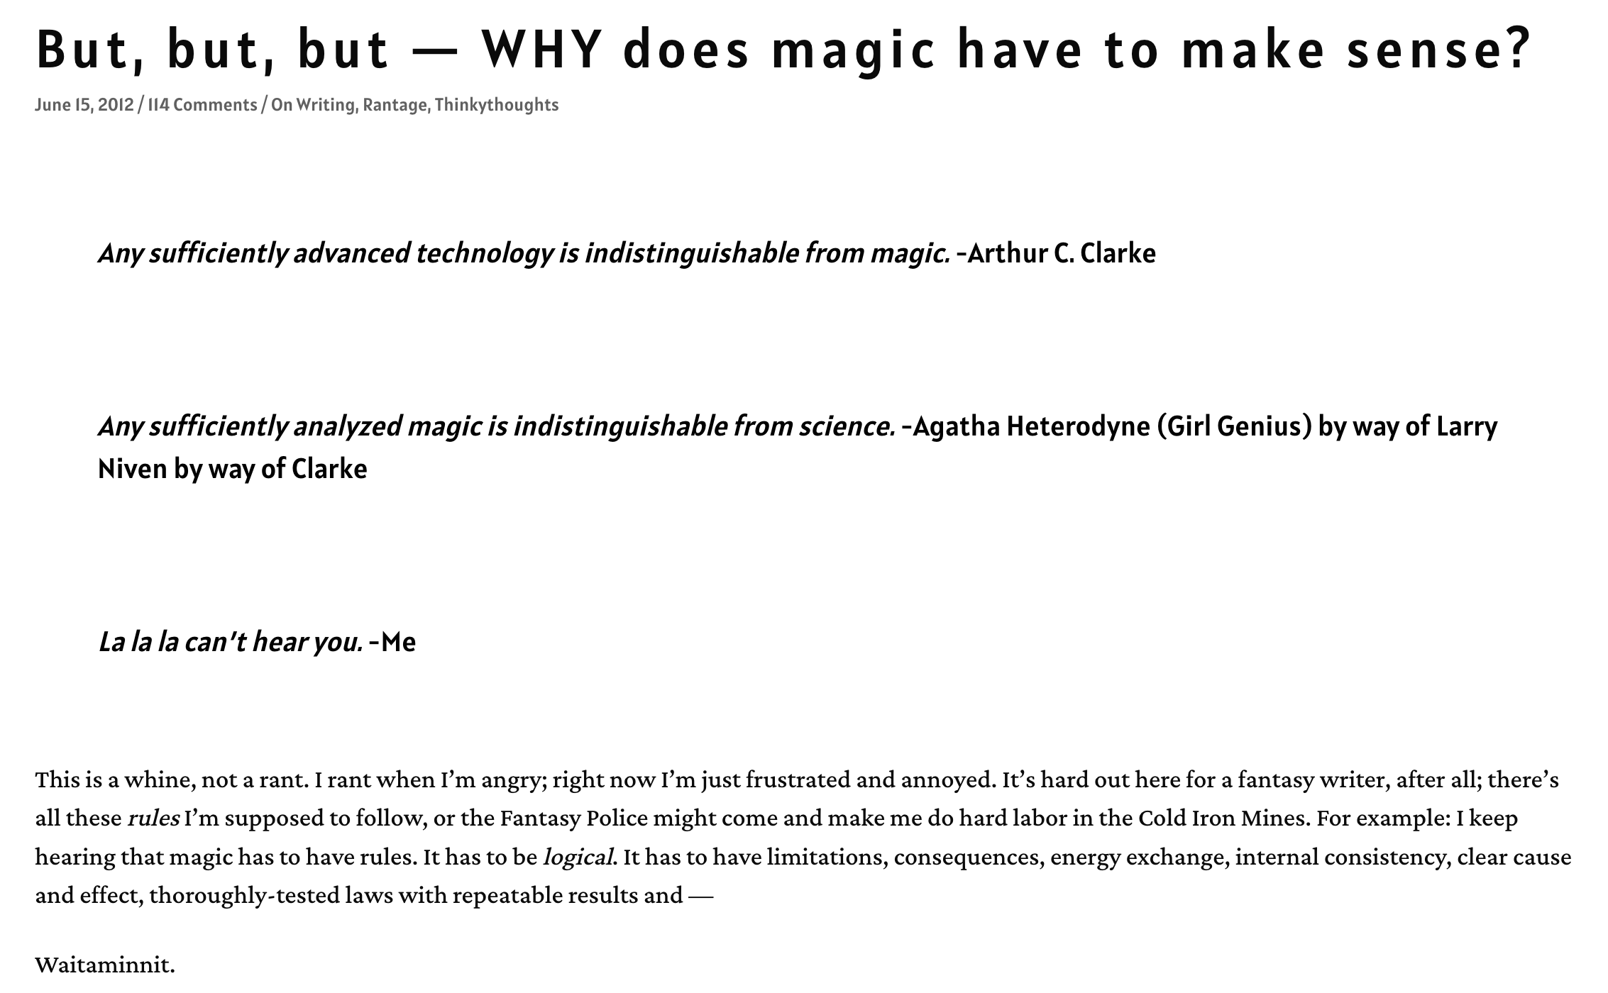
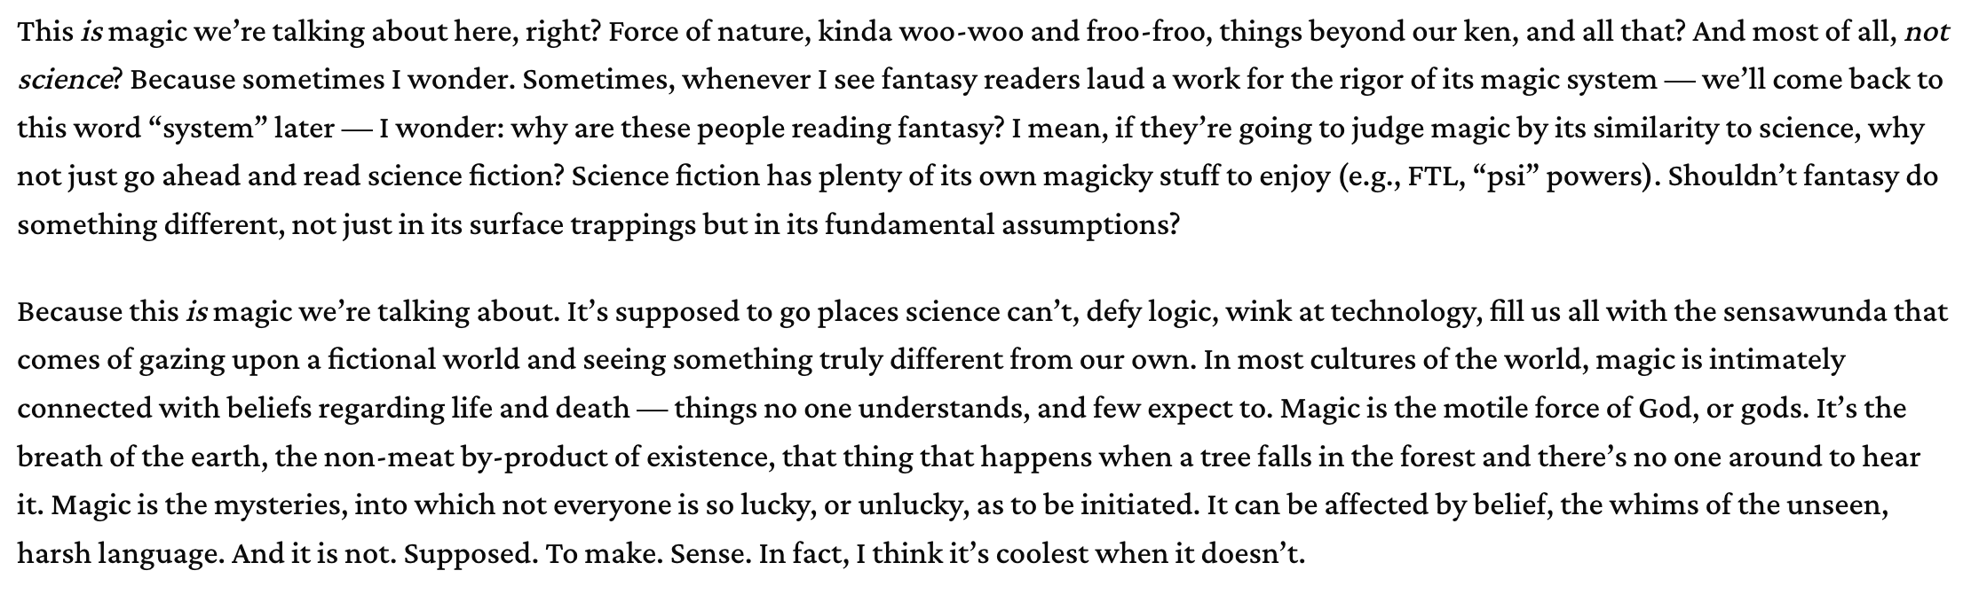
From ’Blog’ @ nkjemisin.com

Slide 16
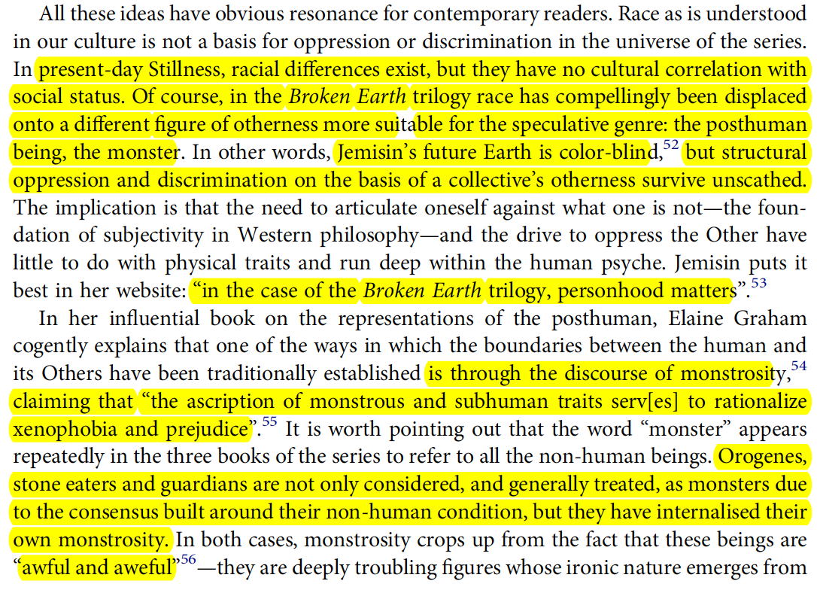
Ferrandéz

Slide 17
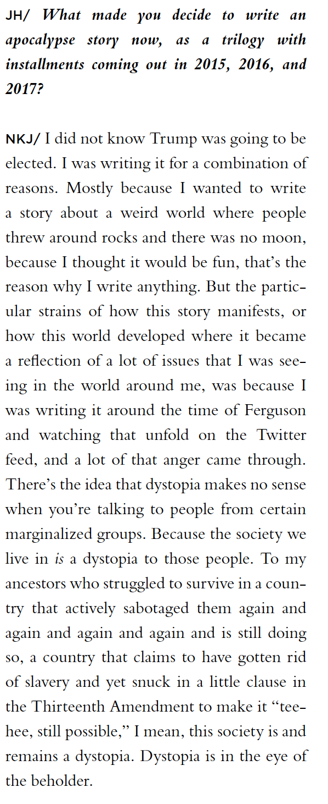
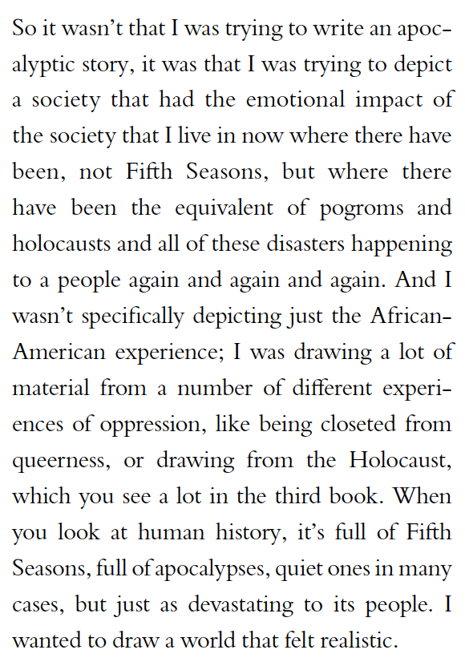
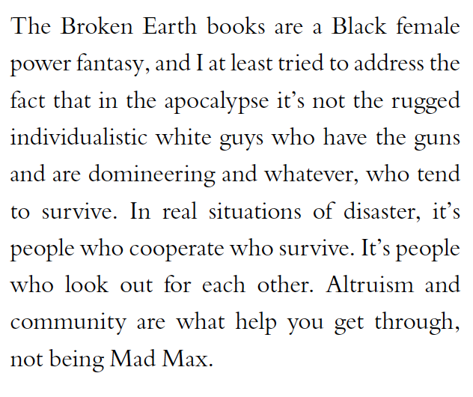
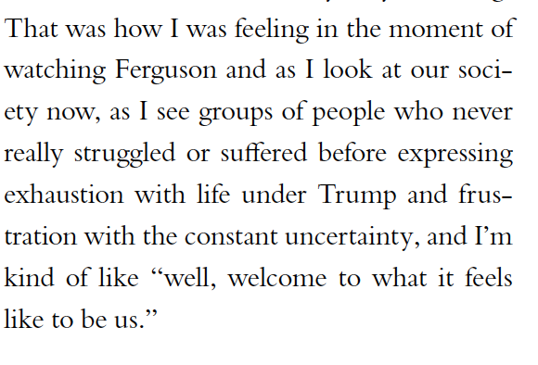
NKJ, from Hurley Interview

Slide 18
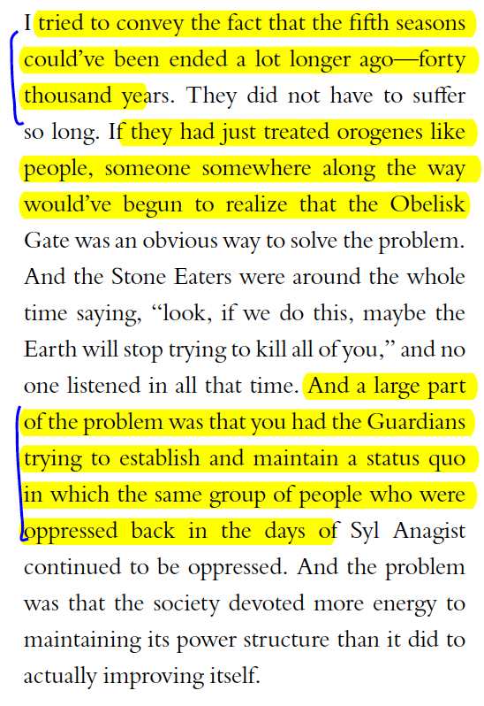
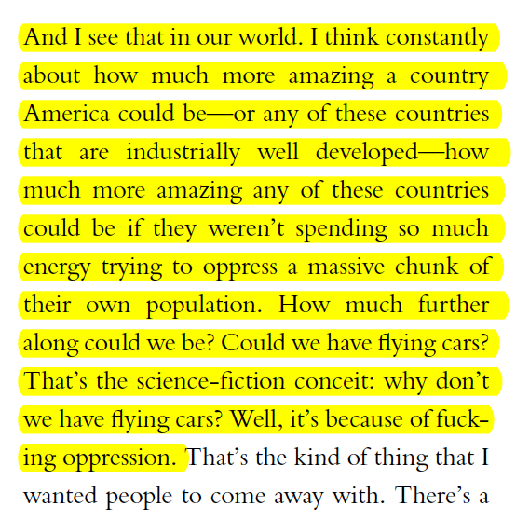
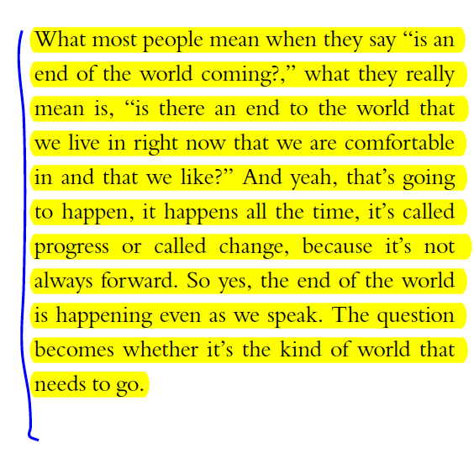

Slide 19
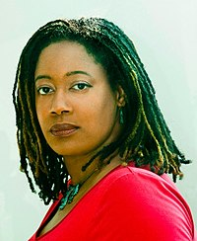
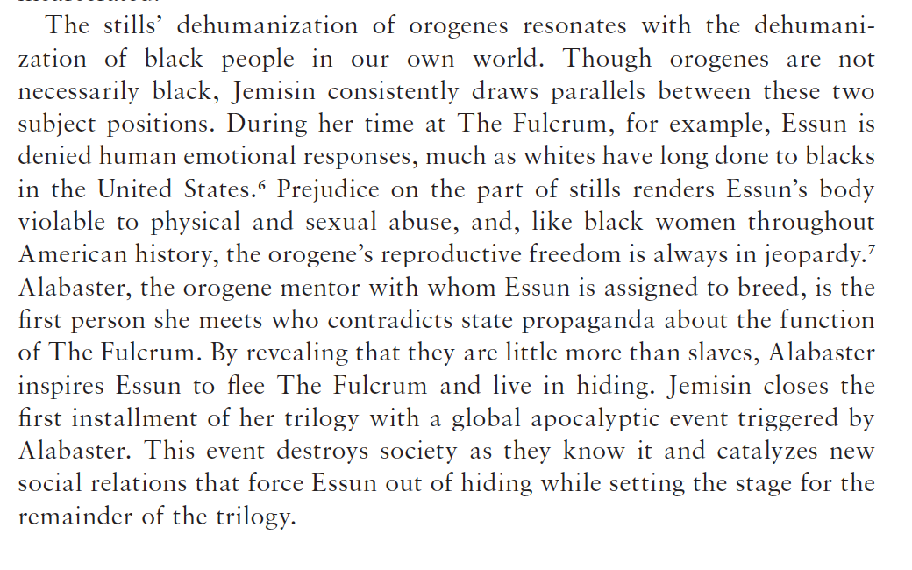
“Land and Pessimistic Futures in Contemporary African American Speculative Fiction”
Kirsten Dillender

Slide 20


Slide 21
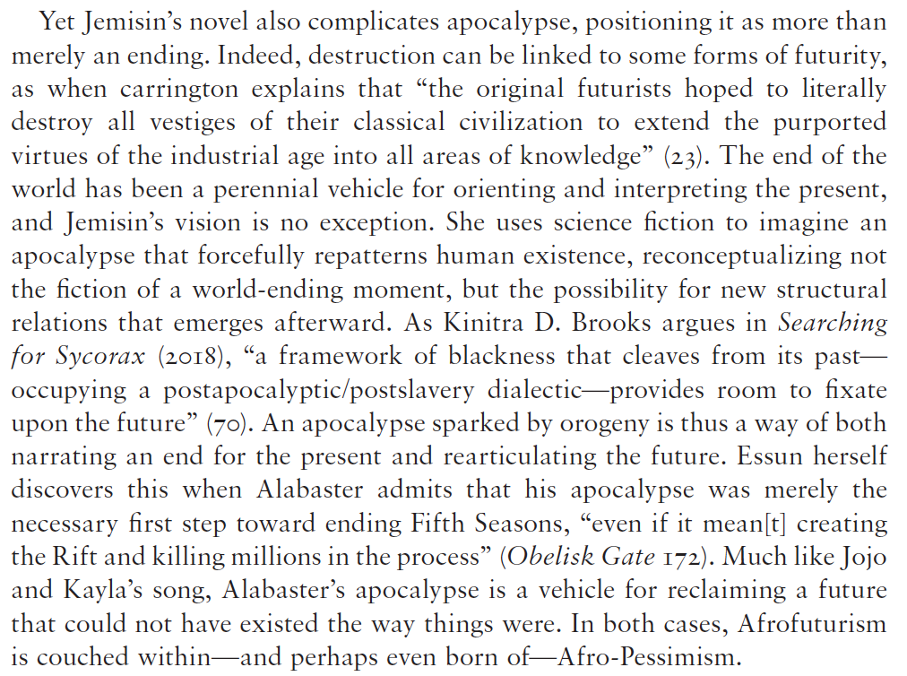
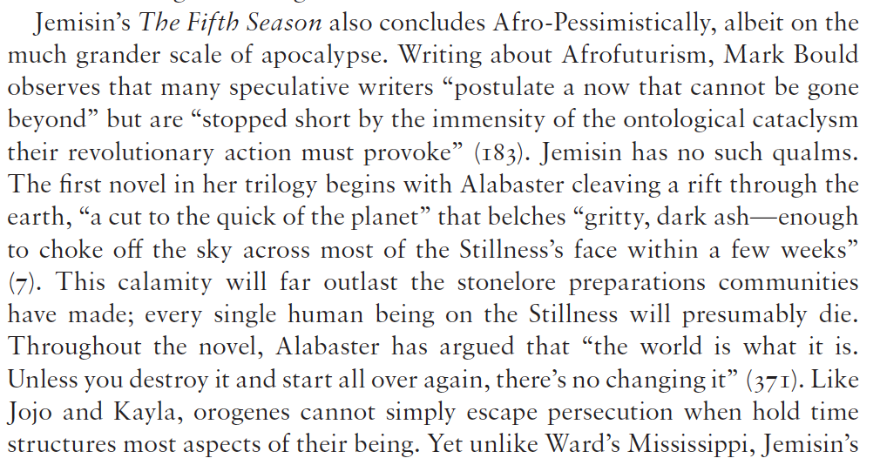
Dillender

Slide 22
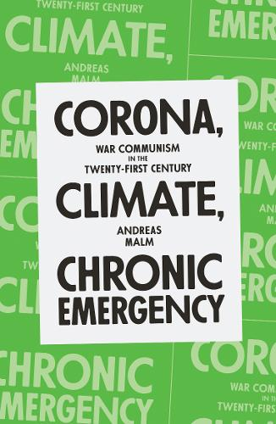
There is a related belief that Covid-19 represented
a more serious danger to humanity in some absolute,
Objective, clinical sense. This is not tenable. Unabated
global heating will burn through the foundations of human
Life (not to mention that of other species without number).
Covid-19 could do no such thing….Climate breakdown…is not
Something from which a majority can recover.
Andreas Malm, Corona, Climate, Chronic Emergency (Verso, 2020)

Slide 24

Notes:
maybe the dystopia is with us now, we are living it - and have been for some time - since when? Its easier to drmatise disaster than resilience, repair, the changed world – maybe the first steo is actually turning the generic tables and recognizing the dystopian in the every day – in what you will do now as you leave the building and drive home, have a beer, eat a burger, buy a book, have a bath – maybe the dystopias are the police dramas, the soaps that show business as usual….maybe its hard to imagine ourselves in a totally retoriftted utopan world of regulated climate and natural restoration, a clean transition

Slide 25
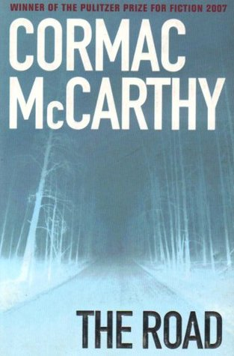
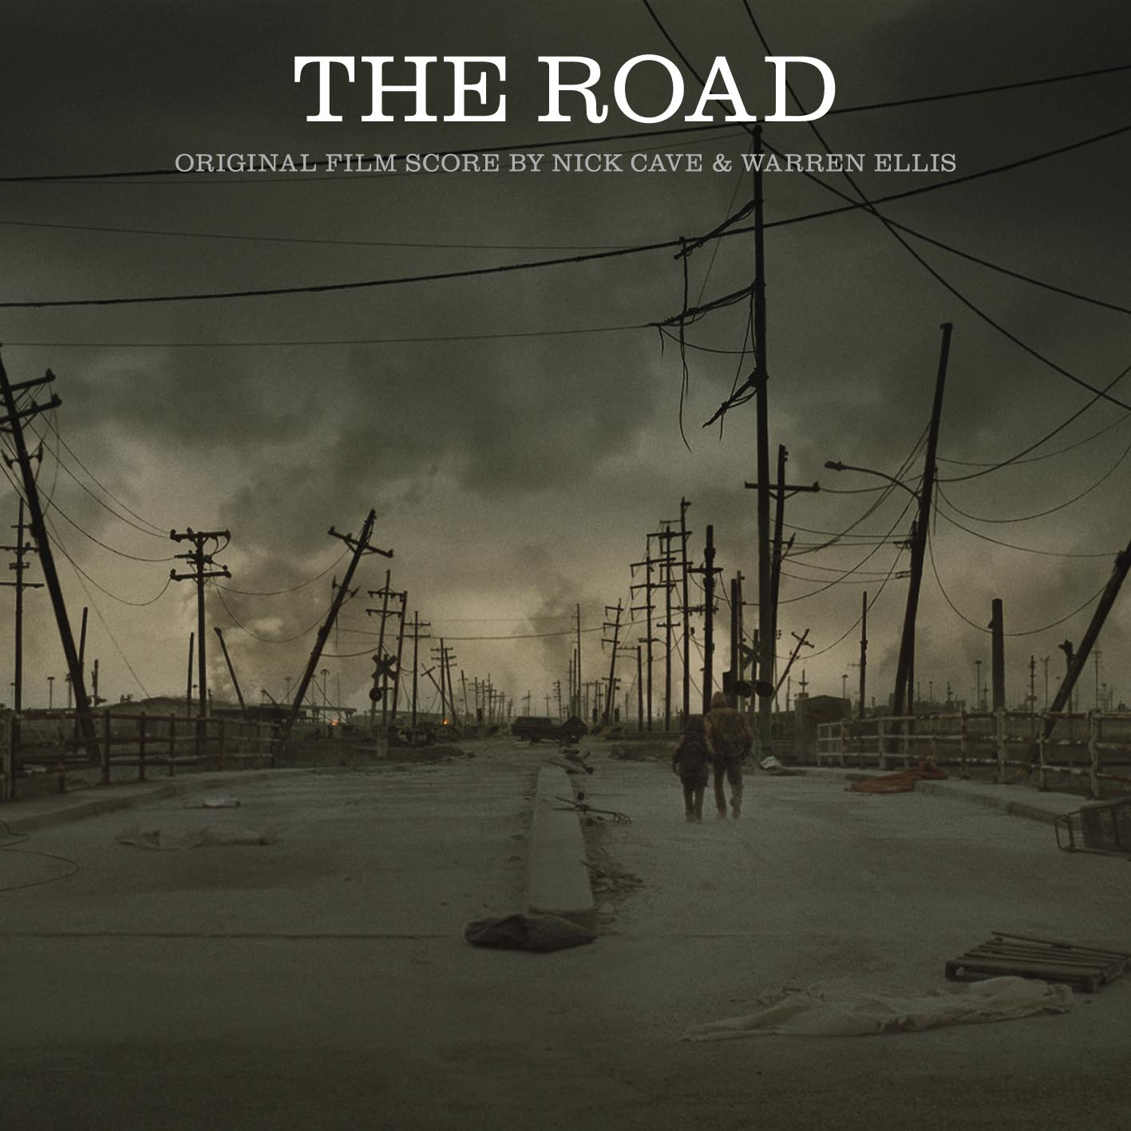
Notes:
collapse, entropy, painful pedestrianism, without maps, following the cracked highway - the bunker episode - Predilection for dystopia and apocalypse (end times threats; cautionary tales; extrapolations of the present; also small morality tales within of how to deal wth it and how to be better and perhaps prevent it)
One vein of thinking is that this seems to be not real at all, difficult to grasp – so maybe bunker thinking is both a natural response and also a fearful/problematic one. other forms of escape and shelter are seen in fagan -

Slide 26
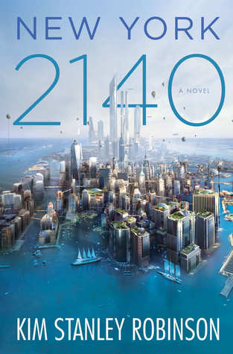
The flood went up to about Thirtieth. And even though it was fast, it did take two hours. So people just ran north ahead of it. They abandoned whatever they were doing and ran in the streets. We did too. Central Park had millions of people in it, standing there looking at each other….No one could believe it. But it was true. A new day had come. We knew it had happened, because there we were. We knew it would never be the same. Downtown was gone. So that was very strange. People were stunned, you could see it. We stood there looking at each other! No one could believe it but there we were. Everyone was like, well, here we are – it must be real. But it was like a dream.
Kim Stanley Robinson, New York 2140 (2017)
Notes:
We see the same thing here in a novel about adaptation to catastrophe in North American continent, where NYC adapts, yet the entrie scene remains cognitively difficult to grasp – long genre, cautionary tales, tales about denialism and consciousness raising, weird tales of strange climate, offshoring the problem by alienating it, then the speculative fccition and the dystopias – usually of resource-starved worlds, depleted stocks of foods, medicines, turn to authoritarianism, and another way of doing this might be seeing a totally transformed world devoid of humans, - so how about Scotland, in 2563…slide

Slide 27
Leaning on the balcony rail, the slack water ten storeys below reflecting his thin angular shoulders and gaunt profile, Kerans watched one of the countless thermal storms rip through a dump of huge horse-tails lining the creek which led out of the lagoon. Trapped by the surrounding buildings and the inversion layers a hundred feet above the water, pockets of air would heat rapidly, then explode upwards like escaping balloons, leaving behind them a sudden detonating vacuum. For a few seconds the steam clouds hanging over the creek dispersed, and a vicious miniature tornado lashed across the 6o-feet-high plants, toppling them like matchsticks. Then, as abruptly, the storm vanished and the great columnar trunks subsided among one another in the water like sluggish alligators.
Rationalising, Kerans told himself that he had been wise to remain in the hotel—the storms were erupting more and more frequently as the temperature rose—but he knew that his real motive was his acceptance that little now remained to be done. The biological mapping had become a pointless game, the new flora following exactly the emergent lines anticipated twenty years earlier, and he was sure that no-one at Camp Byrd in Northern Greenland bothered to file his reports, let alone read them. (1962)

Slide 28

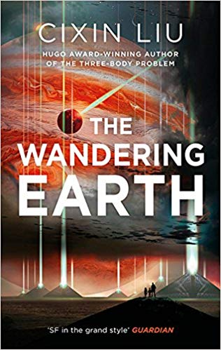
Notes:
FRANT GWO (2019 – AND CIXIN LIU (2000) – expanding sun – technoutopianism – underground life is only ever temporary because of rhe volatile earth – in the end overcomes STRATEGIC REALISM of government’s responses to climate change because the various nations of the world have to overcome their differences and interests to accommodate a CO-ORDINATED RESPONSE– (although china wins in the end) and this bad faith of techno-utopianism and cautionary tale is also seen in various Hollywood fantasies, such as SLIDE

Slide 29

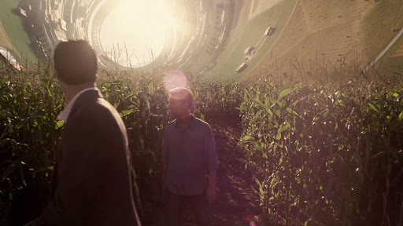
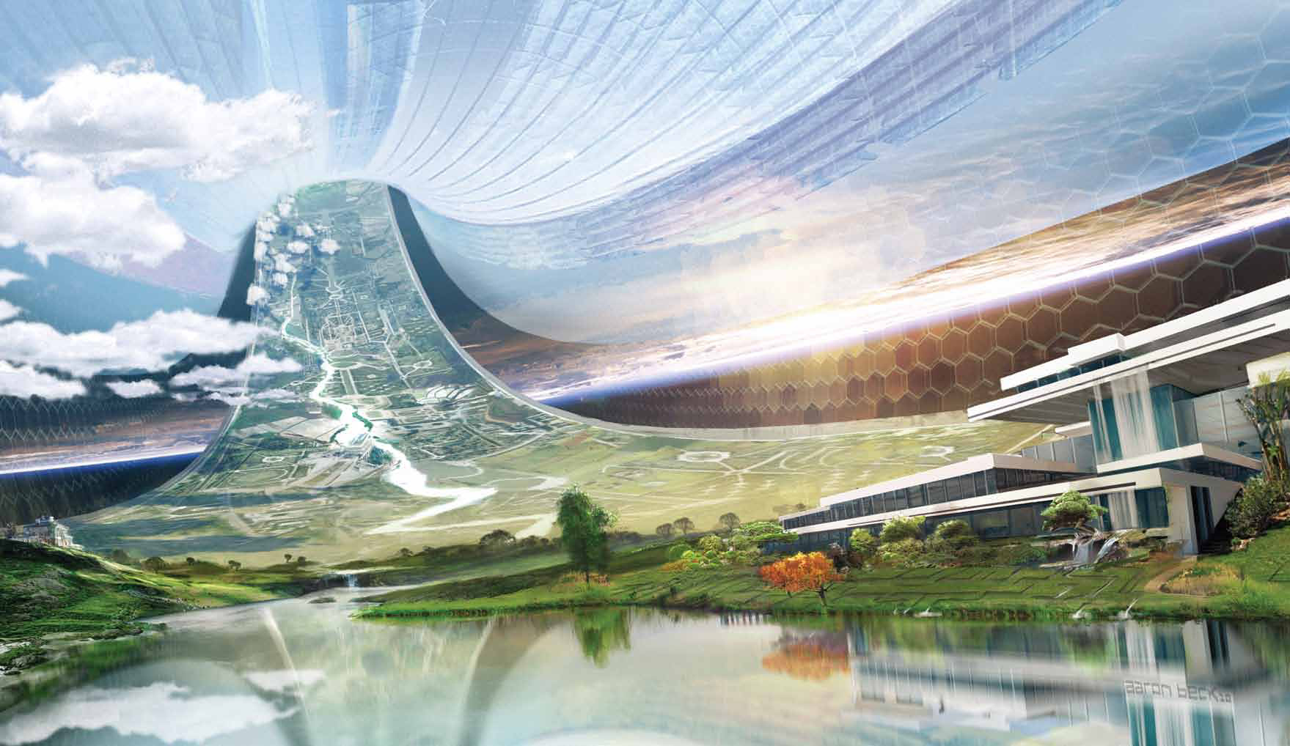
Cooper Station, Interstellar
Elysium, Neill Blomkamp (2013)
Notes:
Offshoring pollution in fantasy of escape from earth - really a coded form of segregation and techno-fantasy – which we see in real world terms as PROMISES OF TECHNOLOGICAL FIXES – hacking the earth and technology to produce new utopian societies, which are problematic in their exclusivity – and that they appear like earth bound suburban disasters in the first place – leads us back to the harder questions of pedestrian difficulty – next slide

