Slide 1
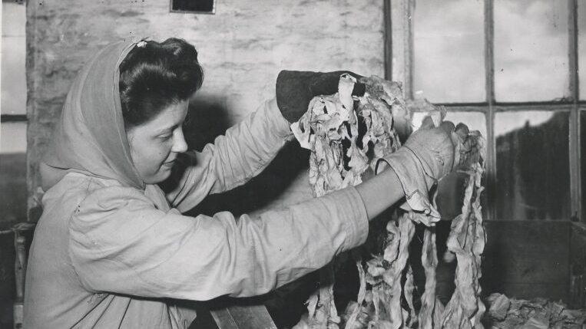
Fashion and Literature
Term One, Week One

Slide 2
Housekeeping
Papers are due Friday, T1W11 and T2W12 (14 December 2024 and 28 March 2025; please check your TABULA for final confirmation)
Intermediate papers 3,000 words, final year 3,500 words
You’ll need to buy Roland Barthes for next week

Slide 3
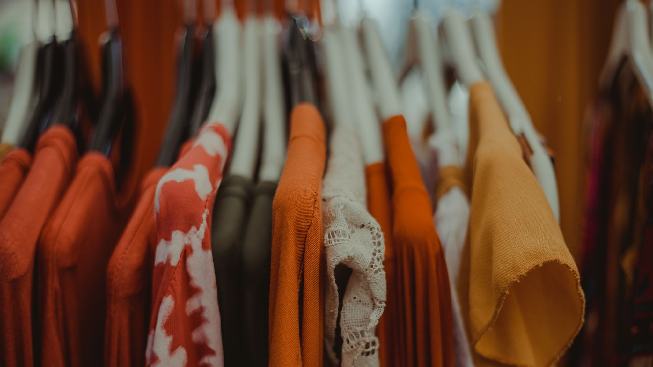
What can clothing tell us?

Slide 4
At last the door opened and his servant entered. He turned glazed eyes upon him.
“Mr. Campbell, sir,” said the man.
A sigh of relief broke from his parched lips, and the colour came back to his cheeks.
“Ask him to come in at once, Francis.” He felt that he was himself again. His mood of cowardice had passed away.
The man bowed and retired. In a few moments, Alan Campbell walked in, looking very stern and rather pale, his pallor being intensified by his coal-black hair and dark eyebrows.
“Alan! This is kind of you. I thank you for coming.”
“I had intended never to enter your house again, Gray. But you said it was a matter of life and death.” His voice was hard and cold. He spoke with slow deliberation. There was a look of contempt in the steady searching gaze that he turned on Dorian. He kept his hands in the pockets of his Astrakhan coat, and seemed not to have noticed the gesture with which he had been greeted.
“Yes: it is a matter of life and death, Alan, and to more than one person. Sit down.”
Campbell took a chair by the table, and Dorian sat opposite to him. The two men’s eyes met. In Dorian’s there was infinite pity. He knew that what he was going to do was dreadful.
The Picture of Dorian Gray (1890)

Slide 5
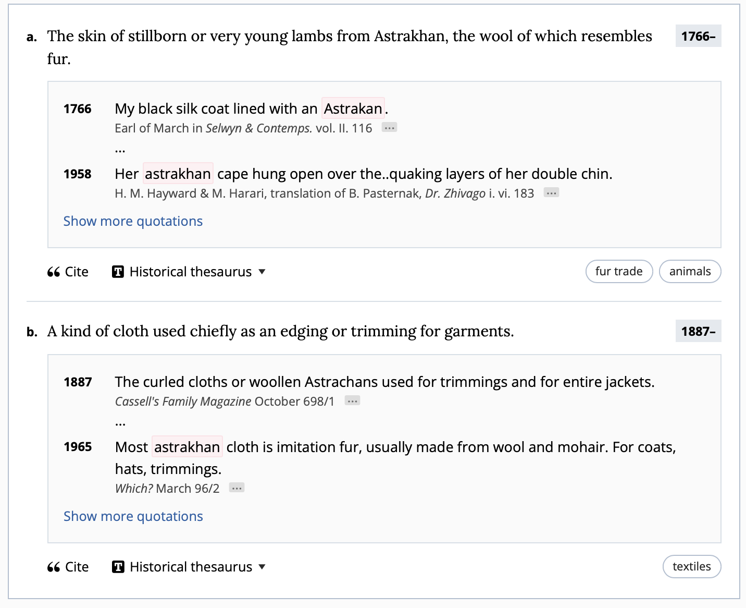
An Astrakahn coat: 1

Slide 6
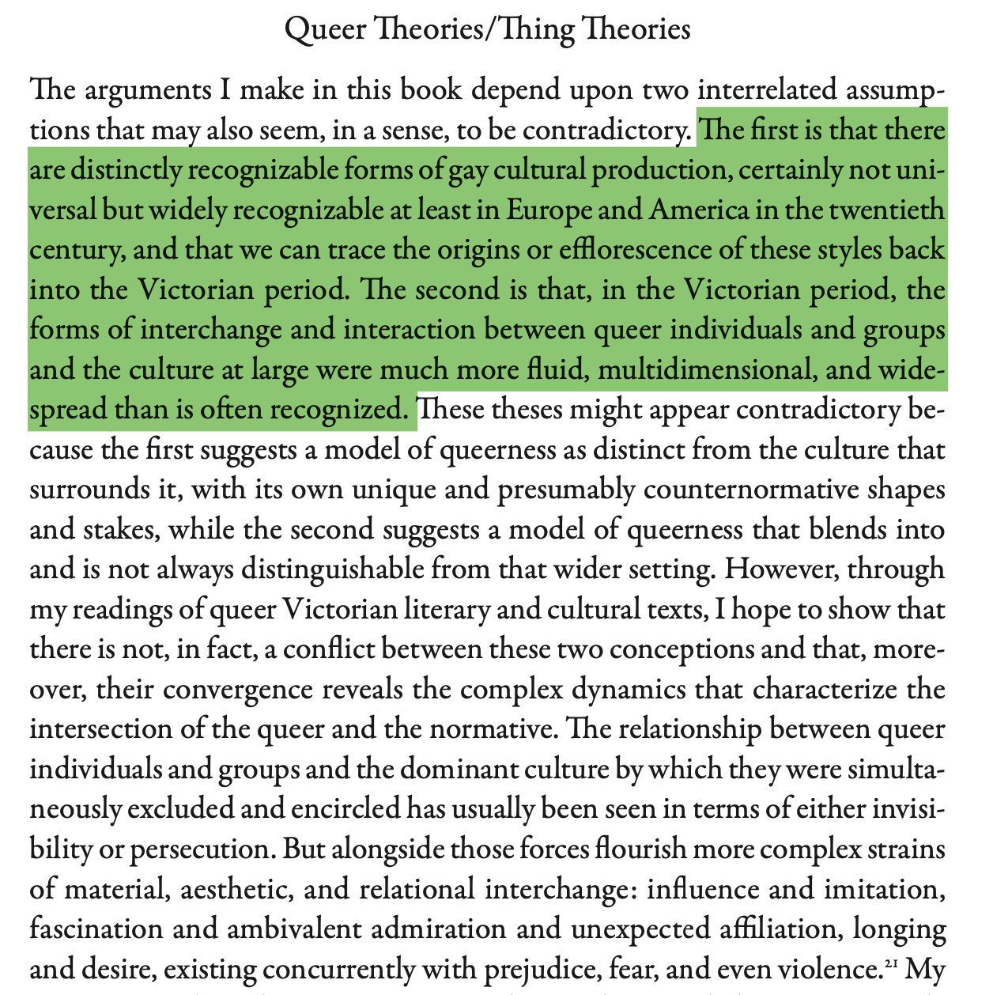

Slide 7
What is the Astrakhan coat?
Place where Alan places his hands
  Repository and register of a deeper-than-surface psychology
  Something that shores up Alan’s resistance to Dorian’s “gesture”—Dorian makes a call to community that Alan rejects
Luxury good
Colonial commodity
Material detail anchoring Alan in a particular historical era
Something at a particular place in the Victorian fashion cycle
Class marker
What else?

Slide 8
The change of clothes had, some philosophers will say, much to do with it. Vain trifles as they seem, clothes have, they say, more important offices than merely to keep us warm. They change our view of the world and the world's view of us. For example, when Captain Bartolus saw Orlando's skirt, he had an awning stretched for her immediately, pressed her to take another slice of beef, and invited her to go ashore with him in the long-boat. These compliments would certainly not have been paid her had her skirts, instead of flowing, been cut tight to her legs in the fashion of breeches. And when we are paid compliments, it behoves us to make some return. Orlando curtseyed; she complied; she flattered the good man's humours as she would not have done had his neat breeches been a woman's skirts, and his braided coat a woman's satin bodice. Thus, there is much to support the view that it is clothes that wear us and not we them; we may make them take the mould of arm or breast, but they mould our hearts, our brains, our tongues to their liking. So, having now worn skirts for a considerable time, a certain change was visible in Orlando, which is to be found if the reader will look at the above, even in her face. If we compare the picture of Orlando as a man with that of Orlando as a woman we shall see that though both are undoubtedly one and the same person, there are certain changes. The man has his hand free to seize his sword, the woman must use hers to keep the satins from slipping from her shoulders. The man looks the world full in the face, as if it were made for his uses and fashioned to his liking. The woman takes a sidelong glance at it, full of subtlety, even of suspicion. Had they both worn the same clothes, it is possible that their outlook might have been the same.
That is the view of some philosophers and wise ones, but on the whole, we incline to another. The difference between the sexes is, happily, one of great profundity. Clothes are but a symbol of something hid deep beneath. It was a change in Orlando herself that dictated her choice of a woman's dress and of a woman's sex. And perhaps in this she was only expressing rather more openly than usual--openness indeed was the soul of her nature--something that happens to most people without being thus plainly expressed. For here again, we come to a dilemma. Different though the sexes are, they intermix. In every human being a vacillation from one sex to the other takes place, and often it is only the clothes that keep the male or female likeness, while underneath the sex is the very opposite of what it is above. Of the complications and confusions which thus result everyone has had experience; but here we leave the general question and note only the odd effect it had in the particular case of Orlando herself.

Slide 9
Class themes and ideas
In this class we will use a focus on clothing to denature and decentre our readings of literature
A garment in literature can tell a story that enriches, exists in parallel to, or contradicts a primary narrative
We will assemble a tool-kit of ways to read garments within literature texts
Some initial concepts (which overlap)
  Making people through social performance—clothing and gender, class, race
  How clothing relates to fashion
  Clothing’s role in the divided self, in what makes us individuals and members of society
  How dress provides us access to being a social archetype; but also how the roles fashion offers constrain us to particular roles
  How clothing involves itself in proprioception, our sense of ourselves in our own bodies
  How we narrate clothing, and how these narratives are involved in the above points

Slide 10
Readings: Gogol, The Overcoat (1842)

Slide 11
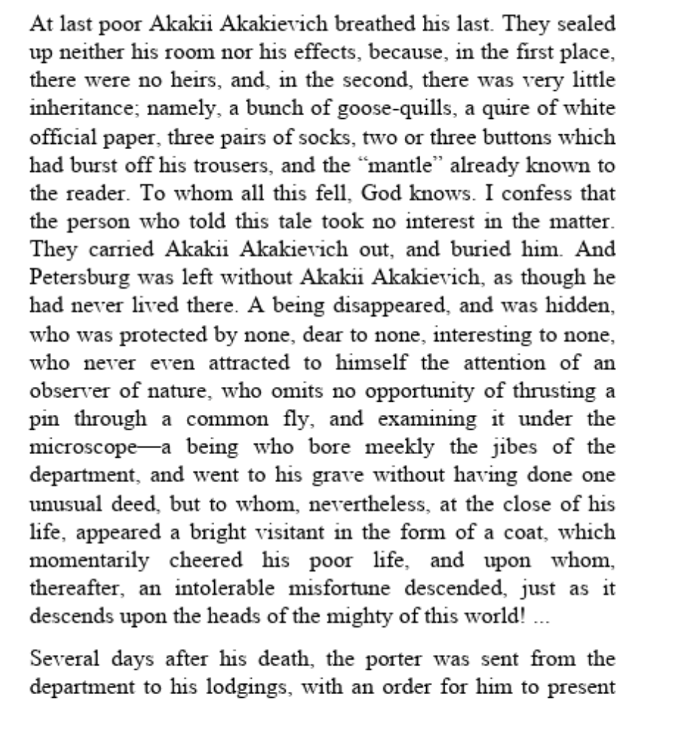
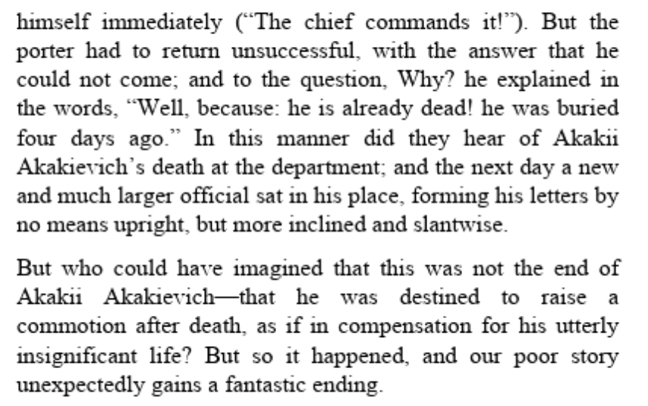

Slide 12
