Slide 1
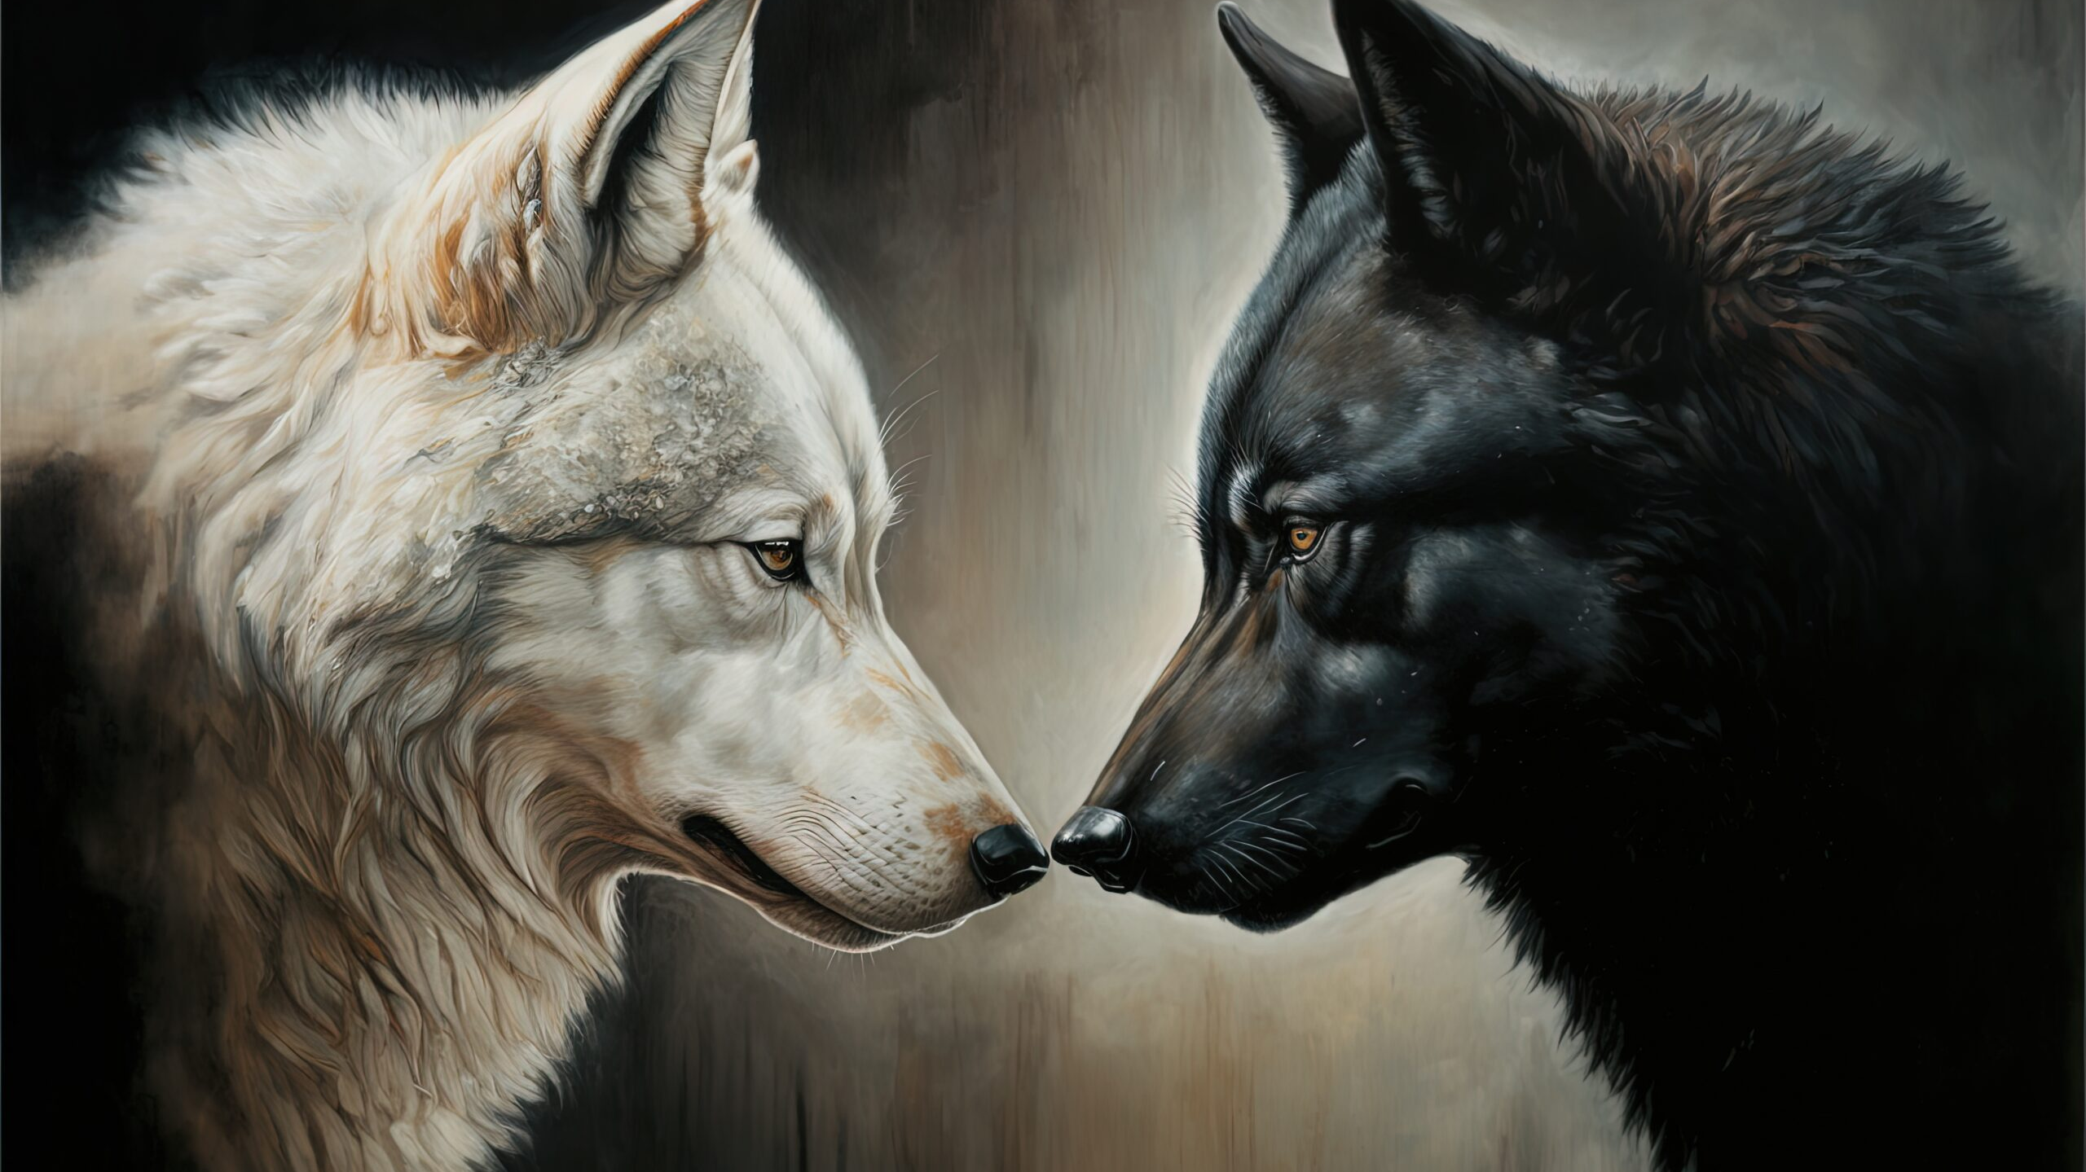
Two Wolves: Bataille and Woolf
Fashion and Literature
Term 1, Week 10

Slide 2

Part (Maudit) One: Bataille

Slide 3
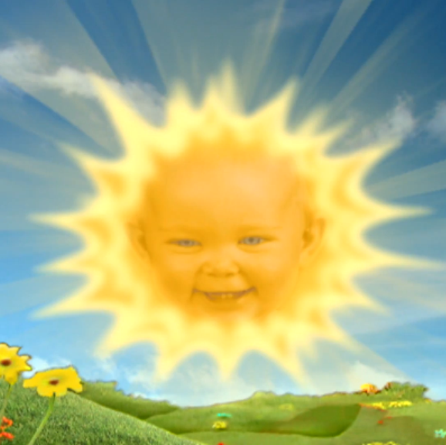
The Accursed Share (1949)
Most economics is grounded in scarcity. What Bataille presupposes is: what if it wasn’t?
Key concept is surplus--the sun provides more energy than we can use, in fact our dilemma is what to do with this surplus

Slide 4
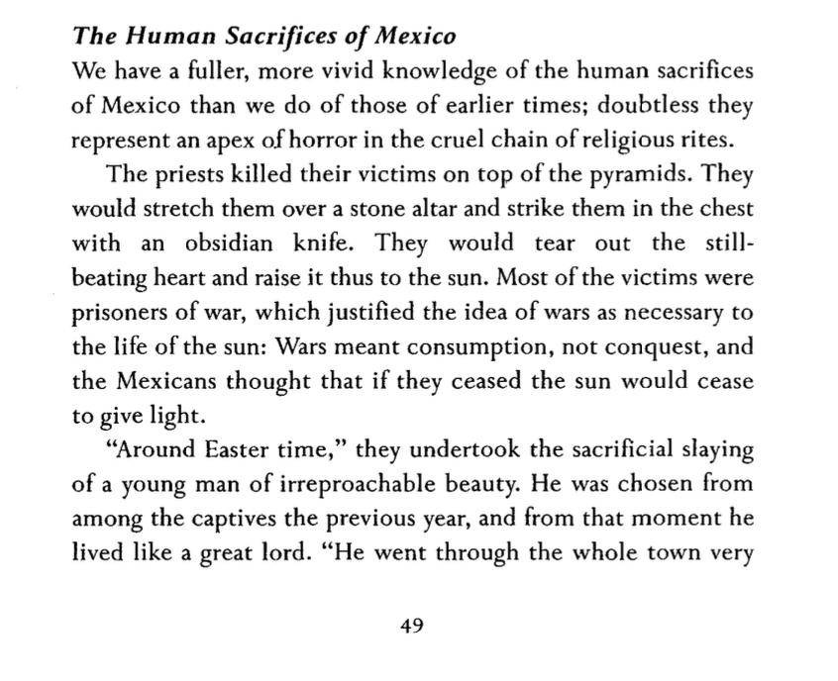

Slide 5
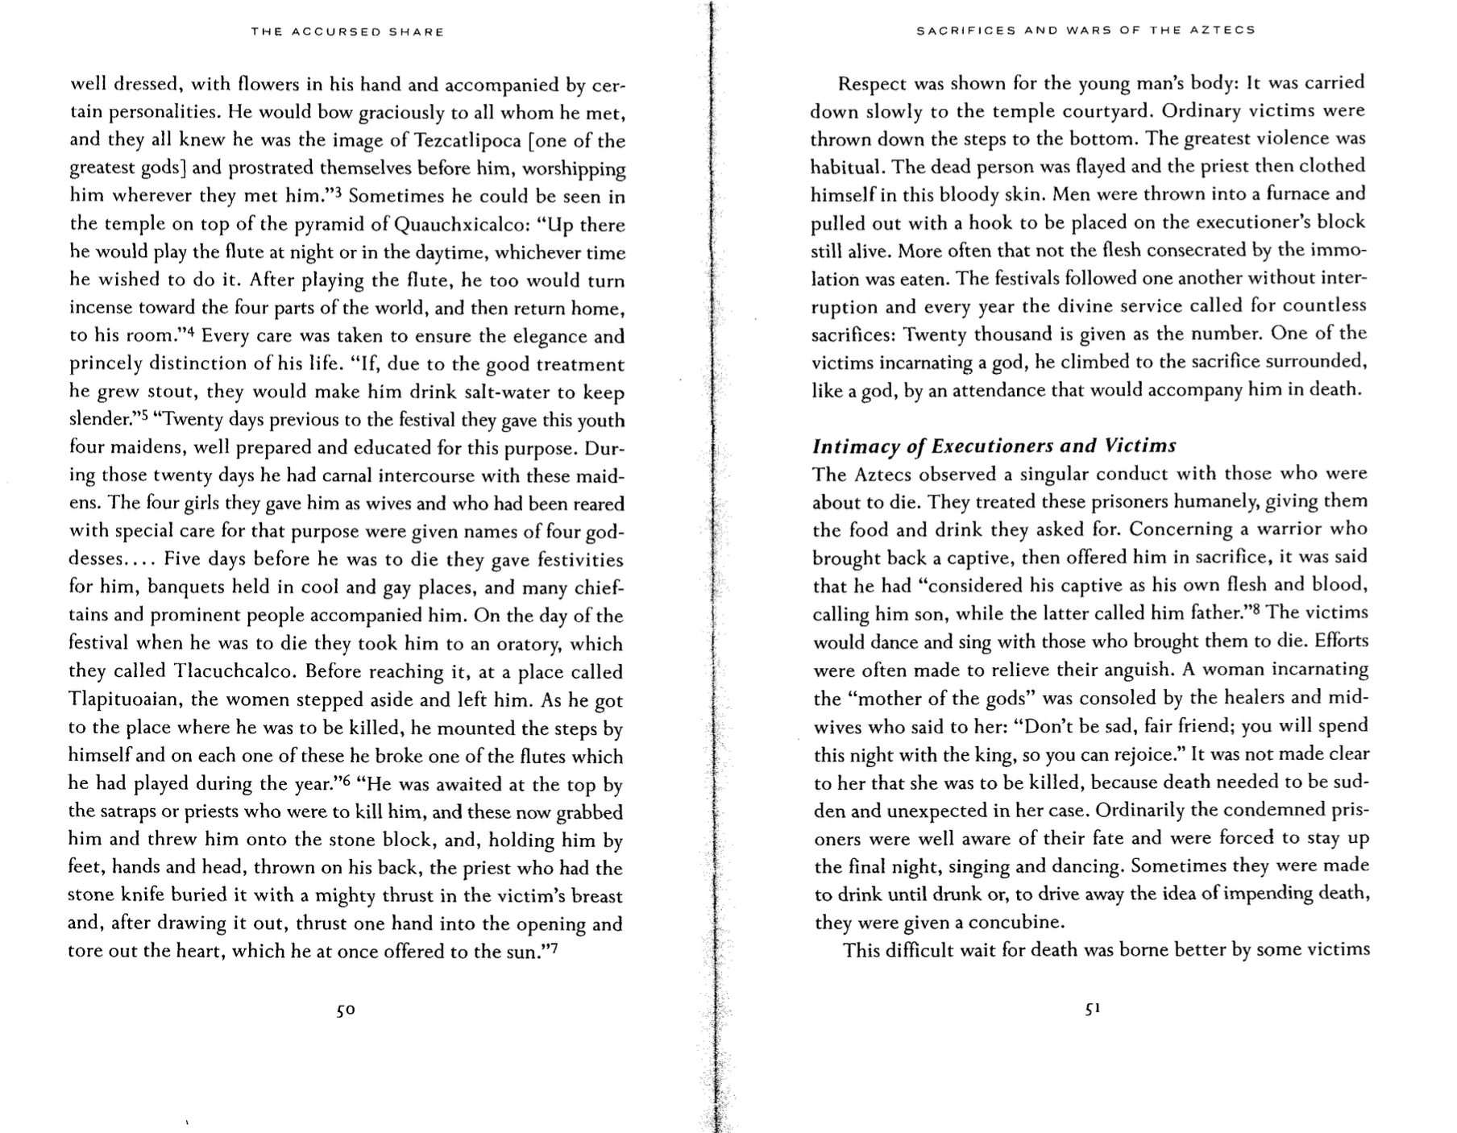

Slide 6
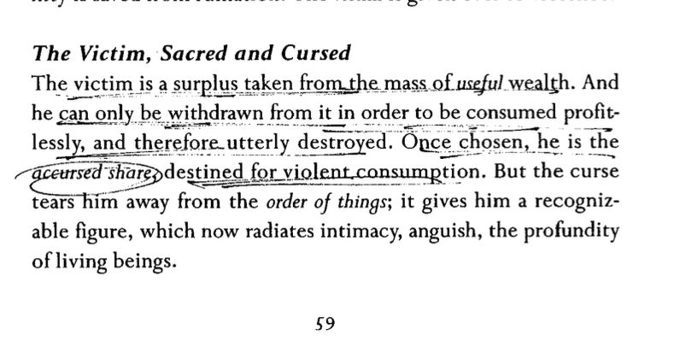

Slide 7
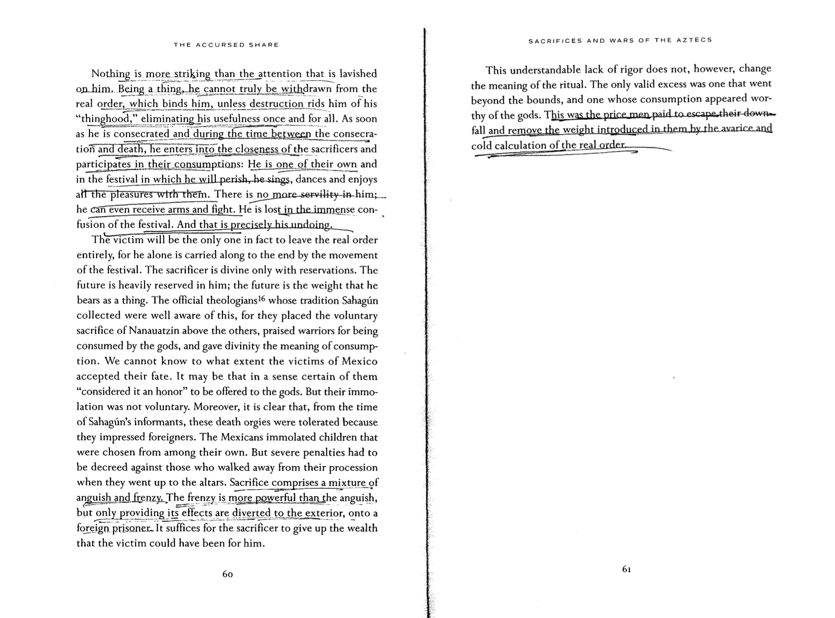

Slide 8
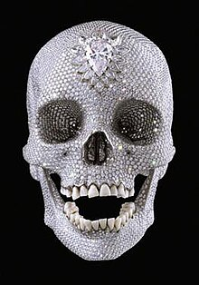

Slide 9
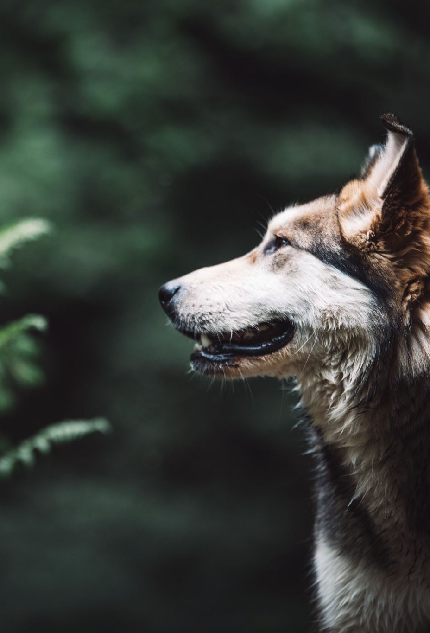
Part (Maudit) Two: Woolf
This is literally what PowerPoint recommends for this slide

Slide 10
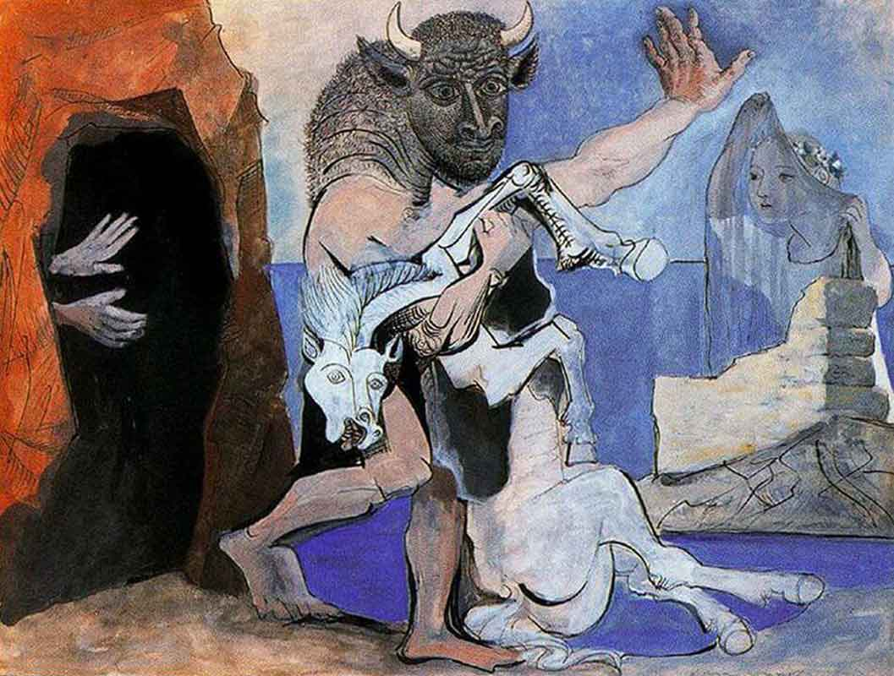

Slide 11
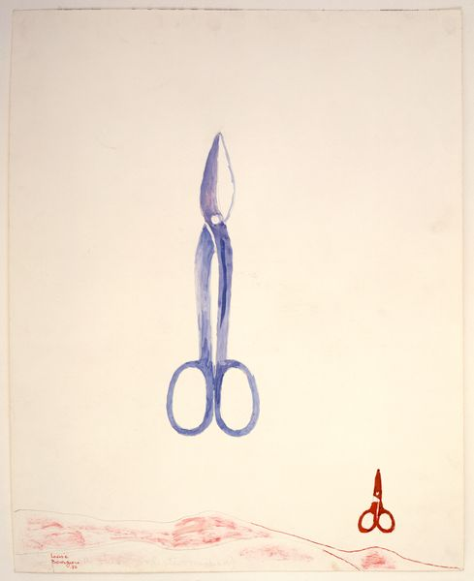

Slide 12
and the shopkeepers were fidgeting in their windows with their paste and diamonds, their lovely old sea-green brooches in eighteenth-century settings to tempt Americans

Slide 13
The car had gone, but it had left a slight ripple which flowed through glove shops and hat shops and tailors’ shops on both sides of Bond Street. For thirty seconds all heads were inclined the same way – to the window. Choosing a pair of gloves – should they be to the elbow or above it, lemon or pale grey? – ladies stopped; when the sentence was finished something had happened. Something so trifling in single instances that no mathematical instrument, though capable of transmitting shocks in China, could register the vibration; yet in its fulness rather formidable and in its common appeal emotional; for in all the hat shops and tailors’ shops strangers looked at each other and thought of the dead; of the flag; of Empire. In a public house in a back street a Colonial insulted the House of Windsor which led to words, broken beer glasses, and a general shindy, which echoed strangely across the way in the ears of girls buying white underlinen threaded with pure white ribbon for their weddings. For the surface agitation of the passing car as it sunk grazed something very profound.

Slide 14
Tall men, men of robust physique, well-dressed men with their tail-coats and their white slips and their hair raked back who, for reasons difficult to discriminate, were standing in the bow window of White’s with their hands behind the tails of their coats, looking out, perceived instinctively that greatness was passing, and the pale light of the immortal presence fell upon them as it had fallen upon Clarissa Dalloway. At once they stood even straighter, and removed their hands, and seemed ready to attend their Sovereign, if need be, to the cannon’s mouth, as their ancestors had done before them. The white busts and the little tables in the background covered with copies of the Tatler and syphons of soda water seemed to approve; seemed to indicate the flowing corn and the manor houses of England; and to return the frail hum of the motor wheels as the walls of a whispering gallery return a single voice expanded and made sonorous by the might of a whole cathedral. Shawled Moll Pratt with her flowers on the pavement wished the dear boy well (it was the Prince of Wales for certain) and would have tossed the price of a pot of beer – a bunch of roses – into St. James’s Street out of sheer light-heartedness and contempt of poverty had she not seen the constable’s eye upon her, discouraging an old Irishwoman’s loyalty. The sentries at St. James’s saluted; Queen Alexandra’s policeman approved. A small crowd meanwhile had gathered at the gates of Buckingham Palace. Listlessly, yet confidently, poor people all of them, they waited; looked at the Palace itself with the flag flying; at Victoria, billowing on her mound, admired her shelves of running water, her geraniums; singled out from the motor cars in the Mall first this one, then that; bestowed emotion, vainly, upon commoners out for a drive; recalled their tribute to keep it unspent while this car passed and that; and all the time let rumour accumulate in their veins and thrill the nerves in their thighs at the thought of Royalty looking at them; the Queen bowing; the Prince saluting; at the thought of the heavenly life divinely bestowed upon Kings; of the equerries and deep curtsies; of the Queen’s old doll’s house; of Princess Mary married to an Englishman, and the Prince – ah! the Prince! who took wonderfully, they said, after old King Edward, but was ever so much slimmer. The Prince lived at St. James’s; but he might come along in the morning to visit his mother.

