Slide 1


Fashion and Literature, T1W2
Kadji Amin, “We Are All Nonbinary”; Roland Barthes, The Language of Fashion; and Virginia Woolf, “The New Dress”

Slide 2
Judith Butler Memorial Week
What does it mean to say that gender is performative?

Slide 3
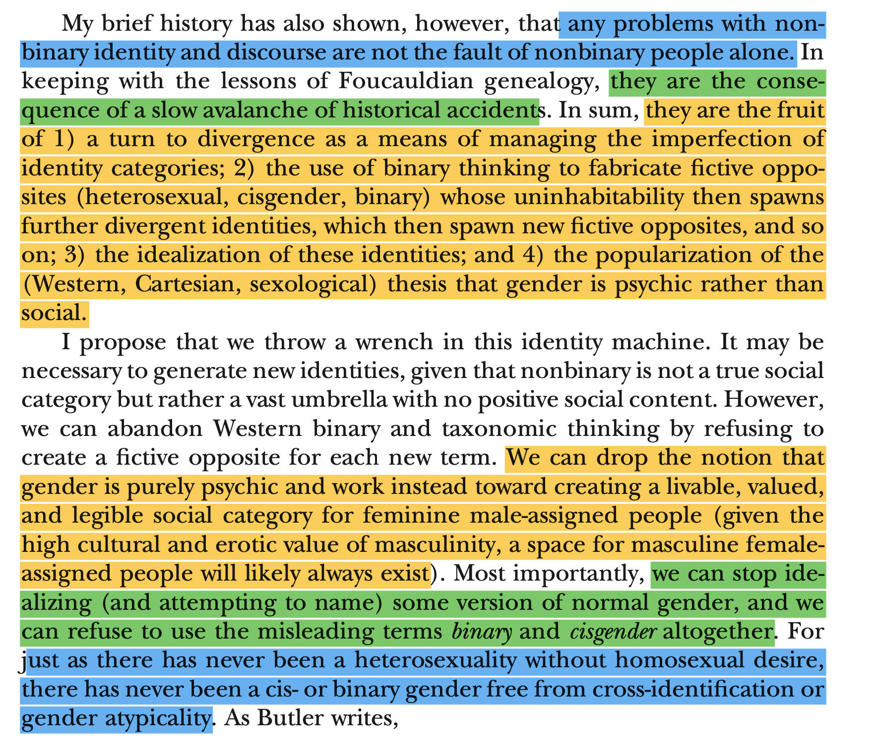

Slide 4
1. Barthes and Semiotics

Slide 5
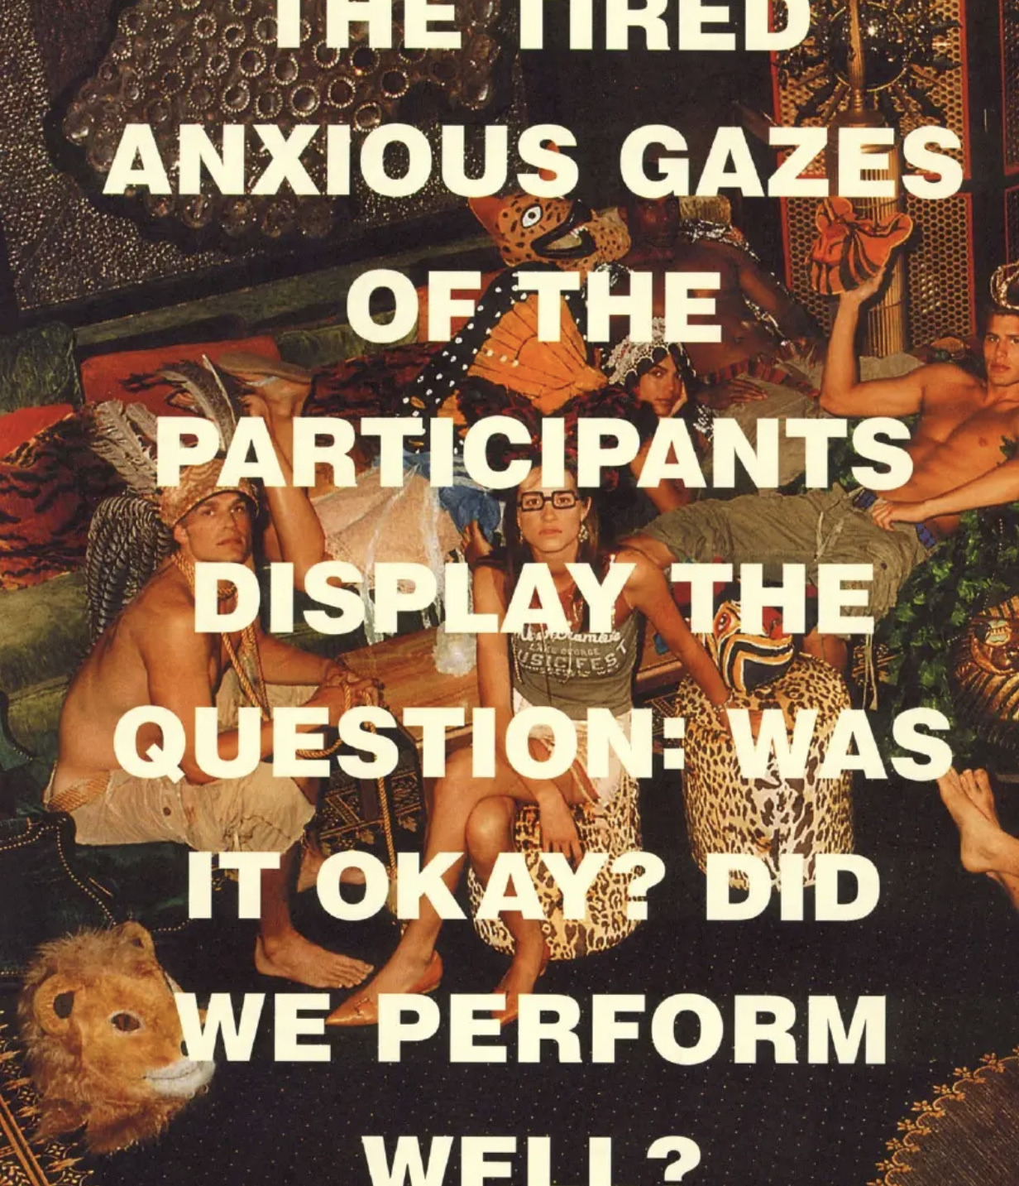

Slide 6
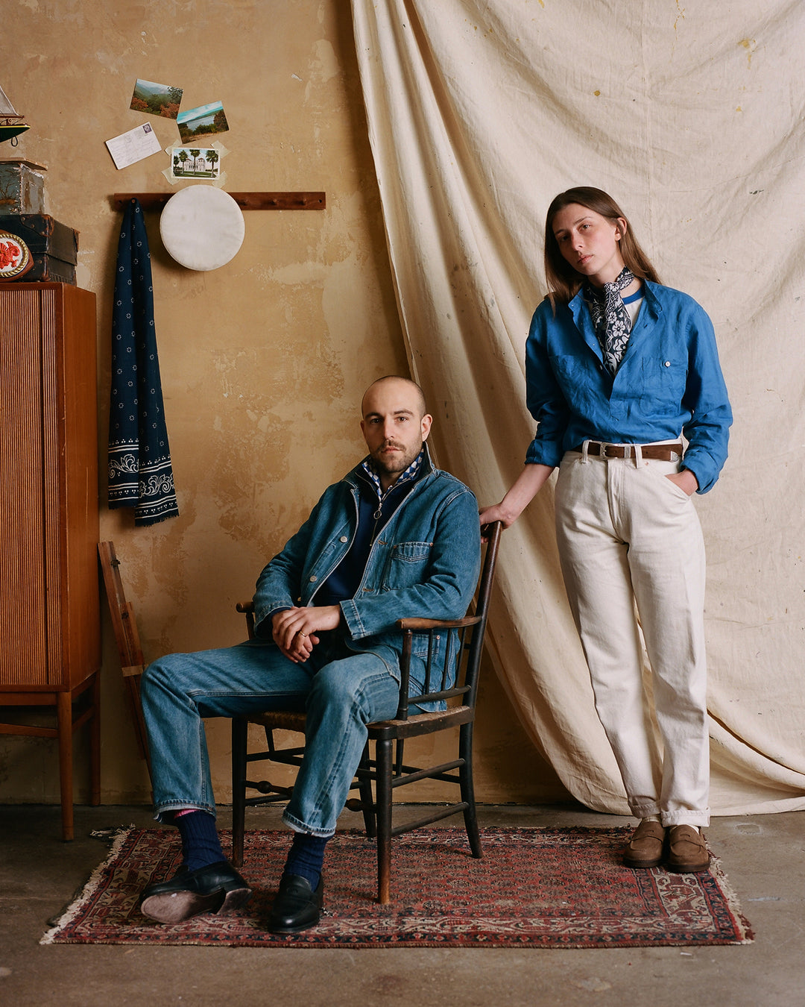
Drake’s Lookbook, s/s 2023

Slide 7
Martine Rose Lookbook, S/S 2022
-https://showstudio.com/collections/autumn-winter-2022/martine-rose-aw-22/lookbook-martine-rose-aw-22

Slide 8
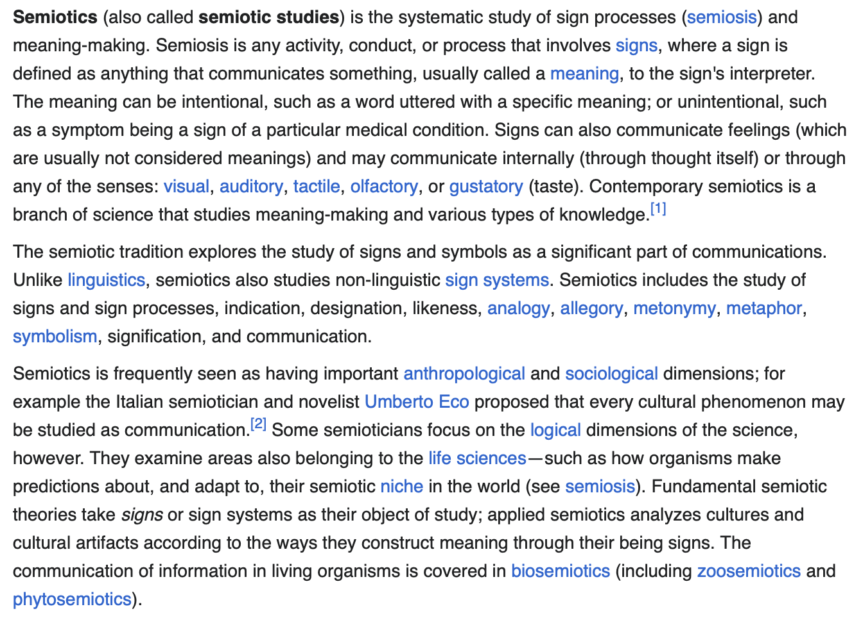
(Cue 1970s music)
Notes:
https://www.youtube.com/watch?v=wy709iNG6i8
https://www.youtube.com/watch?v=i_dpZcOfoH8

Slide 9
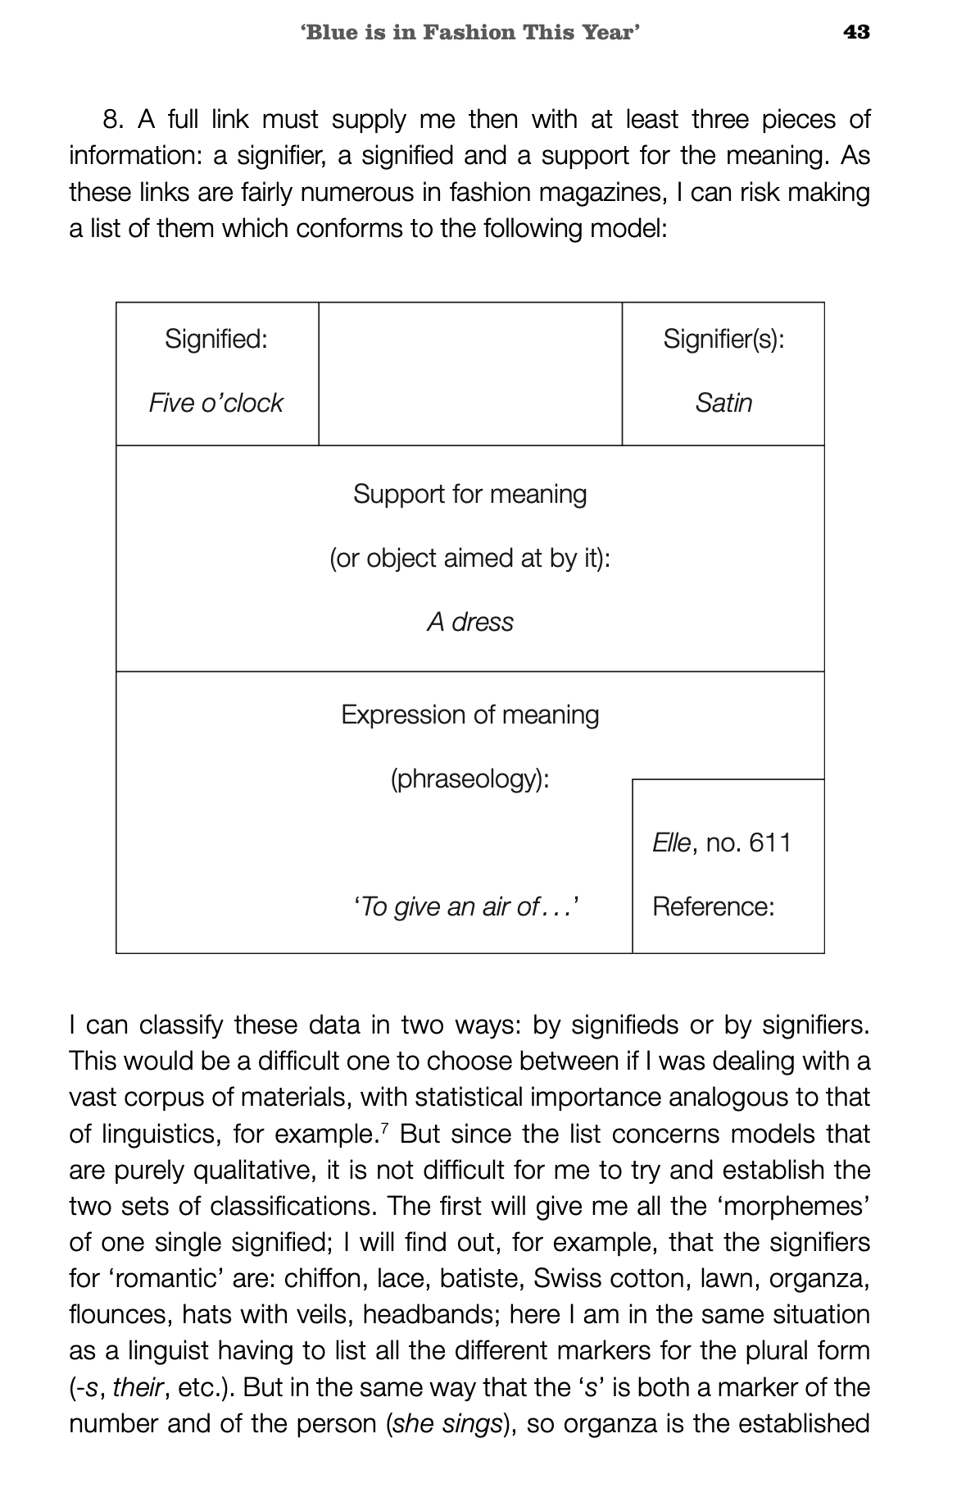

Slide 10
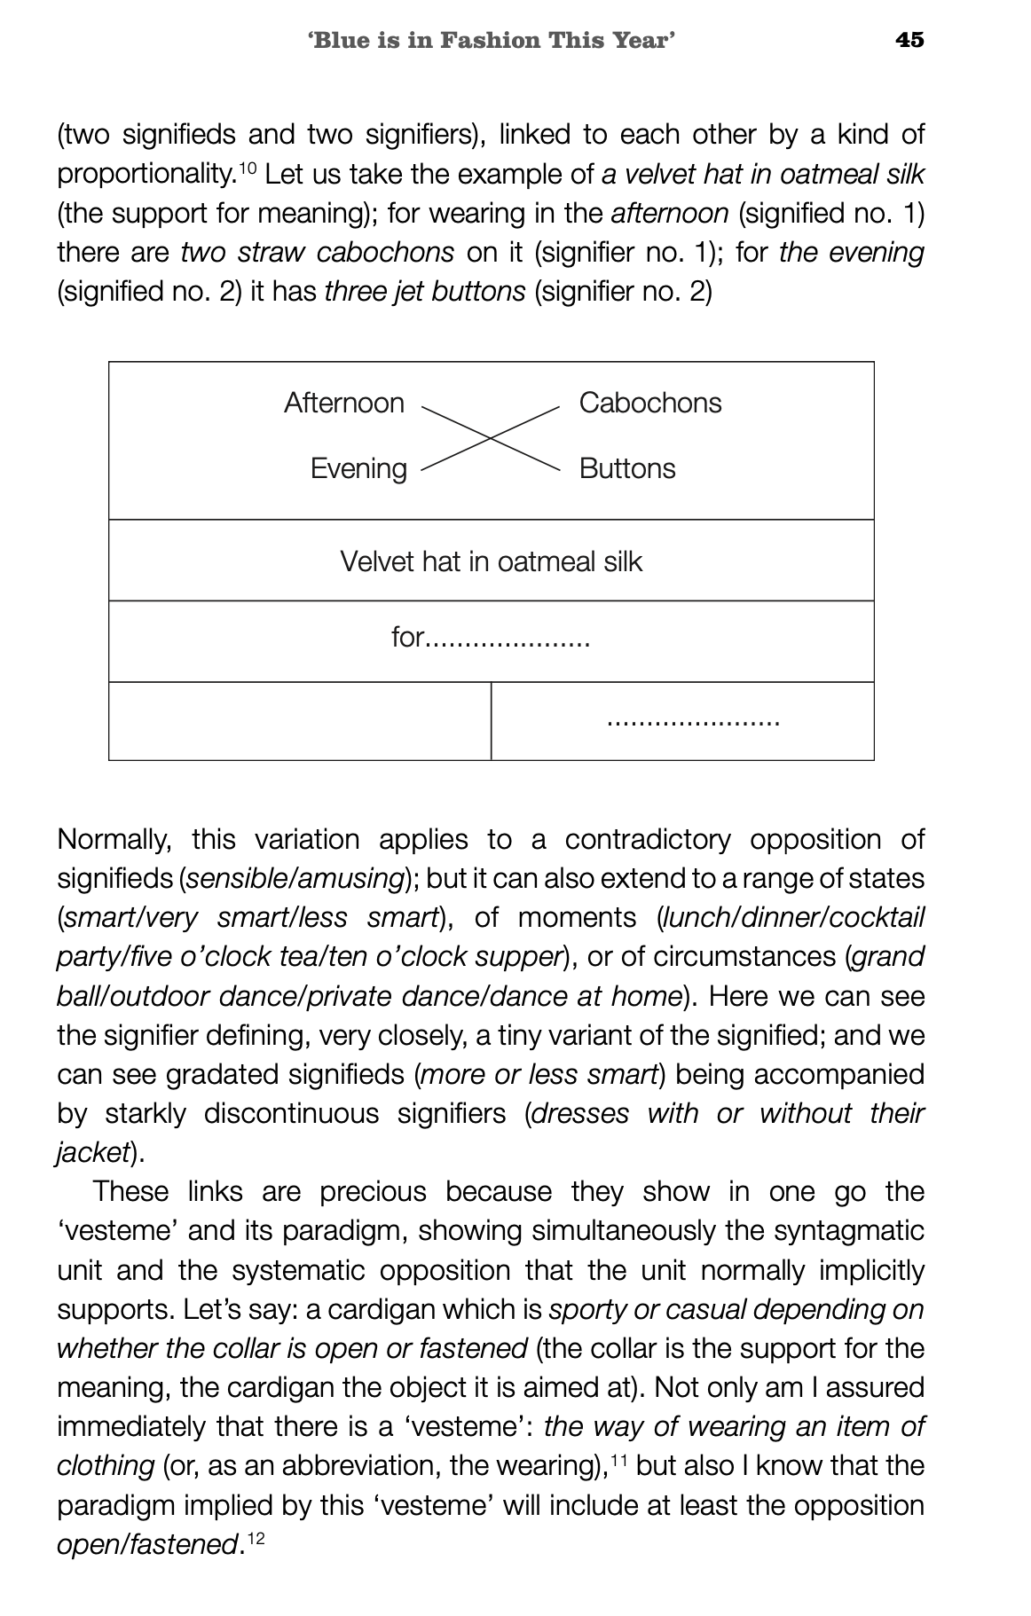

Slide 11
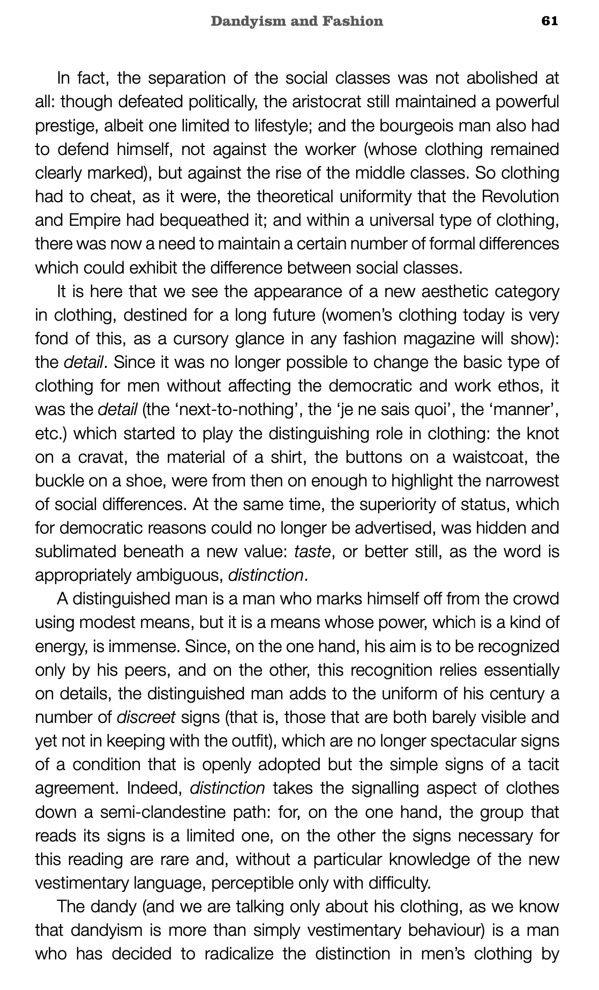

Slide 12
2. “The New Dress” (1924)

