Slide 1

Freud, Lacan, Entwistle, Lehmann
Fashion and Literature
Term 1, Week 3

Slide 2
Opening Questions
Answer if possible in terms of a particular garment, either from literature or from actual life:
Do clothes make us happy?
What needs do clothes fulfill?
Why fashion, rather than simply clothes—what need or needs does fashion fulfil?
Why is fashion not static—why does it change?

Slide 3
Some Notes on Psychoanalytic Writing as Theory
”Treat it as a metaphor”
  When used today, we treat these terms as descriptions of processes rather than as biological truths
  Freud’s biological account of the death drive wasn’t even accepted by Freud—he compares it at one point to the discussion in Plato’s Symposium
  Lacan’s mirror stage also usually treated analogously, as a metaphor
Goblin run 2
  Maybe more even than Marx, take your own ideas out of this

Slide 4
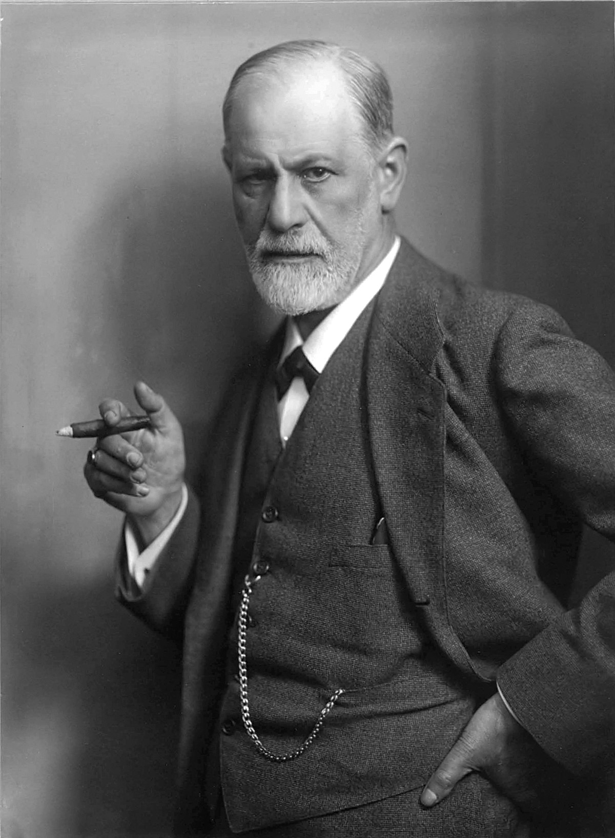
Part One: Freud

Slide 5

Freud: The “reality principle”
Pleasure Principle: basically Cookie Monster
Reality Principle: “me want it but me wait”
  Corrected form of the Pleasure Principle—assesses the world, sets realistic goals

Slide 6
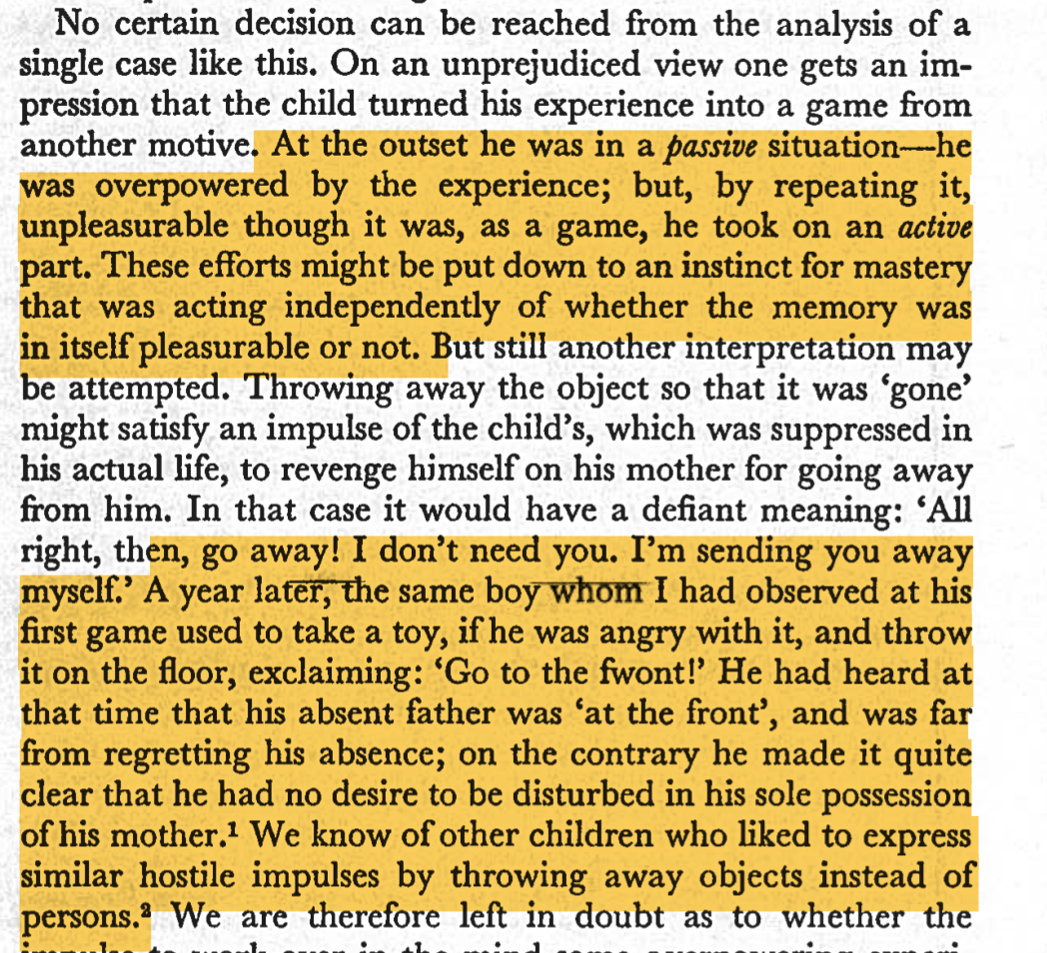
Fort/da

Slide 7
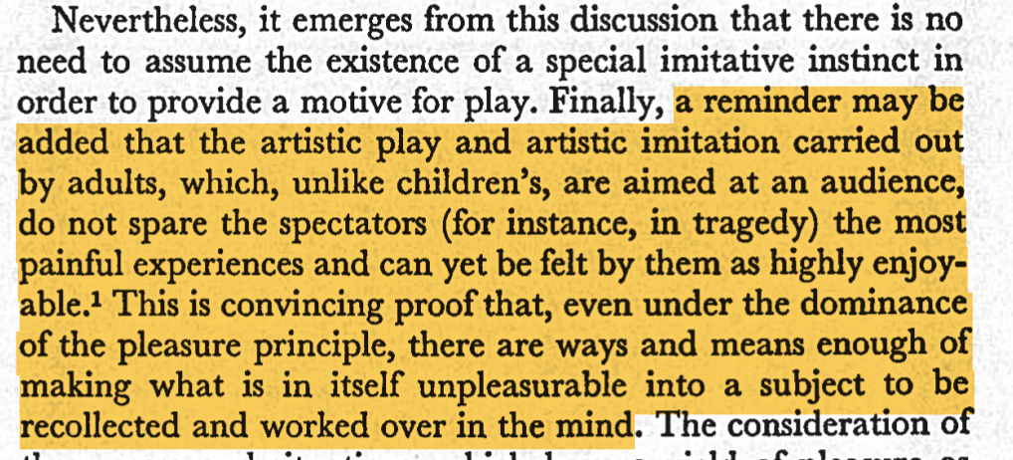
Enjoyment in mastery

Slide 8
Transference
We bring our old experiences into present-day experiences
In Freud we feel this with particular intensity towards the analyst—this explains why people have strong feelings of love, hate, etc. towards them

Slide 9
Later Freud
Pre-1920s: people want to be happy, and want to avoid unhappiness; some people’s happy-making processes get a bit internally snarled up; the analyst helps by in effect helping the patient unspring the traps of their own psyche
Post-1920s: huh, that’s weird. Some people seem driven to repeat unpleasurable experiences, even though they don’t get anything out of it
Freud never ultimately formulates what’s happening here. “Beyond the Pleasure Principle” (1920) never actually proposes a way to resolve this impasse
Instead Freud posits that, alongside libido, there is a death-drive; in a section he frames as “speculation, often far-fetched speculation” (24), he suggests this is living matter returning to a state of being dead matter

Slide 10
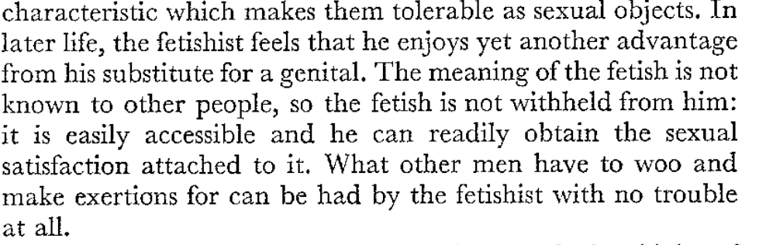
“Fetishism” (1927)
“Treat it as a metaphor”: a guide to surviving Freud on genitalia
  We can make objects, in this case the fetish, stand in for missing phases in our development
  The fetish even has advantages full development doesn’t:
  “Scotomisation” for Freud means we disavow something—our psychic defenses means things are kept out of their perceptions, but also it’s still there, gathering power
  He gives us a way of thinking of objects as satisfying psychological needs—the power external objects hold over our inner life

Slide 11
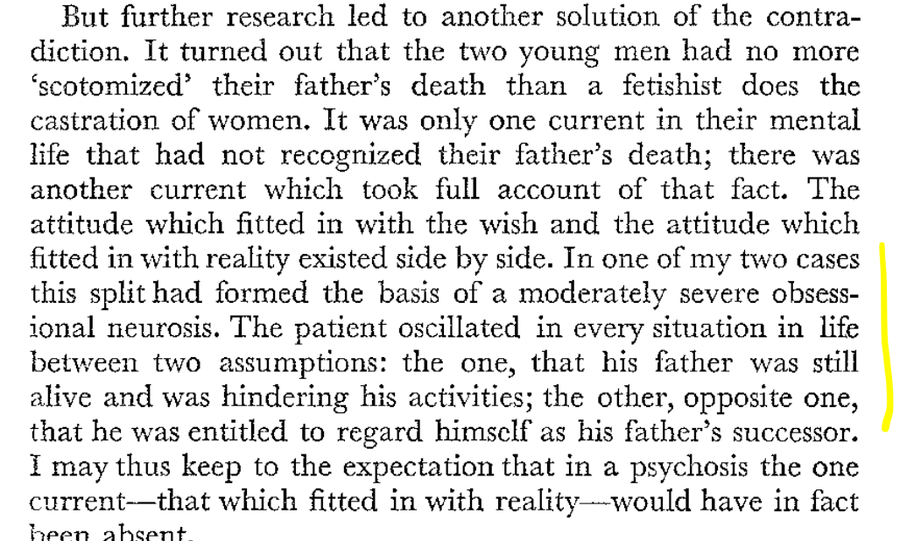

Slide 12
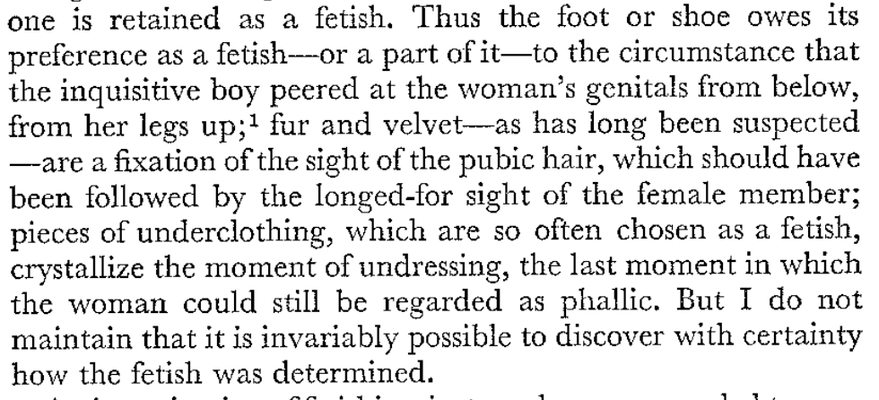
Useful if adapted but, sigh

Slide 13

Part Two: Lacan

Slide 14
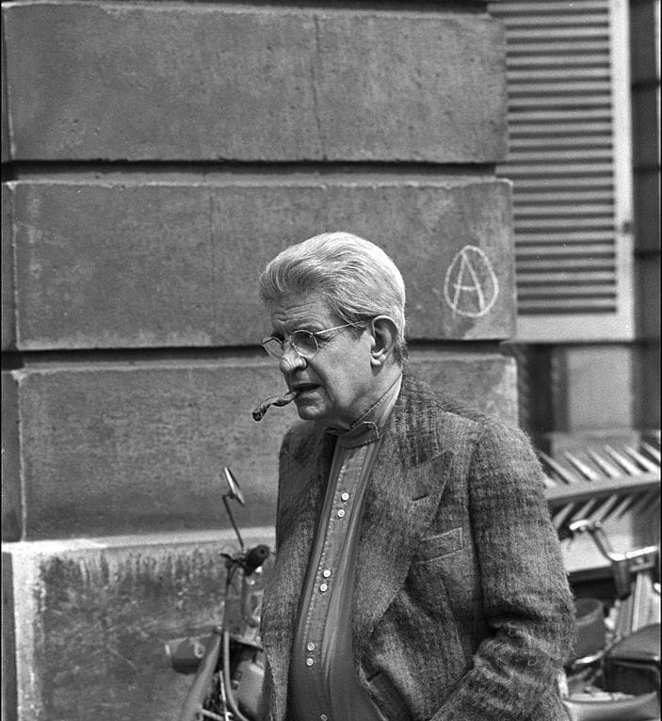
Part Two: Lacan

Slide 15
Lacan: the “Mirror Stage”
Less troubled than Freud with something being irresolute or unsettled
The “Mirror Stage” essay talks about our most defining identification—the imago of ourselves seen in a mirror—being at heart ”the subject anticipat[ing] the maturation of his power in a mirage” (95)
Our self-identification is based on something we see in a mirror, rather than anything intrinsic to ourselves

Slide 16
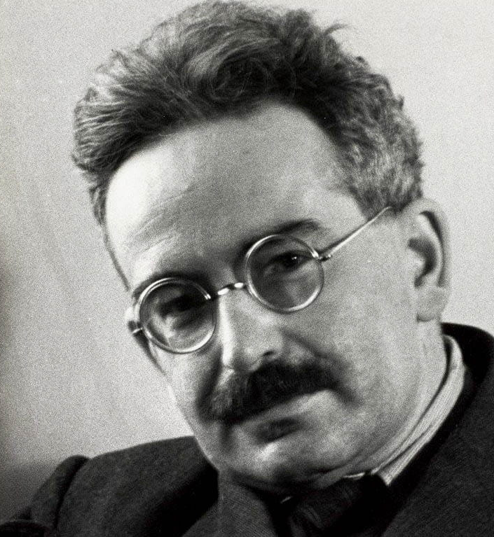
Part ThreE: Benjamin

Slide 17
I hope you like Jamin, too

Slide 18
Towards “Garment Reading”
What story, or stories, can we tell about clothes in this text? Do they complement, or act as counterpoint, to what’s going on with the human characters?
What theorists read in the module so far might illuminate these clothes?
What other questions might we be asking?

Slide 19
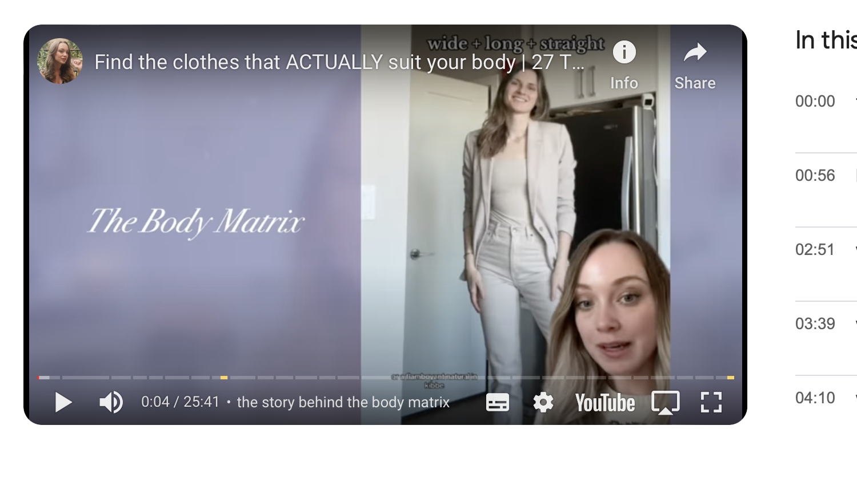
Part Four: Entwistle

Slide 20
