Slide 1

Bruno Latour, Jacques Derrida, Jane Bennett, and The Adventures of a Black Coat
Term 1, Week 5

Slide 2
1
Bruno Latour, “Reassembling the Social”

Slide 3
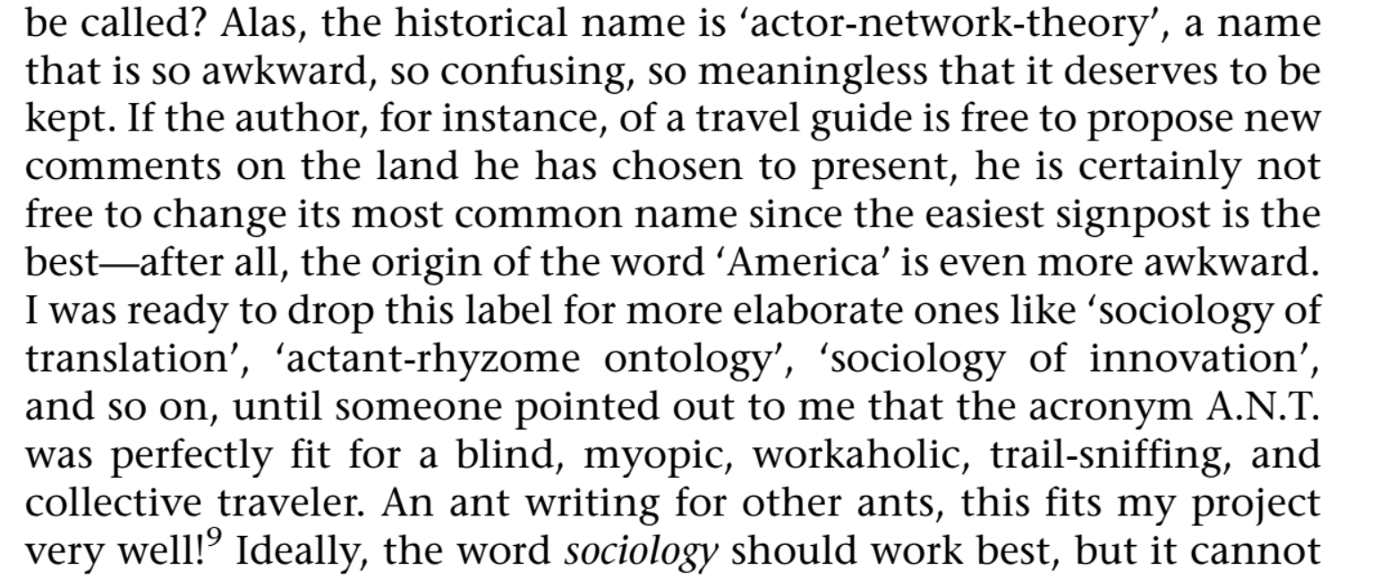

Slide 4
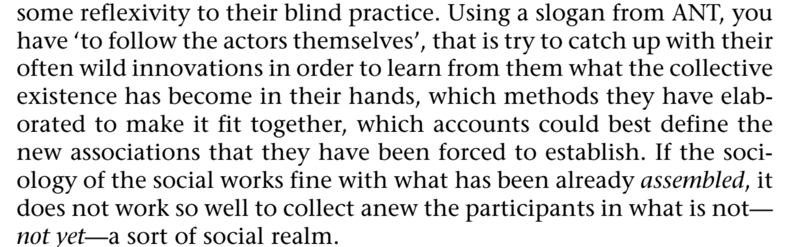

Slide 5


Slide 6
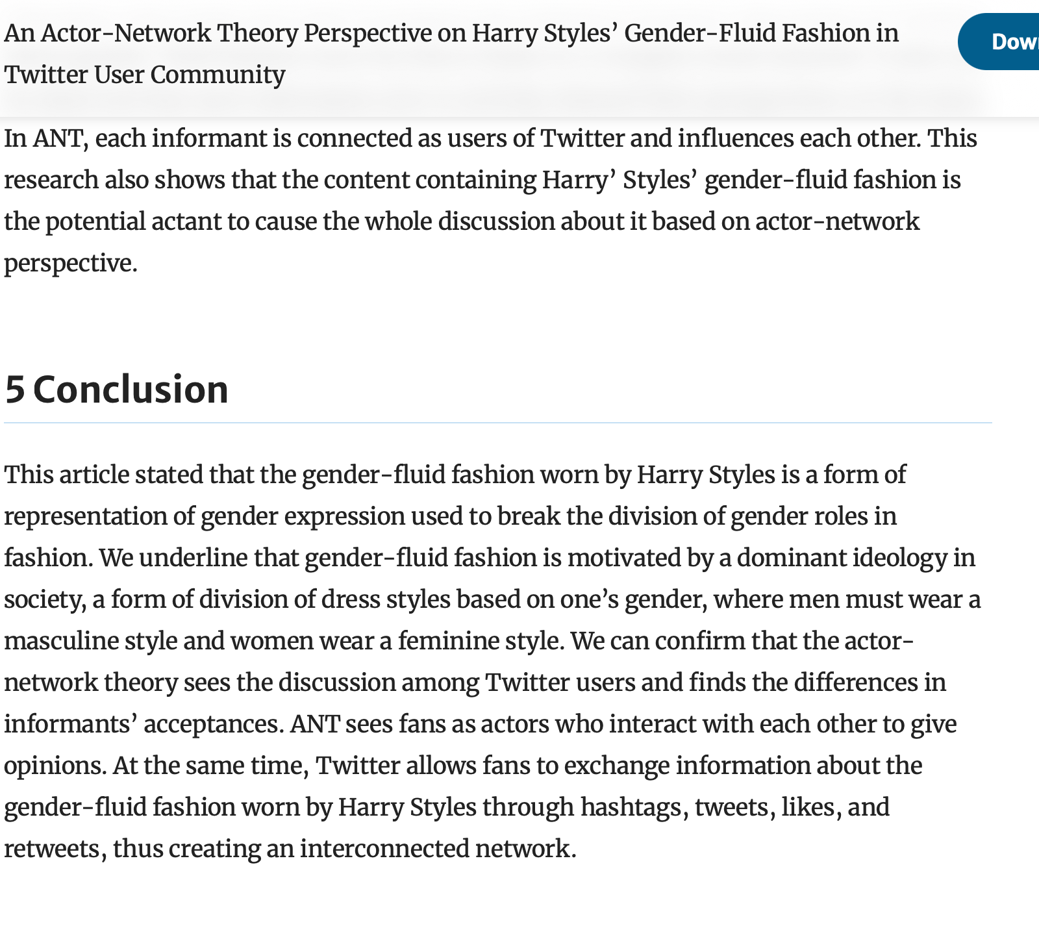

Slide 7
Summing up Latour
Proposes we consider nonhuman agents—democracy, the Northern Line, the academic field of Chemistry, photosynthesis—as actants, possessed of an agency previously only ascribed to humans
We perform a demotic version of this when we—as we commonly do—describe capitalism as doing, wanting, intending something; we also do this when we say fashion dictates…

Slide 8
2
Jacques Derrida, “Spectres of Marx”

Slide 9
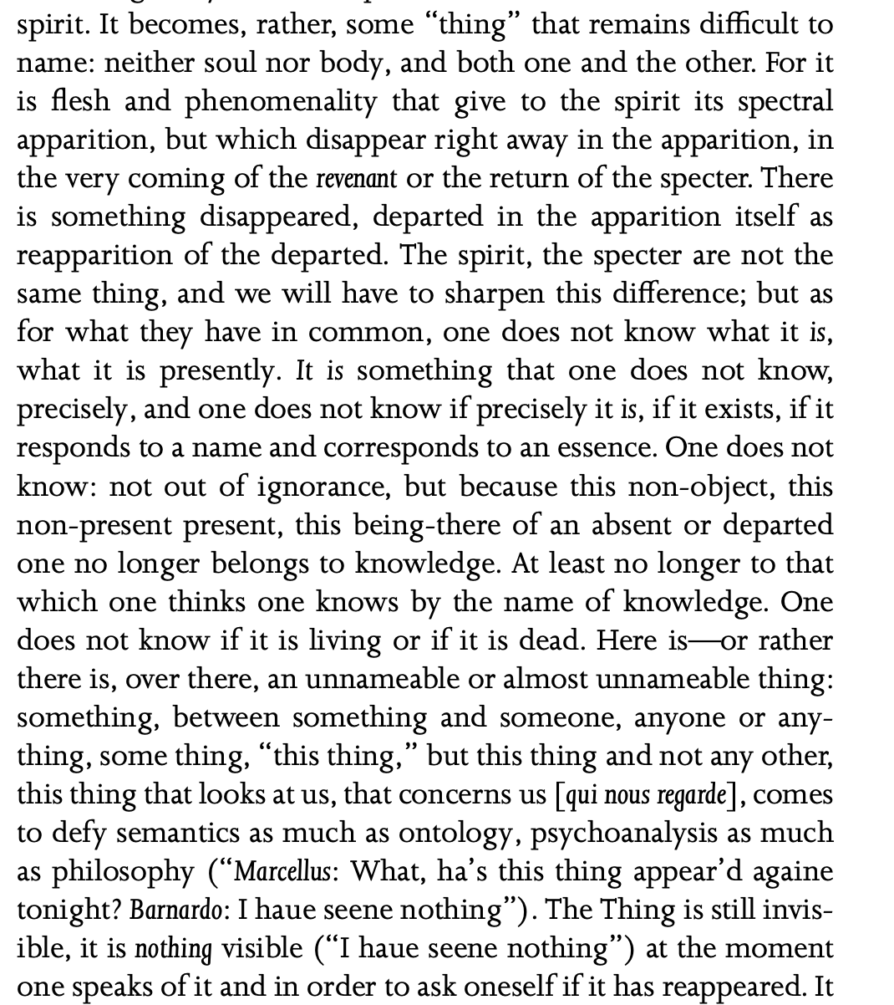

Slide 10
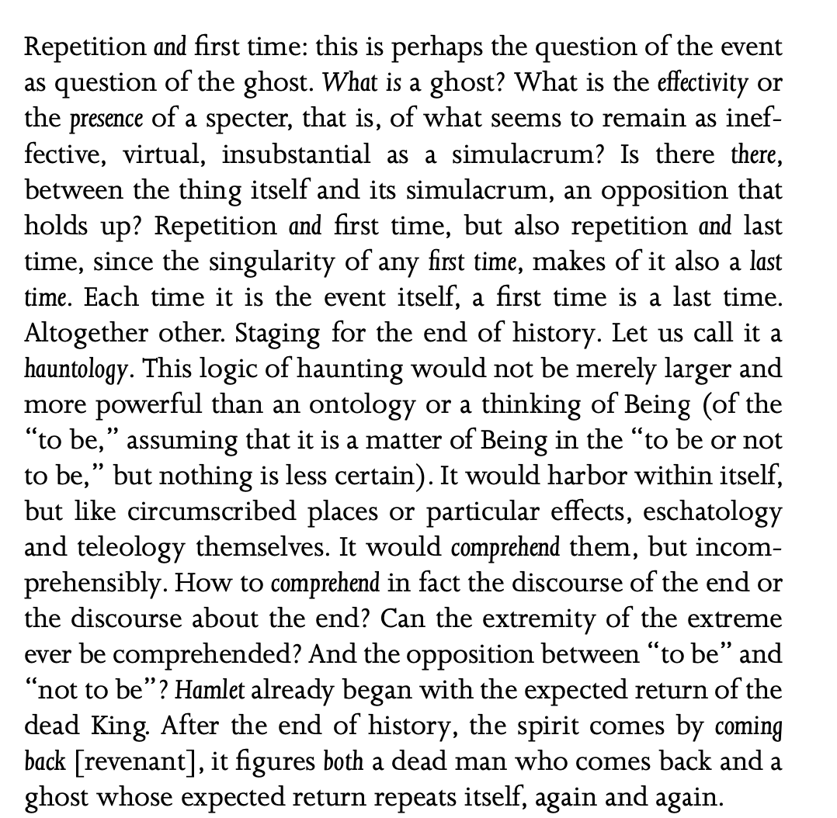

Notes:
Eschatology: study of the end times—death, judgment, etc.
Teleology: study of drive, purpose—purpose rather than where they originate

Slide 11
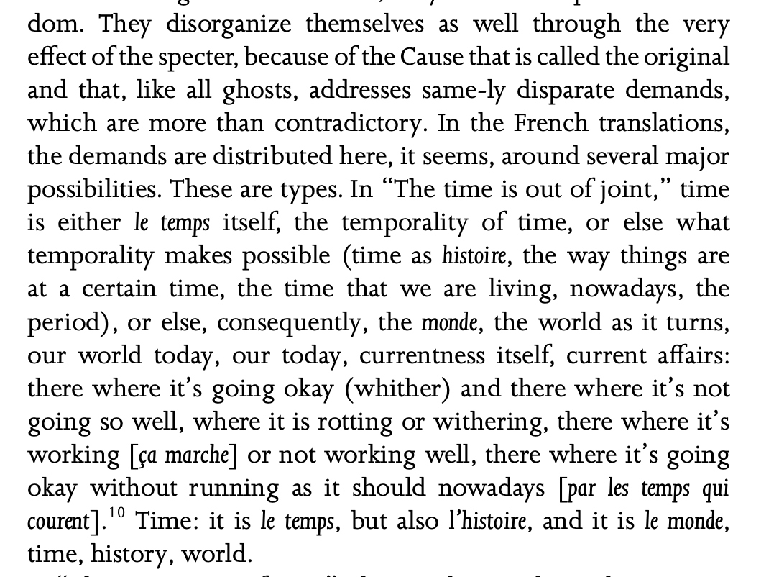

Slide 12
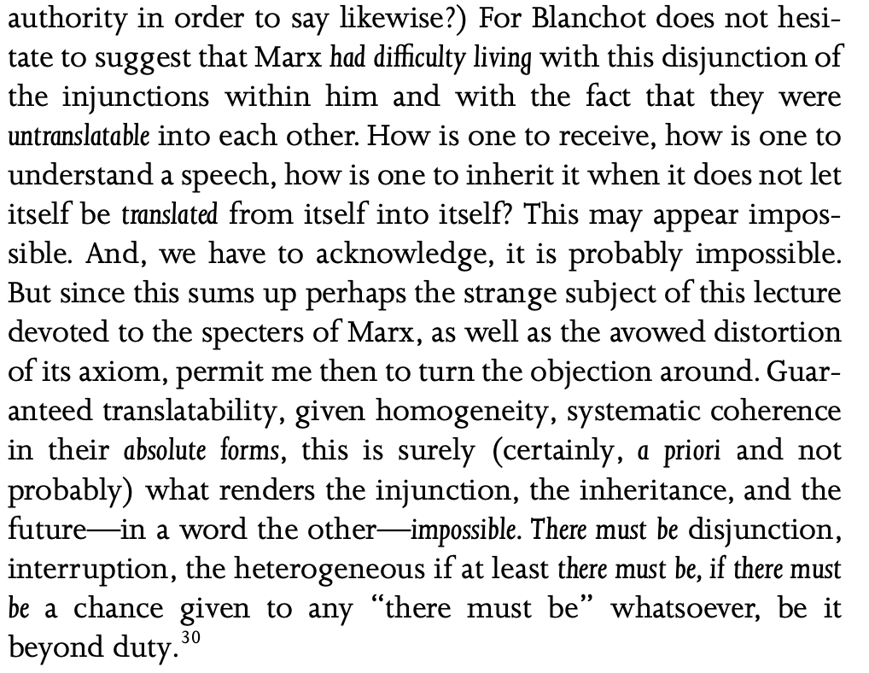

Slide 13
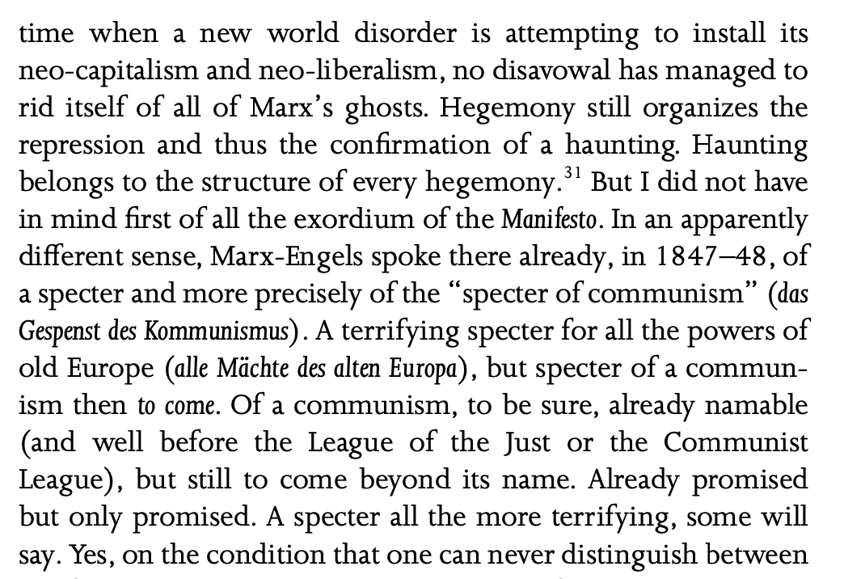

Slide 14
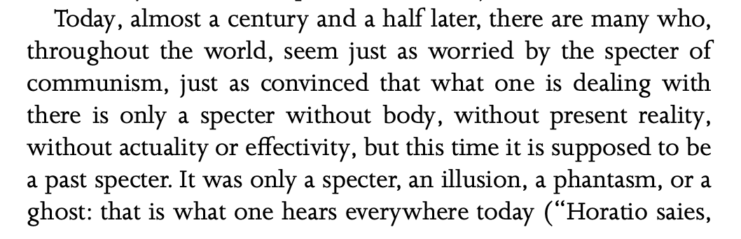

Slide 15
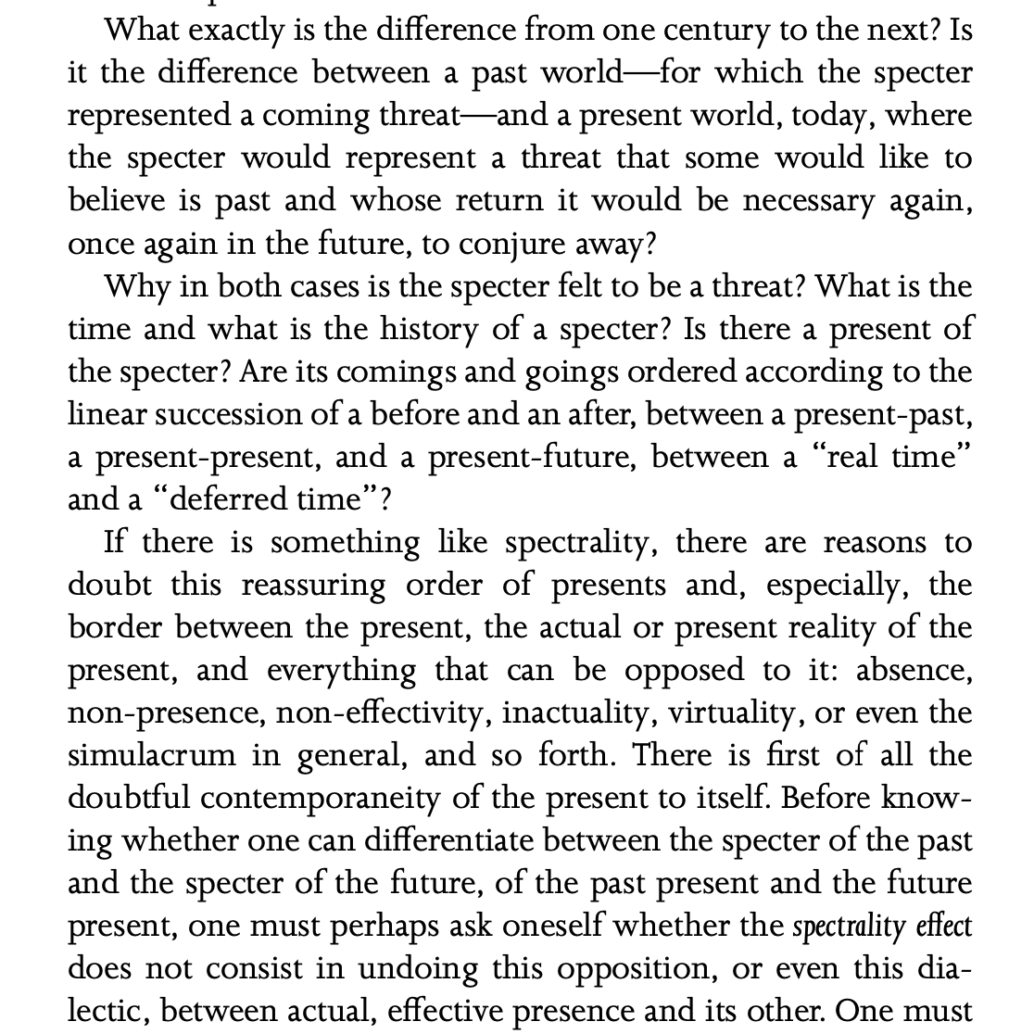

Slide 16
Summing up Derrida’s hauntology
Hauntological: where ideologies, values, or critiques from the past re-emerge, challenging the apparent stability of the present—this is very similar to the revolutionary space Benjamin locates fashion in
Lost pasts—abandoned ideologies, unfulfilled ethical critiques—exist in an about-to-emerge state, neither here nor there
Like the Ghost in Hamlet (on which there is a long meditation), this ghostly state has a huge bearing on the present; it makes people swear to do things, to fulfil these lost promises

Slide 17
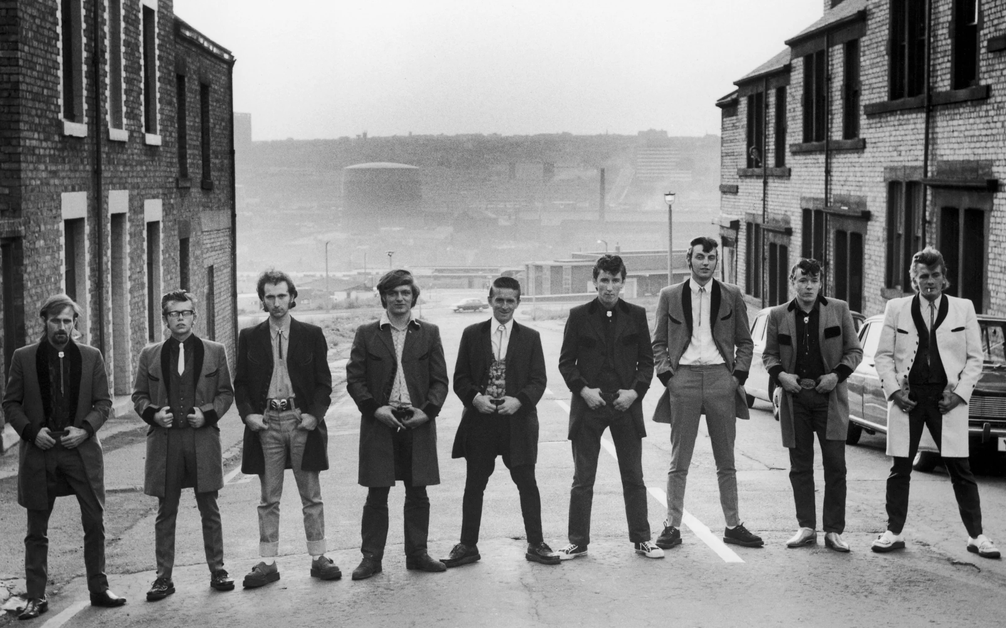

Slide 18
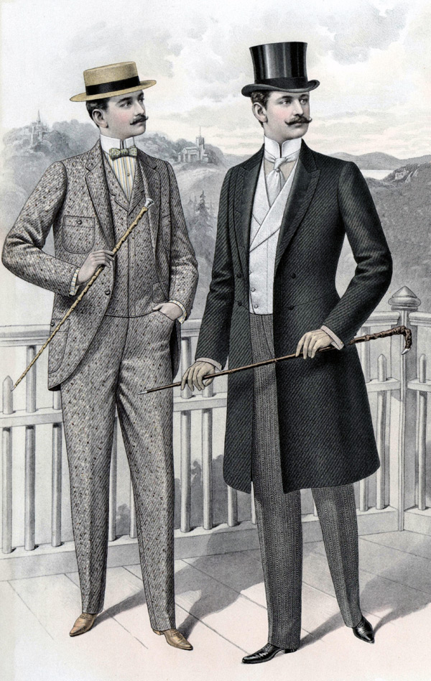

Slide 19

Anti-immigration protests, summer 2024

Slide 20


Slide 21
3
Jane Bennett, Vibrant Matter (2010)

Slide 22
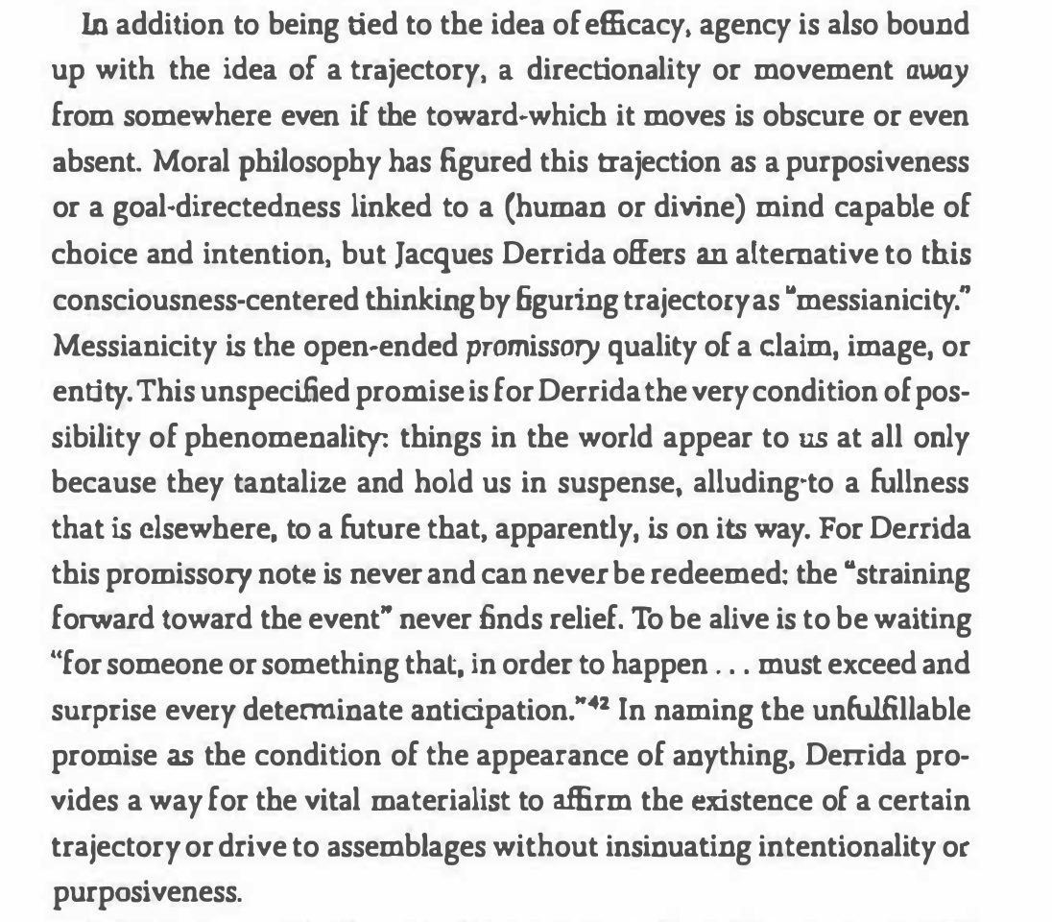

Slide 23
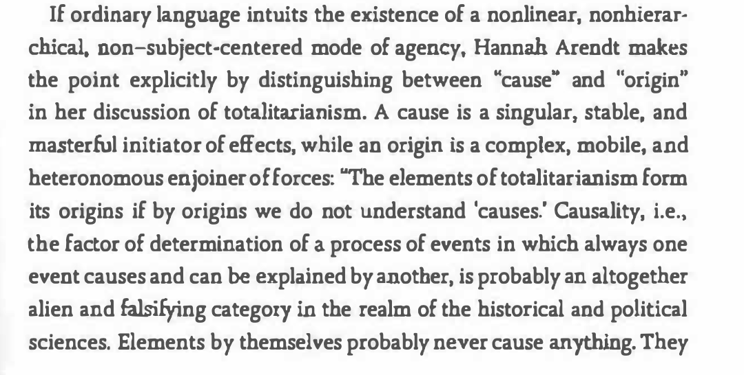
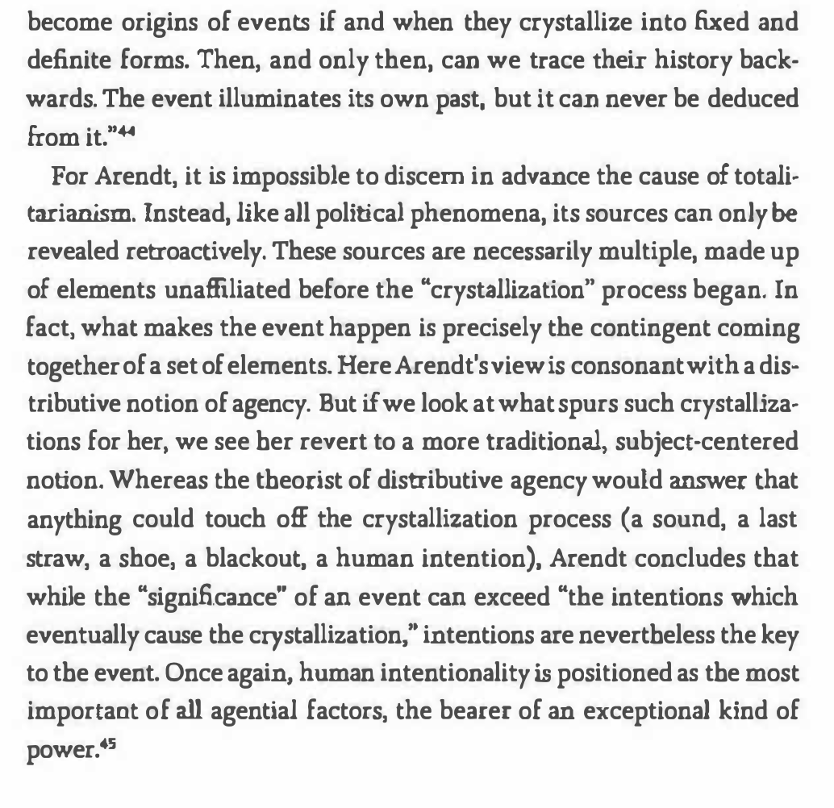

Slide 24
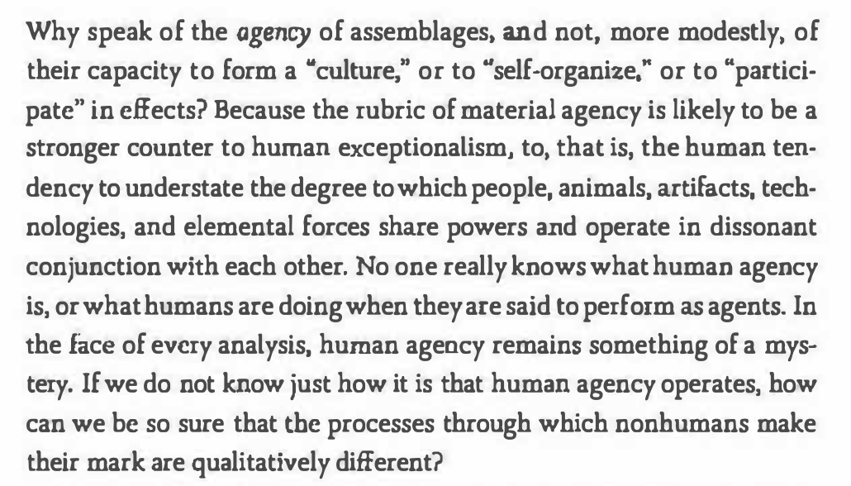

Slide 25
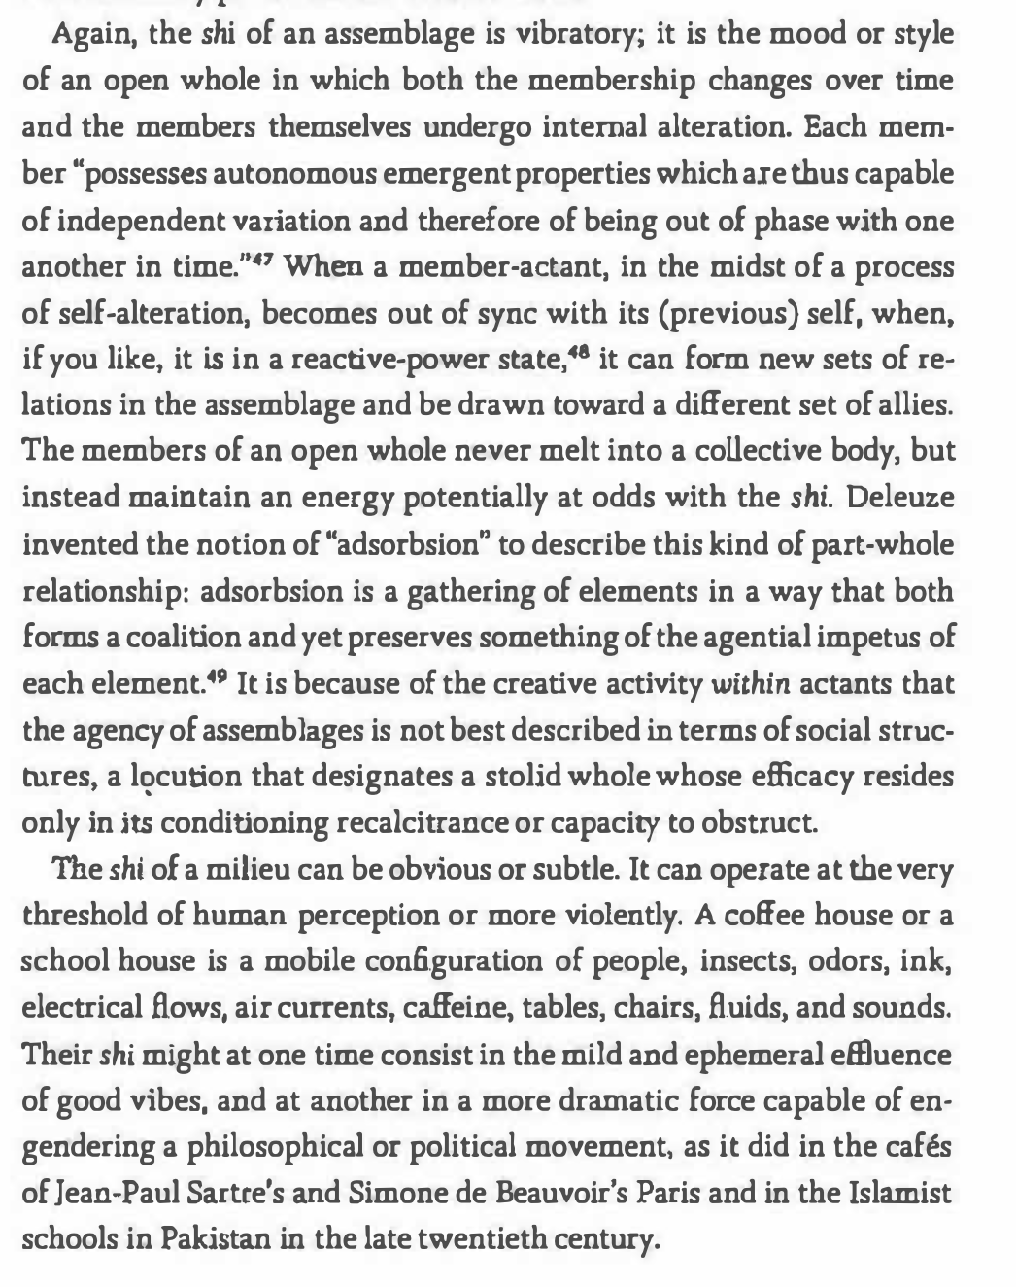

Slide 26
4
The Diary of a Black Coat (1760)
Notes:
A narrative, as Tina Lupton writes, of “declining value” (Lupton, Christina. "Giving Power to the Medium: Recovering the 1750s." The Eighteenth Century, vol. 52 no. 3, 2011, p. 289-302. Project MUSE, https://0-dx-doi-org.pugwash.lib.warwick.ac.uk/10.1353/ecy.2011.0025.)

Slide 27
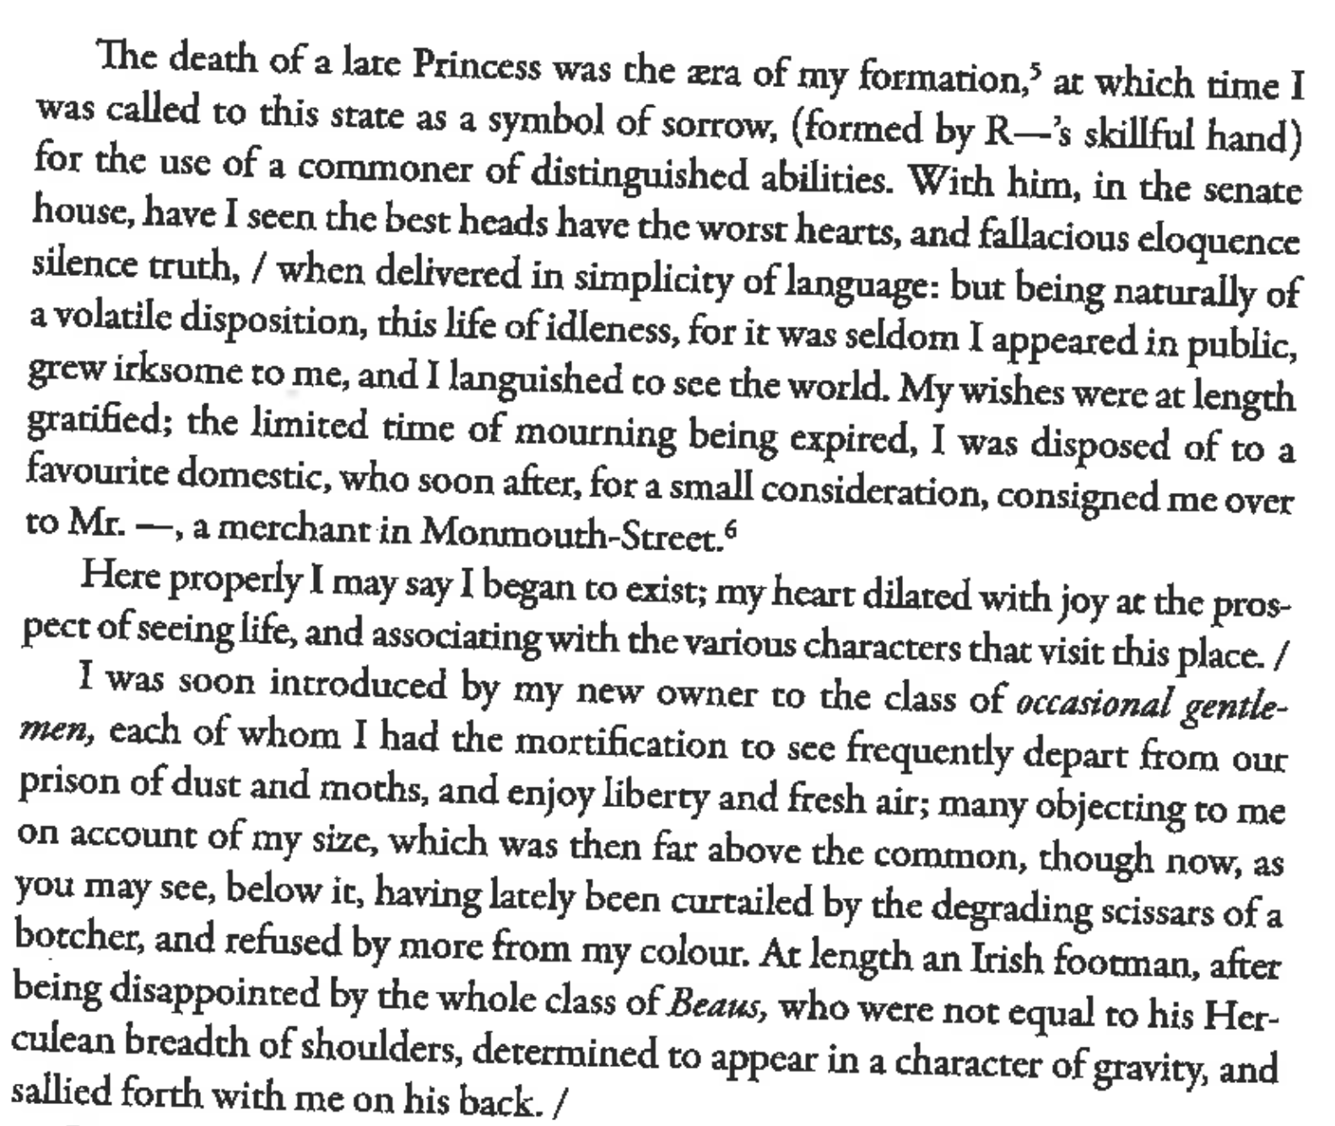

Slide 28
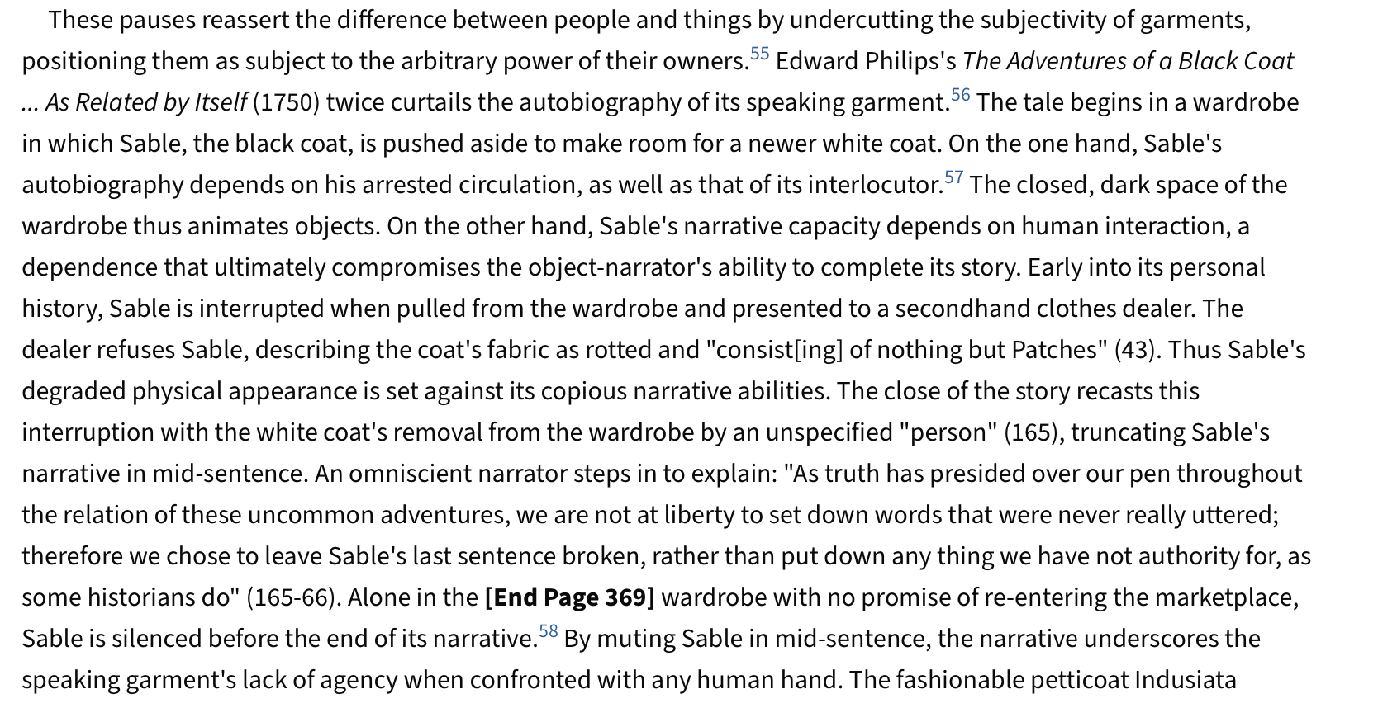
Smith, Chloe Wigston. "Clothes without Bodies: Objects, Humans, and the Marketplace in Eighteenth-Century It-Narratives and Trade Cards." Eighteenth-Century Fiction, vol. 23 no. 2, 2010, p. 347-380. Project MUSE, https://0-dx-doi-org.pugwash.lib.warwick.ac.uk/10.1353/ecf.2010.0020.

Slide 29
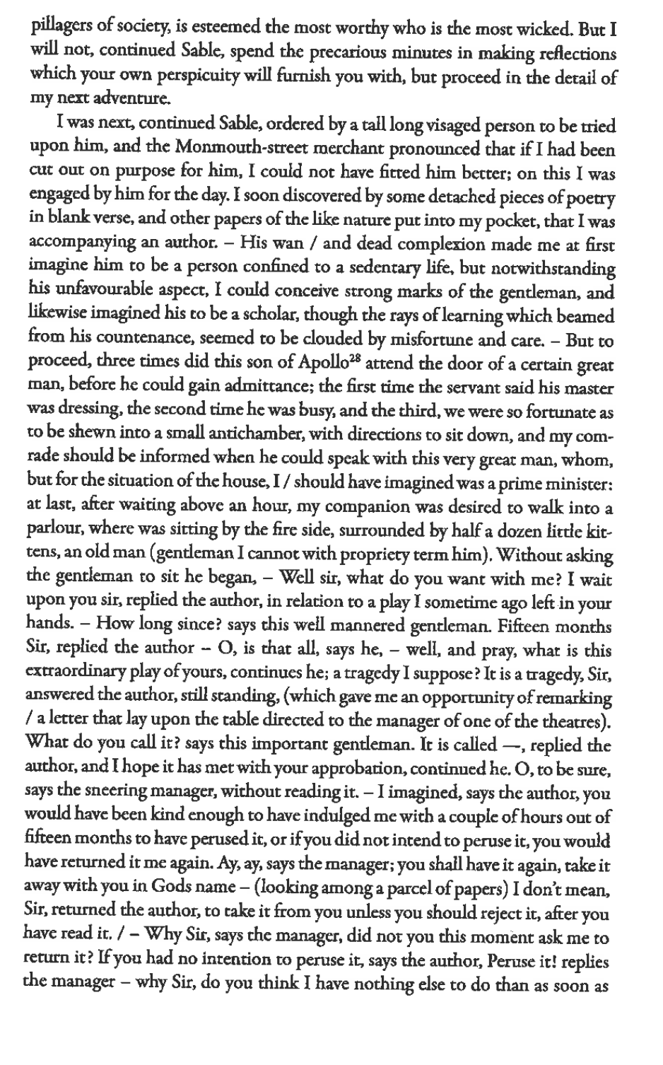

Slide 30
Summing up The Diary of a Black Coat
Imagination of a hidden life to objects pre-exists contemporary theory
A kind of dress anarchy—downward movement of deteriorating garment shows links between classes, performative nature of dress
As Derrida suggests, the dead haunt garments—made for a “commoner of distinguished abilities” for an obsequious royal funeral, it moves via “business” through various characters of low life—instability and turmoil characterize this society

