Slide 1
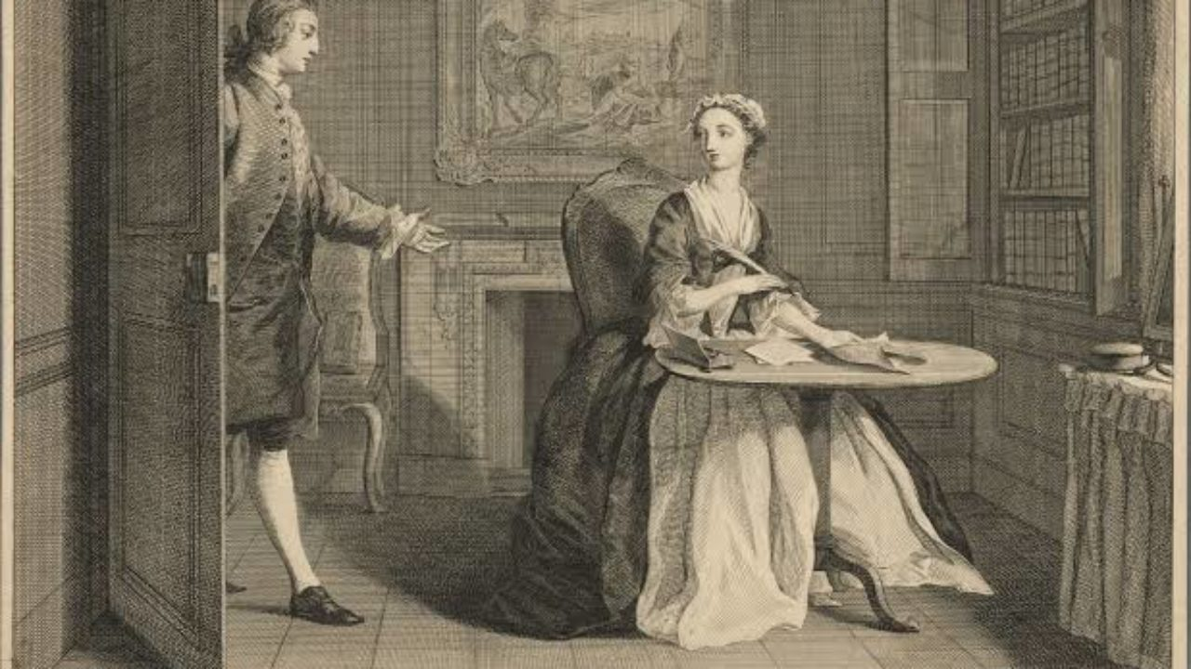
Clothing in Pamela
Fashion and Literature
Term 1, Week 7

Slide 2
Take two minutes, in groups
What do you think about Pamela?

Slide 3
Some Initial Questions
What is a novel? (“extended narrative in prose”)
Is there the novel? Is this a useful thing to talk about?
Term itself doesn’t get used in English to mean what we consider to be novels until approximately the 1740s; before then a disciplinary problem, can we call it a “novel” and still be historically accurate?
What is clothing’s role in the history of the novel?

Slide 4
Some initial points
We’re incredibly early in the development of the novel, a form we come to centuries on in its development—there’s no sense yet that this is for C18 (as it is for us) the default literary genre
The rules are still being set
One of the hardest things for us to let go of is our expectation of uniformity: that novels will be written in one mode, which will remain relatively consistent throughout

Slide 5
Omnium Gatherum
One quality of the novel is its capaciousness: its ability to incorporate other forms
  Dramatic scripts
  Ledgers
  Prayer-books
  Letters and diaries (*)
  Poetry
  Business advice manuals (Defoe, The Complete English Tradesman [1726])
We see many of these in Pamela, which creates its overall impression—whatever we decide it may be—through combining texts together

Slide 6
What we do when we theorise the novel’s history
Try to figure out when it comes together in the forms we recognise, and what the untaken paths were
Try to estrange the form, remind ourselves how much we automatically take for granted when we read novels
Try to show how novels influenced how people thought of themselves in history
(Try to expand the canon—show what we’ve left unread)

Slide 7
Armstrong, Desire and Domestic Fiction (1987)
“1. In the eighteenth and early nineteenth centuries, the middle classes' battle for dominance over the aristocracy takes the form of a struggle to displace power from physical force to discursive force.
2. As a result of this struggle a(n ideological) model of governance by consent and contract triumphs over that of force and punishment.
3. Desire is determined culturally and historically. In the nineteenth century, for reasons of political struggle, it becomes gendered.
4. In this struggle, the function of the conduct manual and particularly of the domestic novel is to de-politicize cultural representation by feminizing it.
5. To this end, the female in nineteenth-century British middle-class culture is empowered (she is an agent rather than merely a victim), partly through novelistic representations of her. She in fact becomes the modern individual.
6. Therefore, representations in the domestic novels (particularly of the female, the household, and the middle-class way of life) are necessarily antecedent to that which they represent. (That is, these objects exist first in literature, and only afterward as extra-literary fact.)”

Slide 8
Some Issues
“Middle class” not actually in use until the 1830s in England—her use of term is at best proleptic, at worst anachronistic
What actually is “desire”? (A Foucauldian problem—power and desire are structural, but have a tendency to seem contentless)
Same problem as Watt: what about earlier texts still being read?
If women are the ideal subjects of novels, why so few political rights?

Slide 9
Another Example: Davis, Factual Fictions (1983)
“The romancer’s view of the world is thus based on the effacing of the offending or noncomforming fact or event and the creation of the ideal, the paradigmatic, the traditional. The writer of novels, on the other hand, sees narrative as more oriented to the specific, the particular, the eccentric, the factual” (my emphases)

Slide 10
Another Example: Hunter, Before Novels (1990)
Another study of influences: in this case, expanding to diaries, journalism, religious tracts
Against the “rise of the novel” in sense that he suggests the tradition is less special than we think it is, less discrete from other types of texts

Slide 11
Another Example: William Warner, Licensing Entertainment (1998)
A “new media” account, inflected by studies in that area
Here the precursors are short fictions by Aphra Behn, Haywood, Manley (from previous century)
There is a “general reader” who read texts by both women and men; were interested in “amorous intrigue”
A sustained issue: why consider the Rise of the Novel in one country, when books moved across countries?

Slide 12
Another Example: Franco Moretti, Distant Reading (2013)
Proposes we devise methods to read the thousands, and tens of thousands, of books that were actually published in period, rather than returning to those often accidentally that have wound up in our canons

Slide 13
Omnium Gatherum
One quality of the novel is its capaciousness: its ability to incorporate other forms
  Ledgers
  Prayer-books
  Letters and diaries (*)
  Poetry
  Business advice manuals (Defoe, The Complete English Tradesman [1726])
We can make claims based on the juxtapositions of these materials—they invoke different aspects of realism, whether how people act or the objects they use to conduct these actions

Slide 14
I now began to consider seriously my condition, and the circumstances I was reduced to; and I drew up the state of my affairs in writing, not so much to leave them to any that were to come after me—for I was likely to have but few heirs—as to deliver my thoughts from daily poring over them, and afflicting my mind; and as my reason began now to master my despondency, I began to comfort myself as well as I could, and to set the good against the evil, that I might have something to distinguish my case from worse; and I stated very impartially, like debtor and creditor, the comforts I enjoyed against the miseries I suffered, thus:—
Evil. | Good.
I am cast upon a horrible, desolate island, void of all hope of recovery. | But I am alive; and not drowned, as all my ship’s company were.
I am singled out and separated, as it were, from all the world, to be miserable. | But I am singled out, too, from all the ship’s crew, to be spared from death; and He that miraculously saved me from death can deliver me from this condition.
I am divided from mankind—a solitaire; one banished from human society. | But I am not starved, and perishing on a barren place, affording no sustenance.
I have no clothes to cover me. | But I am in a hot climate, where, if I had clothes, I could hardly wear them.
I am without any defence, or means to resist any violence of man or beast. | But I am cast on an island where I see no wild beasts to hurt me, as I saw on the coast of Africa; and what if I had been shipwrecked there?
I have no soul to speak to or relieve me. | But God wonderfully sent the ship in near enough to the shore, that I have got out as many necessary things as will either supply my wants or enable me to supply myself, even as long as I live.

Slide 15
My raft was now strong enough to bear any reasonable weight. My next care was what to load it with, and how to preserve what I laid upon it from the surf of the sea; but I was not long considering this. I first laid all the planks or boards upon it that I could get, and having considered well what I most wanted, I got three of the seamen’s chests, which I had broken open, and emptied, and lowered them down upon my raft; the first of these I filled with provisions—viz. bread, rice, three Dutch cheeses, five pieces of dried goat’s flesh (which we lived much upon), and a little remainder of European corn, which had been laid by for some fowls which we brought to sea with us, but the fowls were killed. There had been some barley and wheat together; but, to my great disappointment, I found afterwards that the rats had eaten or spoiled it all. As for liquors, I found several, cases of bottles belonging to our skipper, in which were some cordial waters; and, in all, about five or six gallons of rack. …

Slide 16
DEAR MOTHER,
Well, I will now proceed with my sad story. And so, after I had dried my eyes, I went in, and began to ruminate with myself what I had best to do. Sometimes I thought I would leave the house and go to the next town, and wait an opportunity to get to you; but then I was at a loss to resolve whether to take away the things he had given me or no, and how to take them away: Sometimes I thought to leave them behind me, and only go with the clothes on my back, but then I had two miles and a half, and a byway, to the town; and being pretty well dressed, I might come to some harm, almost as bad as what I would run away from; and then may-be, thought I, it will be reported, I have stolen something, and so was forced to run away; and to carry a bad name back with me to my dear parents, would be a sad thing indeed!—O how I wished for my grey russet again, and my poor honest dress, with which you fitted me out, (and hard enough too it was for you to do it!) for going to this place, when I was not twelve years old, in my good lady’s days! Sometimes I thought of telling Mrs. Jervis, and taking her advice, and only feared his command to be secret; for, thought I, he may be ashamed of his actions, and never attempt the like again: And as poor Mrs. Jervis depended upon him, through misfortunes, that had attended her, I thought it would be a sad thing to bring his displeasure upon her for my sake.

Slide 17
I had got to my pen and ink; and I said, I want some paper, Mrs. Jewkes, (putting what I was about in my bosom:) You know I have written two letters, and sent them by John. (O how his name, poor guilty fellow, grieves me!) Well, said she, you have some left; one sheet did for those two letters. Yes, said I; but I used half another for a cover, you know; and see how I have scribbled the other half; and so I shewed her a parcel of broken scraps of verses, which I had tried to recollect, and had written purposely that she might see, and think me usually employed to such idle purposes. Ay, said she, so you have; well, I’ll give you two sheets more; but let me see how you dispose of them, either written or blank. Well, thought I, I hope still, Argus, to be too hard for thee. Now Argus, the poets say, had a hundred eyes, and was set to watch with them all, as she does.
Notes:
Pamela makes herself out of letters—we can think here of the folds

Slide 18
Question 1: Inventories
What are these objects? Using Google or the OED if necessary, tell us what one unfamiliar item is
What ethics do these objects contain or reflect, as stated by Pamela?
How do the objects reflect, contain, or manage relations between the characters?

Slide 19
Question 2: Theoretical Exercises
What are these objects? Using Google or the OED if necessary, tell us what one unfamiliar item is (as previous entry)
What insight does the theorist mentioned provide on this section of the text?
How do the objects reflect, contain, or manage relations between the characters? (as previous entry)

