Slide 1
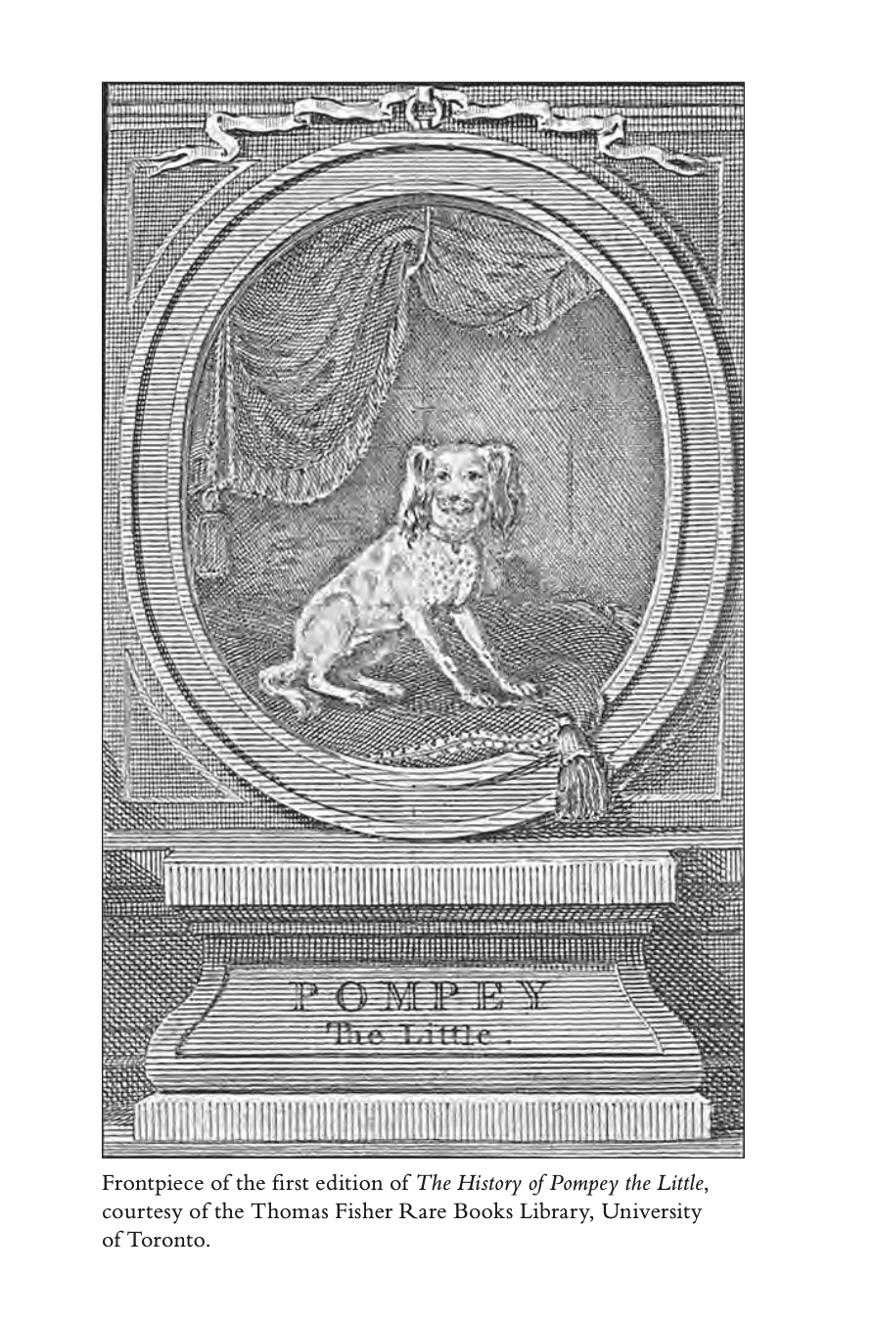
The History of Pompey the Little (1751)
Fashion and Literature
Term 1, Week 9

Slide 2
Pompey the Little and the Eighteenth Century
Consumption a bigger presence in the novel than Pompey—everything, from clothing to bodies, aging and degrading
London a place of social visibility, where appearance is linked to status—even when characters retire to the country (fashioned as basically not-London), they bring the same visual fashion economy with them
Fashion a way people from lower classes can ape their superiors; but in the end, everyone just animals

Slide 3
Defamiliarising People
Characters early in the novel discuss John Locke, the Enlightenment philosopher whose An Essay Concerning Human Understanding (1689) sought to estrange how humans think
Pompey Little takes a dim view of humanity (and indeed of animals): every encounter transactional; all entities mostly interested in ingesting, excreting, sex, and seeming fashionable
Fashion, then, something like an instinct: a thing that humans do, naturally and innately, and without any particular respect for fineness, craft, or aesthetics
Indeed there’s an almost total absence of an aesthetic of any sort in this text

Slide 4
Misogyny
Of course (sigh) women have it worse
Women’s bodies more clearly marked as consumable—aging, deteriorating—than men’s
They receive a heavier critique for engaging in sex, aren’t really given appetites—they’re always a currency, and only in rarer circumstances a consumer
The Milliner a fascinating character: established in life by an annuity received by having sex, lives in her workroom while renting out the rest of her house—a life hollowed out by money

Slide 5
Structure and Fashion
This is a picaresque narrative, which is to say it’s a series of episodes related more by vibe than by unified plot
Like fashion, the narrative is unstable: prone to rabbit-holes and digression, seemingly out of its own control
Like animals, pieces of clothing degrade while fashion-–its anxieties and need for novelty—continues to circulate

Slide 6
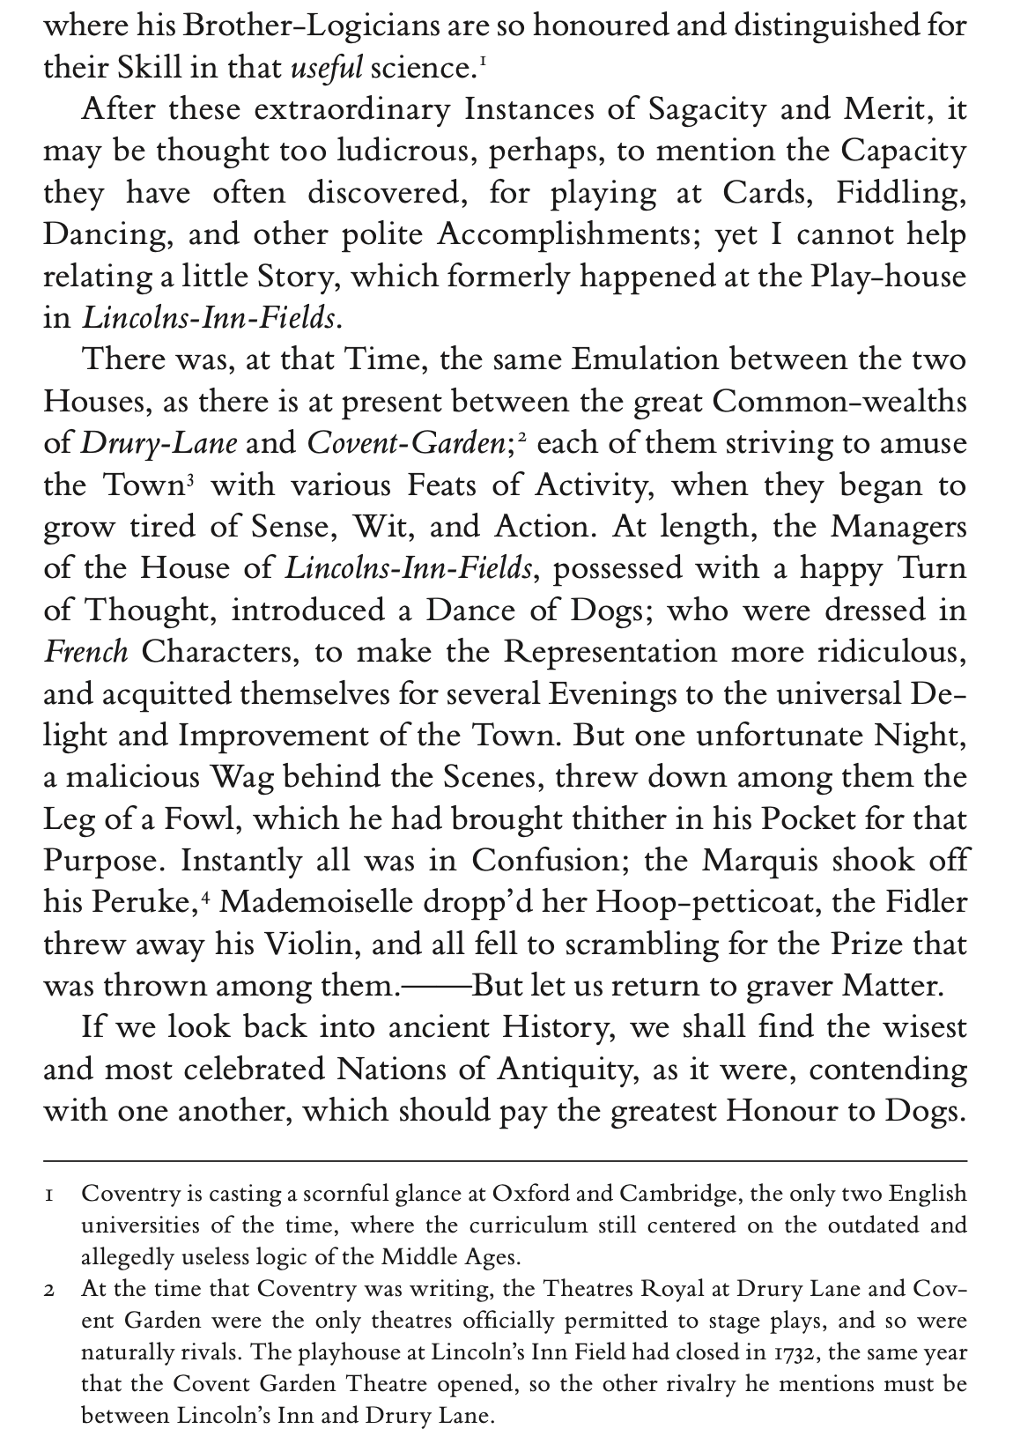

Slide 7
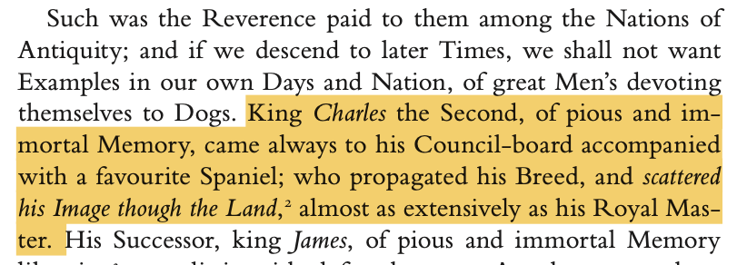

Slide 8
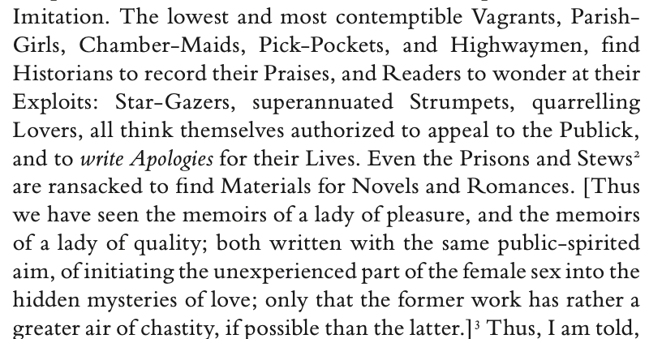

Slide 9
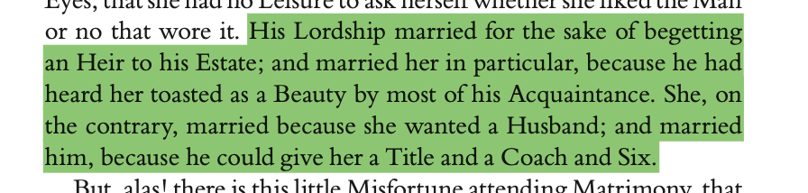

Slide 10
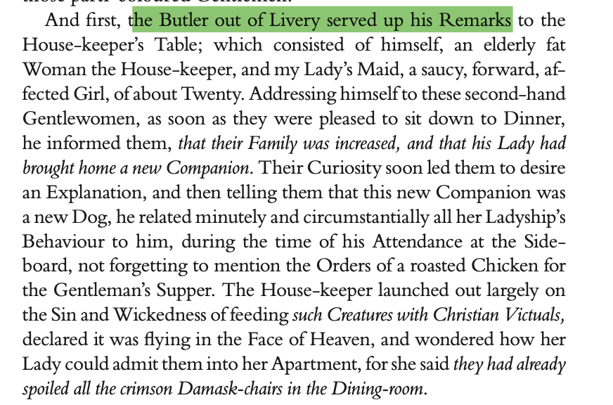

Slide 11
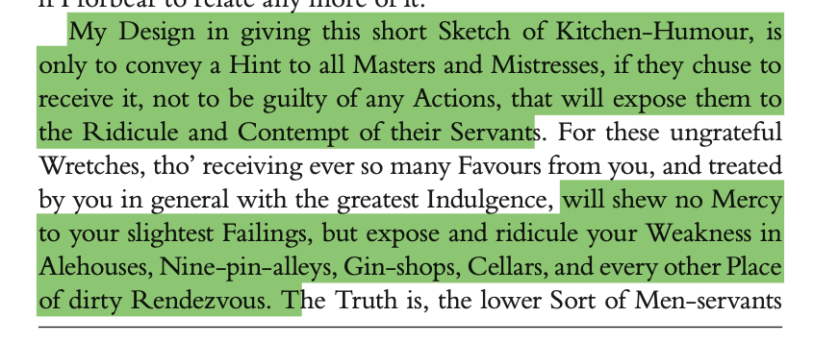

Slide 12
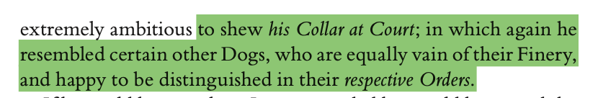

Slide 13
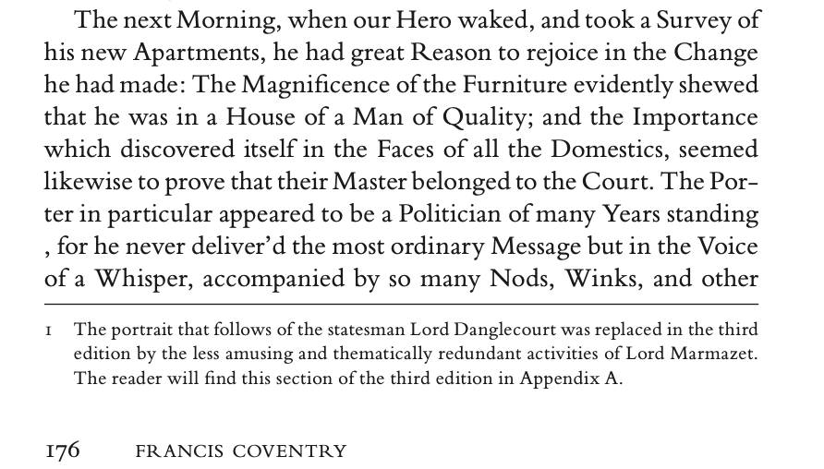

Slide 14
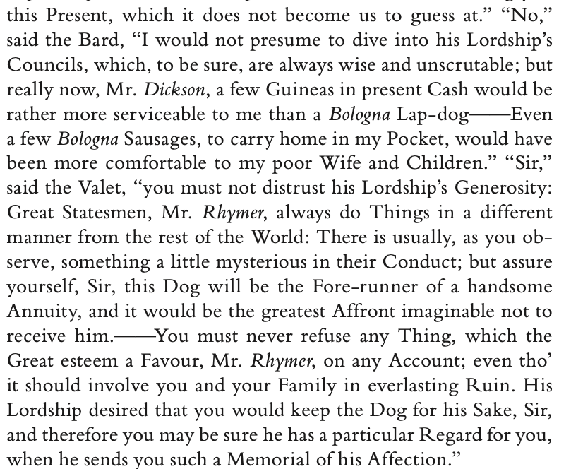

Slide 15
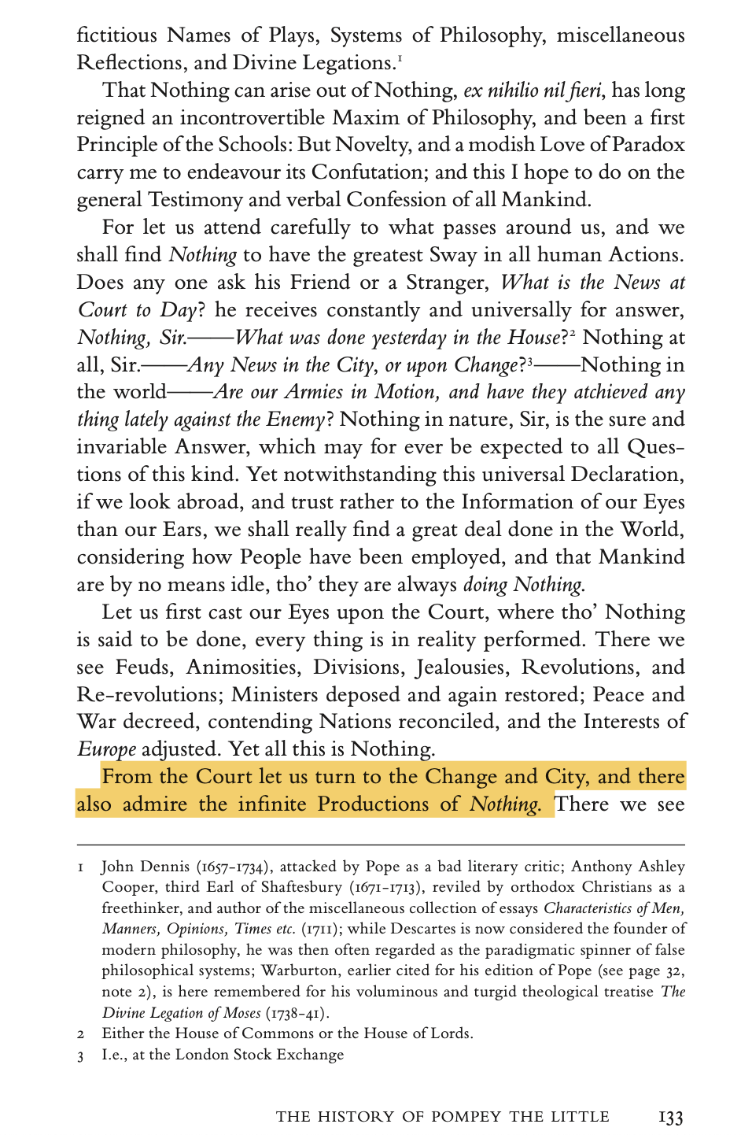

Slide 16
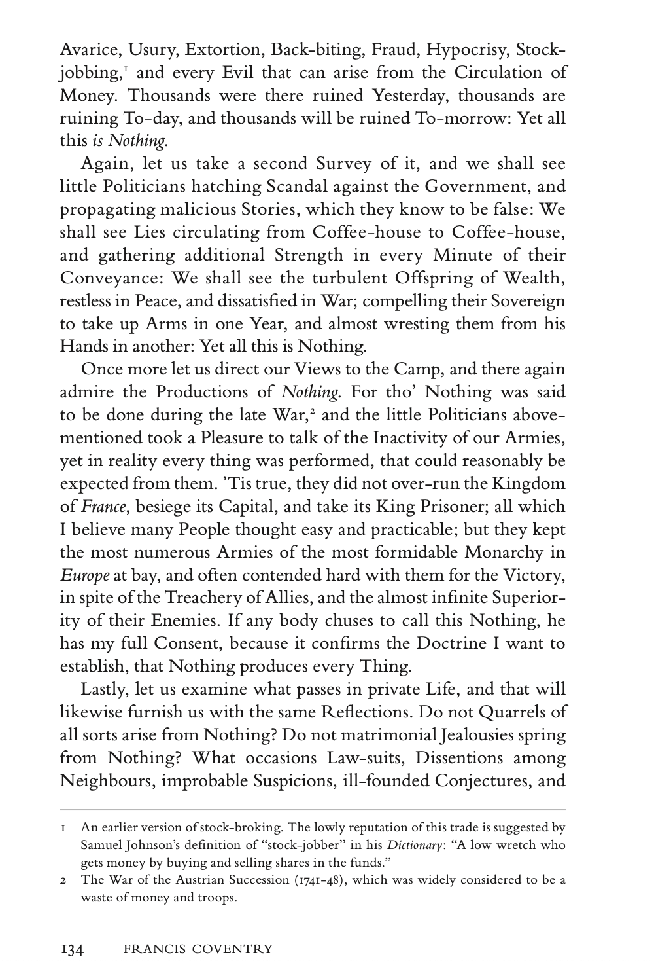

Slide 17
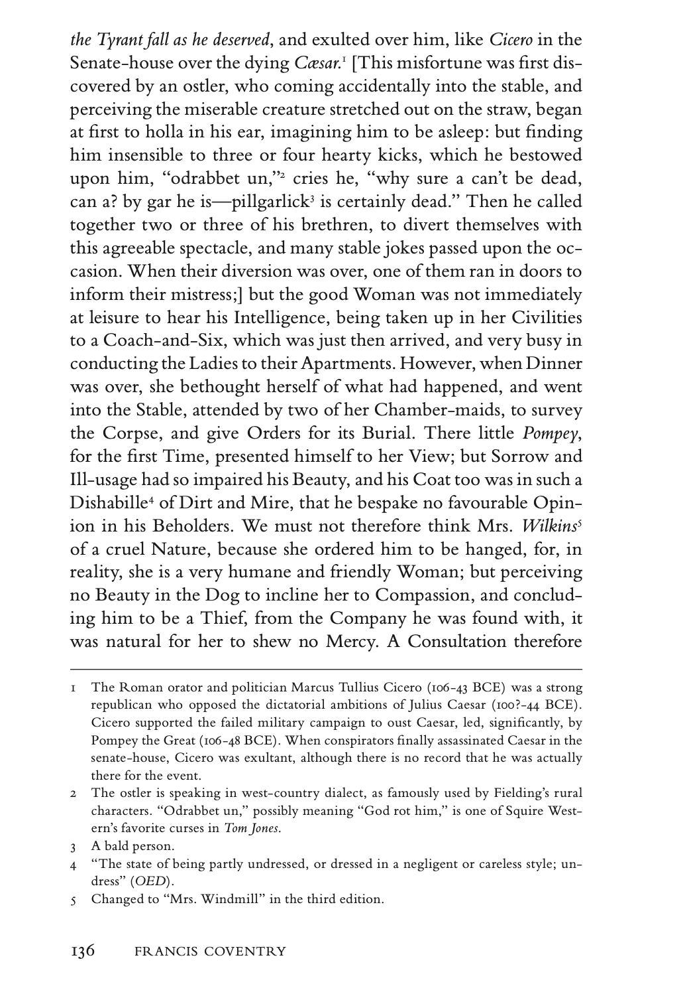

Slide 18
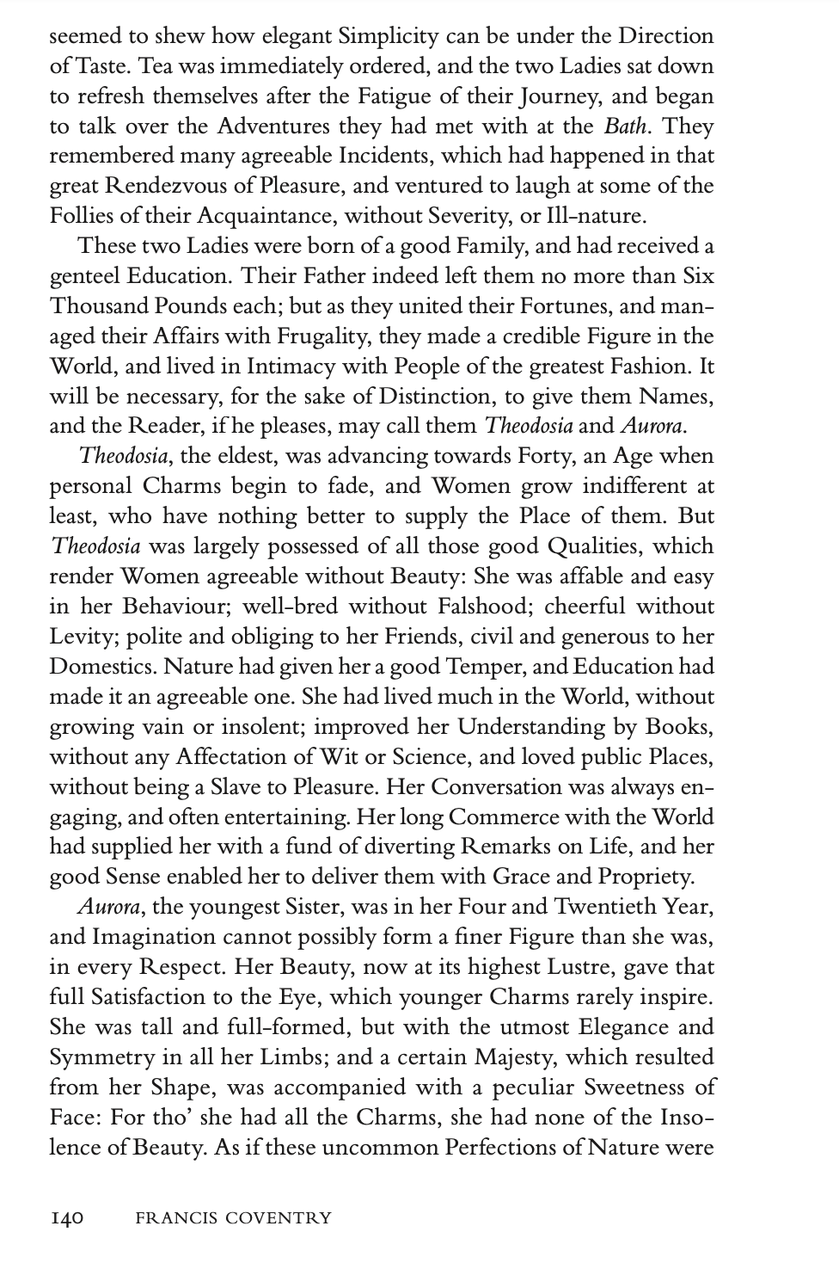

Slide 19
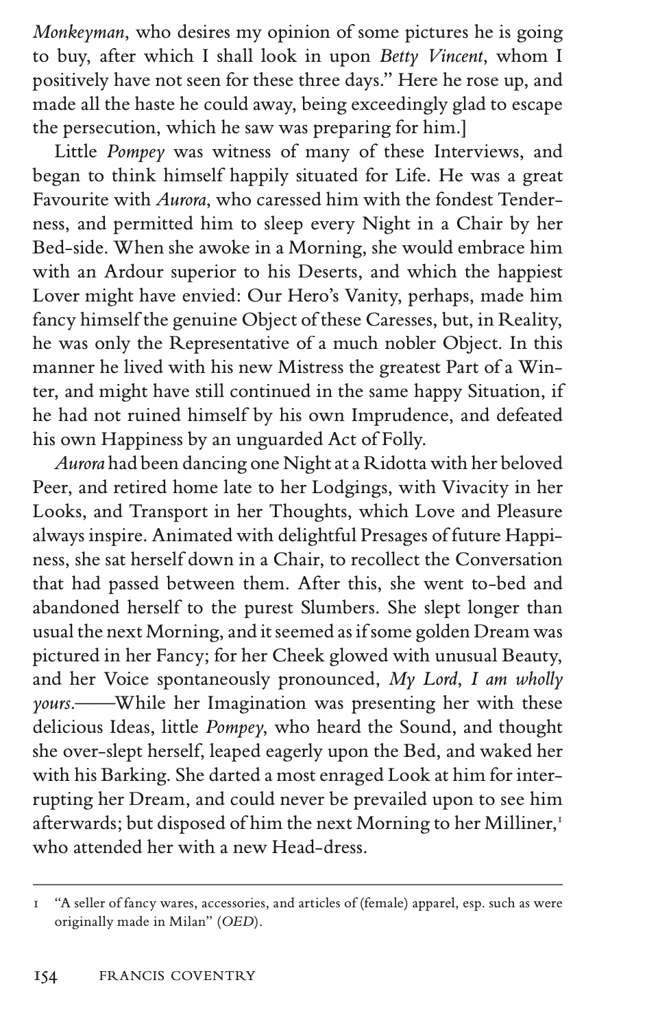

Slide 20
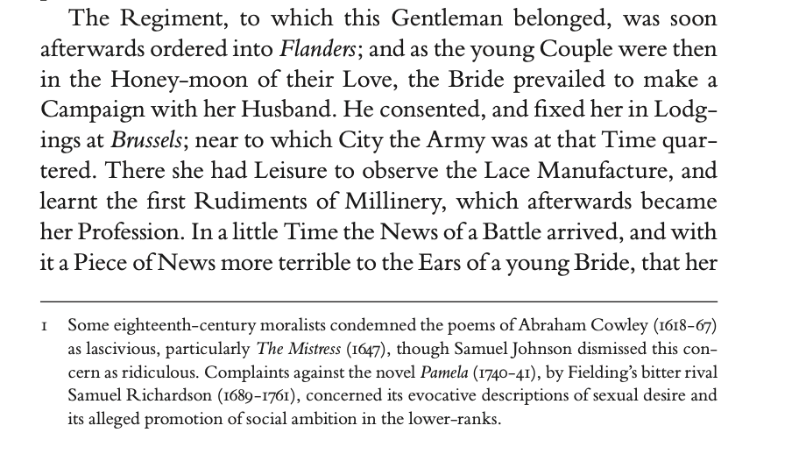

Slide 21
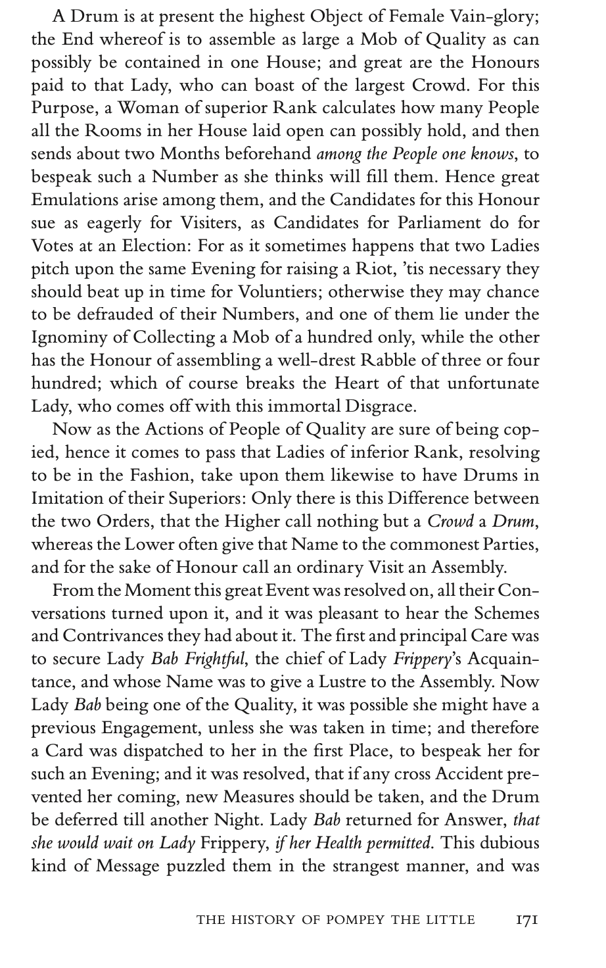

Slide 22
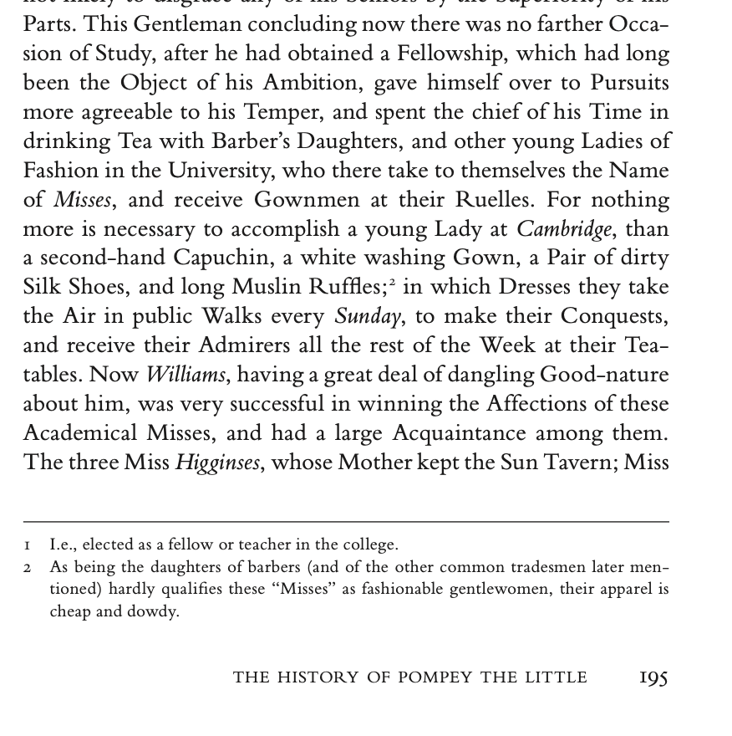

Slide 23
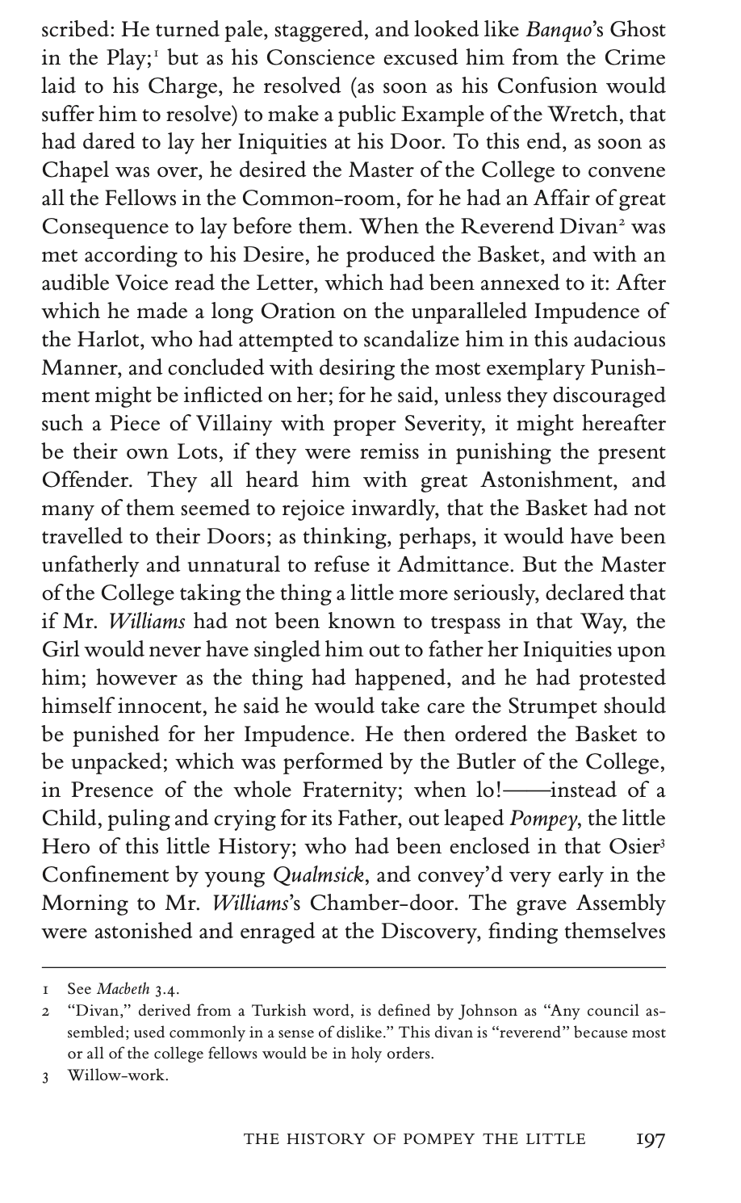

Slide 24
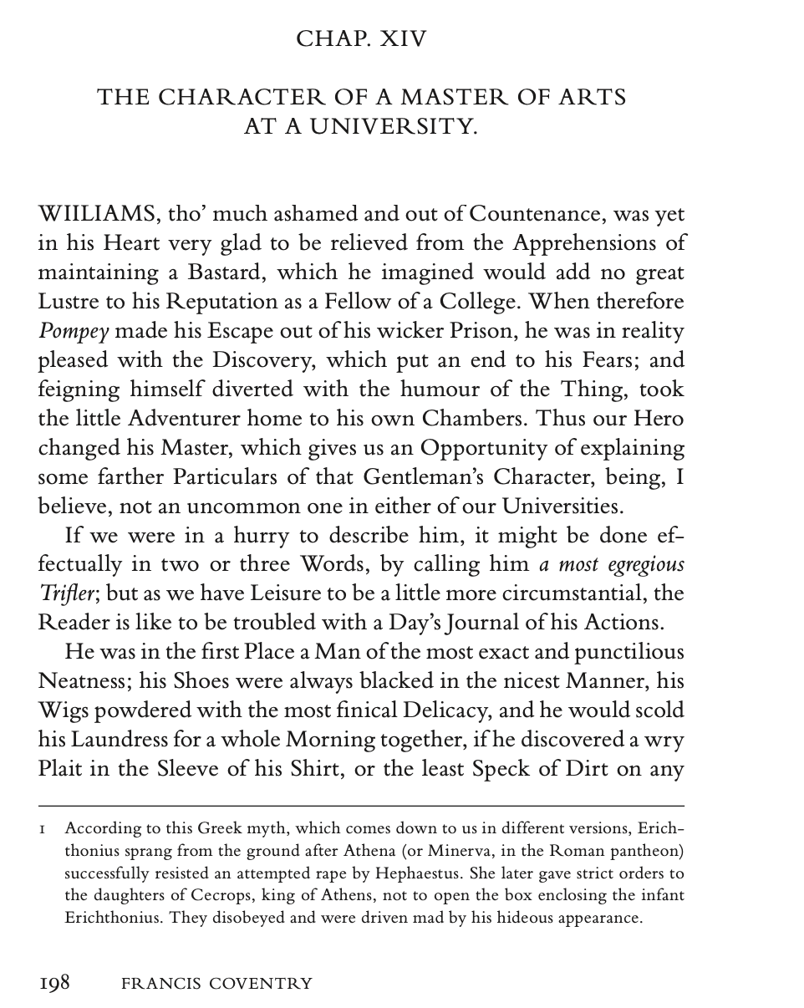

Slide 25
