Slide 1
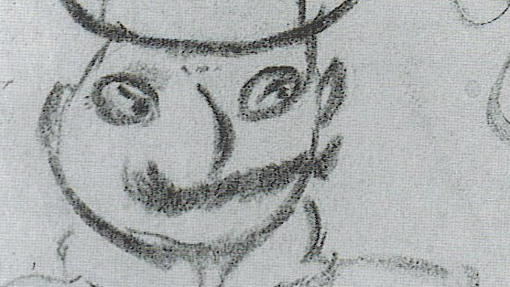
James Joyce, Dubliners (1914)

Slide 2
Controls and forces
Dubliners is set around the turn of the twentieth century—some characters recur in Ulysses (1922), definitively set on Thursday 16 June, 1904
Irish independence discussed throughout the stories—the men in “Ivy Day in the Committee Room” explicitly discuss Charles Parnell (1846-91), a politician who advocated for Irish independence
Influence exerted over the lives of the characters by external forces:
  England
  The Catholic Church
  Consumer culture

Slide 3
Stasis
Joyce writes “I call the series Dubliners to betray the soul of that hemiplegia or paralysis which many consider a city”: first story has a dead priest that nevertheless haunts the child narrator (“the grey face still followed me”)
“I felt my soul receding into some pleasant and vicious region; and there again I found it waiting for me…But then I remembered that it had died of paralysis and I felt that I too was smiling feebly as if to absolve the simoniac of his sin.”
Joyce’s career circles around stasis: a Modernist writer moving literary style forward by endlessly circling (in Ulysses and Finnegans Wake, and arguably in Dubliners) around a day in the past

Slide 4
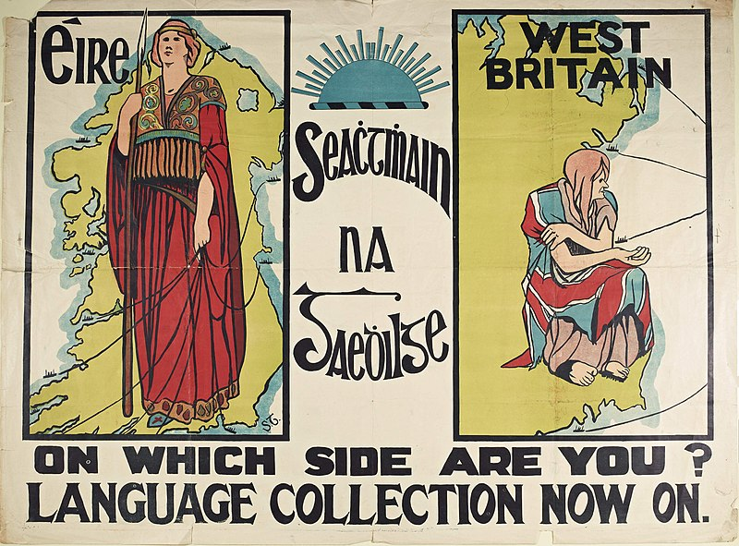

Slide 5
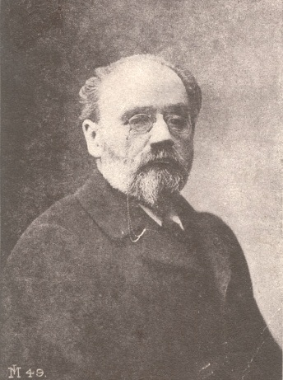
Naturalism
Émile Zola (1840-1902), French novelist and playwright
Influenced by Darwin and the other scientific developments of the century, Zola proposed that literature should reflect the principles of scientific Naturalism:
  Determinism: all behaviour is determined by genetics and environment.
  The writer’s task was to depict reality as objectively and as scientifically as possible.

Slide 6
A world elsewhere
Throughout the stories, a sense that a truer cultural life exists outside of Ireland (and beyond England)
  “Beautiful?” said Ignatius Gallaher, pausing on the word and on the flavour of his drink. “It’s not so beautiful, you know. Of course, it is beautiful.... But it’s the life of Paris; that’s the thing. Ah, there’s no city like Paris for gaiety, movement, excitement....”

Slide 7
Failed Epiphanies
All of the stories have moments of largely unexplained epiphany or realization. These often show characters failing to fully understand a situation or make a situation, or briefly being awaked to something the prejudices of their situation and lives then interrupt, as in “A Painful Case”
  When he reached his house he went up at once to his bedroom and, taking the paper from his pocket, read the paragraph again by the failing light of the window. He read it not aloud, but moving his lips as a priest does when he reads the prayers Secreto…Duffy raised his eyes from the paper and gazed out of his window on the cheerless evening landscape. The river lay quiet beside the empty distillery and from time to time a light appeared in some house on the Lucan road. What an end! The whole narrative of her death revolted him and it revolted him to think that he had ever spoken to her of what he held sacred. The threadbare phrases, the inane expressions of sympathy, the cautious words of a reporter won over to conceal the details of a commonplace vulgar death attacked his stomach. Not merely had she degraded herself; she had degraded him.

Slide 8
Consumer culture
Joyce’s characters frequently eating, consuming, and shopping for products that-–more perhaps than their relatively geographically static lives—tie them to wider European culture
  Between these rival ends ran parallel lines of side-dishes: two little minsters of jelly, red and yellow; a shallow dish full of blocks of blancmange and red jam, a large green leaf-shaped dish with a stalk-shaped handle, on which lay bunches of purple raisins and peeled almonds, a companion dish on which lay a solid rectangle of Smyrna figs, a dish of custard topped with grated nutmeg, a small bowl full of chocolates and sweets wrapped in gold and silver papers and a glass vase in which stood some tall celery stalks. In the centre of the table there stood, as sentries to a fruit-stand which upheld a pyramid of oranges and American apples, two squat old-fashioned decanters of cut glass, one containing port and the other dark sherry. On the closed square piano a pudding in a huge yellow dish lay in waiting and behind it were three squads of bottles of stout and ale and minerals, drawn up according to the colours of their uniforms, the first two black, with brown and red labels, the third and smallest squad white, with transverse green sashes.

Slide 9
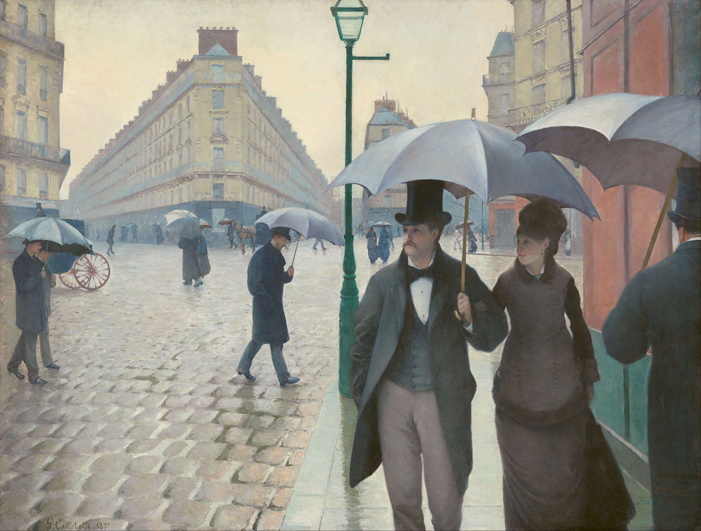

Slide 10
Dress
“Had he not been dead I would have gone into the little dark room behind the shop to find him sitting in his arm-chair by the fire, nearly smothered in his great-coat”: throughout the stories characters are typified by their clothes, often shown shackling them to their social positions and smothering their individuality

