Slide 1
The Waste Land (1922)
Fashion and Literature
Term 2, Week 2

Slide 2
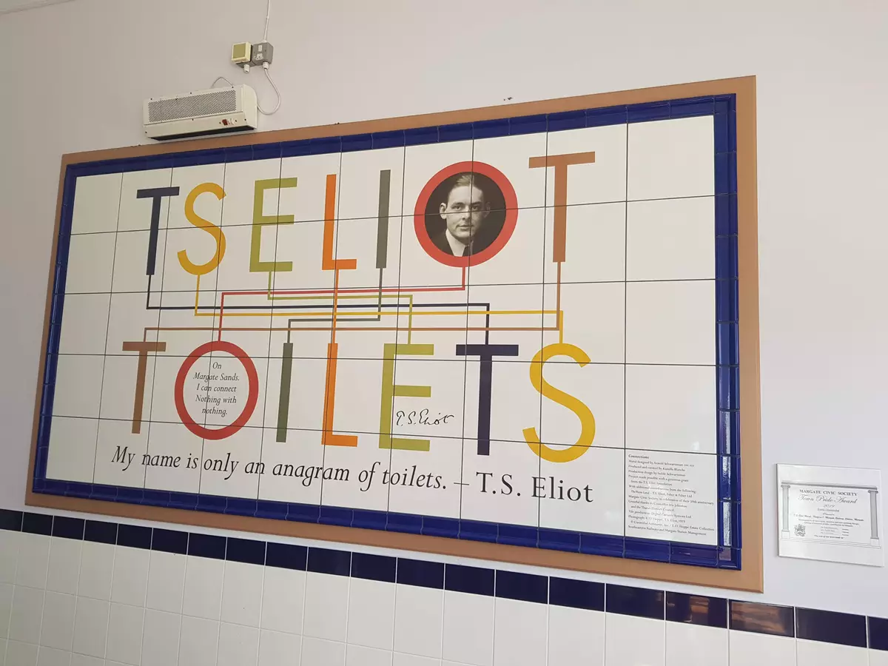

Slide 3


Dior AW23 (d. Kim Jones)

Slide 4


Slide 5


Slide 6


Slide 7


Slide 8
Walter Benjamin, “On Some Motifs in Baudelaire”
Urban modernity defined by a state of shock that atomises rather than brings together individuals
Symptoms include blunted emotional response, individual experiences moments of flickering and occasional beauty—as with ever in Benjamin, sometimes hard to tell if this is meant to be critical or not

Slide 9
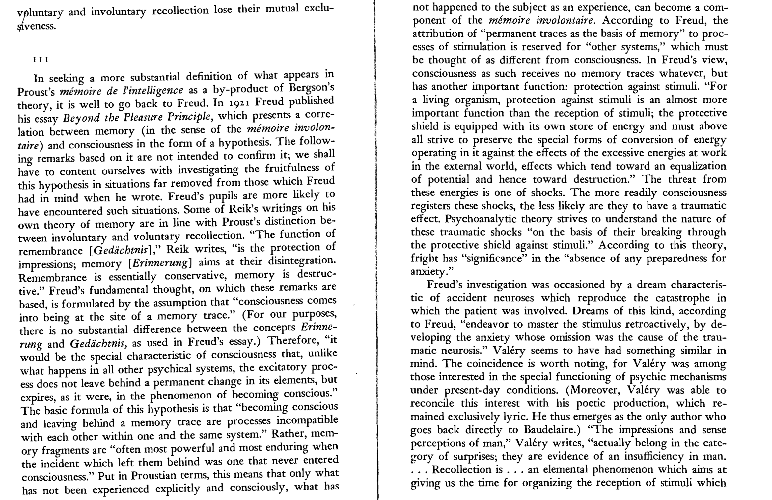

Slide 10
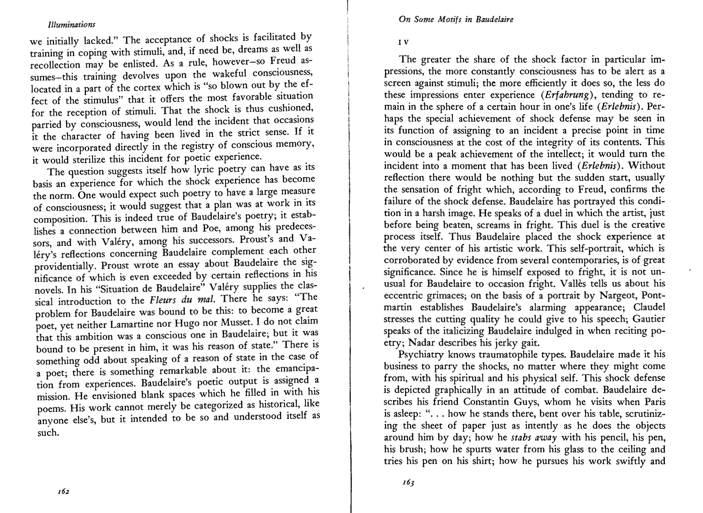

Slide 11
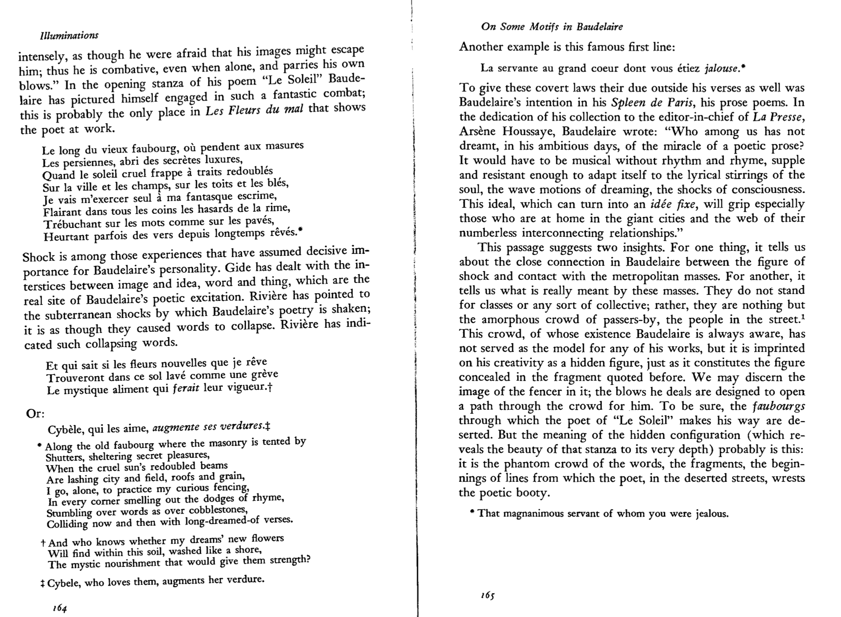

Slide 12
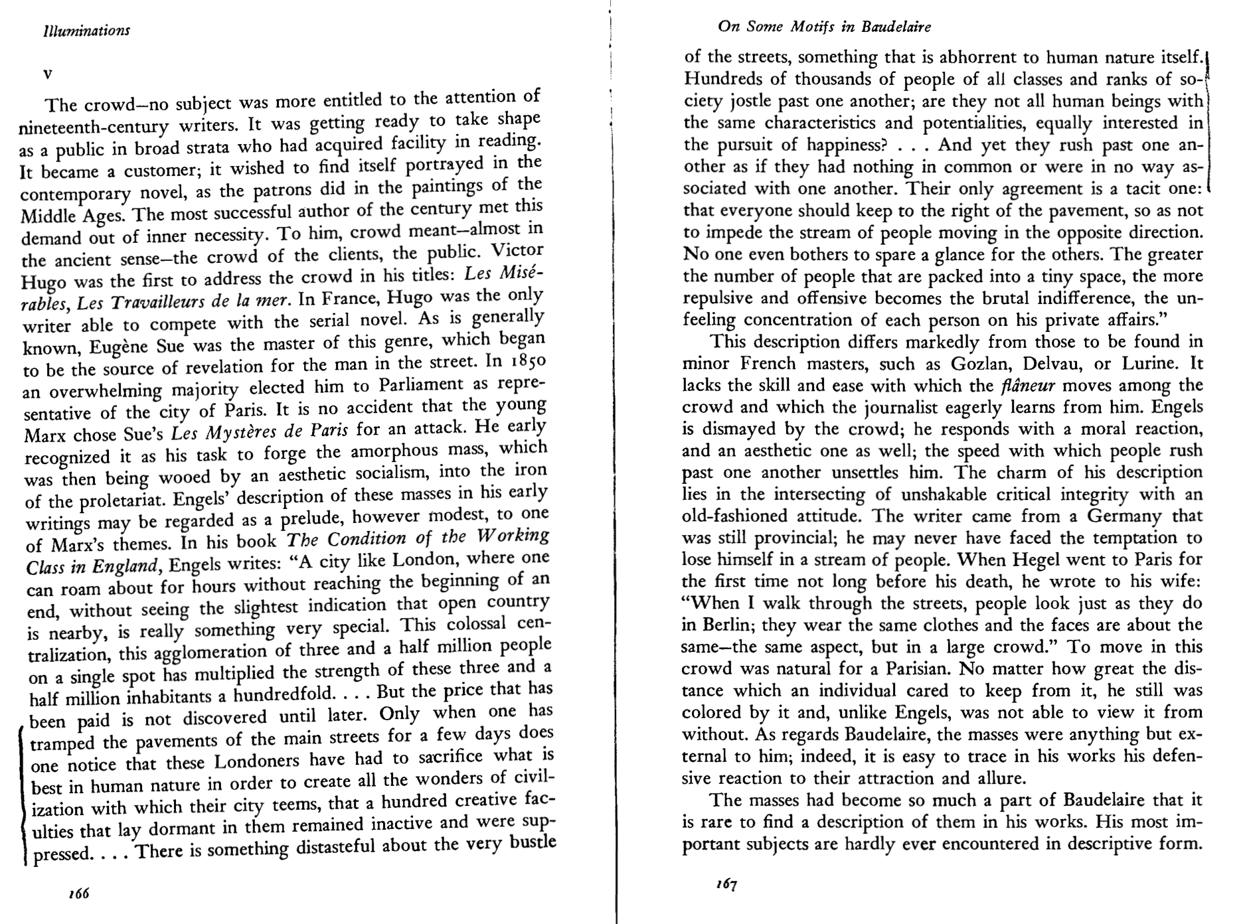

Slide 13
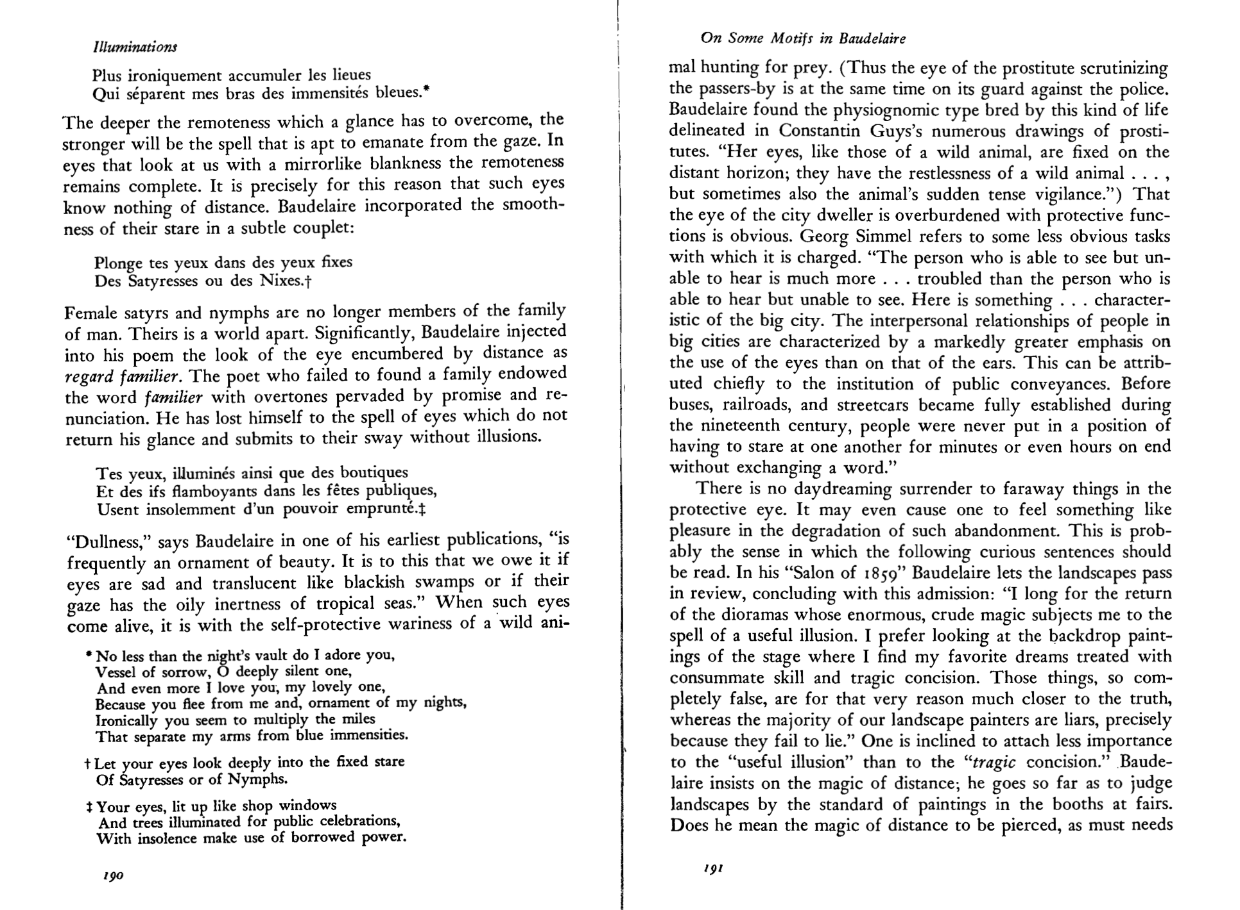

Slide 14
What is that sound high in the air
Murmur of maternal lamentation
Who are those hooded hordes swarming
Over endless plains, stumbling in cracked earth
Ringed by the flat horizon only
What is the city over the mountains
Cracks and reforms and bursts in the violet air
Falling towers
Jerusalem Athens Alexandria
Vienna London
Unreal

