Slide 1
EN107: WEEK SEVEN
Jellicoe, “sport of my mad mother”

Slide 2
Notes on essay-writing

Slide 3
Some words about formatting

Slide 4
How to cite a play: in-text
Play titles are given in italics:
In the first act of The Sport of My Mad Mother, a character uses the drums.
(N.b. the rule is this: if a piece is a standalone work, it gets italics; if part of a larger work, it gets put in quotes)
So:
In “Mad Mothers?,” his article about The Sport of My Mad Mother, Stenwick argues…

Slide 5
Bibliographic formats
A necessary part of academic writing
I am giving you a guide to MLA format—this is the format required for this class.
Note that other classes will require different formats—check with your faculty member
However, all academic work must follow some bibliographic format
Turn with me please to the handout…

Slide 6
Some notes about writing

Slide 7
Keywords
Abstractions in thesis must be defined: polyvalent terms must be given local meaning
E.g. "What do you mean by 'politics'?
Also, for close reading paper: abstractions as way in to clusters of particular words, which are then close-read

Slide 8
Notes on the close-reading essay
Rough, unscientific rule: in body paragraphs, do not let two sentences go by without citation
Also, at least once per paragraph, have two sentences refer to same citation--double back to discuss elements of this citation further
These rules are optional, but will help you

Slide 9
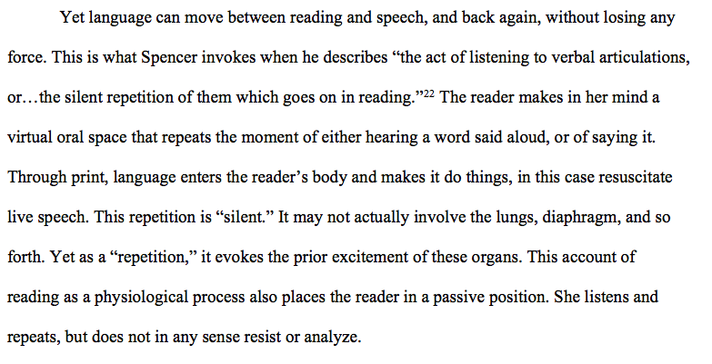
Explains the word

Slide 10
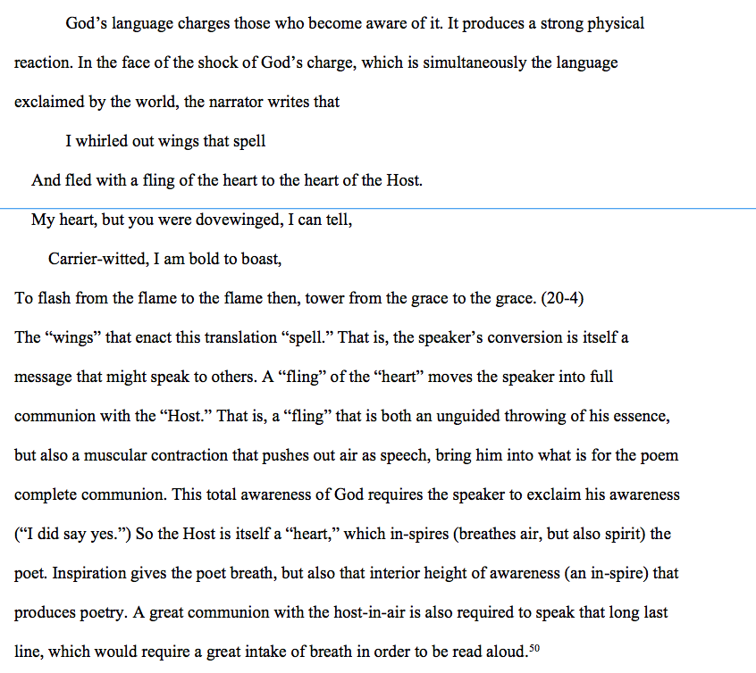
“fling”: goes over word again

Slide 11
What to close read
I would particularly suggest stage directions--how in particular do these address issues of class?
I would suggest ignoring prefaces and other elements included with the play--they will distract from your reading of the play itself, which is paramount
Recommended outline exercise: link each abstraction in thesis to five words/short passages from plays, and then write 2-3 sentences for each one of these words/short passages

Slide 12
Practical writing
If one of your peers has not commented carefully on your writing, followed by your implementation of these comments, your writing is incomplete--find networks for commenting
Write a basic first introduction, then delete it when your revise--do this automatically
Email in advance, then attend faculty office hours--bring completed paragraphs, ideally

Slide 13
The sport of my mad mother

Slide 14
Decisions in performance
Does the play limit what actors, producers, set designers, etc. do in performance?
Conversely: when does it allow actors to make decisions—when does it leave things undefined?
  Consider in effect a power relation—sometimes producers are given more freedom, sometimes not
  Extremes: 1992, 2006, Beckett estate sues all-female Waiting for Godot

Slide 15
Sound, “nonsense”
How does a playscript describe sound?
  Are we, say, referred to a particular recording? To sheet music?
  Are we allowed to imagine it for ourselves?
  Each one of these choices addresses the audience differently
How do we make sense of dialogue that does not resolve itself easily into sense?
  What patterns can we find? What sense can we make?
  What are the characters trying to do with dialogue, if not make sense to each other?
    Are breakdowns in communication—or communication of some sort—present?

Slide 16
Layers of reading in the “experimental play”
I refer you to our first PowerPoint
Which elements of more traditional plays are present here? Which are not?

Slide 17
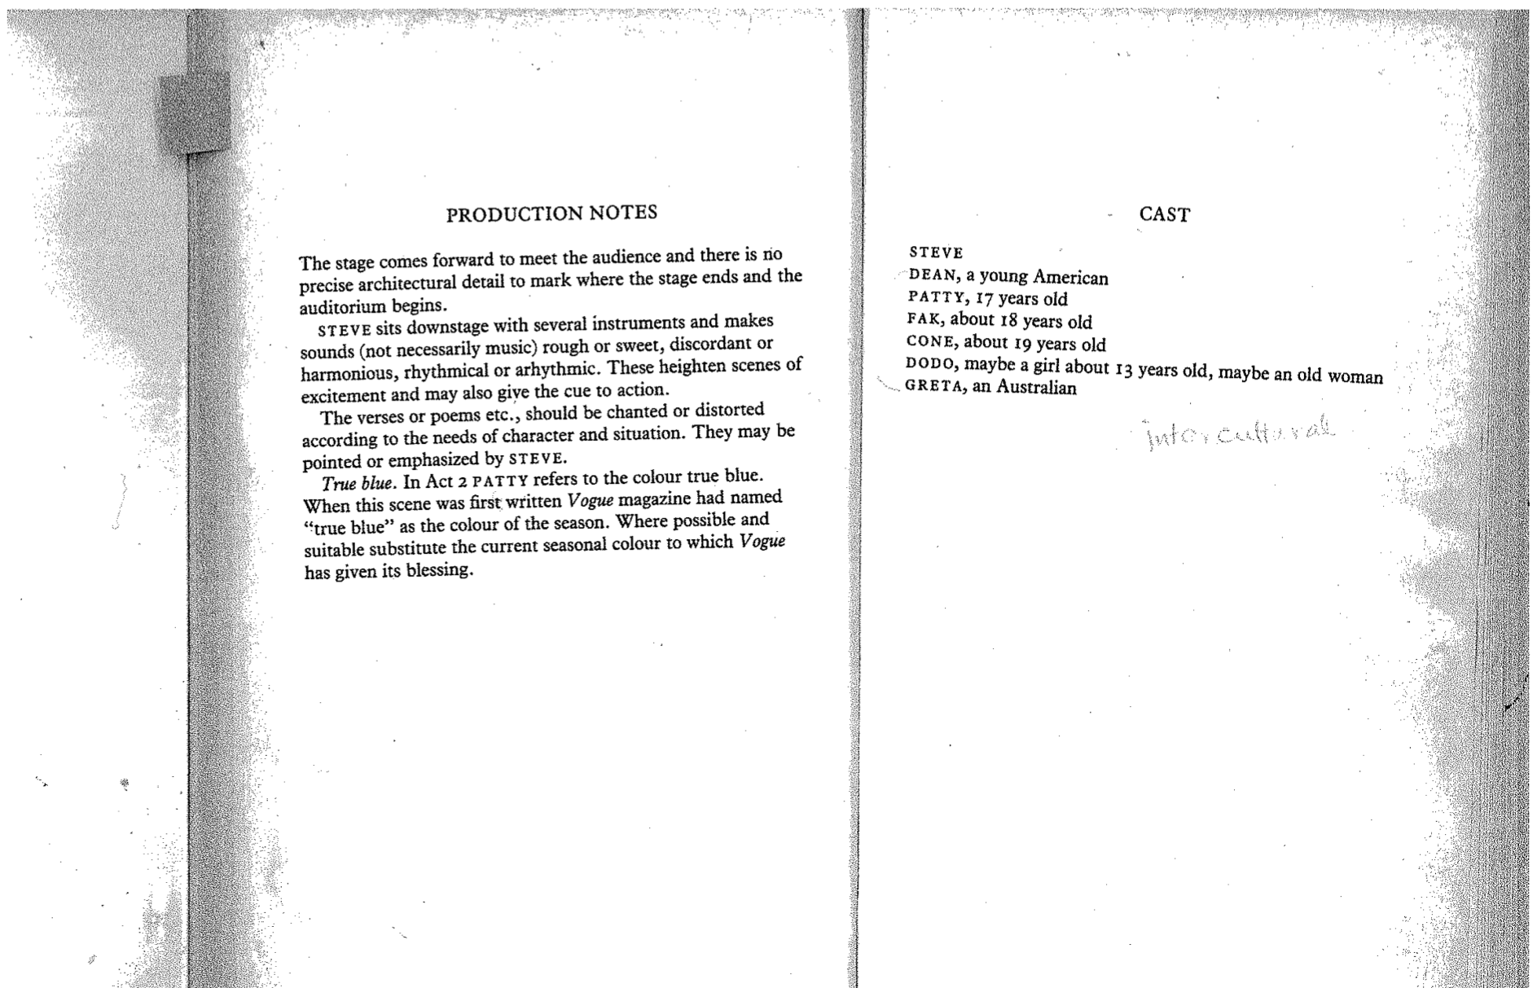

Slide 18
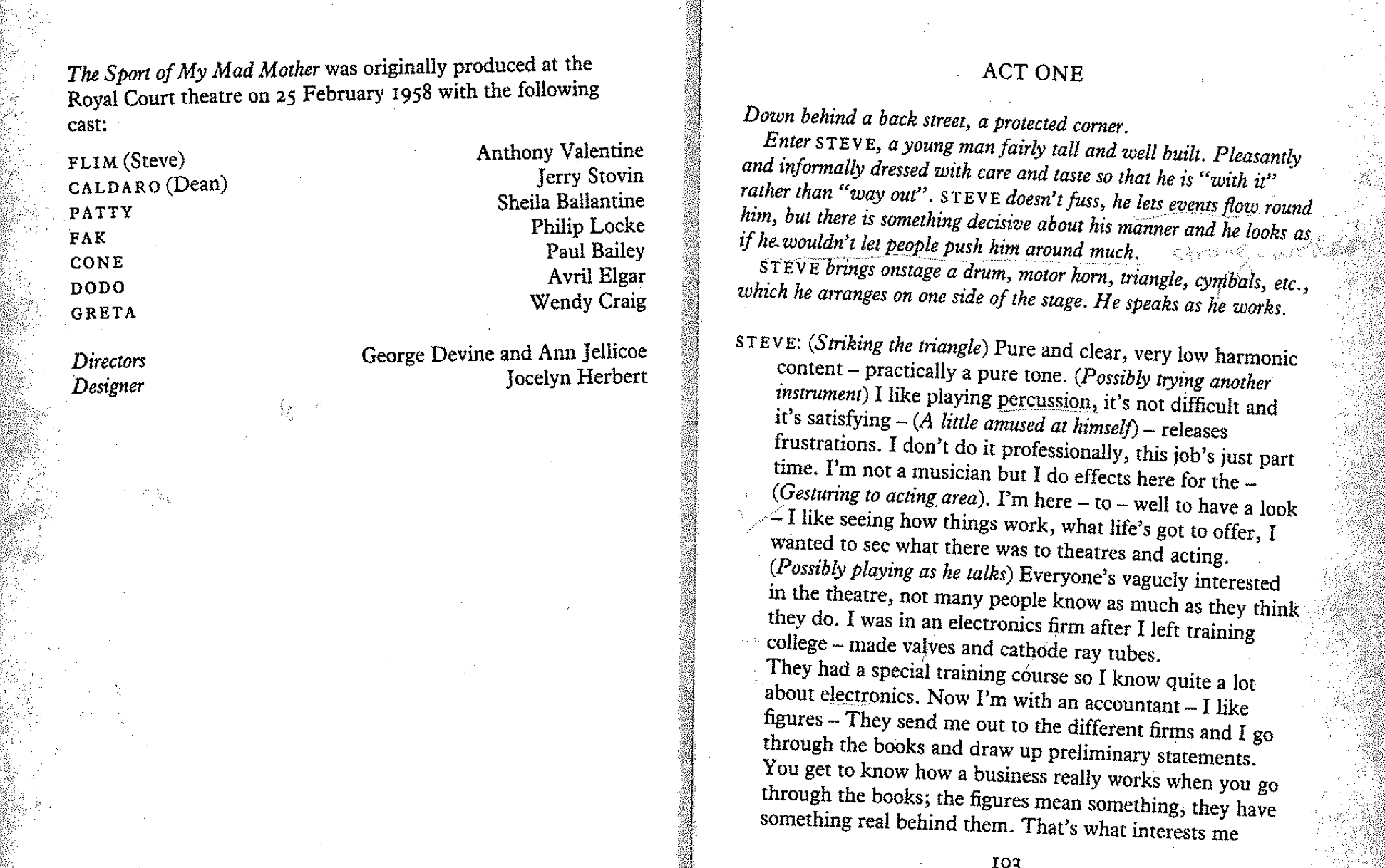

Slide 19
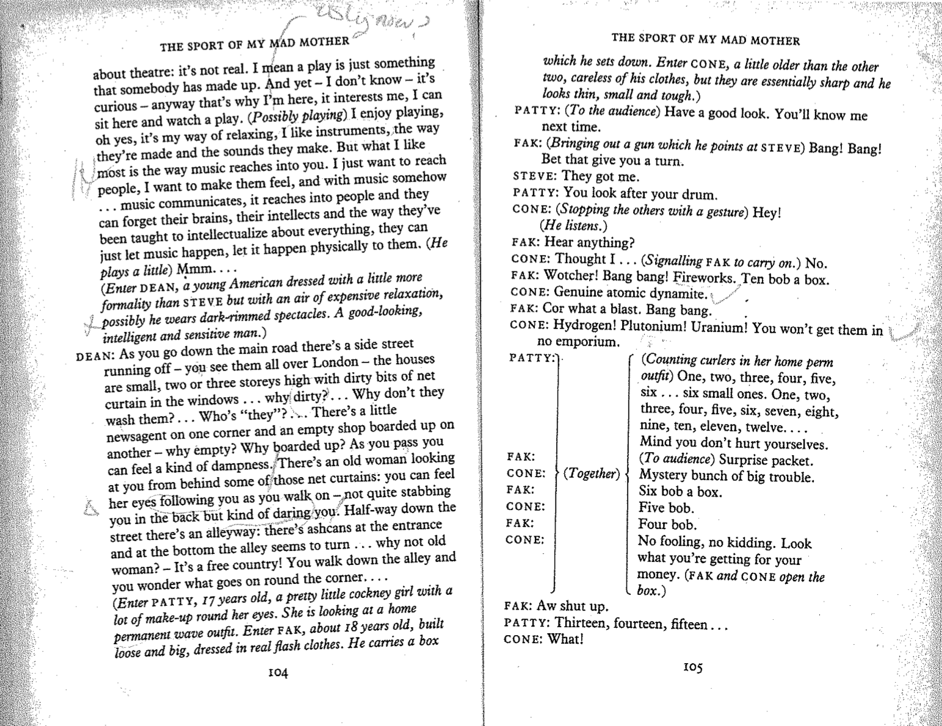

Slide 20
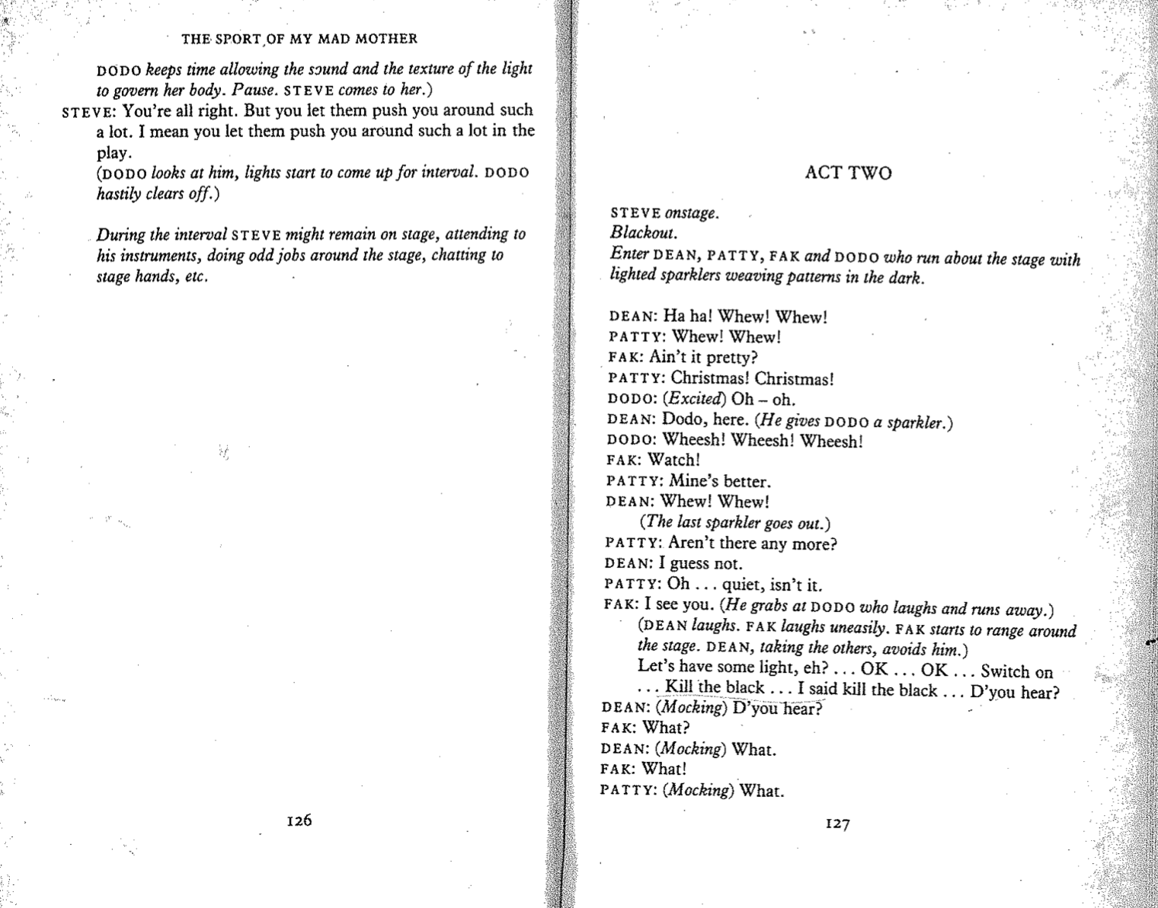

Slide 21
