Slide 1
EN122 Modes of Reading
2016-17
Derrida: the (Impure) Logic of Spectres in the Present
‘One question is who is responsible? Another is can you read?'

Slide 2
“Ah, reason, seriousness, mastery over emotions, the whole gloomy business called reflection, all these privileges and ceremonies of human beings – how expensive they were! How much blood and horror is at the bottom of all ‘good things’.” (Nietzsche ZGdM 2.3)

Slide 3
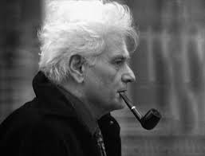

Slide 4
Jacques Derrida (1930-2004)
Philosopher
b. Argelia
Leading French intellectual
Radical questioning of Western philosophical tradition
Deconstruction
1967

Slide 5
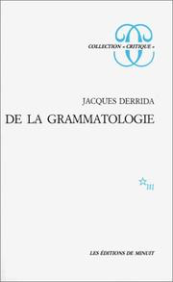

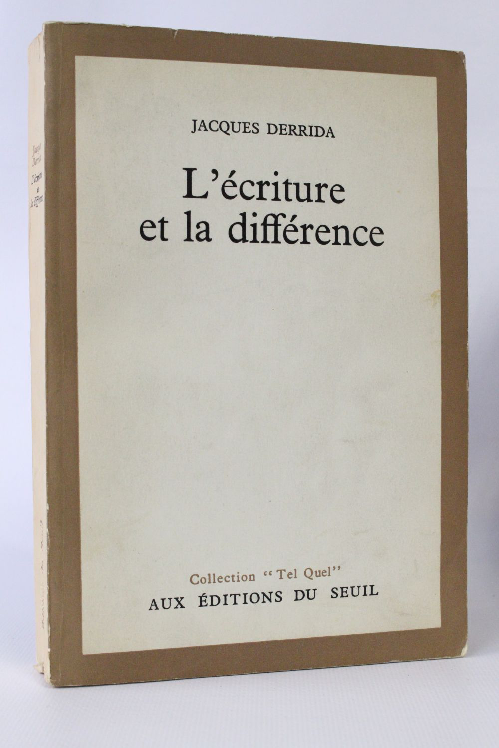

Slide 6
Subverting western metaphysics
Radical questioning of key concepts and their application
Politics and ethics
Influence for literary studies
Poststructuralism
Deconstruction

Slide 8
Destruction
Deconstruction
Said’s contrapuntal reading
Deconstruction not just interpretation
Deconstruction and the dialectic
Focus on difference and repetition
Nietzsche, Heidegger, Husserl …

Slide 9
The question of the political/ethical
Derrida and politics
  Algiers
  Death of Paul De Man (1963)
  Spectres of Marx (1993)
  New conception of Europe

Slide 10


Slide 12
Doubles
Repetition with a difference
On the impure
On the ghost

Slide 15
Hauntology
Question of presence and absence
Revenant
Time out of joint
Reading Marx
Reading Hamlet
Reading A Mercy

Slide 16
Reading Marx
Reading Max Stirner (1806-1856)
(impure “impure impure history of ghosts”)

Slide 18
Notes:
“Ghost Dance” 1983. Director Ken McCullen
Interviewer Pascale Ogier (1958-1984)

Slide 19
A Mercy as a Haunted and Haunting Text
Legacy of the Past – violence, cruelty, slavery
Absences
Florens as a Revenant (as Beloved)

