Slide 1
EN122 Modes of Reading
2016-2017
Introduction

Slide 2
Aims and structure
Lectures and seminars
Optional Extra Lectures on Critical Theory by Prof Docherty Mondays 12-13 Arts Butterworth
Academic Writing Sessions coordinated by Dr Rochelle Sibley
Assessments: formative and assessed essays

Slide 3
Why theory matters

Slide 4


Slide 5
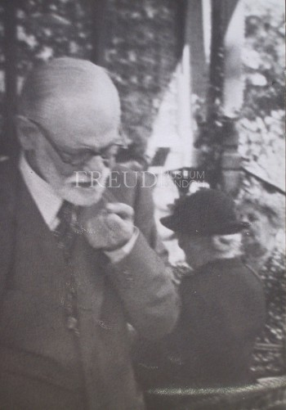

Slide 6
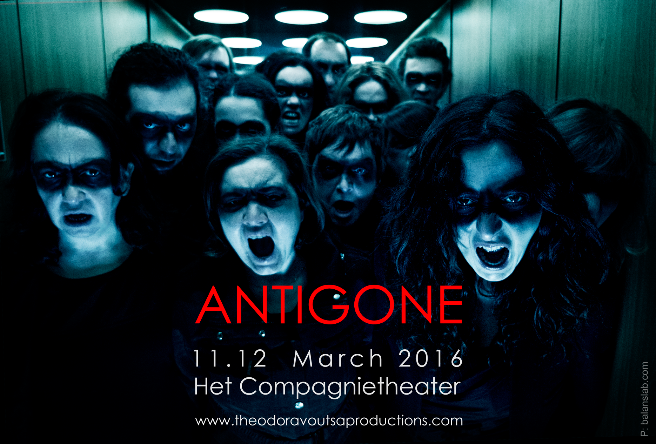

Slide 10
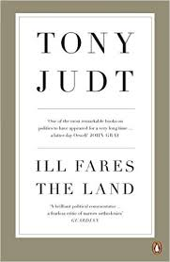

Slide 12
This leads me to the last part of your question: "Is it necessary to
make a distinction between literature and literary criticism here?" I'm
not sure. What has just been said can have to do with both of them.
I don't feel at ease either with a rigorous distinction between "literature"
and "literary criticism" or with a confusion of the two. What
would the rigorous limit between them be? "Good" literary criticism,
the only worthwhile kind, implies an act, a literary signature or counter-
signature, an inventive experience of language, in language, an inscription
of the act of reading in the field of the text that is read. This
text never lets itself be completely "objectified." Yet I would not say
that we can mix everything up and give up the distinctions between all
these types of "literary" or "critical" production (for there is also a
"critical" instance at work "in" what is called the literary work).
"THIS STRANGE INSTITUTION CALLED LITERATURE” AN INTERVIEW WITH JACQUES DERRIDA 1989.

Slide 13
The rise of literary studies
The New Criticism
Intentional Fallacies, Death of the Author
Structuralism
Feminist Theories
Poststructuralism
Postcolonial Theory
Cultural Criticisms
Post-theory, no theory at all
Why theory matters

Slide 14
If the humanities has a future as cultural criticism, and cultural criticism has a task at the present moment, it is no doubt to return us to the human where we do not expect to find it, in its frailty and at the limits of its capacity to make sense.
Judith Butler. Precarious Life. 2004.

