Slide 1
EN122 Modes of Reading
2018-2019
'One question is who is responsible? Another is can you read?'

Slide 2


Slide 3
Cruel to be kin(d)
Hamlet, Act III, Scene 4

Slide 4
Lecture 1
'One question is who is responsible? Another is can you read?'
Responsibility, Representation, Resistance
Mercy and Cruelty
Kinship and Community
Personal and Collective Memory

Slide 5
Lecture 2
Edward Said and the Hauntings of the Past
Decolonizing the Mind
Christina Sharpe and the Hauntings of the Present
In the Wake: Blackness and Being

Slide 6
Lecture 3
Judith Butler
Responsibility and Precariousness

Slide 7
Lecture 4
Jacques Derrida
Impure Ghosts

Slide 8

Toni Morrison
Tim Knox, 2016

Slide 9
Novels
The Bluest Eye. 1970. Sula. 1973.
Song of Solomon. 1977.
Tar Baby. 1981. Beloved. 1987. Jazz. 1992.
Paradise. 1997.
Love. 2003. A Mercy. 2008. Home. 2012.
God Help the Child. 2015.
https://www.youtube.com/watch?v=Q5D5PLI7kvc

Slide 10
In the beginning

Slide 11
Mercy and Cruelty
Vice and Virtue

Slide 12
Novel and Politics

Slide 13
Novel and Politics
Slavery

Slide 15
Novel and Politics
Slavery
Racism (gender and class)

Slide 17


Slide 18
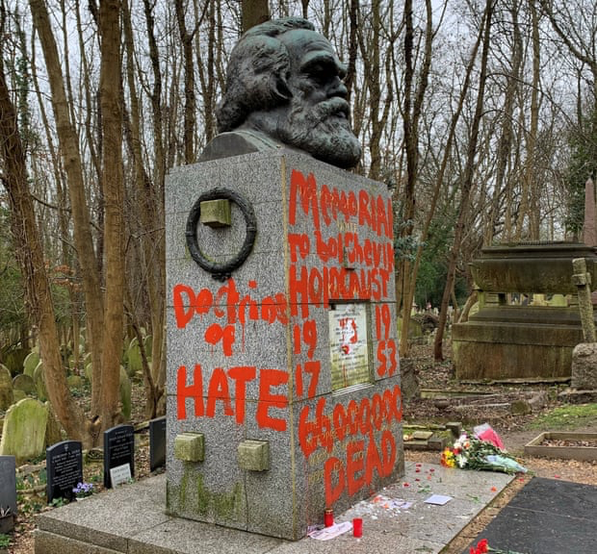


Slide 19
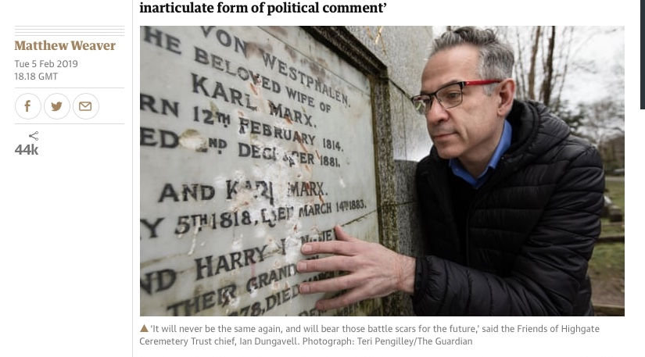

Slide 22
Novel and Politics
Slavery
Racism (gender and class)
Alternative Forms of Community

Slide 23
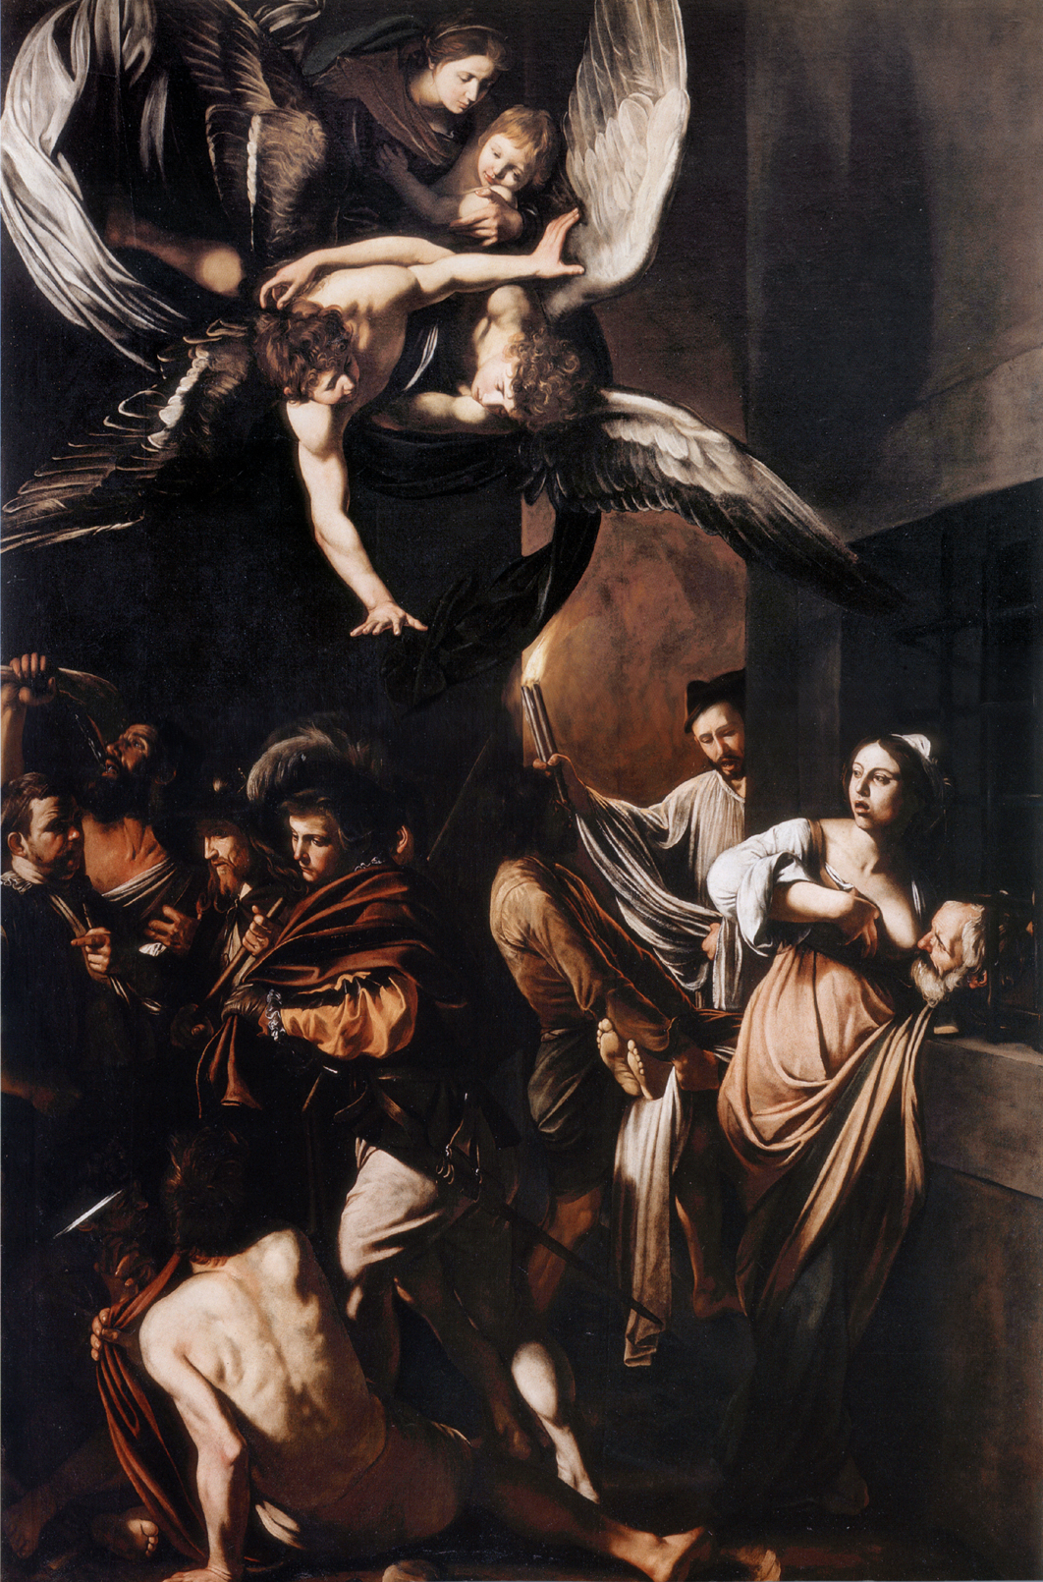

Slide 27


Slide 29
Florens
Jacob Vaark
Florens
Lina
Florens
Rebekka Vaark
Florens
Sorrow
Florens
Scully and Willard (& Jacob’s Ghost)
Florens
Mãe

Slide 30
One chance, I thought. There is no protection but there is difference. You stood there in those shoes and the tall man laughed and said he would take me to close the debt. I knew Senhor would not allow it. I said you. Take you, my daughter. Because I saw the tall man see you as a human child, not pieces of eight. I knelt before him. Hoping for a miracle. He said yes.
It was not a miracle. Bestowed by God. It was a mercy. Offered by a human. I stayed on my knees. (…)

Slide 31
(…) In the dust where my heart will remain each night and every day until you understand what I know and long to tell you: to be given dominion over another is a hard thing; to wrest dominion over another is a wrong thing; to give dominion of yourself to another is a wicked thing.

