Slide 1
Baudelaire and Rimbaud:
From modernity to modernism
Modernity, Capital, Empire

Slide 2
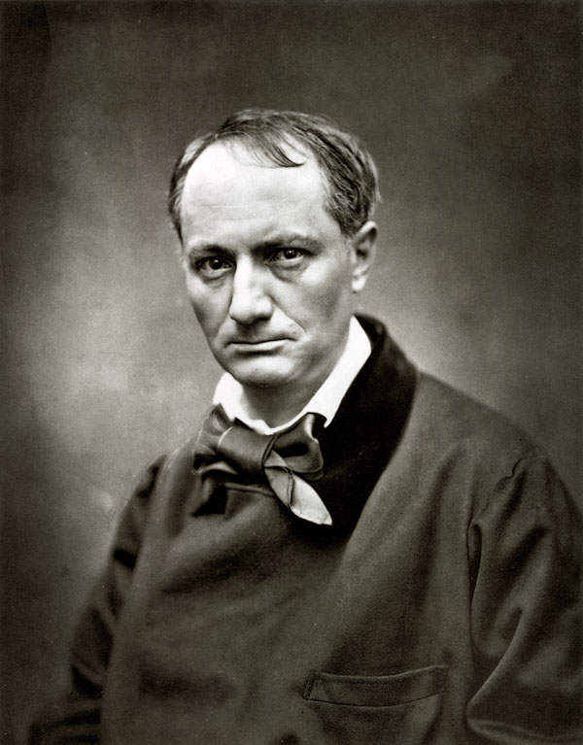
“You give us a new kind of shudder”
(Letter from Victor Hugo to Baudelaire, 6 Oct. 1859)

Slide 3
Two attitudes to modernité
Celebratory, idealist (“The Painter of Modern Life”)
Bitter, melancholic (Paris Spleen, “The Swan”)

Slide 4
The heroism of modern life
“No one is cocking his ear to tomorrow’s wind; and yet the heroism of modern life surrounds and presses upon us.” (“Salon of 1845”)
“Parisian life is rich in poetic, marvelous subjects. We are surrounded by the marvelous, which sustains us like air itself, but which we do not perceive.”
(“Salon of 1846”)
“For most of us, especially for businessmen … the fantastic reality of life becomes strangely blunted.”
(“The Painter of Modern Life”)

Slide 5
“You are the majority, in number and intelligence; therefore you are power; and power is justice. … You can live three days without bread; without poetry, never …
“You have entered into partnership, formed companies, issued loans, to realize the idea of the future in all its diverse forms, political, industrial, and artistic forms …
“For to allow oneself to be forestalled in art and politics is to commit suicide, and a majority cannot commit suicide.
“… And so it is to you, the middle class, that this book is naturally dedicated” (Baudelaire, “The Salon of 1846: To the Middle Class”)

Slide 6
The flâneur
“The crowd is his domain, just as the air is the bird’s, and water that of the fish. His passion and his profession are to merge with [épouser] the crowd. For the perfect idler [flâneur], for the passionate observer it becomes an immense source of enjoyment to establish his dwelling in the throng, in the ebb and flow, the bustle, the fleeting and the infinite. … [He]is an ego athirst for the non-ego.” (“The Painter of Modern Life,” 399-400)
Notes:
Note how CB genders the relation between flâneur and crowd (‘his passion [is to] marry the crowd’

Slide 7
“The proliferation of public places of pleasure and interest created a new kind of public person with the leisure to wander, watch and browse: the flâneur, a key figure in the critical literature of modernity and urbanization. In literature, the flâneur was represented as an archetypal occupant and observer of the public sphere in the rapidly changing and growing great cities of nineteenth-century Europe.” (Elizabeth Wilson)

Slide 8
The dandy
“Dandyism appears especially in the periods of transition when democracy has not yet become all-powerful, and when the aristocracy is only partially weakened and discredited. In the confusion of such times, a certain number of men, disenchanted and leisured ‘outsiders,’ … may conceive the idea of establishing a new kind of aristocracy.”
(“The Painter of Modern Life,” 421)

Slide 9
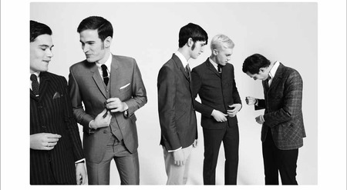
1960s Mods – working class dandies

Slide 10
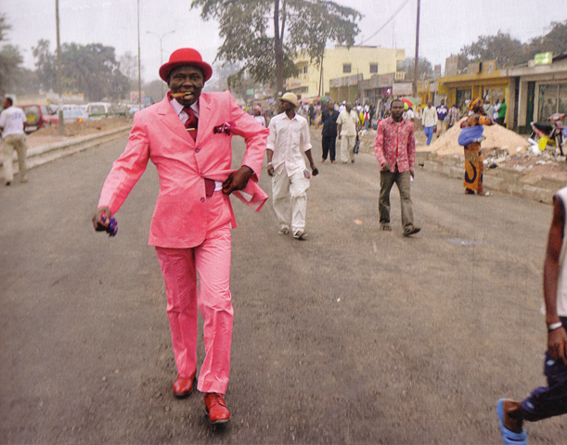
The sapeurs of Brazzaville, Congo

Slide 11
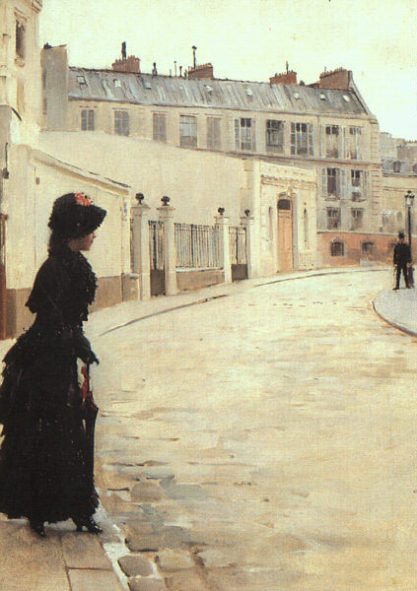
Jean Béraud, L’attente
Jean Béraud, L’attente [Waiting] (1880)

Slide 12
The task of the modern artist
“[T]his solitary … always roaming the great desert of men, has a nobler aim than that of the pure idler [flâneur] … He is looking for that indefinable something we may be allowed to call ‘modernity’ … The aim for him is to extract from fashion the poetry that resides in its historical envelope, to distil the eternal from the transitory … Modernity is the transient, the fleeting, the contingent; it is one half of art, the other being the eternal and the immovable” (“The Painter of Modern Life,” 402-403)

Slide 13
“The bourgeoisie has stripped of its halo every occupation hitherto honoured and looked up to with reverent awe. It has converted the physician, the lawyer, the priest, the poet, the man of science, into its paid wage labourers.
“The bourgeoisie has torn away from the family its sentimental veil, and has reduced the family relation to a mere money relation.
“[The bourgeoisie] has accomplished wonders far surpassing Egyptian pyramids, Roman aqueducts, and Gothic cathedrals; it has conducted expeditions that put in the shade all former Exoduses of nations and crusades.”
(Marx and Engels, The Communist Manifesto, 1848)

Slide 14
Lost Halo
“As I was crossing the road just now as fast as my legs would carry me, hopping through the mud and the chaos of traffic with death hurtling at me from every direction at once, some sharp movement of mine made my halo fall off my head and roll in the mire of the macadam. … Now I can go around incognito, do all sorts of bad stuff, mix with the low life, the way ordinary people do.” (“Lost Halo,” Petits Poèmes en Prose)

Slide 15
“So you want to know why I hate you today?”
(“The Eyes of the Poor,” Petits Poèmes en Prose)

Slide 16
Bash the Poor!
“So I hurled myself on my beggar … With a single punch I blacked one of his eyes, which swelled like a balloon … I seized him by the collar with one hand and caught him by the throat with the other, then starting [smashing] his head vigorously against the wall.” (“Bash the Poor!” Petits Poèmes en Prose)

Slide 17
Le cygne (The Swan)
Andromache, I think of you This rivulet
Poor sad mirror where glittered once
The immense majesty of your widow’s grief
This lying Simoeis swollen with your tears
Suddenly made pregnant my fertile memory
As I was crossing the new Place du Carrousel.
The old Paris is no more (a city’s shell
Changes faster alas than human hearts)
I see only the ghost of former barracks
These heaps of rough capitals and market-stalls
Weeds stone blocks greened by stagnant wet
And bright on tiles the jumbled bric-à-brac.

Slide 18
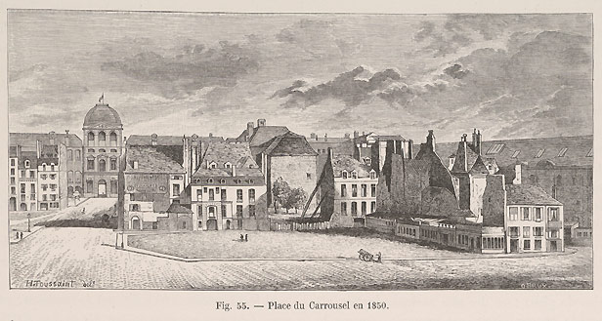
The old Place du Carrousel

Slide 19
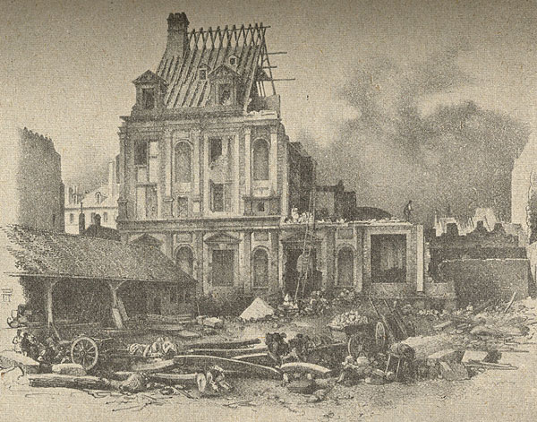
Baron von Hausmann’s excavations of the Place du Carrousel, 1850s

Slide 20
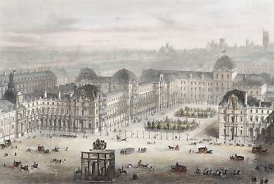
“the new Place du Carrousel”

Slide 21
A century of class struggle in France
Revolution of 1789 (‘the Great Revolution’)
Revolution of 1830 (‘the July Revolution’)
Revolutions of 1848 (February and June)
Louis Napoleon and the Second Empire (1851-1870)
The Paris Commune (1871)

Slide 22
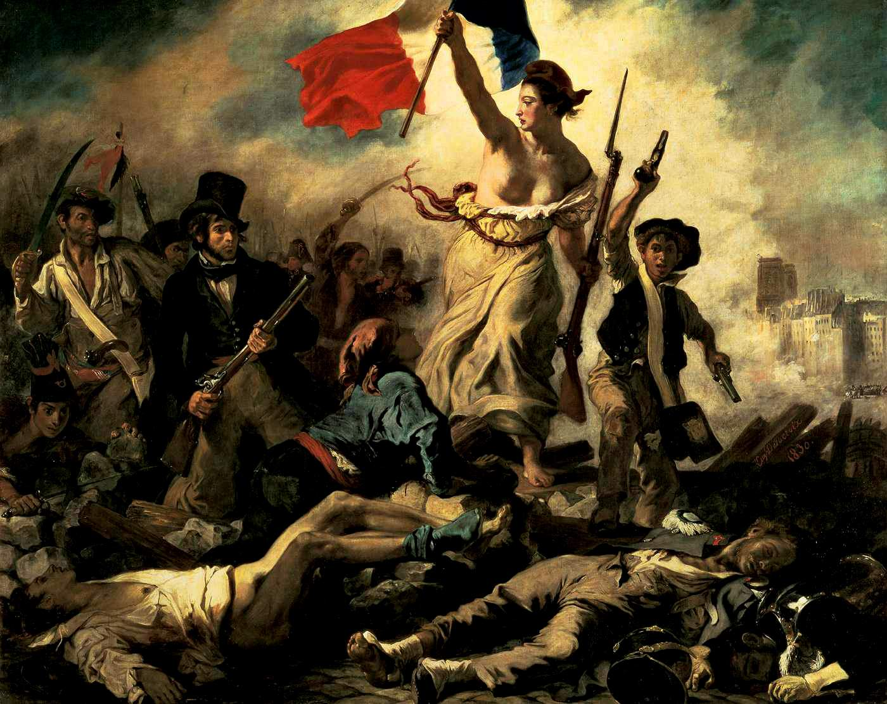
Eugène Delacroix, Liberty Leading the People, 1830

Slide 23
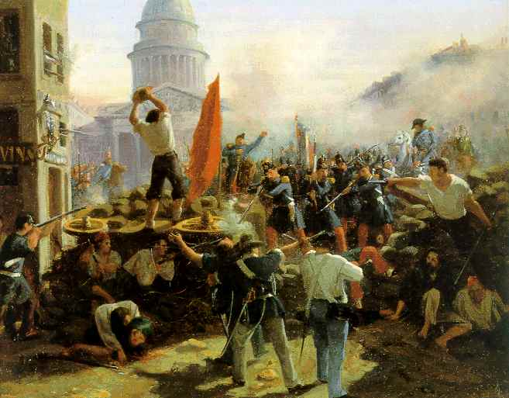
Horace Vernet, Barricade, Rue Soufflot, 1848

Slide 24
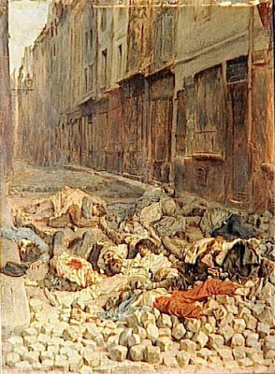
Jean-Louis Ernest Meissonnier, The Barricade,
rue de la Mortellerie, June 1848

Slide 25
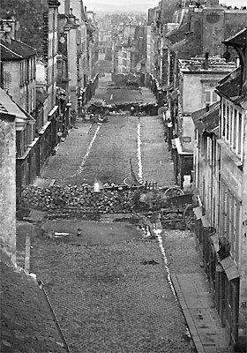
Barricade, Rue St Maur, June 1848

Slide 26
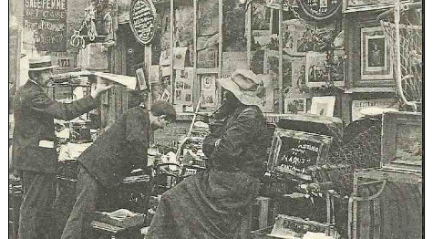
Bric-à-brac sellers, Paris, nineteenth century

Slide 27
II
Paris changes, but nothing in my melancholy
Gives way. New palaces, scaffolds, building blocks,
Old suburbs, everything for me becomes allegory
And my dear memories are heavier than rocks. …
I think of the black woman, skinny and consumptive
Plodding through mud, searching with bleared gaze
For the absent palm trees of her proud Africa
Behind the immense wall of fog and smoky haze;

Slide 28
Of all those who’ve lost what they can’t retrieve –
Never, never! – of those who quench their thirst with tears
And suck at Sorrow as at a she-wolf’s tit;
Of starving orphans withering like flowers;
So in the forest where my mind is exiled
An ancient memory blows its horn;
I think of castaways forgotten on an island;
Of the captured, of the defeated … of many others more.

Slide 29
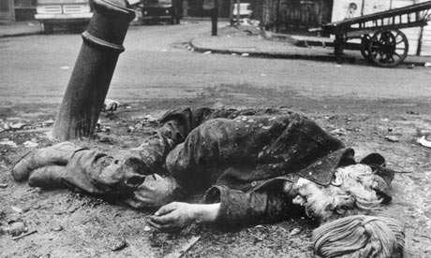
Homeless man, Spitalfields, London (Don McCullin)

Slide 30
Freud on Melancholy
“Mourning is regularly the reaction to the loss of a loved person, or to the loss of some abstraction which has taken the place of one, such as one's country, liberty, an ideal … melancholia is in some way related to an object-loss which is withdrawn from consciousness, in contradistinction to mourning, in which there is nothing about the loss that is unconscious.”
(Sigmund Freud, “Mourning and Melancholia”)

Slide 31
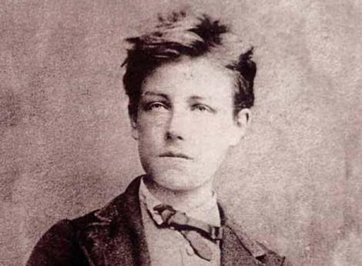
Arthur Rimbaud, 1854-1891

Slide 32
Imperial melancholy
I want none of Europe’s waters unless it be
The cold black puddle where a child, full of sadness,
Squatting, looses a boat as frail
As a moth into the fragrant evening.
(“The Drunken Boat”)

Slide 33
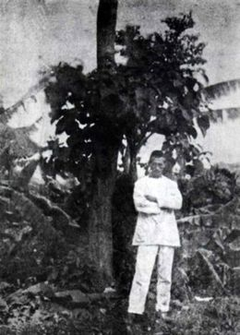
Last known photograph of Rimbaud

