Slide 1
Goethe, Faust Part I
“In the beginning was the deed”

Slide 2
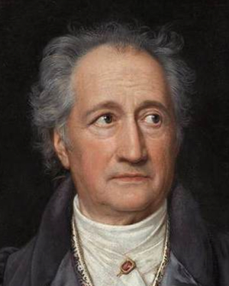
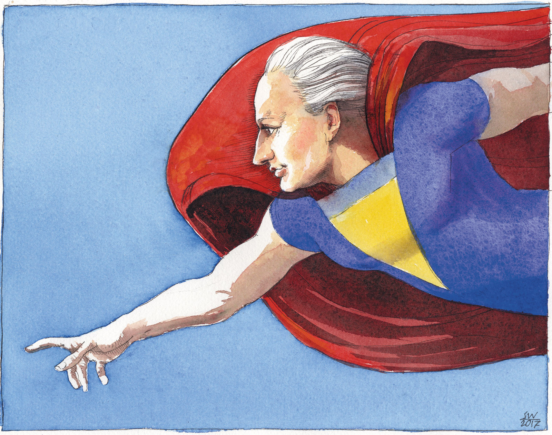
Johann Wolfgang von Goethe
(born Frankfurt, 1749 – died Weimar, 1832)

Slide 3
Why Faust?
WAGNER. Excuse me, but it’s very pleasant
Studying epochs other than the present
Entering their spirit, reading what they say
And seeing how much wiser we have grown today.
(570-574)

Slide 4
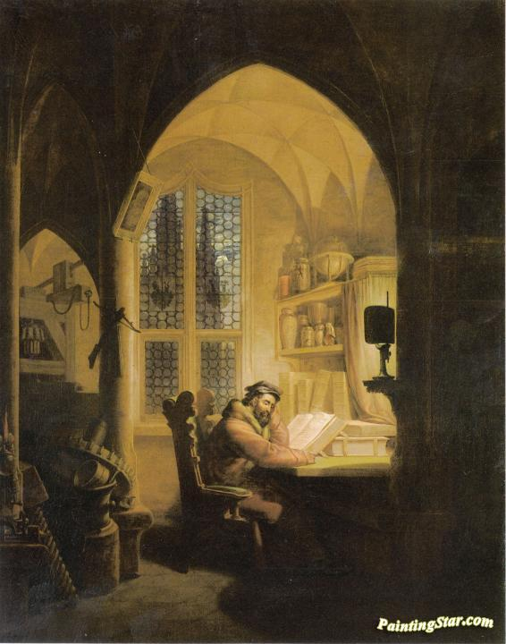

Slide 5
There was a time
Of quiet, solemn sabbaths when heaven’s kiss would fill
Me with its love’s descent, when a bell’s chime
Was deep mysterious music …
As I recall
That childhood, I am moved, my hand is stayed,
I cannot take this last and gravest step of all.
(ll. 770-782)

Slide 6
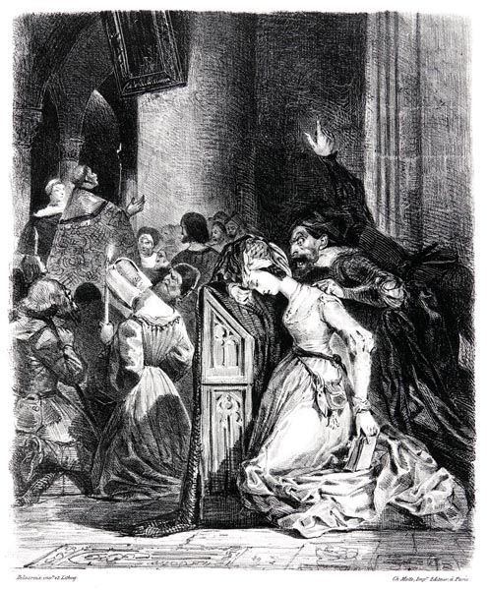

Slide 7
THE EVIL SPIRIT. How different things were for you, Gretchen,
When you were still all innocence,
Approaching that altar …
What are you thinking?
What misdeed burdens your heart now?
GRETCHEN. Oh God! Oh God!
If I could get rid of these thoughts
That move across me and through me,
Against my will!
(ll. 3776-3797)

Slide 8
The dual revolution
Political (the French Revolution of 1789, the Haitian Revolution of 1792-1804)
Economic (the Industrial Revolution originating in Britain during the C18)
… plus
Intellectual (the ‘Enlightenment’)

Slide 9
“The dual revolution was to make European expansion irresistible, though it was also to provide the non-European world with the conditions and the equipment for its eventual counter-attack” (Hobsbawm, The Age of Revolution, 1789-1848 )

Slide 10
Problems in reading Faust as a pioneering work of modernity
Germany in the late C18 was hardly modern
The story is filled with pre-modern materials: folklore, magic, superstition, witchcraft
The play’s archaism goes beyond its content to encompass its form – it can feel deliberately old-fashioned

Slide 11
Some claims
Culture precedes politics (Antonio Gramsci)
Culture isn’t unitary: there are at least three kinds of socio-cultural formation – dominant, residual, emergent (Raymond Williams)
Uneven and combined development of modern literary form: the ‘amalgam of archaic with more contemporary forms’ that is the hallmark of belated and irregularly developing societies

Slide 12
The unevenness of Faust
“[It is] a project which … turned out to be something less than unitary in its conception or homogeneous in its execution.” (David Luke, translator)

Slide 13
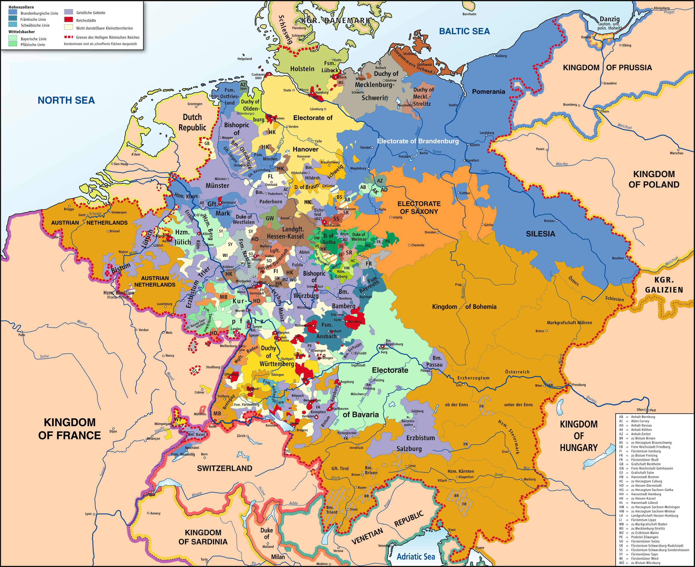
‘Deutschland, wo bist du?’

Slide 14
‘Germany’ in 1789
Regional particularism, lack of national identity
Growth of middle classes and intelligentsia
Development of the Enlightenment project
C18 deference to French neoclassical models of reason, replaced by Stürm und Drang movement (‘storm and stress’) – proto-Romanticism, adoption of Shakespeare as model (cf. Johann Gottfried Herder’s philosophy of cultural nationalism based in language)
Focus of debate: Should Germany modernize politically (as in France), or economically (as in Britain), or both, or neither – should it take its own path?

Slide 15
“Das Drama der Deutschen”
“the drama of the Germans”
and/or ...
- “An Iliad of modern life“ (Pushkin)
- A drama of “the process by which, at the end of the C18 and the start of the C19, a distinctively modern world-system comes into being” (Berman)

Slide 16
Five features of modernity
A break with the past
Time is always ‘out of joint’
Space-time compression
The rise of the ‘everyday’
An experience of fragmentation, displacement and dispersal

Slide 17
Modernity ‘invents’ tradition as its antagonist
Faust as modern subject rejecting traditional ways of learning; embracing instead a quest for experience as the ground of true knowledge
But also: Mephistopheles as ‘ironic’ spirit of modernity, questioning the basis of established values and pursuing an agenda of negation and destruction

Slide 18
Science vs. magic
FIRST YOUNG LADY (of an old woman in Scene 5):
In public I steer clear
Of her; she’s an old witch with second sight.
It’s true that on St Andrew’s night
She caused my future sweetheart to appear.
(876-879)

Slide 19
Out of the mist and murk you rise, who so
Besiege me, and with magic breath restore,
Stirring my soul, lost youth to me once more.
(‘Dedication,’ 6-8)
DIRECTOR. Only the poet’s magic so holds sway
Over them all: make it, my friend, today!
(57-58)

Slide 20
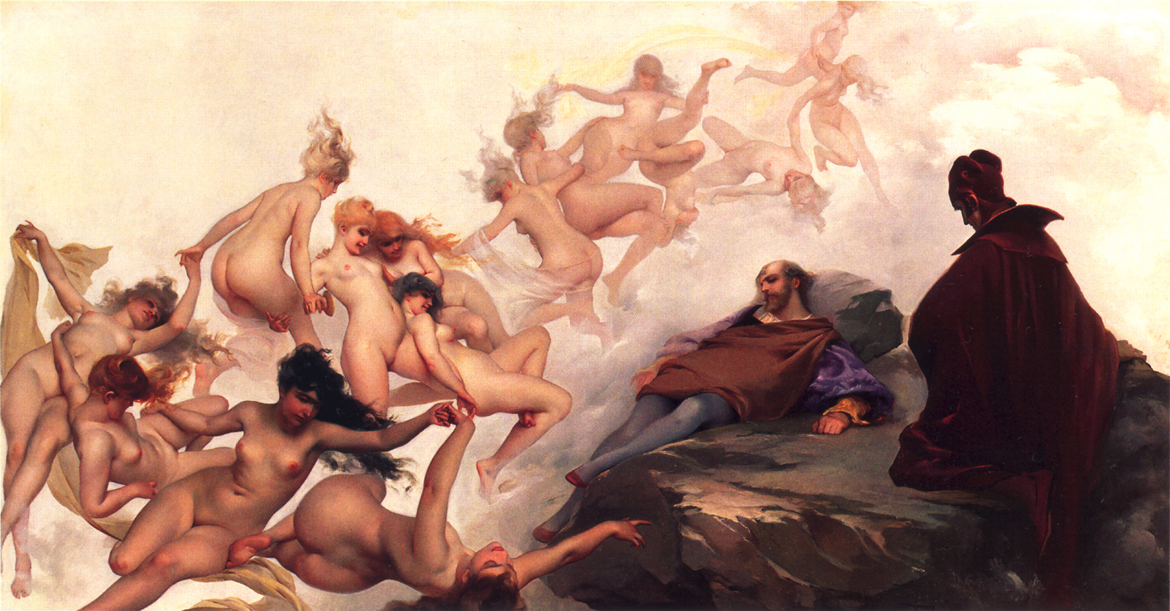
Walpurgisnacht

Slide 21
What does ‘magic’ look like in modernity?
The miraculous advances heralded by new technologies (steam engine, spinning jenny, power loom)
The sudden appearance of wealth in a community, through no apparent cause

Slide 22
Disjointed time/ time-space compression
the time of creative enterprise vs. the time of community-based ritual (religion, gender roles, economic production in service of the status quo)
the play’s own disjointed time sequences, with gaps, reversions, sudden transitions
rapid succession of scenes

Slide 23
Rise of the everyday
It is only through the habit of everyday life that we come to think it perfectly plain and commonplace that a social relation should take on the form of a thing, so that the relation of persons in their work appears in the form of a mutual relation between things, and between things and persons. (Marx, A Contribution to the Critique of Political Economy)

Slide 24
Fragmentation
… let your piece be all in pieces too!
You’ll not go wrong if you compose a stew:
It’s quick to make and easy to present.
Why offer them a whole? They’ll just fragment
It anyway, the public always do. (2: 99-103)

Slide 25
Faust Part I
(1808; written c. 1770-1806)
Faust Part II
(1832; written mainly during the 1820s, Goethe’s final years)

Slide 26
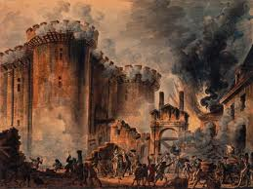

Slide 27
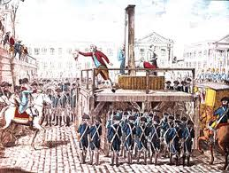

Slide 28
FAUST. Save her! Or woe betide you! …
MEPHISTOPHELES. Save her! – Who was it who ruined her? I or you?
(Scene 26)

Slide 29
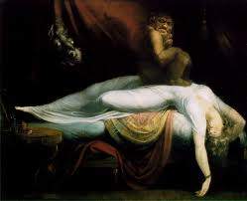
Henry Fuseli, The Nightmare

Slide 30
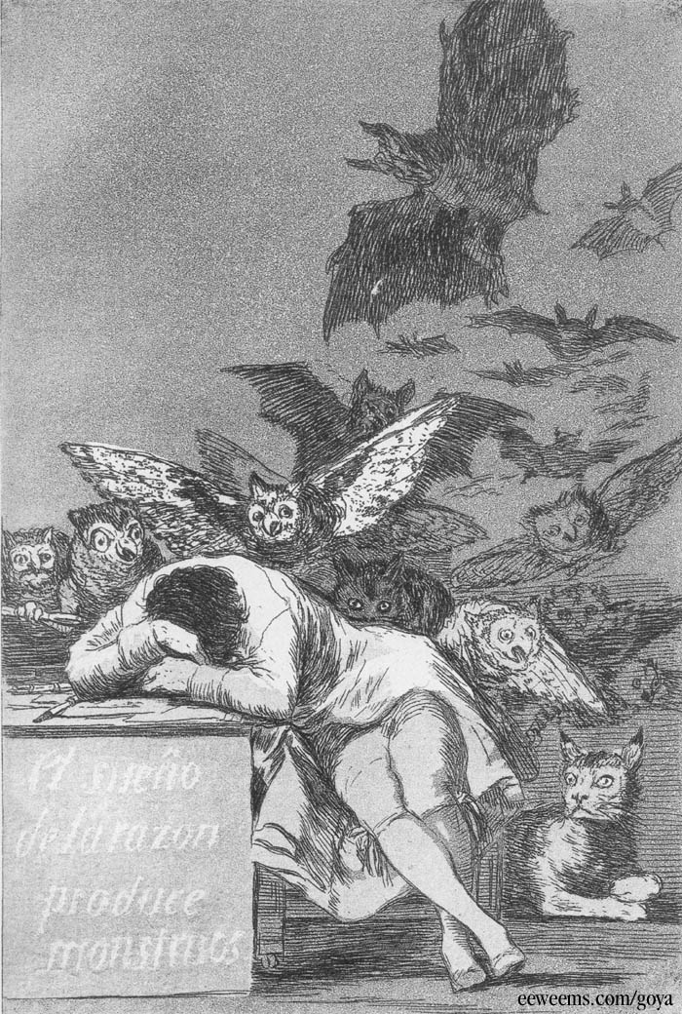
Francisco Goya, The Sleep of Reason Begets Monsters

