Slide 1
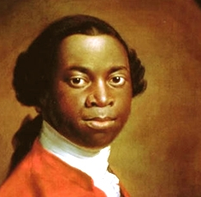
Olaudah Equiano
The Interesting
Narrative of the Life
of Olaudah Equiano
(1789)

Slide 2
A note on terminology:
‘enslaved’ rather than ‘slave’
‘enslaver’ rather than ‘owner/master’
‘indigenous’ or ‘native’ rather than ‘Indian’

Slide 3
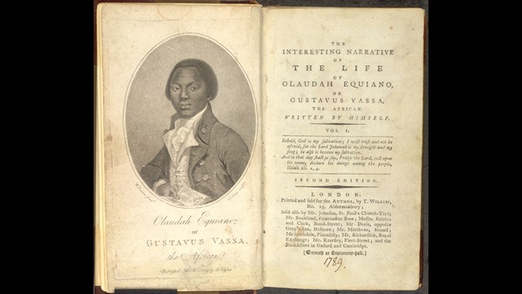

Slide 4
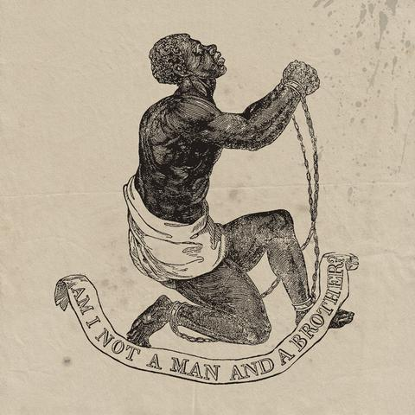
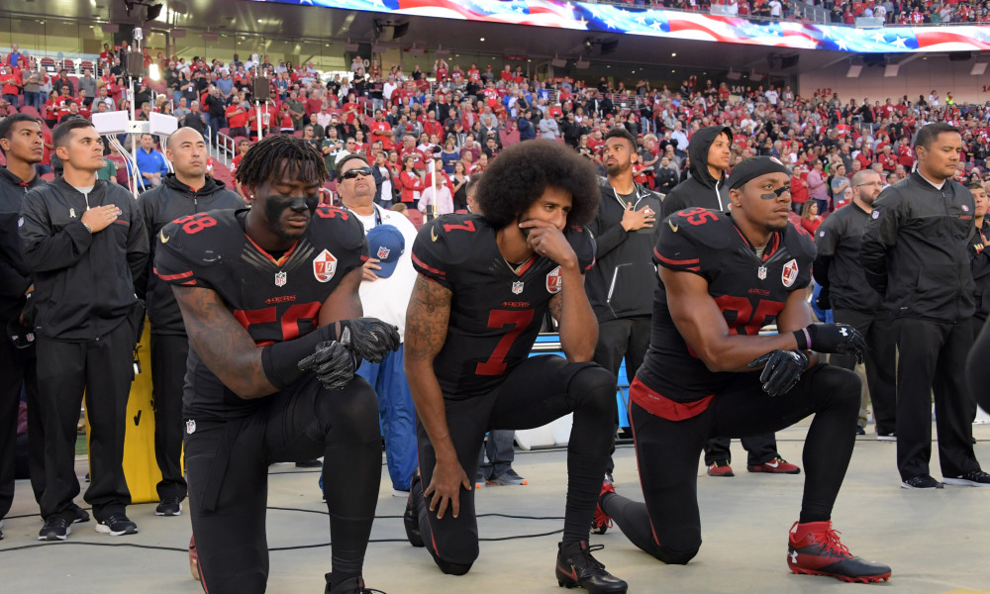
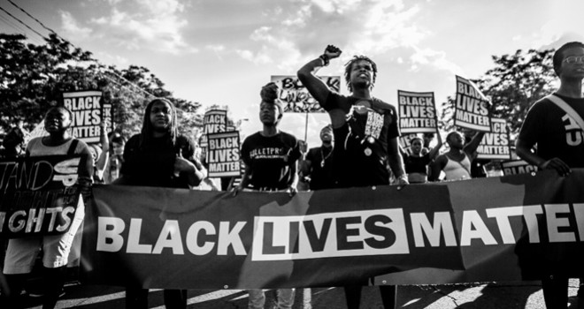


Slide 5
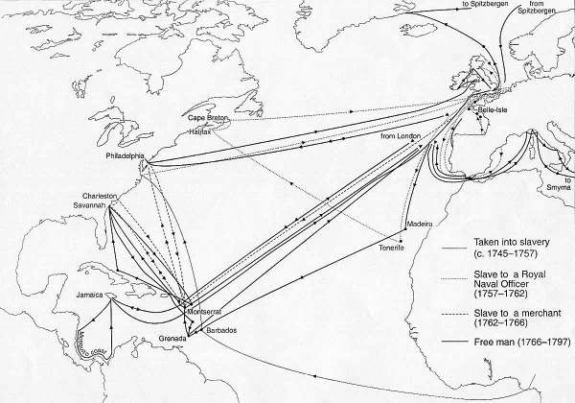
Equiano’s transatlantic travels, 1745-1797

Slide 6
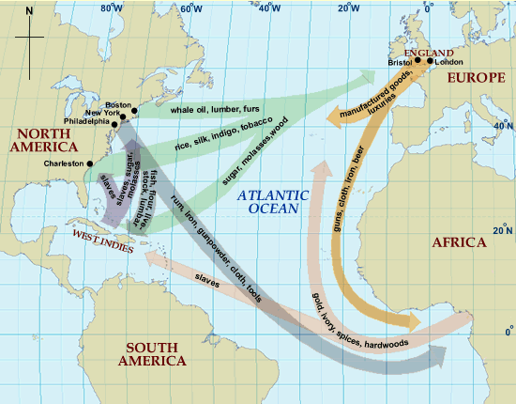

Slide 7
1776: U.S. Declaration of Independence
1789: French Revolution
1789: Equiano, The Interesting Narrrative…
1791: The Haitian Revolution
1791: Thomas Paine, Rights of Man
1791: United States Bill of Rights (first ten principles of the US Constitution)
1792: Mary Wollstonecraft, Vindications of the Rights of Woman

Slide 8
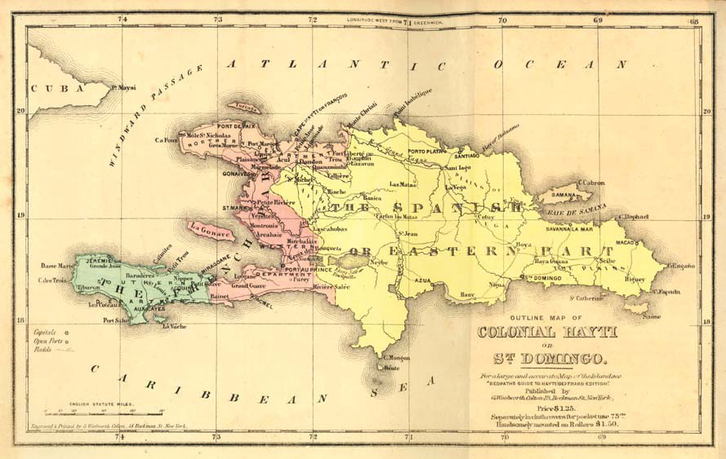
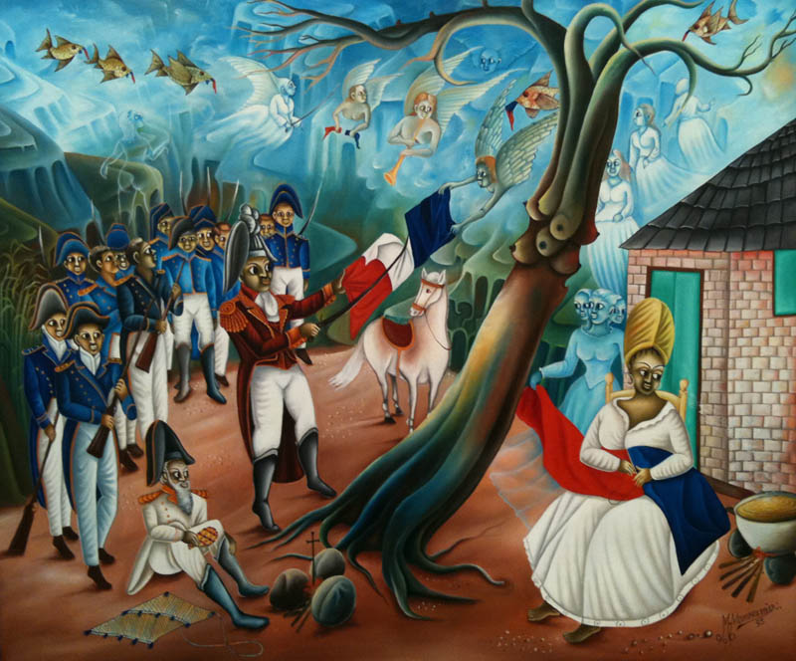
The Haitian Revolution (1791-1804)

Slide 9
The trope of the ‘talking book’:
“I had often seen my master and Dick employed in reading; and had a great curiosity to talk to the book, as I thought they did; and so to learn how all things had a beginning: for that purpose I have often taken up a book, and have talked to it, and then put my ears to it, when alone, in hopes it would answer me; and I have been very much concerned when I found it remained silent.” (83 [Ch. 3])

Slide 10
Henry Louis Gates, The Signifying Monkey:
“[The trope of the Talking Book] also reveals, rather surprisingly, that the curious tension between the black vernacular and the literate white text, between spoken and the written word, between the oral and the printed forms of literary discourse, has been represented and thematised in black letters at least since the slaves and ex-slaves met the challenge of the Enlightenment to their humanity by literally writing themselves into being through carefully crafted representations of themselves in language.” (131)

Slide 11
“I had resolved to keep a journal of this singular and interesting voyage; and I had no other place for this purpose but a little cabin, or the doctor’s store-room, where I slept. This little place was stuffed with all manner of combustibles, particularly with tow and aquafortis, and many other dangerous things. Unfortunately, it happened in the evening, as I was writing my journal, that I had occasion to take the candle out of the lanthorn, and a spark having touched a single thread of the tow, all the rest caught the flame, and immediately the whole was in a blaze. I saw nothing but present death before me, and expected to be the first to perish in the flames.” (189-90 [Ch. 9])

Slide 12
“Our land is uncommonly rich and fruitful, and produces all kinds of vegetables in great abundance. We have plenty of Indian corn, and vast quantities of cotton and tobacco. Our pine apples grow without culture; they are about the size of the largest sugar-loaf, and finely flavoured. We have spices of different kinds [. . .] together with gums of various kinds, and honey in abundance.” (52 [Ch. 2])

Slide 13
“Carretta himself suggests that his possible birth in Carolina rather than Africa in no way diminishes the power of his testimony. Autobiography, after all, is always partly fictional, the narrator excited by storytelling, by shaping and plotting the tale and by dressing up dull facts. Equiano was African in terms of origin, he knew the horrors of the slave trade which by the 1780s were widely broadcast by white abolitionists. What he did was to take it upon himself to write the first substantial account of slavery from an African viewpoint but, as importantly, to write it with pulse and heartbeat, giving passion to the subject so as to arouse sympathy and support for the cause of abolition.” (David Dabydeen)

Slide 14
“The intense social value accorded the autobiographical genre illustrates how liberal emancipation required a literary narrative of the self-authoring autonomous individual to be distilled out of the heteronomous collective subjectivity of colonial slavery. [. . .] Autobiography, a genre of liberal political narrative that affirms individual right, may precisely contribute to the “forgetting” of the collective subject of colonial slavery”
Lisa Lowe, The Intimacies of Four Continents, p. 50

Slide 15
“The first object that engaged my attention was a watch which hung on the chimney, and was going. I was quite surprised at the noise it made and was afraid it might tell the gentleman any thing I might do amiss: and when I immediately after observed a picture hanging in the room which appeared to look at me, I was still more affrightened, having never seen such things before.” (Ch. 3)
“. . . but that there were cloths put upon the masts by the help of ropes I saw, and then the vessel went on. And the white men had some spell or magic they put in the water when they liked in order to stop the vessel. I was exceedingly amazed at this account, and really thought they were spirits.” (72 [Ch. 2])
“As every object was so new to me every thing I saw filled me with surprise.” (75-76 [Ch. 2])

Slide 17
“We then proceeded to the markets to sell [the bags of fruit]. Providence was more favourable to us than we could have expected, for we sold our fruits uncommonly well; I got for mine about thirty-seven bits. Such a surprising reverse of fortune in so short a space of time seemed like a dream, and proved no small encouragement for me to trust the Lord in any situation.” (Ch. 6)

Slide 18
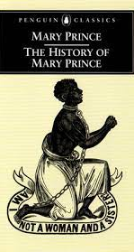
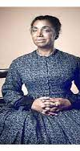
Historical role of white editors and publishers in the production of slave narratives

Slide 19
Angela Davis: “Even while true, literary representations of black women’s bodies as targets of slavery’s most horrific forms of violence might also tend to objectify slave women and discursively deprive them of their capacity to strike out for their own freedom.”
Angela Davis, “Introduction,” in The Narrative of the Life of Frederick Douglass An American, Written by Himself, by Frederick Douglass, ed. by Angela Davis (San Francisco: Open Media Series, 2010), 26.
)

