Slide 1

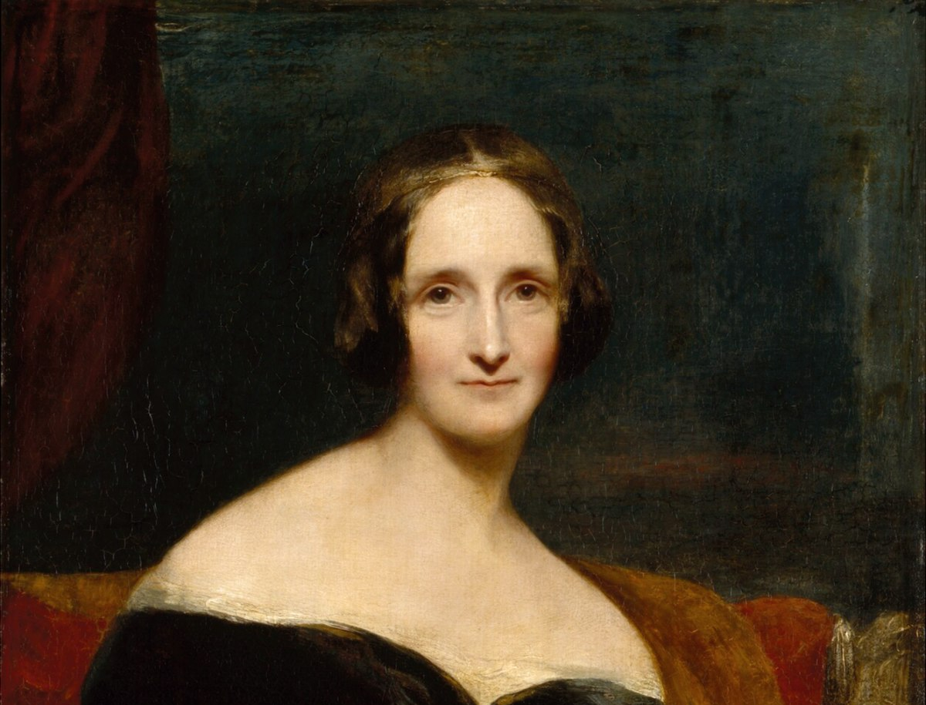
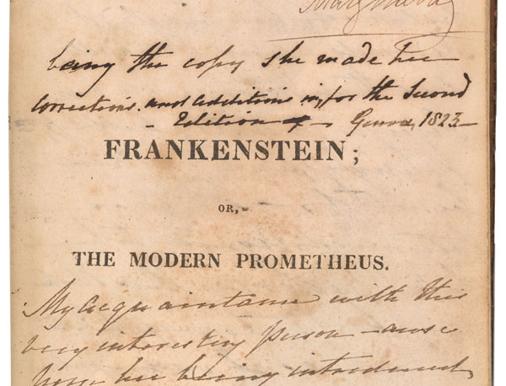
Mary Shelley, Frankenstein (1818)

Slide 2
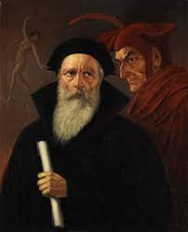
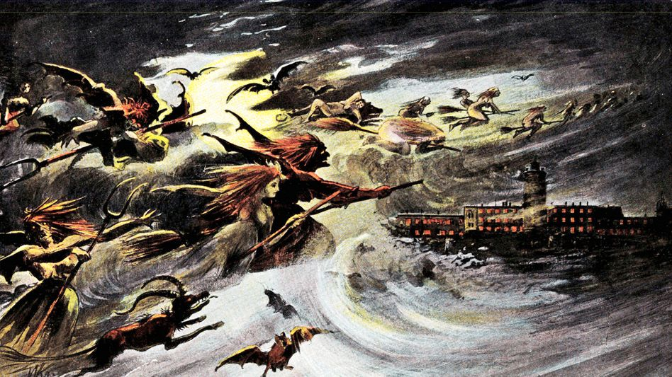

Slide 3
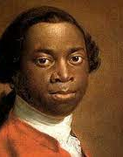
“The first object that engaged my attention was a watch which hung on the chimney, and was going. I was quite surprised at the noise it made and was afraid it might tell the gentleman any thing I might do amiss: and when I immediately after observed a picture hanging in the room which appeared to look at me, I was still more affrightened, having never seen such things before.” (Ch. 3)
“. . . but that there were cloths put upon the masts by the help of ropes I saw, and then the vessel went on. And the white men had some spell or magic they put in the water when they liked in order to stop the vessel. I was exceedingly amazed at this account, and really thought they were spirits.” (72 [Ch. 2])
“As every object was so new to me every thing I saw filled me with surprise.” (75-76 [Ch. 2])

Slide 4
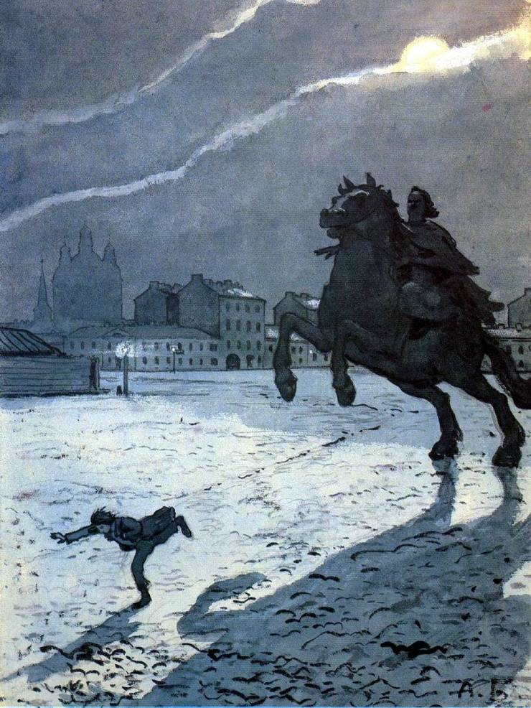

Slide 5
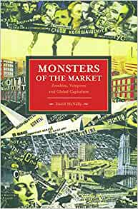
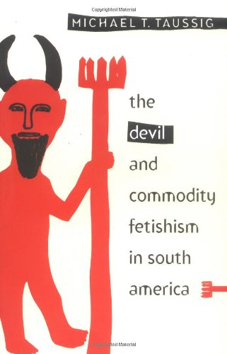

“certain fantastic and magical reactions to our nonfantastic reality” should be viewed as “part of a critique of the modern mode of production” (Taussig, 10).
David McNally: “a whole genre of monster-tales, both past and present, manifest recurrent anxieties about corporeal dismemberment in societies where the commodification of human labour – its purchase and sale on markets – is becoming widespread.” (4)
China Miéville: “The fantastic might be a mode peculiarly resonant with the forms of modernity.”

Slide 6
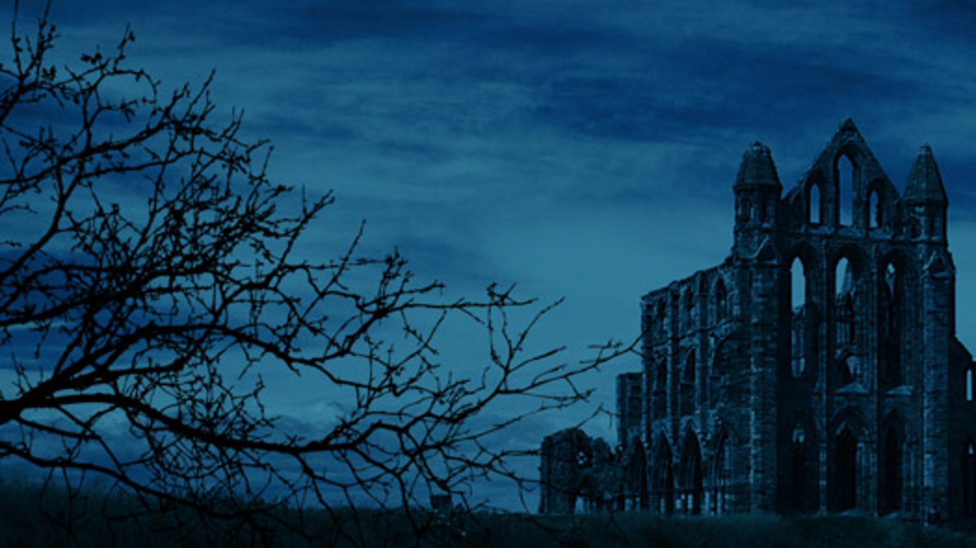
The Gothic and anxieties over…
nonhuman nature / the environment
the ‘monstrous feminine’
class and racial ‘others’

Slide 7
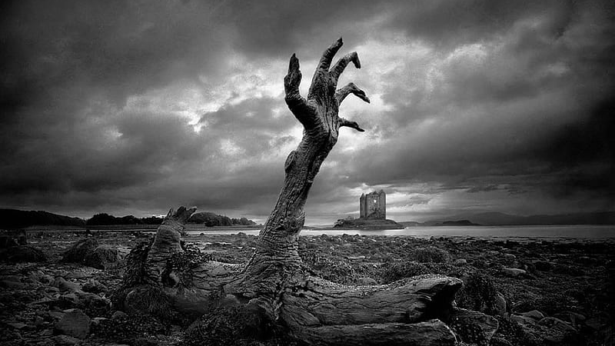
The Gothic and anxieties over
nonhuman nature:
“one might read the ecophobic impulse of the Gothic as itself a Frankensteinian revivification of nature; the Gothic then is that which wants to dwell in a preternatural insecurity about nature’s power.” (Sarah Juliet Lauro (2011), “The Eco-Zombie”, Generation Zombie)

Slide 8
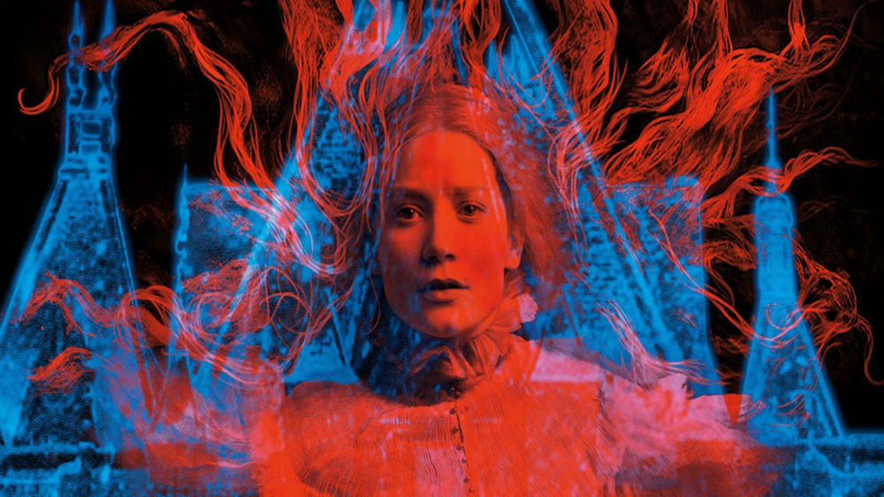
the ‘monstrous feminine’ in Gothic fiction
“female Gothic novelists uncovered the horror of the familiar: the routine brutality and injustice of the patriarchal family, conventional religion, and classist social structures” (Kari J. Winter, Subjects of Slavery, Agents of Change)

Slide 9
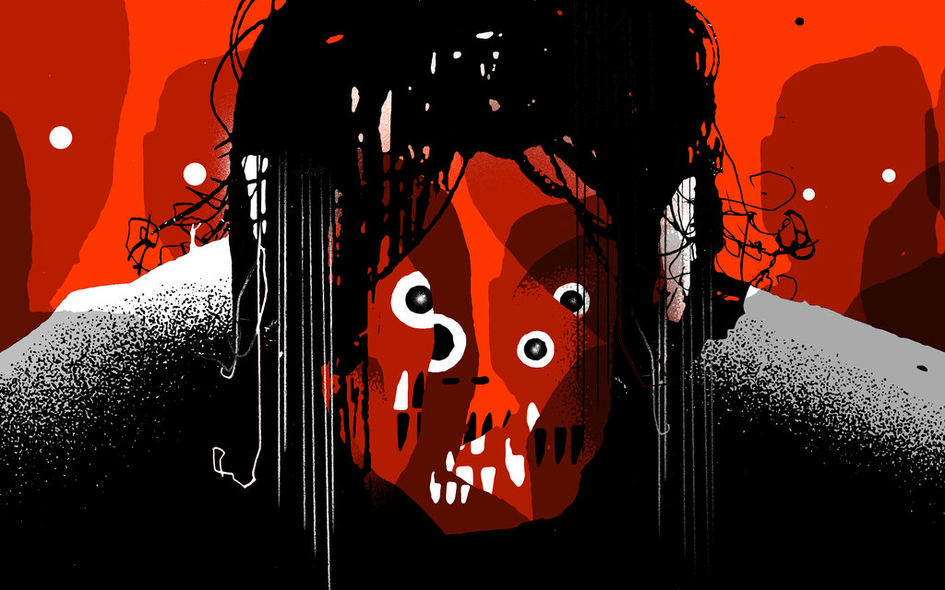
Class and Racial ‘others’
“the Gothic is marked by an anxious encounter with Otherness…Gothic fear is relocated onto the racial and social Other, the Other who replaces the supernatural ghost” (Bienstock Anolic and Howard, The Gothic Other)

Slide 10
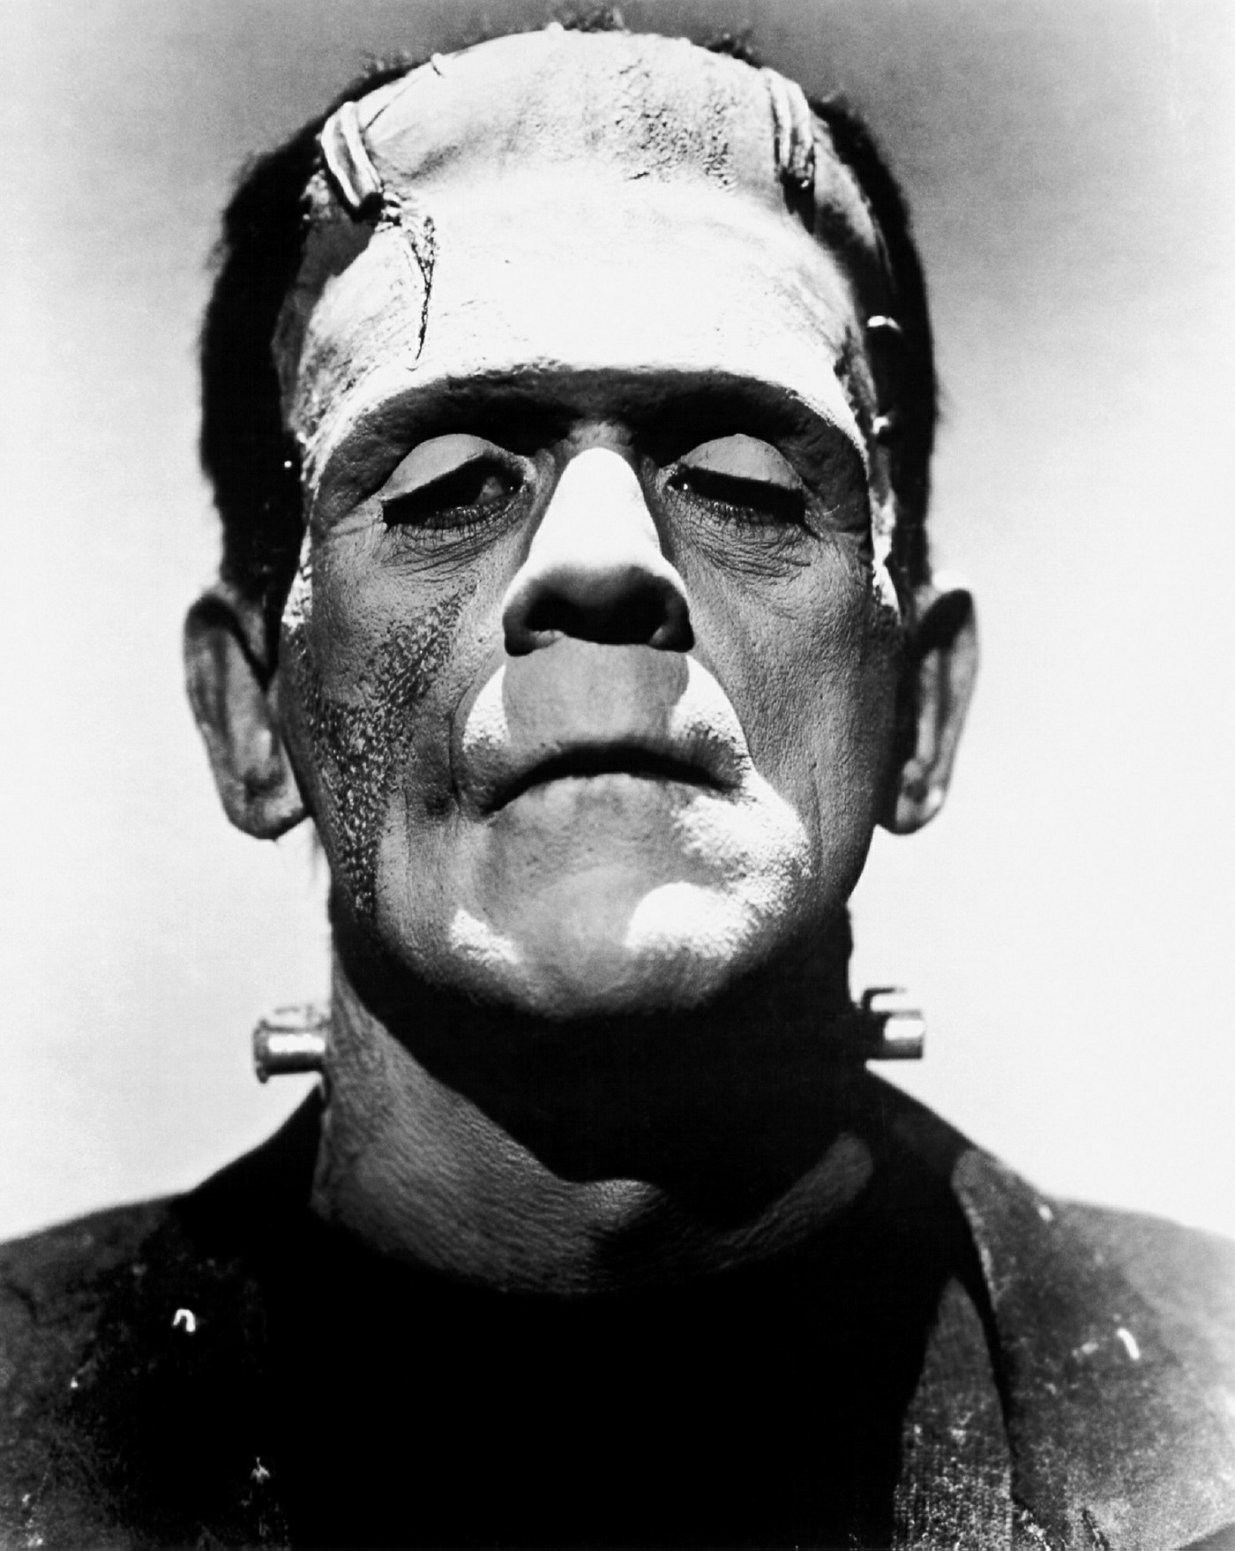

Slide 11
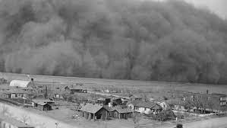
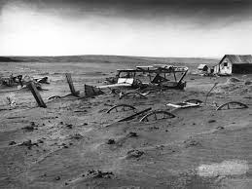

Slide 12
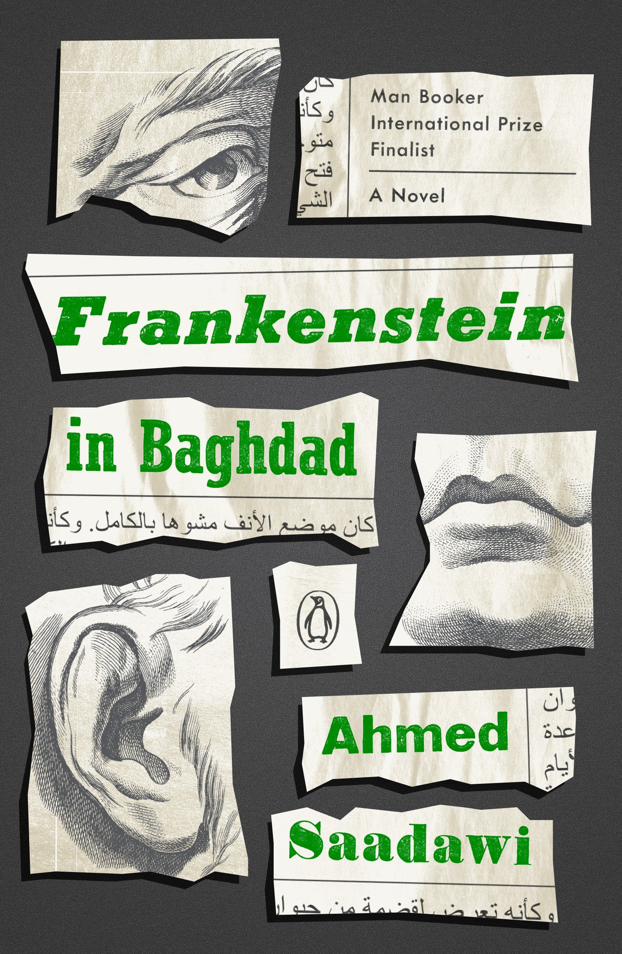

Slide 13
The Gothic and anxieties over…
nonhuman nature / the environment
the ‘monstrous feminine’
class and racial ‘others’

Slide 14
“Frankenstein can be read as an ecogothic text on several scales. As a story of unintended consequences, it remains a story for our time as well as for our culture [. . .]. Frankenstein interrogates ethical positions in human relations with the more-than-human world, using the figure of the creature to problematise those, presciently” (E. Alder and J. Bavidge, “Ecocriticism and the Genre”, 232)
Timothy Morton: “Frankenstein’s creature is the distorted, ambient category of the environment pulled around to the ‘front’ of the reader’s view, the ‘answer of the real’ whose very form embodies a terrible split: the horrific ugliness of alienated social cruelty, and the painful eloquence of enlightened refection. […] If a poisoned rainforest could speak, it would sound like Frankenstein’s creature” (“Ecology without Nature, 195)

Slide 15
“In Shelley's Frankenstein, the figure of the doctor is the focus for a set of anxieties about science, marriage, female sexuality and violence which combine to oust him from his position within bourgeois society.” Emma Liggins, “The Medical Gaze And The Female Corpse: Looking at Bodies in Mary Shelley's Frankenstein.” Studies in the Novel 32.2 (2000): 134.
In Frankenstein: “the very success of the scientist’s misogynist and ambitious project paradoxically exposes his limitations and weaknesses in dealing with the consequences, and his desire to surpass nature is represented as an indication of moral irresponsibility and male aggression.” (Galia Benziman, “Challenging the Biological: The Fantasy of Male Birth as a Nineteenth-Century of Ethical Failure.” Women’s Studies 35.4 (2006): 375–395

Slide 16
Adriana Craciun: “Shelley’s descriptions of the creature’s size, strength and implied sexual threat would have been suggestive of African racial difference to her British readers. The threat the creature embodies thus included ‘the threat of non-white races’ claiming equality, at a time when slavery continued in the British colonies.” (“Frankenstein’s Politics” in The Cambridge Companion to Frankenstein)
foreign secretary George Canning in an 1824 parliamentary debate:
in dealing with the enslaved, “we are dealing with a being possessing the form and strength of a man, but the intellect only of a child. [To turn an enslaved individual] loose in the manhood of his physical strength, in the maturity of his physical passions, but in the infancy of his uninstructed reason, would be to raise up a creature resembling the splendid fiction of a recent romance; the hero of which constructs a human form, with all the . . . sinews of a giant; but being unable to impart to the work of his hands a perception of right and wrong, he finds too late that he has created a more than mortal power of doing mischief and himself recoils from the monster which he has made.”

Slide 17
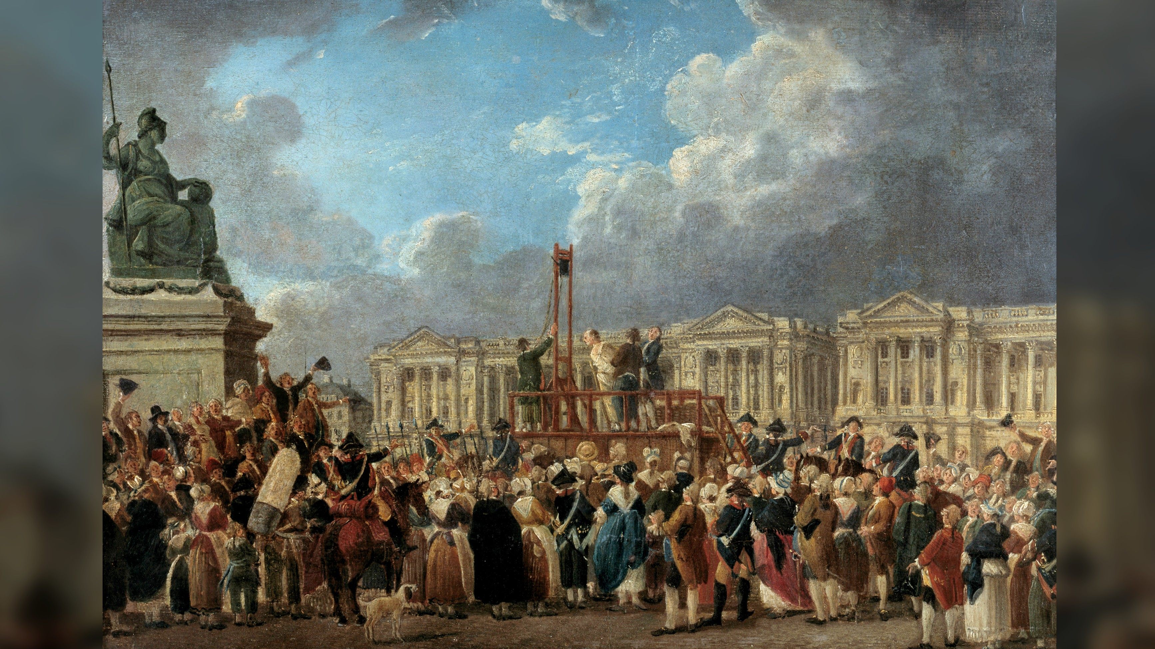

Slide 18
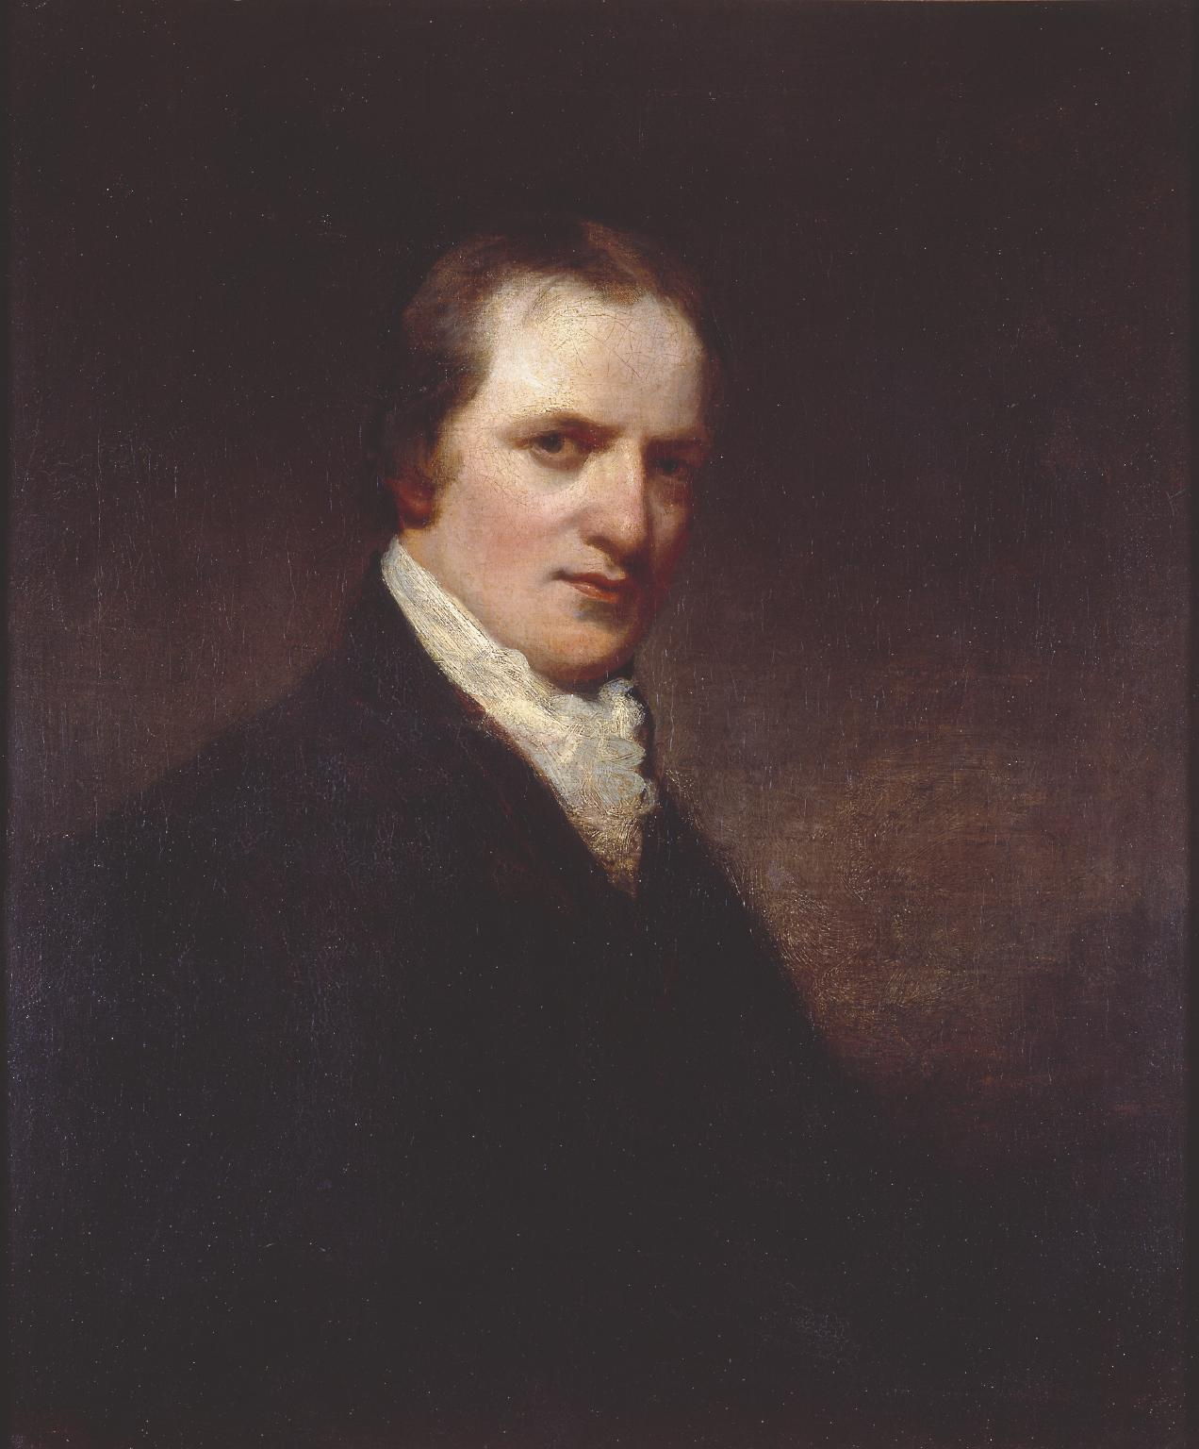
William Godwin:
There will be no war, no crimes, no administration of justice as it is called, and no government . . . Beside this, there will be neither disease, anguish, melancholy, nor resentment.
William Godwin, Enquiry Concerning Political Justice (1793), Vol. II, pp. 872–3.

Slide 19
Burke called Godwin's opinions "pure defecated atheism . . . the brood of that putrid carcase the French Revolution." […] The Anti-Jacobin Review, which championed the attack upon William Godwin and Mary Wollstonecraft, denounced the couple's disciples in 1800 as "the spawn of the monster."
Lee Sterrenburg, Mary Shelley's Monster: Politics and Psyche in Frankenstein (1979), pp.146-7
“[M]ost people felt of Mr. Godwin with the same alienation and horror as of a ghoul, or a bloodless vampyre, or the monster created by Frankenstein”
Thomas de Quincey, Tait's Magazine (March 1837)

Slide 20
“As yet I looked upon crime as a distant evil; benevolence and generosity were ever present before me, inciting within me a desire to become an actor in the busy scene where so many admirable qualities were called forth and displayed.”
Shelley, Frankenstein (Volume II, Chapter VII)
“All, save I, were at rest or in enjoyment: I, like the arch fiend, bore a hell within me; and, finding myself unsympathized with, wished to tear up the trees, spread havoc and destruction around me, and then to have sat down and enjoyed the ruin.”
Shelley, Frankenstein (Volume II, Chapter VIII)

Slide 21
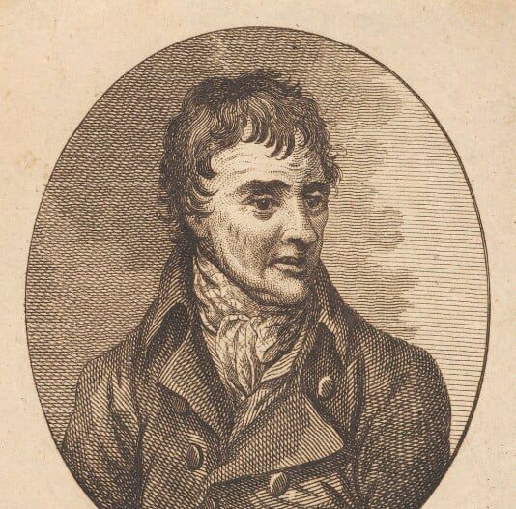


Slide 22
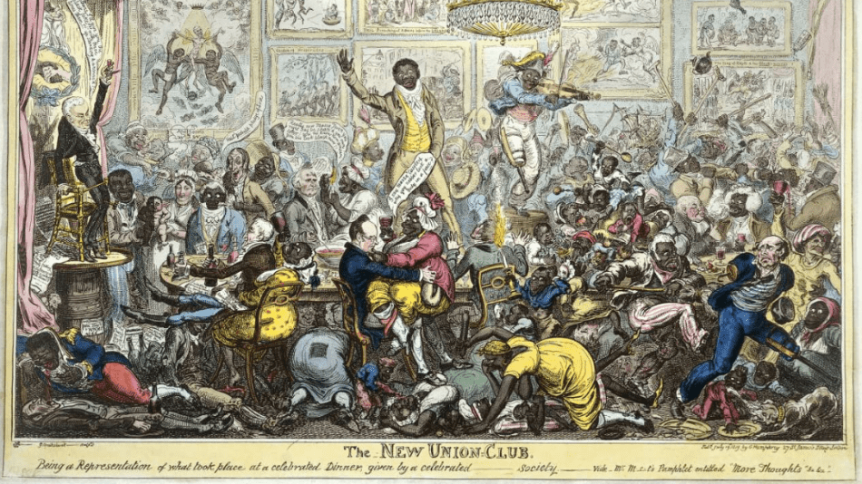
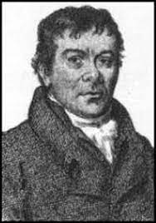
Robert Wedderburn:
“he sought a republican revolution grounded on a thoroughgoing redistribution of property both in Britain and the West Indies, and he did not hesitate to advocate violent methods to bring it about. He attacked slavery as part of a wider system of landed monopoly and corruption instituted by landlords, fundholders, kings and priests, and he offered his countrymen in the West Indies and England a detailed blueprint of liberation. (McCalman 1986: 108)

Slide 23
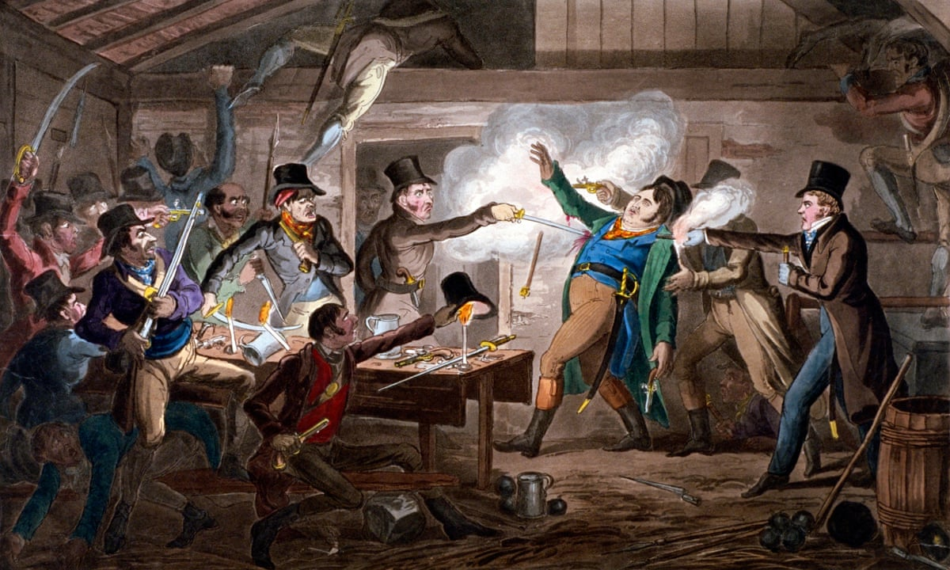
Cato Street Conspiracy, 1820

Slide 24
“I heard of the division of property, of immense wealth and squalid poverty; of rank, descent, and noble blood. The words induced me to turn towards myself. I learned that the possessions most esteemed by your fellow-creatures were, high and unsullied descent united with riches. A man might be respected with only one of these acquisitions; but without either he was considered, except in very rare instances, as a vagabond and a slave, doomed to waste his powers for the profit of the chosen few.” (Frankenstein Volume II, Ch. V)
“I heard of the discovery of the American hemisphere, and wept with Safie over the hapless fate of its original inhabitants” (Frankenstein Volume II, Ch. V)

Slide 25
“We stopped at Mettingen to dine, and surveyed at our ease the horrid and slimy faces of our companions in voyage; our only wish was to absolutely annihilate such uncleanly animals, to which we might have addressed the boatman’s speech to Pope: “Twere easier for God to make entirely new men than attempt to purify such monsters as these”. After a voyage in the rain, rendered disagreeable only by the presence of these loathsome “creepers”, we arrive, Shelley much exhausted, at Dettingen, our resting-place for the night.”
Mary Shelley’s journal for 28 August 1814
“[S]ince I lost Shelley I have no wish to ally myself to the Radicals -- they are full of repulsion to me -- violent without any sense of Justice -- selfish in the extreme -- talking without knowledge -- rude, envious, and insolent -- I wish to have nothing to do with them.”
Mary Shelley’s journal, October 1838

Slide 26
“Mary Shelley picks up a way of seeing – the populace as a destructive monster – provided by Tory journalism and tries to re-think it in her own radical-liberal terms. And so in the novel the monster remains a monster – alien, frightening, violent – but is drenched with middle-class sympathy and given central space in the text to exercise the primary liberal right of free speech which he uses to appeal for the reader’s pity and understanding. The caricatured people-monster that haunts the dominant ideology is reproduced through Mary Shelley’s politics and becomes a contradictory figure, still ugly, vengeful and terrifying but now also human and intelligent and abused.”
Paul O’ Flinn, “Production and Reproduction: The Case of Frankenstein,” Literature and History 9 (1983)

Slide 27
“Mary Shelley crafted Frankenstein using a nested set of narrative frames so that each frame's protagonist – Walton, Victor, the creature, and (via the creature) Safie – refracts the novel's politics through a different contemporary debate. The result is a kaleidoscopic political imaginary that has helped regenerate the novel's iconic status for new generations.” (Adriana Craciun, “Frankenstein’s Politics” in The Cambridge Companion to Frankenstein 84)

Slide 28
“I heard of the discovery of the American hemisphere, and wept with Safie over the hapless fate of its original inhabitants”

Slide 29
Craciun: “In the shared desires and similar barriers to belonging of Safie and the creature, Shelley connects political claims across racial, sexual and class differences that the novel explores, in ways inconceivable to followers of Burke, who had literally demonized political radicals. [. . .] In placing this dramatic example of feminist cultural rebellion at the heart of this novel littered with the bodies of ineffectual, passive or self-sacrificing women, Shelley expands the revolutionary political critique of her time, reviving a radical case for the rights of woman that had been vilified along with Wollstonecraft’s reputation.” (“Frankenstein’s Politics” in The Cambridge Companion to Frankenstein 95)

