Slide 1
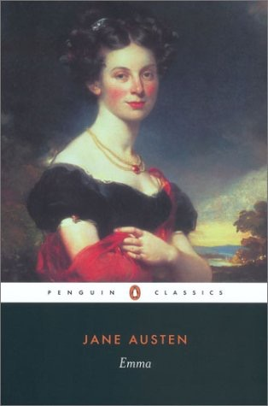
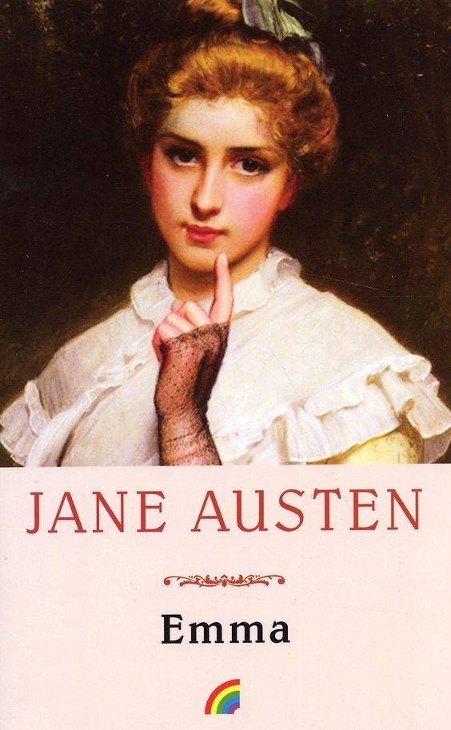
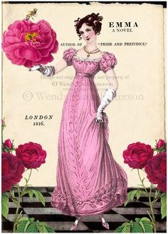
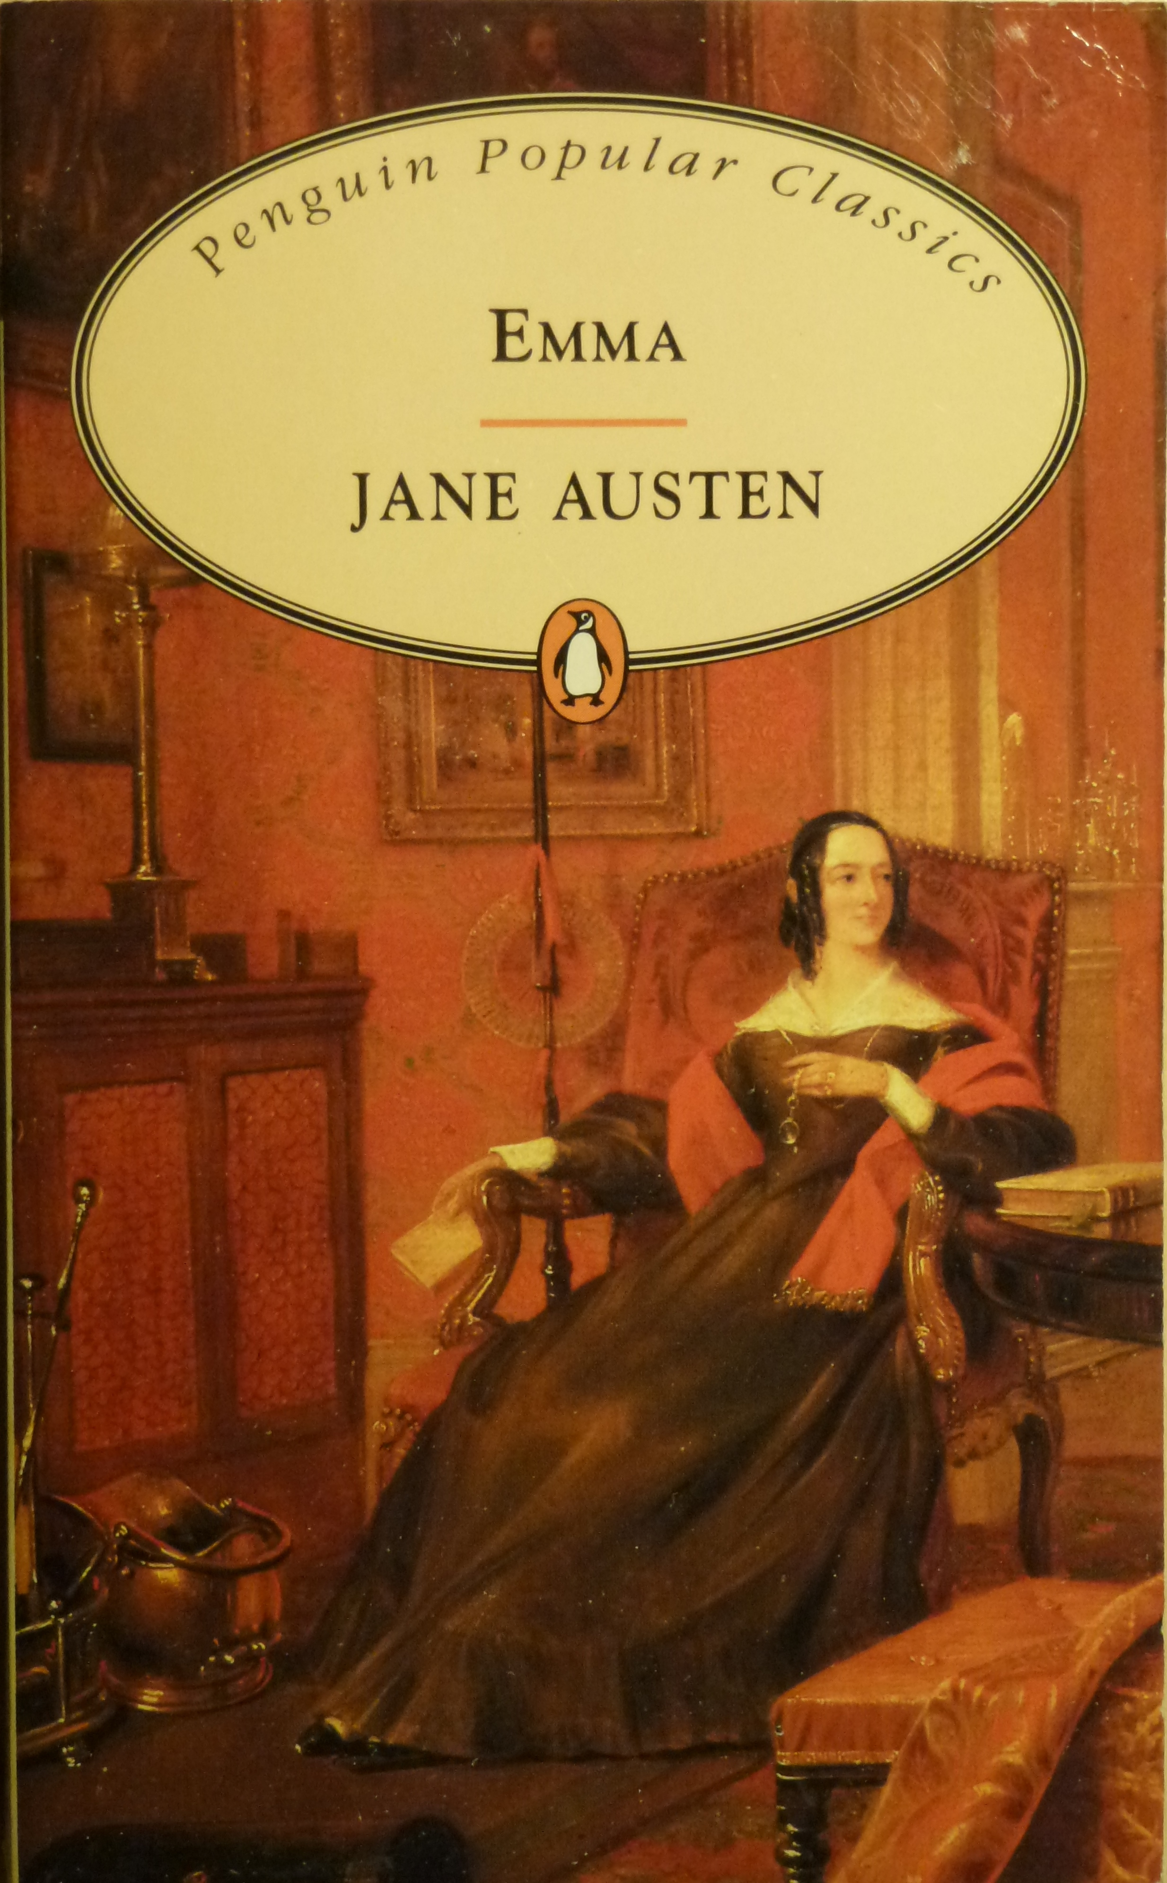
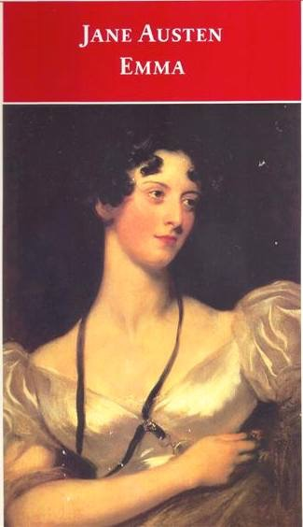
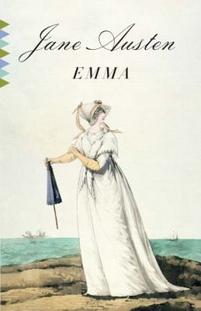
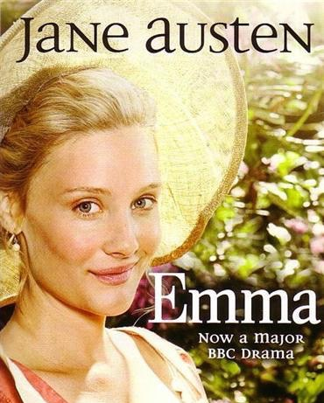
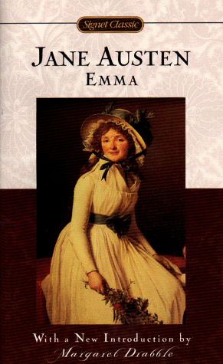
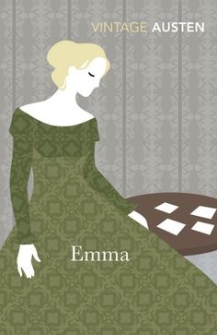
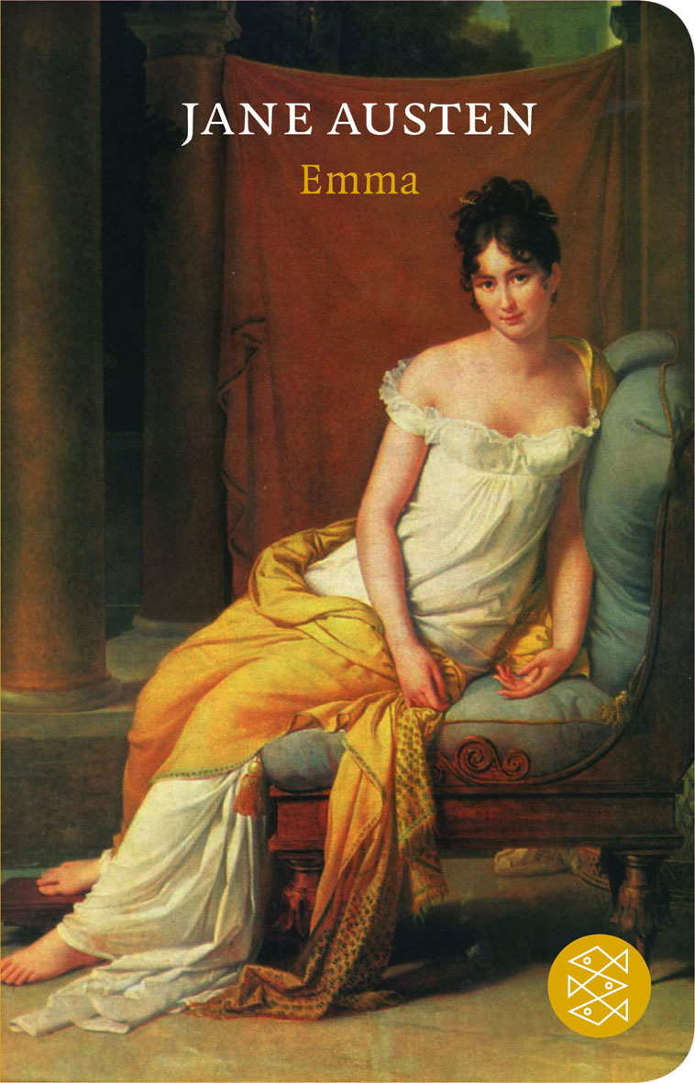

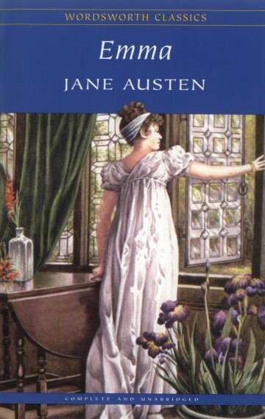
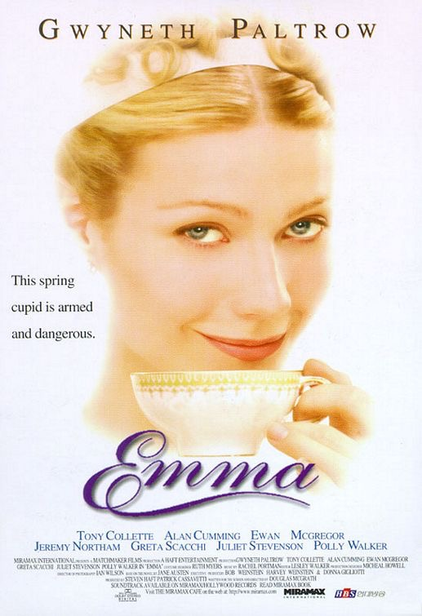

Slide 2
Context
The heroine
Property and privilege
The bildungsroman
Free indirect speech
Marriage
Adaptations

Slide 3
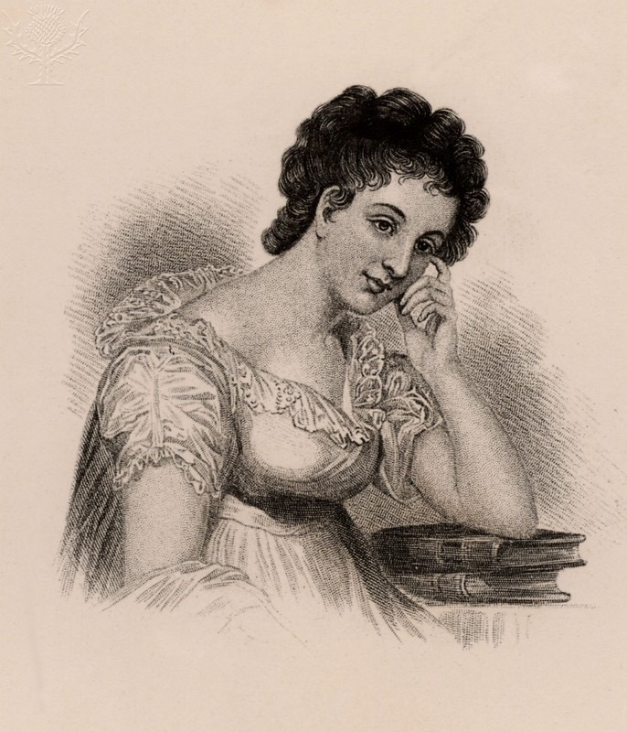
1. Context
“There was no story in it, except that Miss Emma found that the man whom she designed for Harriet’s lover was an admirer of her own - & he was affronted at being refused by Emma & Harriet wore the willow - and smooth, thin-water gruel is according to Emma’s father’s opinion a very good thing…”
Butler, Marilyn. Maria Edgeworth: A literary biography. Clarendon Press, 1972.
Maria Edgeworth

Slide 4
1. Context
1799 - French Revolution ends. Napoleon seizes power
1803 - War breaks out between France and England
1811 - Prince George is appointed regent to his father King George III
January 1814 - Jane Austen starts writing Emma
March 1815 - Jane Austen finishes Emma
November 1815 - War between France and England ends

Slide 5
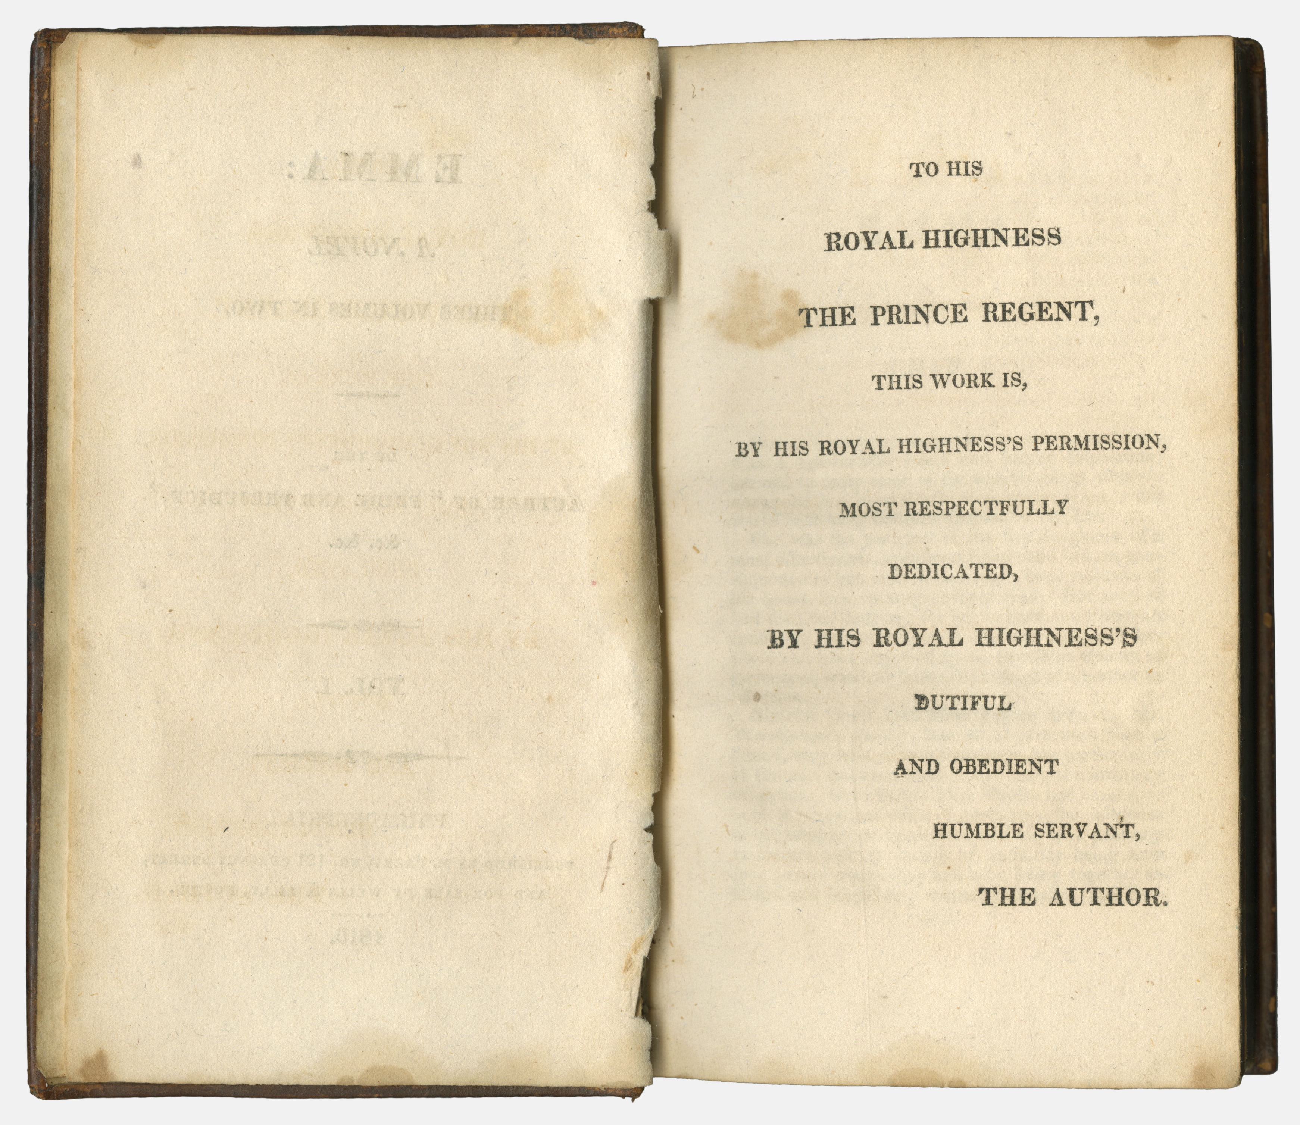
1. Context
Dedication to the Prince Regent

Slide 6
1. Context
“Scene to be in the Country, Heroine the Daughter of a Clergyman, one who after having lived much in the World had retired from it and settled in a Curacy, with a very small fortune of his own. -- He, the most excellent Man that can be imagined, perfect in Character, Temper, and Manners -- without the smallest drawback or peculiarity to prevent his being the most delightful companion to his Daughter from one year's end to the other. -- Heroine a faultless Character herself, -- perfectly good, with much tenderness and sentiment, and not the least Wit -- very highly accomplished, understanding modern Languages and (generally speaking) everything that the most accomplished young Women learn, but particularly excelling in Music -- her favourite pursuit -- and playing equally well on the PianoForte and Harp -- and singing in the first stile …The name of the work not to be Emma, but of the same sort as S. & S. and P. & P.”
http://www.pemberley.com/janeinfo/plannovl.html

Slide 7
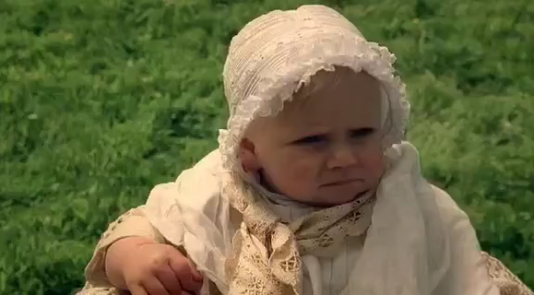
2. The heroine

Slide 8
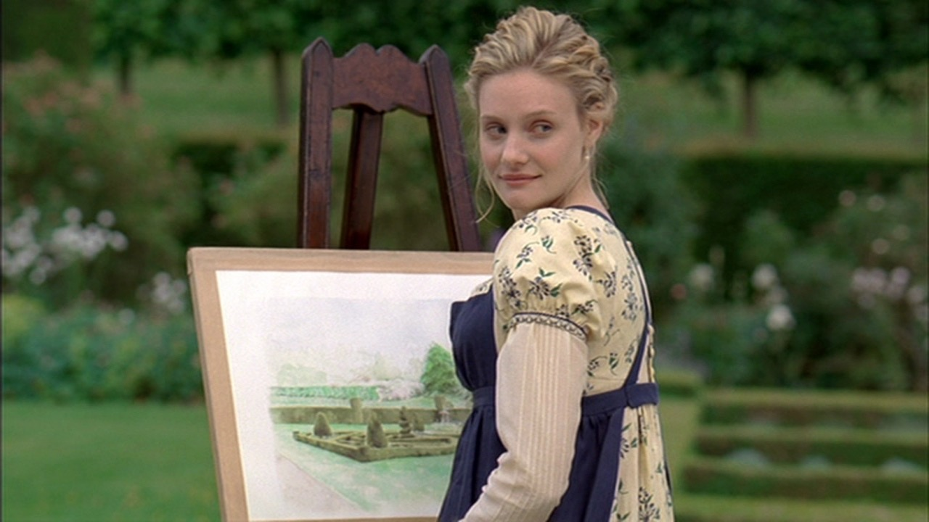
2. The heroine
“Emma Woodhouse, handsome, clever, and rich, with a comfortable home and happy disposition, seemed to united some of the best blessings of existence; and had lived nearly twenty-one years in the world with very little to distress or vex her.”
Austen, Jane. Emma. Oxford University Press, 2008, pp. 6.

Slide 9
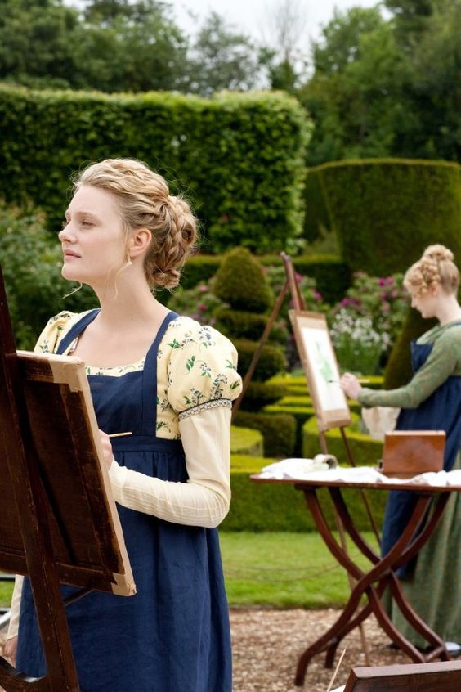
2. The heroine
“The real evils indeed of Emma’s situation were the power of having rather too much her own way, and a disposition to think a little too well of herself; these were the disadvantages which threatened alloy to her many enjoyments.”
Austen, Jane. Emma. Oxford University Press, 2008, pp. 6.

Slide 10
2. The heroine
“Austen … shows that there are real dangers in the situation of a highly intelligent and energetic young woman, wholly protected from the need to make her way in the world and with nothing much to do in life but pamper her silly father and meddle in the lives of those she thinks she is assisting …Emma’s misdeeds are the result of her staying at home in an environment which makes it difficult for her to grow up; her errors of judgement about social relationships in general are the direct outcome of the infantile role which she plays as perfect daughter.”
Kirkham, Margaret. Jane Austen, Feminism and Fiction. Harvester Press, 1983, pp. 136.

Slide 11
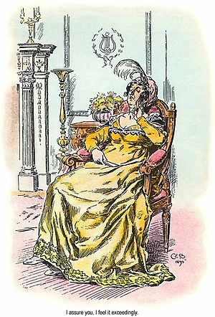
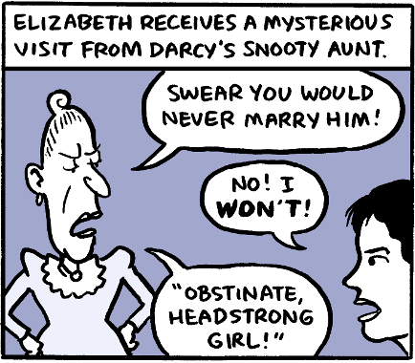
3. Property and privilege
Lady Catherine de Bourgh
Pride and Prejudice

Slide 12
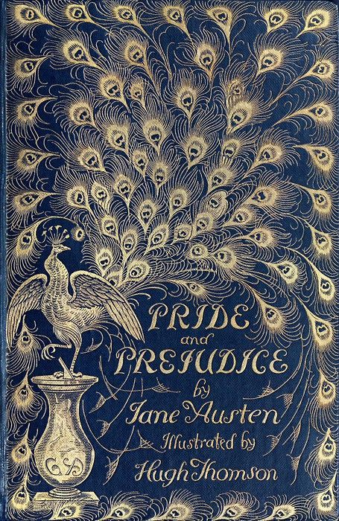
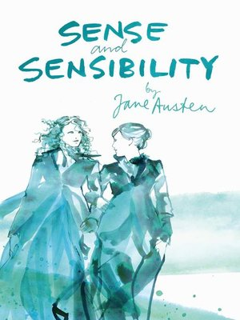
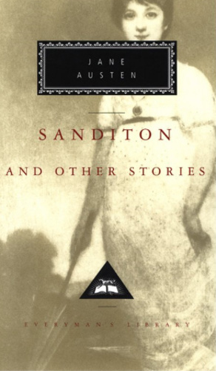
3. Property and privilege
1. Refusal to undertake the duties that belong to a woman of her position
2. Prejudices against people of lower social classes, and pride of rank
3. Desire to control other people’s lives
Lady Catherine
Mrs. Ferrars
Lady Denham

Slide 13
3. Property and privilege
“She had had many a hint from Mr. Knightley and some from her own heart, as to her deficiency - but none were equal to counteract the persuasion of its being very disagreeable, - a waste of time - tiresome women - and all the horror of being in danger of falling in with the second rate and third rate of Highbury, who were calling on them for ever, and therefore she seldom went near them.”
Austen, Jane. Emma. Oxford University Press, 2008, pp. 121.

Slide 14
4. The bildungsroman
“A novel that has as its main theme the formative years or spiritual education of one person.”
Common characteristics of the English bildungsroman include:
- A protagonist who was literally or metaphorically orphaned;
- A quest motivated by the loss of a parent and the accompanying loss of faith in past values;
- A journey from a rural to an urban world in which money was prominently featured;
- Tests of the protagonist (frequently involving money and love);
- Internal conflicts ending in a burst of life-altering clarity that James Joyce later called an “epiphany”;
- An ending often ambiguous or ambivalent.
(Salem Press Encyclopedia of Literature)

Slide 15
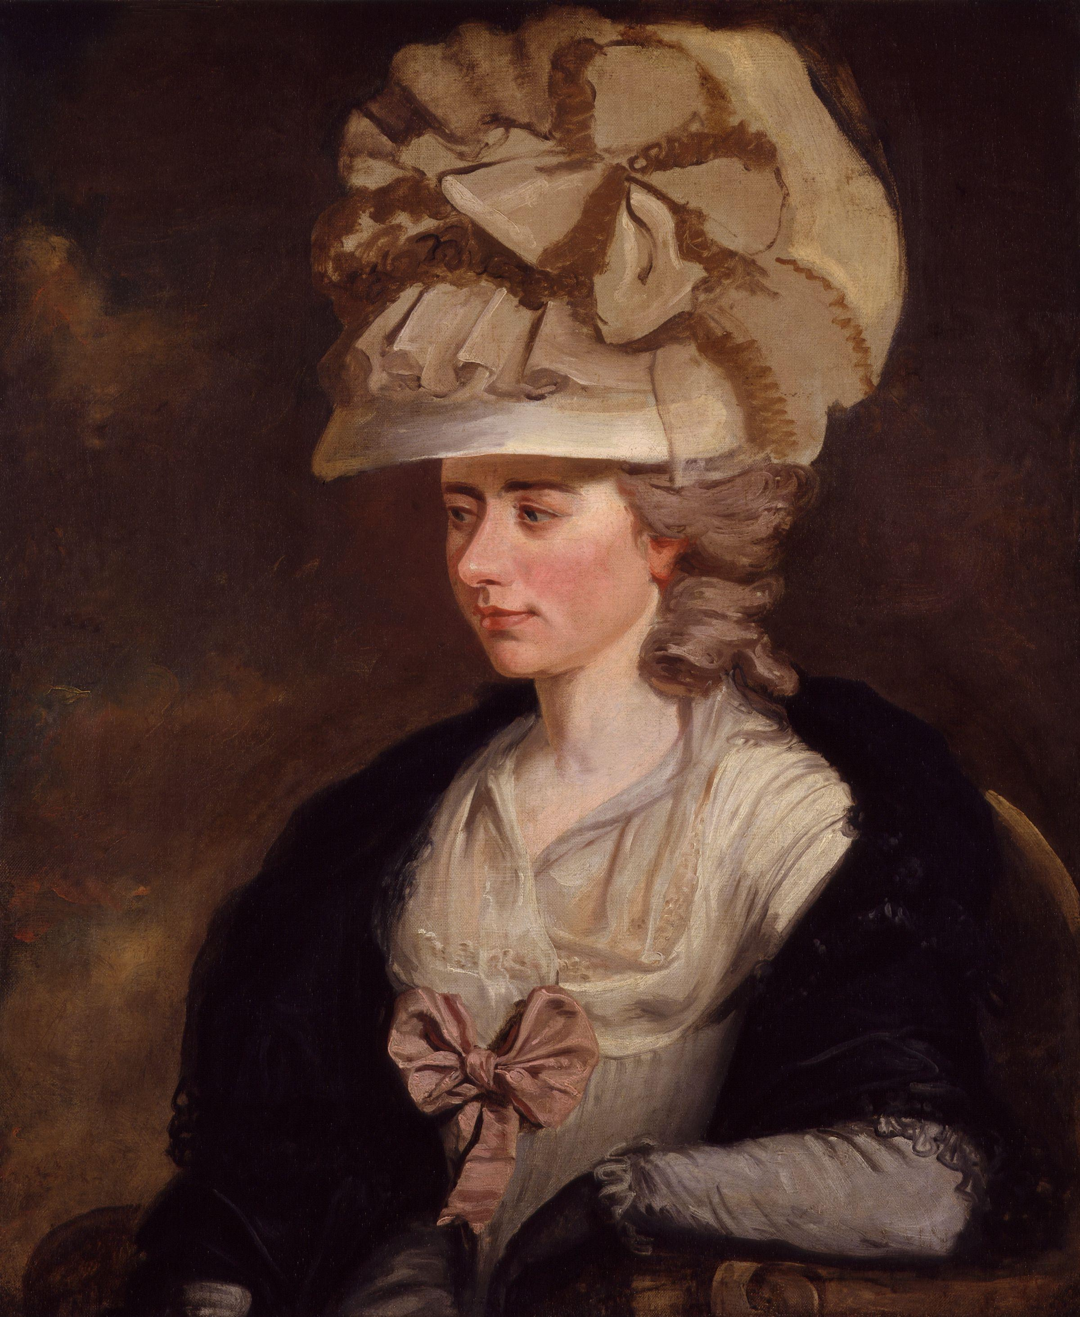
5. Free indirect speech
“She had repeatedly refused to borrow anything more of Mrs. Arlbery, always hoping every call for money would be the last; but she was too inexperienced to know, that in gay circles, and public places, the demands for wealth are endless and countless; and that oeconomy itself, which is always local, is there lavish and extravagant, compared with its character in private scenes and retired life.”
Burney, Fanny. Camilla. Oxford University Press, 2009, pp. 518
Fanny Burney

Slide 16
^{5. Free indirect speech}
“She had had many a hint from Mr. Knightley and some from her own heart, as to her deficiency - but none were equal to counteract the persuasion of its being very disagreeable, - a waste of time - tiresome women - and all the horror of being in danger of falling in with the second rate and third rate of Highbury, who were calling on them for ever, and therefore she seldom went near them.”
Austen, Jane. Emma. Oxford University Press, 2008, pp. 121.

Slide 17
^{5. Free indirect speech}
“Essentially, a young protagonist is poised at the outset of life, with two missions to perform: to survey society, distinguishing the true values from the false; and in the light of this new knowledge of ‘reality’ to school what is selfish, immature, or fallible in herself.”
Butler, Marilyn. Jane Austen and the War of Ideas. Oxford University Press, 1975, pp. 250.

Slide 18
^{5. Free indirect speech}
“Austen makes Emma’s lack of submission to industry and patience (and Mr. Knightley), and the supremacy of her fancy over both her understanding and the understandings of others, the impetus driving the plot of the novel and one of the lasting pleasures of the text.”
McInnes, Andrew. “Labyrinths of Conjecture: The Gothic Elsewhere in Jane Austen’s Emma,” Gothic Studies, vol. 18, no. 1, 2016, pp. 79.

Slide 19
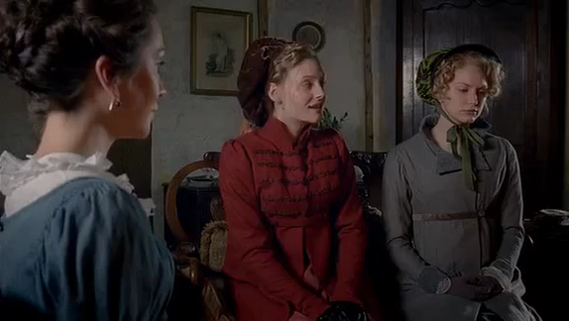
^{5. Free indirect speech}

Slide 20
^{5. Free indirect speech}
“At this moment, an ingenious and animating suspicion entering Emma’s brain with regard to Jane Fairfax, this charming Mr. Dixon, and the not going to Ireland.”
Austen, Jane. Emma. Oxford University Press, 2008. pp. 125.
“With regard to her not accompanying them to Ireland, her account to her aunt contained nothing but truth, though there might be some truths not told. It was her own choice to give the time of their absence to Highbury; to spend, perhaps, her last months of perfect liberty with those kind relations to whom she was so very dear: and the Campbells, whatever might be their motive or motives, whether single, or double, or treble, gave the arrangement their ready sanction.”
Austen, Jane. Emma. Oxford University Press, 2008. pp. 130.

Slide 21
^{5. Free indirect speech}
“Her caution was thrown away. Emma saw its artifice, and returned to her first surmises. There probably was something more to conceal than her own preference; Mr. Dixon, perhaps, had been very near changing one friend for the other, or been fixed only to Miss Campbell, for the sake of the future twelve thousand pounds.”
Austen, Jane. Emma. Oxford University Press, 2008. pp. 132-133.

Slide 22
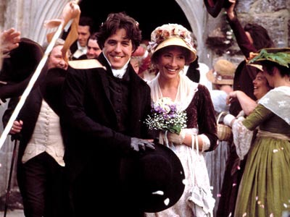
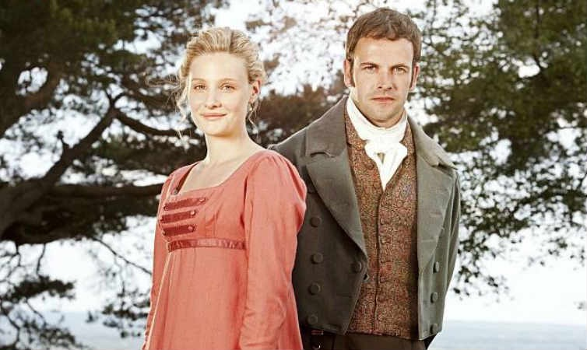
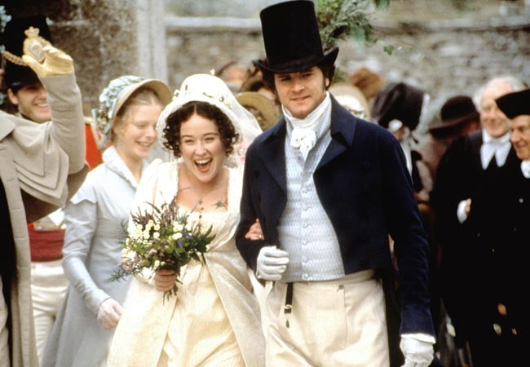
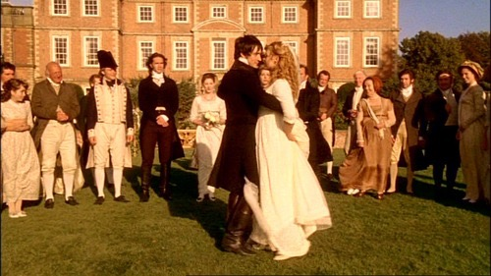
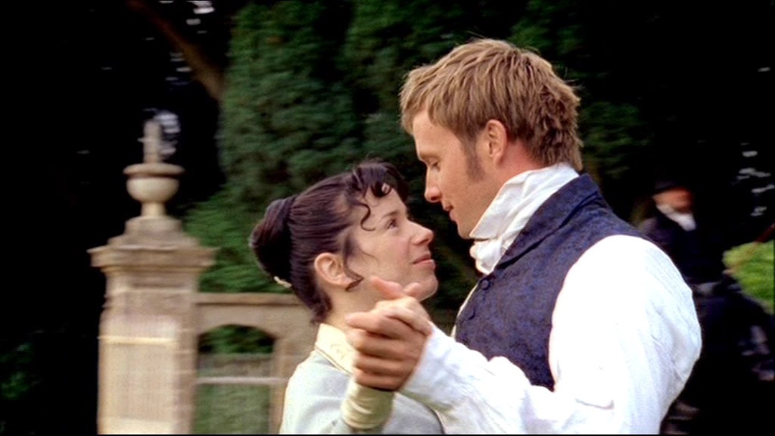
6. Marriage

Slide 23
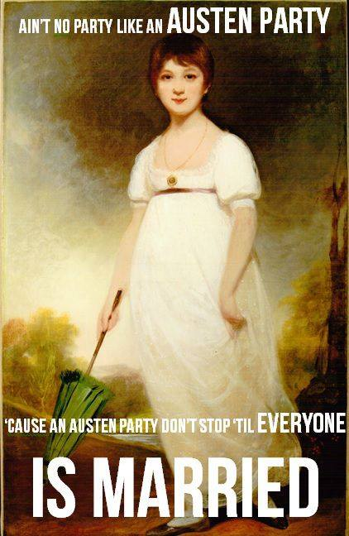
6. Marriage

Slide 24
6. Marriage
“On the brink of growing up, the necessity of marriage revealed to her, Emma is rescued, as it were, of Mr. Woodhouse’s inevitable resistance to her ever leaving his hearth and jurisdiction. In what could be construed as a regressive move for Emma, the new couple decide they will remain at Hartfield with her father. ( . . . ) Mr. Woodhouse’s authority will protect Emma, one feels, from the worst excesses of Knightley’s exasperating correctness. Her father will weigh in on her side, and help her maintain a proper balance of power.”
Perry, Ruth. Novel Relations: The Transformation of Kinship in English Literature and Culture, 1748-1818. Cambridge University Press. 2004. pp. 90.

Slide 25
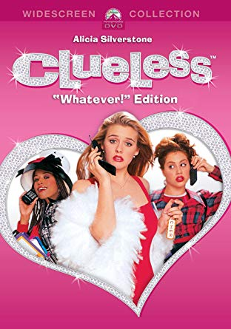
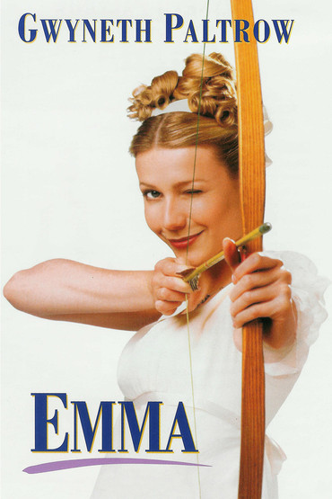
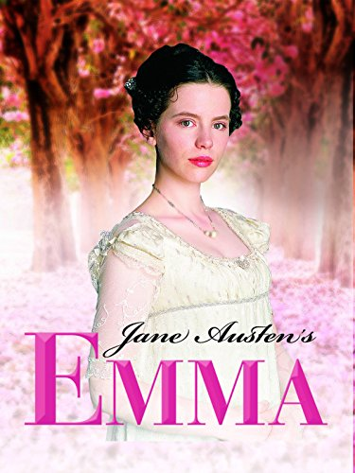

7. Adaptations
1995
Film
1996
Film
1996
TV Series (BBC)
2009
TV Series (BBC)

Slide 26
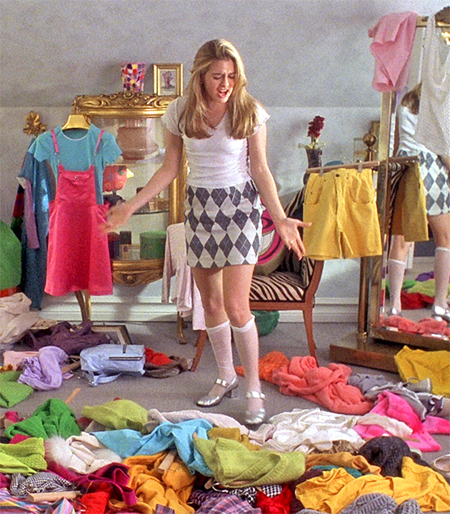
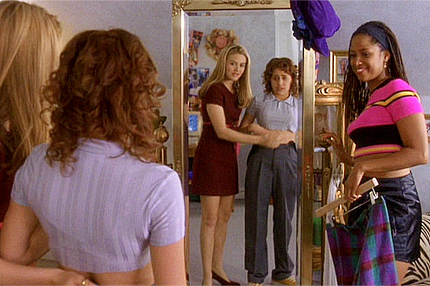
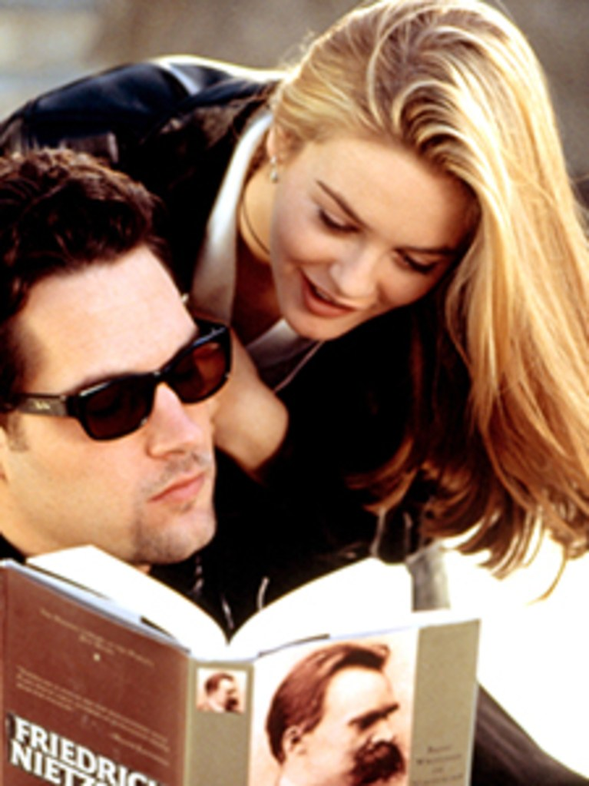
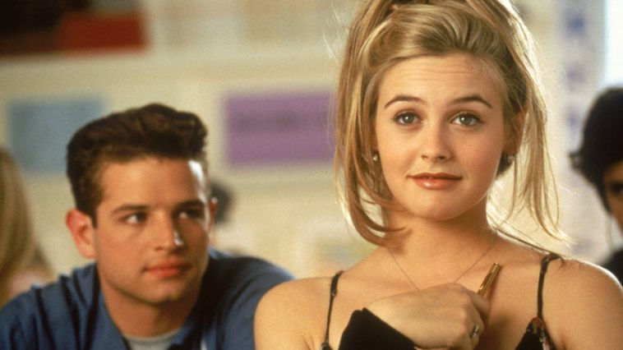
7. Adaptations

Slide 27
