Slide 1

Madame Bovary
Gustave Flaubert
Laura Wood
L.C.Wood@warwick.ac.uk

Slide 2
Realism
'As a starting point I shall define literary realism as any writing that is based upon an implicit or explicit assumption that it is possible to communicate about a reality beyond the writing.' (Pam Morris, Realism : 6)

Slide 3
Realism
'There is one distinction between realist writing and actual everyday reality beyond the text that must be quite categorically insisted upon: realist novels never give us life or a slice of life nor do they reflect reality. In the first place, literary realism is a representational form and a representation can never be identical with that which it represents. In the second place, words function completely differently from mirrors. If you think for a moment about a mirror reflecting a room and compare it to a detailed written description of the room, then reversal of images aside, it is obvious that no writing can encompass every tiny visual detail as a mirror faithfully does. Writing has to select and order, something has to come first, and that selection and ordering will always, in some way, entail the values and perspective of the describer.' (Pam Morris, Realism : 4)

Slide 4
Language and Realism
'Emma was like all other mistresses; and the charm of novelty, slipping off gradually like a piece of clothing, revealed in its nakedness the eternal monotony of passion, which always assumes the same forms and uses the same language. He could not perceive - this man of such broad experience - the differences in feeling that might underlie similarities of expression. Because licentious or venal lips had murmured the same words to him, he had little faith in their truthfulness; one had to discount, he thought, exaggerated speeches that concealed commonplace affections; as if the fullness of the soul did not sometimes overflow in the emptiest of metaphors, since none of us can ever express the exact measure of our needs, or our ideas, or our sorrows, and human speech is like a cracked kettle on which we beat out tunes for bears to dance to, when we long to inspire pity in the stars.' (Madame Bovary, Part 2 Chapter 12)

Slide 5
Language and Realism
'Flaubert's irony is present in the eloquent juxtapositions he creates between the "poetic" and the brutally commonplace, with an effect that is sometimes humorous, sometimes shocking, but that always draws us up short, breaks the "mood." An exquisite passage – often a description of nature – will be undercut, as though here Flaubert is also undercutting his own lyrical impulse, by what immediately follows it, a banal, mundane comparison or action.' (Lydia Davis)

Slide 6
Realism and the Romantic Reader
'Yet, although the author remains, as Flaubert says, invisible, the perspective conveyed is subtly larger and more discriminating than Emma Bovary's view of things. The writing conveys the scene that she sees but it also sees her within that scene with an objectivity she never achieves in the course of her story. Emma sees herself fantastically as a romantic heroine [...] but the reader sees her posing as a self imagined heroine in a romance. [...] such language points beyond Emma's own consciousness to the popular sentimental poetry and novels that are the sources of her imagining.' (Pam Morris, Realism :66)

Slide 7
Realism and the Romantic Reader
'they were always and only about love, lovers, paramours, persecuted ladies fainting in lonely pavilions, postilions killed at every stage, horses ridden to death on every page, gloomy forests, troubled hearts, oaths, sobs, tears, and kisses, skiffs by moonlight, nightingales in groves, gentlemen brave as lions, gentle as lambs, virtuous as no one ever is, always well dressed, and weeping like tombstone urns. And so for six months, at the age of fifteen, Emma soiled her hands with the greasy dust of those old lending libraries.' (Madame Bovary, Part 1, Chapter 6)

Slide 8
Bovary and Things
'Flaubert is holding up a mirror to the middle and lower middle-class world of his day, with all its little habits, fashions, fads. French readers who belonged to that world would recognise themselves (or their parents) and either blush or laugh complicitly: they, or their parents, might play whist in the evening (as did the King himself), or have a similar piece of coral on the mantelpiece or the same print on the parlor wall; perhaps it was their aunt who, like Emma, coveted a Tilbury – that fashionable English carriage – or a mouth-rinsing bowl on the dinner table; or perhaps a self-important uncle, like Homais, hoped to be awarded the cross of the Legion of Honor.' (Lydia Davis)

Slide 9
Bovary and Things
'Sometimes, too, she would talk to him about the things she had read, such as a passage from a novel, a new play, or the high society anecdote being recounted in the paper; for, after all, Charles was someone, always an open ear, always ready approbation. She confided many secrets to her greyhound! She would have done the same to the logs in the fireplace and the pendulum of the clock.' (Madame Bovary, Part 1, chapter 9)

Slide 10
Bovary and Things
'On a sunny Tuesday morning on 4 June in the grate over the storm drain to the Chesapeake Bay in front of Sam's Bagels on Cold Spring Lane in Baltimore, there was:
One large men's black plastic work glove
One dense mat of oak pollen
One unblemished dead rat
One white plastic bottle cap
One smooth stick of wood
Glove, pollen, rat, cap, stick. As I encountered these items, they shimmied back and forth between debris and thing – between, on the one hand, stuff to ignore, except insofar as it betokened human activity (the workman's efforts, the litterer's toss, the rat poisoner's success), and, on the other hand, stuff that commanded attention in its own right, as existents in excess of their association with human beings, habits, or projects. [...]
For had the sun not glinted on the black glove, I might not have seen the rat; had the rat not been there, I might not have noted the bottle cap, and so on. But they were all there just as they were, and so I caught a glimpse of an energetic vitality inside each of these things, things that I generally conceived as inert. In this assemblage, objects appeared as things, that is, as vivid entities not entirely reducible to the context in which (human) subjects set them, never entirely exhausted by their semiotics. In my encounter with the gutter on Cold Spring Lane, I glimpsed a culture of things irreducible to the culture of objects.' (Jane Bennett, Vibrant Matter : 4)

Slide 11
Bovary and Things
'She loved the sea only for its storms, and greenery only when it grew up here and there among ruins. She needed to derive from things a sort of personal gain; and she rejected as useless everything that did not contribute to the immediate gratification of her heart, – being by temperament more sentimental than artistic, in search of emotions and not landscapes.' (Madame Bovary, Part 1, chapter 6)

Slide 12
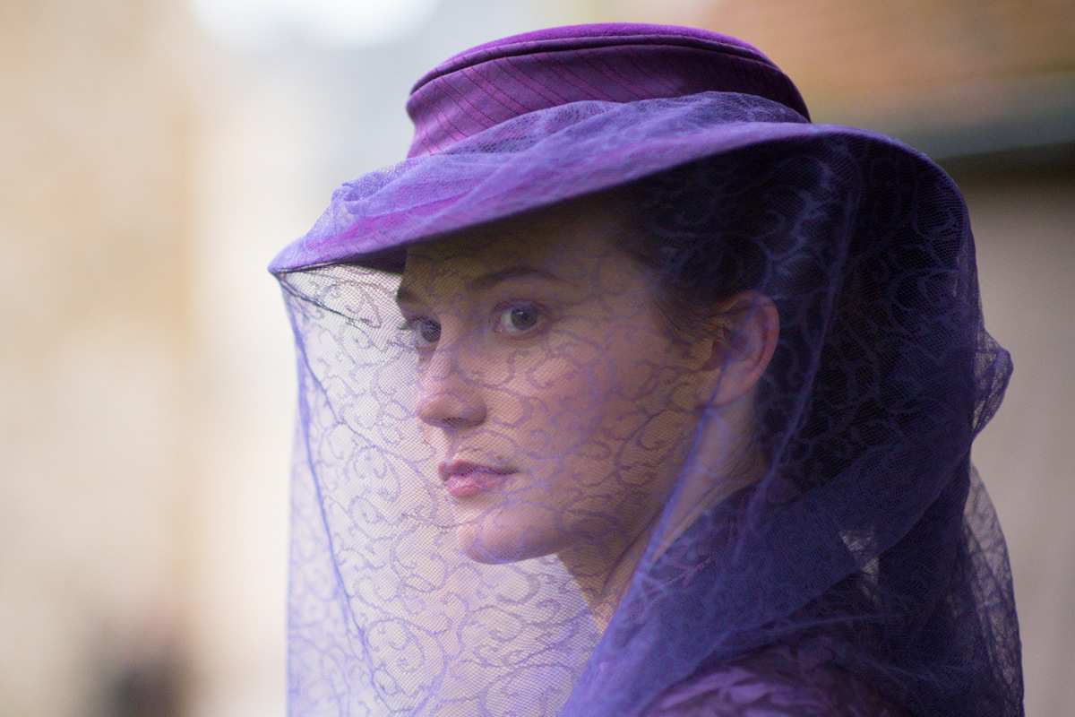
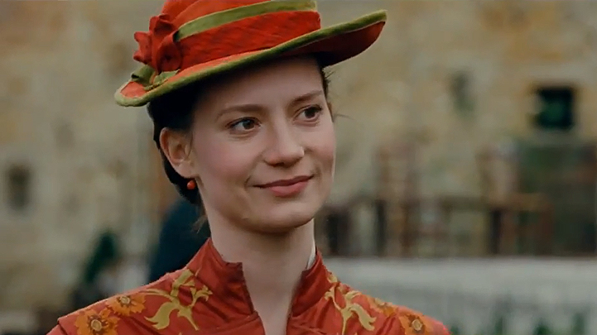
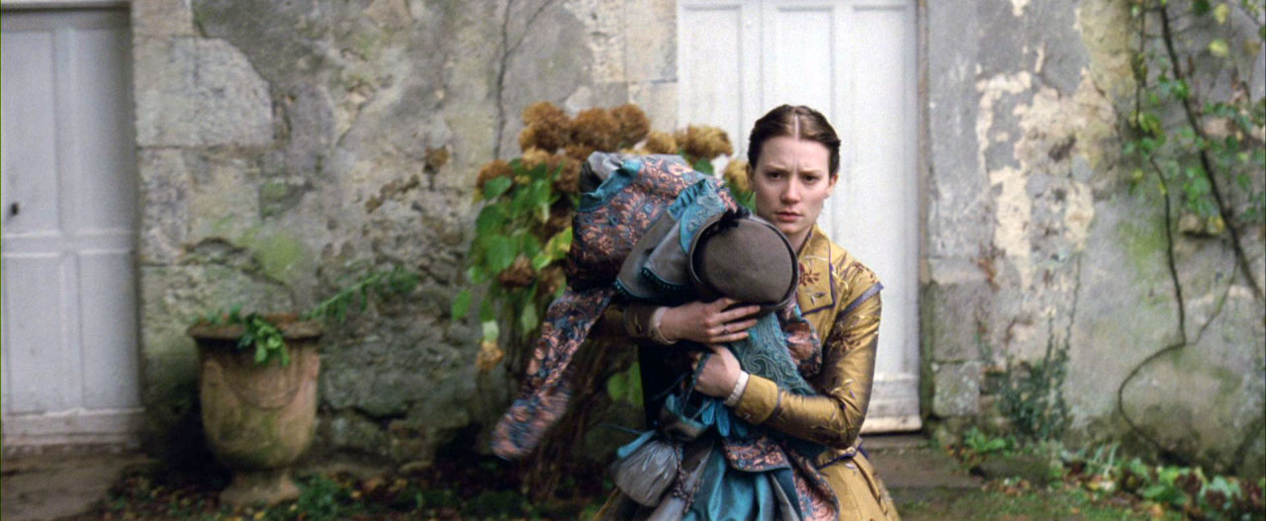
Madame Bovary (2015)
Madame Bovary Trailer

Slide 13
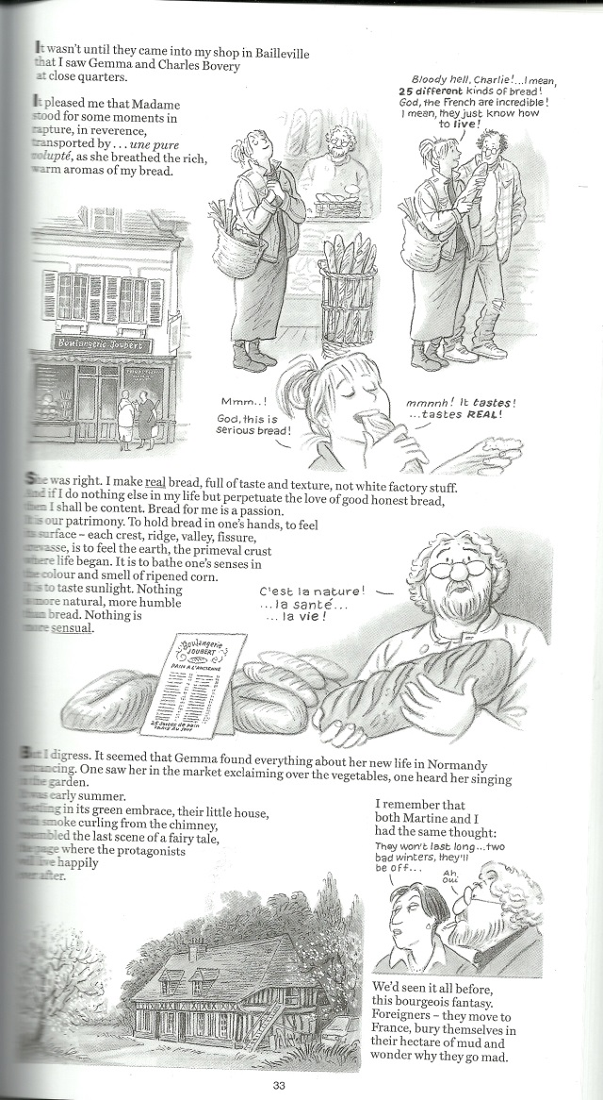
Gemma Bovery

Slide 14

Gemma Bovery
Gemma Bovery Clip

