Slide 1

Hauntings: On Algerian White
EN201 The European Novel
English & Comparative Literary Studies

Slide 3
Assia Djébar (1936-2015)
http://www.theguardian.com/books/2015/feb/09/assia-djebar-algerian-novelist-dies

Slide 4
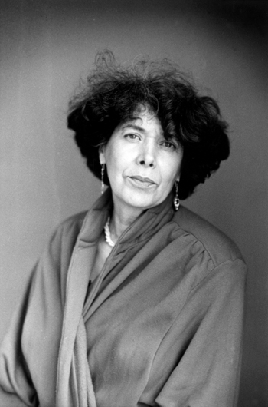
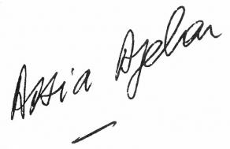

Slide 5
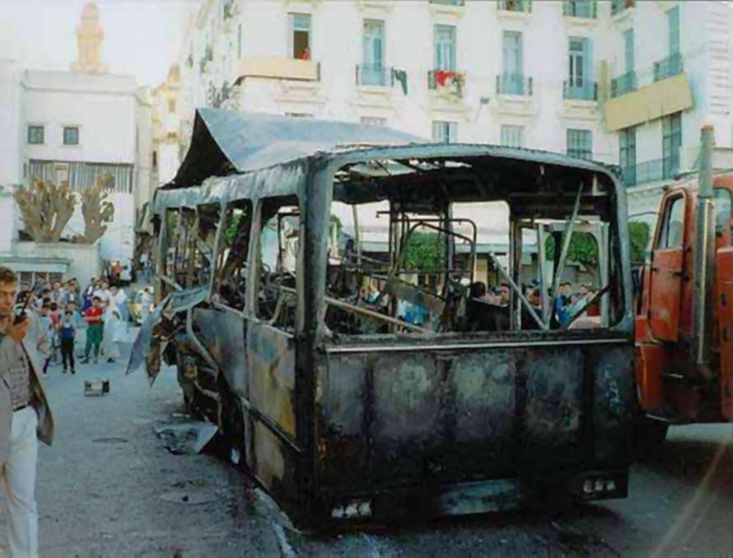

Slide 6
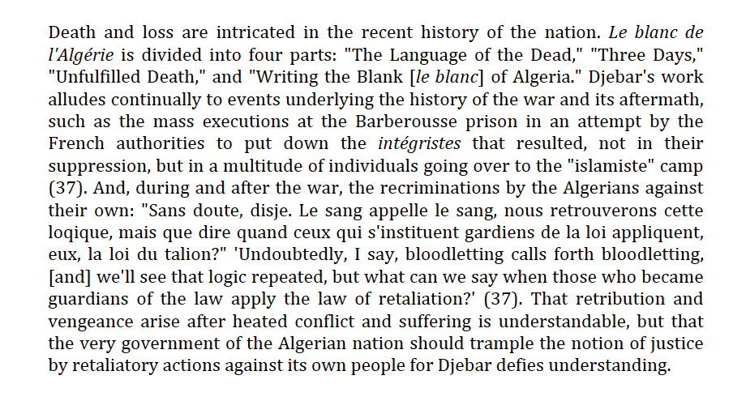
John Erickson. ‘Translating the Untranslated: Djébar’s Le blanc de l’Alg´´riweResearch in African Literatures 30.3 (1999) 95-107

Slide 7

What is a novel? Challenging notions of genre
Fiction/Reality
Prose/Poetic Language
Autobiographical/ Testimony/Imagined
Memory and Ethics
And Europe? Algerian White as European novel

Slide 8
Postcolonial Violence
Imbrications
Conflations
Distinctions

Slide 9
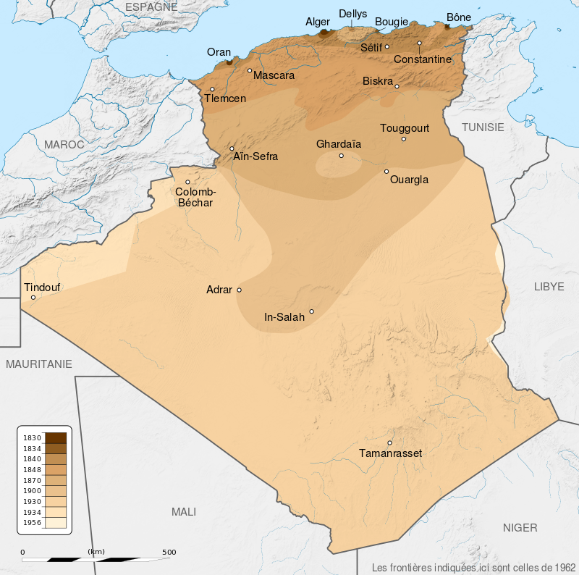

Slide 10
1830 French invasion
1954-1962 War of Independence
1991 – 2002(?) civil war
FLN
And Europe?

Slide 12


Slide 14
Rewriting History
Opening up public sphere
Checking imbrications
Writing back

Slide 17


Slide 20
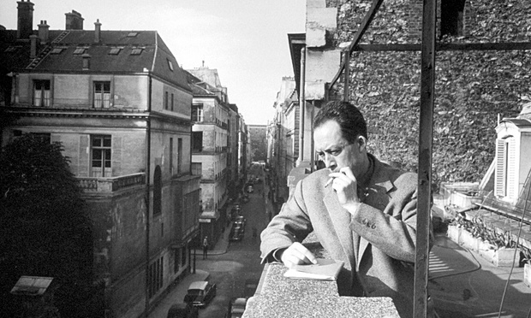
Albert Camus (1913-1960)

Slide 21
The Question of Algiers

Slide 23


Slide 24
Hanneke and Silence
Language of the dead
French as imperial language, as neutral, as always impossible

Slide 25
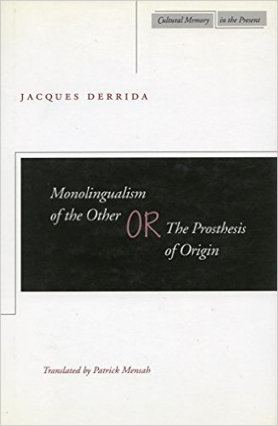
Notes:
1996

Slide 26
Ethics, Aesthetics, Duty, Responsibility; Witnessing, Dialogue of the Dead, What is a novel? And Europe?

Slide 27
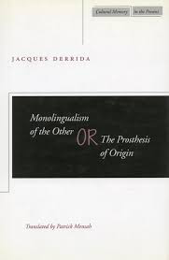

Slide 30
