Slide 1
A Desert with Silent Voices
Lobo Antunes and a Postimperial Europe

Slide 2


Slide 3
Memória de Elefante (1979) Elephant's Memory
Os Cus de Judas (1979) The Land at the End of the World (available in English)
Conhecimento do Inferno (1980) Knowledge of Hell (available in English)
Explicação dos Pássaros (1981) An Explanation of the Birds (available in English)
Fado Alexandrino (1983) Fado Alexandrino (available in English)
Auto dos Danados (1985) Act of the Damned (available in English)
As Naus (1988) The Return of the Caravels (available in English)
Tratado das Paixões da Alma (1990) Treatise on the Soul's Passions
A Ordem Natural das Coisas (1992) The Natural Order of Things (available in English)
A Morte de Carlos Gardel (1994) The Death of Carlos Gardel
A História do hidroavião (1994) illustrated by Vitorino
O Manual dos Inquisidores (1996) The Inquisitors' Manual (available in English)
O Esplendor de Portugal (1997) The Splendor of Portugal (available in English)
Exortação aos Crocodilos (1999) Exhortation to the Crocodiles
Não Entres Tão Depressa Nessa Noite Escura (2000) Don't Go Through That Dark Night So Fast
Que Farei Quando Tudo Arde? (2001) What Can I Do When Everything's on Fire? (available in English)
Letrinhas das Cantigas (Limited Edition 2002)
Boa Tarde às Coisas Aqui em Baixo (2003) Good Evening to the Things From Here Below
Eu Hei-de Amar uma Pedra (2004) I Shall Love a Stone
D'este viver aqui neste papel descripto: cartas da guerra ("Cartas da Guerra") (2005)
Ontem Não te vi em Babilónia (2006) Didn't See You In Babylon Yesterday
O Meu Nome é Legião (2007) My Name Is Legion
O Arquipélago da Insónia (2008) Archipelago of Insomnia
Que Cavalos São Aqueles Que Fazem Sombra no Mar? (2009) What Horses Are Those That Make Shade On The Sea?
Sôbolos Rios Que Vão (2010)
Comissão das Lágrimas (2011)
Não é Meia-Noite quem quer (2012)
(source: wikipedia 2014)

Slide 4
Lobo Antunes and Writing
Writing against the family’s wishes
Writing as a destiny
Double Writing: Elephant Memory
‘Os Cus de Judas’and the end of the world
No apocalypse but no false hope either
Exposing bourgeois cruelty

Slide 5
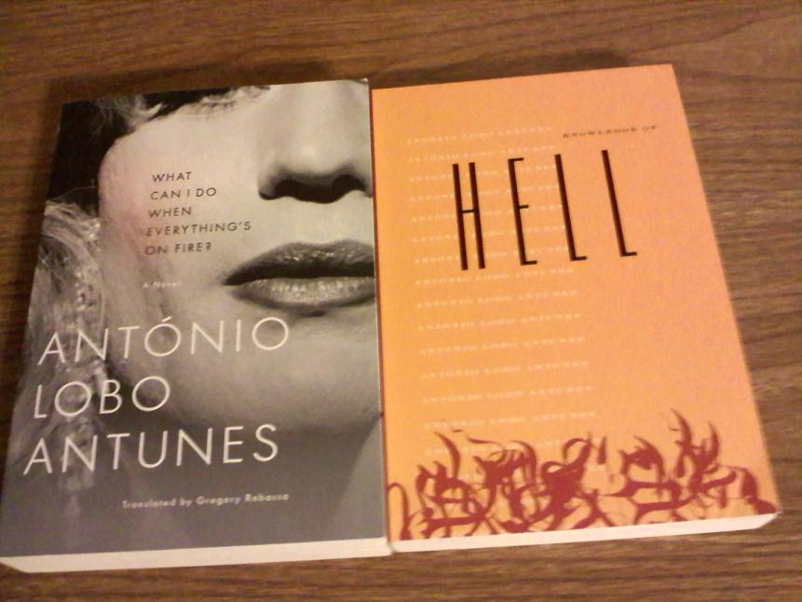

Slide 7


Slide 8


Slide 9
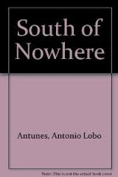

Slide 10
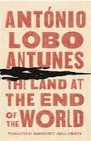

Slide 11
Lobo Antunes and Writing
Writing against the family’s wishes
Writing as a destiny
Double Writing: Elephant Memory
‘Os Cus de Judas’and the end of the world
No apocalypse but no false hope either
Exposing bourgeois cruelty

Slide 12
http://www.youtube.com/watch?v=cM5bSKc3Wuc
Lobo Antunes on his novel, “The Archipelago of Insomnia”
I know no one writes like me…. but that does not bring me any happiness.
If one aspires to write seriously one must aspire to silence and fill the books with silence, and the reader must read the words that are not written in the books and yet are there
I find that all books depict an internal landscape (…) All I had when I started was… was the voice of the autist.”

Slide 13


Slide 14
Cruelty, Blood and Ghosts
In Archipelago of Insomnia all are ghosts
In The Land at the End of the World the narrator is also as if dead
History, Memory and Politics

Slide 15
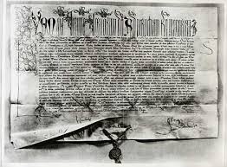
Romanus Pontifex Pope Nicholas V 1454

Slide 16
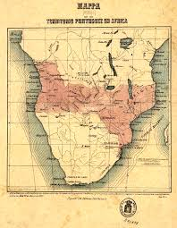
Pink Map

Slide 17
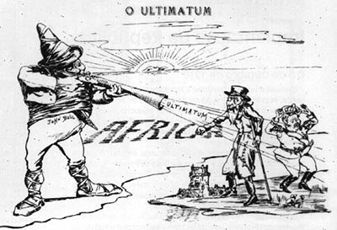

Slide 18


Slide 19


Slide 20


Slide 21


Slide 22


Slide 23
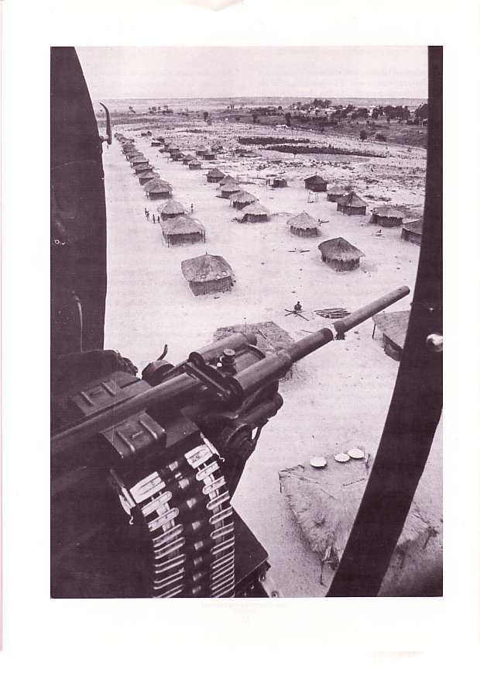

Slide 24
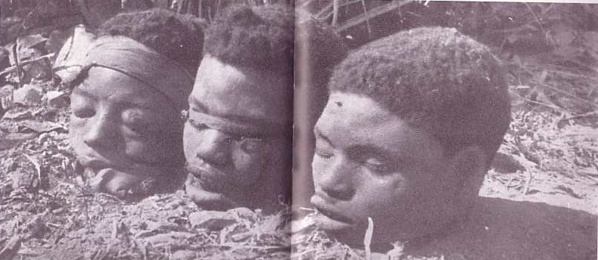

Slide 25
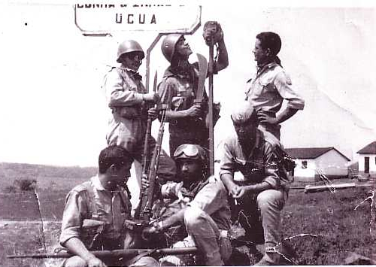

Slide 26
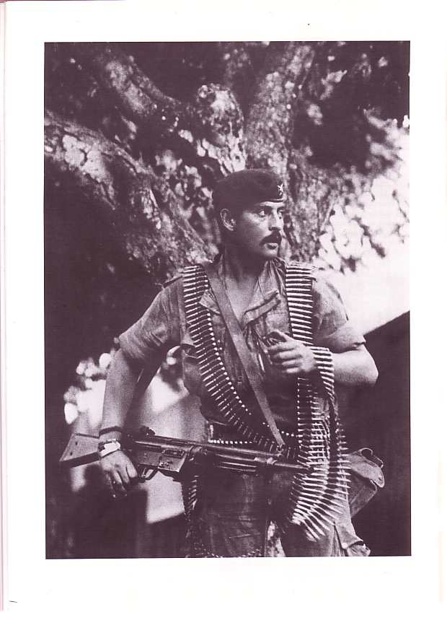

Slide 27


Slide 28


Slide 31
