Slide 1

EN201 The European Novel: The Trial

Slide 2
Chapter One Arrest - Conversation with Mrs. Grubach - Then Miss Bürstner
Someone must have been telling lies about Josef K., he knew he had done nothing wrong but, one morning, he was arrested. Every day at eight in the morning he was brought his breakfast by Mrs. Grubach's cook - Mrs. Grubach was his landlady - but today she didn't come. That had never happened before. K. waited a little while, looked from his pillow at the old woman who lived opposite and who was watching him with an inquisitiveness quite unusual for her, and finally, both hungry and disconcerted, rang the bell. There was immediately a knock at the door and a man entered. He had never seen the man in this house before. He was slim but firmly built, his clothes were black and close-fitting, with many folds and pockets, buckles and buttons and a belt, all of which gave the impression of being very practical but without making it very clear what they were actually for. "Who are you?" asked K., sitting half upright in his bed. The man, however, ignored the question as if his arrival simply had to be accepted, and merely replied, "You rang?" "Anna should have brought me my breakfast," said K.

Slide 3
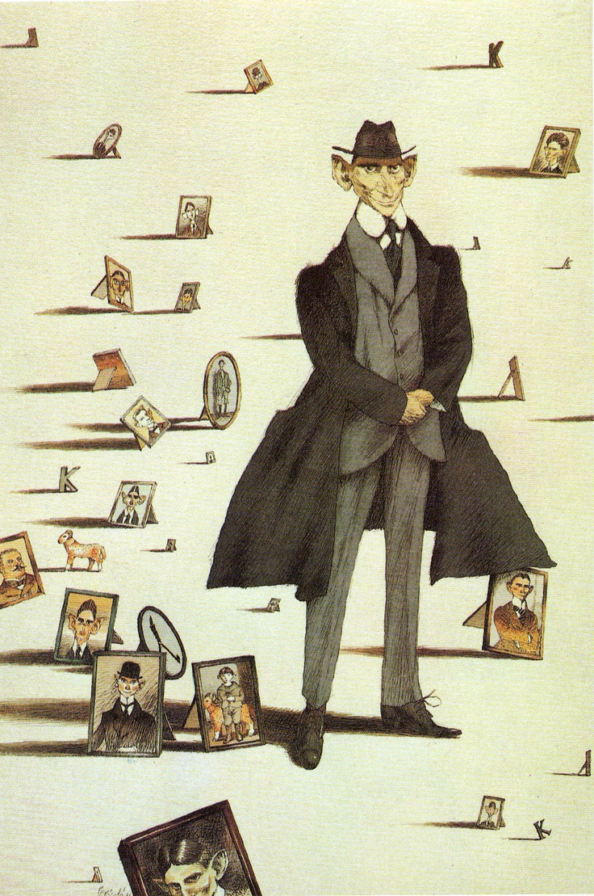
Franz Kafka (1883-1924)
Background
Historical Context

Slide 4
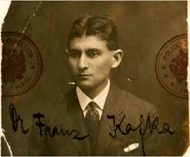

Slide 5
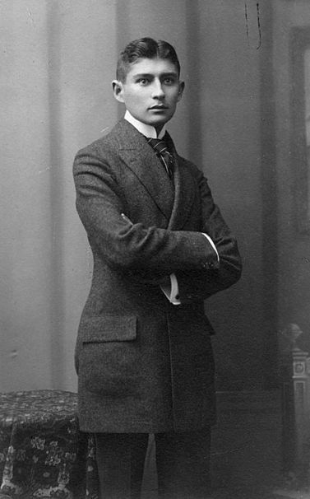

Slide 6
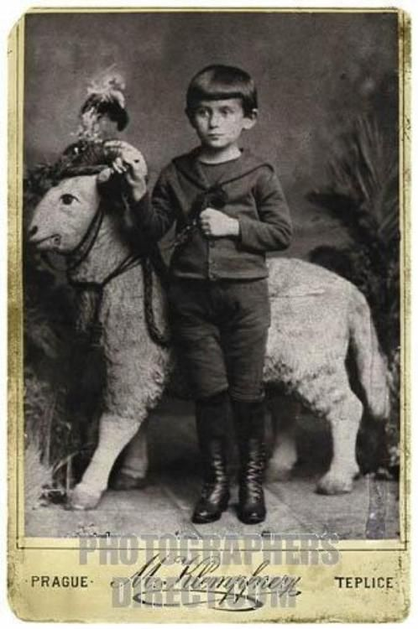

Slide 7
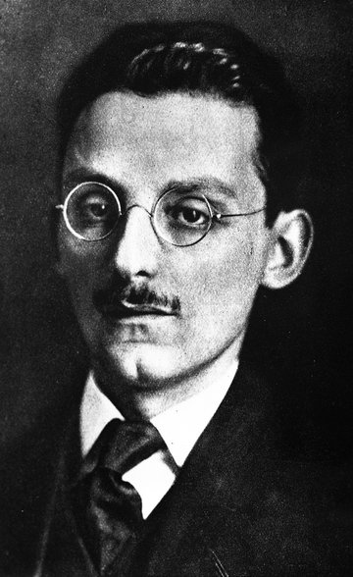
Max Brod (1884-1968)

Slide 9
Reading The Trial
Importance of Kafka for European Modernism
Novels as exemplary failures
Institutions and individuals
The Law
State of Exception
Guilt and Punishment

Slide 10
Adorno’s Notes on Kafka

Slide 11


Slide 12
Reading The Trial
Importance of Kafka for European Modernism

Slide 13
Reading The Trial
Novels as exemplary failures
Kafka’s texts as a form of failure
Family issues (Letter to the Father)
Other texts (Metamorphosis, Hunger Artist, Josephine, The Silence of the Sirens Report to an Academy)

Slide 14
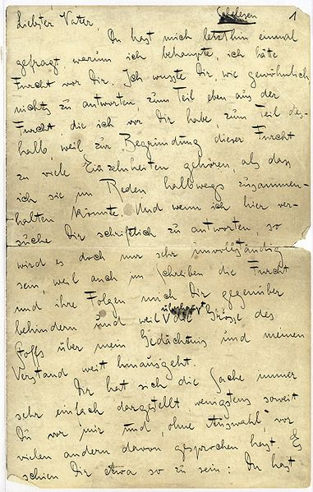
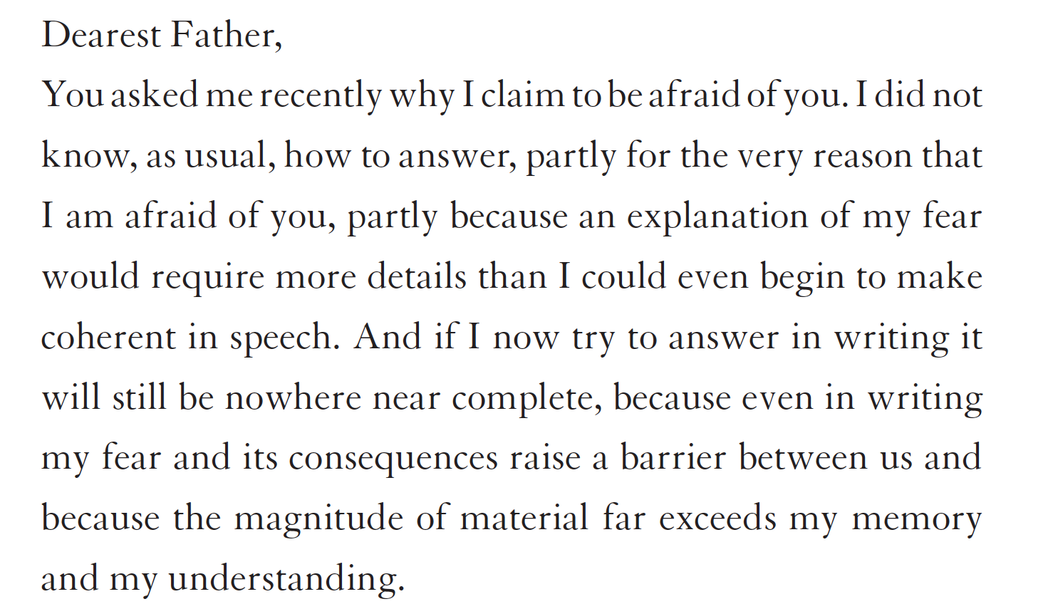

Slide 15
Reading The Trial
Institutions and individuals
The Law
State of Exception
Guilt and Punishment

Slide 16
“Before the Law”
Parable
Aporetic logic
Modernity, Transcendence, Religion
Totalitarianism (today)
Nietzsche and responsibility

Slide 17
In front of the law there is a doorkeeper. A man from the countryside comes up to the door and asks for entry. But the doorkeeper says he can't let him in to the law right now. The man thinks about this, and then he asks if he'll be able to go in later on. 'That's possible,' says the doorkeeper, 'but not now'. The gateway to the law is open as it always is, and the doorkeeper has stepped to one side, so the man bends over to try and see in. When the doorkeeper notices this he laughs and says, 'If you're tempted give it a try, try and go in even though I say you can't. Careful though: I'm powerful. And I'm only the lowliest of all the doormen. But there's a doorkeeper for each of the rooms and each of them is more powerful than the last. It's more than I can stand just to look at the third one.' The man from the country had not expected difficulties like this, the law was supposed to be accessible for anyone at any time, he thinks, but now he looks more closely at the doorkeeper in his fur coat, sees his big hooked nose, his long thin tartar-beard, and he decides it's better to wait until he has permission to enter.

Slide 18
The doorkeeper gives him a stool and lets him sit down to one side of the gate. He sits there for days and years. He tries to be allowed in time and again and tires the doorkeeper with his requests. The doorkeeper often questions him, asking about where he's from and many other things, but these are disinterested questions such as great men ask, and he always ends up by telling him he still can't let him in. The man had come well equipped for his journey, and uses everything, however valuable, to bribe the doorkeeper. He accepts everything, but as he does so he says, 'I'll only accept this so that you don't think there's anything you've failed to do'. Over many years, the man watches the doorkeeper almost without a break. He forgets about the other doormen, and begins to think this one is the only thing stopping him from gaining access to the law. Over the first few years he curses his unhappy condition out loud, but later, as he becomes old, he just grumbles to himself. He becomes senile, and as he has come to know even the fleas in the doorkeeper's fur collar over the years that he has been studying him he even asks them to help him and change the doorkeeper's mind. Finally his eyes grow dim, and he no longer knows whether it's really getting darker or just his eyes that are deceiving him. But he seems now to see an inextinguishable light begin to shine from the darkness behind the door. He doesn't have long to live now. Just before he dies, he brings together all his experience from all this time into one question which he has still never put to the doorkeeper. He beckons to him, as he's no longer able to raise his stiff body. The doorkeeper has to bend over deeply as the difference in their sizes has changed very much to the disadvantage of the man. 'What is it you want to know now?' asks the doorkeeper, 'You're insatiable.' 'Everyone wants access to the law,' says the man, 'how come, over all these years, no- one but me has asked to be let in?' The doorkeeper can see the man's come to his end, his hearing has faded, and so, so that he can be heard, he shouts to him: 'Nobody else could have got in this way, as this entrance was meant only for you. Now I'll go and close it'."

Slide 21
The madman jumped into their midst and pierced them with his eyes. "Whither is God?" he cried; "I will tell you. We have killed him—you and I. All of us are his murderers. But how did we do this? How could we drink up the sea? Who gave us the sponge to wipe away the entire horizon? What were we doing when we unchained this earth from its sun? Whither is it moving now? Whither are we moving? Away from all suns? Are we not plunging continually? Backward, sideward, forward, in all directions? Is there still any up or down? Are we not straying as through an infinite nothing? Do we not feel the breath of empty space? Has it not become colder? Is not night continually closing in on us? Do we not need to light lanterns in the morning? Do we hear nothing as yet of the noise of the gravediggers who are burying God? Do we smell nothing as yet of the divine decomposition? Gods, too, decompose. God is dead. God remains dead. And we have killed him.
Friedrich Nietzsche. The Gay Science. Aphorism 125 (The Madman)

Slide 22
Dialectics and Abyssal Thought
W. Benjamin, T. Adorno
G. Deleuze, F. Guattari: “Minor Literature”
Gerhard Neumann: Outsider Perspective, Sliding Paradox
Stanley Corngold: “The negativity of the vermin has to be seen as rooted, in an absolute sense, in the literary enterprise itself, as coming to light in the perspective which the act of writing offers of itself. Here the activity of writing appears only autonomous enough to demand the loss of happiness and the renunciation of life. But of its own accord it has no power to restitute these sacrifices in a finer key. Over Kafka's writing stands a constant sign of negativity and incompleteness”. (1973)

Slide 23
Letetr to Oskar Pollack (1904)
“If the book we are reading does not wake us, as with a fist hammering on our skulls, then why do we read it? Good God, we also would be happy if we had no books and such books that make us happy we could, if need be, write ourselves.. …. What we need are books that hit us like a most painful misfortune, like the death of someone we loved more than we love ourselves, that make us feel as though we had been banished to the woods, far from any human presence, like a suicide.”

